Slide 1
GOOS-AFRICA: Current Status
AFFIAN Kouadio / AMAN Angora
UFHB – Abidjan – Cote d’Ivoire
SEAMARCS workshop
24-26 september 2025, Mombasa, Kenya

Slide 2
WHY GOOS AFRICA
GOOS can’t exist in isolation, it is embedded in a network of international, regional, and national programs, with which it works to deliver a system that is fit for purpose.
Greater availability of ocean data through the adoption of common approaches
The challenge is great. The ocean is vast and variable, making it an expensive place to operate.
GOOS believes that it is important to work with the community, partners, governments, and the public, towards achieving its goal
Trans-boundary issues in the ocean continue to grow, and a global and sustainable GOOS requires a determined level of capacity development through the GOOS Regional Alliances (GRAs)

Slide 3
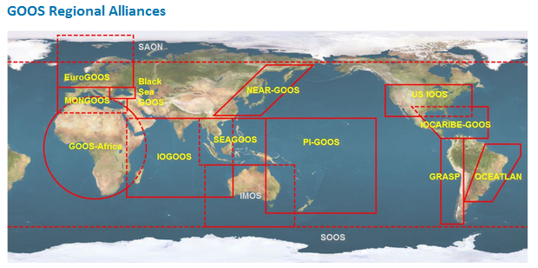
11 regional alliances

Slide 4
General Context
Establishing ocean observation in Africa is crucial because it:
enhances the continent’s ability to monitor and respond to climate change,
improve disaster preparedness (e.g. tsunamis, coastal flooding),
support sustainable fisheries, and protect marine ecosystems. It also
strengthens data-driven decision-making for maritime economies and regional development,
https://goosafrica.appli.edu.ci/

Slide 5
Historical Background of GOOS-AFRICA
1998: Formal establishment at African Ministerial Conference
1999: Adopted at IOC Assembly
2000: Resolution of UNESCO General Conference
2001: Integration of the Nairobi Convention
2002: Integration of the Abidjan Convention
2002: Adoption by the Summit of African Heads of States and presentation by the Heads of States at the WSSD as a Priority Program for Africa’s development

Slide 6
Mandate (1/2)
GOOS AFRICA aims to provide Ocean & Coastal Services to Africa. For this purpose GOOS-AFRICA works towards:
Effective management of coastal environments
Controlling pollution and safeguarding human health
Supporting expansion of economic activities in the coastal and offshore areas
Protection of the growing coastal populations, especially in the Great Harbour Cities of Africa
Effective management of living marine resources
Mitigation of natural disasters and extreme events and the impacts of climate change.

Slide 7
Mandate (2/2)
Promoting operational oceanography with a multi-modular mechanism including stand alone and interconnected work packages.
In-situ observing stations in the coastal areas
Satellite remote sensing of marine and coastal environments
Ocean data assimilation, modelling & forecasting
End-to-end communications & information delivery systems
Strategic Business and Industry Partnerships
Project management integration and coordination

Slide 8
Future Plan (1/2)
For the future, GOOS-AFRICA will serve as an engine to:
maintain enhanced collaboration with the African Union through GMES & Africa and other relevant initiatives in oceanography initiated by the AU;
Implement the GOOS Strategic Plan in Africa.
To fulfil that mission, GOOS-AFRICA’s actions will be:
Ensuring the functioning of the GOOS-AFRICA secretariat established at CURAT at the University F.H.B. Abidjan, Côte d'Ivoire;
Promoting in situ ocean observations and remote sensing in Africa;
Contributing to implementation of the African Decade of Oceans and Seas;
Contributing to implementation of the African Union's integrated marine strategy;

Slide 9
Future Plan (2/2)
Contributing to implementation of the blue economy strategy developed within the framework of the African Vision 2063;
Supporting the development of an ocean academy in Africa based on existing institutions and infrastructure;
Developing oceanography curricula at the Master's and Doctorate levels;
Developing networks of young researchers for GOOS-AFRICA;
Holding a Pan-African conference on ocean sciences, technology, and operational oceanography;
Implementing a project on the vulnerability of coastal areas to dangerous substance spills;
Promoting projects aimed at adaptation in coastal areas.

Slide 10
Current Governance of GOOS-AFRICA
An Advisory Board has recently been formalized to provide strategic guidance and support.
Coordinated leadership structure at the African level (Leader of Working group included in the coordinating committee
Advisory Board in support (recently formalized)

Slide 11
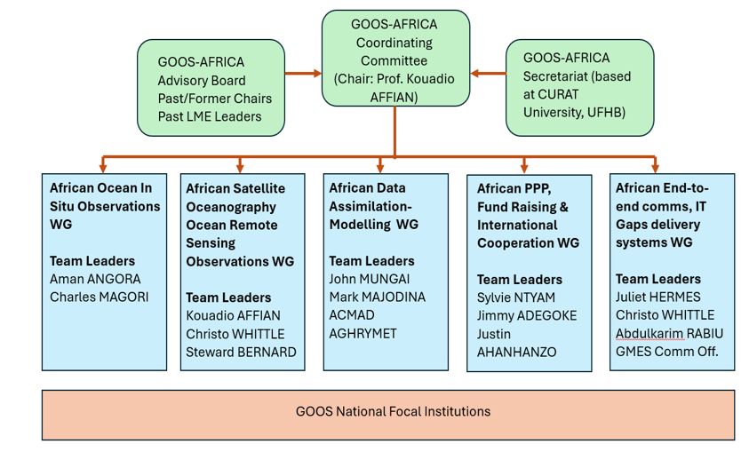

Slide 12
The main Achievements
Revitalisation of GOOS-AFRICA (2021) –Africa Union / Government of RCI)
Meeting on operational oceanography in Africa and GOOS
-AFRICA revitalization in Abidjan 16-18 December 2019.
Establishment of partnership between GOOS-AFRICA and GMES & AFRICA
Workshop on collaboration between GMES & AFRICA and GOOS
-AFRICA, Kigali Rwanda, 24th – 28th October 2022.
Training course on remote sensing at CURAT, Abidjan Côte d’Ivoire, December 2023
Webinar on operational oceanography
Action plan in process

