Slide 1
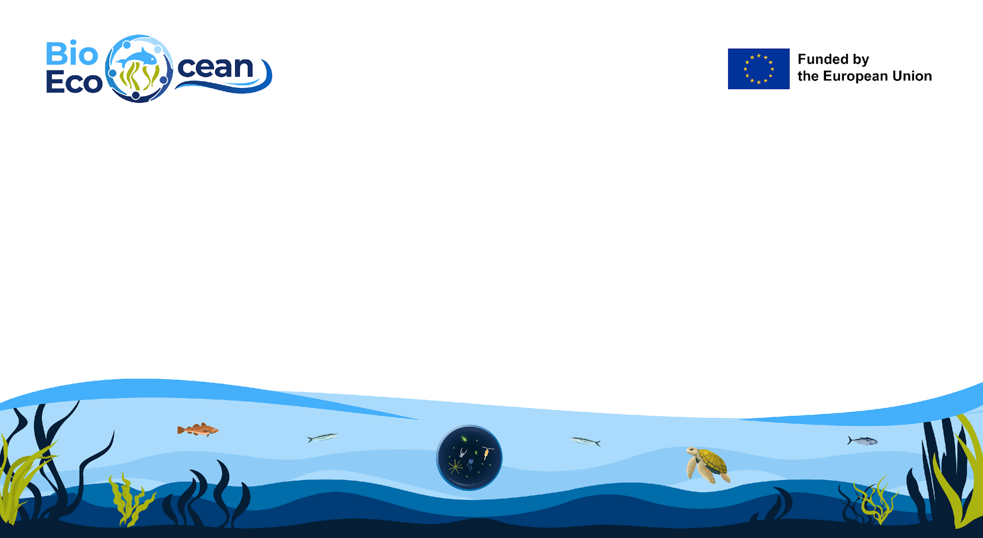
BioEcoOcean and EOV implementation
Ana Lara-Lopez & Lina Mtwana-Norlund

Slide 2
We aim to advance BioEco ocean observations and service delivery by building on existing knowledge, models, and data management flows related to biology and ecosystem Essential Ocean Variables (EOVs)​
BioEcoOcean’s Ultimate goal:
Enhance the BioEco ocean observing capacity for advancing scientific understanding of the Ocean
Increase the utility of ocean observations
We need coordination and interoperability
Making the system operational requires more consistent communication and collaboration among sectors and stakeholders
BioEcoOcean: Feb 2024 – Jan 2028
Notes:
The project will be looking at how do we enable a more holistic, coordinated and interoperable ocean observing system to advance our understanding of life and better manage our marine resources.

Slide 3















Key Project Objectives
Accelerate and improve the implementation and usage of EOVs for biology and ecosystems to drive progress towards global biodiversity, ecosystem and climate assessments.

Slide 4
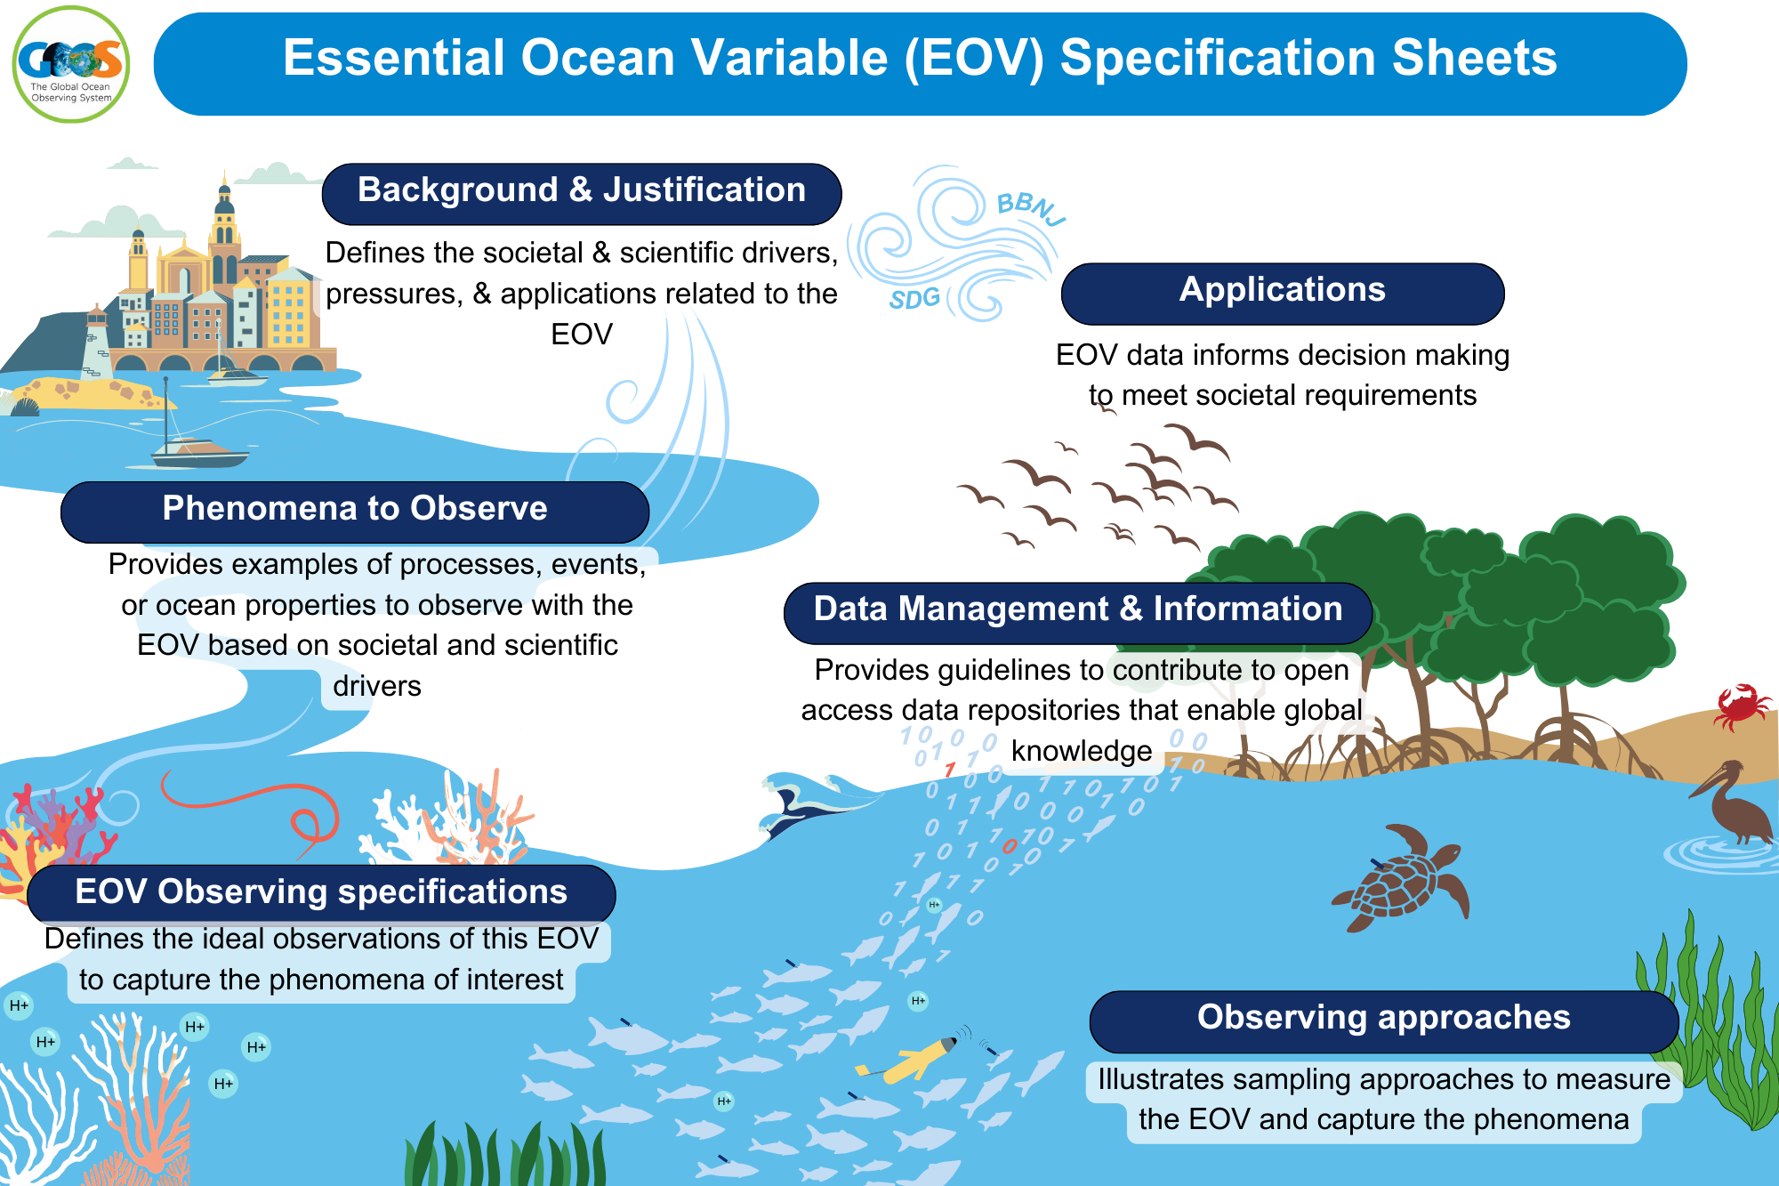
EOV implementation

Slide 5
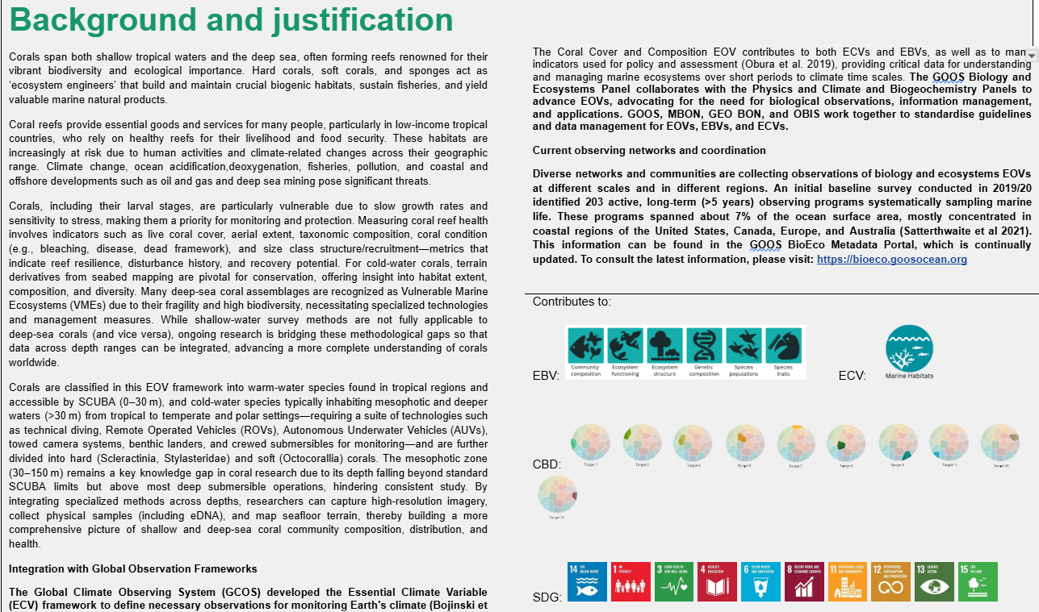

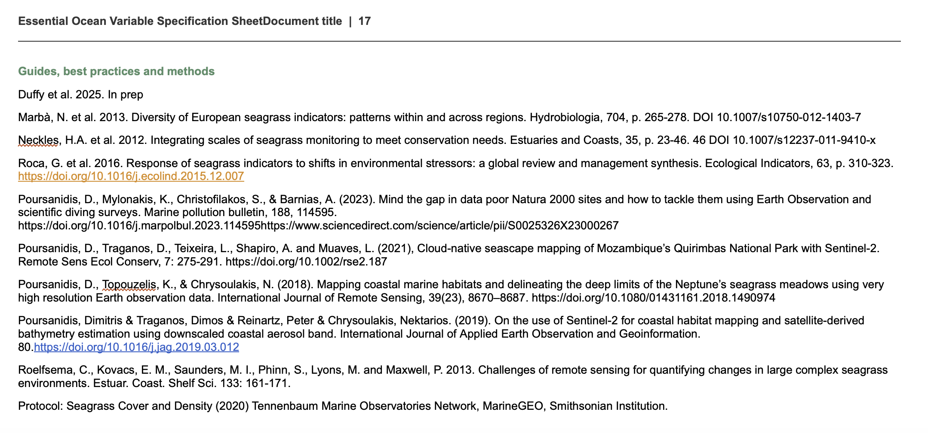
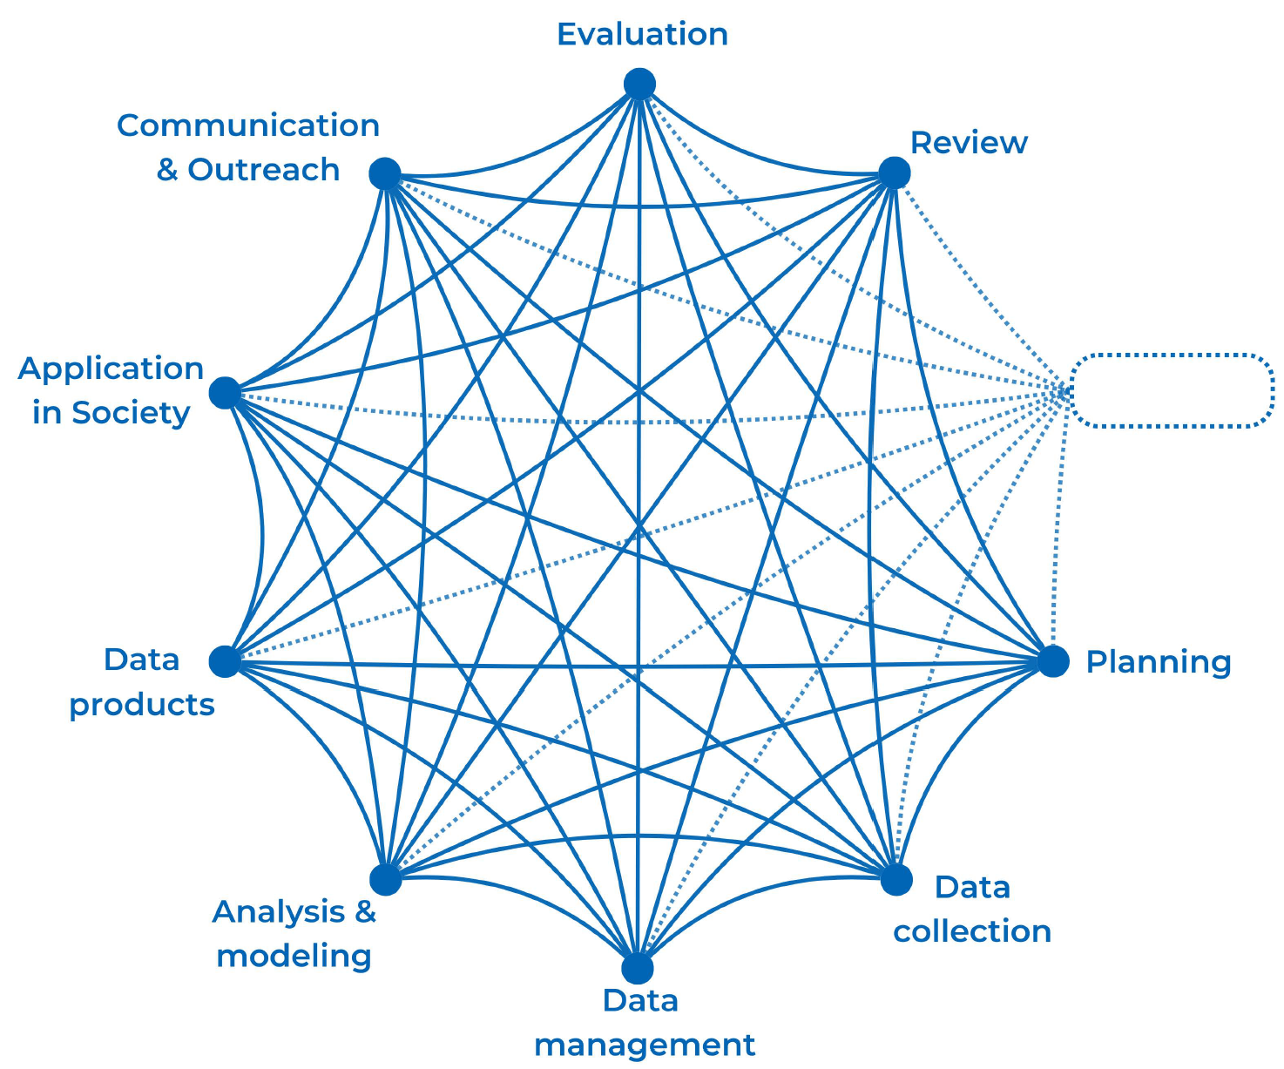
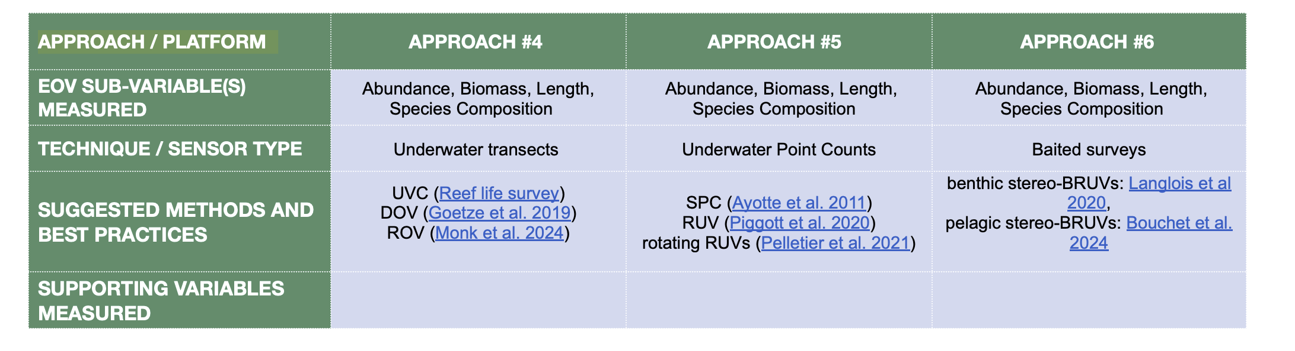
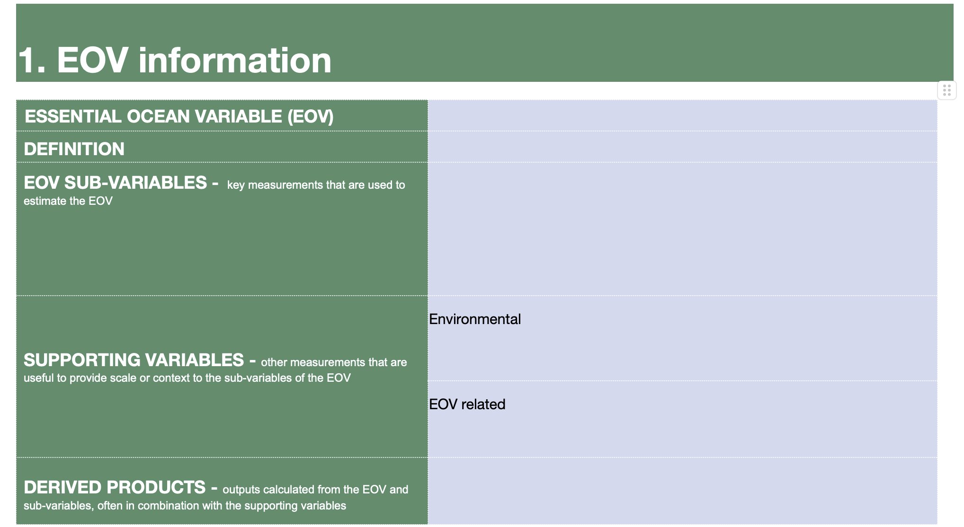
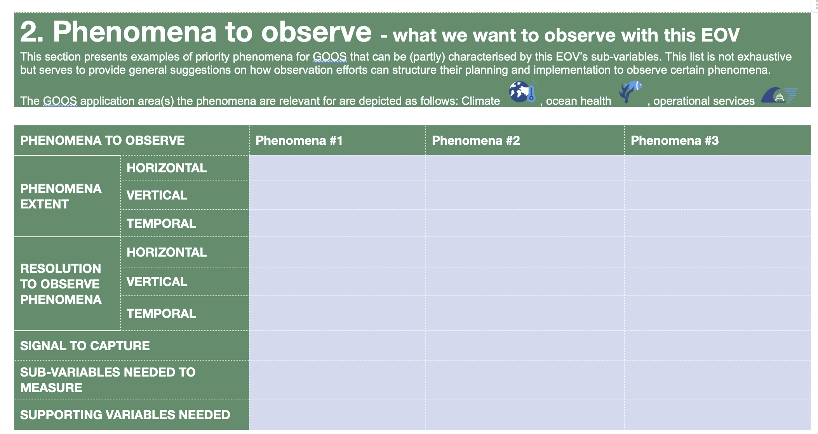
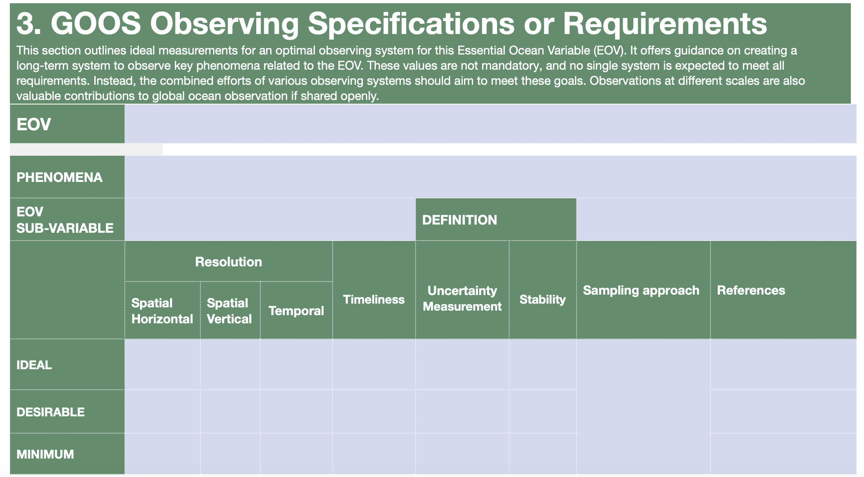
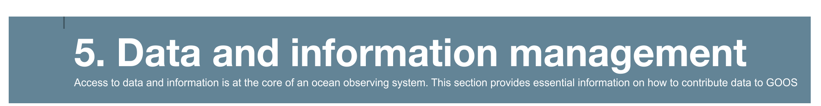
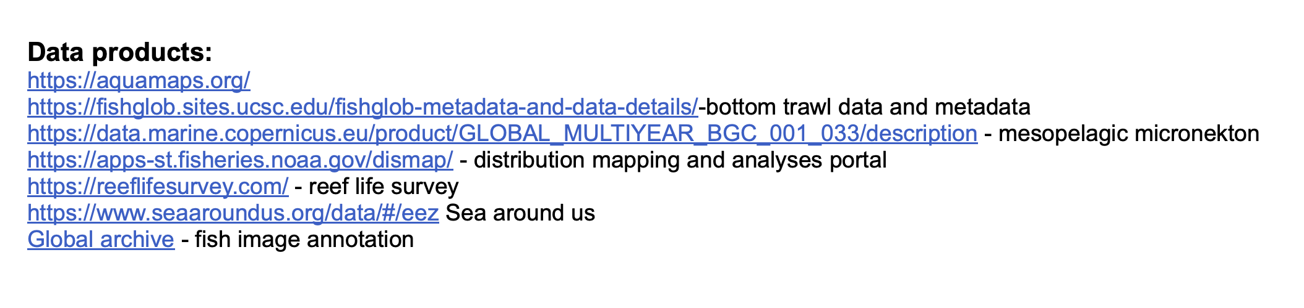
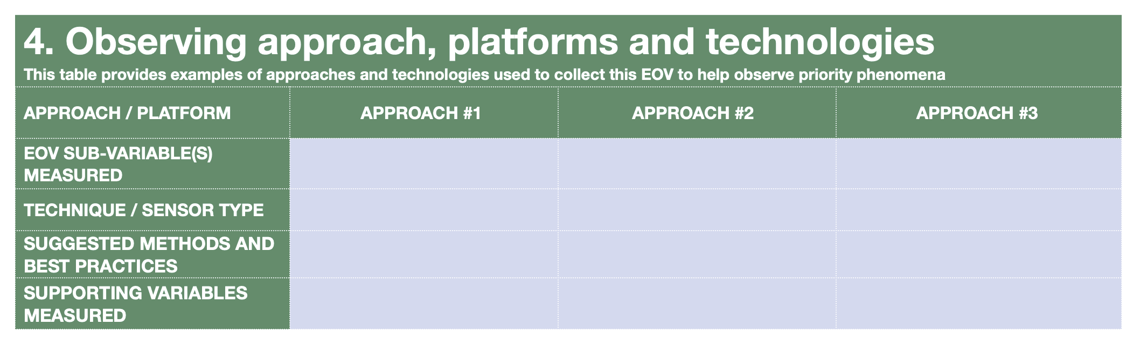
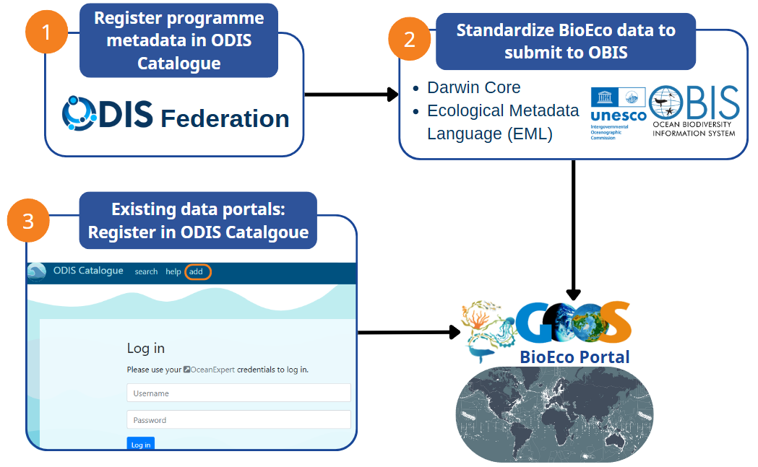

Slide 6

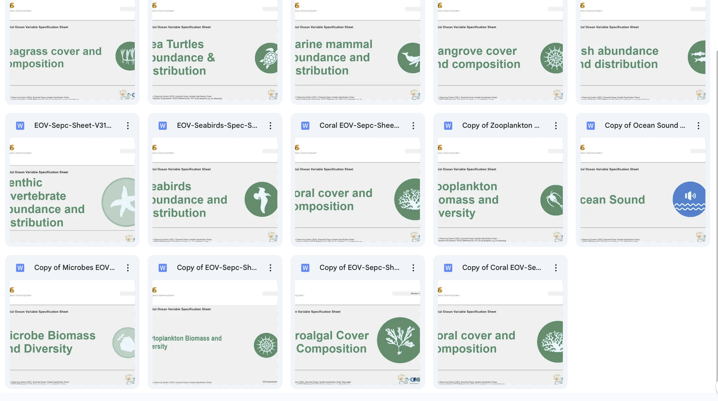
EOV spec sheet review

Slide 7
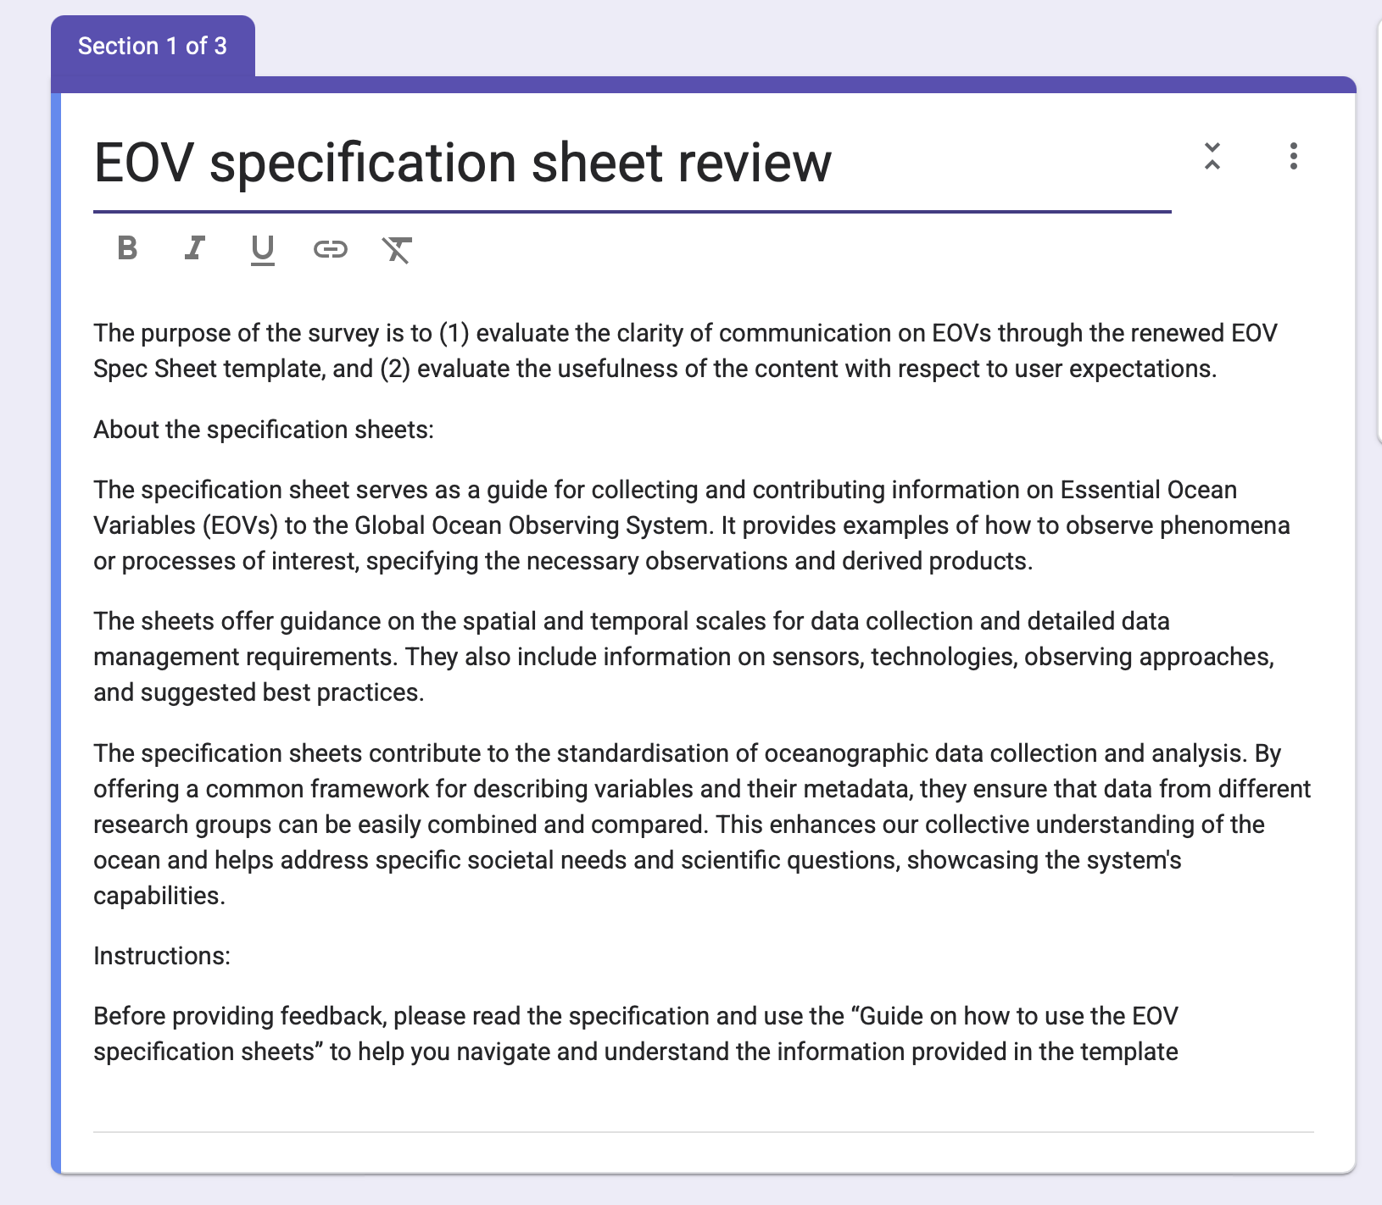
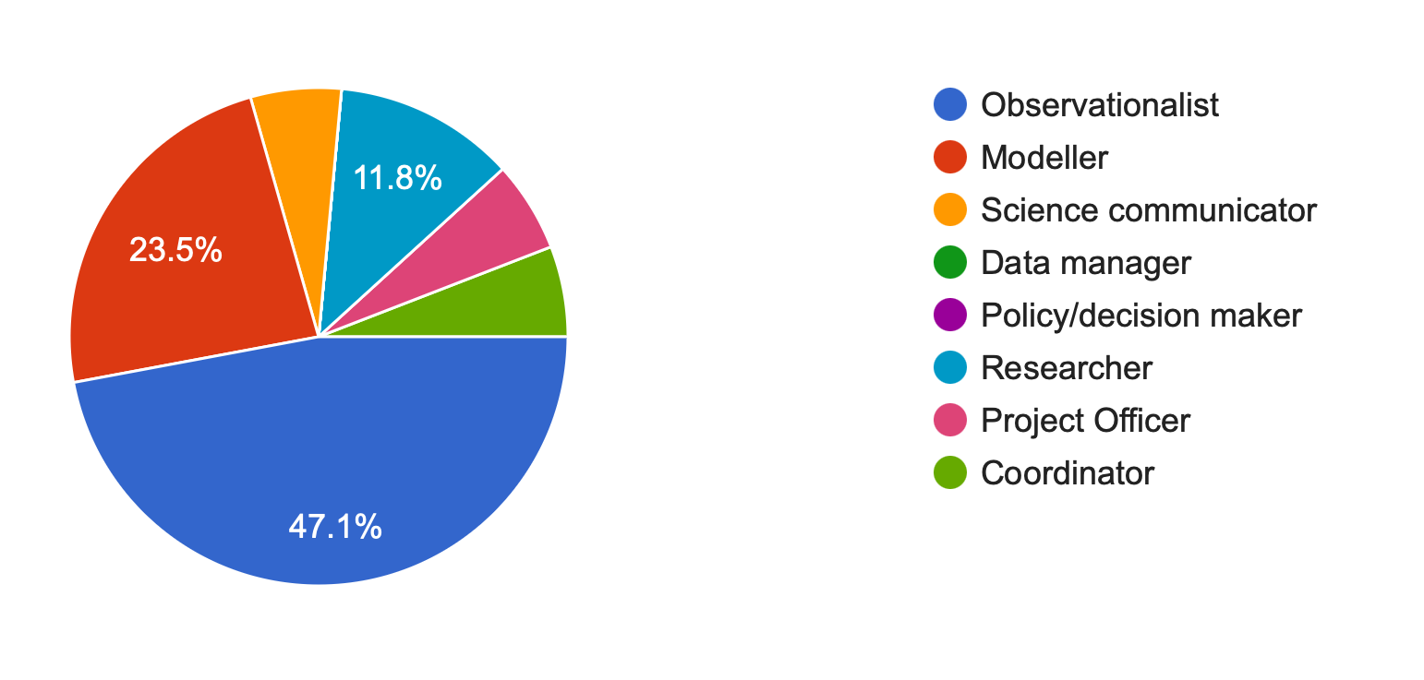
Review
17 responses

Slide 8
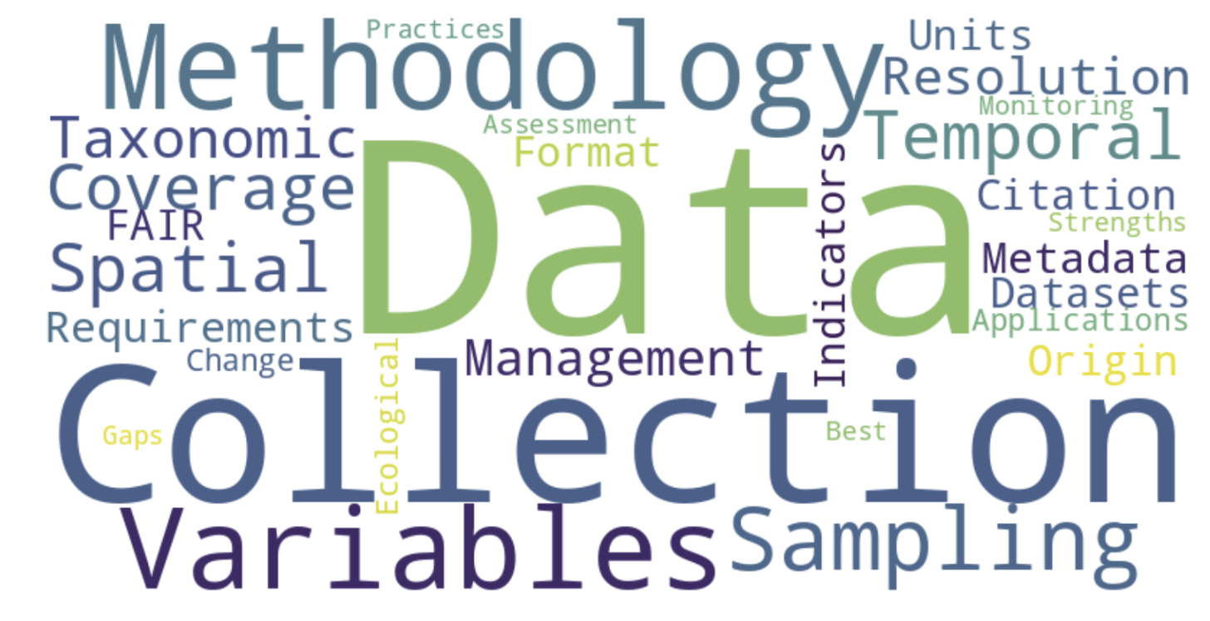
Primary information expected to be found in an EOV specification sheet

Slide 9
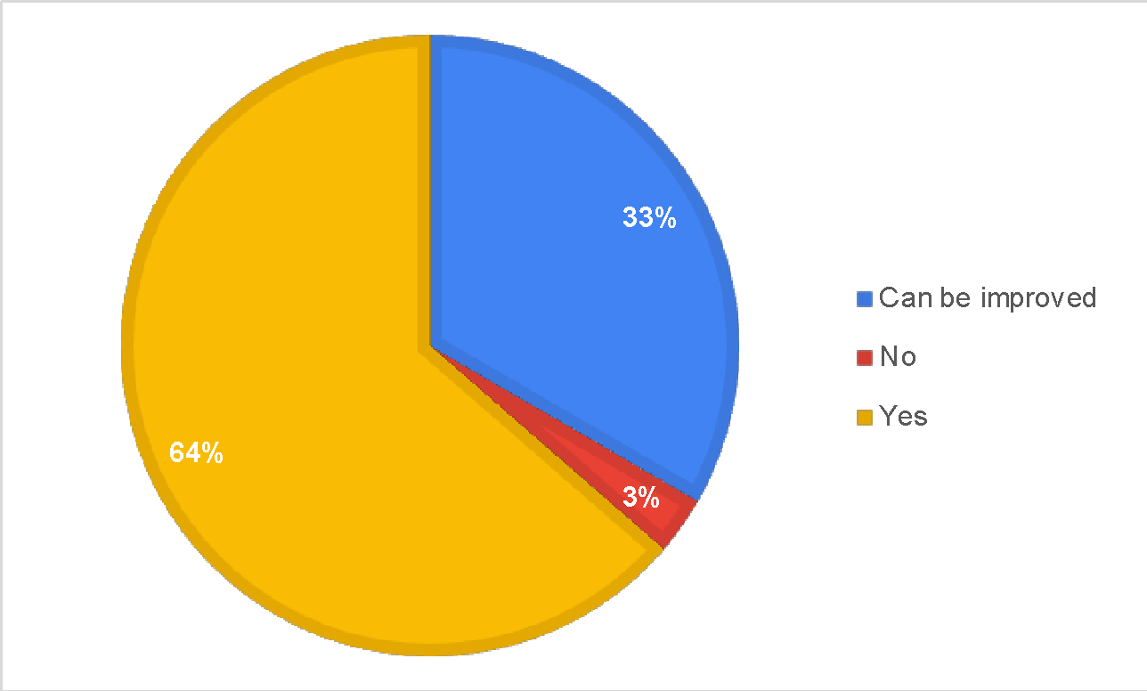
Does the BACKGROUND AND JUSTIFICATION section provide the needed high-level information about the importance of observing this specific EOV?
N=33

Slide 10
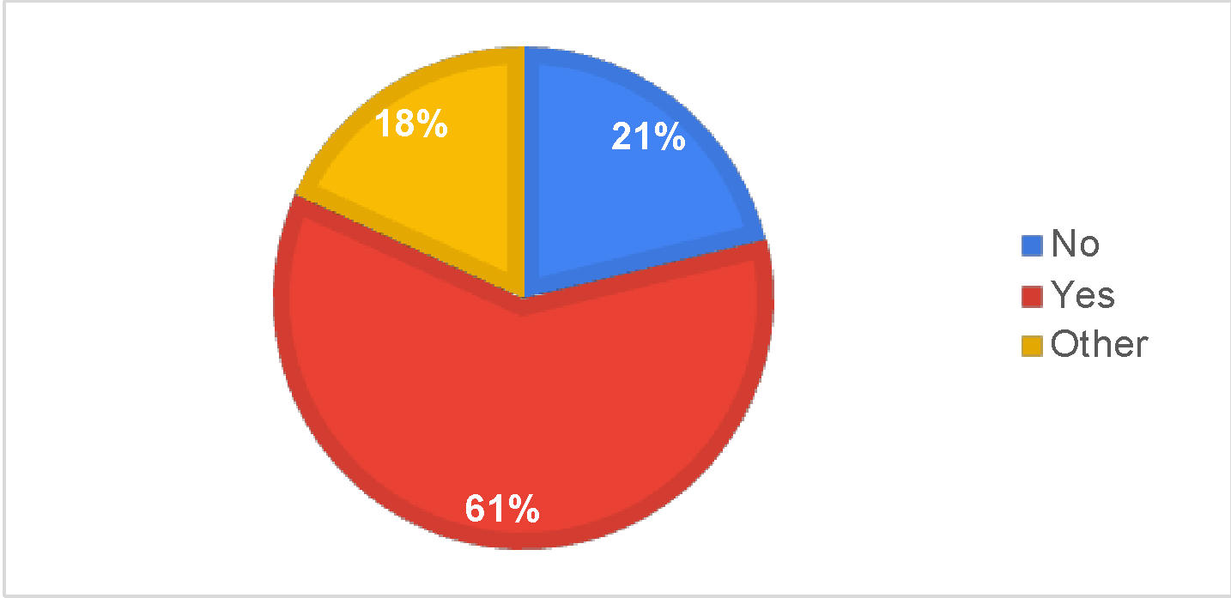
Does SECTION 1. EOV INFORMATION provides clear guidance on the main measurements (sub-variables) and supplementary measurements (supporting variables) needed to observe this EOV on a global scale?
N=33

Slide 11
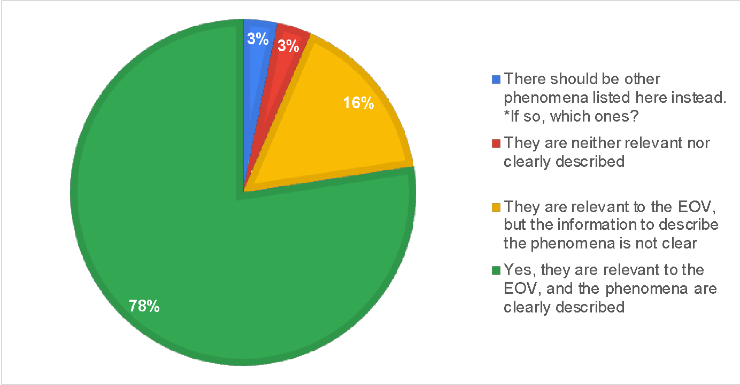
SECTION 2. PHENOMENA TO OBSERVE Are the example phenomena in this table relevant to the EOV and is the information to describe the phenomena clear?
N=32

Slide 12
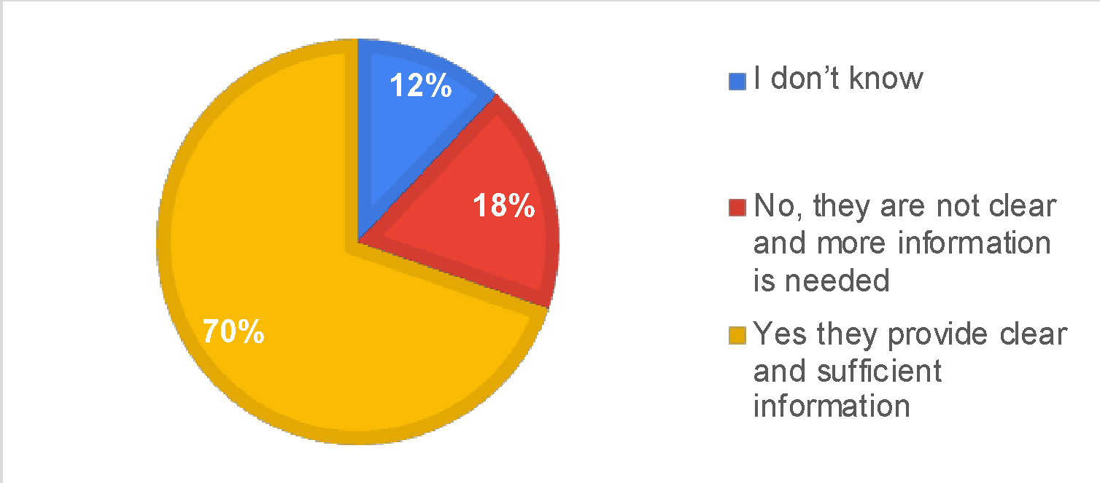
GOOS OBSERVING SPECIFICATIONS OR REQUIREMENTS Do the tables provide clear and sufficient guidance on each measurement and the scales needed to observe, including units of measurement where appropriate?
N=33

Slide 13
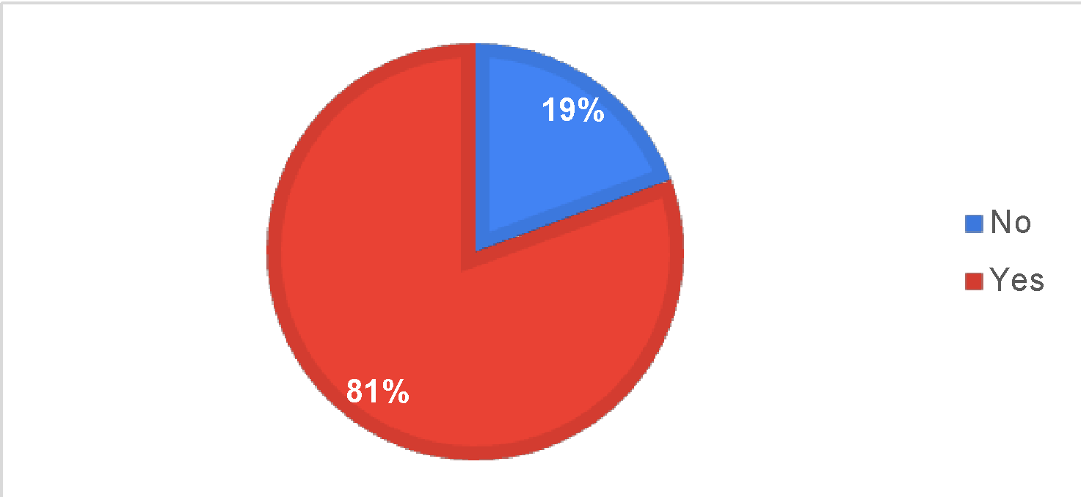
OBSERVING APPROACHES - are the approaches shown in the table the most known, feasible to implement globally and provide the most impactful information?
N=32

Slide 14
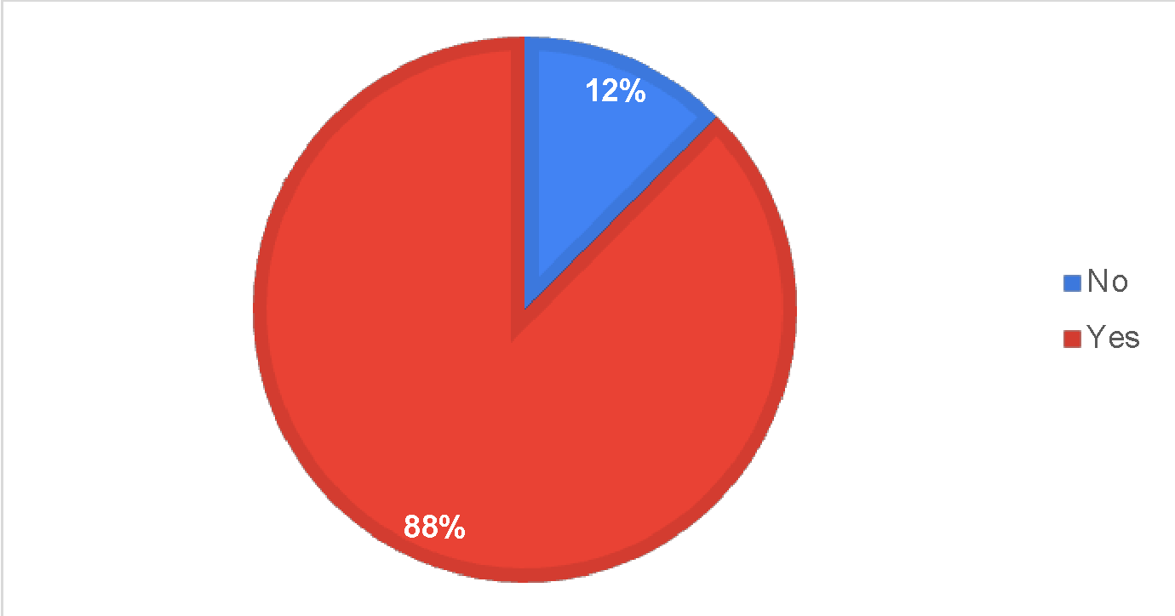
DATA AND METADATA - Are the instructions clear on how you would submit metadata and data to the system (ODIS and OBIS)?
N=33

Slide 15
Translating the specification sheets into observing implementation
Did you find the information needed to work in your living lab?
What is missing?
What happens if I need to collect data for more than one EOV?

Slide 16
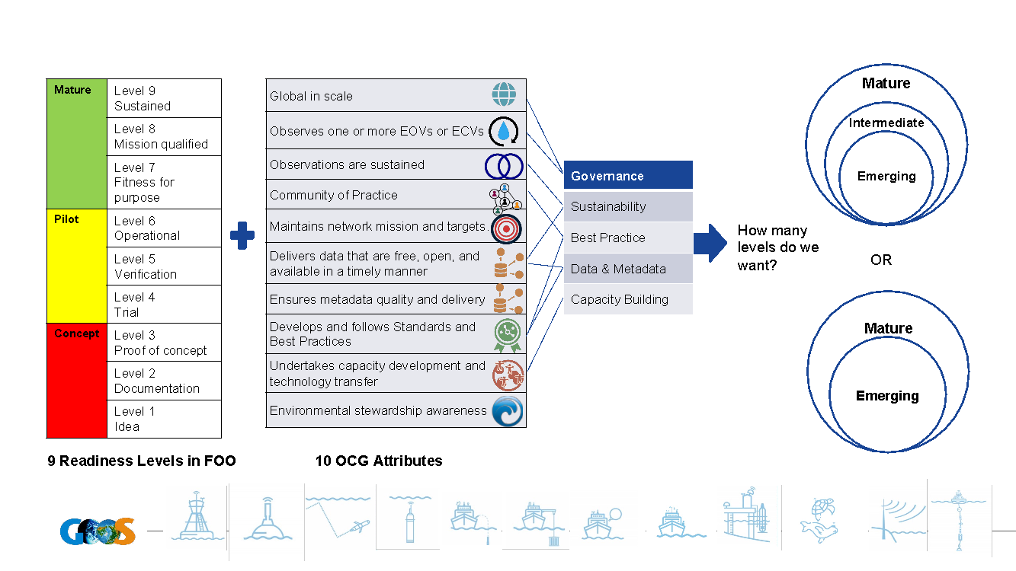
What about the Technical Readiness Level?
How mature are BioEco EOVs and the observing communities

Slide 17
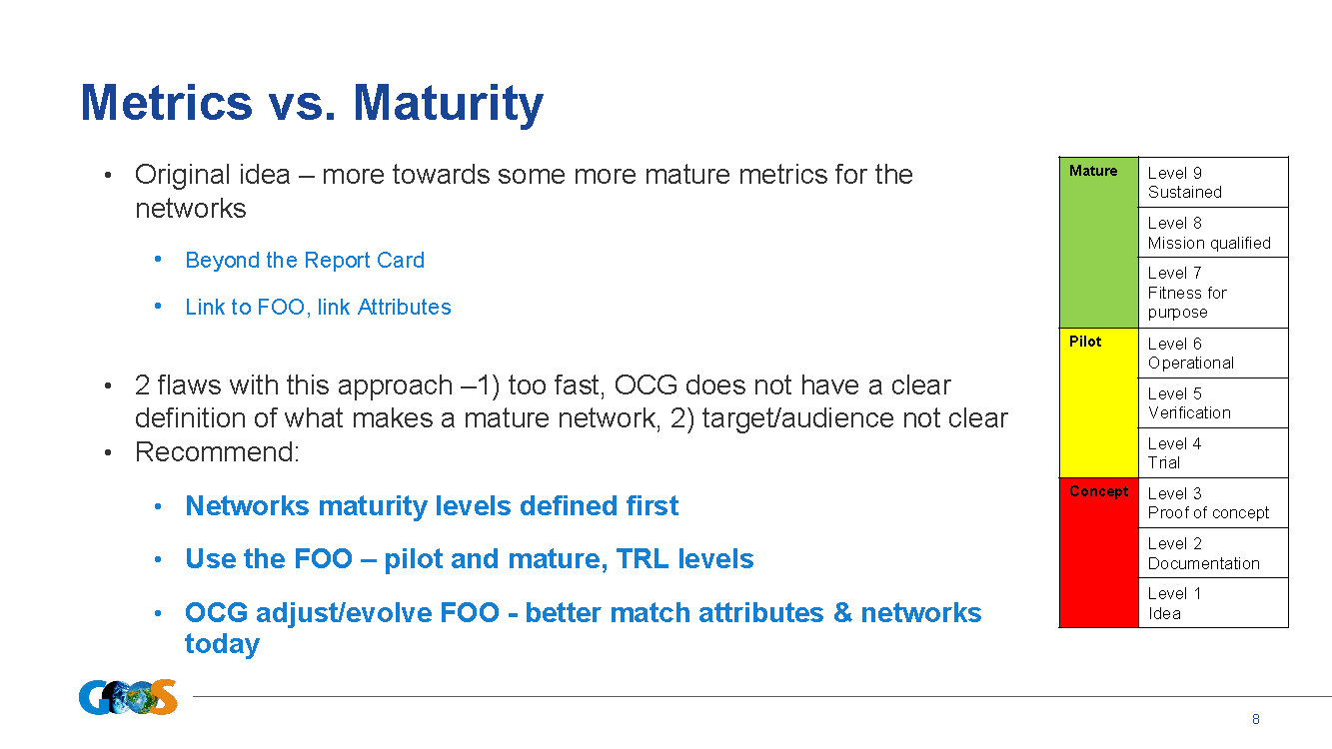

Slide 18
