Slide 1

Tsunami Ready Coalition-Support and Sustain Tsunami Preparedness: Scaling Up Ready Coalition
UNESCO-IOC established an International Tsunami Ready Coalition in 2022.
A TRC IP was prepared for ODTP SC to review and was endorsed by TOWS TT DMP in Feb 2025
The Implementation Plan of the Tsunami Ready Coalition is expected to be endorsed at the 33rd IOC Assembly, June 2025

Slide 2
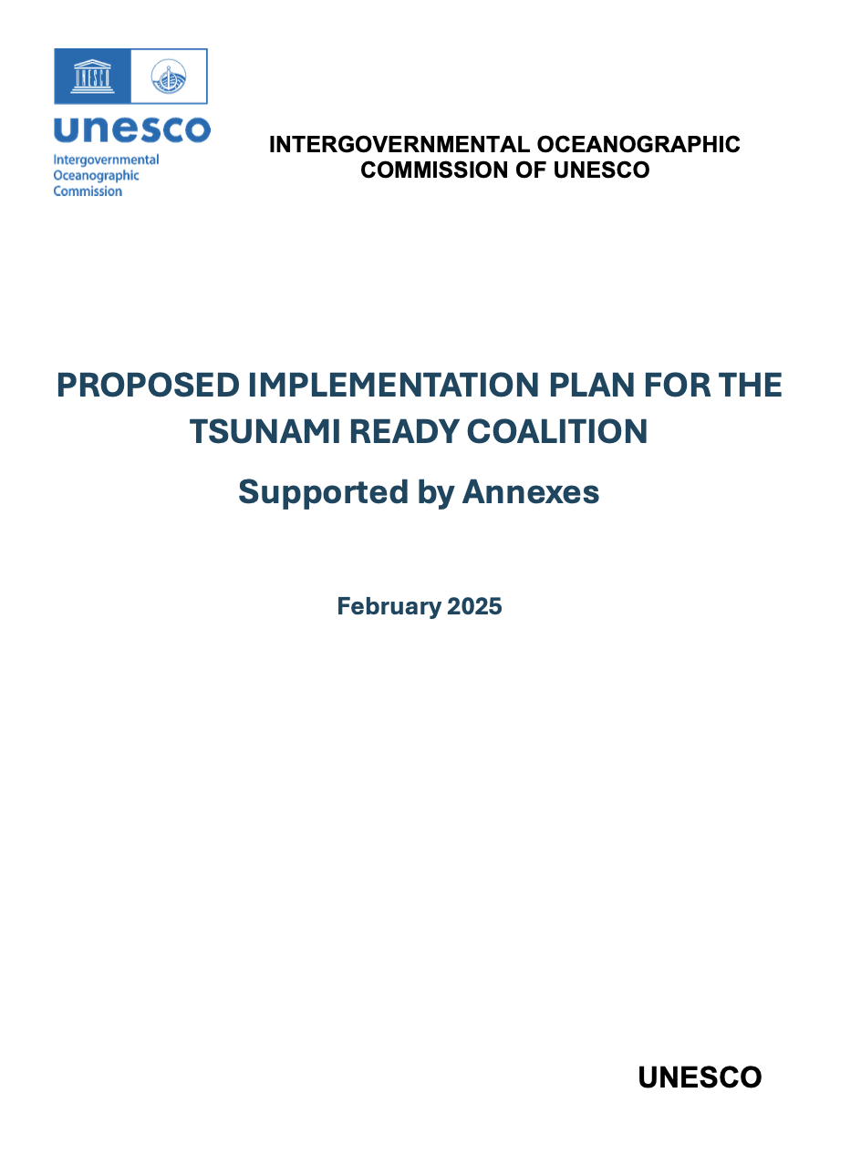






The Tsunami Ready Coalition Collaboration and Cooperation
The Tsunami Ready Coalition is:
A collaborative global effort to support and sustain tsunami preparedness through the UNESCO-IOC Tsunami Ready Recognition Programme
The objectives are the TRC will be to:
Raise the Profile of TRRP in Collaboration with Critical Stakeholders
Increase Funding Resources for TRRP Implementation
Advocate for the conduct of Tsunami Ready Indicator Workshops in the Regions,
Effectively Organize the Tsunami Ready Coalition

Slide 3
Uniting key institutions and stakeholders to promote, fund, and advocate for safer coastal communities
The Coalition will have a diverse membership (including ‘TRC Ambassadors’ by invitation of the UNESCO-IOC)
Membership is primarily at the institutional level.
Existing supporters of TR

Slide 4
Recommendations to TOWS WG
Notes that TOWS-WG-XVI (2023) requested the Tsunami Ready Coalition Chair to propose a governing structure for the Tsunami Ready Coalition and that TOWS WG approval is essential for advancing the work of the Tsunami Ready Coalition.
Also notes that the Tsunami Ready Implementation Plan was reviewed by the Ocean Decade Scientific Committee (16-17 January 2025) and the TOWS-TT-DMP (21 February 2025) and is included as part of the Coalition Chair’s report to TOWS-WG-XVIII).

Slide 5
Having considered the Tsunami Ready Coalition Implementation Plan,
● Approves the Implementation Plan, including:
○ The Coalition mandate and terms of reference,
○ The Coalition structure, and
○ The identified key Coalition Partners.
● Notes that the Plan will remain a dynamic document to allow for updates to the Plan, with updates reflected in the Coalition’s reports to the TOWS-WG
●

Slide 6
Recommends the Secretariat to finalize in consultation with the Tsunami Ready Coalition Chair the Coalition Partners, 'Ambassadors' or similar namesake, and Coalition Co-Chair.
●Recommends the IOC Executive Secretary to extend invitations to the proposed Coalition Partners and Ambassadors, and a Coalition Co-chair.
●Requests ICGs to prioritize regional Tsunami Ready workshops or summits in 2025 and conduct further workshops or summits before 2030.
●Notes resource and capacity constraints that will stymie progress of the TRC Coalition Implementation Plan, requests the IOC Executive Secretary to urgently address.

