Slide 1
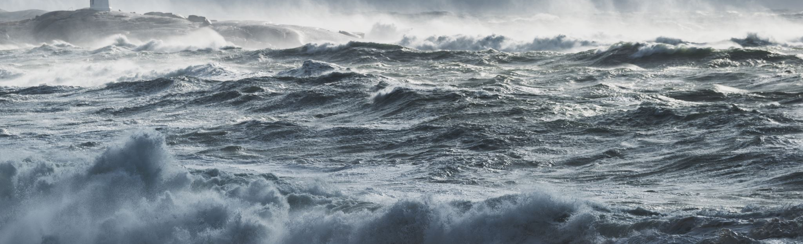

Ocean Decade Tsunami Programme, Actions , KPI and First ODTP Conference
Denis Chang Seng, PhD
Programme Specialist
Technical Secretary (ICG-NEAMTWS and TOWS TT DMP)
Focal Point TSR ODTP-ODTP-SC-OD
CoastWAVE Project
UNESCO -IOC

Slide 2
ODTP RELATED ENDORSED* ACTIONS
The Ocean Decade Tsunami Programme
Decade Collaborative Centre for Coastal Resilience
CoastWAVE-Strengthening the Resilience of Coastal Communities in NEAM to The Impact Of Tsunamis And Other Sea Level-Related Coastal Hazards
Tsunami Potential Coastal Area of Indonesia Mountain Anak Krakata, Banten, Sunda Straint
Global Real-Time Early Alarm for Tsunami (Great),
Sea Level Station Monitoring Facility
Tsunami & Climatic Risk Reduction at Protected Areas In Costa Rica
Integrating Coastal Hazard Warning Systems for Tac, North Atlantic Ocean/ Caribbean Sea
Open Access to GTS Project (Open-Gts Project),
US Tsunami Contributions to IOC Tsunami Pt1
US Tsunami Contributions to IOC Tsunami Pt2
National Institute of Oceanography and Fisheries
Promote Seabed 2030 And Ocean Mapping
Smart Subsea Cables
The Nippon Foundation-GEBCO Seabed 2030
Facing And Addressing Ocean Hazards Together
Epos Thematic Core Services Tsunami
Sustaining AGITHAR Towards a Global Tsunami Model
Scaling-Up and Strengthening the Resilience of Coastal Communities in NEAM To The Impact Of Tsunamis And Other Sea Level-Related Coastal Hazards (CoastWAVE 2.0)
INCOIS Submarine Cable Multi-Parameter Observatory
Tsunami Ready Odisha
People Centred Tsunami Early Warning for India
Development Of Comprehensive Tsunami Software
Sustain (Tsunami Resilient Critical Infrastructure)
Global Tsunami Model Association (Gtm)
NEAM-Commitment

Slide 3
Call 7 & 8 ~19-20 M USD

Slide 4
Ocean Decade Call 9 / ODTP
UN31. The Ocean Decade Tsunami Programme
Project Priorities
a) Geographical priorities: Within the framework of the Research, Development and Implementation Plan for the Ocean Decade Tsunami Programme (ODTP) we are seeking projects submission for all ocean basins (Caribbean, Indian Ocean, Pacific, Northeastern Atlantic and Mediterranean);
b) Thematic priorities:
Artificial Intelligence (A.I) applications to Tsunami Early Warning Systems
Tsunami hazard assessments covering less understood sources for example volcano/continental land slopes sources
Real-time modelling and impact forecasting of coastal inundation from tsunamis and other ocean-related hazards
Installation/deployment of additional coastal tide gauges and tsunami detection/observation systems and enhanced data sharing from existing networks in regions under high tsunami risk with known coverage gaps: Aegean Sea, Caribbean Sea (West, North and South-East), Indian Ocean (East and North), North Africa, Philippine Sea, Solomon Sea, South China Sea, Timor Sea, and Yellow Sea (alphabetical order), to ensure tsunami detection and verification as early as possible;
Website: Research, development and implementation plan for the Ocean Decade Tsunami Programme
Programme Contact Point
Bernardo Aliaga: b.aliaga@unesco.org , copied to d.chang-seng@unesco.org

Slide 5
OD Call 9 / ODTP
Interest Expressed to IOC /TSR
The 1956 Amorgos tsunami was long thought to result mainly from submarine landslides. New research reveals a 9 m seafloor fault offset, suggesting a larger seismic role. The project combines seafloor and coastal data, tsunami modeling, and paleo-studies to assess both sources. Outreach includes school engagement and a public event during the UNOC meeting in Nice. Research Agency, CEA and Université Côte d’Azur.
Frédérique Leclerc
Asst. Prof. Université Côte d'Azur
GEOAZUR

Slide 6
Tsunami Programme and Ocean Decade Tsunami Programme (ODTP) Monitoring and Tracking Tool

Slide 7
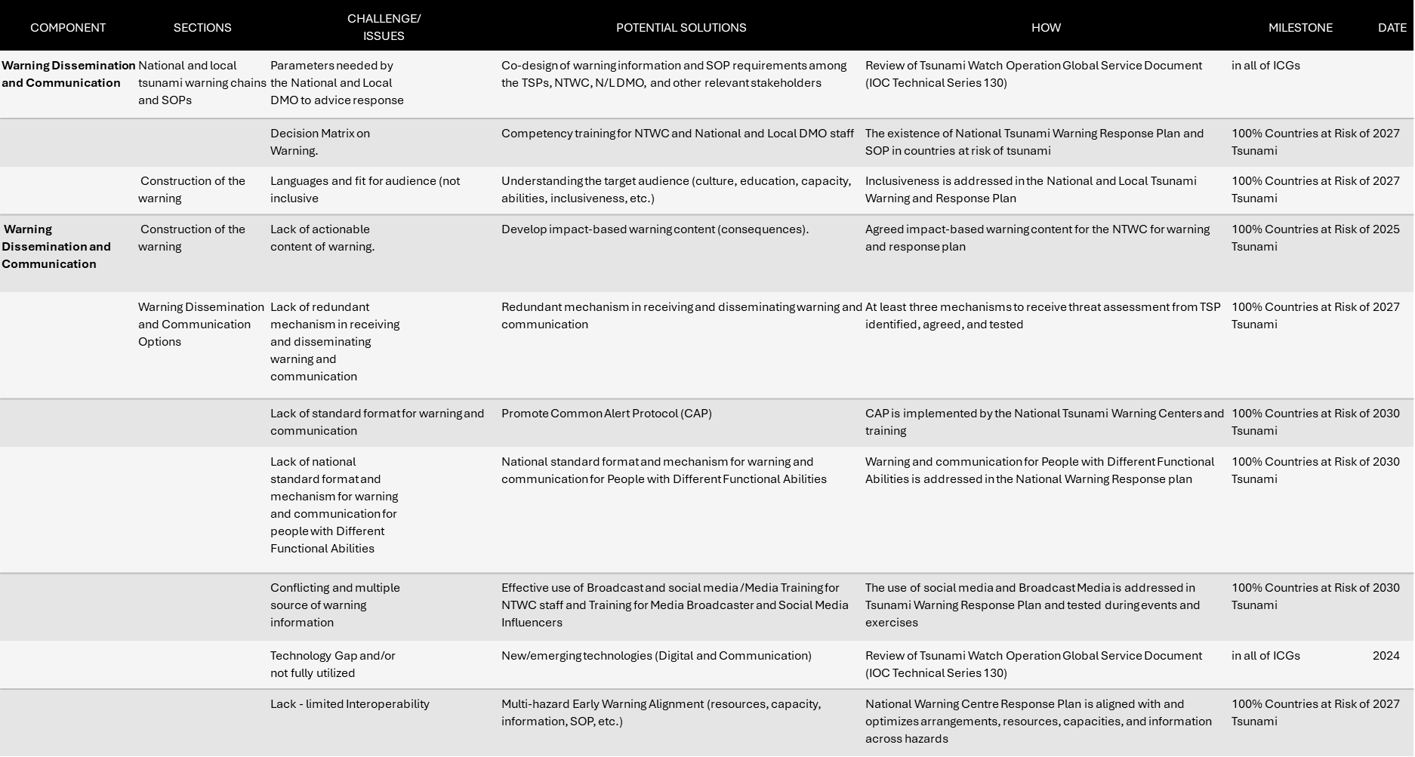
Ocean Decade Tsunami Programme (ODTP) Monitoring and Tracking Tool
Current situation?
Recalls that the appendices (Appendix 1-4, Pages 60-80) in the ODTP RDI (Aug 2023) was developed to guide the measurement/assessment of progress actions (ODTP-RDI).
Notes that no progress achieved to date in its implementation.
Further notes the TOWS TT DMP recommendation in Sendai, Japan, 19 - 20 February 2024
  Requests the TT TWO and TT DMP to develop KPIs for the relevant sections of the ODTP Research & Development Implementation Plan (RDIP) to monitor progress.
  Requests the Secretariat develop a reporting mechanism to allow ICGs to report progress on related projects within the Ocean Decade and against the ODTP RDIP KPIs, aligning this with the proposed Global KPI Framework for the UNESCO-IOC Tsunami Programme.

Slide 8


Key Issues & Challenges
SMART indicators( Specific, Measurable, Achievable, Relevant:
  Are they SMART indicators? Very technical in details designed by technical experts.
Level of detail/ granularity:
  Are there too many indicators and too granular?
Strategic fit /efficiency/seamless challenges:
  How can KPIs from one assessment framework be used efficiently and seamlessly, avoiding duplication in assessments and reporting efforts, especially important in a resource and staff constraint environment?

Slide 9
Ocean Decade Tsunami Programme
Monitoring and Tracking Tool
WHAT IT IS AND WHAT IT IS NOT ?
ODTP-RDI KPI (Two High Level Objectives)
Tsunami Programme (ICG/GTKPI)
The ODTP Monitoring and Tracking Tool to be applied only to endorsed Ocean Decade Actions relevant to the ODTP while the ICG/GTKPI is designed for the entire Tsunami Programme

Slide 10
Way Forward?
The TRS inspires to develop an Ocean Decade Tsunami Programme –Monitoring and Tracking Tool to better support implementation, tracking and monitoring of the ODTP. ODTP-Monitoring and Tracking Tool aligns
  Clear SMART (Specific, Measurable, Achievable, Relevant, and Time-bound) Actions
  Aligns with:
    future Global Key Performance Indicator (KPI) Framework spearheaded by the Pacific Tsunami Warning System with the aim of reporting to the Sendai Framework for Disaster Risk Reduction
    and facilitates the implementation of the Monitoring and Evaluation Framework of the United Nations Decade of Ocean Science for Sustainable Development 2021-2030

Slide 11

Way Forward (Con’t)
UNESCO-IOC/TSR invited written proposals from Individual Consultants to Support the Tsunami Resilience Section (TSR) to develop the Ocean Decade Tsunami Programme (ODTP) Monitoring and Tracking Tool
Only one application was received after extension and readvertising.
Evaluation found the application is not only unaffordable, but also focused on disaster response technological tools/platforms. Perhaps more useful for developing the ODTP RDI KPI survey platform at the final stages. Not a simple task?
TRS decided to develop the new ODTP-RDI KPI in house based on work already started.
A first meeting was organized with the participation of key TRS staff mid-December 2024

Slide 12

Way Forward (Con’t)
AIM: To develop Single Tsunami Performance M &T Tool. From this tool, users can choose ICG-KPIs and or ODTP-KPIs depending on application and use.
Proposed Approach
  ICG-KPI: The foundation to build the new Tsunami Performance Monitoring & Tracking Tool.
  ODTP-RDI-KPI: Align/mapping of ODTP-RDI Indicators onto the ICG-KPI.
  Others: Align/mapping other KPIs (e.g. Vision 2030 White Paper
Seamless connections- granular (ICG) operational technical level to macro-policy making level (OD/ Sendai, SDG) , ensuring efficiency while avoiding duplication in assessments and reporting.
STEP 2
STEP 1
Original ODTP-RDI-KPI
ICG-KPI
STEP 3
Other KPI Vision 2030
ICG-KPI
SFDRR-KPI
ODTP -KPI
OD-KPI
New ODTP RDI KPI for M & T

Slide 13
Ongoing Work
First proposal was shared with secretariat team (Technical Secretaries and Head of Section, Associate Project Officer) before Christmas
Main tasks : Align and mapping of indicators. Eliminate duplication of indicators, add any missing indicators
Feedbacks have been received and under consideration/ implementation.
One to one online meeting.

Slide 14
Key Questions
Operational/Practical
Who to complete the surveys (ICG and ODTP), noting that ODTP actions may also be the addressed under ICG-KPI [TNCs, Action Leads?].
Information meetings required before rolling out tool?
What is the expected time frame to operationalize the M & T Tool (Jan 2026?). NB:-The OD M &T takes place every year in the first semester.
ODTP-RDI KPI (Two High Level Objectives)
Tsunami Programme (ICG/GTKPI)

Slide 15
Questions (Con’t)
Strategic
How can TSR effectively and sustainably manage such a tool to ensure standardization/alignment with best practices for KPIs and performance measures ( data collection, analysis, knowledge information, dissemination, review, and continuous adaptation?
What strategies and resource planning approaches can be employed to coordinate and manage additional layers of performance monitoring and tracking, considering the current heavy workload of TRRP and its increasing demands?

Slide 16
5th Ocean Decade Tsunami Programme
Scientific Committee, 16-17 Jan 2025
The discussion centered on user input and evaluations
Noted the importance of Tsunami National Contacts (TNCs) as the primary national representatives.
Recommended that requests be communicated through Circular Letters (CLs), to also inform TWFPs, NTWC’s and IOC Focal Points.
Further recommended alternatively employing ICG structures, particularly their Working Groups (WGs), to conduct assessments was proposed.
Welcomed the proposal for flexible data entry by various stakeholders in liaison with TNC, as demonstrated by past survey practices in the IOTWMS.
Agreed that assessments should not be mere "tick-box" exercises but should include concise text/narrative responses to KPI surveys.
Clarifications are needed on how Member States with memberships in different ICGs or territories will respond to these surveys, as the SC expressed a preference for an ICG-based approach.

Slide 17
5th Ocean Decade Tsunami Programme
Scientific Committee, 16-17 Jan 2025
Discussions
Appreciated the progress made in developing a comprehensive Tsunami Programme -ODTP–RDI Performance Monitoring and Tracking Tool with clear SMART (Specific, Measurable, Achievable, Relevant, and Time-bound) indicators and actions.
Agreed to further advance the Tsunami Performance Monitoring and Tracking Tool and present an update at the TOWS-Working Group and Task Team meetings scheduled between 20 and 25 February 2025.

Slide 18
Work Plan
16–17 Jan 2025
Feedbacks/inputs from 5th ODTP-SC
20–22 Feb 2025
Feedbacks/inputs from TOWS-WG TTs meetings
Mar–Apr. 2025
First final draft + supporting documentation
Aug–Sep. 2025
Online Feedbacks/ inputs
Oct 2025
Develop online platform tool(Consultant)
Nov 2025
Test

Slide 19
ODTP-SC and TOWS (Feb 2025) recommend organizing webinars on each of the two High Level Objectives between June –October 2025
Organize the FIRST UNESCO –IOC OCEAN DECADE TSUNAMI PROGRAMME (ODTP) CONFERENCE alongside the Joint Tsunami Commission (JTC) International Tsunami Symposium (ITS) in Hyderabad, scheduled for November 12–14, 2025.
Communication plan –showcasing each ODTP related action leading to the conference.

Slide 20
FIRST UNESCO –IOC OCEAN DECADE TSUNAMI PROGRAMME (ODTP) CONFERENCE
Building Resilient Coasts: Accelerating Actions
Combining Technologies and tsunami community preparedness
10-11 November 2025, Hyderabad, India
Concept, Work Plan and Guidance Note
23 April 2025
Tsunami Resilience Section
UNESCO IOC

Slide 21
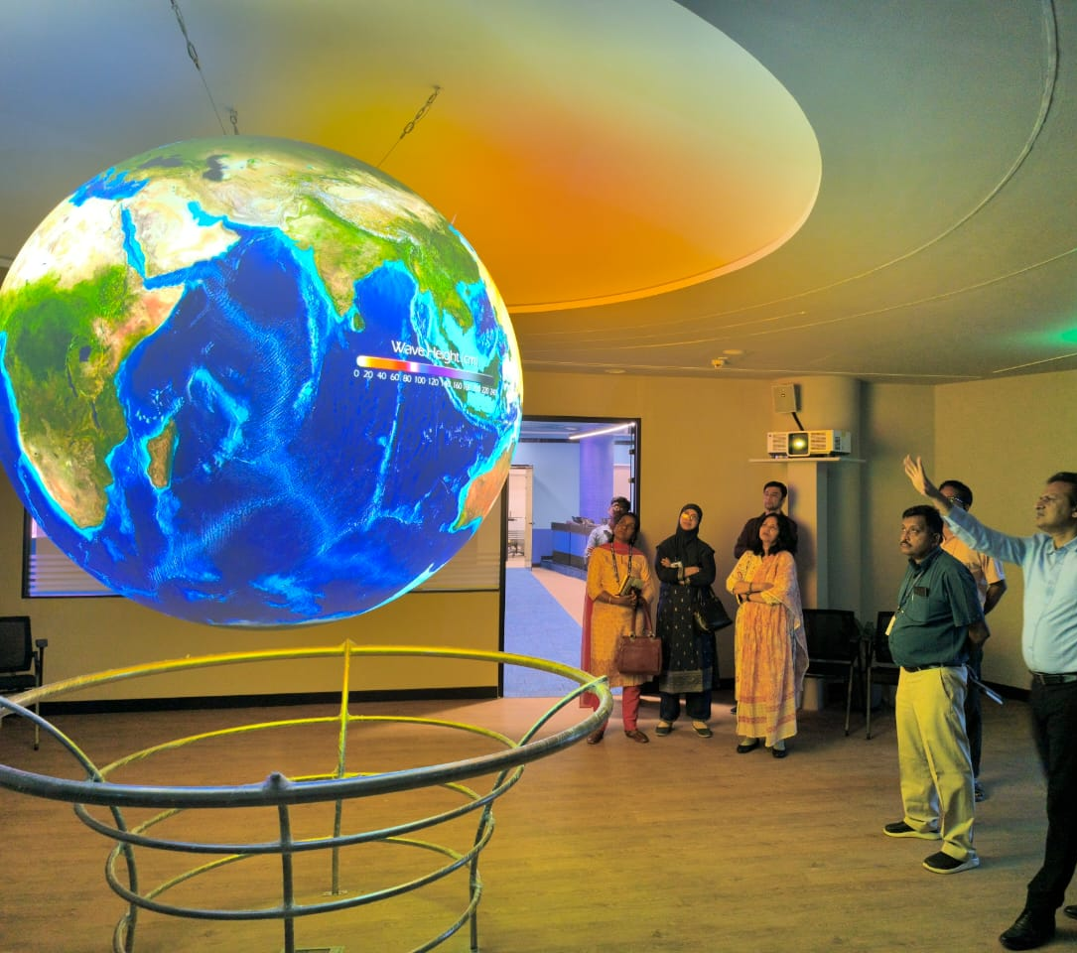
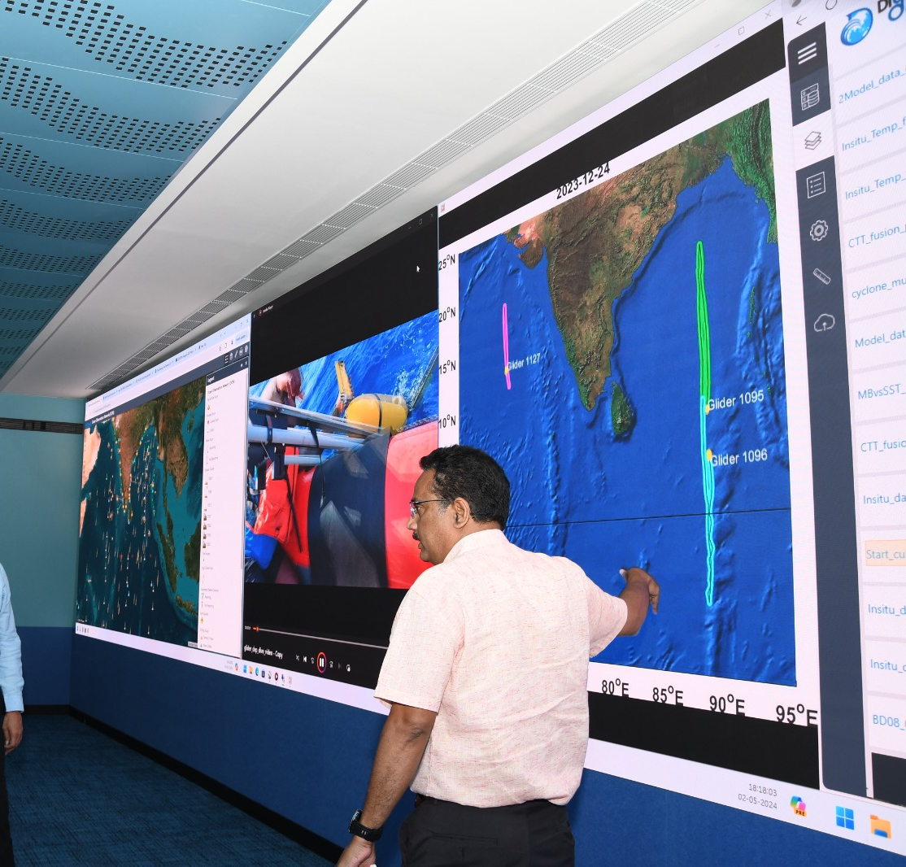
INCOIS
Indian National Centre for Ocean Information Services

Slide 22
INTRODUCTION /BACKGROUND
At the 5th ODTP-SC held in Paris, 16-17Janary 2025 members agreed to collaborate on conferences addressing both the ODTP’s high-level objectives alongside the IAPSO/IASPEI/IAVCEI Joint Tsunami Commission (JTC) International Tsunami Symposium (ITS) in Hyderabad, scheduled for November 12–14, 2025.
During the TOWS -XVIII meetings, it was decided to organize the First ODTP Conference in Hyderabad alongside the IUGG-JTC ITS event, hosted by INCOIS, with a focus on advancing both ODTP’s high-level objectives.
INCOIS on 8th April 2025 agreed to host the first ODTP Conference, 10-11 Nov 2025.

Slide 23
AIMS
The first ODTP Conference offers an important opportunity to unite the TEWS and coastal resilience communities within the framework of Ocean Decade Challenge 6 and the ODTP , with a strong emphasis on coastal hazards, particularly tsunamis.
Propose strategies to enhance/accelerate and energize endorsed and future actions to contribute to the ODTP and OD challenge 6
Foster collaboration, strengthen connections, and co-design strategic pathways forward.

Slide 24
OBJECTIVES
The event will
Provide an overview of the ODTP endorsed actions and their progress
Showcase how are ODTP actions contributing to OD challenge 6 on increasing community resilience to ocean hazards/risks
Share knowledge and experiences amongst ODTP endorsed actions
Identify gaps, challenges, priorities and opportunities to implement the ODTP-RDI Plan.
Propose strategies to enhance/accelerate and energize endorsed and future actions to contribute to the ODTP and OD challenge 6 [Refine the aim of conf)
Propose new actions, and way forward, especially in support for SIDS and LDCs
Identify how to enhance coordination, collaboration, cooperation, partnerships among ODTP actions and other similar initiatives.

Slide 25
ODTP RELATED ENDORSED* ACTIONS
The Ocean Decade Tsunami Programme
Decade Collaborative Centre for Coastal Resilience
CoastWAVE-Strengthening the Resilience of Coastal Communities in NEAM to The Impact Of Tsunamis And Other Sea Level-Related Coastal Hazards
Tsunami Potential Coastal Area of Indonesia Mountain Anak Krakata, Banten, Sunda Straint
Global Real-Time Early Alarm for Tsunami (Great),
Sea Level Station Monitoring Facility
Tsunami & Climatic Risk Reduction at Protected Areas In Costa Rica
Integrating Coastal Hazard Warning Systems for Tac, North Atlantic Ocean/ Caribbean Sea
Open Access to GTS Project (Open-Gts Project),
US Tsunami Contributions to IOC Tsunami Pt1
US Tsunami Contributions to IOC Tsunami Pt2
National Institute of Oceanography and Fisheries
Promote Seabed 2030 And Ocean Mapping
Smart Subsea Cables
The Nippon Foundation-GEBCO Seabed 2030
Facing And Addressing Ocean Hazards Together
Epos Thematic Core Services Tsunami
Sustaining AGITHAR Towards a Global Tsunami Model
Scaling-Up and Strengthening the Resilience of Coastal Communities in NEAM To The Impact Of Tsunamis And Other Sea Level-Related Coastal Hazards (CoastWAVE 2.0)
INCOIS Submarine Cable Multi-Parameter Observatory
Tsunami Ready Odisha
People Centred Tsunami Early Warning for India
Development Of Comprehensive Tsunami Software
Sustain (Tsunami Resilient Critical Infrastructure)
Global Tsunami Model Association (Gtm)
NEAM-Commitment

Slide 26

PRINCIPLES GUIDING THE FIRST ODTP CONFERENCE
Ocean Decade Tsunami endorsed actions and stakeholders' interest in the programme
Coherence with global agendas including OD challenge 6, EW4ALL Sendia Framework for DRR Target G;
Multi-stakeholder approach;
Focus on those most at risk and ensuring that no one is left behind;
Interactive, innovative, scientific-based and impact-focused;
Inclusion and accessibility;
Gender equality and the promotion of women’s agency and leadership.

Slide 27
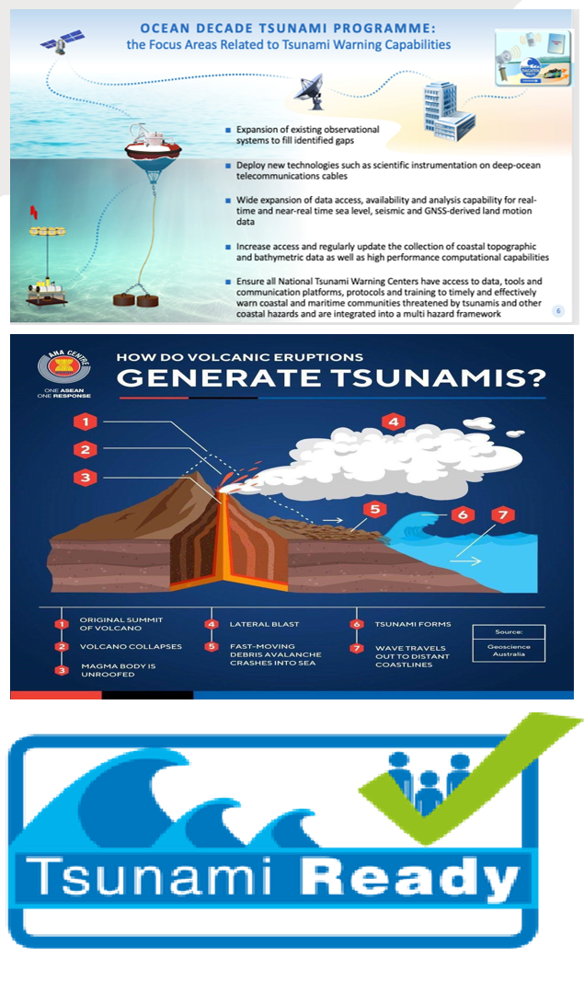
CONFERENCE STRUCTURE & SESSION THEMES
The ODTP Research Development and Implementation Plan is organized around five key pillars. However, the first ODTP Conference will focus on the ODTP two High Level Objectives (HLO):
To develop the warning systems’ capability to issue actionable and timely (<10 min) tsunami warnings for tsunamis from all identified sources to 100% of coasts at risk.
100% of communities at risk be prepared and resilient to tsunamis by 2030 through programmes like the IOC-UNESCO Tsunami Ready Recognition Programme (TRRP).

Slide 28
FIRST OCEAN DECADE TSUNAMI PROGRAMME CONFRENCE INCOIS, 10 – 11 Nov’25) 09:30-17:30
Day 1 10 Nov 2025 | Day 2 11 Nov 2025
Opening Ceremony | 09:30-17:30 Session 2: HLO 2
High Level Talks on each ODTP High Level Objectives HLO 1 & HLO 2 | Session 3: Tools to support ODTP Implementation
Tea Break (11:00 – 11:30)
Session 1: HLO 1 | Session 4: Engaging with Decade Structures (DCCs, WG 6 etc)
Lunch Break (13:00-14:00)
Session 1 HLO1 (Cont.) | Session 5 : Round Table Dialogue/panel
Tea Break (15:30-16:00)
Session 2: HLO 2 | Session 6: Synthesizing key Outcomes and identifying new actions for advancing the ODTP and challenge 6
End (17:30)
DAY 1
Day 1 will focus on both High-Level Objectives (HLOs) of the ODTP.
Day 1 will begin with an opening segment, followed by two high-level talks—one on each of the ODTP's High-Level Objectives. The remainder of the day will be structured around two focused sessions:
Session 1: High-Level Objective 1 (HLO 1)
This session will begin after the morning tea break and continue until the afternoon tea break.
Session 2: High-Level Objective 2 (HLO 2)
This session will begin after the afternoon tea break and continue into the morning of Day 2.

Slide 29
FIRST OCEAN DECADE TSUNAMI PROGRAMME CONFRENCE INCOIS, 10 – 11 Nov’25) 09:30-17:30
Day 1 10 Nov 2025 | Day 2 11 Nov 2025
Opening Ceremony | 09:30-17:30 Session 2: HLO 2
High Level Talks on each ODTP High Level Objectives HLO 1 & HLO 2 | Session 3: Tools to support ODTP Implementation
Tea Break (11:00 – 11:30)
Session 1: HLO 1 | Session 4: Engaging with Decade Structures (DCCs, WG 6 etc)
Lunch Break (13:00-14:00)
Session 1 HLO1 (Cont.) | Session 5 : Round Table Dialogue/panel
Tea Break (15:30-16:00)
Session 2: HLO 2 | Session 6: Synthesizing key Outcomes and identifying new actions for advancing the ODTP and challenge 6
End (17:30)
DAY 2
Session 3: Tools to Support ODTP Implementation
This session will begin after the conclusion of HLO 2 in the morning and continue until the morning tea break.
Session 4: Engaging with Decade Structures (e.g. DCCs, WG 6)
Starting after the morning tea break and continuing until lunch, this session will explore broader issues and objectives aimed at triggering and supporting the ODTP’s Research, Development, and Innovation (RDI) components.
Session 5: Round Table Dialogue / Panel Discussion
This closing session will bring together action leads and a broad range of stakeholders for an interactive dialogue on engagement and collaboration.
Session 6 will aim to synthesize key outcomes and identifying new actions for advancing the ODTP and challenge 6

Slide 30
6.0 EXPECTED PARTICIPANTS
The First Ocean Decade Conference expect to attract up to a maximum 50-100 participants, including local participants from India?
ODTP SC members (11)
OD WG 6 members (20)
TOWS TTs Chairs (2)
ICG Chairs (4)
DCU representative (1)
DCCs members (3)
UNDRR Representative (1)
WMO Representative (1)
UNESCAP (1)
DG ECHO Representative (1)
ODTP action leads (~25)
Representatives of INCOIS, India (2)
IUGG-JTC member/representative (2)
IUGG -JTC stakeholders (10)
UNESCO-IOC /TSR Secretariat
Support SIDs/LDS representatives? Even if not having endorsed actions?
Goal? Certain countries to step up? Another set of participants ?
Need to feel important thing and why they need to come/prioritize?

Slide 31

ROLES AND RESPONSIBILITIES
The Steering Committee
A relatively small steering committee will lead preparations and takes final decisions related to the organization of the ODTP conference. The SC will meet at 2-3 monthly intervals and when necessary.
The ODTP conference SC
Chair of ODTP-SC: Ms Silvia Chacon, Costa Rica National Tsunami Warning System, National University of Costa Rica
TOWS TTs Chairs: Yuji Nishimae, Japan, JMA, Chair of TT-TWO
Harkunti Pertiwi Rahayu. Indonesia, Research Center for DM Institute of Technology
ICG Chairs: Alessandro Amato (ICG/NEAMTWS), Pattabhi Rama Rao Eluri, India, INCOIS, Scientist-G & Group Director (ICG/IOTWMS), Gerard Metayer, Haiti, Haiti Maritime and Navigation Service, (ICG/CARIBE-EWS Chair), Dakui Wang, China, National Marine Environmental Forecasting Center (ICG/PTWS)
Head of Tsunami Resilience Section: Bernardo Aliaga
Focal Point for ODTP and Technical Secretaries: Denis Chang Seng, Srinivas Kumar and Necmioglu
TICs Representative: Laura Kong ITIC
Representative of INCOIS, India: Balakrishnan Nair
IUGG-JTC member/representative: Prof Yuichiro TANIOKA (Chair of the IUGG JTC) and Alexander Rabinovich

Slide 32

ROLES AND RESPONSIBILITIES (Con’t)
The Organizing Committee
To coordinate and contribute to the preparatory process including organization of the sessions, advise on relevant speakers and engagement in the selection of posters; and contribute to the ODTP Conference outcomes. The organizing committee will meet more regularly at least twice a month ahead of the conference.
Chairs of TOWS TTs
Technical Secretary/ Focal Point for ODTP
Technical Secretaries of ICGs
Director of INCOIS, India
IOC TSR staff

Slide 33
ROLES AND RESPONSIBILITIES (Con’t)
SESSION FOCAL POINTS, MODERATORS & RAPPORTEURS
Sessional Focal Points are members of the organizing committee who are lead responsible and accountable for the preparations and delivery of an assigned ODTP session, in line with the guiding principles of the ODTP and guidance provided by the Steering Committee.
Only members of the organizing committee that can attend the conference in person are eligible to act as Session focal points.
Moderators/ rapporteurs may be selected from the leads of the ODTP actions.
Session Focal Point /moderator1/rapporteur
Session Focal Point /moderator 2 / rapporteur
Session Focal Point /moderator 3/ rapporteur
Session Focal Point/moderator 4/ rapporteur
Session Focal Point /moderator 5/ rapporteur

Slide 34
ROLES AND RESPONSIBILITIES (Con’t)
  National Focal Point
To coordinate, support, and manage the technical arrangements and local organization of the ODTP conference in collaboration with Organizing Committee.
INCOIS Representative(s)

Slide 35
PROPOSED WORKPLAN
Time Frame | Action/Task | Comments/Status
Mid-March 2025 | Zero Draft Concept Note/Work Plan | DONE
Mid-Apr 2025 | Selection of ODTP Conference Title and ODTP Session Themes and first announcement (IOC CL)/website
Mid -May 2025 | Development of Draft Agenda / List of Sessions
End of May 2025 | Selection of Session Focal Points
Mid-Jun 2025 | Final Draft of Concept Note/Workplan
Mid-Jul 2025 | Identification of Speakers, Moderators. Rapporteurs & invitations
Mid -Sep 2025 | Session Finalization
Mid-Oct 2025 | Website Update
End of Oct 2025 | Speaker and Moderator Preparation
10-11 Nov 2025 | In-situ Session Management
Mid- Dec 2025 | Development of Outcome Document
Mid -Jan 2026 | Final ODTP Conference Summary Report to 6 ODTP-SC

Slide 36
IMPORTANT DISCUSSIONS
Invitations to SIDS & LDS even without current endorsed actions?
Registration and funding mechanisms to be discussed via email asap (priority )
Aligning Timetable with the Joint Tsunami Commission (JTC) International Tsunami Symposium
Duration of presentations?
Parallel ODTP Scientific Committee (ODTP- SC) meetings/discussions to support ODTP conference planning

