Slide 1
ICG/NEAMTWS
Steering Committee
Technical Secretary Report
15-16 May 2025
KOERI, Istanbul , Türkiye
Denis Chang Seng, PhD Programme Specialist
Technical Secretary (ICG-NEAMTWS & TOWS Task Team on Disaster Management and Preparedness
ODTP’ ODTP SC Focal Point
CoastWAVE Project Responsible Officer
Tsunami Resilience Section
UNESCO IOC

Slide 2
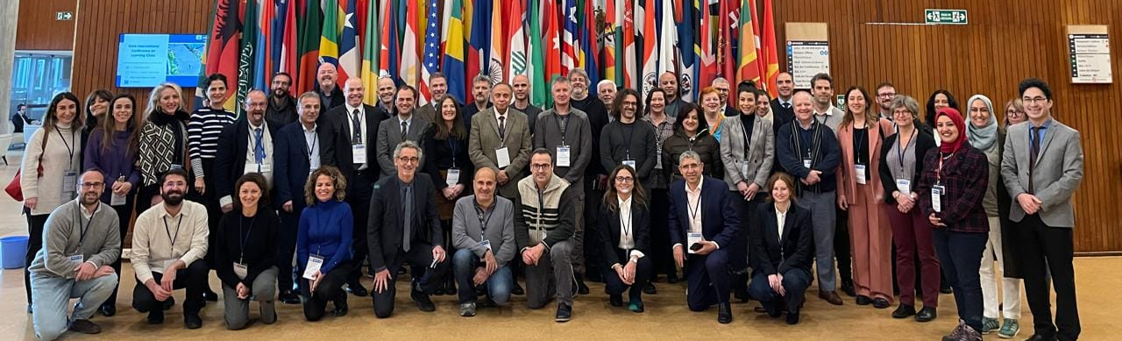
ICG/NEAMTWS 19th session
The ICG/NEAMTWS held its 19th session on 27–29 November 2024, at the UNESCO-IOC Headquarters in Paris, France.
Strong participation from 17 Member States including Algeria, Egypt, Morocco and Tunisia

Slide 3
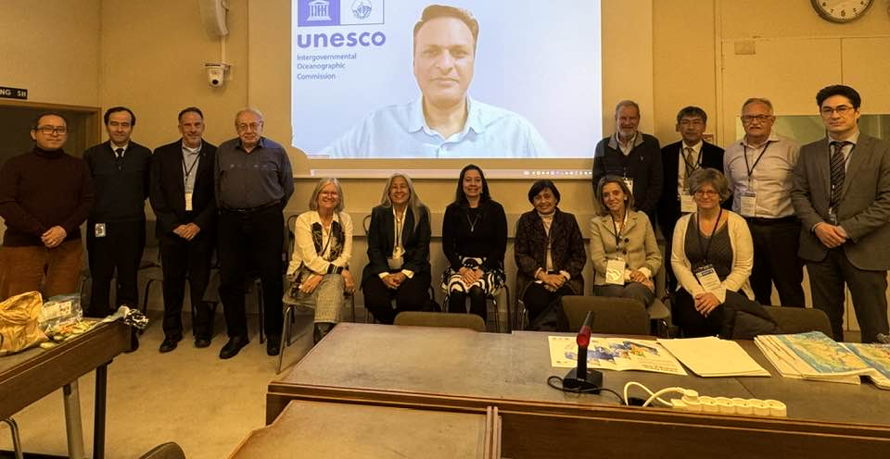
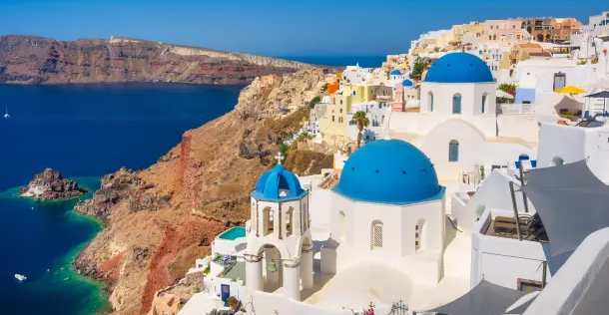
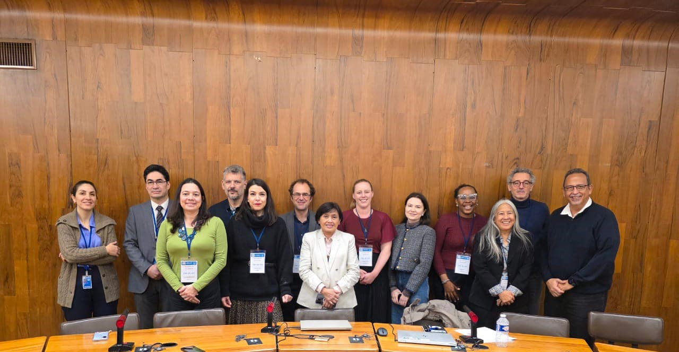
Meetings
5th ODTP RDI Meeting, HQ, Paris, 16-17 January and prepared Summary Report. This includes coordinating IOC TRS input and engagement with ODU on ODTP Actions , Calls, Reviews and Promotion of Actions etc.
Scientific Meeting on Santorini situation, 18 Feb 2025 (Online).
Webinar organized/moderated by Prof Costas Synolakis- Symposium on Santorini-Amorgos seismic crisis , Academy of Athens (Online)
TOWS Meetings, Joint Meetings of TT TWO and TT DMP and TT DMP, 20-22 Feb 2025 and prepared both Summary Reports

Slide 4
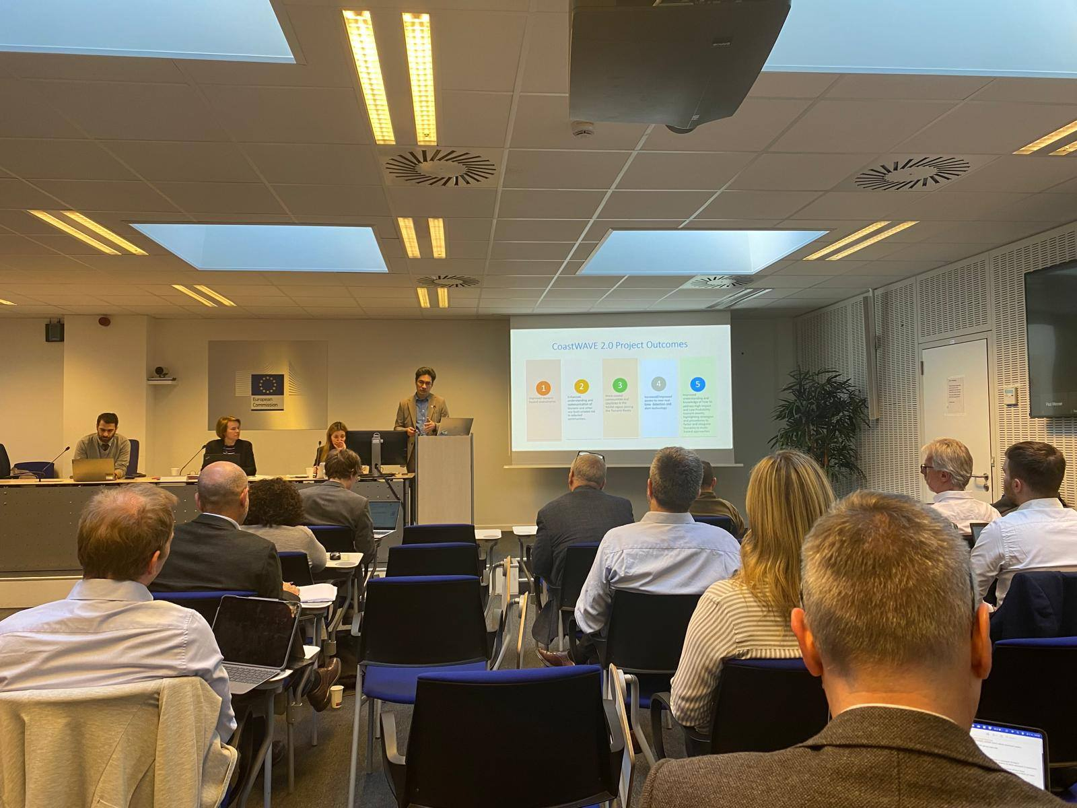
Early Warning Systems (EWS) Expert Group Meeting
Early Warning Systems (EWS) Expert Group Meeting, Brussels ERCC, 31 March -1 April 2025, European Commission DG ECHO.
Exchanged with experts , especially the Deputy Director for Prevention and Risk Management at the Portuguese National Authority for Emergency and Civil Protection.
Renewed European Scientific Partnerships on Natural Hazards (ENHSP-ARISTOTLE) Alberto Michelini
Possible Access to UNESCO-IOC?
Support decisions -UNESCO Natural Science Emergency Fund, supported by Japan

Slide 5
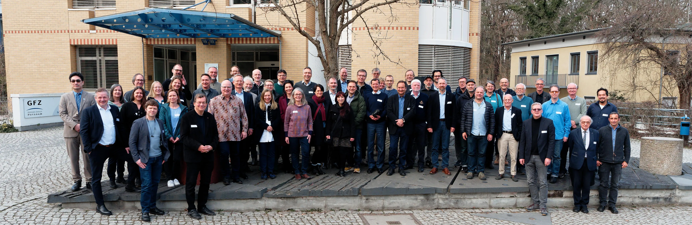
German Indonesian Tsunami Early Warning System (GITEWS) 20 Years Ago
Invited by Prof Alexander Rudloff to the Scientific colloquium on the occasion of the signing of the Joint Declaration for the German Indonesian Tsunami Early Warning System (GITEWS) 20 years ago, GFZ , Helmholtz-Zentrum für Geoforschung, Potsdam, Germany, 14 March 2025.
Delivered a talk on Multi-Level and Scale Coordination and Cooperation & The Ocean Decade Tsunami Programme (ODTP)

Slide 6


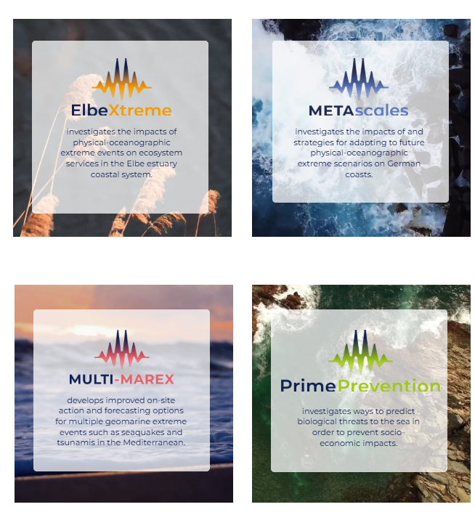
EPOS ON and mareXtreme
Invited member to the Advisory Board of EPOS ON (EPOS Optimization and EvolutioN) - a project dedicated to strengthen and evolve the EPOS Research Infrastructure. Participated in its first meeting, 18 March 2025. 2nd EPOS ON Advisory Board meeting planned in October 2025
Invited member to the Scientific Advisory Board of mareXtreme. Participated in the first board meeting, 25 March 2025 .
Over the next three years, about 150 scientists from 29 institutions will work on enhancing risk management for extreme marine events and natural hazards.
Supported by the German Federal Ministry of Education and Research and northern German state science ministries, with funding totaling around 20 million euros

Slide 7
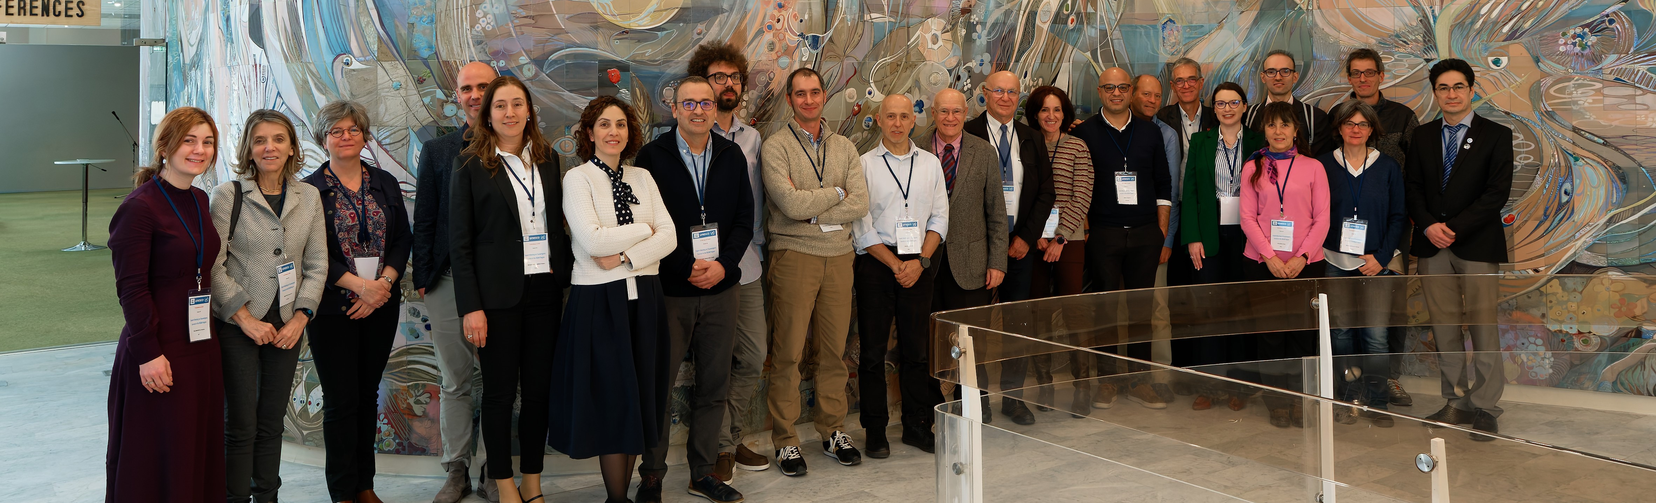
CoastWAVE 2.0 Tsunami Source Expert meeting at UNESCO HQ
Tsunami Source Expert meeting at UNESCO HQ, 18-20 March 2025 with a special focus on two high-risk zones:
the Hellenic Arc and the
Azores-Gibraltar Fracture Zone
The workshop identified the Hellenic Arc south of Crete as a significant "seismic gap" with the potential to generate powerful earthquakes (M>8) and tsunamis
Santorini volcanic complex—including the Santorini caldera and the Kolumbo submarine volcano—as key potential tsunami sources.
In the Azores-Gibraltar Fracture Zone, tsunamis could result not only from earthquakes but also from volcanic landslides and slope failures off the southwest coast of Iberia.
Future meetings will build on the outcomes of this first expert meeting

Slide 8
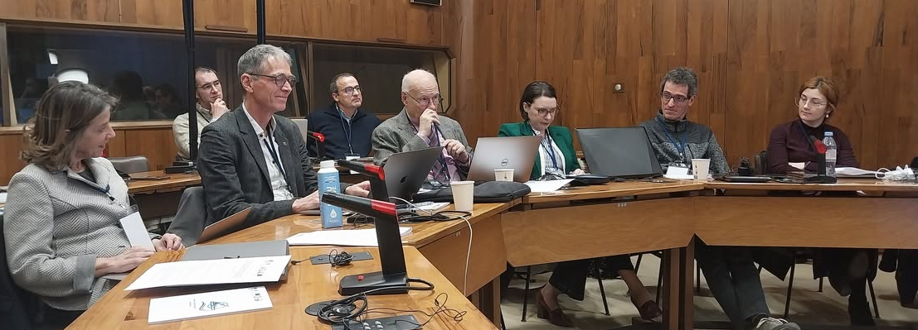
Expert Meeting of UNESCO-IOC Expert Meeting on Tsunami Sources Associated with Hellenic Arc and Azores–Gibraltar Fault Zone in the North-Eastern Atlantic, the Mediterranean, and Connected Seas (NEAM) Region Link here
Seismic sources
Non-Seismic (volcano and landslide)

Slide 9
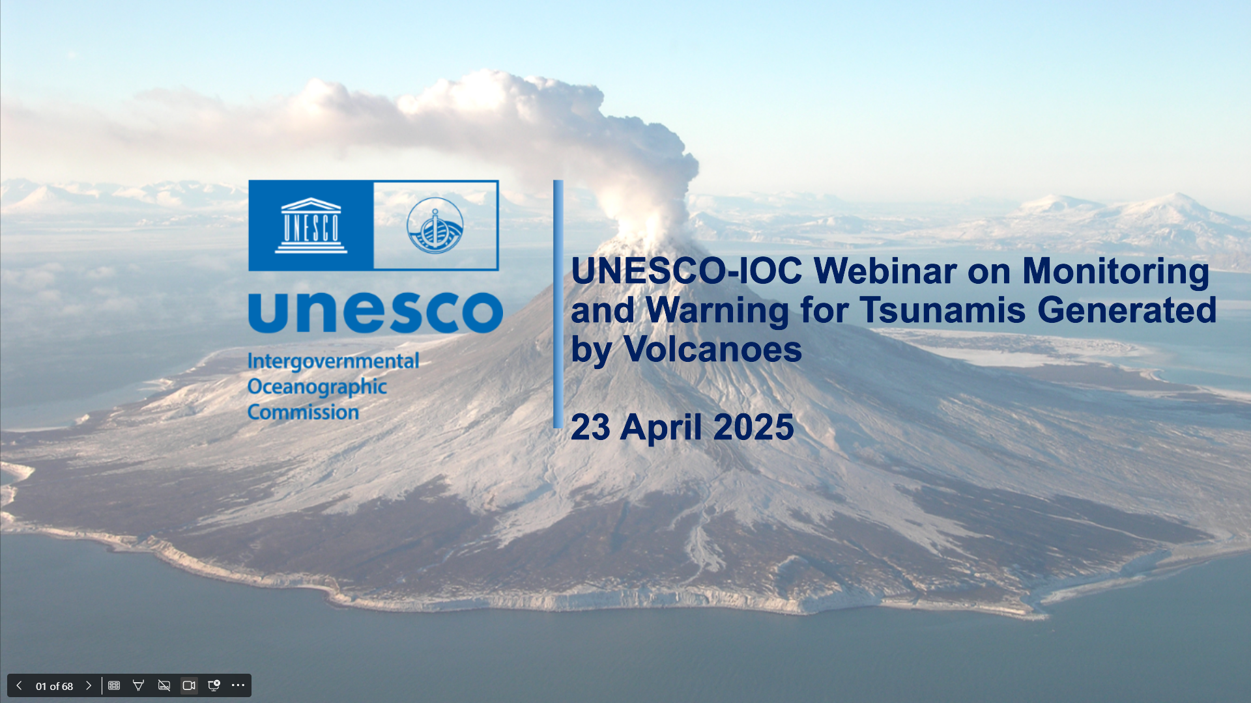
UNESCO-IOC Global Online Webinars on Tsunamis Generated by Volcanoes (TGVs), 16 April 2025 and 23 April 2025.
~220 participants in total.
Regional TGV webinars to follow in each ICG. Received first ideas/ proposal from TT on Non-Seismic

Slide 10
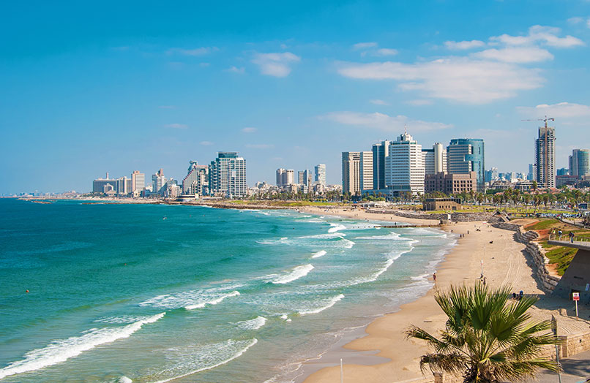
Tsunami Ready
Israel Tsunami Ready Recognition Application
Establishment of RTRB and members
3 online meetings ~6-7 total hours
Several challenges ( Scale, NTRB, Community, Indicators etc.) .
RTRB requested to focus and conduct a separate evaluation on the 12 Indicators and provide recommendations on the way forward
Report forthcoming/recommendation following meeting on 12th May.

Slide 11


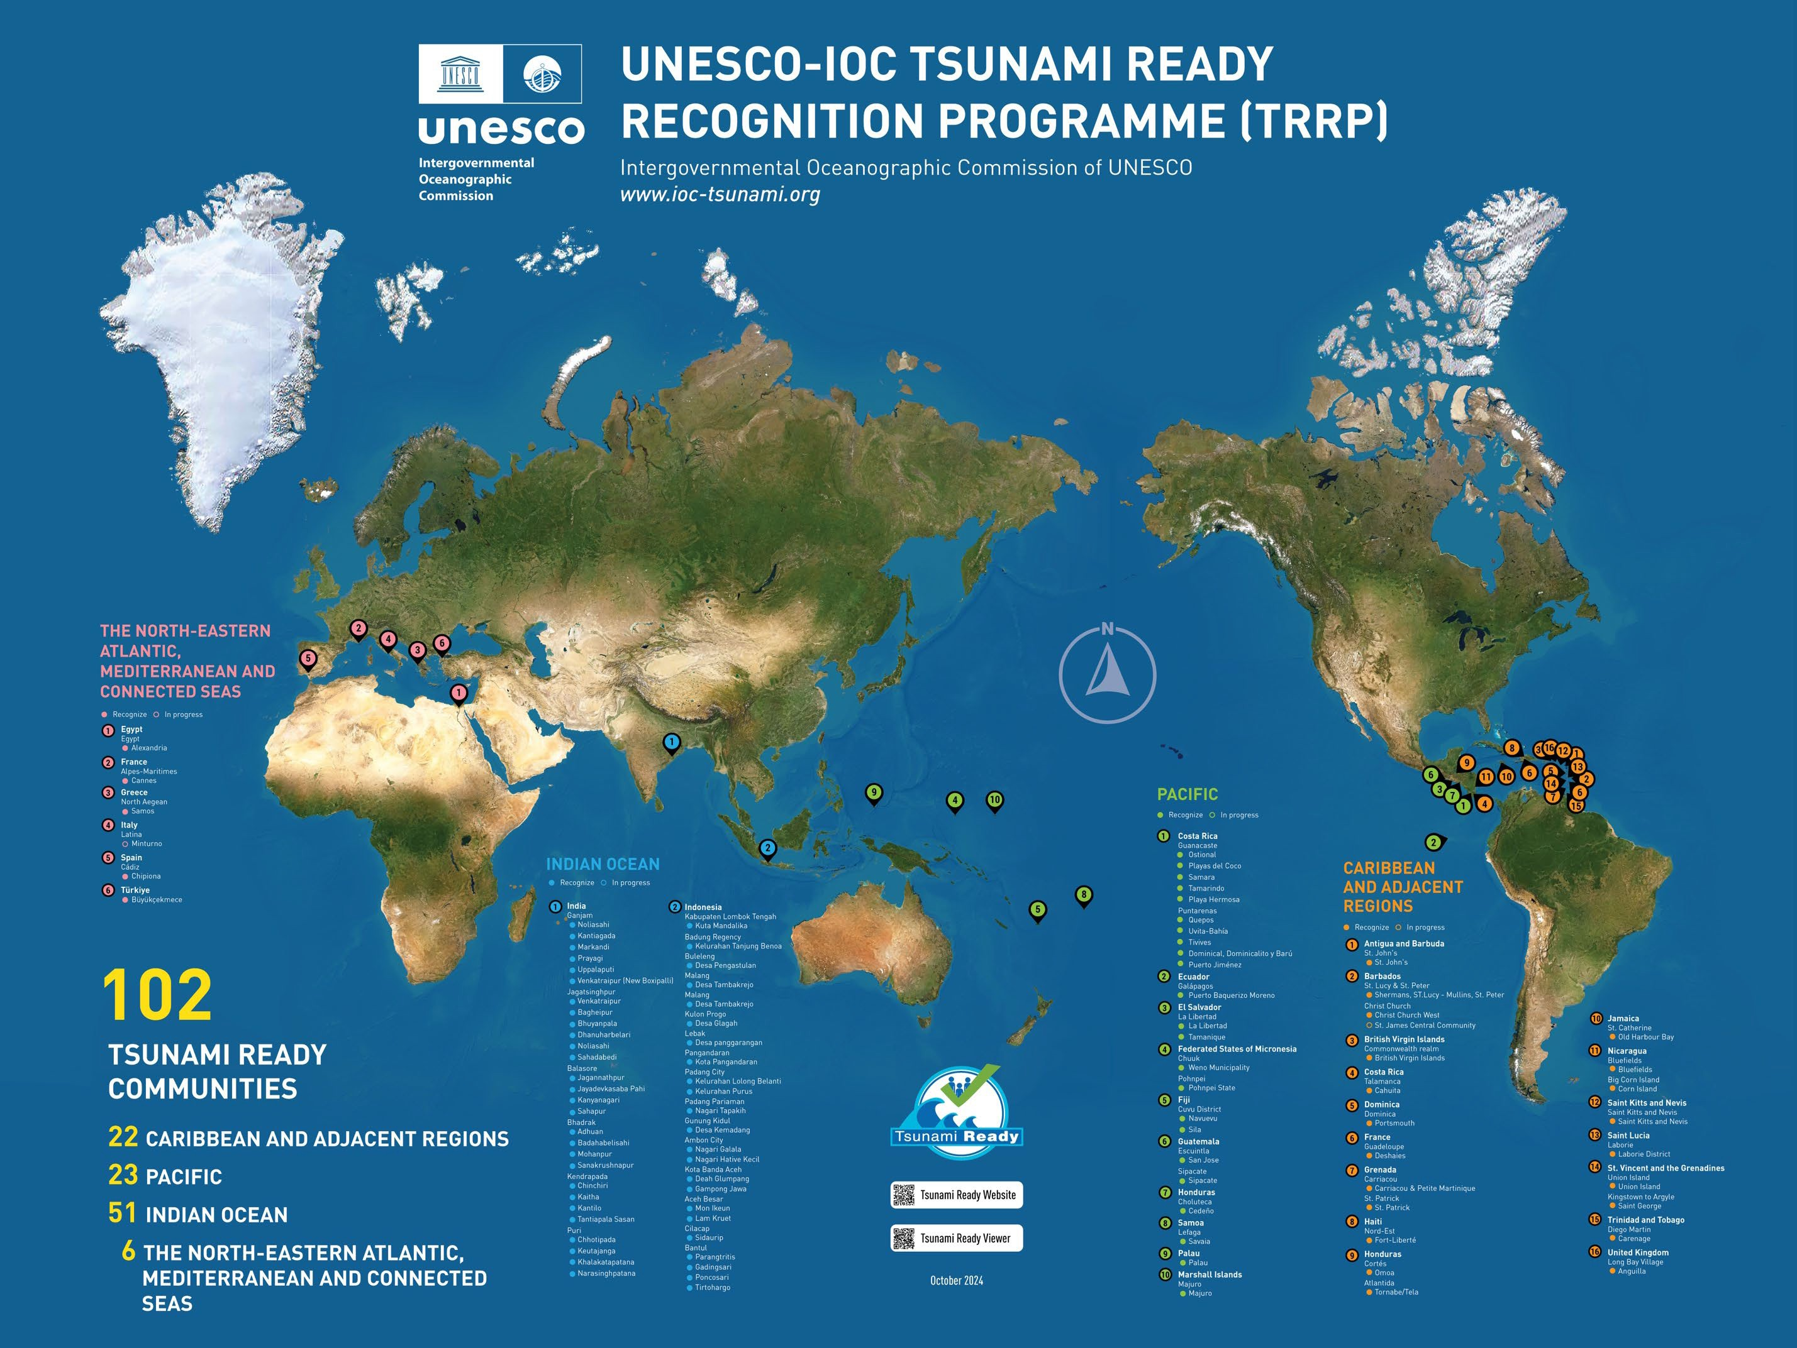
100
Tsunami Ready Communities
48 INDIAN OCEAN
23 CARIBEAN & ADJACENT REGIONS
23 PACIFC
6 NORTH EASTERN ATLANTIC , MEDITERRANEAN AND CONNECTED SEAS
30 / 139 Member States
14 CAR
18 PAC
2 IO
6 NEAM
Morocco a
and Cyprus encouraged to finalize work and apply for TRR
Malta -No update/reply
15 SIDS
10 CAR
5 PAC
0 IO
0 NEAM

Slide 12

New IOC DG-ECHO Funded CoastWAVE 2.0 Project
Scaling-Up and Strengthening the Resilience of Coastal Communities in the North-Eastern Atlantic and Mediterranean Regions to the Impact of Tsunamis and other Sea level-related coastal hazards.
Amount: 1.2 M Euros -Phase –II
Start: 1 July 2024
Duration : 2 years [ ~1 year left]
Direct Beneficiary Countries:7 and several partners
First Progress Report to be submitted by mid-May 2025 :, Progress -On track. Portugal leadership, collective commitment and the engagement of CPA is notable and very encouraging. Acceleration required for other communities.
Most significant challenges : Resolving/negotiating budget and multi-partnerships and selection of communities

Slide 13
Technical Documents-Published or close to
ICG/NEAMTWS XIX Summary Report (Pub)
NEAMWave 23 Evaluation Summary Report-Not finalized /published yet
Community Perceptions of Coastal Sea-Level Related Hazard Risks, TS 192
Evaluation of Inexpensive Devices for Sea Level (IDSL)

Slide 14
Upcoming Activities
ICG/NEAMTWS SC , Istanbul, 15-16 May 2025
First Intergovernmental Session of the IOC Sub-Commission for the Central Indian Ocean, 19-23 May 2025- To deliver a talk on ODTP and IOTWMS
Coordinating and co-organizing EW4ALL Global Stakeholder Forum, 2-3 June, Geneva at the GPDRR(2025) and coordinating group (7) engagement/participation (More details day 2)
33rd session of the General Assembly of the Intergovernmental Oceanographic Commission, 25 June 2025 - 10:00 am - 3 July 2025
CoastWAVE 2.0 Evacuation Mapping Workshop in partnership with Paul Valéry University Montpellier, France, 30 June-4 July 2025
Regional TGV webinars , Sep 2025
CoastWAVE 2.0 Tsunami Hazard Assessment training workshop ?
CoastWAVE 2.0 SOP Workshop/ TRR certification and Commemoration of 270 years of tsunami aligned with WTAD, 5 Nov 2025 [ ~End of October- 2 Nov 2025]
Coordinating and organizing the First ODTP Conference,10-11 November hostedn by INCOIS alongside the Joint Tsunami Commission (JTC) International Tsunami Symposium (ITS) in Hyderabad, scheduled for November 12–14, 2025.
ICG/NEAMTWS XX Session November/December 2025
NEAMWave26 in March 2026
CoastWAVE 2.0 HILP Dialogues April 2026?
-END-

