Slide 1
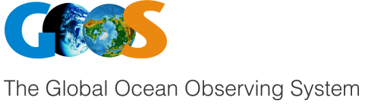


OceanOPS & EU/FR Projects
Laurent Mortier, ENSTA / IP Paris
laurent.mortier@ensta.fr

Slide 2
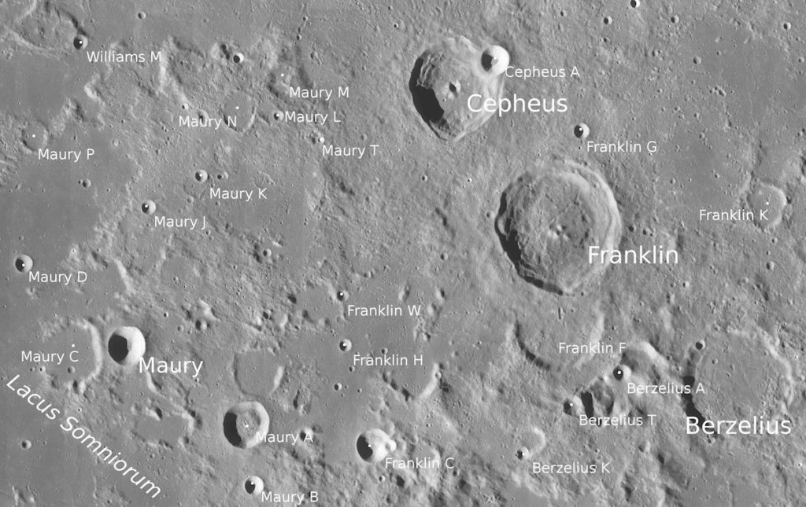
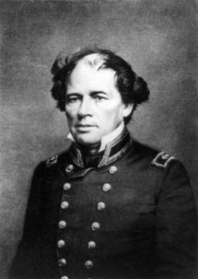
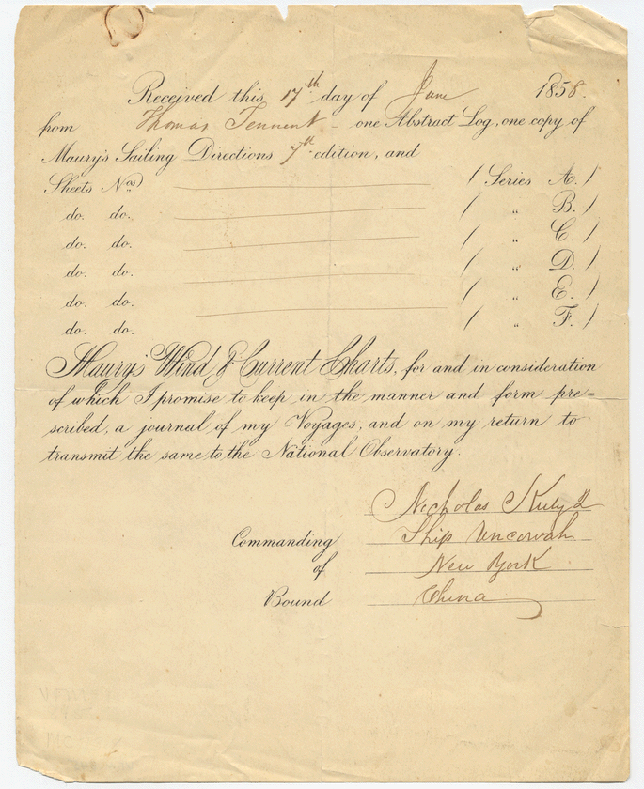
Brussels Conference 1853
(Even the Pope joined in, creating honorary flags for papal ships that collected data with Maury’s logbooks.)
“Rarely before has there been such a sublime spectacle presented to the scientific world : all nations agreeing to unite and co-operate in carrying out one system of philosophical research…
Though they may be enemies in all else, here they are to be friends. Every ship that navigates the high seas, with these charts and blank abstract logs on board, may henceforth be regarded as a floating observatory, a temple of science.”
Matthew Fontaine Maury, 1855
Maury’s Abstract Logs

Slide 3
A ⇒ B
A ⇒ B
If you always do what you’ve always done, you’ll always get what you’ve always got (Henry Ford or Darin Figurskey, NOAA)
⇁B ⇒ ⇁A
If you want something you've never had, be ready to do something you have never done (Thomas Jefferson)
B ⇒ ⇁A
If you want your country to become great again, do the crazy things that some people are doing today (X)

Slide 4
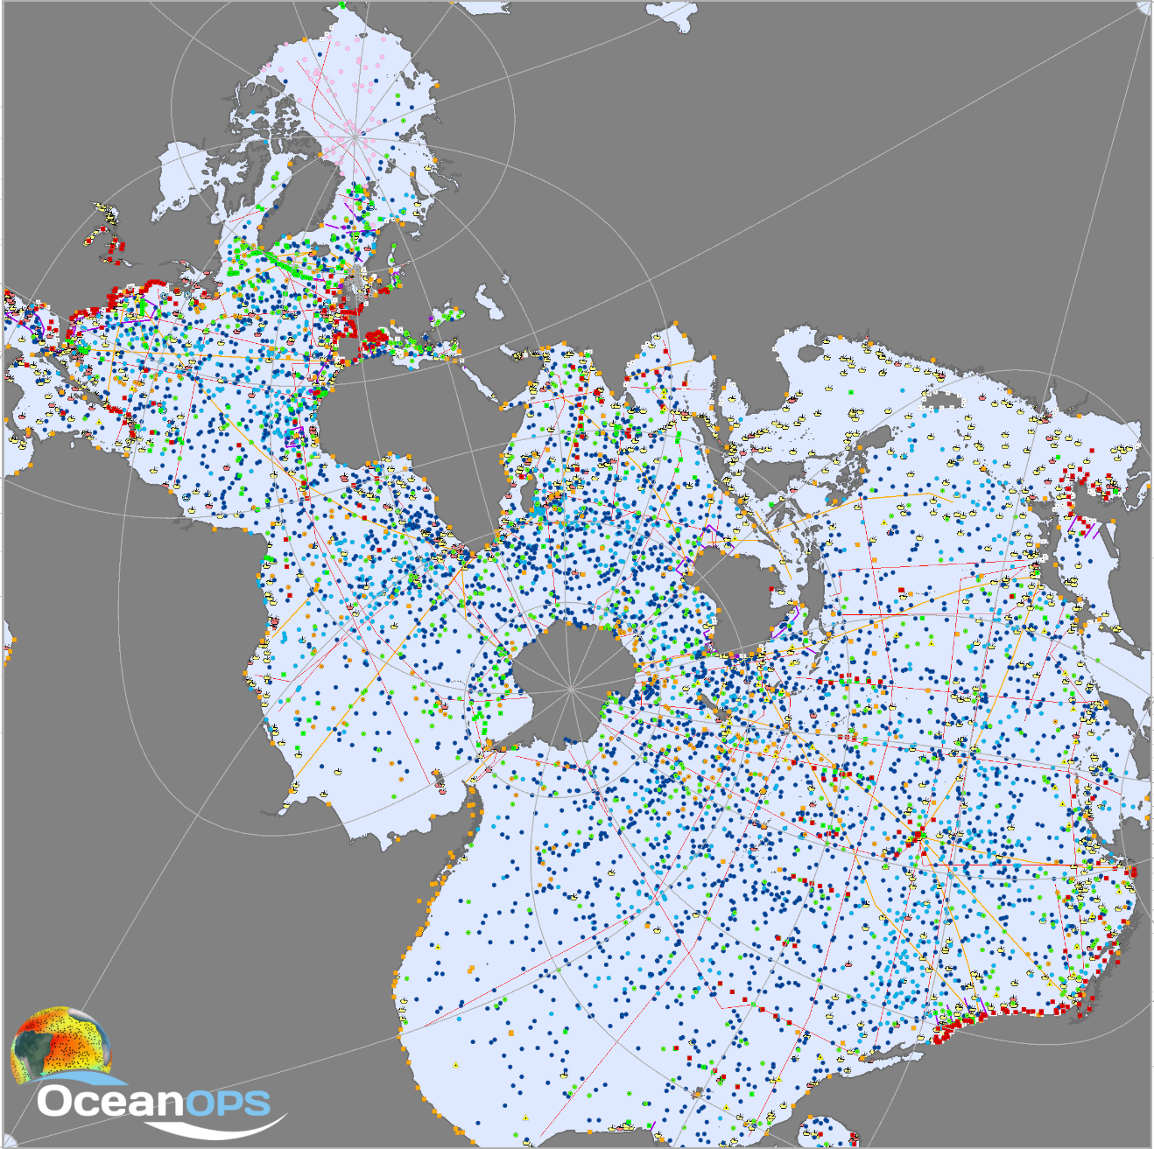
GOOS and OCG networks: a complex techno-socio system
GOOS products for society
GOOS OCG Networks
  EOVs: From platforms & sensors to information and services
  From local to global, from events to the long term
  Working with the satellite component
  Working with all the digital tools: Modelling, data assimilation, digital twins and AI, …
Many people involved from
  Operational agencies
  Research performing organisations, incl. Universities
  Some CSOs and private entities
  Distributed research infrastructures
  as “Principal Investigator”
A complex organisation and governance
  Composite: National, Regional, Global networks
  Heterogeneous between countries
  Blends the organisation and working streams of operational agencies and international scientific networks
  Managed by two specialised UN agencies
  A fully multilateral system of governance

Slide 5
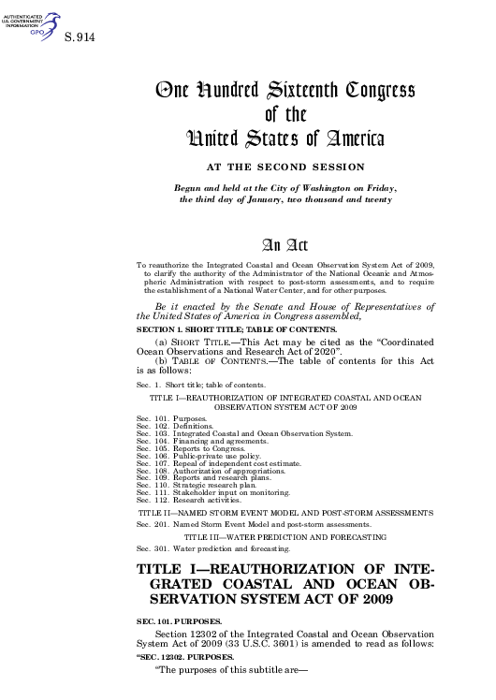
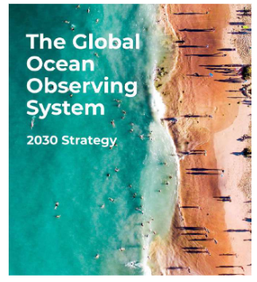
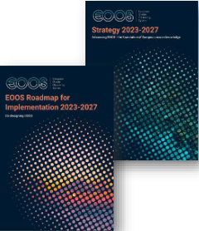
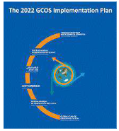
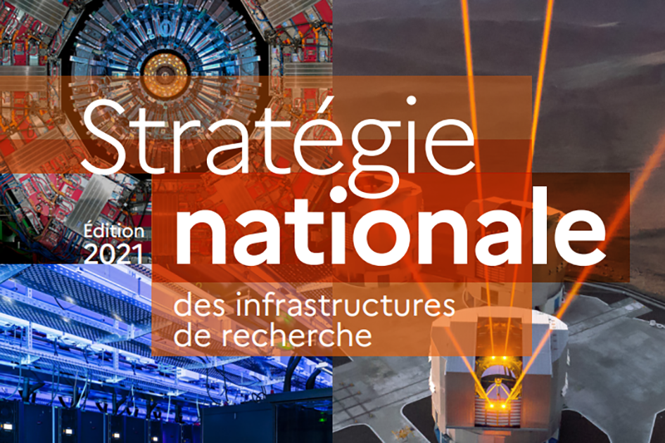
The French Ocean Observing System
A recent initiative to coordinate, with a formal governance, French sea observation infrastructures from Ifremer, CNRS, MétéoFrance, CNES, … (IP Paris joins in 2025?)
Fr-OOS builds on multiple pre-existing operational and research driven observing networks (some being part of GOOS OCG network)
Fr-OOS builds on national research infrastructures (some being the French mirror of EU ones)
Fr-OOS as national node for EOOS and GOOS & GCOS (alignment of national, European and international strategies & implementation)
https://iooc.us/about

Slide 6
Marine Research Infrastructures Integration and Harmonization
A 2025 priority with a new working group on MRIs:
“Strengthen coordination, harmonization, and sharing of national and regional marine research infrastructures to support Ocean research and data delivery as a public service for the global commons, contributing to the global ocean observing system.”
“strengthen collaborations with the Group of Senior Officials on Global Research Infrastructures (GSO-GRI)”
“[ . . . ] with a specific issue to identify with GOOS the core backbone global observing system (Ocean Global Basic Observing Network GBON) and focus on developing those networks as GRIs using the GSO-GRI framework as appropriate”
g7fsoi.org/activities
Satellite Remote Sensing
Marine
Research Infrastructure
Research Vessels
Experimental Capability
Marine Autonomy & Observation Platforms
Sustained
Ocean
Observing
Marine and fisheries observations for Monitoring and Compliance
Research Funded Sustained Observations
=> Res. Perform. Organisations
Prediction Systems
Marine autonomy:
Profiling floats
Gliders and USVs
Fixed points (moorings, …)
AS on opportunity platforms
Cables ?
Operationally funded Observations
=> Met (& Ocean) Services
Data/Digital Infrastructure
K. Hill, NOC
Notes:
Truly Distributed and data focused Research Infrastructure with strong innovation and digital components

Slide 7
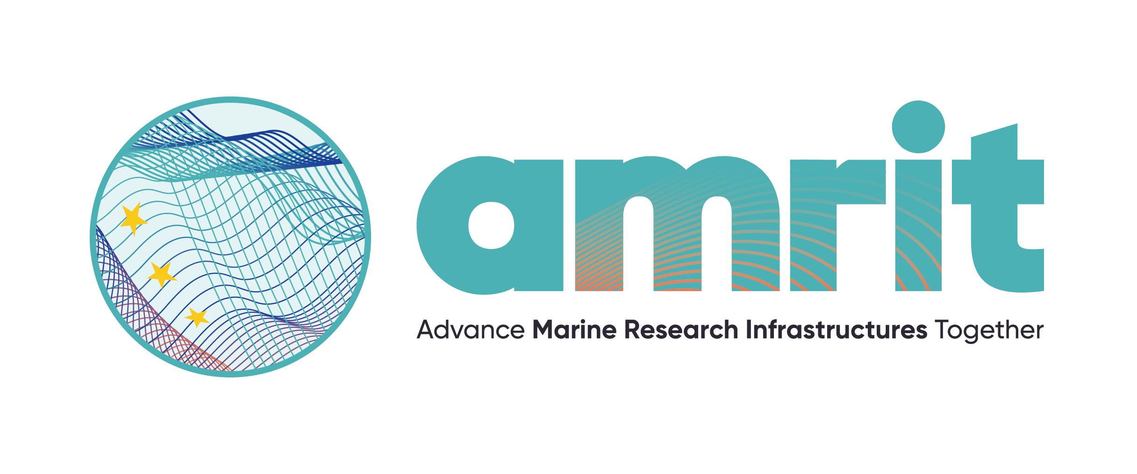
European Marine Research Infrastructures
AMRIT strives to become the catalyst for the development and consolidation of all EU Marine Research Infrastructures (MRIs) and be the cornerstone of the future European Ocean Observing System.
Funded by the European Union's Horizon Europe INFRA-2023-DEV-01 programme under Grant Agreement No 101132013.

Slide 8

Why AMRIT emerged? The current MRI Landscape
AMR
I
T
&
AQUAR
I
US
&
POLAR
I
N
EuroGO-SHIP
JERICO DS
FP7, H2020, HE DS
(bottom up)
GROOM
GROOM II
MINKE
FP7, H2020 I3
(targeted or open)
SeaDataNet II
JERICO
JERICO Next
JERICO S3
FP7, H2020 I3
(bottom up)
EUMR
Eurofleets
Eurofleets 2
Eurofleets+
GEORGE
&
ANERIS
T
R
I
C
U
S
O
Lifewatch
FP6/FP7 PP
(ESFRI)
ICOS-OTC
EMBRC
EMSO
Euro-Argo
Sideri
2008
2009
2010
2011
2012
2013
2014
2015
2016
2017
2018
2019
2020
2021
2022
2023
2024
2025
Adapted from“Reasons for the EU to optimize / integrate its research infrastructures in marine sciences?” Hervé Péro, INFRA/DGRI/EC, 2011

Slide 9
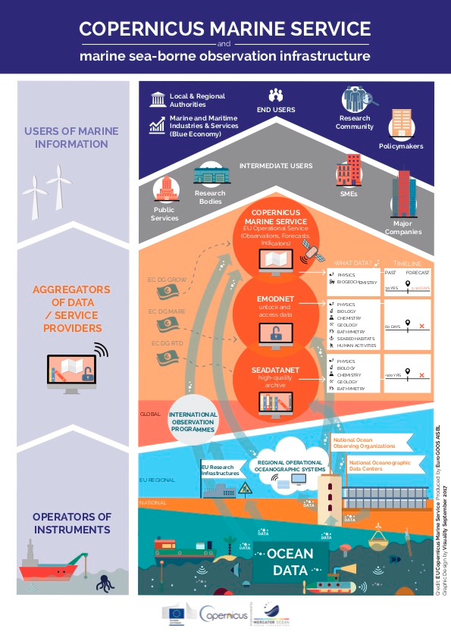
Challenges for AMRIT : COPERNICUS and EOOS
Copernicus Marine Service relies on a loose organisation for data collection
⇒ need for EOOS ⇒ EOOS 2023-2027 roadmap
Weaknesses
  Little coordination for operations between national operators (except in Euro-Argo; starting support by MRIs : EMSO, GROOM RI, EuroGO-SHIP, etc.)
  No real mechanism for joint programming of (multiplaform) offshore operations
  No service to support multi-platform operations to offshore operations
  A lot of duplication between national operators (and sometime at the national level too)
  Poor metadata descriptors to support operations and ensure quality and uptake throughout the data value chain
OPERATORS
EOOS

Slide 10
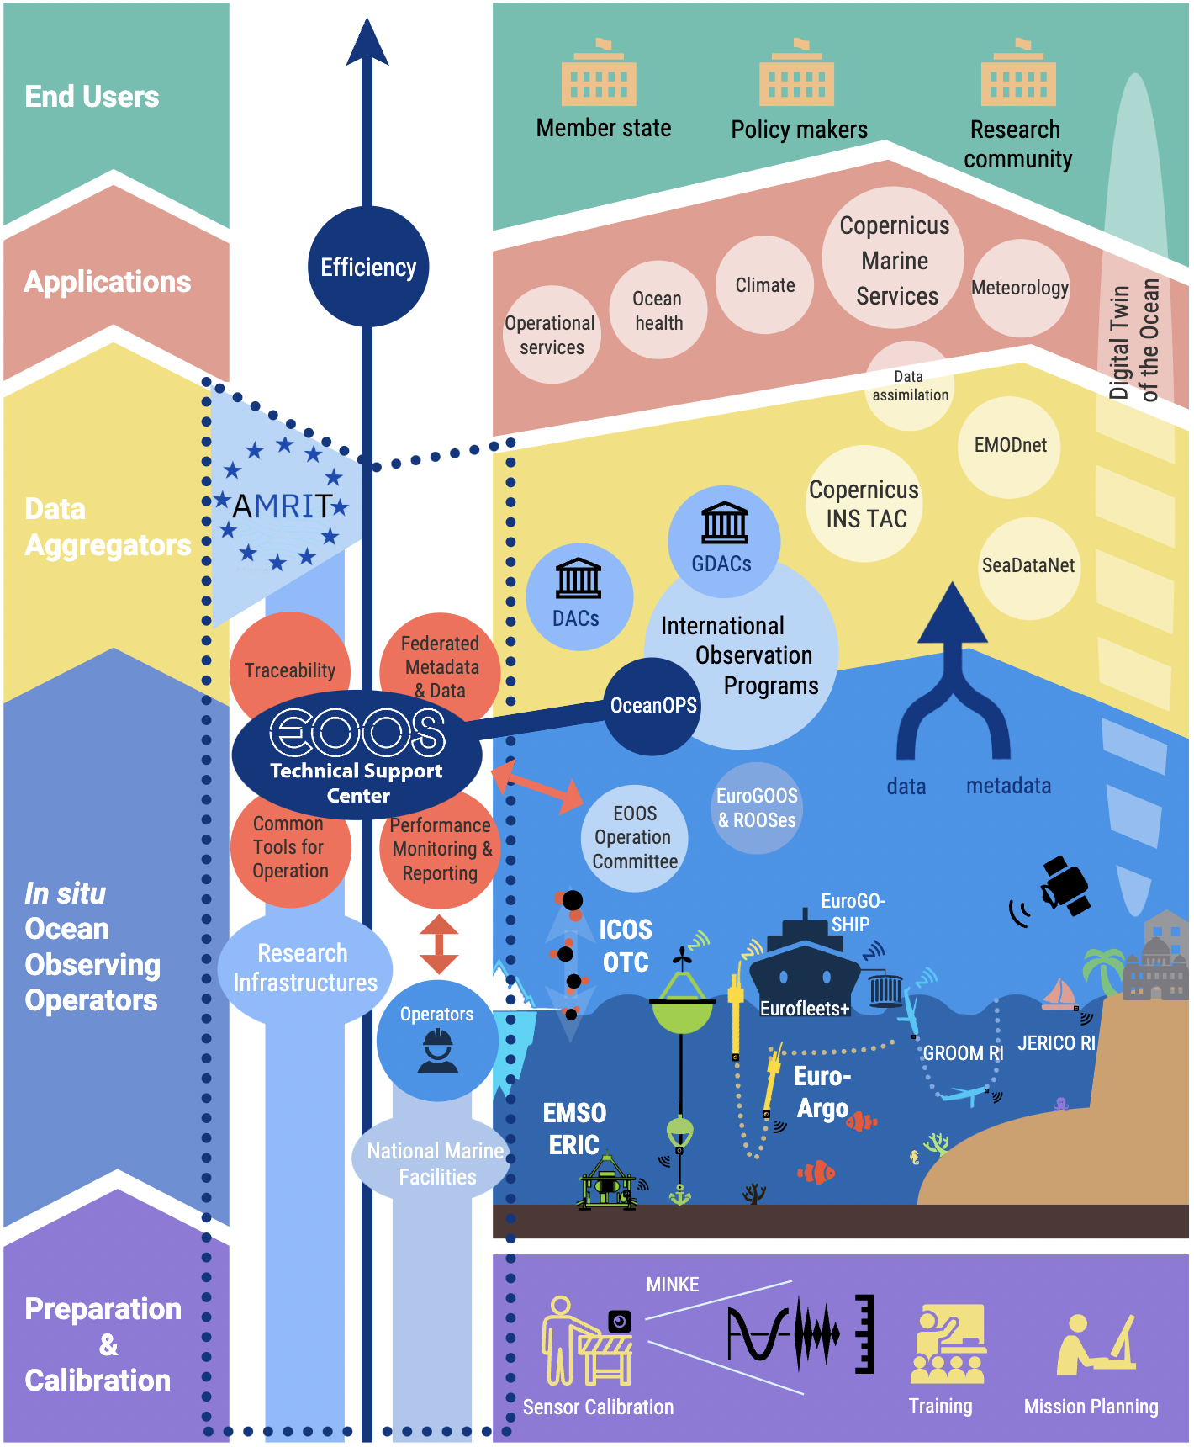
EOOS Technical Support Center
A federation of existing and new services
  Performance monitoring & reporting
  Common tools for operations
  Traceability of the data down to the users and feedback (persistent & unique IDs!)
  Materialize best practices with adequate metadata
  Monitor the carbon footprint of observations ?
⇒ Establish a ‘AMRIT scrum team of IT developers’
⇒ Focus of common vocabularies and metadata
standards
A single entry point for all operators (operational, MRIs, PIs, etc.) supported by OceanOPS
Focus on physical and biogeochemical EOVs
Prepare inclusion of biological EOVs (ANERIS, etc.)

Slide 11
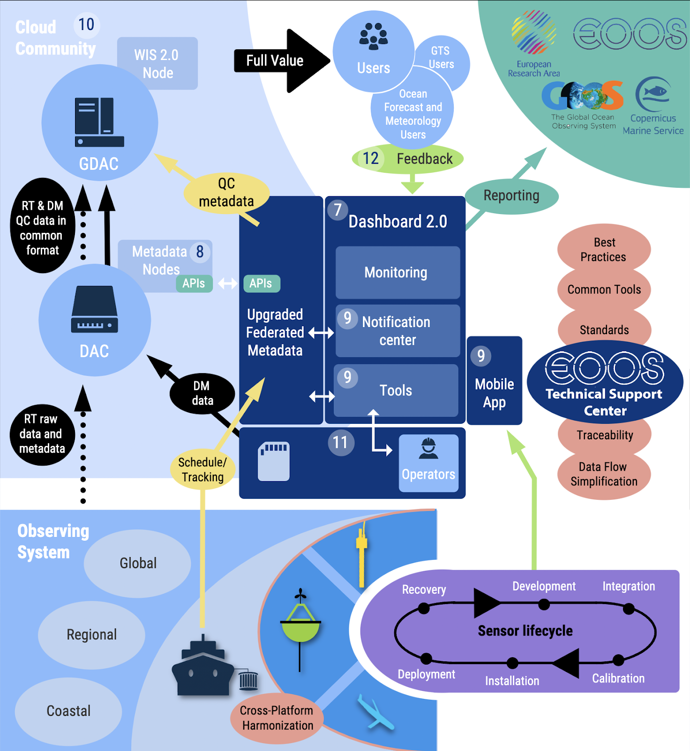
How to feed the Technical Support Center with information ?
Collect information along the life of the sensor (calibrations)
Collect information along the life of the platform (from planning to end of mission)
Collect information along the life of the data set (availability, processing, real time, delayed time, timeliness, usage)

Slide 12
AMRIT long term strategy ?

Slide 13


EuMetNet, a telling analogy
Belgian law EIG of 31 National Meteorological and hydrological/ocean Services. It works with ECMWF, EuMetSat, etc.
Its Observations Capability Area (Obs CA) coordinated by UKMO, operates EUCOS (C=composite) the European contribution to the WIGOS
In the Obs CA, the NMHSs operates together 7 programmes (2 are marine) and services
  Obs. Programmes E-SURFMAR (coord. MetFrance), E-ASAP (coord. DWD)
  Services: Regional WIGOS Centre (RWC)
  an R&D programme
  International representation of NMHSs in WIGOS, Copernicus, etc.

Slide 14

AMRIT long term strategy ?
Today
  NMHSs jointly operates the operational marine meteorology OS, with little interactions with National Oceanographic Agencies
  NOAs and National RPOs
    Are coordinated by EuroGOOS, contribute to CMEMS, and already have a coherent national/european data portal organisation
    Work together in the EOOS framework
    Are the core members of the European Marine Research Infrastructures (Euro-Argo, …)
  Universities
    Many marine univ. have a local role in coastal obs. networks and OOSs. They also maintain key marine life observatories (‘marine stations’)
    Some larger univ. are key stakeholders for OO and works with NOAs and RPOs

Slide 15

AMRIT long term strategy ?
Tomorrow, we can have
  The ‘Observation Capability Area’ of the future EOOS organisation is in charge of EOOS offshore operations
  In its Obs CA, EOOS members - NOAs, RPOs and MRIs - jointly operate:
    The national OOSs as part of EOOS and contribute to the GOOS / WIGOS, organised along MRIs and GOOS programmes
    Shared services:
      EOOS TSC (AMRIT)
      EOOS C2 (AMRIT C2)
      EOOS Sensors (eg GEORGE, ANERIS, TRICUSO, …)
      EOOS Citizen Science Programme
      EOOS R&D pPogramme
      Coordination of the European GRAs with GOOS (EuroGOOS),
      International repres. of NOAs in GOOS, WIGOS, Copernicus, EUMETNET, EUMETSAT

Slide 16
OBPS
portal
?
EOOS TSC
AMRIT
EOOS C2
AMRIT C2
EOOS - Sensors
EOOS
Capability
area:
Services
and
support
Digital
portal
EU RI
EU RI
EU RI
?
Nation
Decision
and
financing
Nation
Nation
Nat. RI
Nat.RI
Nat.RI
Nat.RI
Nat.RI
Nat.RI
Nat.RI
Nat.RI
Nation
Operation
Institution
Institution
Institution
Institution
Institution
Institution
Ocean Observation Sharing Responsibility
DG-MARE
RI
RI
RI
RI
RI
RI
RI
RI
RI
RI
RI
RI
GOOS – EOOS - Copernicus system

Slide 17
OceanOPS
GOOS C2
GOOS - sensor
GOOS - R&D
GOOS
Capability
area:
Services
and
support
OCG RI
OCG RI
OCG RI
Decision
and
financing
Nation
Nation
Nat. RI
Nat.RI
Nat.RI
Nat.RI
Nat.RI
Nat.RI
Nat.RI
Nat.RI
Operation
Institution
Institution
Institution
Institution
Institution
Institution
RI
RI
RI
RI
RI
RI
RI
RI
RI
RI
RI
RI
GOOS Observation Capability Area (~ OCG)

Slide 18
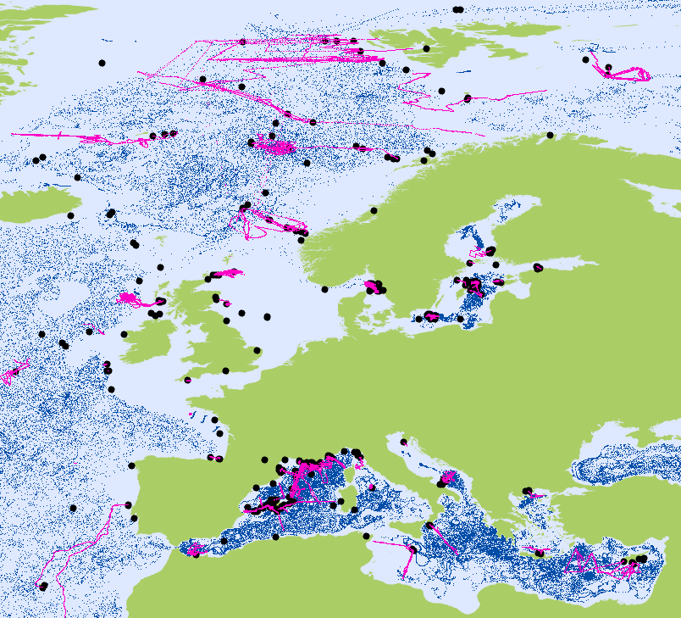
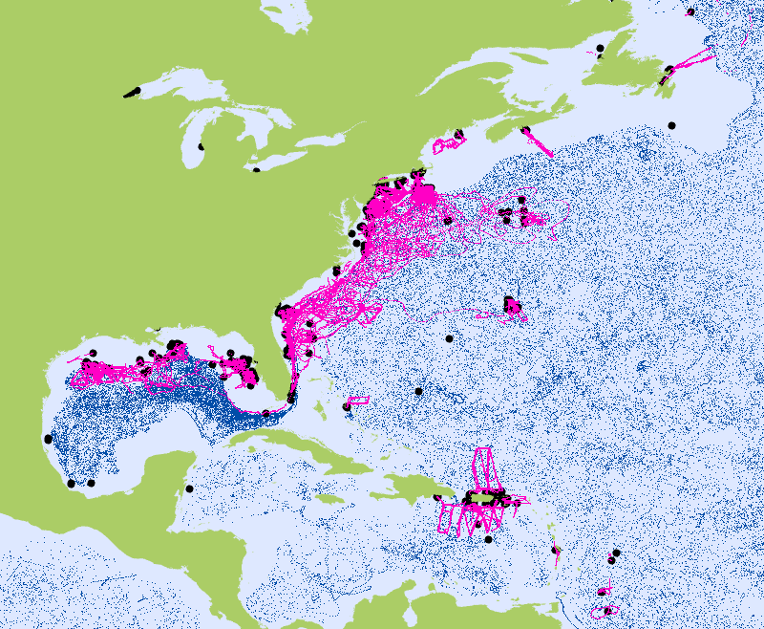
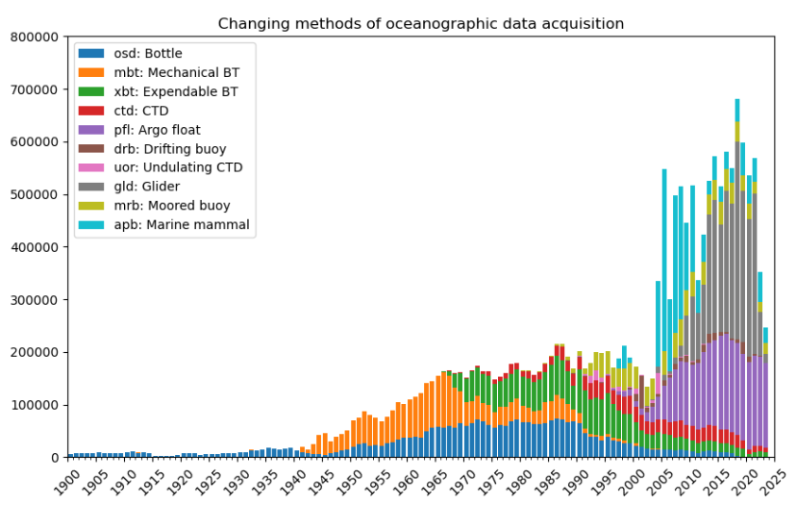
Challenges for AMRIT C2: MAS massive data flows
Glider
Argo
Argo OceanGliders
Global deep ocean Regional seas | Boundary Current Water Mass Transformation / Polar Storms

Slide 19
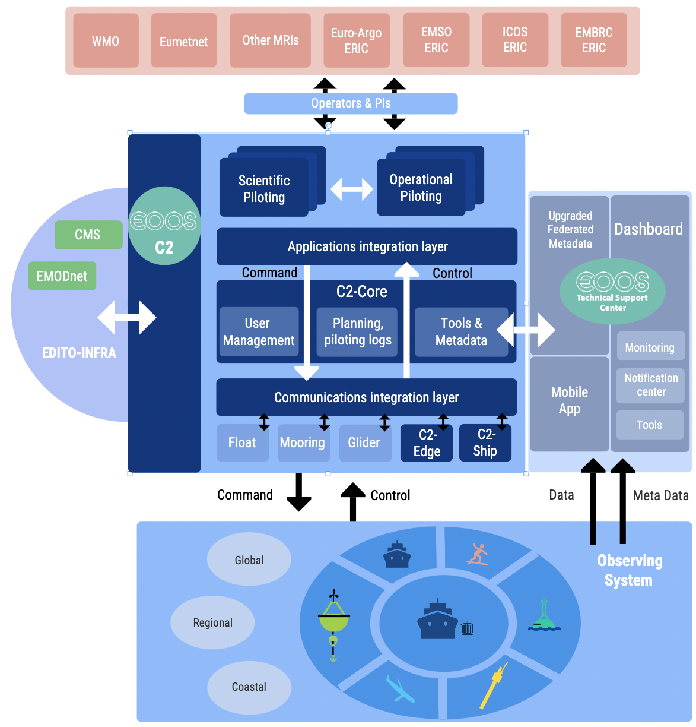
EOOS Control & Command Support Center
A federation of existing and new ‘Command and Control’ services to remotely operate
  long range marine autonomous systems (profilers, gliders, USVs, etc.)
  fixed points observatories
  underway systems on RVs and SOPs, such as meteo station and pCO2 sensors
and digital twins of
  single systems
  ocean observing systems and research field campaigns
⇒ Work with the EOOS TSC ‘scrum team’ (AMRIT)
⇒ Includes NMHS devoppers (from EumetNet, NOAA)
⇒ rely on ocean digital twin architecture E-DITO
A single entry point for all operators (operational, MRIs, PIs, etc.)
A cloud architecture based on core and edge computing

Slide 20
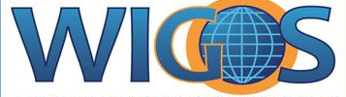


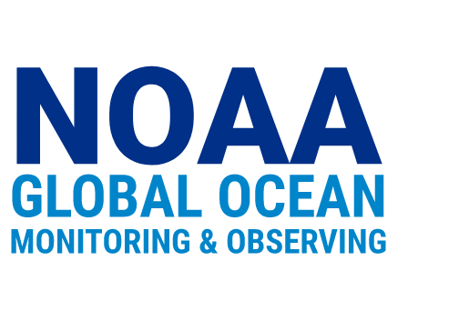

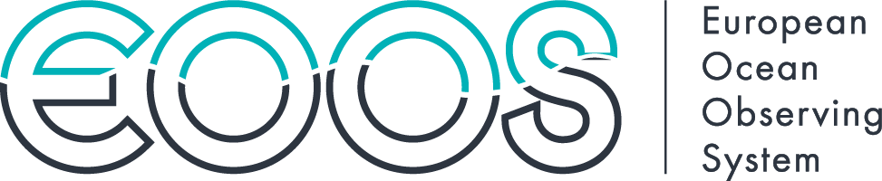
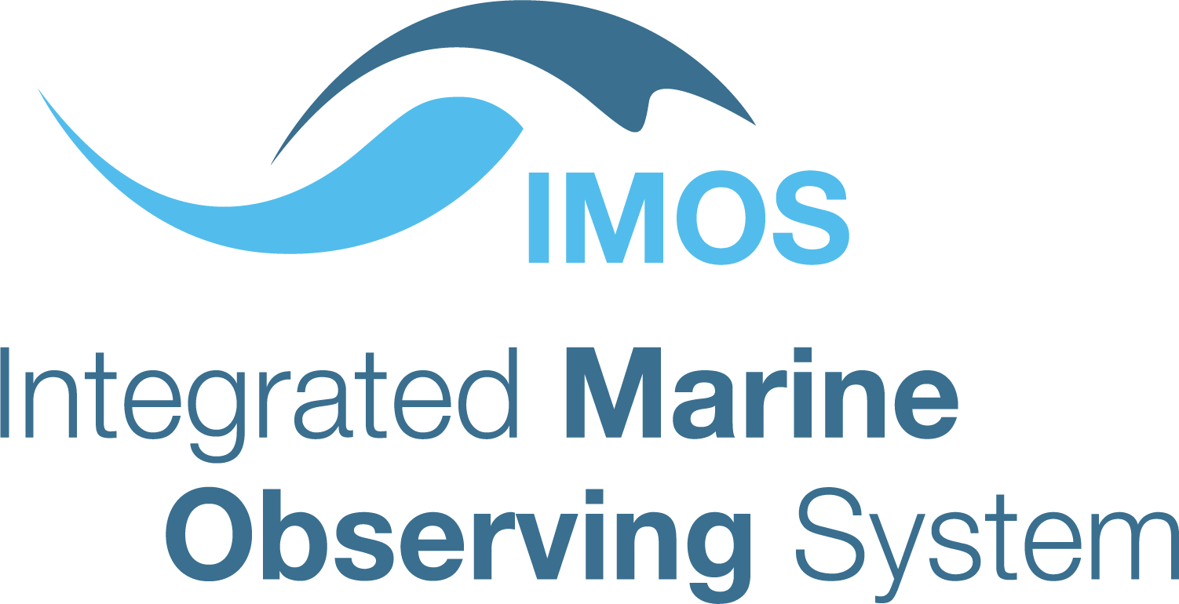
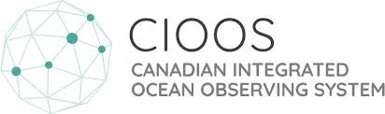

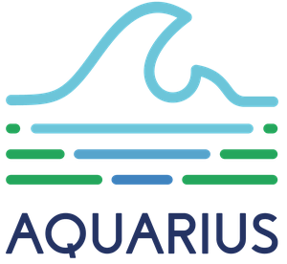

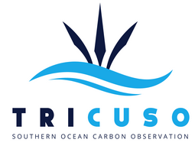
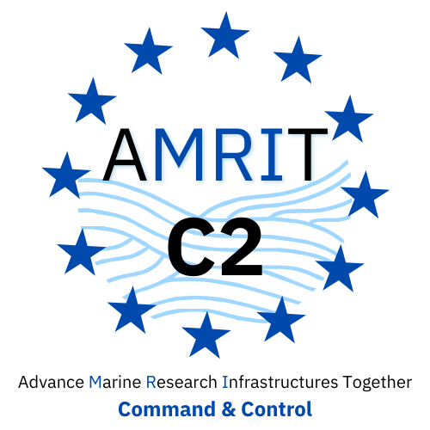
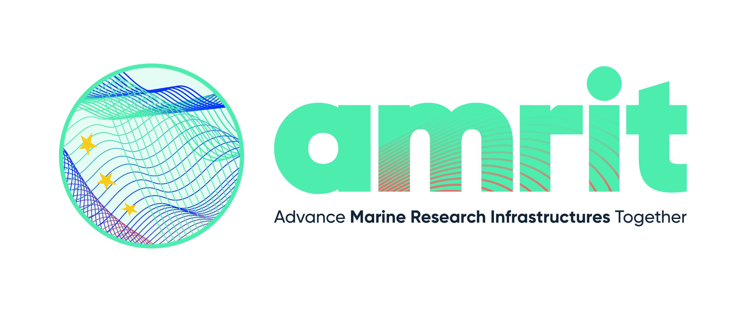


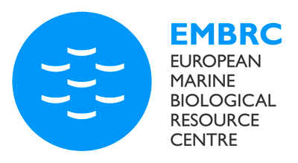
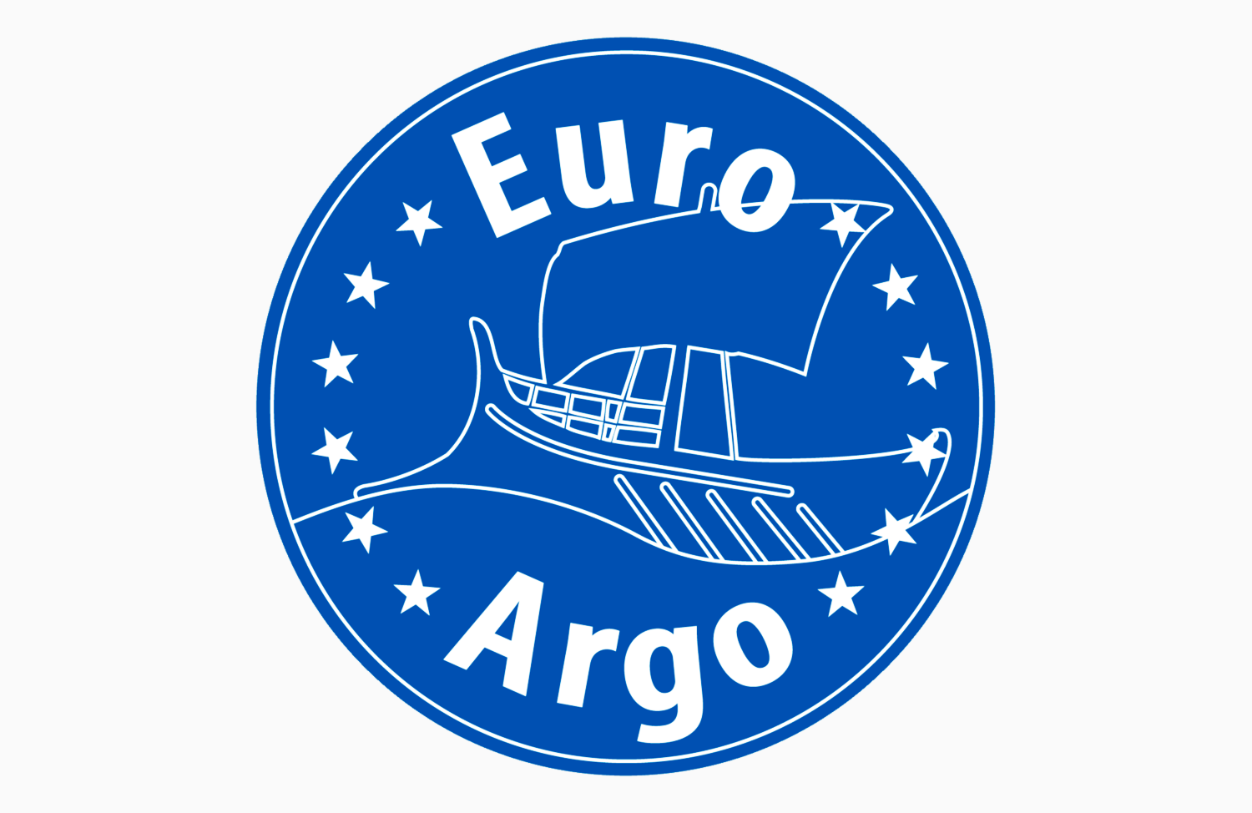

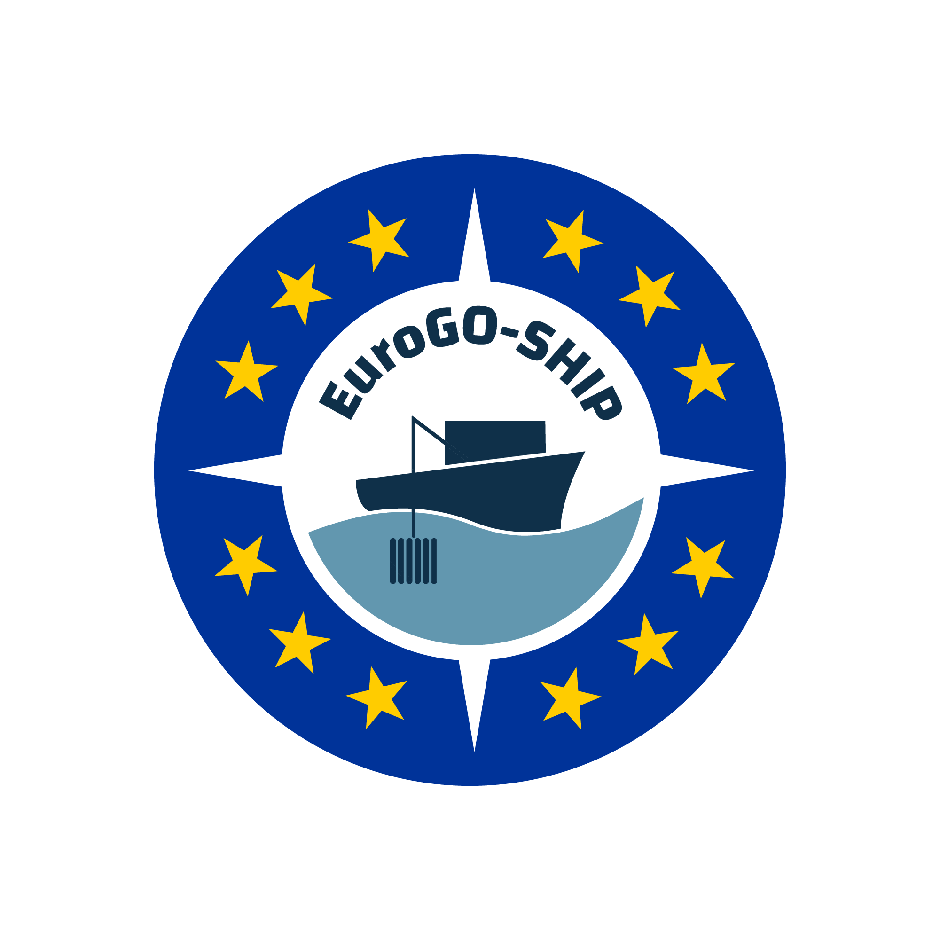
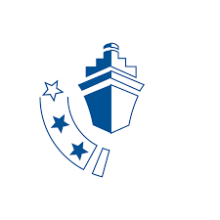
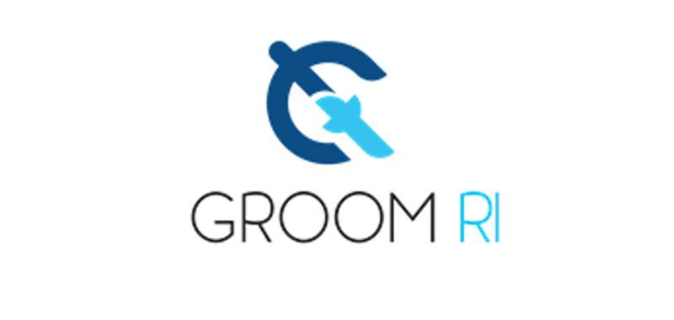





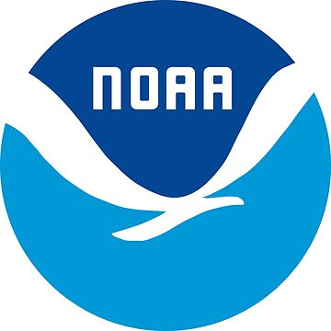

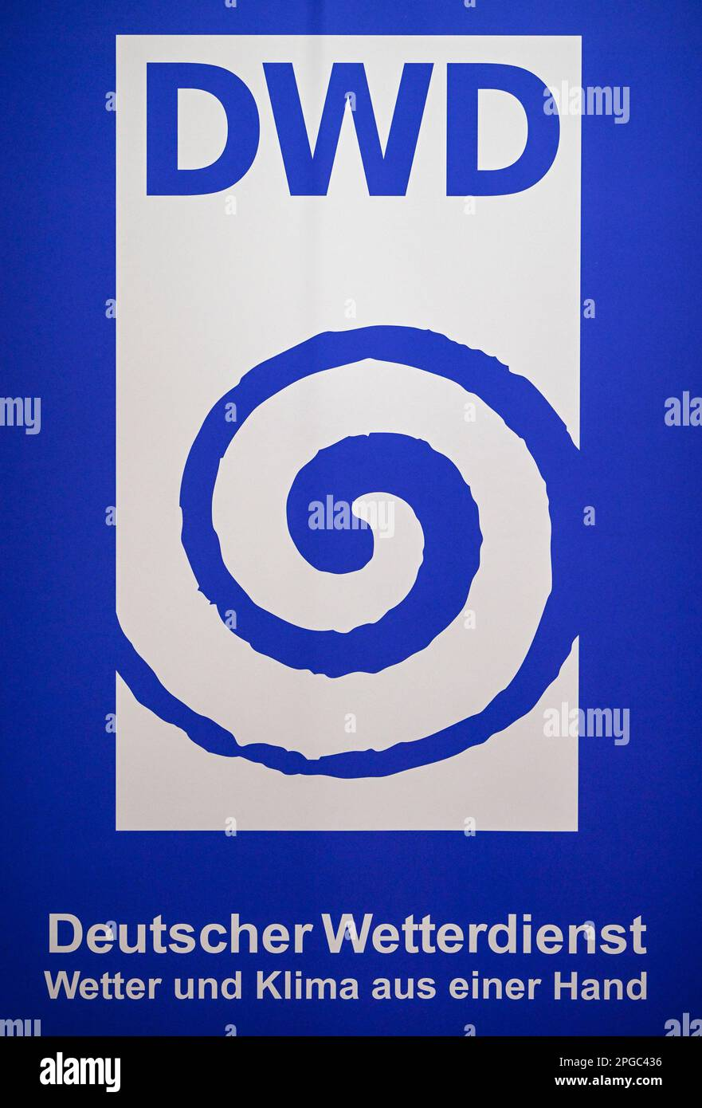
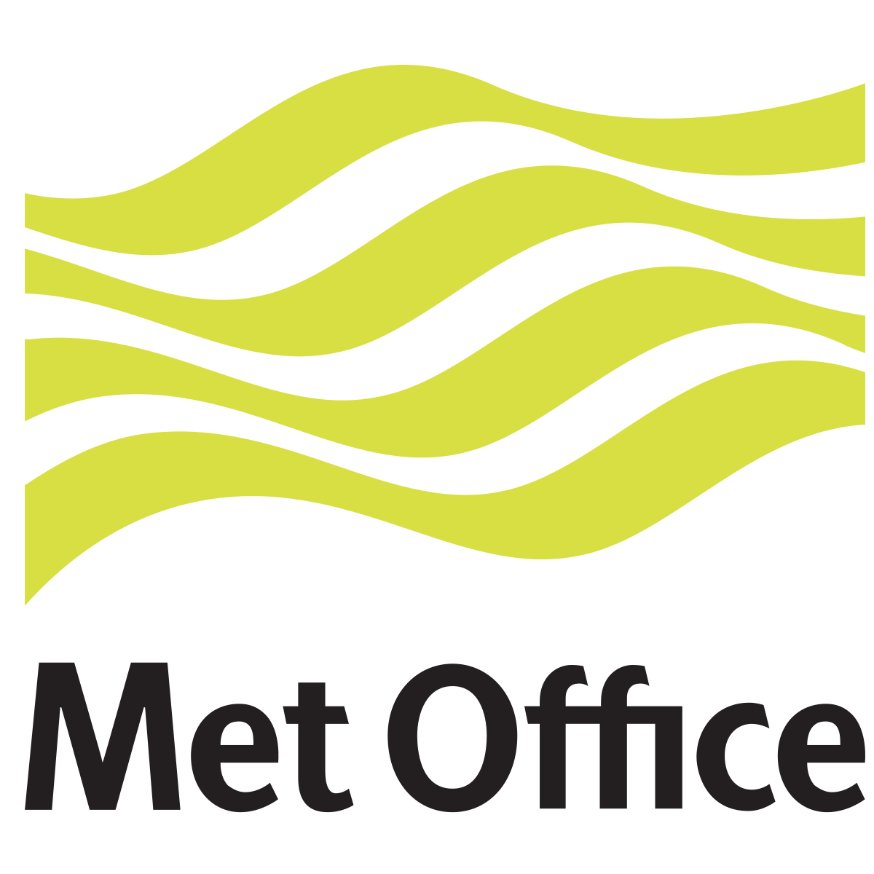

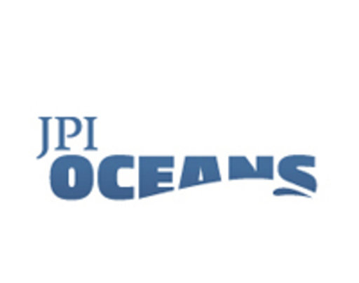
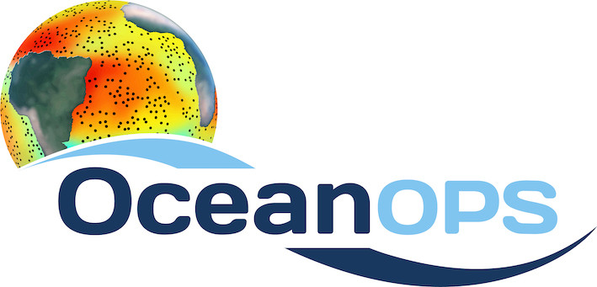
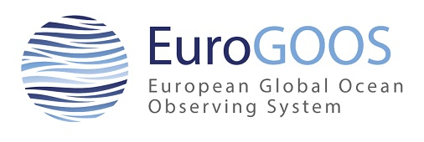

Slide 21
GOOS and AMRIT projects
GOOS provides the global coordination, integration, advocacy for Ocean Observing
Aim: A sustained and sustainable critical ocean observing infrastructure that meets societal needs for forecasting, risk management and ocean economy
OceanOPS
  GOOS technical arm and integration force (monitoring, operations, data/metadata...)
  increasing contribution from EU through AMRIT and other projects (eg TRICUSO recently) is welcome, to the benefit of all (EU and IOC/WMO Member States)
AMRIT projects will support European, and beyond, countries’ contribution to the GOOS
  Align EU countries with NOAA, IMOS, CIOOS, etc.
  Sharing resources to support OceanOPS
  Better planning and coordination of national activities in GOOS programs
  Support sea operations by agencies, RPOs, … (the GOOS Ecosystem of providers) in GOOS OCG programs
  Possibly other services

