Slide 1
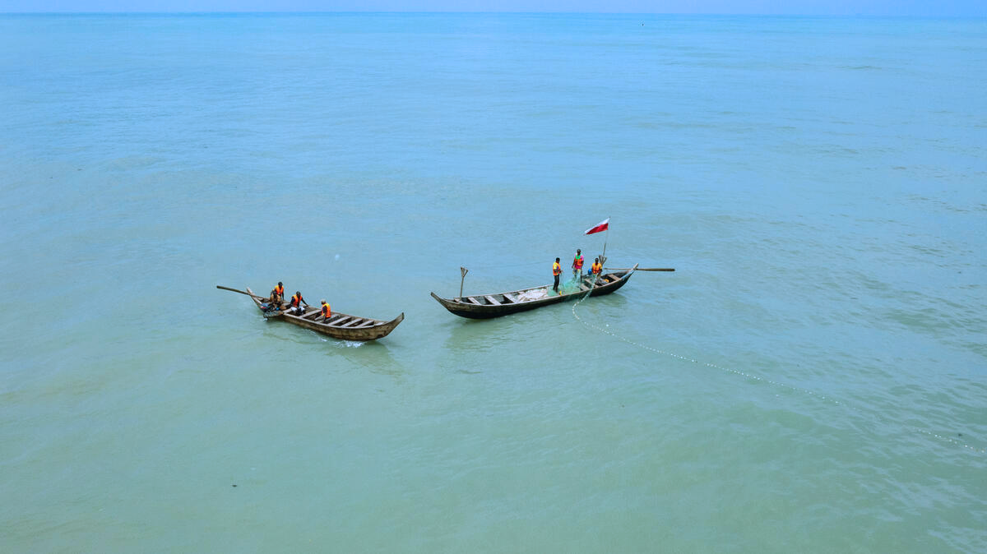
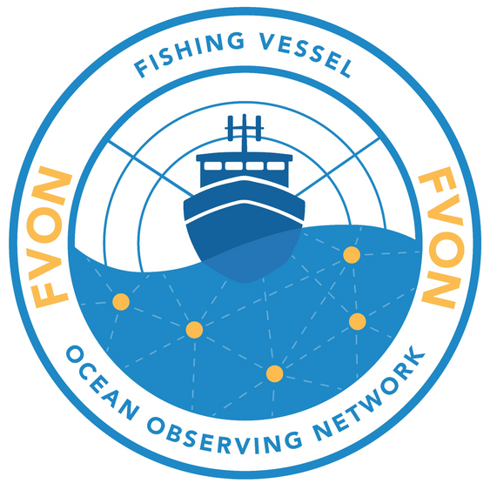


GOOS OCG-16 Network report:
FVON
Steering Committee: Cooper Van Vranken, A. Miguel Piecho-Santos, Julie Jakoboski, Christopher Cusack, Patrick Gorringe, Michela Martinelli, Moninya Roughan, João de Souza, Peter McComb, George Maynard, Shinichiro Kida, Hassan Moustahfid
Secretariat: Aubrey Taylor, Emilie Brévière, Rita Esteves, Matt Irwin, Dustin Colson Leaning

Slide 2

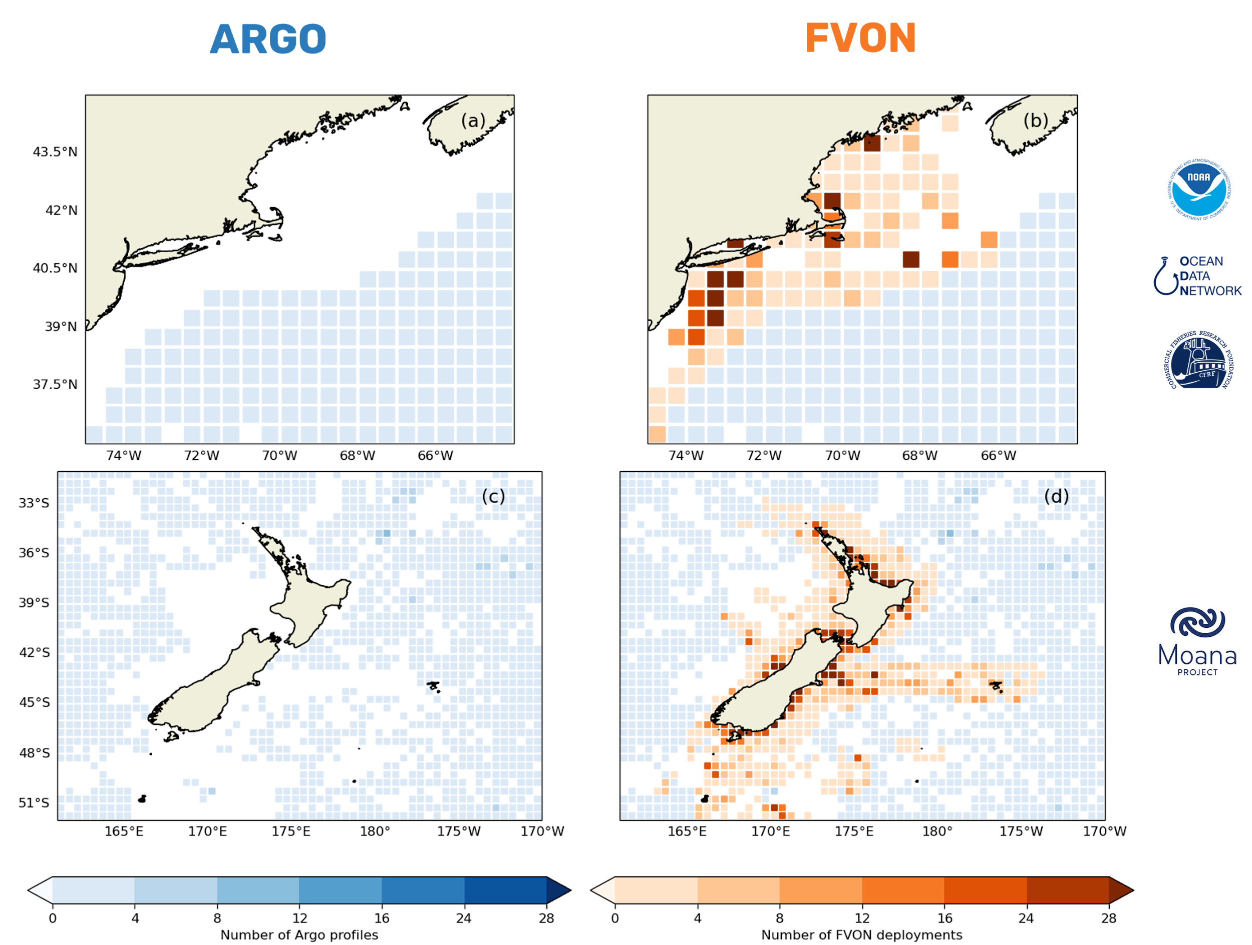
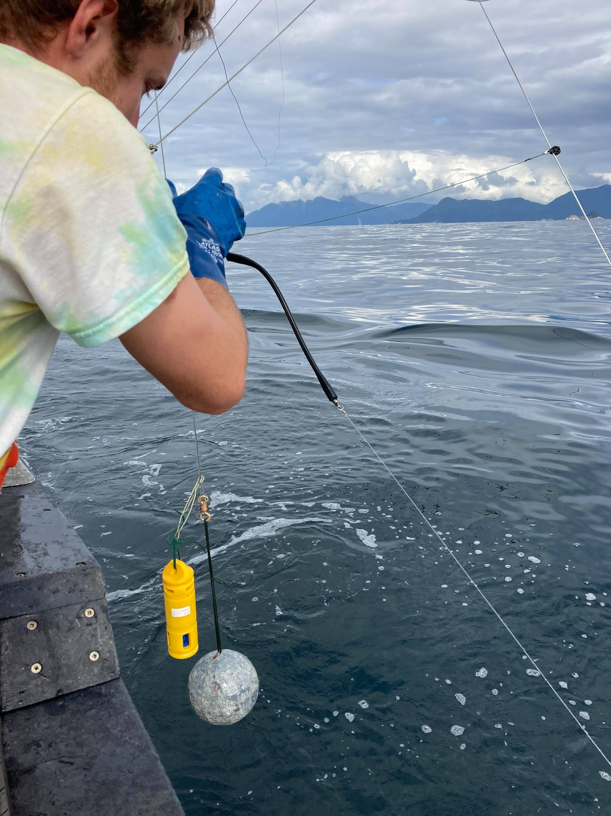
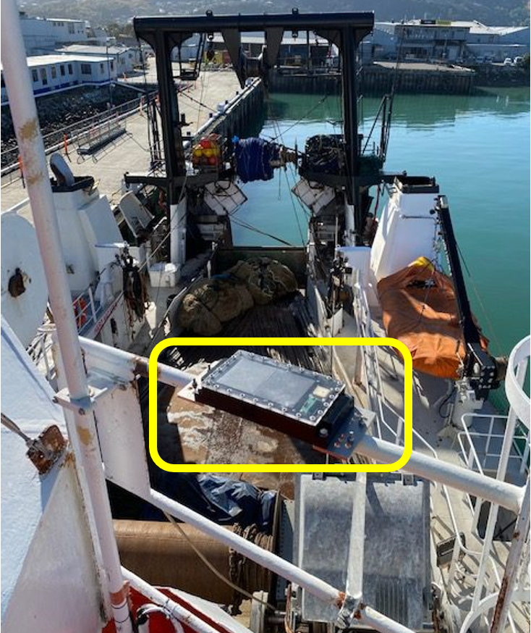

THE SHELF COMPLEMENT TO ARGO

Slide 3
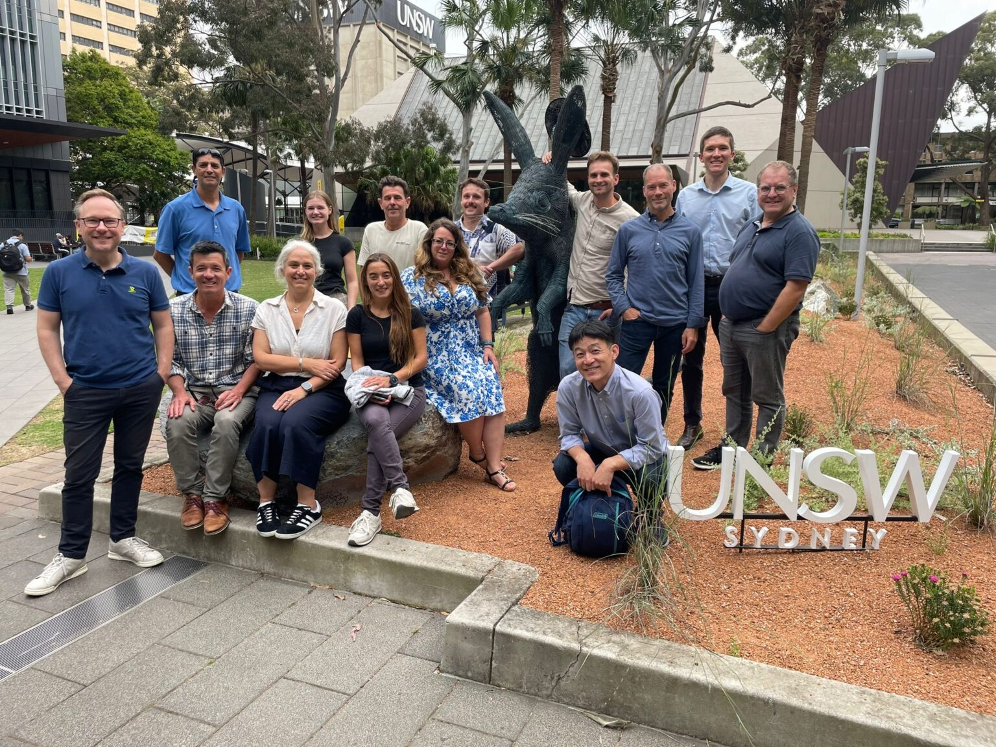
GENERAL UPDATES
Planning and strategy meetings in Sydney
Online workshops prior (thanks to Terry M, Zdenka W, Nadia P, and R. Venkat)
Formalized governance structures (Thanks to other OCG networks for participating in interviews)
Balancing science with ‘business model’ for sustainability and scalability
Logo and brand development > new website
Looking for host institution: legal entity and central bank account
Financial Innovation SubCom > Market Shaping

Slide 4
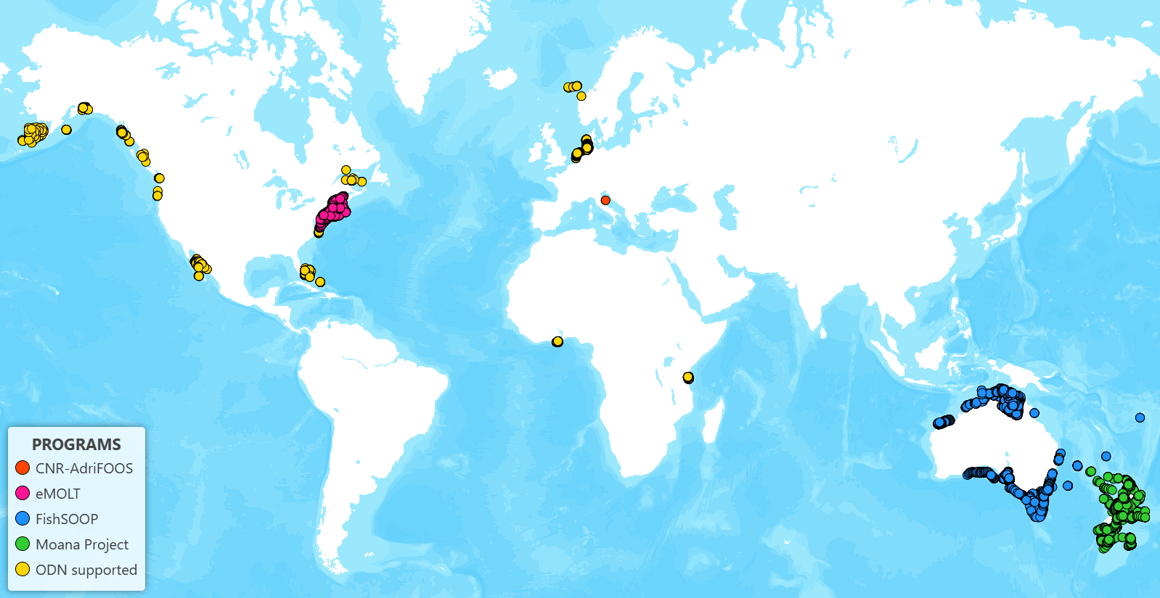
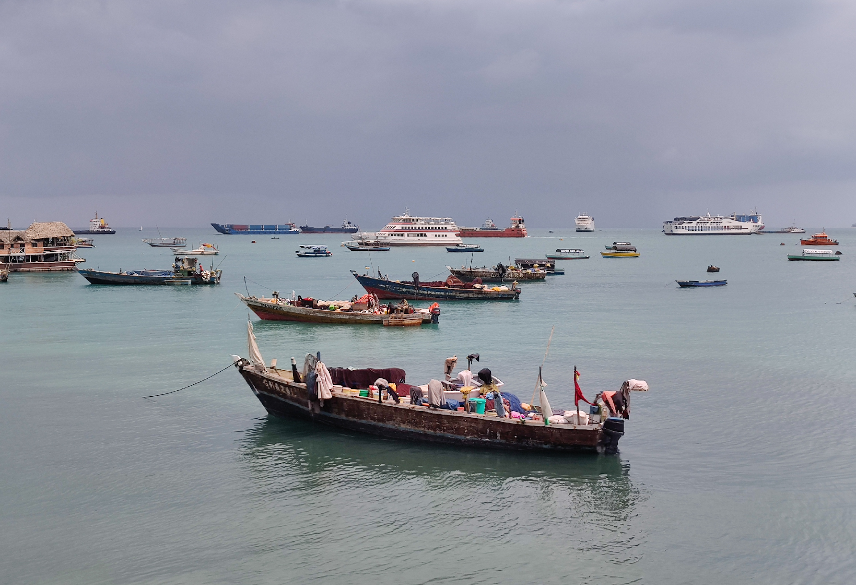
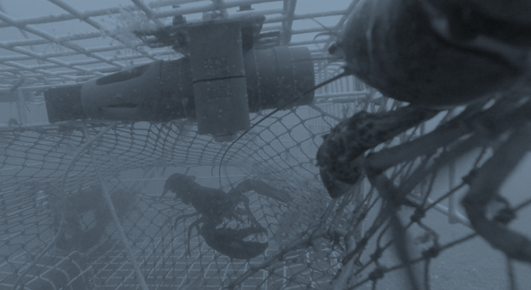
NETWORK STATUS
~600 fishing vessels contribute data (~50% open)
36792 complete down and up profiles open in 2024.
Aiming for 10s of thousands of vessels within a decade.
Exciting new deployments: Papua New Guinea, Fiji, New Caledonia, Southern Ocean, Tanzania
Mostly TD profiling, some DO and CTD
Working on federated central data access point
GTS, big thanks to Kevin and OceanOps

Slide 5

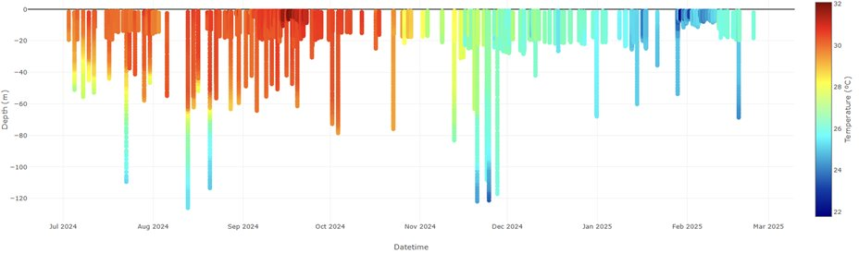
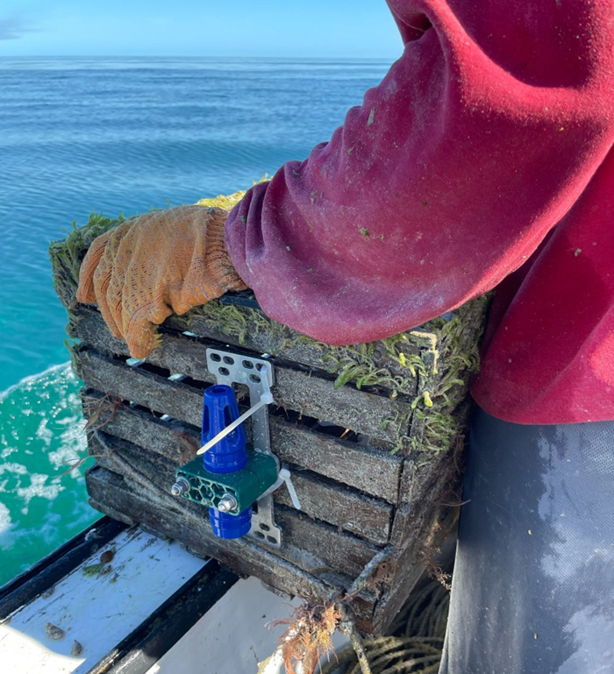
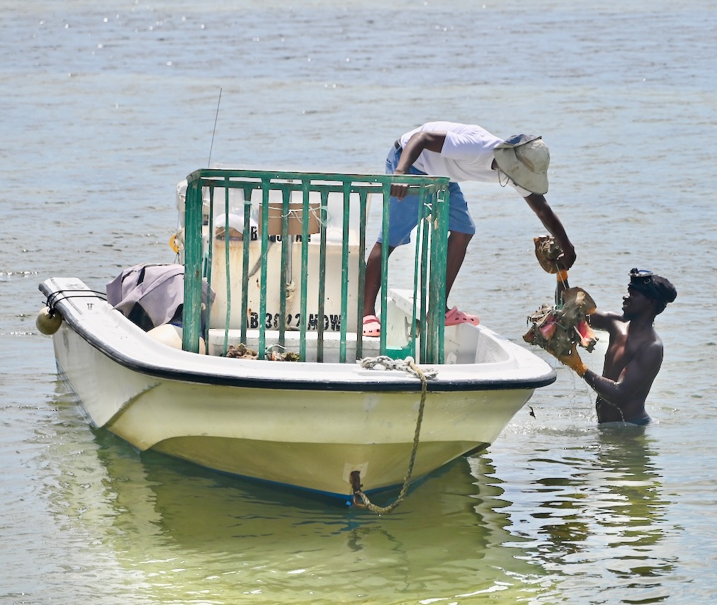


Bahamian Hurricane Pilot Highlight for IOCaribe
Goal: improve Tropical Cyclone rapid intensification forecasting before landfall
10 small-scale vessels across Bahamas starting July 2024
Captured rapid cooling of Hurricane Oscar 2024/10/20
Thanks to Scott Glenn for inspiration and continued guidance

Slide 6
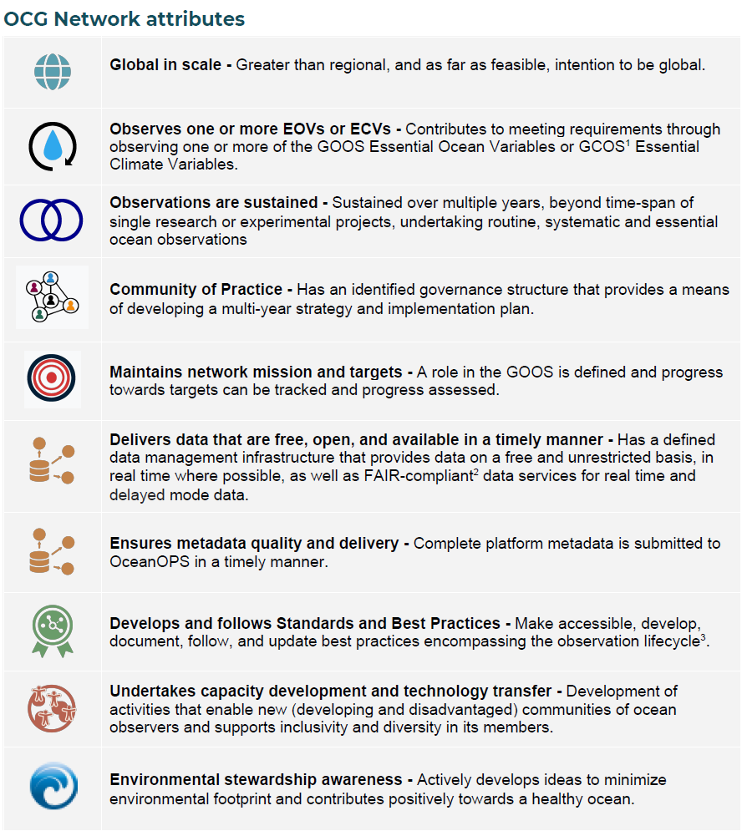
Challenges
Progress
Piloted or better: every continent, equator to the poles 600+ vessels
Financial Innovation SubC, Market Shaping
Official Governance, long term planning
Strategic focus on fisheries science and mgmt > FAO
Significant amount remains closed
GTS, CMEMS, EMODnet
Need more cohesion between networks
Progress from Data Mgmt SubC
Not great for global BP
Full steam ahead! Also, broader FVON member committee
No platform, decreasing fishing ecosystem impacts

Slide 7
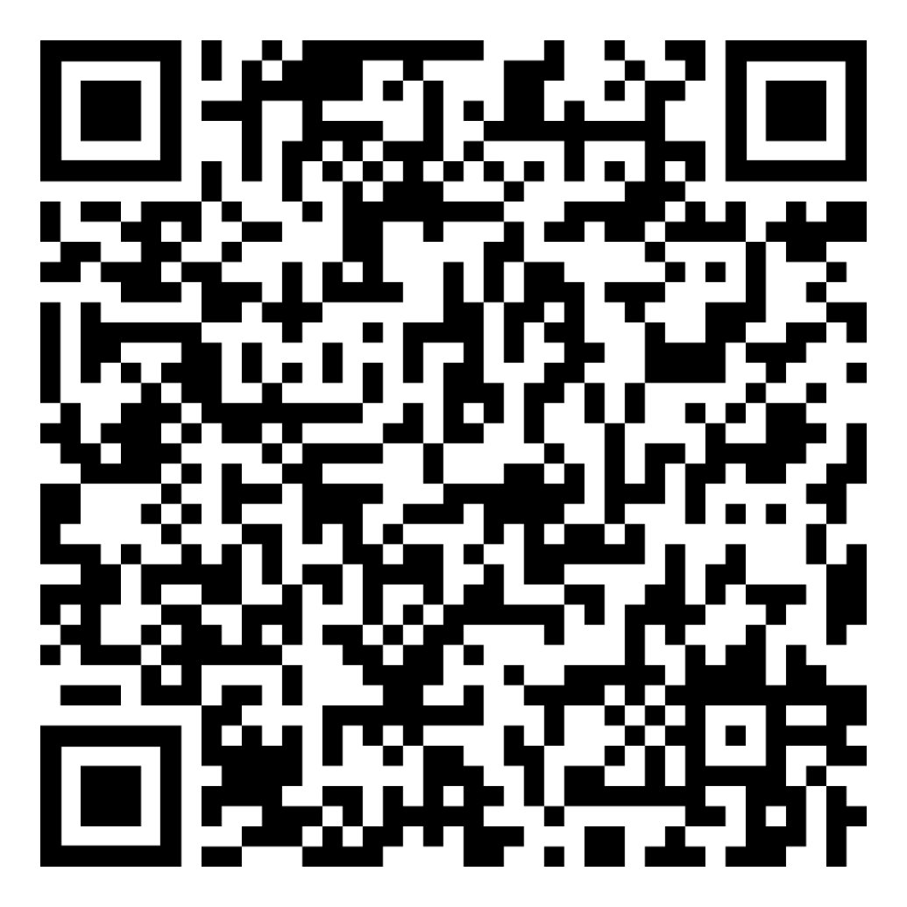











THANK YOU
Sign up for our newsletter:
CO-CHAIRS
  cooper@oceandata.net
  amsantos@ipma.pt
SECRETARIAT
  autaylor@edf.org
Visit our website:
https://fvon.org/

