Slide 1
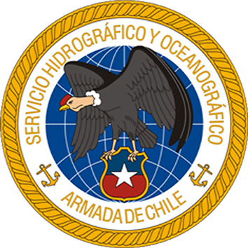


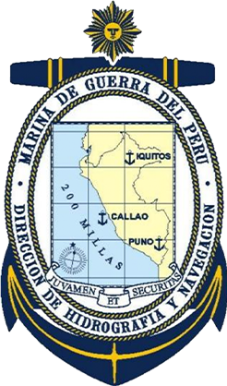
SOUTH EAST PACIFIC WORKING GROUP
(SEP –WG)
REPORT
ICG/PTWS XXXI Meeting
Beijing , 7- 11 April 2025
Chair Leonardo Alvarado
Vice - Chair Lorena Márquez

Slide 2

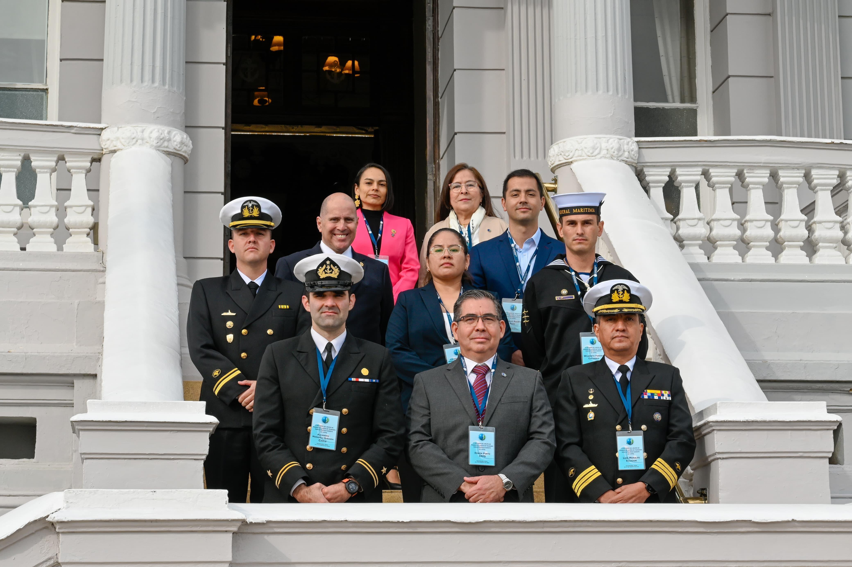



Member States
Chile
Colombia
Ecuador
Perú

Slide 3
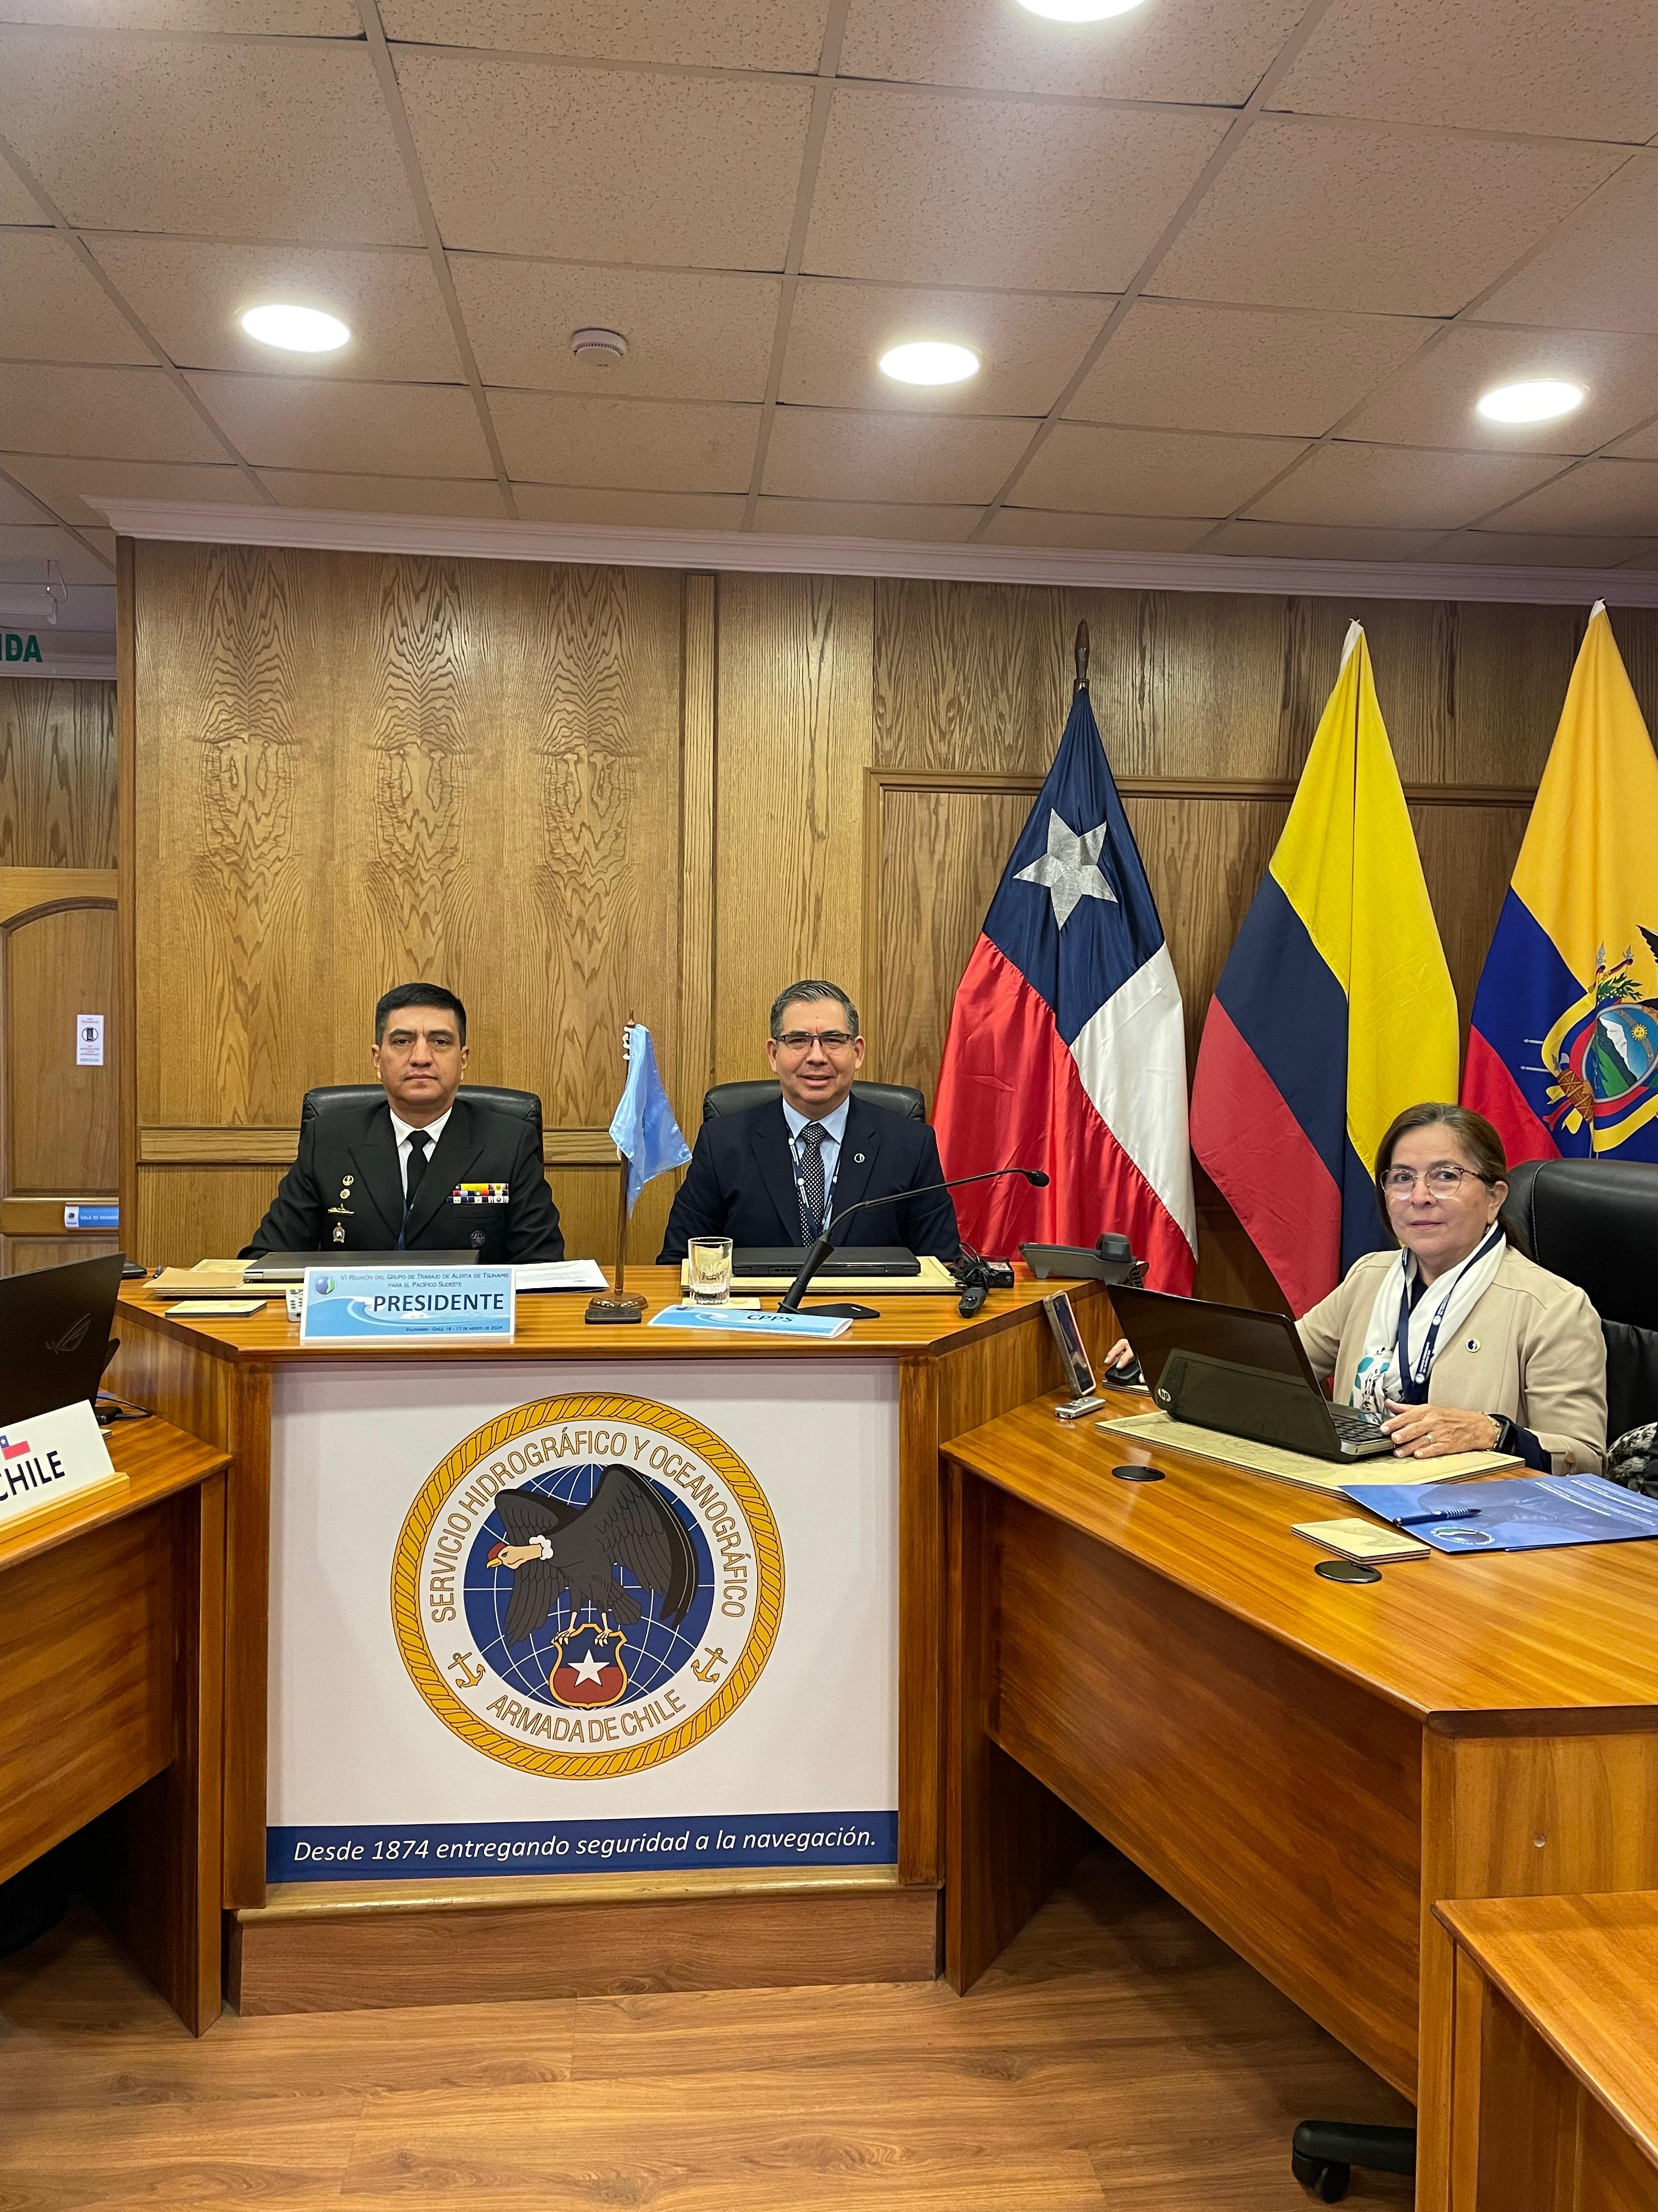
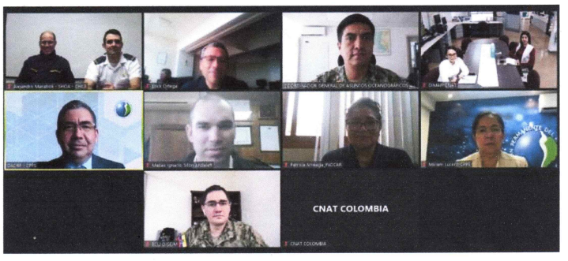
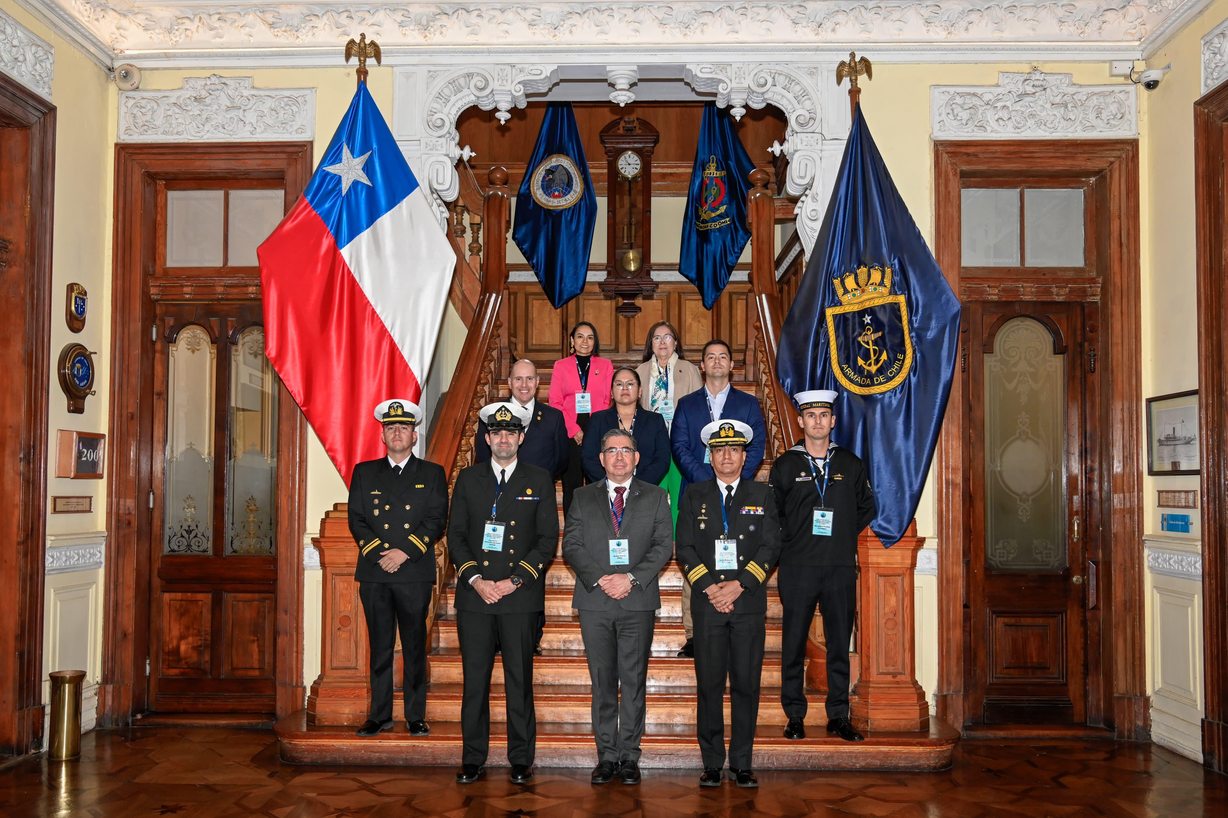
Meetings
Annual regional meeting. December 2023. ICG/PTWS XXX Meeting Activities Report. (virtual).
Turnover of Chair: From Chile to Ecuador
Turnover of vice-Chair: From Ecuador to Perú
Regular virtual meetings March 19th (2024), may 14th (2024). The main objective of these meetings was to plan activities for the region, coordinate regional exercises, projects or proposals for cooperation between countries within the region and other working groups.
Annual regional meeting 2024: Report of activities working group. 16 - 17 August 2024. Valparaiso, Chile.
Steering Committee Meeting of the Intergovernmental Coordination Group for the Pacific Tsunami Warning and Mitigation System (ICG/PTWS) 2024: Report of working South East Pacific Region. 16 - 20 September 2024. Honolulu, Hawaii.

Slide 4
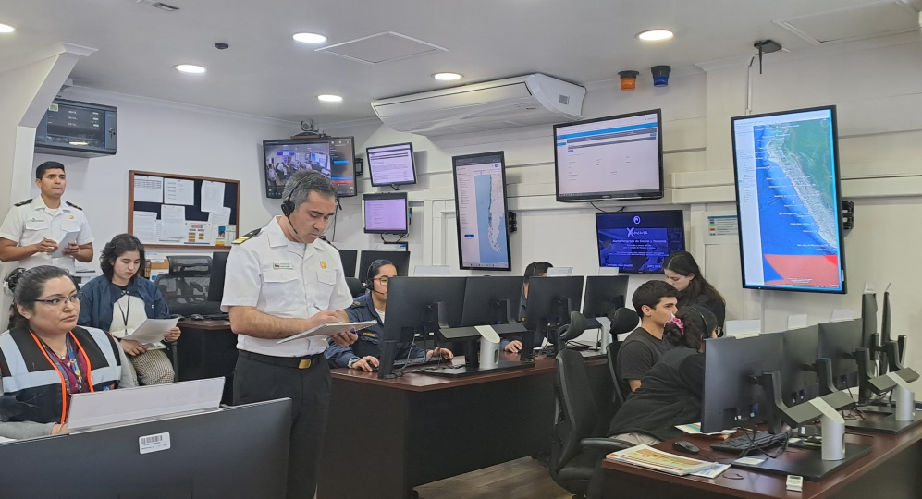
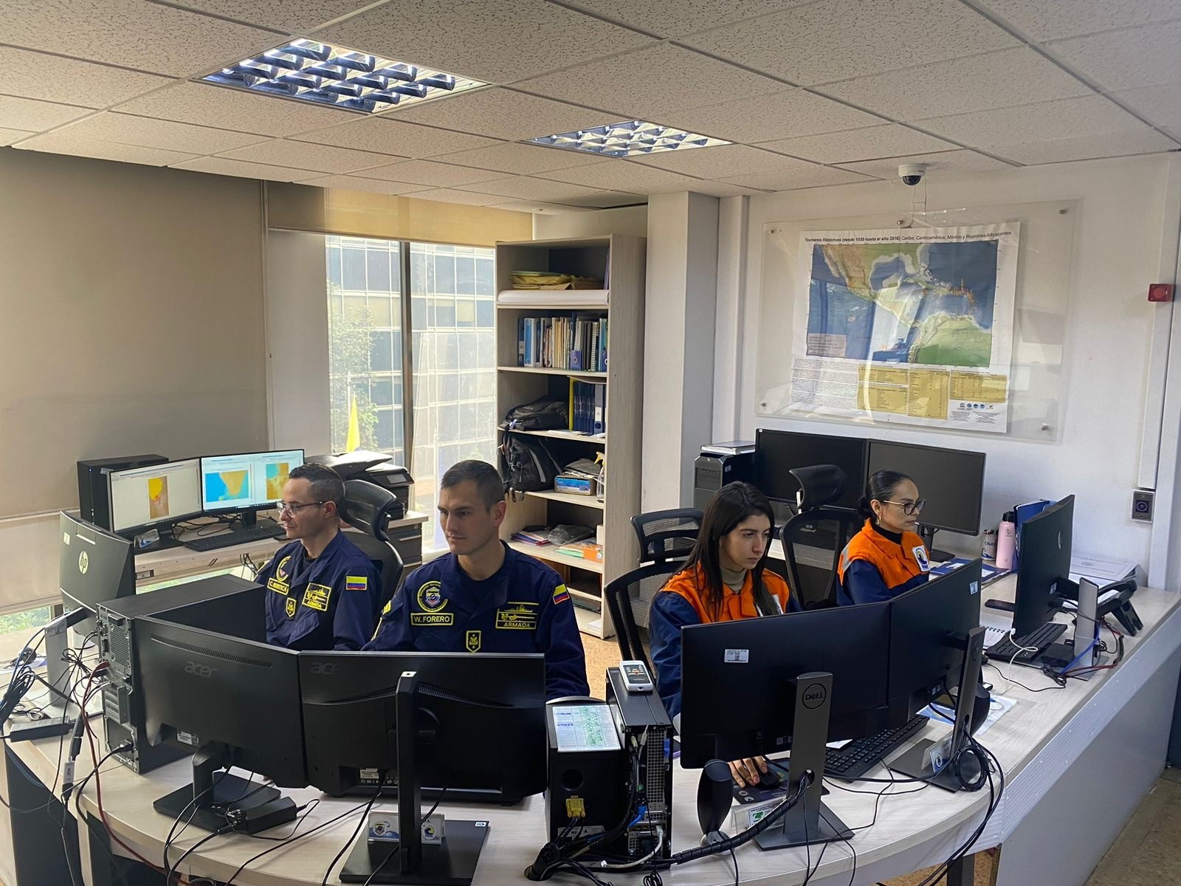
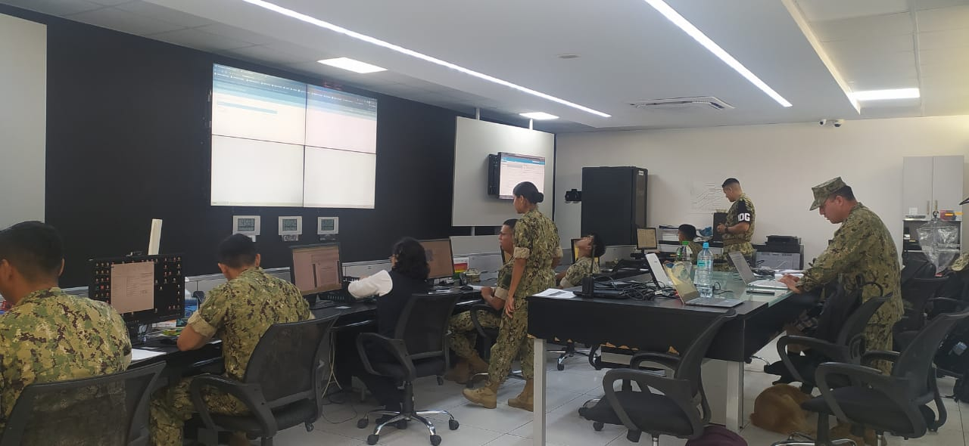
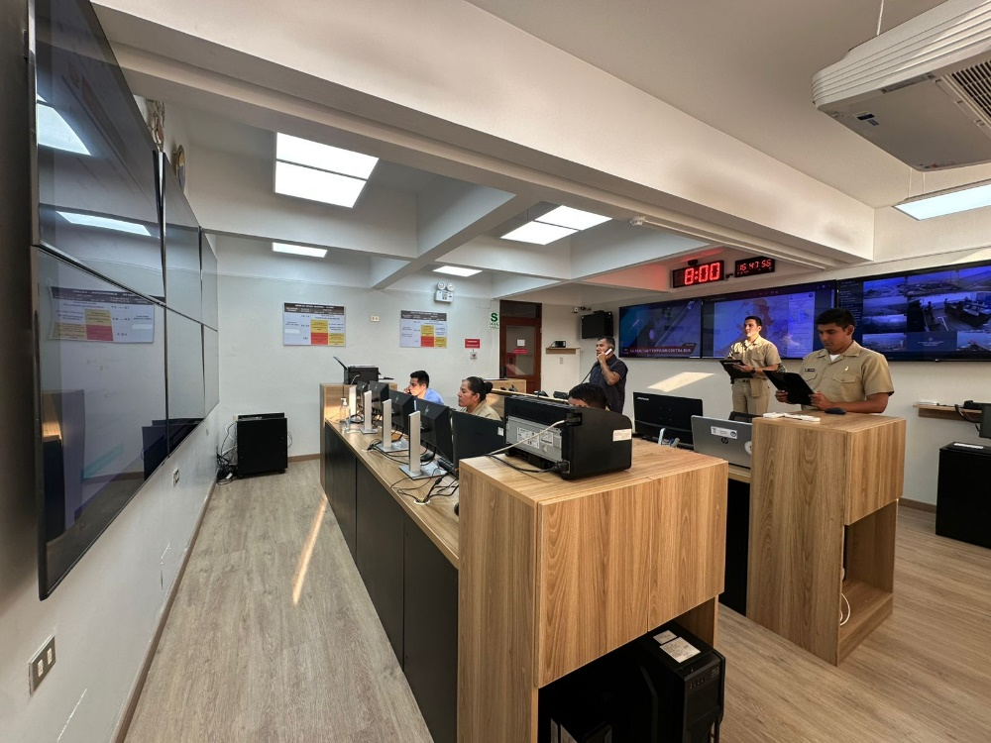
Regional Exercises
The first regional exercise was held in May 16, 2024. All Member States of the WG-SEP executed an Operational Exercise organized by Ecuador and Perú, proposing a scenario with a significant magnitude off the coast of the Gulf of Alaska (9.2 Mw).
The second regional exercise was held in June 19, 2024, organized by Colombia -Ecuador, with a scenario off the coast of Nicaragua (9.2 Mw).
Pacific Wave 2024 (PACWAVE24) exercise, organized by Chile and Perú. The activity had two scenarios: Off the central coast of Perú (first scenario) 9.1 Mw, Off the south coast of Perú, 8.3 Mw. For this exercise the GT-ATPS invited Mexico to take part.

Slide 5
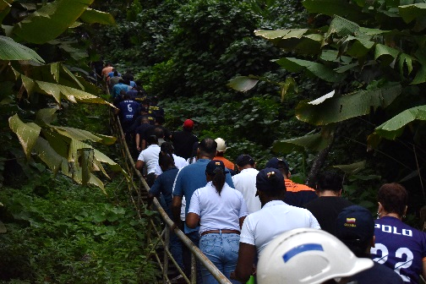
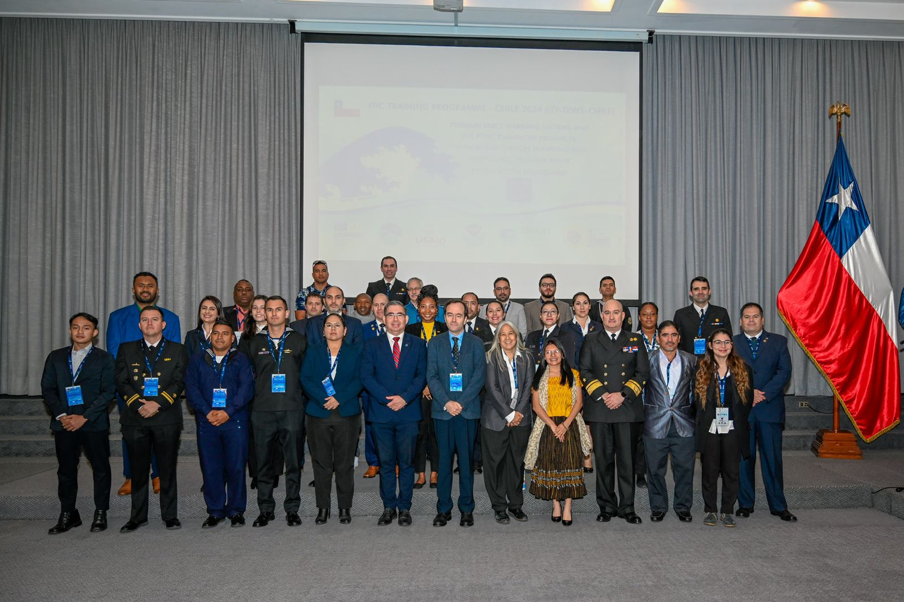
Other activities
Annual Tsunami Experts Meeting. 13th March 2024.
Training communities, naval personnel on tsunamis prevention.
National Tsunami Drill with the participation of Risk Management Agencies and Seismology institutes.
ITIC Training Program (ITP): With representatives from 19 countries. This program was developed in the city of Valparaiso, Chile. The objective of the program is to strengthen the response capacities of countries through preventive and scientific work on monitoring and alerting of tsunamigenic events, and the cooperation of countries to manage this type of disasters. This event was organized in collaboration with the COI, ITIC and SHOA from 19th to 30th august 2025. Valparaíso – Chile.

Slide 6
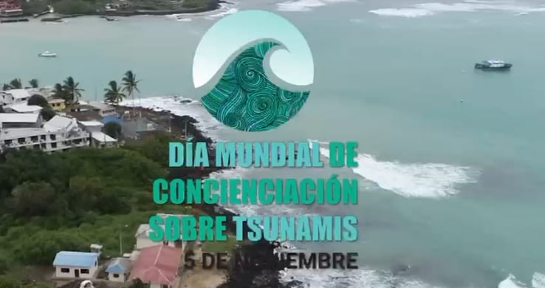
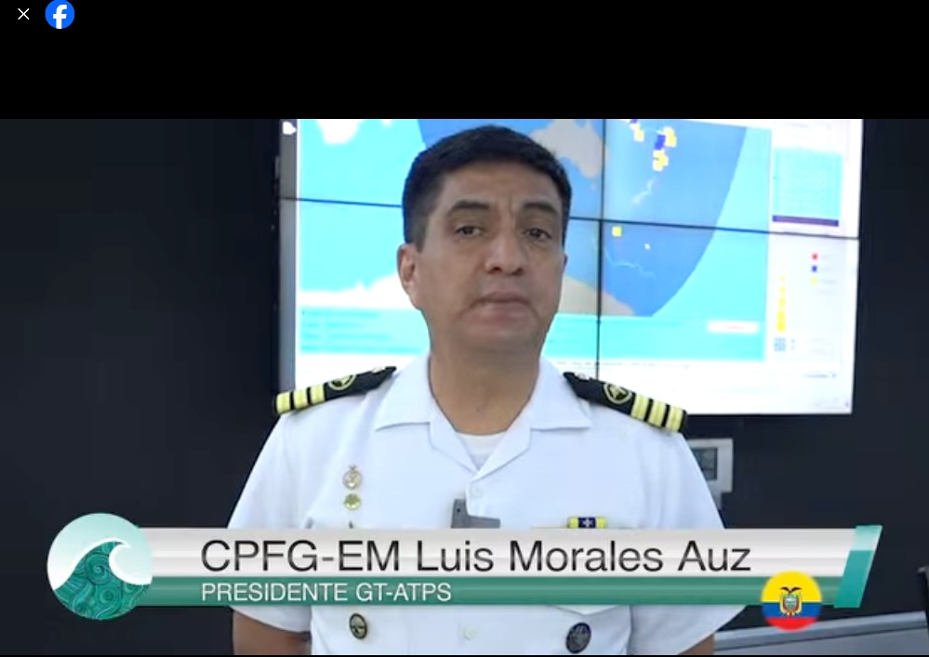
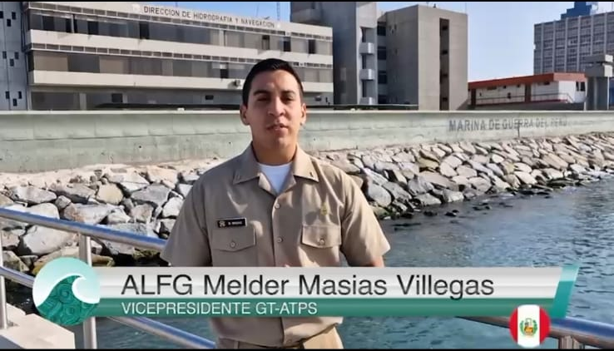
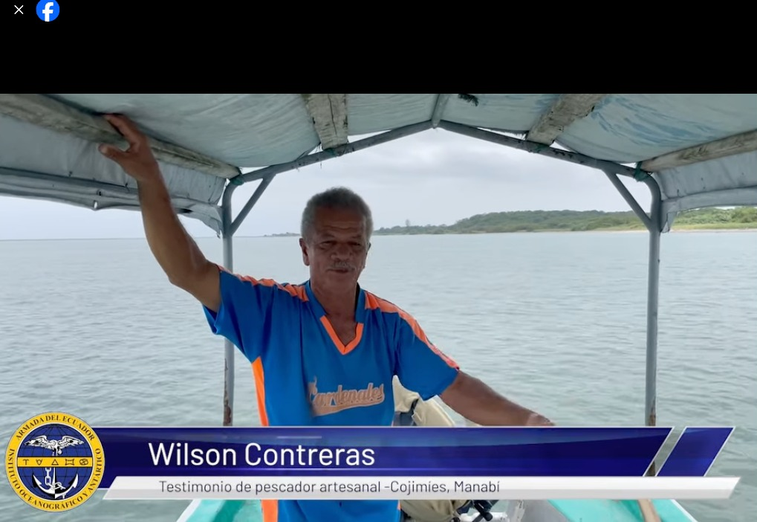
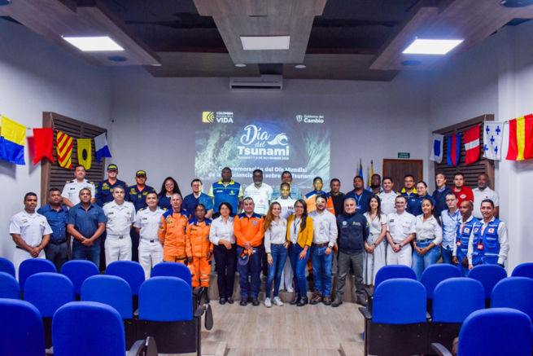
Regional video about the GT-ATPS activities. November 5th.
CNAT activities: Activities to raise awareness communities about tsunamis. November 5th.
Implementation of new technologies for the development of tsunami material, information and dissemination.
Elaborate Tsunami Hazard Maps for communities along the coast.

Slide 7
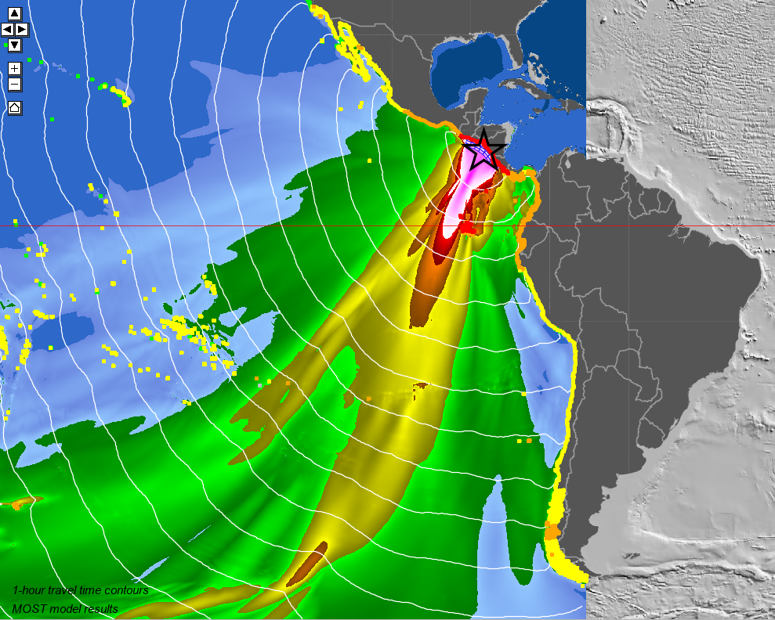
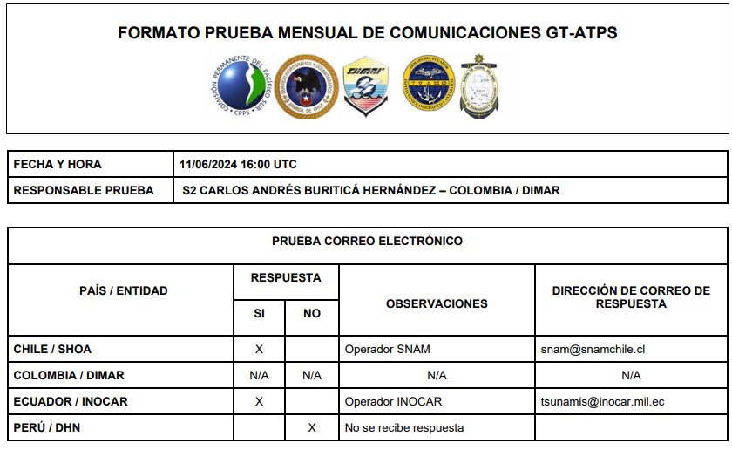
Planned activities
Regional virtual meeting.
First regional exercise, Chile – Colombia organizers.
Second regional exercise, Ecuador – Perú organizers.
November 5th regional activities coordination.
In-person meeting.
Turnover of Chair and Vicechair to Perú and Colombia, respectively.
Promote the Certification of Tsunami ready communities (region).
Manage projects for the region in cooperation with Tsunami System Members to improve Tsunami monitoring and mapping technologies.
Smart cables

Slide 8
GRACIAS

