Slide 1
Intergovernmental Coordination Group for Indian Ocean Tsunami Warning and Mitigation System (ICG/IOTWMS)
Mr. Eluri Pattabhi Rama Rao
Chair, ICG/IOTWMS
Scientist-G & Group Director
Indian National Centre for Ocean Information Services (INCOIS)
Hyderabad, India
ICG/PTWS XXXI, 08-11 Apr 2025

Slide 2
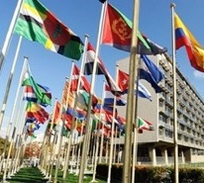

Governance in ICG/IOTWMS
UN OCEAN DECADE
UNESCO-IOC
Assembly/Executive Council
WMO, IHO, IMO, UNDRR, UNDP, UNESCAP…
Task Team Disaster Management & Preparedness
Global Coordination
Working Group for Tsunami & Other sea level related Warning & mitigation Systems (TOWS-WG) [4x ICG Chairs, WMO, UNISDR, UNDP, IMO, IHO]
UN Ocean Decade Tsunami Programme
Science Committee
Task Team Tsunami Watch Operations
ICG/IOTWMS Secretariat
Srinivas Tummala Kumar
Nora Gale
ICG
Caribbean & Adjacent Seas (CARIBE-EWS)
Intergovernmental Coordination Group (ICG)
Indian Ocean Tsunami Warning & Mitigation System (IOTWMS)
Chair: Mr. Pattabhi Rama Rao Eluri (India)
Vice Chair: Dr. Yuelong Miao (Australia)
Vice Chair: Dr. Harkunti Rahayu (Indonesia)
ICG
Pacific Tsunami Warning & Mitigation System (PTWS)
ICG
NE Atlantic & Mediterranean Seas (NEAMS-TWS
UNESCO-IOC Member States
UNESCO-IOC Tsunami Resilient Section
UNESCO Disaster Risk Reduction Section
Steering Group: Officers, WG Chairs/VCs, TT Chairs
WG1 Tsunami Risk, Community Awareness and Preparedness - DMOs,
Chair: Ms. Weniza (Indonesia)
WG2 Tsunami Detection, Warning & Dissemination
Mr Jijjavarapu Padmanabham (India)
Indian Ocean Tsunami Information Centre (IOTIC) Ardito Kodijat
WG3 Tsunami Ready Implementation
Chair: Ms. Suci Anugrah (Indonesia)
Task Team –New Technologies Observations and Forecasting (under WG2)
Chair: Dr. Wahyu Pandoe (Indonesia)
Task Team – IOWAVE25
Chair: Dr. Ajay Kumar Bandela (India)
RWG North-West Indian Ocean
Chair: Ms. Sunanda Manneela (India)
Task Team –Mid-Term Strategy (MTS)
Chair: Dr. Yuelong Miao (Australia)
IOC Regional Programmes and Offices

Slide 3
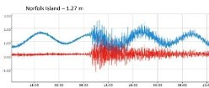
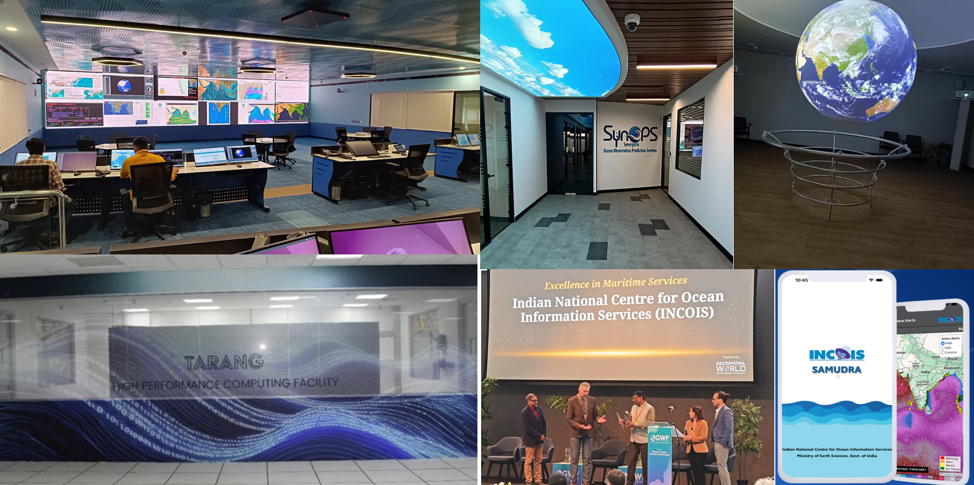
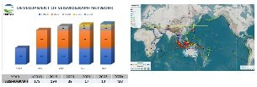
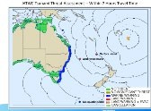
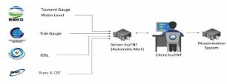
TSP Progress Report
TSP Australia TSP India
TSP Indonesia
Capability to produce Indian Ocean products for Non-Seismic events
Capability to deliver Navarea maritime product
Bureau-Joint Australia Tsunami Warning Center in progress with ISO 9001 recertification
Non-seismic tsunami source SOPs worked well in the Hunga Tonga Volcanic Eruption generated tsunami
Bureau-JATWC replaced the current tsunami Decision Support Tool with TOAST
Maintaining CFZs Layers for IOTWMS
Capability to deliver NAVAREA maritime products
SAMUDRA Mobile App. It is a comprehensive multi-hazard early warning app to the coastal communities about oceanic threats.
Established SynOPS Lab: A cutting-edge facility advancing ocean monitoring and predictive capabilities.
HPC facility “TARANG” at INCOIS - Dedicated to real-time tsunami inundation modeling, operational oceanography, and advanced simulations.
Progressive deployment of the seismometers (535 in 2024)
Developing Indonesia Tsunami Non- Tectonic monitoring system
Multi-Hazard Platform (InfoBMKG mobile App)
Establishment of the National Consortium of the EQ and Tsunami Experts
Developd impact based real time system of InaTEWS supported by National Consortium
3

Slide 4
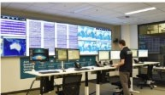
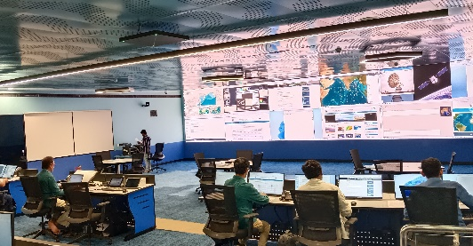
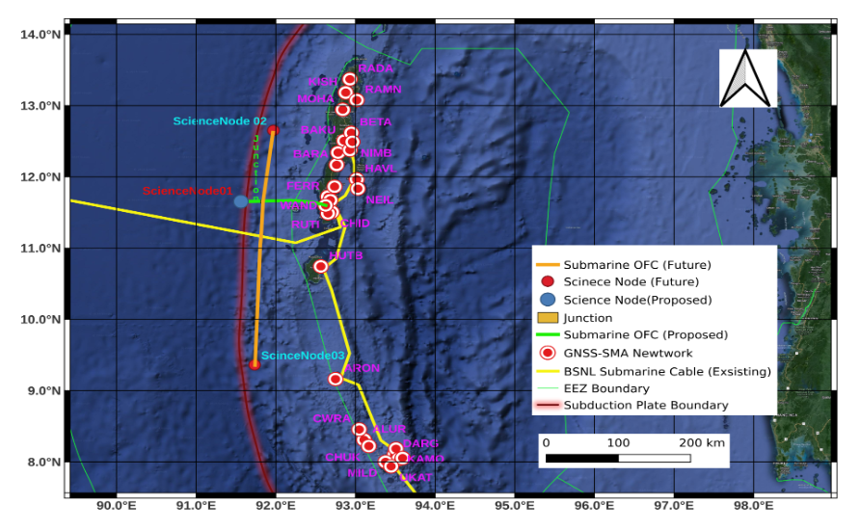
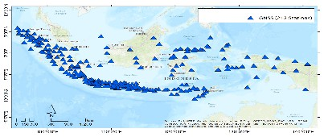

TSP Future Plans
TSP India
TSP Australia
TSP Indonesia
Deploy 100 Tsunami Gauges
Utilization of GNSS data for earthquake parameter calculation
Research on non seismic tsunami
Provide sea level observation portal for the Indian Ocean area
Support the On-the-job Training for the IO member states
Development of processing system for Earthquake Early Warning
4
Developing SOPs and implementing products for non-seismic tsunamis
Utilizing GNSS & SMA for precise rupture characterization.
Establishing the GPS co-located tide Gauges along the Indian coast.
Archiving Makran source PTHA Data for access to member states.
Establishing new technologies (Under sea cable) for rapid tsunami detection
Providing on-the-job trainings for IO member states.
GA-JATWC to integrate, test and operationalise seismic array processing as input to rapid earthquake detection and characterization.
GA-JATWC to commence work towards ISO 9001 accreditation for GA-JATWC systems

Slide 5
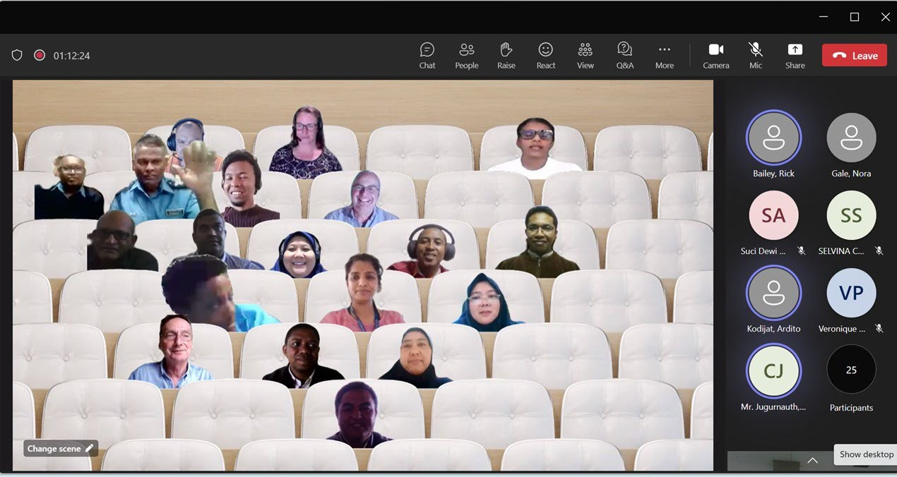
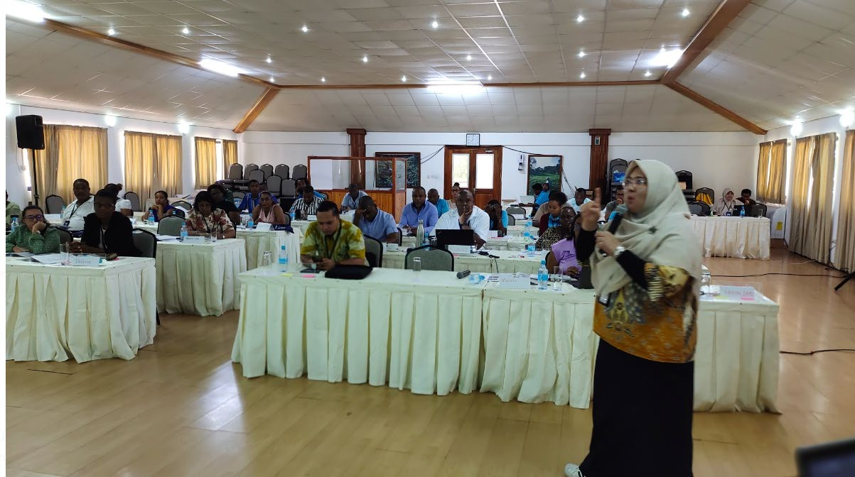
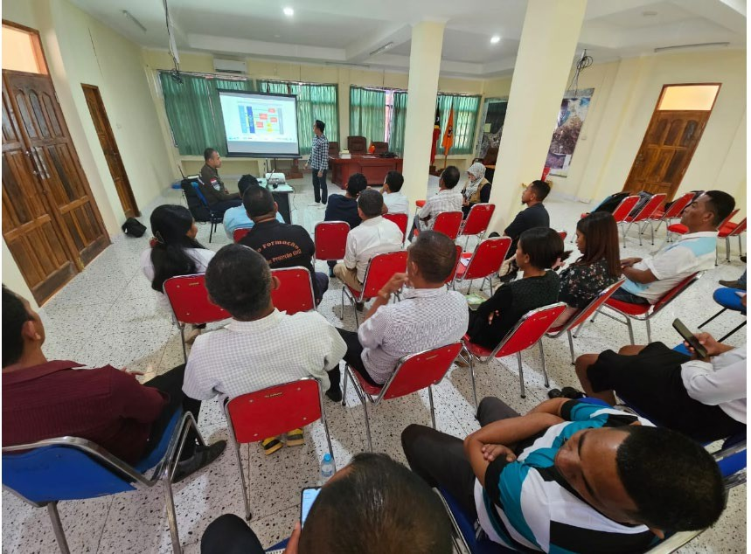
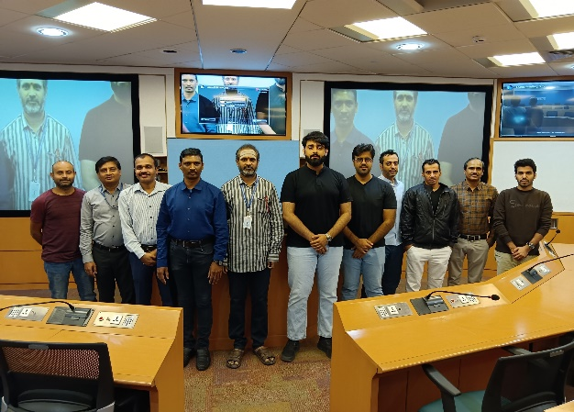
CAPACITY DEVELOPMENT ACTIVITIES IN 2023 - 2024
No | Activities | Date
1 | SOP Workshop for the West Indian Ocean | 03-06 July
2 | SOP Workshop for the Eastern Indian Ocean, | 10-13 July 2023
3 | SOP Workshop for the North-West Indian Ocean, | 7-8 August 2023
4 | Tsunami Ready Training Timor Leste | 31 July- 1 August 2023
5 | Tsunami Ready Training Seychelles | 31 July- 1 Agustus 2023
6 | On-the-job trainings for the Indian Ocean Member States (Oman and Timor Leste) | 13-21 March 2023
7 | TSP-India at INCOIS, conducted in-person on-job training course for Oman on “Tsunamis & Other Ocean Hazards” | 11-22 December 2023 & 2-6 September 2024
8 | Workshop on the UNESCAP Capacity Assessment Validation to result recommendation | 4-6 September 2024
SOP Training
Tsunami Ready Training in Seychelles
Tsunami Ready Training in Timor Leste
Oman, On-the-Job Training
5

Slide 6
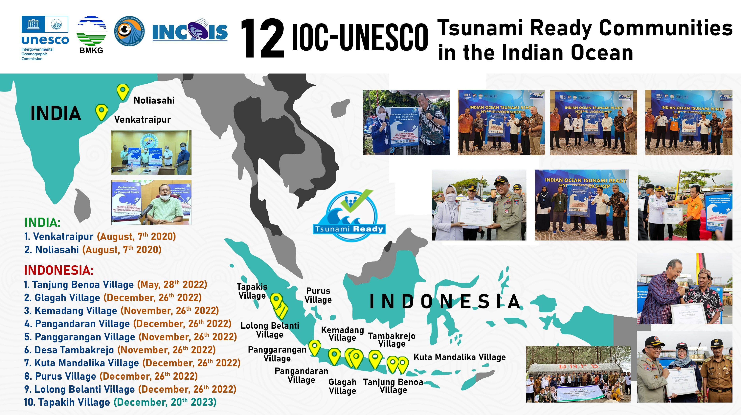
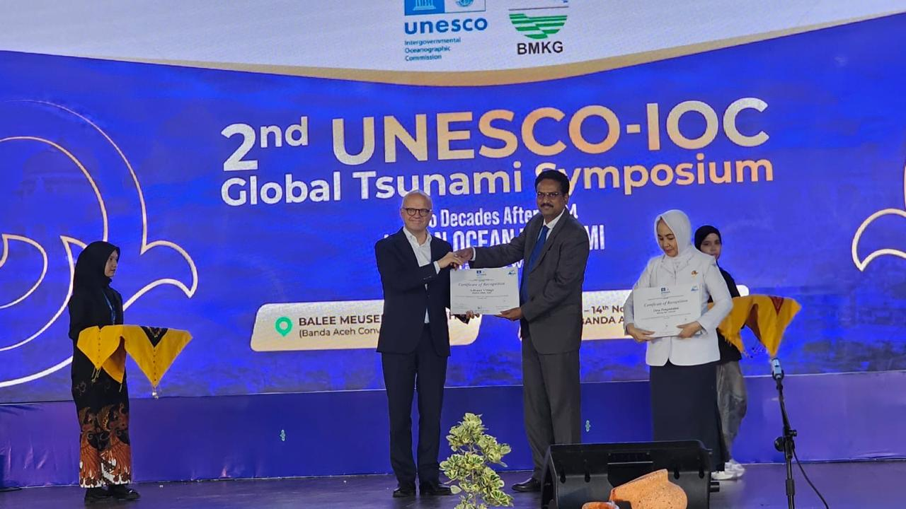
48
36 New communities of India [24] and Indonesia (12) were recognized as Tsunami Ready at the 2nd UNESCO-IOC Global Tsunami Symposium

Slide 7
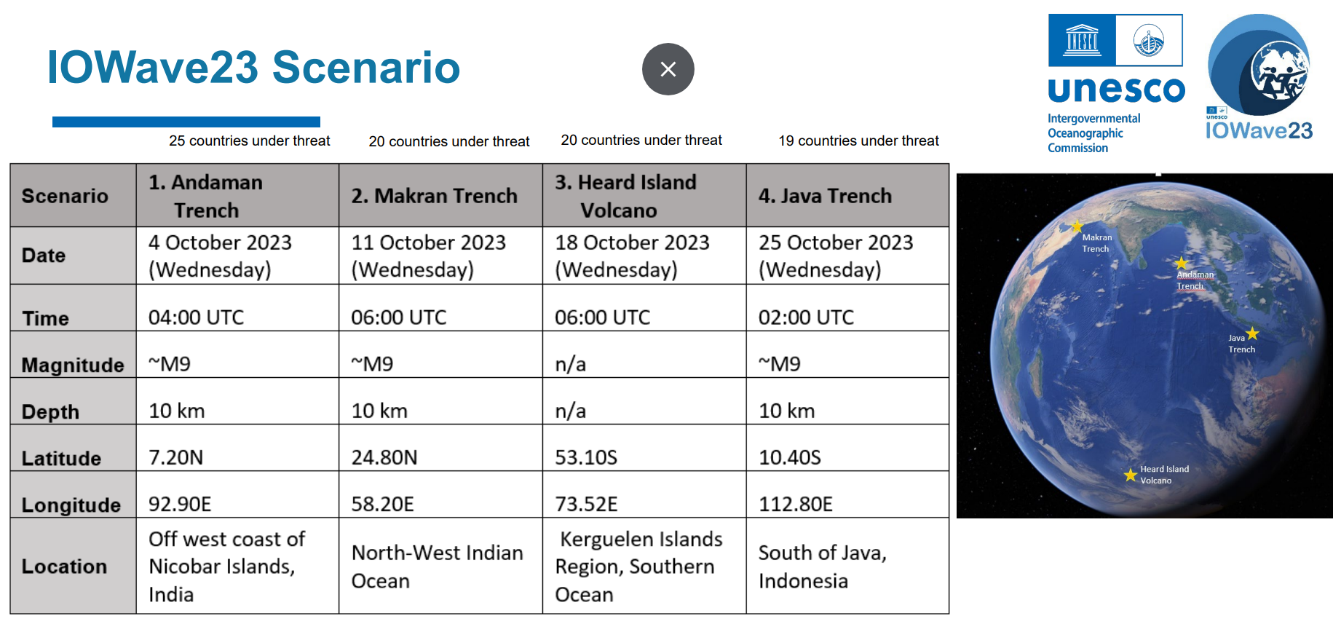
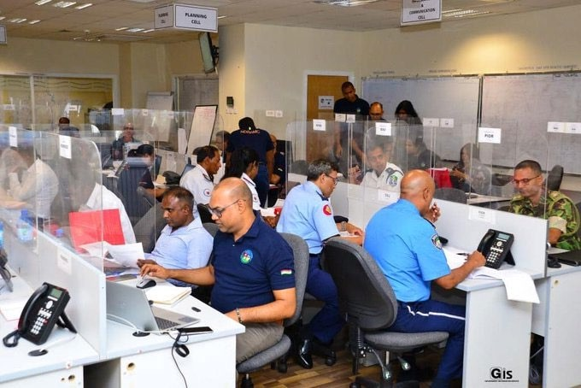
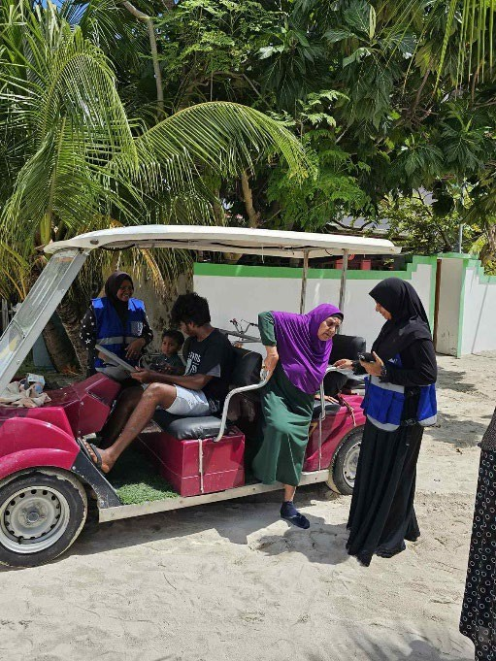
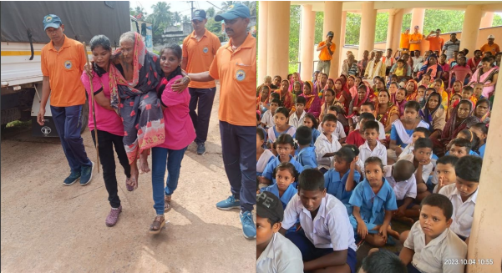
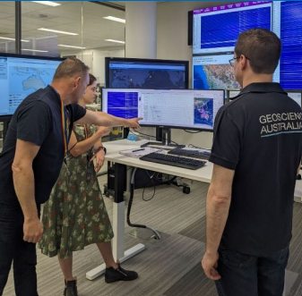
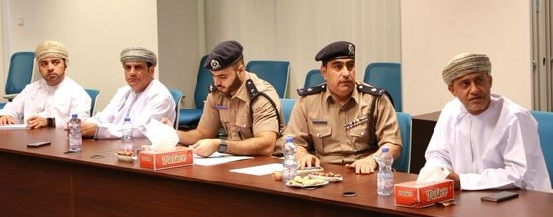
IOWAVE 2023 (4, 11, 18, and 25 October 2023)
IOTWMS Member States participation in the scenarios included:
4 scenarios including a non-seismic tsunami scenario
20 Member States
More than 45.000 people participated tsunami evacuation drill, including disabilities people
Critical infrastructure and decision makers
Propose for the next Exercise:
to conduct sub regional exercise, based on the needs and potential tsunami hazards
to carry out the Multi-Hazard exercise
8

Slide 8
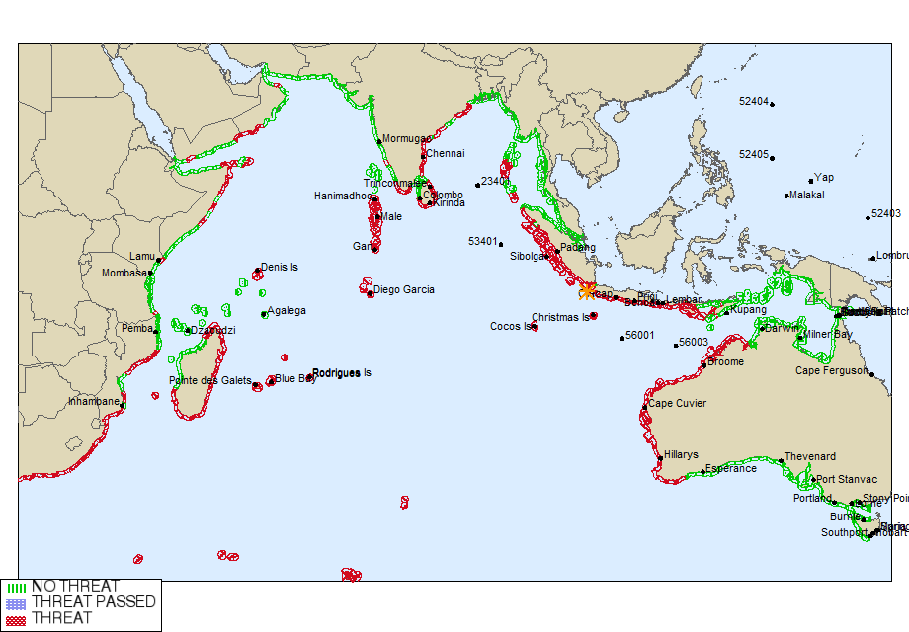
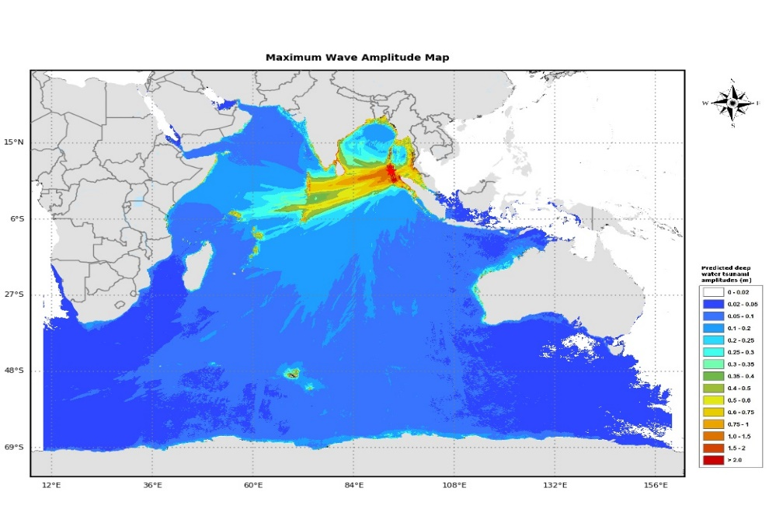
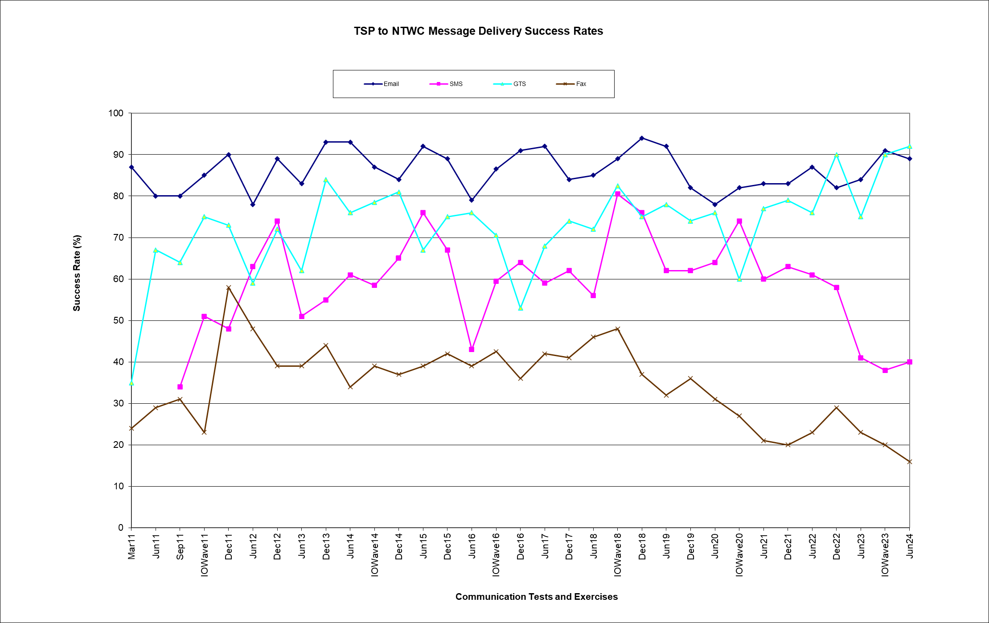
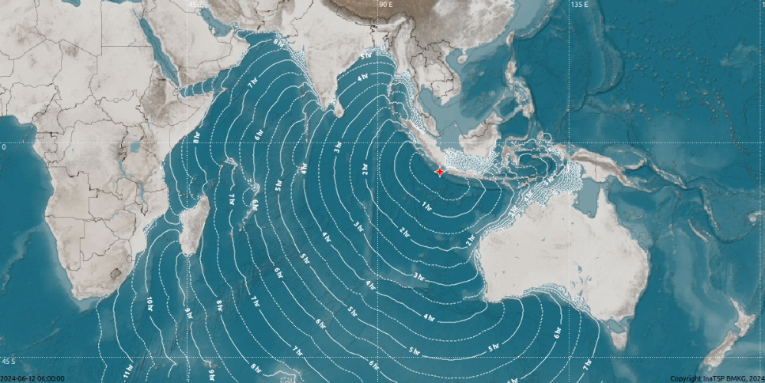
IOTWMS Communications Test
27th Communication test was conducted on 12th June 2024 with the below scenario.
Twenty-one (21) IOTWMS Member States participated in the test.
28th Communication test is planned on 11 Dec 2024
Magnitude:9.0 Mwp
Depth: 10 km
Date: 12 June 2024
Origin Time:06:00 UTC
Latitude: 6.94S
Longitude: 104.70E
Location: Sunda Strait, Indonesia

Slide 9
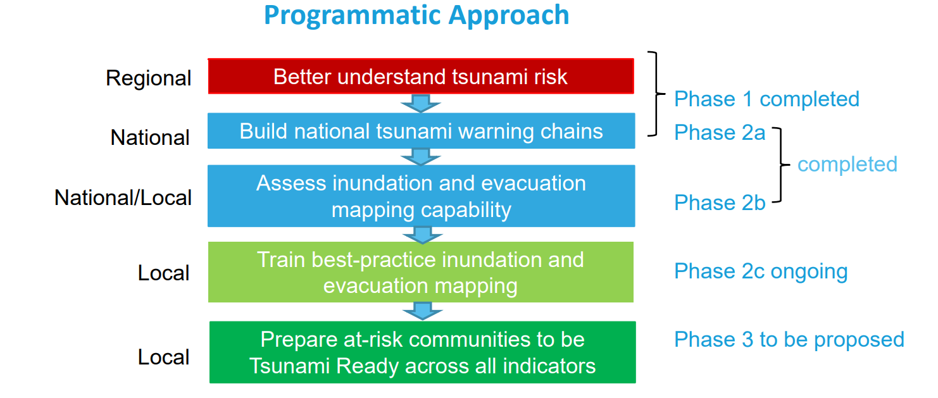
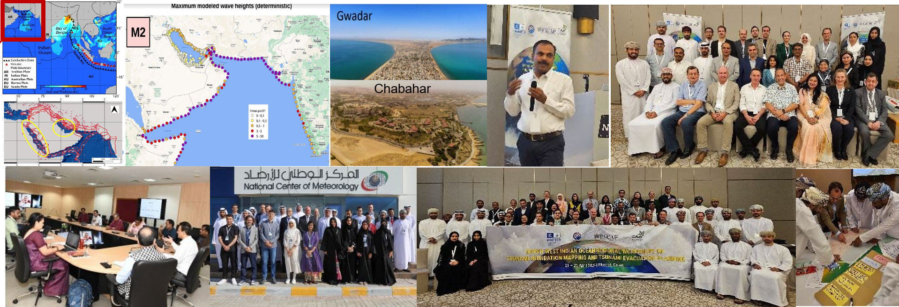
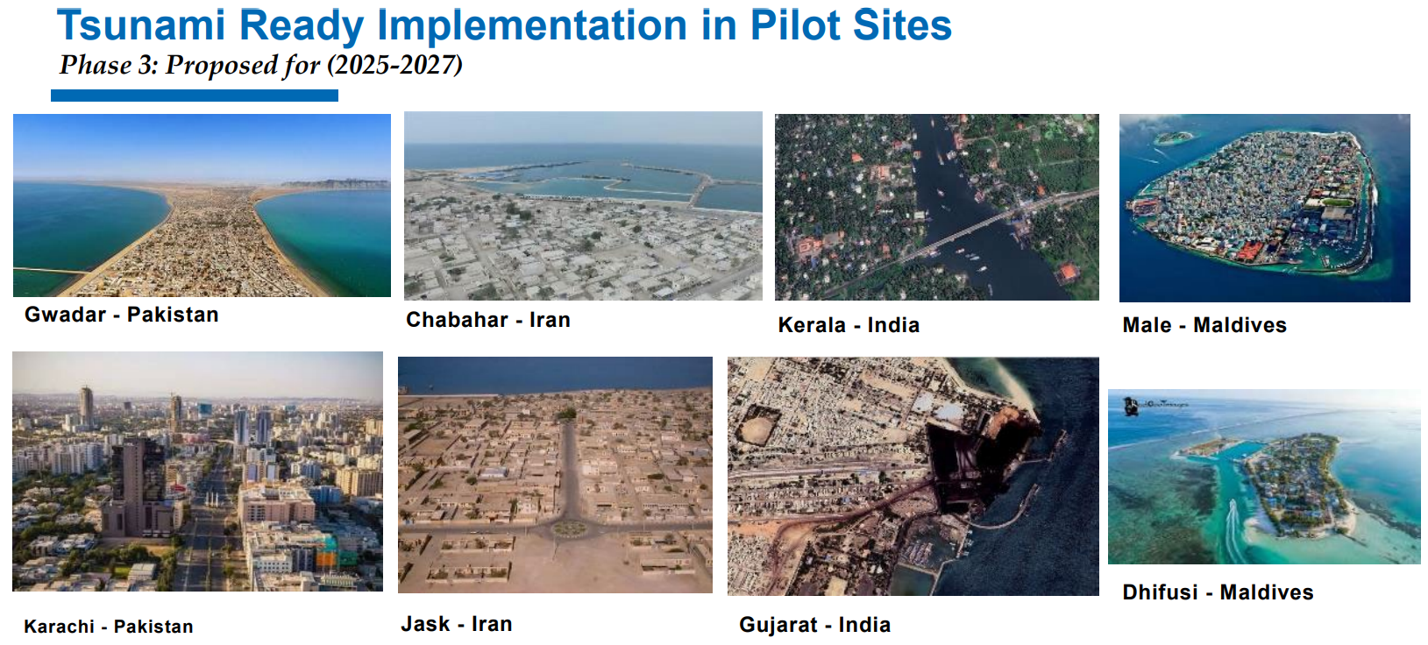
Strengthening tsunami warning in the North- West Indian Ocean through regional cooperation
Phase 1, 2a & 2b Achievements:
  PTHA for NW Indian Ocean Completed: Supported by experts (GFZ, INGV, NGI, INCOIS); PTHA results will be hosted by INCOIS for NWIO countries.
  Workshops/Trainings Conducted:
              “Makran Subduction Zone Science Strengthening Tsunami Warning and Preparedness”: 14–16 Nov 2023, Abu Dhabi, UAE.
              UNESCO-IOC Indian Ocean Tsunami Ready Hybrid Workshop: 22–26 Nov 2022, Bali, Indonesia.
              Training in tsunami inundation mapping, “Enhancing Capacities in Tsunami Modelling”, Muscat, Oman (19–23 Apr 2024).
  Tsunami Ready Recognition Programme (TRRP): Guide countries to prepare at-risk communities.
Phase 2c ongoing/planned activities:
The project on “Strengthening tsunami warning in the North- West Indian Ocean through regional cooperation – Phase 2c”, was launched on 15 November 2023
Phase 2c funded by the ESCAP Tsunami Trust Fund over a 12-month period
  A capacity-building workshop on Tsunami Evacuation Maps, Plans, and Procedures is planned for early 2025 supported by IOTIC, UNESCAP, UNESCO-IOC, INCOIS and BMKG. India will host this training at the INCOIS
  Translate Manual and Guides – Ongoing
  Engaged National Consultants to support the facilitation coordination at the local level to Pilot the Tsunami Evacuation Plan in selected sites in the country. – On Going
Phase 2a, 2b, 2c ➔ 3

Slide 10

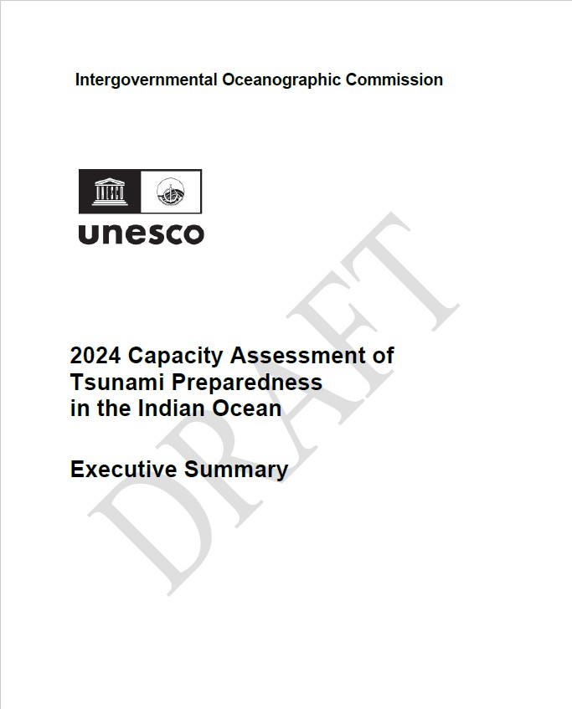
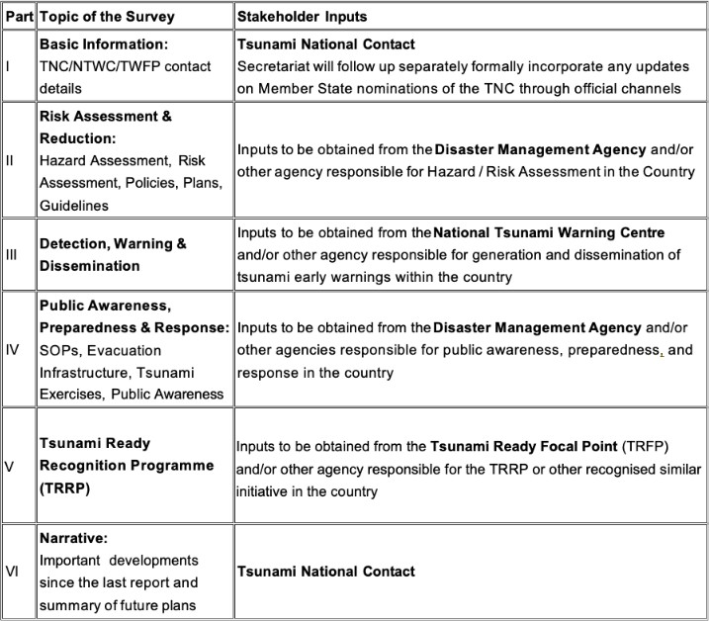
ICG/IOTWMS 2024 Capacity Assessment Survey
ICG/IOTWMS conducted the 2024 UNESCO-IOC Capacity Assessment of Tsunami Preparedness in the Indian Ocean to track regional change and to identify gaps and challenges that could be addressed through future projects and activities.
Survey responses from twenty-two (22) Member States have been received.
The University of Huddersfield analysed the data and compared with the results of the 2018 Assessment to produce a draft report.
The Capacity Assessment Team, supported by the ESCAP Tsunami Trust Fund and the Asian Development Bank, convened a meeting in Bangkok from 4–6 September to formulate recommendations.
The preliminary draft report and executive summary are now available for review on the meeting website.

Slide 11
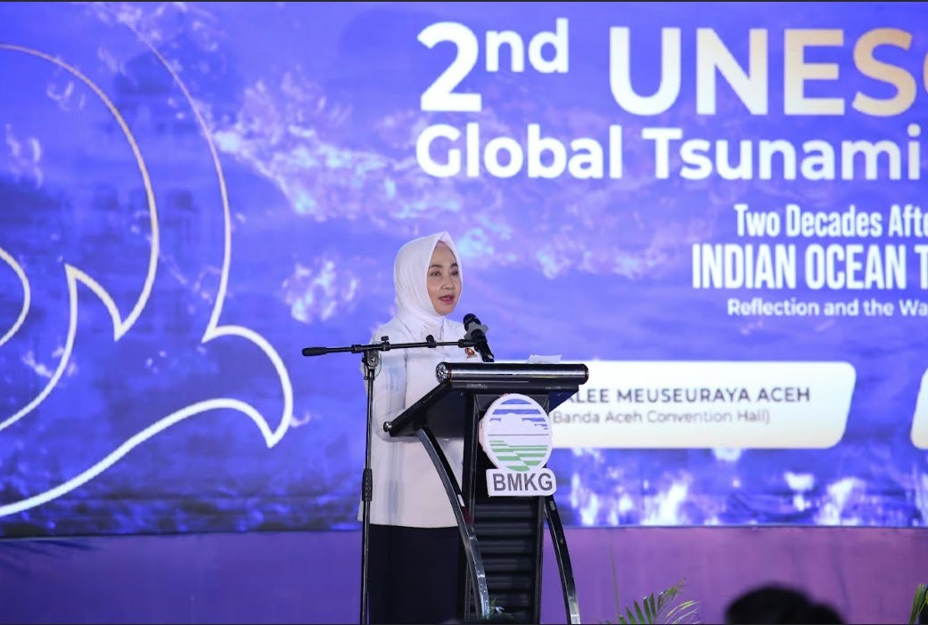
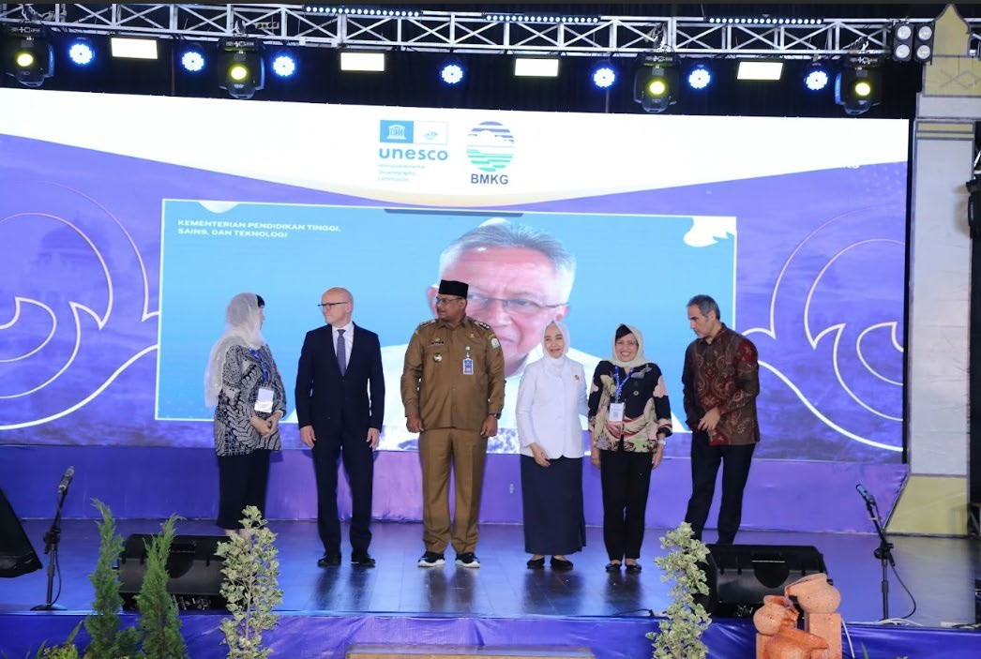
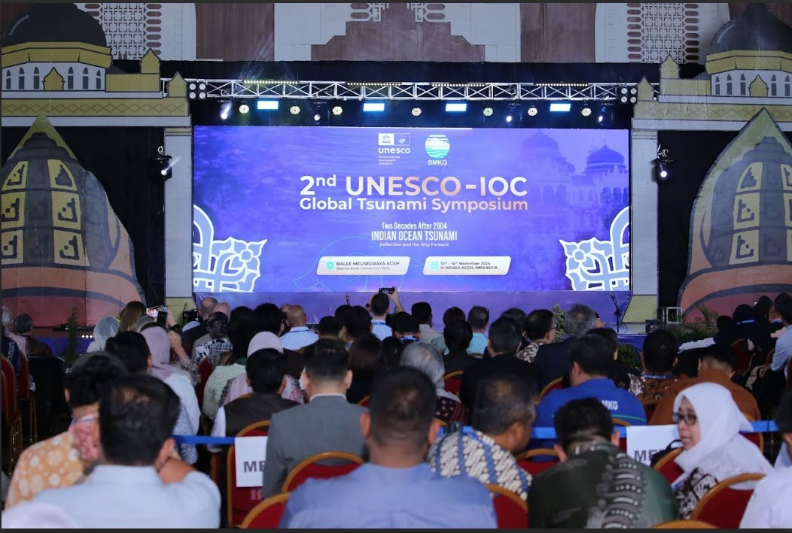
UNESCO-IOC 2nd Global Tsunami Symposium, Banda Aceh, Indonesia (10-14 Nov 2024)
Outcomes:
Banda Aceh Statement:
Participants:
− 682 participants
− 170 online participants
− 1200 viewers of Youtube
− From about 32 countries
Engaged many parties including:
− Scientists, Policy Makers, Academia, Professionals, Practitioners, Private Sector, School, Communities, Youth, NGO, UN Organizations
Showing the achievement of the technical development of tsunami warning and mitigation system
Showing the achievement of the community’s engagement in the Tsunami Preparedness capacity and response
Identifying priorities and gaps
Global Tsunami Warning and Mitigation: Building Sustainability for The next decade through Transformation and Innovation.
UNESCO and its partners call on States and civil society to drastically step up their investments and efforts to achieve 100% of Tsunami Ready Communities across the world by 2030.

Slide 12
Major Decisions from the 14th Session of ICG/IOTWMS
(14-19 Nov 2024, Jakarta, Indonesia)
Include the instructions from 57th Session of the IOC Executive Council, and the recommendations from TOWS-WG XVI and XVII in the work plans of the ICG for the next inter-sessional period;
Extend the TSP services to include tsunamis generated by non-seismic and complex sources
Instructs the Steering Group to finalize the 2024 Capacity Assessment Report and Executive Summary in 4 weeks, for further review by the Member States, incorporate feedback if any, and endorse the final report for publication as UNESCO-IOC Document
Establish a new intersessional Task Team on Indian Ocean Wave 25 Exercise (IOWave25) reporting to the Steering Group
Establish a new intersessional Task Team on New/Emerging Technologies for Observations and Forecasting under the WG2
Establish a new intersessional Task Team on Mid-Term Strategy (MTS) to prepare a draft MTS
Request the Steering Group to supervise the work of the Task Team and to finalise the MTS 2025-2030 by early half of 2025
Instructs the Steering Group, Working Groups and Task Teams to consider the recommendations of the ODTP RDIP, IOWave23, 2024 Capacity Assessment and 2nd Global Tsunami Symposium into their work plans.
Decides to continue the capacity development initiatives related to SOPs, TEMPP, TRRP and on-the-job training for warning centre operators by TSPs.
Request the Steering Group to explore if there is a need of expanding sub-regional working groups to address regional gaps and strengthen collaborations.
Develop the summary statement of the 2nd UNESCO-IOC Global Tsunami Symposium together with the Program Committee for publication as a UNESCO-IOC document.

Slide 13
THANK YOU
Mr. Eluri Pattabhi Rama Rao
Chair, ICG/IOTWMS
pattabhi@incois.gov.in
13

