Slide 1
Requirements implementation
- RRR, Co-Design, GBON -
Champika Gallage, Emma Heslop, Ann-Christine Zinkann
GOOS, IOC/UNESCO, WMO & NOAA
OCG-16 Session, 07 - 11 April 2025
Ifremer, Brest, France

Slide 2
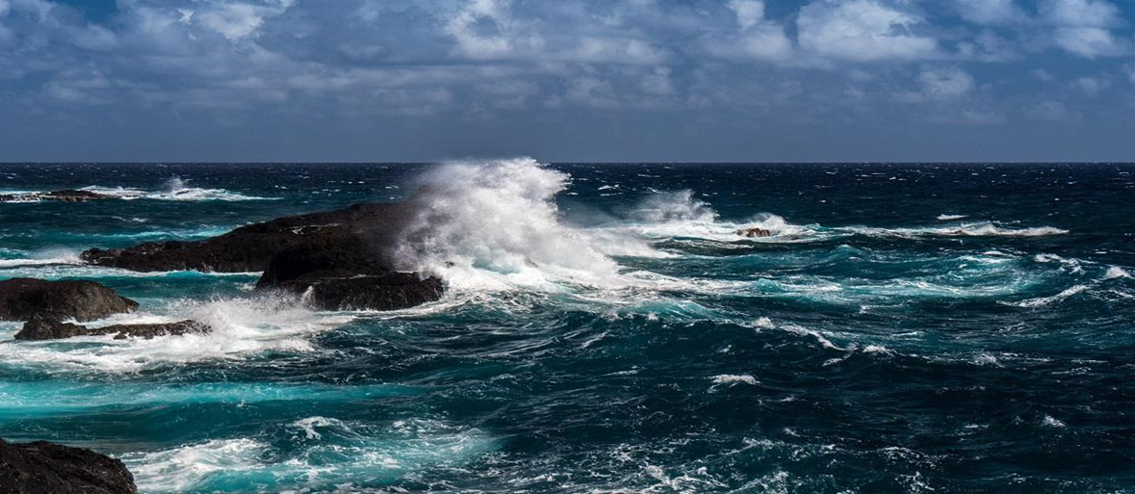
What is RRR?
The Rolling Review of Requirements (RRR) is a systematic and transparent process within the WMO Integrated Global Observing System (WIGOS) framework that supports the design and evolution of WIGOS by compiling information on service (user) requirements for observations across various WMO Earth System Application Categories (ESACs). These are then brought together into a summary called a Statement of Guidance (SoG) document.
The RRR involves a review of service (user) requirements for a set of Application Areas (AAs).
It is also designed to query the needs for existing and developing services, not future services. As the name suggests the RRR is undertaken regularly, and there have been 10 SoGs developed since 2011-2020.

Slide 3
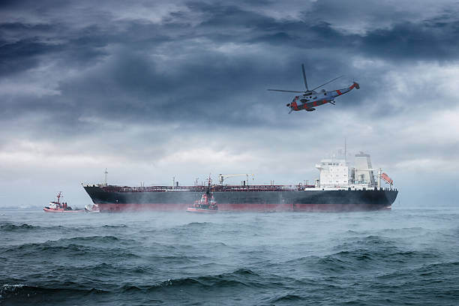
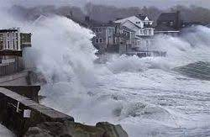
Ocean advances in RRR
First Ocean Earth System Application Category
6 Application Areas:
3.1 Ocean Forecasting and Real-Time Monitoring
3.2 Coastal Forecasting
3.3 Oceanic Climate Monitoring and Services
3.4 Tsunami Monitoring and Detection
3.5 Marine Environmental Emergency Response
3.6 Maritime Safety (ports to open ocean)
3.7 Ocean Biogeochemistry
First Statement of Guidance for Ocean ESAC complete:
Definitions, Variables (EOVs) , collect and consolidate requirements from operational systems, gap analyses by variables, recommendations, risks

Slide 4
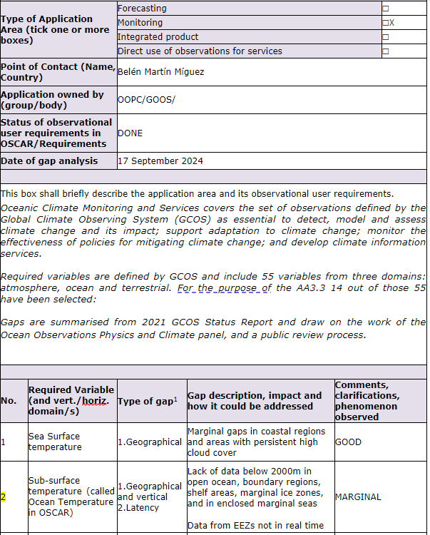
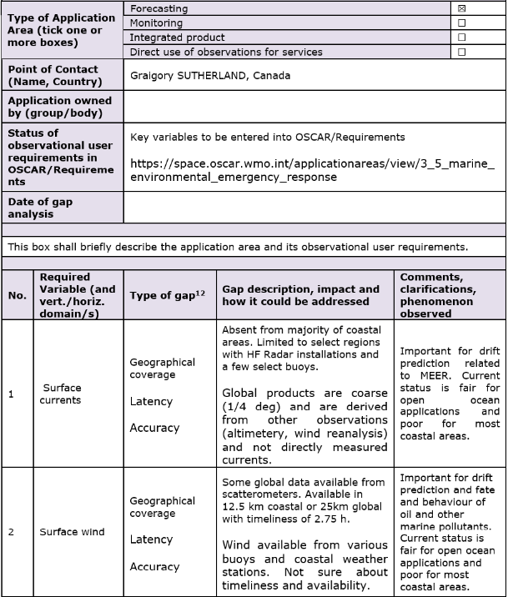
Activity Areas – Gap Analysis (examples)
By Application Area and variable
>> consolidated by variable

Slide 5
Surface currents
Impact/need | Sea surface currents are vital for many ocean forecasting and monitoring application areas. Near-real-time and seasonal forecasting, both weather and ocean, benefit from surface current data as they are responsible for transport of heat, salt, passive tracers and pollutants. Information on surface currents also enhances safety of maritime traffic and helps route optimization and increases the energy efficiency of shipping. For the planning and execution of search and rescue operations at sea, information of surface currents is essential.
Gap analysis | Surface currents are available from in-situ and satellite observations. Although the global coverage of satellite data is relatively good its accuracy, and spatial resolution especailly in coastal regions does not fully meet the requirements of ocean applications The current in-situ observation network. including lagrangian drifters, ACDPs and buoys, spatial coverage is too sparse and there are significant gaps, especially in polar, coastal and boundary current regions. Coastal high frequency (HF) radars provide relatively good coverage in coastal regions, where they are present. However, there are some challenges in data availability in near-real time.
Subsurface currents
Impact /need | Subsurface currents are responsible for the transport of heat, salt, passive tracers and pollutants in the ocean.
Gap analysis | Subsurface current data is based on in-situ profile measurements, which are very sparse, and estimates from autonomous floats at drift depth (e.g. Argo floats) and subsurface gliders.

Slide 6
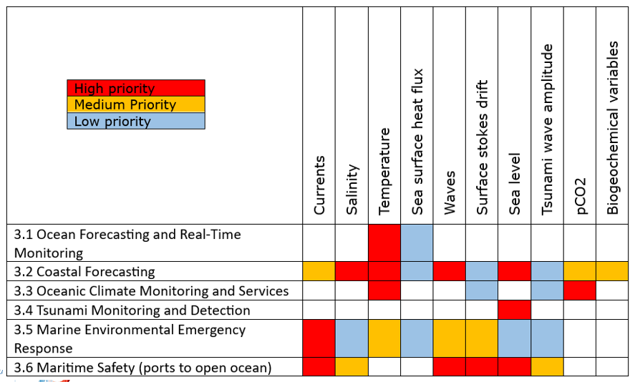

Slide 7


Launch and impact
  Review
April 2025 review by OCG, GOOS, others
Ocean, atmosphere and ice SoG
June approval by INFCOM president
Sept 2025 launch - comms WMO/ GOOS
  Impact / why matters
First consolidated multi-application set of requirements - operational services
First Ocean and Ice SoGs
Step towards expressing a Global Basic Observing Network (GBON)

Slide 8
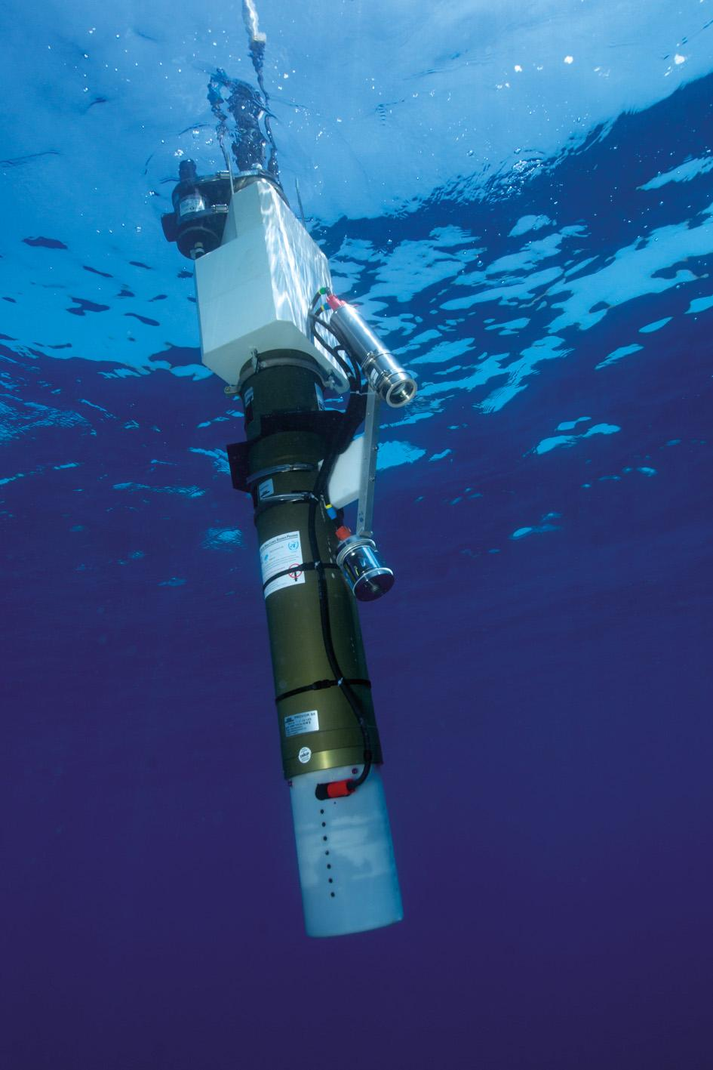
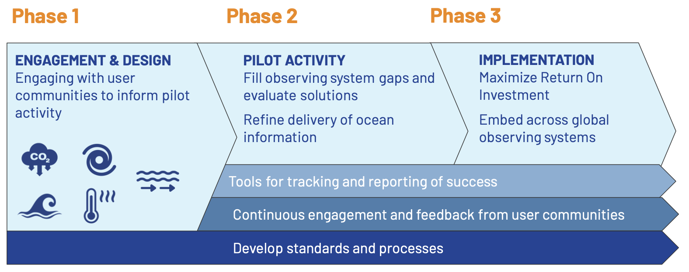
RRR connection to Co-Design?
Concepts are similar - Co-Design working in areas where services not yet mature / impact regional
WMO supporting Exemplar projects - Tropical Cyclones, Marine Heatwaves, Storm Surge and Carbon
New partnerships - interacting WMO (national and regional), CLIVAR, users

Slide 9
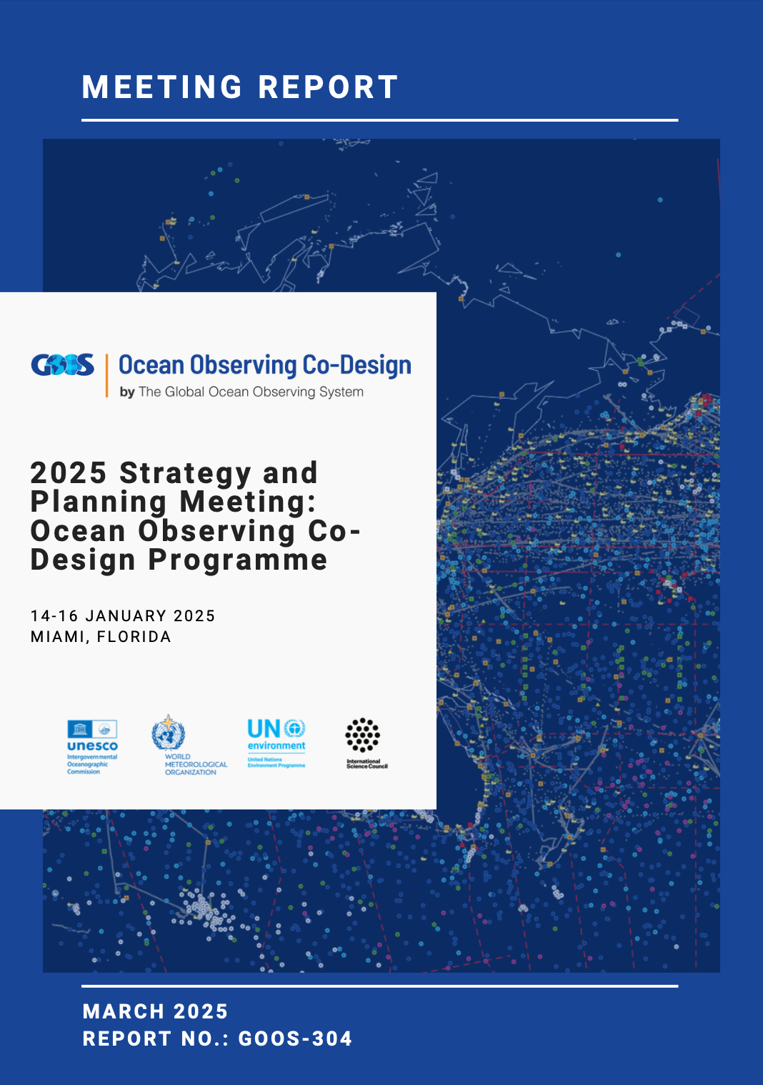
Advances in Co-Design
Focusing on the user needs bringing in new support - especially TC, BC, MHW, OC
Important are GOOS (and WMO) connections and co-design value chain approach - opens doors to collaboration
Exemplars advancing through initial phases - engaged with stakeholders (Phase 1), developing support for pilots (Phase 2)
Funding for building international Co-Design community - AccelNet proposal - first stage approved
Collaborating with GOOS Panels (BGC, OOPC)
Pitch deck for Tropical Cyclones - for industry engagement through Decade DCO Ocean Observing

Slide 10





Advances in Co-Design
WMO RA II RBON: Presented work and recommendations to enhance cyclone forecasting, including guidance for RA RBON teams and draft observation requirements.
WMO RA V RBON: Invited and ensuring aligned messages with PI-GOOS to tackle regional needs.
WMO RA IV Hurricane Committee: Attending the 2nd ocean panel
Planned: 2025 Caribbean Glider Missions
Strengthened leadership, including a CLIVAR co-lead and a geographically diverse Steering Committee.
Defining pilot selection criteria and aligning with TC and BC Exemplars.
Plans of defining minimum MHW observational requirements
Assembled international Steering Committee
International Workshop to develop backbone observing system for the Agulhas Current
Draft design to be published within the next month
Exemplar is integrated as part of the GOOS Carbon Plan (inc links to G3W)
Developing a proposal for European funding with strategic partners - ocean-atmosphere-land
WMO RBON RA II included some recommendations for Storm Surge
Focus on potential workshop and capacity development in Asia and Caribbean

Slide 11
Network connections
Network members connected to / interested in Exemplar Pilot areas
How can exemplars ensure Networks are connected to system design conversations? What level of engagement is needed?
Network decade Projects connected to / interested in Exemplar projects - members of steering groups etc.?

Slide 12
RRR connection to GBON?
The Global Basic Observing Network (GBON) is a crucial component of the WIGOS framework and was designed to identify the ‘basic’ requirements of global numerical weather prediction (NWP). GBON is mandated, in that WMO Members are responsible for establishing and managing the GBON for areas under their national jurisdiction and for ocean variables are requested to contribute towards maintaining a global network in high seas.
The Systematic Observations Financing Facility (SOFF) was established to enable WMO Members meet their GBON commitments by providing necessary financial, planning, and technical support to less developed countries and SIDs. Currently GBON considers only input from the Atmosphere ESAC, Hydrology is under development and a pathway for Ocean to be a part of GBON is in process.

Slide 13
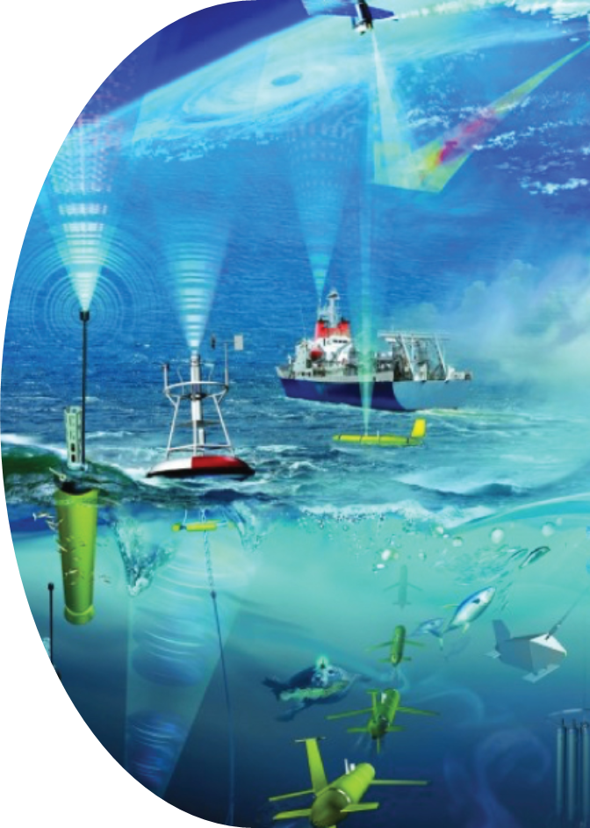
Recent advances GBON
JCB* established a subgroup to work on Observations - GBON:
(1) TT GBON - Global Basic Observing Network for the Ocean from a WMO and GOOS perspective
(2) ToRs complete, members under discussion, TT to initiate after April 2025
2026: JCB GBON work, including defining EEZ and open ocean national responsibilities
2026: JCB GBON develops a model for an Ocean GBON including a an approach for requirements setting that leverages existing processes
2027: Ocean included in SOFF - funding for SIDs/less developed countries
*The Joint Collaborative Board (JCB) is mandated to promote high-level collaboration and broad engagement of the relevant bodies of the IOC and WMO

Slide 14
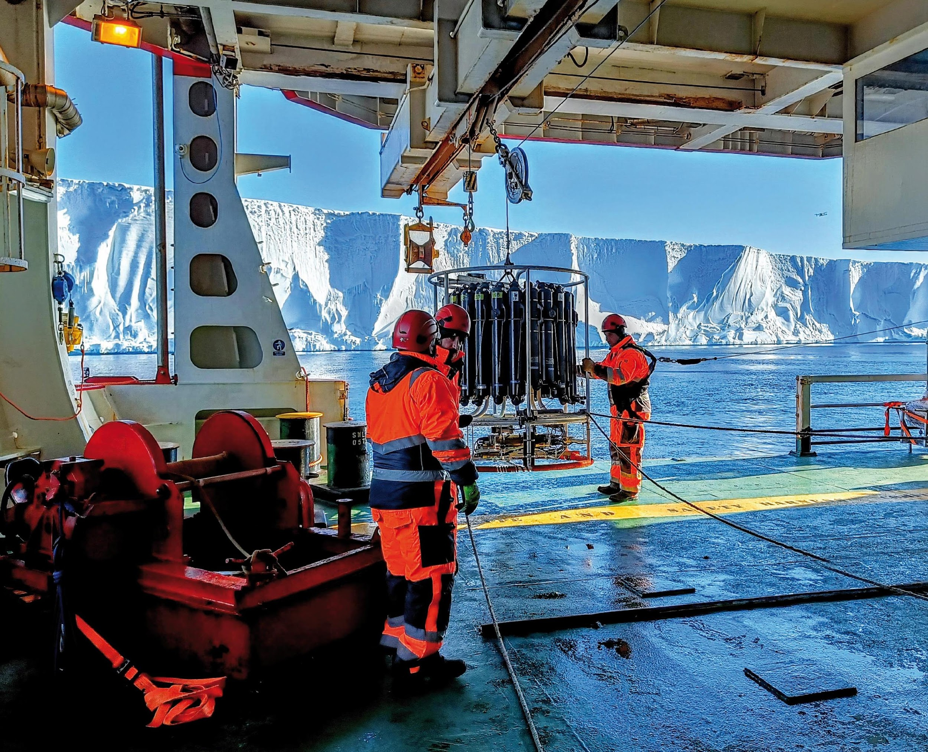
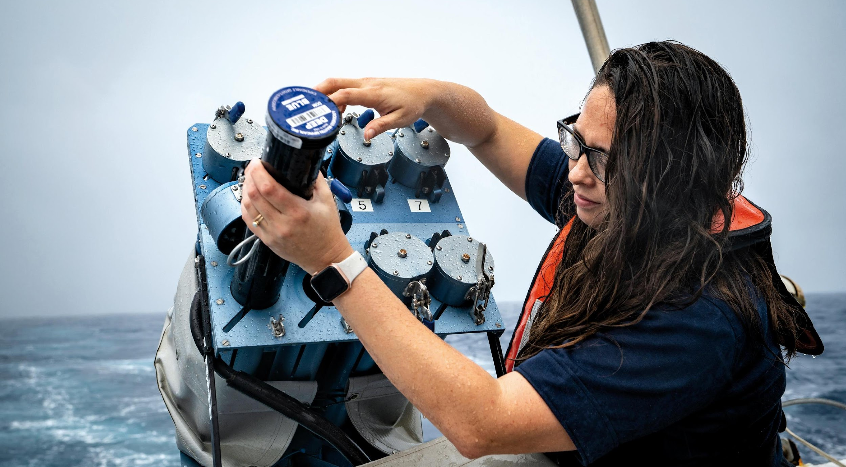
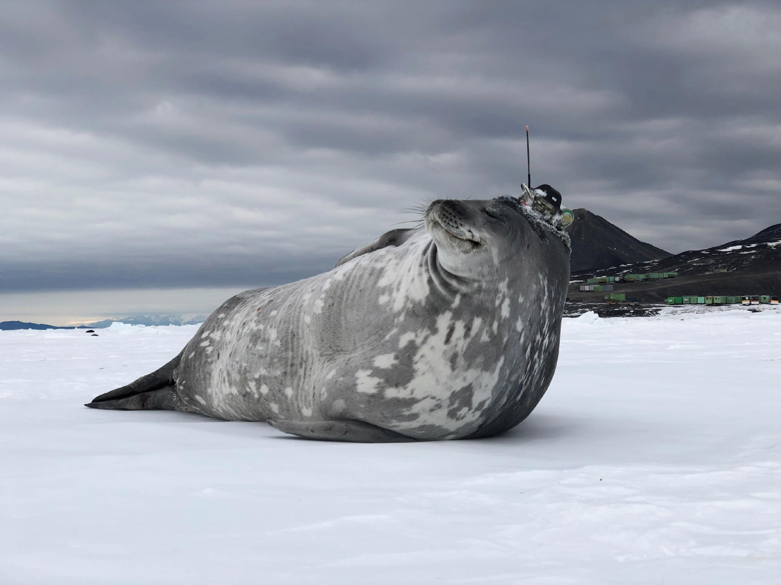
Thank you
goosocean.org

Slide 15
Application Area Definitions –
6 approved by ET-EOSDE & published in OSCAR (here)
3.1 Ocean forecasting and real-time monitoring: Provide essential information to support monitoring ocean state in near-real-time & ocean forecasting systems on global, basin and regional scale, and vital for model development for verification of numerical weather prediction on medium-range to seasonal forecasts.
3.2 Coastal forecasting: Contribute to oceanographic forecasting systems from nearshore to estuaries to continental shelf and slope.
3.3 Oceanic climate monitoring and services: observations defined by the GCOS as essential to detect, model and assess climate change and its impact; support adaptation to climate change; monitor the effectiveness of policies for mitigating climate change; and develop climate information services.
3.4 Tsunami Monitoring and Detection: is a processes to detect and forecast tsunamis, assess their potential threat to the coasts, marinas and harbours and issue timely tsunami advisory information to the stakeholders. The essential elements for early detection include the real-time transmission of seismic data, sea-level observations, and GNSS (Global Navigation Satellite System) measurement​
3.5 Marine Environmental Emergency Response: refers to the response of any immediate and imminent threat of harm to the marine environment. This response is highly time sensitive as marine pollutants drift and disperse in the surrounding fluid and, thus, increasing the extent of the potential environmental harm. The time sensitivity of the data required to monitor and predict the transport of pollutants is of the utmost importance to mitigate damage to the marine environment.
3.6 Maritime Safety (ports to open ocean): It covers the sets of observations to provide the services and warnings for the protection of life and property on all ships on all voyages at sea and in all [port] waters connected therewith.
3.7 Ocean Biogeochemical Cycles: yet to be developed – initiate in 2025

Slide 16
ESAC - Ocean Applications Area
1. Activity Area - definitions
2. Variables
3. Requirements - Notes
4. Timeline
5. Questions

Slide 17
Ocean Application Areas
3.1 Ocean Forecasting and Real-Time Monitoring
3.2 Coastal Forecasting
3.3 Oceanic Climate Monitoring and Services
3.4 Tsunami Monitoring and Detection
3.5 Marine Environmental Emergency Response
3.6 Maritime Safety (ports to open ocean)
3.7 Ocean Biogeochemistry

Slide 18
Contacts Ocean Pilot
Current Status 12/2024
ESAC | Ocean Applications | Emma Heslop | GOOS in collaboration with SERCOM/SC-MMO Andreas Schiller and WMO
 | Area | POC / AAO | Committee / Additional consulted
AA | 3.1 Ocean Forecasting and Real-Time Monitoring | Hao Zuo / Sabrina Speich | OOPC / in collaboration NWP, OceanPredict, ETOOFS, CMEMS
AA | 3.2 Coastal Forecasting | Laura Tuomi / Val Swail | SERCOM/SC-MMO / in collaboration with CMEMS, EuroGOOS Coastal WG, CoastPredict, OceanPredict, ETOOFS, CMEMS
AA | 3.3 Oceanic Climate Monitoring and Services | Belén Martín Míguez / Sabrina Speich | OOPC / in collaboration with GCOS, WCRP, ETOOFS, OceanPredict
AA | 3.4 Tsunami Monitoring and Detection | Dr. Yuji Nishimae, Chair of the TOWS-WG Task Team on Tsunami Watch Operations / support Ocal Necmioglu (IOC) | IOC/TOWS-WG / in collaboration SERCOM/SC-MMO
AA | 3.5 Marine Environmental Emergency Response | Graigory (Graig) Sutherland / Øyvind Breivik | SERCOM/SC-MMO / in collaboration with community
AA | 3.6 Maritime Safety (ports - open ocean) | Anish Hebbar / Daniel Peixoto de Carvalho​ | SERCOM/SC-MMO, in collaboration ETOOFS and user community 9port/shipping)
AA | 3.7 Ocean Biogeochemical Cycles | Maciej Telszweski / | GOOS BGC Panel (IOCCP), 3GW – estimated for 2025
Updates based on call 26 Oct 2023)

Slide 19
Ocean ESAC Application Areas - progress
Activity Area | Definition | Requirements gathering | Gap analysis | SOG
3.1 Ocean Forecasting and Real-Time Monitoring | Complete | Variables in OSCAR. Some new variables and name changes submitted | Completed | Cross-AA summaries by variable groupings
3.2 Coastal Forecasting | Complete | Stakeholder consultations ongoing | Some initial work completed | Some input
3.3 Oceanic Climate Monitoring and Services | Complete | Variables in OSCAR. Some new variables and name changes submitted | Completed | Cross-AA summaries by variable groupings
3.4 Tsunami Monitoring and Detection | Complete | New variables submitted to ET-EOSDE for review | Completed | Cross-AA summaries by variable groupings
3.5 Marine Environmental Emergency Response | Complete | Variables in OSCAR. Some new variables submitted | Completed | Cross-AA summaries by variable groupings
3.6 Maritime Safety (ports to open ocean) | Complete | Variables in OSCAR. Some new variables and name changes submitted | Completed | Cross-AA summaries by variable groupings
3.7 Ocean Biogeochemical Cycles |  | Due to initiate in 2025

Slide 20

AA requirements notes
Input by variable directly into OSCAR
POCs to make notes on requirements as developing – to document decisions on evolution of requirement

Slide 21
ESAC-Ocean Variables
Ocean surface currents (vector) Ocean velocity Ocean salinity Sea surface salinity Ocean temperature Sea surface temperature Significant wave height Dominant wave direction Dominant wave period Ocean dynamic topography pCO2 | Surface Stokes Drift Tsunami Wave Amplitude 1D Wave Spectra Coastal sea level (tide) Colour Dissolved Organic Matter (CDOM) Dissolved inorganic carbon (DIC) Nitrate Nitrous oxide (GHG) Phosphate Ocean chlorophyll concentration | Sea level Ocean subsurface tracers Ocean subsurface dissolved oxygen concentration pH Sea surface heat flux Silicate Water-leaving spectral radiance Sea-ice age Sea-ice cover | Sea-ice elevation Sea-ice motion Sea-ice surface characteristics (included in albedo) Sea-ice surface temperature Sea-ice thickness Sea-ice type Snow depth Wind Stress Wind vector (near surface)
Available in OSCAR
Coordinate with Cryosphere
Bold – Variables required by ≥ 3 AAs

Slide 22
Activity Areas -Variables
New Variables | Definition
Nitrate | Concentration of NO3 in the water column
Nitrous oxide (GHG) | Concentration of N2O gas in the water column
pH | The hydrogen ion concentration in seawater, which is a measure of acidity and alkalinity
Phosphate | Concentration of PO4 in the water column
Silicate | Concentration of Si(OH)4 in the water column
Sea Ice Age | To be filled in by AA5.3 (Sea Ice pilot)
Sea-ice albedo
Snow Depth in Sea Ice
Surface Stokes Drift | The net drift of a fluid parcel at the surface due to surface waves.
Tsunami wave amplitude | 1) absolute value of the difference between a particular peak or trough of the tsunami and sea level at that time, or 2) half the difference between an adjacent trough and peak and can be corrected for the change of tide between that trough and peak.
Changes in terminology: alignment with EOV/ECV
Existing | Proposed | Comments
Ocean dynamic topography | Sea Level | While SSH is the name of the EOV, the group favored sea level. It is also more consistent with the other sea-level related OSCAR variables (coastal sea level)
Ocean Salinity | Subsurface Salinity | The team agrees it is important to add "subsurface"
Ocean Temperature | Subsurface Temperature | The team agrees it is important to add "subsurface"
Wind Stress | Ocean surface Wind Stress | Agreed this for clarity and consistency
  Common list of variables - agreed common names
  Request to ET-EOSDE for name changes/other simplifications
  Where needed, agree combined requirements with other AAs (e.g. Cryosphere)
  EOV / ECVs vs OSCAR variable list - make relationship visible

Slide 23
NEW Ocean Variables (not in OSCAR)
Variable name | Code Registry link | Github Entry | Comment
Nitrate | NO₃-(nitrate) (312) | N/A | Definition acceptable to ESAC-Ocean
Nitrous oxide | Not available | #560 | Available in Code Registry(here) without any details
Phosphate | PO4= (phosphate) (399) | N/A | Definition acceptable to ESAC-Ocean
Silicate | Not available | #562
Surface Stokes Drift | Not available | #564
Tsunami Wave Amplitude | Not available | #563
Sea level | Not available | #565 | Preferred to ocean dynamic topography (ODT) (64)

Slide 24
Proposed changes to Ocean Variables (in OSCAR)
Variable name (OSCAR) | Code Registry link | Github Entry | Comment
Ocean Salinity | Subsurface salinity (91) | N/A | Name and definition in Code Registry acceptable to ESAC-Ocean. Request name change to Subsurface salinity in OSCAR
Ocean Temperature | Subsurface temperature (94) | N/A | Name and definition in Code Registry acceptable to ESAC-Ocean. Request name change to Subsurface temperature in OSCAR
wind stress | Wind stress (103) | #561 | Name should change to Ocean surface wind stress in Code registry and OSCAR

Slide 25
Statement of Guidance
Introduction of overall ESAC
Application Areas (AA)
  Considered AAs and their prioritization
  Disaster Risk Reduction and Early warning aspects
  Climate applications
  Regional aspects
  Summary of Key variables to be observed and identified key gaps for the Ocean Earth System Application Category
  Risks and Sustainability
  Recommendations on how to address the gaps
  Impact
Acknowledgement of contributors
Physical variables
  Sea Surface Temperature
  Subsurface Temperature
  Sea Surface Salinity
  Subsurface Salinity
  Ocean surface currents (vector)
  Ocean velocity
  Significant wave height
  Dominant wave period and direction
  Sea Surface Heat flux
  Sea Level
  Tsunami wave amplitude
  Sea Ice* -Included in AA- Sea Ice
  Surface Stokes Drift
Biogeochemical variables
  Ocean subsurface dissolved oxygen concentration
  Silicates
  Phosphate
  Nitrate
  pCO2
  Ocean chlorophyll concentration

Slide 26
Timeline 2025 - 2027
Gap analysis to end 2024
  more mature AAs available, excepting Coastal AA
Frist Draft Statement of Guidance (SoG) - ESAC Ocean end Feb 2025
  Mature AAs
  All AA POCs taking a role to consolidate gap analyses by variables
Review Draft SoG
  End Feb - ESAC internal review
  March-April 2025 - GOOS/other communities review of Ocean, Atmosphere and Cryosphere SoGs
  April-May 2025 – ET-EOSDE review, INFCOM review
  June 2025 - President INFCOM approves - visibility
SOGs (3) available autumn 2025
  Communications – highlight SoGs and new areas, ensure members, GOOS, others know purpose and how to use
Complete Ocean/other SoGs for WMO Congress 2027 (complete end 2026)
  Major Update - available autumn 2026
  Endorsed by WMO Congress

Slide 27
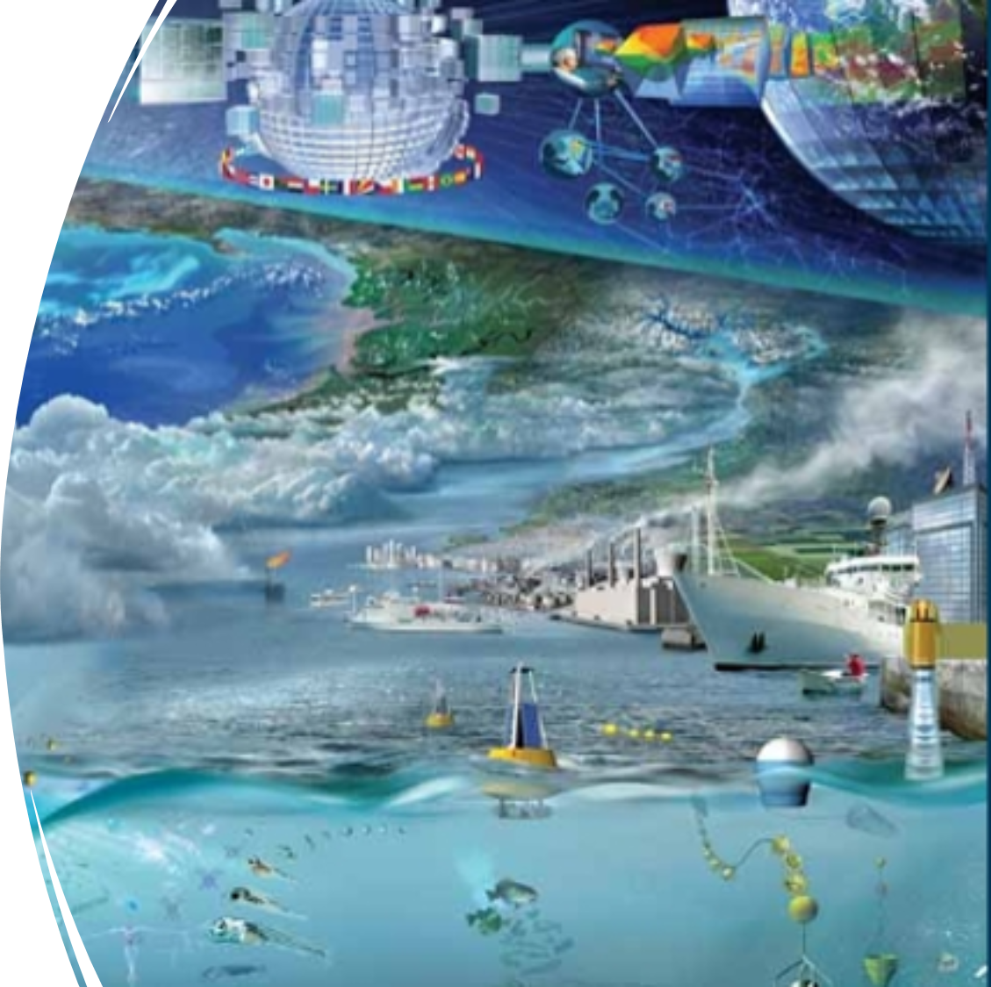
Comments & learning
Participation important to GOOS: understand process, consider how use the process within the community more broadly, integrate/work with outcomes
Significant effort as need to coordinate with 7 different ocean-related communities
Supporting consistency between GOOS Essential Ocean Variables and OSCAR will assist understanding
Important to track provenance (groups contacted) and decisions made, and communicate on process
Consistent concepts – what required for services today and what would you advise MS (audience). What would you want them to understand. Consider variables independent of specifics of how measured

Slide 28
SoG Workshop - useful outcomes
Timeline – first 3 SoG atmosphere, cryosphere, oceans - 2025
  Delivery INFCOM president June 01, delivery ET-EOSDE May 01, review ESAC communities March 01
Review period (March 2025)
  3 related SoGs – reviewed by members ocean community
  community assessment (GOOS, Tsunami, implementors, expert panels), implementation feedback, community knowledge and buy in
  Cross ESAC consistency in recommendations
Communication
  Considered audience – members and ESAC area communities, WMO community and key partners
  Introduction of new ESAC areas - why important, what, how use?
  WMO behind this, significance, links to other processes (WiGOs Vision, GBON)
Statement of Guidance – common format, new elements
  Acknowledgment of significant effort from ocean-related communities to develop SoG
  Risk to existing and impact following recommendations – high level summaries
Clarification on how does the RRR feeds into GBON development
Future - what does success look like? How to track if/how used? Measure impact?

Slide 29
Developing connections
WMO-IOC Joint Collaborative Board – Sept 2024
4 areas for priority collaborative work – GBON Ocean
Task Team to a) ocean >> WMO GBON and b) ocean GBON, concept applied to global ocean observing system
GOOS Steering Committee (SC-14) February 2025
Session on WMO RRR, GBON and relevance to GOOS work plan
GOOS Ocean Observing Ocean Decade Co-Design Programme
Working on enhancing ocean observations specifically for new and existing application areas with service delivery partners – Tropical Cyclones, Ocean Carbon, marine Heatwaves – interaction with WMO and future RRR
European Commission EOV projects keen to use the RRR framework:
ObsSea4Clim – physical EOVs - considering RRR applied to work in projects, indicators, best practices
BioGeoSea– just gained– funding for 2 years support for the the BGC Cycles AA
GOOS work to consider/analyse the WMO SoG gaps/recommendations with other sources (CMEMS requirements in situ/satellite) for consistency. Understand utility of this information for GOOS / met agencies
https://obssea4clim.eu/

Slide 30

ObsSea4Clim EU Project
1 Feb 2024 - 31 Jan 2028
https://obssea4clim.eu/
Coordinator: Steffen Olsen, DMI (DK)
Co-coordinator: Sabrina Speich, LMD-ENS (F)
Project goals
Develop and deliver new ocean indicators for sustainable development, provide improved Essential Ocean Variables / Essential Climate Variables and evolve European ocean observing
Using the WMO RRR process and applying it to EOV/ECVs, ObsSea4Clim will synthesize information about requirements for observations and observing system capabilities from regional/national applications for communication and dialogue with coordination groups (GCOS, GOOS, WMO, SAON) drawn on experts.
Develop best practices and standards for in-situ and satellite ocean observing
Create an interoperable data ecosystem serving multidisciplinary needs
Support regional and global climate assessments
Objective: deliver an improved, standardized framework for sustainable ocean observation and demonstrate the functioning of a sustainable ocean observation system

Slide 31
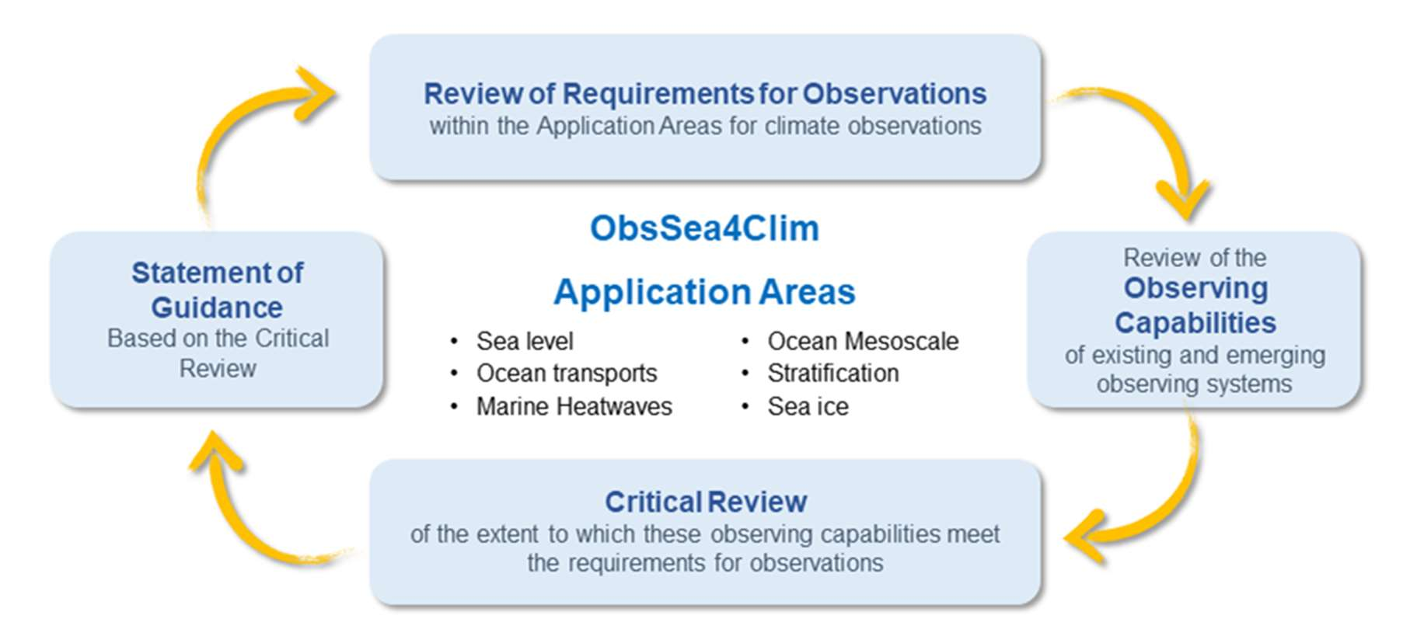
RRR – ObsSea4Clim Application Areas
& Approach
Define the Rolling Review of Requirements (RRR) process approach for the Essential Ocean Variables (EOV/ECVs) and provide a guidance
Using the WMO RRR process and applying it to EOV/ECVs
Focus: Defining the processes and identifying the needs to ensure European nations observing (e.g., EuroGOOS, EOOS, MSFD) deliver strong and coordinated input to the global collaboration for addressing large-scale and global climate information requirements and climate-linked marine extremes
Outcome: A general framework to the RRR process approach for EOVs/ECVs
Transforming RRR to various Ocean application areas
Notes:
ObsSea4Clim and Defining Ocean Requirements "At ObsSea4Clim, we are working to apply the WMO RRR process specifically to Essential Ocean Variables (EOVs) and Essential Climate Variables (ECVs). This involves defining the processes and identifying the needs to ensure that national observing programs—such as EuroGOOS and EOOS—deliver coordinated input to global efforts addressing climate-linked marine extremes. The goal is to transform the RRR approach into a functional framework for ocean observation."

