Slide 1
ICG/PTWS– XXXI
April, 2025
Revised Northwest Pacific Tsunami Advisory Center (NWPTAC)
users guide
Northwest Pacific Tsunami Advisory Center (NWPTAC)
Japan Meteorological Agency (JMA)
Notes:
Thank you for chairman. Good morning, everyone.
I am Takeshi Sato in Northwest Pacific Tsunami Advisory Center (NWPTAC), Japan Meteorological Agency (JMA).
I'm very glad to see all of you today
I would like to talk about the revised Northwest Pacific Tsunami Advisory Center (NWPTAC) user’s guide.

Slide 2

Progress of the revised NWPTAC User’s Guide
In NWPTAC, according to Recommendation ICG/PTWS-XXX.3, the NWPTAC user’s guide was gotten started the revise with on a common structure and contents.
The progress about the revised user’s guide was reported at PTWS SC on September, 2024.
NWPTAC has drafted the revised NWPTAC user‘s guide and sent it to TNCs in the recipient countries of the NWPTA on 13 March to request feedback from them.
As we have received no comments until the deadline, NWPTAC will finalize the revised one.
The revised NWPTAC user‘s guide will be published to the recipient countries after the endorsement of the ICG/PTWS.
Notes:
In NWPTAC, according to Recommendation ICG/PTWS-XXX.3, the NWPTAC user’s guide was gotten started the revise with on a common structure and contents.
The progress about the revised user’s guide was reported at PTWS SC on September, 2024.
NWPTAC has drafted the revised NWPTAC user‘s guide and sent it to TNCs in the recipient countries of the NWPTA on 13 March to request feedback from them.
As we have received no comments until the deadline, NWPTAC will finalize the revised one.
The revised NWPTAC user‘s guide will be published to the recipient countries after the endorsement of the ICG/PTWS.

Slide 3
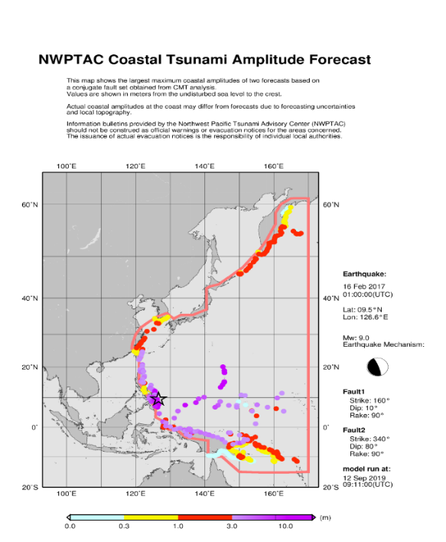
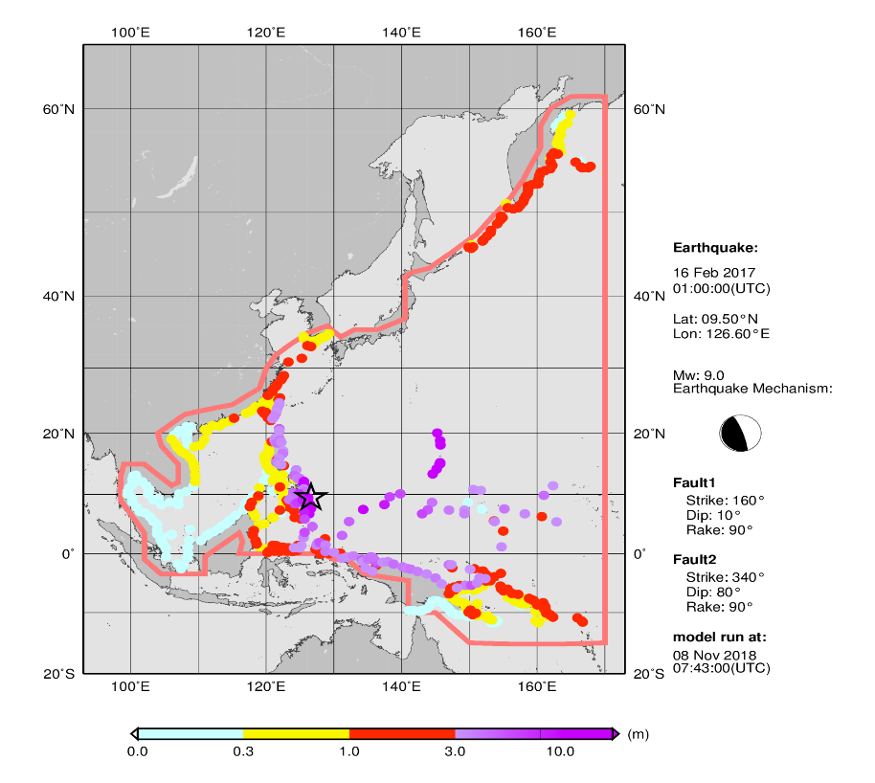
Problems of the current version of NWPTAC User’s Guide
Current NWPTAC User's Guide was published in 2019 when the NWPTAC started to provide the graphical products.
Several years passed after the publication, some descriptions became out of date and differ from the current situation. One example is the changes which should have been made with the start of SCSTAC's operational services.
Therefore, we would like to modify them in conjunction with the update to reflect the common structure. It should be done as soon as possible to make the guide more useful to users.
Graphical product of present NWPTA
Current version of NWPTAC user’s guide
Notes:
We would like to talk about problems of the current version of NWPTAC user’s guide.
Current NWPTAC User's Guide was published in 2019 when the NWPTAC started to provide the graphical products.
Several years passed after the publication, some descriptions became out of date and differ from the current situation.
One example is the changes which should have been made with the start of SCSTAC's operational services.
As shown in graphical product of present NWPTA, the Area of Service of NWPTAC does not include the South China Sea. However, the Area of Service of the current version of the user's guide includes the South China Sea region because this version was published before the service of the SCSTAC.
Therefore, we would like to make these updates in conjunction with this update, and this should be done as soon as possible to make the guide more useful to users.

Slide 4
Table contents of the revised NWPTAC User’s Guide
The revised NWPTAC user’s guide is organized into 4 chapters and 4 annexes.
Table contents
1. Overview
1.1 Background
1.2 Area of Service (AoS)
1.3 Earthquake Source Zone
1.4 Tsunami Hazard
2. Operations
2.1 TSP Facility
2.2 Operational Tools and Procedures
2.2.1 Tsunami Source Detection and Characterization
2.2.2 Tsunami Wave Observations
2.2.3 Tsunami Forecasting
2.2.4 Decision Support
2.2.5 Product Creation and Dissemination
2.2.6 Timeline
3. Products
3.1 Product Types and Criteria
3.1.1 Informational
3.1.2 Threat
3.2 Product Content
3.2.1 Text Products
3.2.1.1 Earthquake Information
3.2.1.2 Tsunamigenic Potential
3.2.1.3 Tsunami Estimated Amplitude and Arrival Time
3.2.1.4 Tsunami Observation
3.2.2 Graphical Products
3.2.2.1 Tsunami Travel Time Map
3.2.2.2 Coastal Tsunami Amplitude Forecast Map
3.2.2.3 Deep-Ocean Tsunami Amplitude Forecast Map
4. Dissemination
4.1 Methodologies
4.1.1 Products
4.1.2 Customer Decision Support
4.2 Communication Testing
4.3 Contact Information
REFERENCES
ANNEXES
I. Example Products
II. Forecast Points (FPs)
III. Observation Sites
IV. Defined Coastal Points
Notes:
This slide shows the table contents of the revised NWPTAC user’s guide.
Based on common structure and contain similar contents by recommendation ICG/PTWS-XXX.3, the revised user’s guide is organized into 4 chapters and 4 annexes.
First chapter is the overview with sub-chapters in background, Area of service, earthquake source zone and tsunami hazard in the NWPTAC.
Second chapter is the operations with sub-chapters in TSP Facility, and Operational Tools, and Procedures.
Third chapter is the products with sub-chapters in Product types and criteria, Product contents about text and graphical products.
Fourth chapter is the dissemination with sub-chapters in methodologies, communication testing, and contact information.
Annexes compose of example products, forecast points, observation sites and defined coastal points.

Slide 5
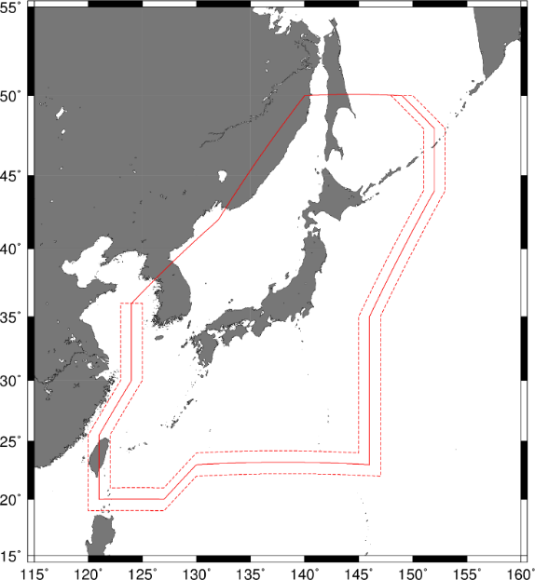
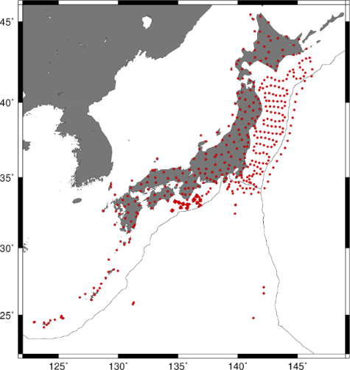
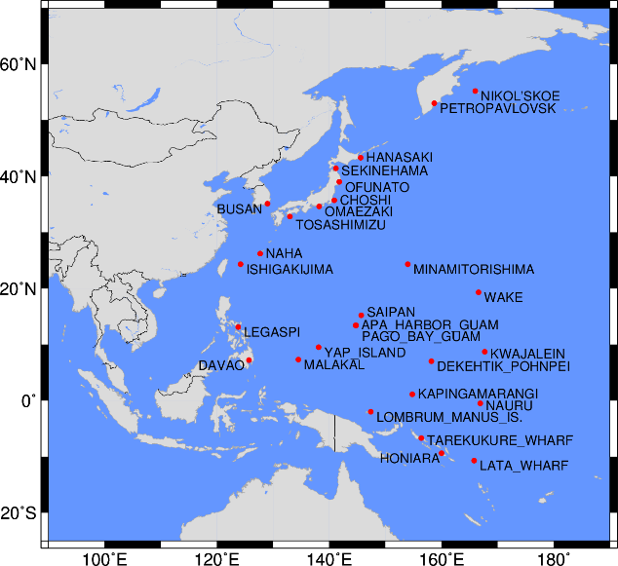
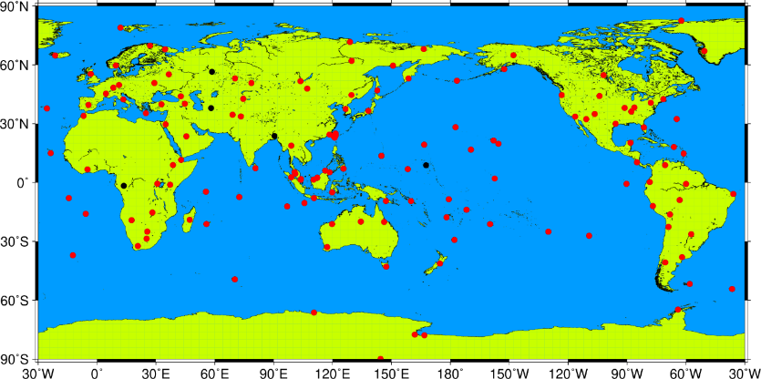
Modification points of the revised NWPTAC User’s Guide
A description of how to determine the seismic elements of earthquakes within NWPTAC’s AER and teleseismic earthquake has been added to the sub-chapter of “Tsunami source detection and characterization“.
Maps in seismic and sea-level stations used by NWPTAC have been added to “Tsunami Source Detection and Characterization” and “Tsunami Wave Observation”.
Seismic stations used by NWPTAC by earthquakes within its AER (left) and in teleseismic event (bottom)
NWPTAC’s AER and buffer zones
Sea-level stations used by NWPTAC
Notes:
This slide shows modification points of the revised NWPTAC user’s guide.
A description of how to determine the seismic elements of earthquakes within NWPTAC’s AER and teleseismic earthquake has been added to the sub-chapter of “Tsunami source detection and characterization“ in the revised user’s guide.
Maps of seismic and sea-level stations used by NWPTAC have been added to “Tsunami Source Detection and Characterization” and “Tsunami Wave Observation”.

Slide 6
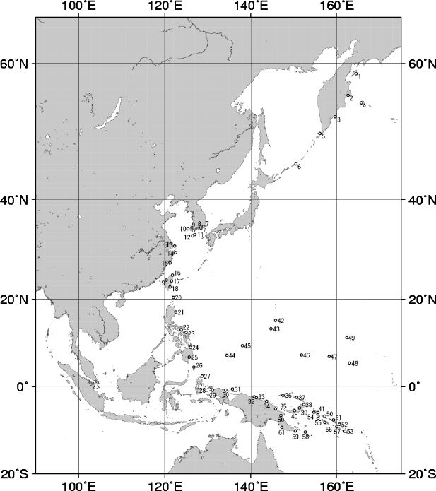
Modification points of the revised NWPTAC User’s Guide
Operation, creation, and dissemination have been added to the chapter of “Operations“.
Locations of forecast points and coastal points providing data for NWPTA graphical products has been added to “Annexes”.
Forecast points
Coastal points providing data for NWPTA graphical products
Notes:
Operation, creation, and dissemination have been added to the chapter of “Operations“.
Locations of forecast points and coastal points providing data for NWPTA graphical products has been added to “Annexes”.

Slide 7
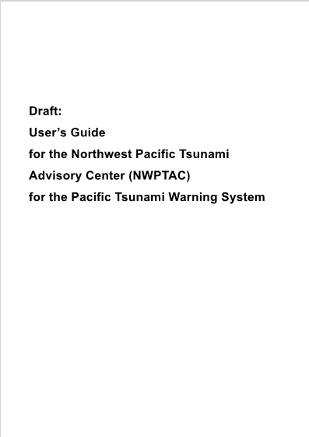
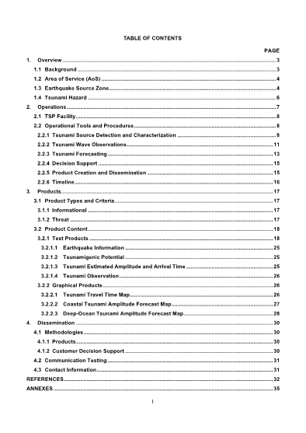
The revised NWPTAC User’s Guide
NWPTAC invites ICG/PTWS to;
  Welcomes NWPTAC work towards revision of its user’s guide (IOC Technical series 142） in accordance with the common table of contents agreed by ICG/PTWS-XXX.3,
  Endorses the revised user’s guide as proposed,
  Recommends IOC secretariat to take necessary actions to publish the revised NWPTAC user’s guide.
Notes:
Lastly, NWPTAC invites ICG/PTWS to;
Welcomes NWPTAC work towards revision of its user’s guide (IOC Technical series 142） in accordance with the common table of contents agreed by ICG/PTWS-XXX.3,
Endorses the revised user’s guide as proposed,
Recommends IOC secretariat to take necessary actions to publish the revised NWPTAC user’s guide.

Slide 8
Thank you very much for your kind attention.
Notes:
That concludes my report.
Thank you very much for your kind attention.

