Slide 1
ICG/PTWS-XXXI Session
8 - 11 April 2025
4.10. CENTRAL AMERICA tsunami advisory center (CATAC)
NISHIMAE Yuji
Chair of ICG/PTWS

Slide 2
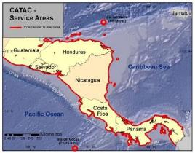
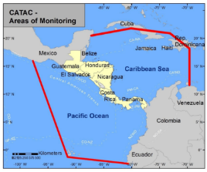
Start of the official full functional operation of the Central America Tsunami Advisory Center (CATAC)
Recommendation ICG/PTWS-XXX-6
Decides to admit the start of the official full functional operations of CATAC, starting after the IOC governing body meeting in 2024, with the specific starting date to be decided after the coordination with the ICG/CARIBE-EWS
Recommendation ICG/CARIBE-EWS-XVII.8
Recommends CATAC to continue with the implementation of EEW methods for the acceleration and improvement of the tsunami warning for Central America.
Recommends the use of additional methods for the transmission of CATAC’s products to its users.
Recommends that CATAC continues full functionality in an interim manner to be able to support the National Tsunami Warning Centers (NTWCs), Tsunami Warning Focal Points 18 (TWFPs), and emergency management authorities of Central America in addressing those challenges,
Further recommends the consideration of CATAC as a TSP in its XVIII Session in 2025 to enable the IOC Assembly to consider the final admission of CATAC as TSP in June 2025

Slide 3
Chair’s Proposals for Recommendation
The ICG/PTWS requests the CATAC to continue full functionality in an interim manner until the ICG/CARIBE-EWS admits the CATAC as TSP of the ICG/CARIBE-EWS and then the IOC governing bodies endorse the recommendation of the ICG/CARIBE-EWS.

