Slide 1
ICG/PTWS-XXXI Session
8 - 11 April 2025
3.1 CHAIRPERSON REPORT
NISHIMAE Yuji
Chair of ICG/PTWS

Slide 2
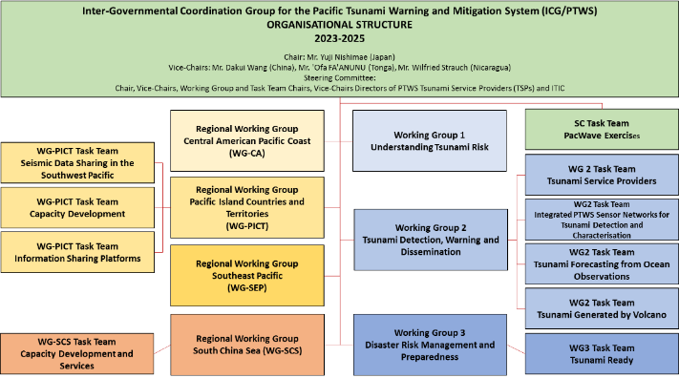
ICG/PTWS Organizational Structure (since September 2023)
Chair: Mr. Yuji Nishimae (Japan)
Vice-Chairs: Dr. Dakui Wang (China), Dr. Wilfreid Strauch (Nicaragua), Mr. ‘Ofa Fa’anunu (Tonga)

Slide 3
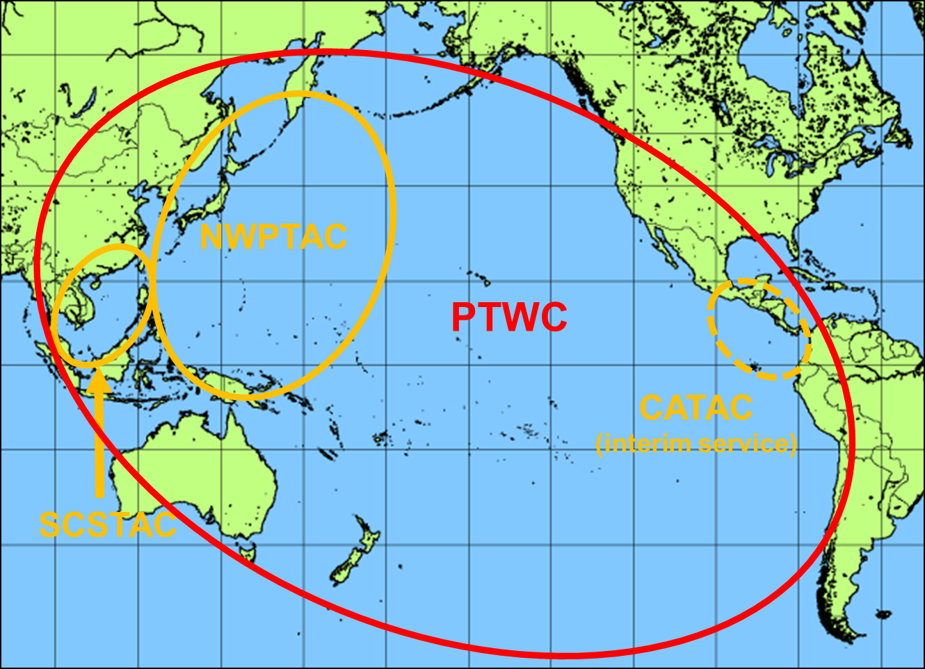
Four Tsunami Service Providers
Tsunami Service Providers in the Pacific
Four Tsunami Service Providers
Pacific Tsunami Warning Center (PTWC) operated by USA
Northwest Pacific Tsunami Advisory Center (NWPTAC) operated by Japan
South China Sea Tsunami Advisory Center (SCSTAC) operated by China
Central America Tsunami Warning Center (CATAC) operated by Nicaragua
The CATAC is fully operated (24hours/7days) on the interim service.

Slide 4
Related Events to the ICG/PTWS since February 2024
Date | Event | Venue
26 - 27 March 2024 | ICG/PTWS Steering Committee Meeting | Online
10 May 2024 | Seventh Meeting of the ICG/PTWS Regional Working Group on Tsunami Warning and Mitigation System in the Central America Region (ICG/PTWS WG-CA-VII) | Managua, Nicaragua
13 – 14 May 2024 | Pacific Island Country and Territories (PICT) Tsunami Ready Workshops | Port Vila, Vanuatu
14 – 17 May 2024 | Expert Meeting on Tsunami Sources, Hazards, Risk and Uncertainties Associated with Vanuatu, San Cristobal and New Britain Subduction Zones | Port Vila, Vanuatu
12 July 2024 | PTWS Working Group 3 Task Team Tsunami Ready Meeting | Online
30 – 31 July 2024 | Solomon Islands Tsunami Ready Workshop | Solomon Island
19-30 August 2024 | ITIC Training Programme on Tsunami Early Warning Systems and the PTWC Enhanced Products, Tsunami Evacuation Planning and Tsunami Ready Programme (ITP-TEWS-Chile) | Valparaiso, Chile
1 September – 30 November 2024 | Exercise Pacific Wave 2024 (PacWave24)
16 – 20 September 2024 | ICG/PTWS Steering Committee Meeting | Honolulu, Hawaii, USA
07 – 08 November 2024 | Twelfth Meeting of the ICG/PTWS Regional Working Group on Tsunami Warning and Mitigation System in the South China Sea Region (ICG/PTWS-WG/SCS-XII) | Jakarta, Indonesia

Slide 5
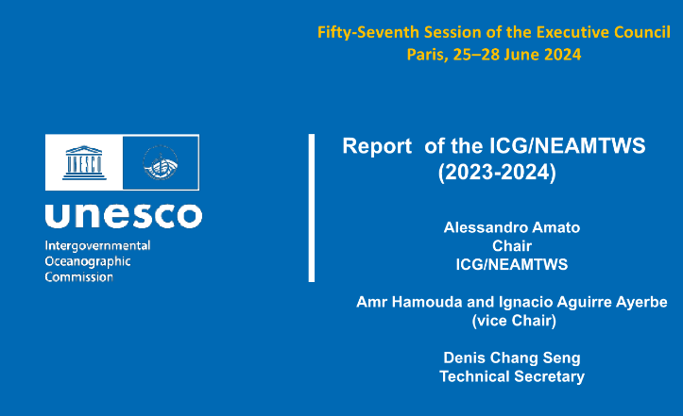
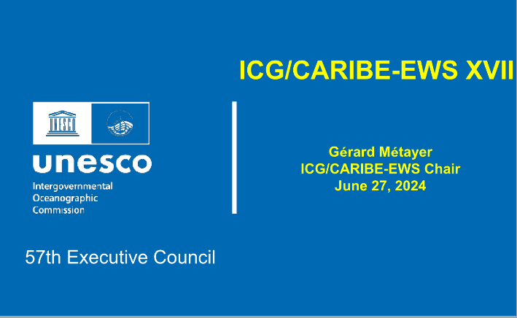
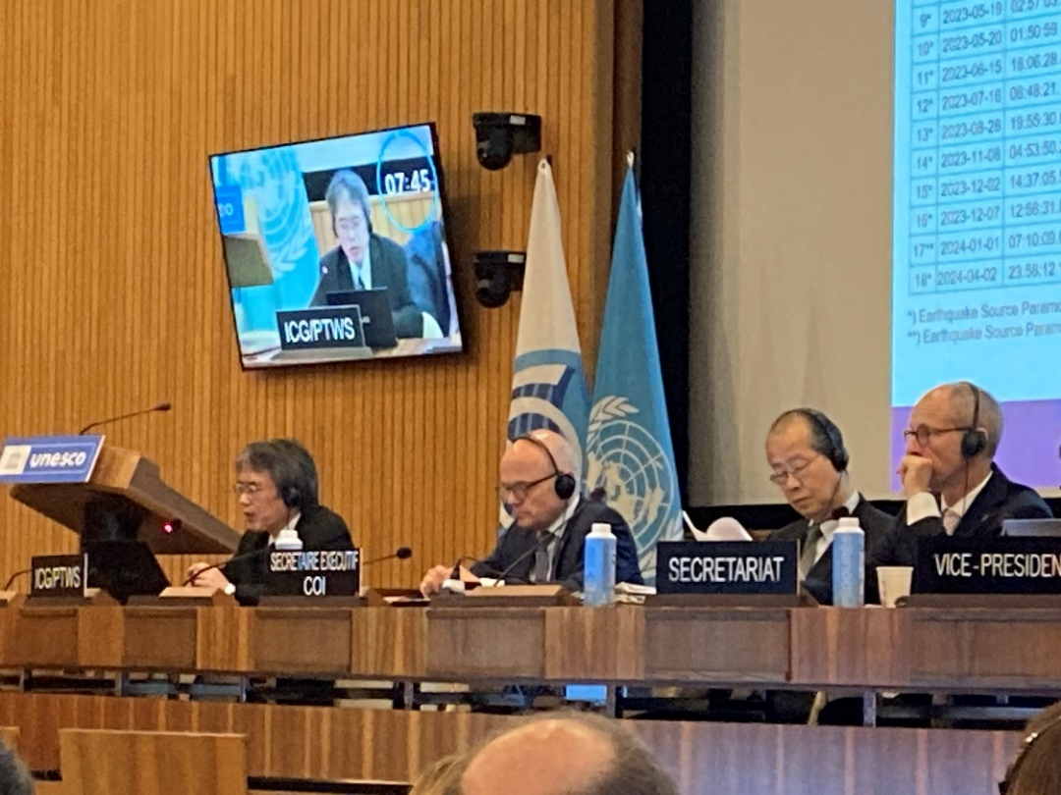

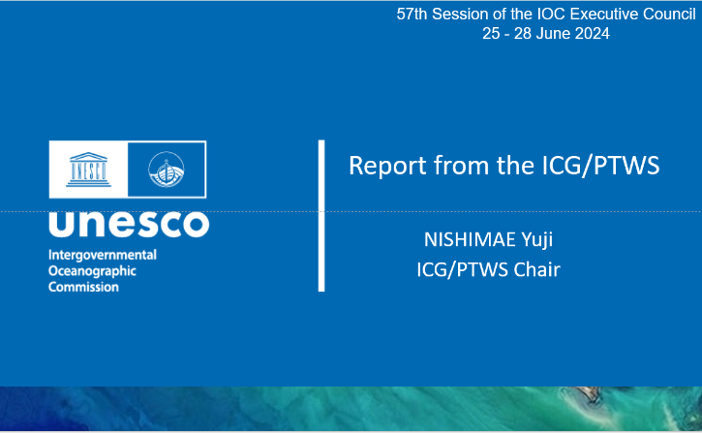
IOC EC 57th Session (25 June to 28 June 2024)
ICG and | Session | Reporter
ICG/CARIBE-EWS | XVII Session | Dr. Regina Browne on behalf the Chair
ICG/NEAMTWS | XVIII Session | Dr. Alessandro Amato
ICG/PTWS | XXX Session | Mr. Yuji Nishimae
TOWS-WG | XVII Session | Dr. Srinivasa Kumar Tummala

Slide 6
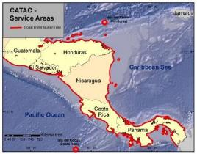
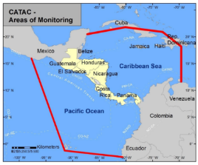
Start of the official full functional operation of the Central America Tsunami Advisory Center (CATAC)
Recommendation ICG/PTWS-XXX-6
Decides to admit the start of the official full functional operations of CATAC, starting after the IOC governing body meeting in 2024, with the specific starting date to be decided after the coordination with the ICG/CARIBE-EWS
Recommendation ICG/CARIBE-EWS-XVII.8
Recommends CATAC to continue with the implementation of EEW methods for the acceleration and improvement of the tsunami warning for Central America.
Recommends the use of additional methods for the transmission of CATAC’s products to its users.
Recommends that CATAC continues full functionality in an interim manner to be able to support the National Tsunami Warning Centers (NTWCs), Tsunami Warning Focal Points 18 (TWFPs), and emergency management authorities of Central America in addressing those challenges,
Further recommends the consideration of CATAC as a TSP in its XVIII Session in 2025 to enable the IOC Assembly to consider the final admission of CATAC as TSP in June 2025

Slide 7
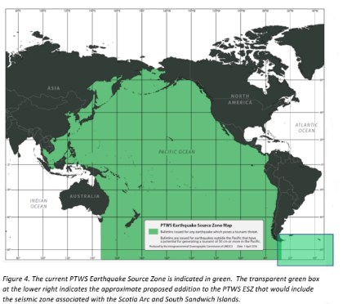
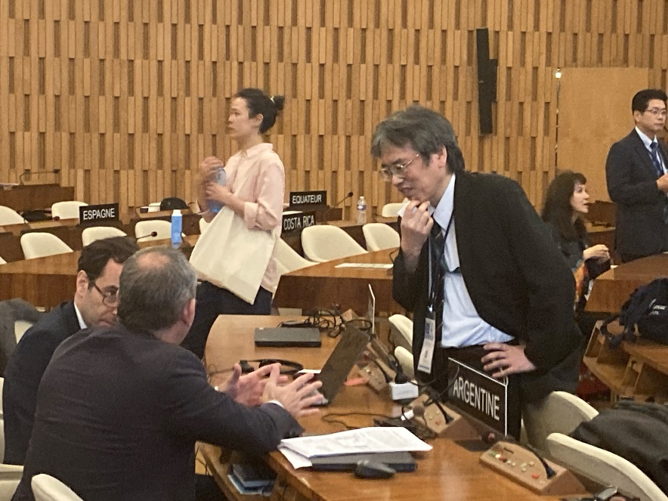
Expansion of the ICG/PTWS Earthquake Source Zone
Recommendation ICG/PTWS-XXX.3
Decides to expand the PTWS Earthquake Source Zone to include an area from 63º to 52º south latitude and from 72º to 18º west longitude to include the Scotia Arc and its adjacent seismic zones.
Adopted decision about the ESZ
The related paragraph to the Recommendation ICG/PTWS-XXX.3 was deleted.
Notes:
(i) the concerns of ICG/PTWS regarding the seismic activity in the Scotia Arc region as reflected in the Executive Summary of the ICG/PTWS-XXX (IOC/ICG/PTWS-XXX/3s);
(ii) that tsunami bulletins are issued by the PTWC for the ICG/CARIBE-EWS and ICG/PTWS for earthquakes in the Scotia Arc and its adjacent seismic zones for events fulfilling certain criteria as reflected in the IOC Technical Series, 130, ‘Tsunami Watch Operations-Global Service Definition Document’;
(iii) the need for the active engagement of Argentina with the ICG/CARIBE-EWS and ICG/PTWS regarding Argentinian Search and Rescue (SAR) and NAVAREA VI coordination responsibilities;

Slide 8
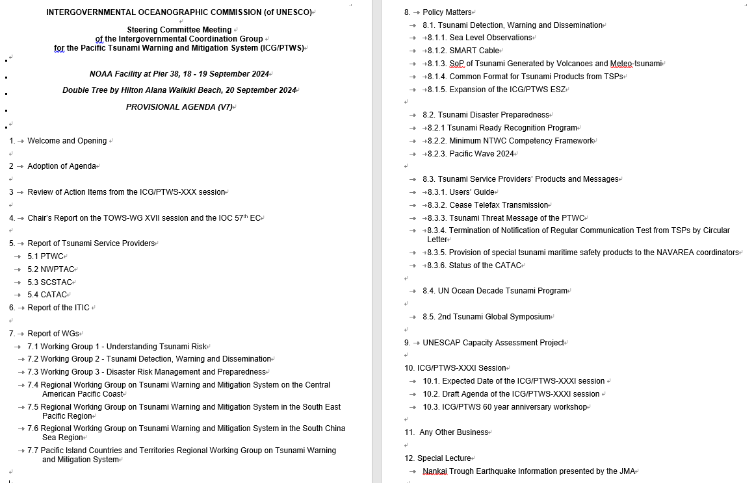
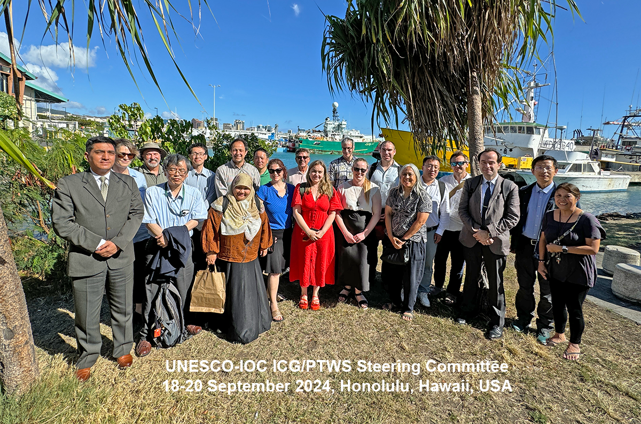
ICG/PTWS Steering Committee Meeting
Date:16 - 17 September TT and WG meeting
18 - 20 September SC meeting
Venue; Honolulu, Hawaii, USA

Slide 9
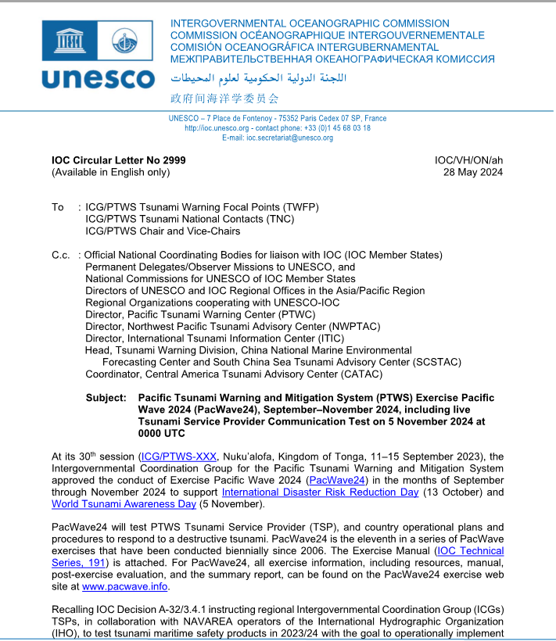
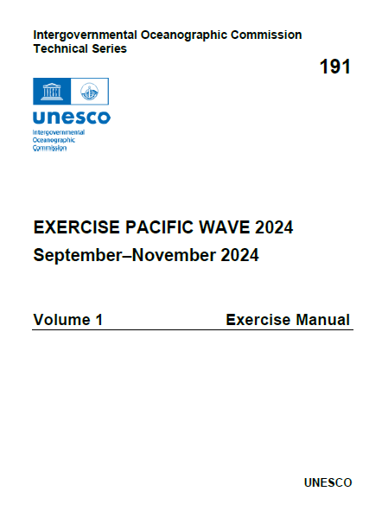
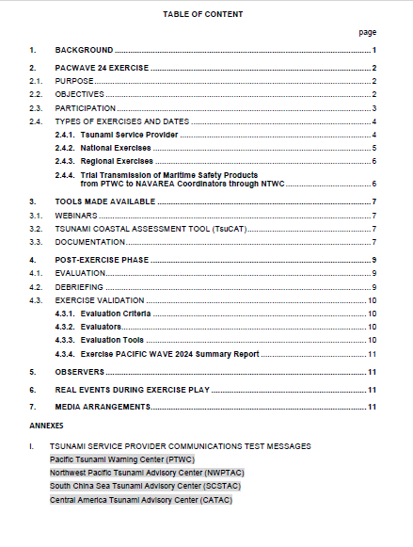

IOC Circular Letter No 2999 and the Exercise Manual (IOC Technical Series, 191)

Slide 10
Timeline Milestones (1)
KEY DATES
31 August 2024 | Deadline for PTWS Regional Working Groups to inform TSPs if products needed, copied to ITIC
1 September – 30 November 2024 | PacWave24 Member State national exercise
2 weeks before Regional Exercise (5 Nov.) | TSP products available on regional exercise webpage
5 November 2024 (0000 UTC) | Live TSP Communications Test
5 November 2024 (0100 UTC) | Live NAVAREA Coordinators Communication Test from PTWC through concerned NTWC
4 November 2024 | Pacific Island Countries and Teritories Regional Exercise
21 November 2024 | South East Pacific Regional Exercise
.

Slide 11
Timeline Milestones (2)
KEY DATES
15 December 2024 | Deadline for Member States to complete and submit online PacWave24 Post-Exercise Evaluation Surveys for: • Live TSP Communication Test •Live NAVAREA Coordinators Communication Test •National Exercise •Regional Exercise
15 December 2024 | Deadline for Submission of Regional Exercise Reports. •PICT Regional Exercise •SEP Regional Exercise
10 days prior to ICG/PTWS-XXXI (April 2025) | Draft PacWave24 Summary Report shared with Member States
30 June 2025 | Final PacWave24 Summary Report published and posted at http://www.pacwave.info/

Slide 12
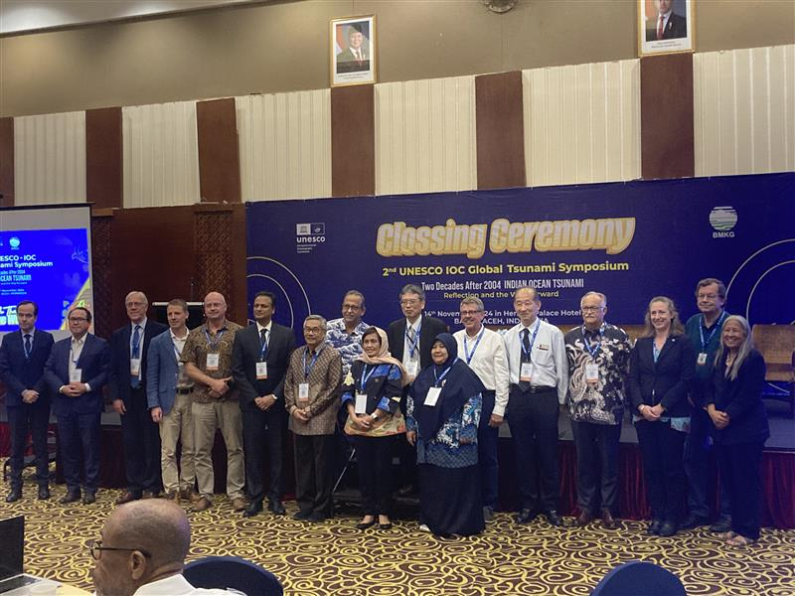

2nd Global Tsunami Symposium (11 – 14 November 2024)
Participants related to the ICG/PTWS
Mr. Yuji Nishimae (Chair)
Dr. Dakui Wang (Vice-Chair)
Dr. Charles McCreely (PTWC Director)
Dr. Laura Kong (ITIC Director)
Dr. Ocal Necmioglu (Technical Secretary)
Summary Statement
Banda Aceh Statement
Global Tsunami Warning and Mitigation: Building Sustainability for the next decade through Transformation and Innovation. UNESCO and its partners call on States and civil society to drastically step up their investments and efforts to strengthen Tsunami Early Warning Systems and achieve 100% of Tsunami Ready Communities across the world by 2030.

Slide 13


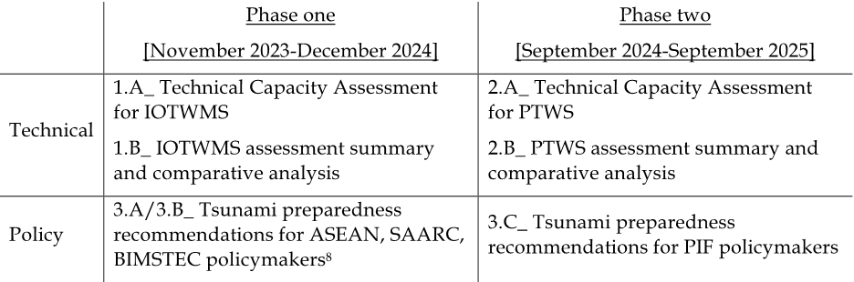
ESCAP Tsunami Preparedness Capacity Assessment
The key objectives of this assessment have been identified as follows:
To evaluate the existing capacity of the UNESCO-IOC Indian Ocean Tsunami Warning and Mitigation System (IOTWMS) (Phase I) and Pacific Tsunami Warning and Mitigation System (PTWS) (Phase II) and highlight the progress made since 2004 IOT and subsequent assessments.
To identify specific gaps and capacity development requirements at regional and national levels for strengthening the technical and policy aspects of the tsunami warning and mitigation systems in the region.
To provide recommendations for the next strategic phase of ESCAP's Trust Fund for Tsunami Disaster and Climate Preparedness, aiming to address the identified gaps through regional cooperation and mainstreaming science.
Output of the assessment

Slide 14
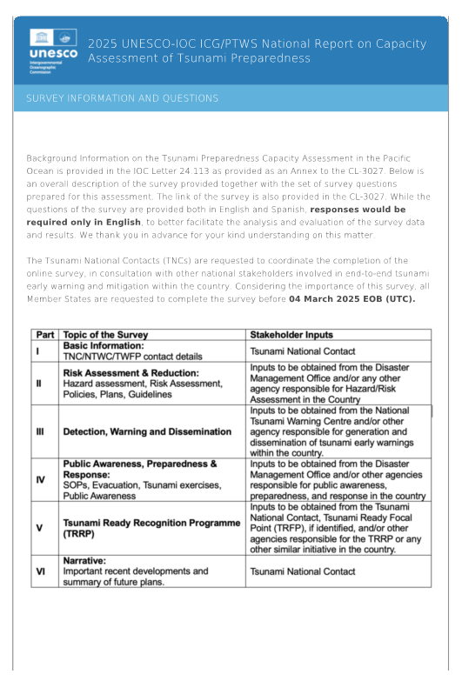
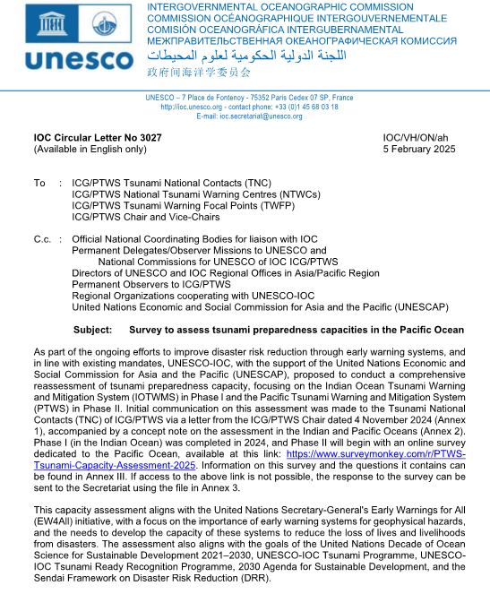
IOC CL No.3027 dated on 5 February
Questions and Answers for Survey by 4 March
ICG/PTWS XXXI
in April in Beijing
Validation Workshop in May in Manila
IOC/UNESCO 32nd Assembly in June
Technical report and Policy Report to be distributed to ICG/PTWS Member States in October
ESCAP Tsunami Preparedness Capacity Assessment (Timeline)
Steering Committee members will attend
Draft Technical Report and its Summary will be made available
A preliminary compilation of the survey results will be presented

Slide 15
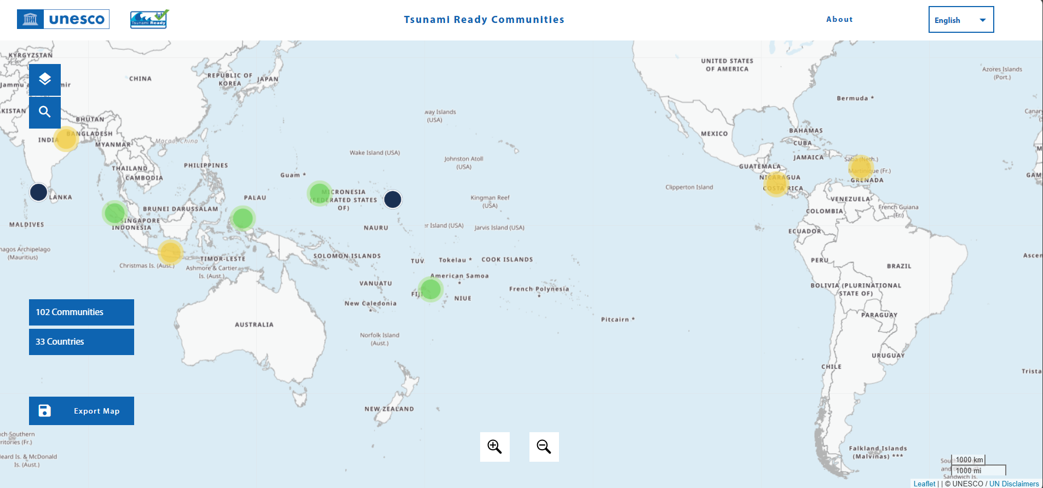
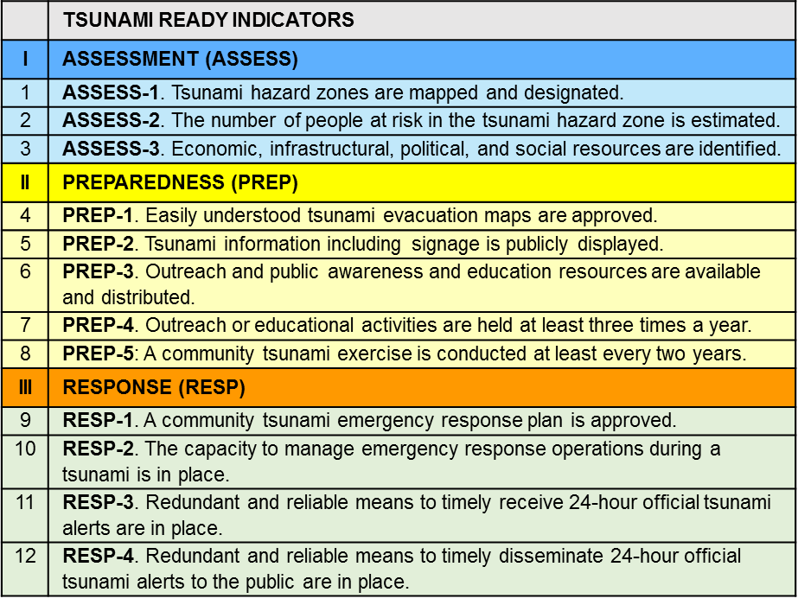
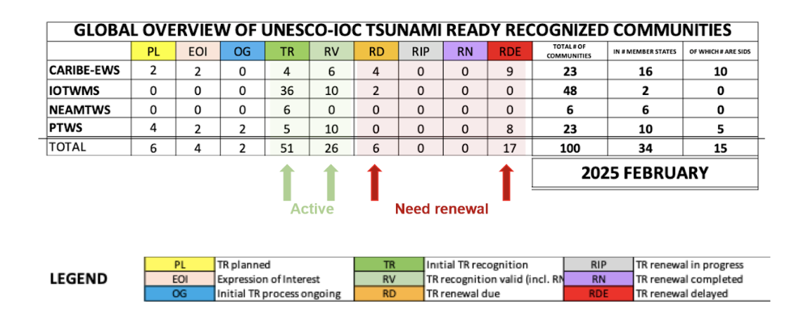
Promoting for the IOC Tsunami Ready Recognition Programme
Development of Equivalent approach guideline to the Tsunami Ready recognition program is progressive and the guideline will be submitted to the ICG/PTWS XXXI

Slide 16
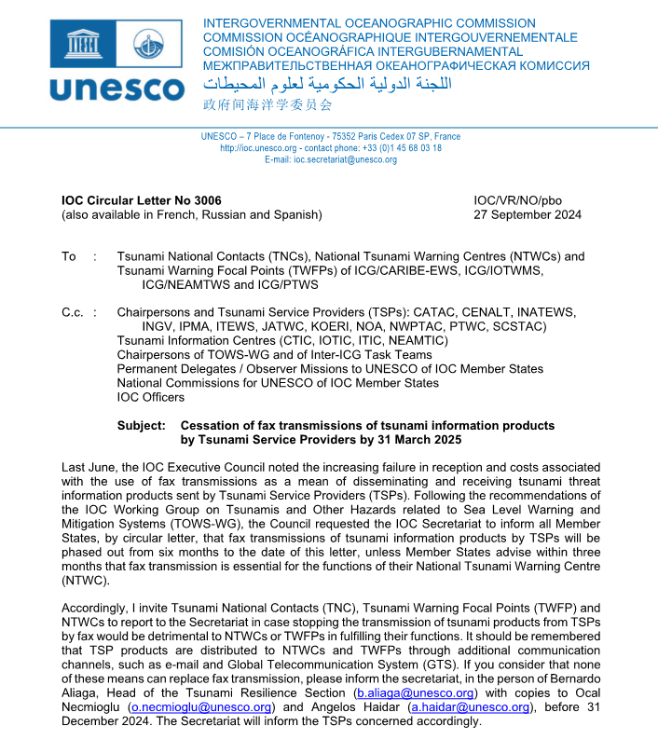
Cessation of fax transmissions of tsunami information products by Tsunami Service Providers by 31 March 2025 (IOC CL-3006)
IOC CL-3006 dated on 27 Sep. 2024 issued.
Last June, the IOC Executive Council noted the increasing failure in reception and costs associated with the use of fax transmissions as a mean of disseminating and receiving tsunami threat information products sent by Tsunami Service Providers (TSPs).
Following the recommendations of the IOC Working Group on Tsunamis and Other Hazards related to Sea Level Warning and Mitigation Systems (TOWS-WG), the Council requested the IOC Secretariat to inform all Member States, by circular letter, that fax transmissions of tsunami information products by TSPs will be phased out from six months to the date of this letter, unless Member States advise within three months that fax transmission is essential for the functions of their National Tsunami Warning Centre (NTWC).
The TSPs in the ICG/PTWS has stopped the fax transmission on 1 April 2025 except some member states that hope to continue the fax transmission.

Slide 17

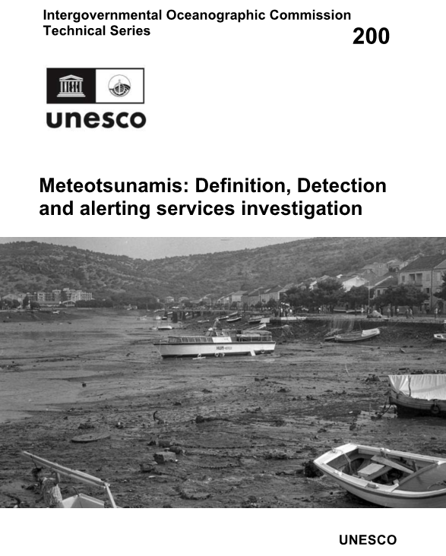
Reports from TOWS-WG TTTWO Ad Hoc Teams (TGV and Meteotsunam)
Monitoring and Warning for Tsunamis Generated by Volcanoes was published in February 2024 as IOC TS-183.
Meteotsunamis: Definition, Detection and alerting services investigation was published in February 2025 as IOC TS-200.

Slide 18
Introduction of the Meteotsunami Report
A ‘meteotsunami’ (heretofore ‘MT’) is a technical term that is sometimes used to describe long ocean waves generated by weather disturbances. It differs from tsunamis generated by undersea earthquakes, volcanic eruptions, or landslides. ‘MTs’ can form when a transitory weather disturbance moves over a body of water at roughly the depth-dependent tsunami phase velocity, creating ocean resonance and shallow water gravity waves that can either travel with (“forced” wave) or become disconnected from the source disturbance (“free” wave). For the purposes of this report, such weather-driven long waves are differentiated from tsunami-like waves induced by atmospheric acoustic-gravity or by gravity waves generated by rare cataclysmic events such as volcanic eruptions or meteor impacts.
Although these weather-driven long ocean waves are commonly referred to as ‘meteotsunami’ in academic circles, ‘meteotsunami’ is not an official term recognized and/or used by the World Meteorological Organization (WMO). Some National Meteorological and Hydrological Services (NMHS) have traditionally treated these phenomena within the same class of weather-driven coastal inundation events such as storm surges, seiches and other secondary tidal motions. Concern exists in the meteorological community that the introduction of the term ‘meteotsunami’ in forecasts and early warnings has the potential to confuse the public with imminent and potentially devastating tsunami events.

Slide 19
Recommendation at the TOWS-WG XVIII session
Organizational Relationships between TSPs, NTWC and Regional/National Hydro-Meteorological Services
Since 'MT' are hazards driven by weather conditions, warning responsibility lies solely with the servicing NMHSs.
However, since NWP-based 'MT' detection and forecast systems are imperfect, particularly as they do not normally provide direct tsunami detection and measurement, there are instances when monitoring tsunami-specific instruments such as deep ocean tsunameters and tsunami capable tide gauges can provide support to NMHSs.
And while operational tsunami forecast and warning activities such as IOC-designated Tsunami Service Providers (TSPs) or National Tsunami Warning Centres (NTWCs) will play no role in real-time operational alerting, the Ad Hoc Team on MT does advise that NMHS’ create working relationships with overlapping TSPs and/or NTWCs to become more familiar with monitoring tsunami-specific instrumentations.
The Group recommended the IOC Assembly at its 33rd session in 2025 recommend the regional ICGs:
to create relationships between National Meteorological and Hydrological Services (NMHS) and TSPs/NTWCs in order to ensure that tsunami-specific instrumentation including Tsunameters/DART® and ocean cable systems are correctly monitored and utilized for detection of meteotsunami;

Slide 20
9th ICG/PTWS – IUGG JTC Joint Tsunami Workshop
60th Anniversary of the ICG/PTWS - Past and Future -
1 April 2025 (Online)
Aims
7 April 2025 (Hybrid)
Aims
Guide 5-year research and development strategy for detection, monitoring and forecasting through:
1) Investigating challenges to achieving Decade forecasting goals
2) Exploring emergent data technologies to achieve Decade forecasting goals
3) Exploring emergent forecasting technologies to achieve Decade forecasting goals
4) Exploring impact-based forecasting including challenges faced when forecasting inundation and time-dependence
1) Recognition of contributions of 60 years of PTWS
2) Prospective of the future of PTWS
3) Tsunami DRR within the context of the IODTP – lessons from 60 years

