Slide 1
Agenda 4. Reports of the Inter-ICG Task Teams
Recommendation and Reports from
TT on Tsunami Watch Operation
TOWS-WG XVIII Session
24 - 25 February 2025
NISHIMAE Yuji
Chair of Task Team on Tsunami Watch Operation

Slide 2
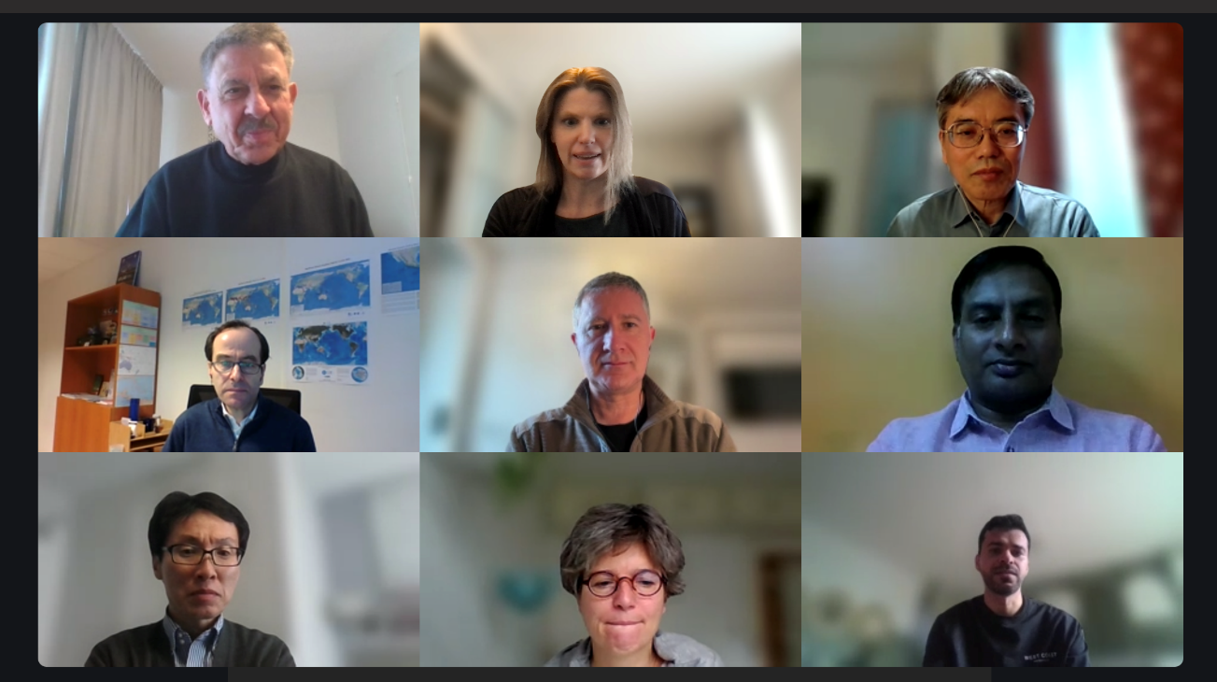
Members and Observers of TOWS Task Team on Tsunami watch Operation
Members:
Yuji Nishimae, Chair of TOWS-WG-TTTWO (PTWS/JMA)
Alessio Piatanesi (NEAMTWS/INGV)
Charles McCreery (CARIBE-EWS/NOAA-PTWC
Dakui Wang (PTWS/NMEFC)
Elizabeth Vanacore (CARIBE-EWS/PRSN)
Helene Hebert (NEAMTWS/CEA)
Jijjavarapu Padmanabham (IOTWMS/INCOIS)
Nasser Al Ismaili (IOTWMS/ DGMAN)
Observers:
Bruce Howe (SMART Cable JTF/U. of Hawaii)
Ceci Rodriguez Cruz (SMART Cable JTF/U. of Hawaii)
Takeshi Sato (JMA/Japan)
Fujiang Yu (NMEFC/China)
Carlos Zuniga (SHOA/Chile)
IOC Technical Secretary
Öcal Necmioglu

Slide 3
Agenda of the TTTWO Meeting
21 February 2025
Welcome and Introductions
Session Organisation (Logistics and agenda)
Discussion on the outcomes of the joint Meeting with TT-DMP
Review of TTTWO Action Items
Tsunami Watch Operations status and plans in all ICGs
Updates to Area of Coverage and ESZ Maps of the ICGs
Tsunami Service Provision Considerations for Events Outside ICG Earthquake Source Zones
Updates on Products for Maritime Community
Optimal Seismic and Sea level Monitoring Networks
Discussion on SOPs for Tsunamis Generated by non-seismic sources
Common Format for the TSPs’ Tsunami Products
Updates on the Global Service Definition Document
22 February 2025
Support for Ocean Decade Tsunami Programme Research & Development Implementation Plan
TT-TWO Work Plan
AOB
Recommendations and Report to the TOWS-WG (1115-1230)
3

Slide 4
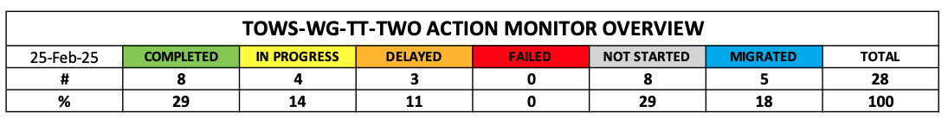
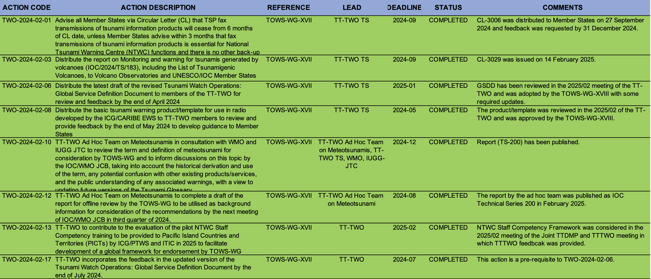
Review of Action Items
Completed
4

Slide 5
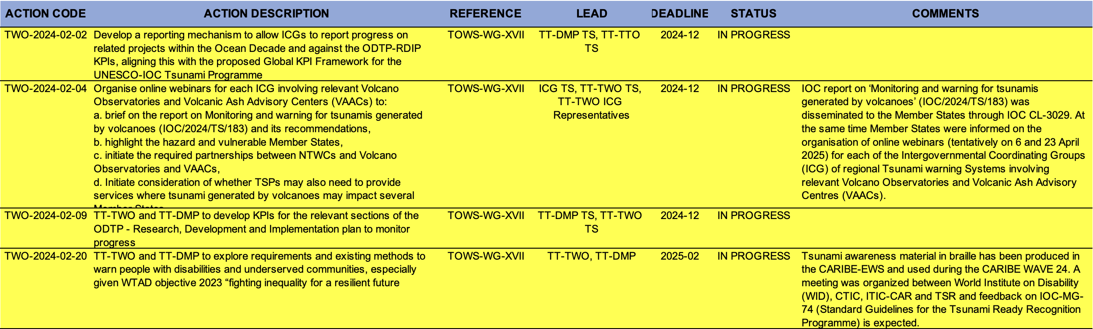
Review of Action Items
In Progress
5

Slide 6
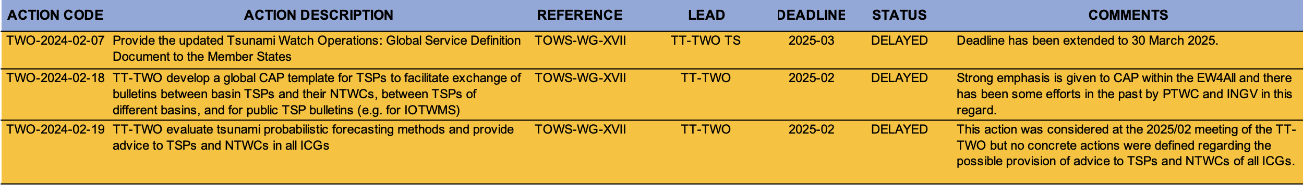
Review of Action Items
Delayed
6

Slide 7
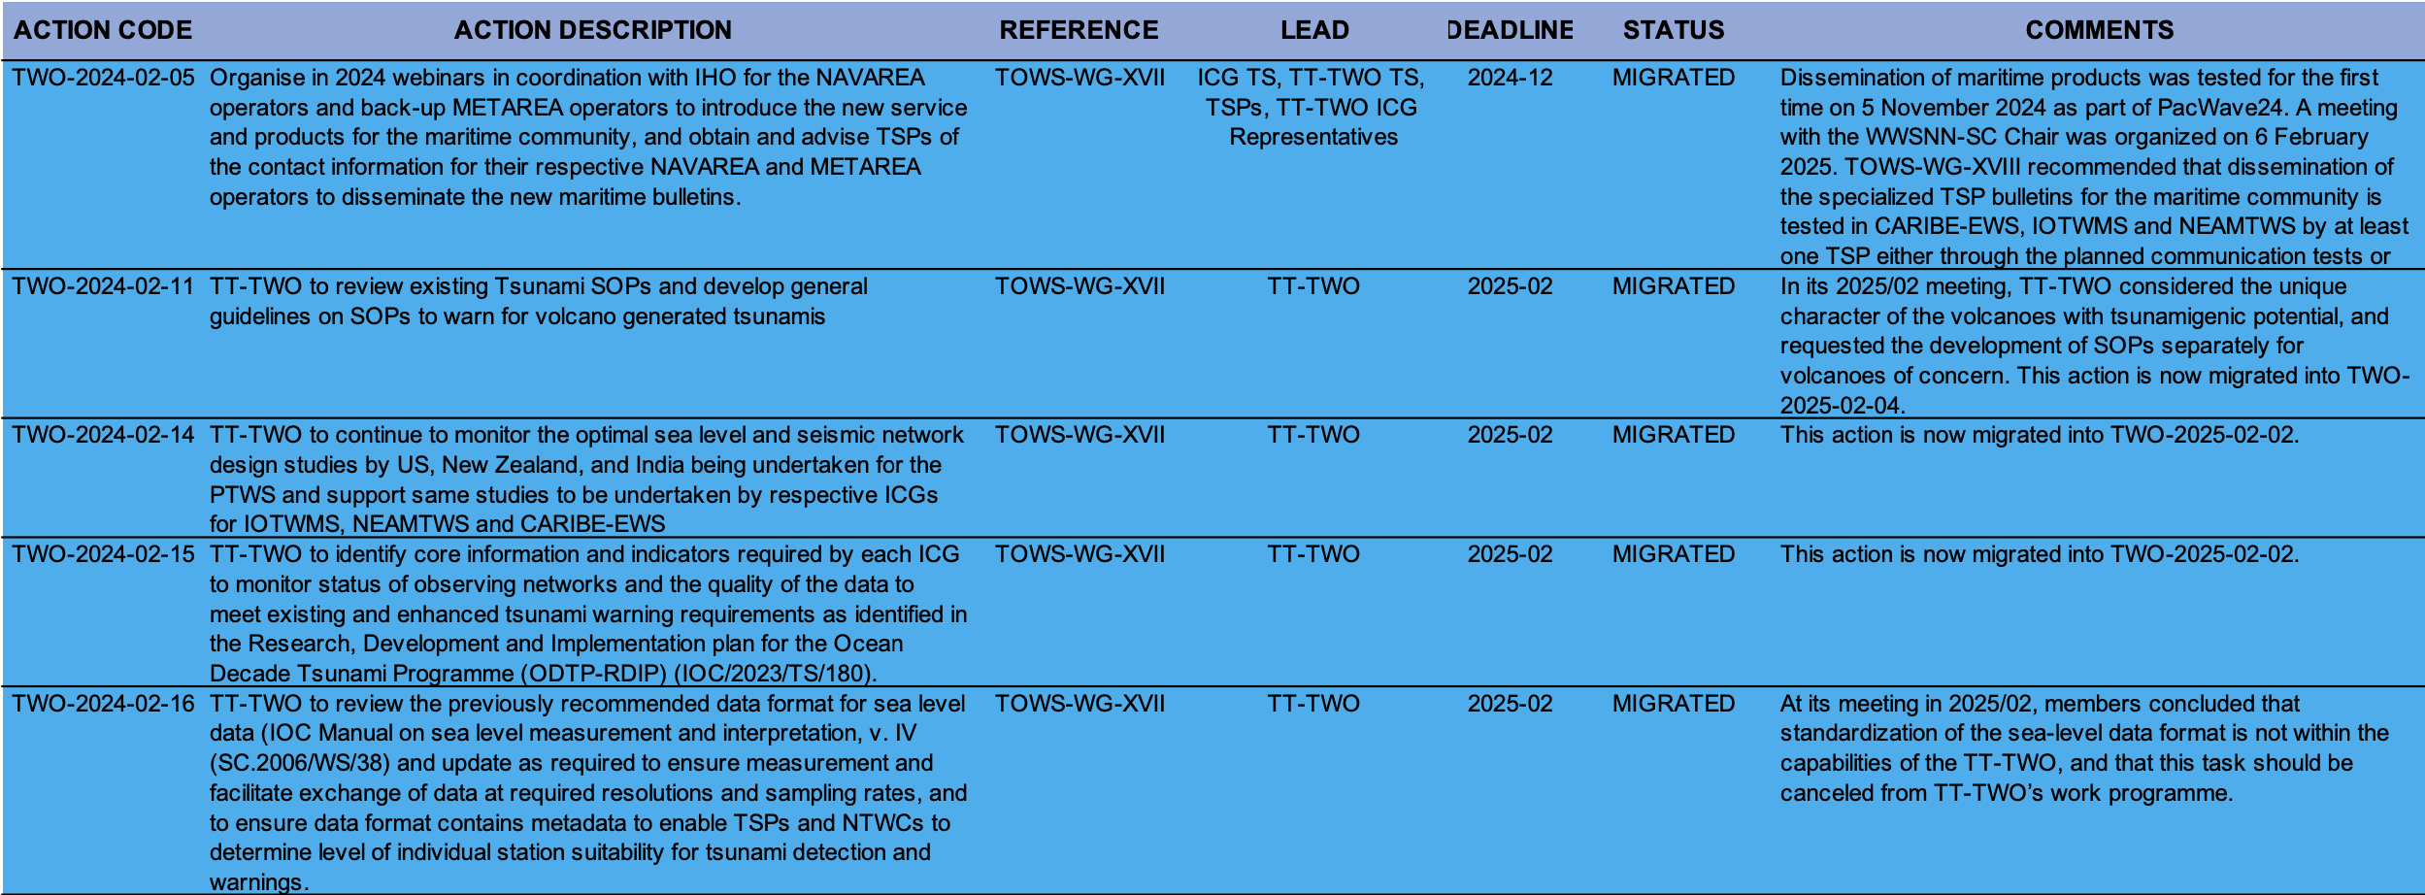
Review of Action Items
Migrated
7

Slide 8
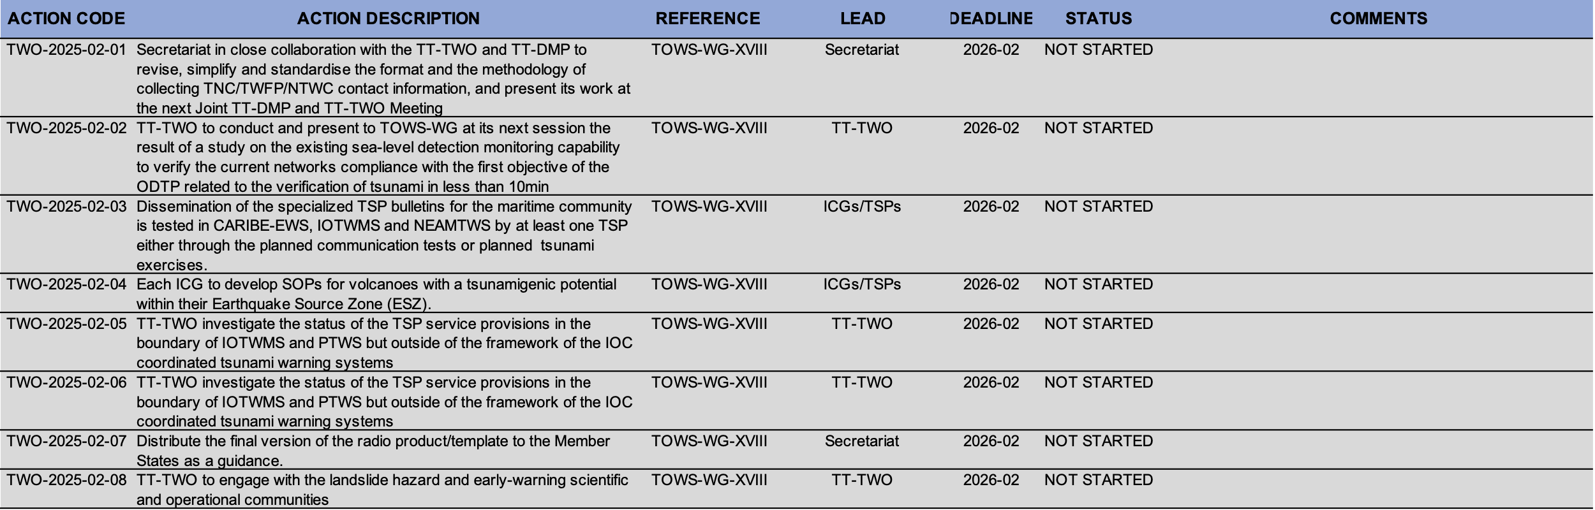
Review of Action Items
Not Started (New)
8

Slide 9
Recommendations
GLOBAL SERVICE DEFINITION DOCUMENT
ALL CLEAR MESSAGES
THREAT LEVELS
PRODUCTS FOR MARITIME COMMUNITY
FORECASTING METHODS
OFFSHORE TSUNAMI DETECTION AND OBSERVATIONS
RADIO MESSAGES
OPTIMUM SEA-LEVEL NETWORK
SOPs FOR TSUNAMI GENERATED BY VOLCANOES
METEOTSUNAMIS
TSUNAMIS GENERATED BY LANDSLIDE
CESSATION OF FAX DISSEMINATION
COMMON ALERTING PROTOCOL
TSUNAMI SERVICE PROVISION CONSIDERATIONS FOR EVENTS OUTSIDE ICG ESZ

Slide 10
1. GLOBAL SERVICE DEFINITION DOCUMENT
Recommendation to the ICGs
Notes the revisions on the Global Service Definition Document (GSDD);
Notes that in some ICGs segments of Area of Services are subject to the services of only one Tsunami Service Provider;
Further notes that the Global Area of Service map needs to be updated with the changes reflecting the Interim Service Provided by the Central America Tsunami Advisory Center / Nicaraguan Institute for Territorial Studies (CATAC/INETER) for both ICG/PTWS and ICG/CARIBE-EWS and CATAC service area (coasts of Costa Rica, El Salvador, Honduras, Guatemala, Nicaragua, Panama) should also be reflected;
Recommends establishing arrangements among TSPs within each ICG to ensure that service provision is ensured at all times for the full Area of Service of the ICG;
Recommends the approval of the revised GSDD with the updates as noted above;

Slide 11
2. ALL CLEAR MESSAGES
Recommendation to the ICGs
Noted the possible complexities and challenges which may arise from the All Clear messages issued by the NDMO/CPA of Member States and widely disseminated through social media, for others that may not have done so yet;
Notes that TSP’s responsibility is limited to inform that the threat has passes, whereas issuance of the “All Clear” message is the responsibility of the sovereign nation and its responsible institutions;
Recommended Member States NTWCs to work with national and local emergency management authorities to define the criteria for and institutions in charge of issuing the All Clear message, as recommended also in the GSDD;

Slide 12
3. THREAT LEVELS
Notes with appreciation the ICG/NEAMTWS XIX agreement to adopt the threat levels according to the revised draft version of the Global Service Definition Document (GSDD);
Further notes that preparation of a template for the implementation of these threat levels by the NEAMTWS TSPs;

Slide 13
4. PRODUCTS FOR MARITIME COMMUNITY
Recommendation to ICGs
Notes the continuous engagement of the TT-TWO in developing specialized TSP bulletins for the maritime community in consultation with the International Hydrographic Organisation (IHO) Sub-Committee on the World-Wide Navigational Warning Service (WWNWS-SC);
Notes with appreciation the trial transmission of a dummy message from the PTWC to the NAVAREA coordinators directly or through the NTWCs as part of PTWS Exercise Pacific Wave 2024 on 5 November 2024;
Notes that JATWC(Australia), ITEWC(India) as TSPs of the IOTWMS, respectively, have developed the required capabilities, while CEA as TSP of NEAMTWS aims at testing a maritime product during next NEAMWave in the Atlantic scenario;
Recommends that dissemination of the specialized TSP bulletins for the maritime community is to be tested in CARIBE-EWS, IOTWMS and NEAMTWS by at least one TSP either through the planned communication tests or tsunami exercises;
Further recommends that full operational implementation of such services by at least one TSP in each ICG takes place in 2025;
JATWC & ITEWC (TSP-Australia & India) have been included, as both TSPs have developed the required capabilities.

Slide 14
5. FORECASTING METHODS
Recommendation to ICGs
Notes the continuous need for more accurate and precise tsunami forecasts, especially in the complex tectonic context;
Notes the progress made within the ICG/NEAMTWS investigation and possible adoption of the tsunami probabilistic forecasting method by TSPs in NEAMTWS, which may represent an improvement over the method in use with the goal of reducing uncertainty and false alarms, particularly the forecasting methods that consider tsunami numerical modelling and uncertainty quantification;
Strongly recommends continuation of the investigation and the possibility to adopt tsunami forecasting methods, including probabilistic methodologies, toward impact-based forecasting, that could also post-disaster response, recovery and needs assessment processes;

Slide 15
6. OFFSHORE TSUNAMI DETECTION AND OBSERVATIONS
Recommendation to Member States
Notes the critical importance of offshore seismic and sea-level detection and observation instrumentation, such as DART/GPS buoys or cabled systems (e.g. SMART Cables);
Further notes the progress made in the ongoing project of the CAM SMART cable off Portugal, TAM TAM SMART cable between New Caledonia and Vanuatu, undersea cable installations being deployed by Indonesia and India;
Notes with appreciation the deployment of the Western Ionian Sea Infrastructure in 2023 in the Mediterranean, and the plans for deployment of 2 tsunami buoys in the Ionian sea during Summer 2025;
Recommends Member States to invest more in such offshore measurement systems, where possible with multi-hazard observational capabilities, serving the needs of earthquake seismology, meteorology and oceanography, where possible;

Slide 16
7. RADIO MESSAGES
Recommendation to the Secretariat
Notes the considerations and review of the TT-TWO on the basic tsunami warning product/template for use in radio developed by the ICG/CARIBE EWS;
Recommends that the final version of this product/template to be disseminated to the Member States as a guidance;
At _(XX:XX)_ local time a magnitude _X.X_ earthquake occurred at _Lat, Lon_ with a depth of _X_ km, _X_ km _Direction_ of _(Place)_. The _(NTWC)_ has issued a tsunami _(level)_ for _(Place)_.

Slide 17
8. OPTIMUM SEA-LEVEL NETWORK
Request to TT-TWO
Recalls that the first objective of the ODTP also requires provision of tsunami confirmation within 10 minutes or less of origin for the most at-risk coastlines;
Recognizes the need to conduct a study on in which areas this requirement is met and not met;
Recognizes huge costs to install and to maintain sea level stations, especially in remote areas.
Requests TT-TWO to conduct and present to TOWS-WG at its next session the result of this study with reference to the sea-level stations available in the IOC’s Sea Level Station Monitoring Facility;
Encourages the TT-TWO to also include in this study an indicative assessment on possible locations of the future sea-level station monitoring installations to ensure that this requirement is met;

Slide 18
9. SOPs for Tsunami Generated by Volcanos
Recommendation to the ICGs
Notes that Hunga Tonga Hunga Ha’apai Volcano Permanent Monitoring and Warning Procedures of the Pacific Tsunami Warning Center (OTWC) ((IOC/2024/TS/188) was disseminated to Member States through IOC CL-2984;
Notes with appreciation that the IOC report on ‘Monitoring and warning for tsunamis generated by volcanoes’ (IOC/2024/TS/183) was also disseminated to the Member States through IOC CL-3029;

Slide 19
9. SOPs for Tsunami Generated by Volcanos (continued)
Recommendation to the ICGs
Also notes with appreciation that at the same time Member States were informed on the organisation of online webinars (tentatively on 6 and 23 April 2025) for each of the Intergovernmental Coordinating Groups (ICG) of regional Tsunami warning Systems involving relevant Volcano Observatories and Volcanic Ash Advisory Centres (VAACs) to:
brief on the report on ‘Monitoring and warning for tsunamis generated by volcanoes’ (IOC/2024/TS/183) and its recommendations,
highlight the hazard and vulnerable Member States,
initiate the required partnerships between National Tsunami Warning Centres (NTWC) and Volcano Observatories and VAACs,
initiate consideration of whether Tsunami Service Providers may also need to provide services where tsunami generated by volcanoes may impact several Member States.

Slide 20
9. SOPs for Tsunami Generated by Volcanos (continued)
Also notes the challenges to develop general guidelines on SOPs to warn for volcano generated tsunamis due the unique characteristics and mechanisms related to their tsunamigenic potentials;
Recommends each ICG to develop SOPs for volcanoes with a tsunamigenic potential within their Earthquake Source Zone (ESZ);
Recommendation to the Member States
Recommended Member States to consider deployment of sea level gauges close to each identified volcano with tsunamigenic potential, with real-time continuous data transmission and 1 sec sampling 1cm accuracy for automatic detection purposes;

Slide 21
10. Meteotsunami
Recommendation to the ICGs
Notes with appreciation that the IOC report on ‘Meteotsunamis: definition, detection and alerting services investigation’ (IOC/2025/TS/200) was disseminated to the Member States;
Notes that since meteotsunami are hazards driven by weather conditions, warning responsibility lies solely with the servicing NMHSs and TSPs or NTWCs play no role in real-time operational alerting;
Notes that tsunami-specific instrumentation including DART and ocean cable system can play a supporting role in terms of detection of meteotsunami;
Recommends each ICGs to create relationships between NMHS’ and TSPs/NTWCs in order to ensure these instruments are correctly monitored and utilized for detection of meteotsunami.

Slide 22
11. TSUNAMIS GENERATED BY LANDSLIDE
Recommendation to TT-TWO
Notes that tsunami risk can be considered on the rise as a result of landslides due to increased rainfall or glacial melting as a result of global warming/climate change;
Further notes that tsunamis generated by landslides (in a non-volcanic setting) remains as a challenge for the Global Tsunami Warning and Mitigation System (GTWMS);
Note: GTWMS (Global Tsunami Warning and Mitigation System); This is not agreed abbreviation yet but maybe this TOWS-WG meeting could provide an opportunity to agree on the use of this abbreviation.
Recommends the Task Team on Tsunami Watch Operations to include tsunamis generated by the submarine and subaerial landslides in its work programme and engage with the landslide hazard and early-warning scientific and operational community to address the requirements of the first objective of the ODTP to develop the warning systems’ capability to issue actionable and timely tsunami warnings for tsunamis from all identified sources to 100 percent of coasts at risk;

Slide 23
12. CESSATION OF FAX DISSEMINATION
Recommendation to the TSP(s)
Noted that the IOC CL-3006 on the Cessation of fax transmissions of tsunami information products
by Tsunami Service Providers by 31 March 2025 was issued on 27 September 2024,
Further noted that only one Member State requested the need to continue receipt of tsunami information products through fax,
Noted that fax transmissions of tsunami information products will en by Tsunami Service Providers by 31 March 2025, except for those Member State who requested the continuation of this service, for which individual arrangements between the concerned Member State and respective TSP(s) will be established bilaterally;

Slide 24
13. COMMON ALERTING PROTOCOL
Request to TT-TWO
Notes that the Common Alerting Protocol (CAP) is the international standard format for emergency alerting and public warning, designed for all hazards, which can be used for exchanging multi-hazard emergency alerts and public warnings over all kinds of information and communications technology;
Also notes that CAP is now widely used in EWS and 91% of the world’s population lives in a country that is implementing CAP ;
Recognizes that the advancement of CAP implementation globally represents a significant milestone in the Early Warnings for All (EW4All) initiative, and the fact that CAP can be considered as the bridge connecting “observations, monitoring, analysis and forecasting” to “warning dissemination and communication”.
Notes that NOAA/PTWC in 2013 provided details and rationale for an initial version of a tsunami profile for CAP;
Requests the TT-TWO to develop a global CAP template for TSPs to facilitate exchange of bulletins between basin TSPs and their NTWCs, between TSPs of different basins, and for public TSP bulletins, to be presented and approved by the TOWS-WG at its next session;

Slide 25
14. TSUNAMI SERVICE PROVISION CONSIDERATIONS FOR EVENTS OUTSIDE ICG ESZ
Request to TT-TWO
Noted that there is a region in the boundary of IOTWMS and PTWS but outside of the framework of the IOC coordinated tsunami warning systems,
Requested the TT-TWO investigate the status of the TSP service provisions in this region.

Slide 26
TT-TWO WORK PLAN
DELAYED:
Provide the updated Tsunami Watch Operations: Global Service Definition Document to the Member States
TT-TWO develop a global CAP template for TSPs to facilitate exchange of bulletins between basin TSPs and their NTWCs, between TSPs of different basins, and for public TSP bulletins (e.g. for IOTWMS)
TT-TWO evaluate tsunami probabilistic forecasting methods and provide advice to TSPs and NTWCs in all ICGs

Slide 27
TT-TWO WORK PLAN (continued)
ONGOING:
Develop a reporting mechanism to allow ICGs to report progress on related projects within the Ocean Decade and against the ODTP-RDIP KPIs, aligning this with the proposed Global KPI Framework for the UNESCO-IOC Tsunami Programme
Organise online webinars for each ICG involving relevant Volcano Observatories and Volcanic Ash Advisory Centers (VAACs)
TT-TWO and TT-DMP to develop KPIs for the relevant sections of the ODTP - Research, Development and Implementation plan to monitor progress
TT-TWO and TT-DMP to explore requirements and existing methods to warn people with disabilities and underserved communities, especially given WTAD objective 2023 “fighting inequality for a resilient future

Slide 28
TT-TWO WORK PLAN (continued)
NOT STARTED (NEW ACTION ITEMS):
Secretariat in close collaboration with the TT-TWO and TT-DMP to revise, simplify and standardise the format and the methodology of collecting TNC/TWFP/NTWC contact information, and present its work at the next Joint TT-DMP and TT-TWO Meeting
TT-TWO to conduct and present to TOWS-WG at its next session the result of a study on the existing sea-level detection monitoring capability to verify the current networks compliance with the first objective of the ODTP related to the verification of tsunami in less than 10min
Dissemination of the specialized TSP bulletins for the maritime community is tested in CARIBE-EWS, IOTWMS and NEAMTWS by at least one TSP either through the planned communication tests or planned tsunami exercises.

Slide 29
TT-TWO WORK PLAN (continued)
NOT STARTED (NEW ACTION ITEMS):
Each ICG to develop SOPs for volcanoes with a tsunamigenic potential within their Earthquake Source Zone (ESZ).
TT-TWO investigate the status of the TSP service provisions in the boundary of IOTWMS and PTWS but outside of the framework of the IOC coordinated tsunami warning systems
Distribute the final version of the radio product/template to the Member States as a guidance.
TT-TWO to engage with the landslide hazard and early-warning scientific and operational communities

