Slide 1
Ocean Decade Tsunami Program (ODTP)
5th Meeting Report
Silvia Chacón Barrantes
Chair a.i.

Slide 2
Monitoring and tracking progress in implementing the ODTP endorsed projects
COASTWAVE (NEAM)
4 UNESCO-IOC Tsunami Ready Recognized communities, with three additional countries in the final stages of recognition, pending the formation of their National Tsunami Ready Boards.
5 new SLS and 5 new seismic devices
Phase II started: targeting additional TR communities
GREAT (Global Real-Time Early Alarm for Tsunami)
New software developed based on hydroacustic data. Currently testing and improving
Access to CTBTO real-time hydroacustic data
SLSMF
Steady increase of usage and stations
New DART buoys added
Automated RT QC procedure

Slide 3
Monitoring and tracking progress in implementing the ODTP endorsed projects
Tsunami preparedness at protected wild areas in Costa Rica
2 new TR communities adjacent to Protected Areas in Costa Rica and 6 more working in indicators
Working on guides to replicate further and ensure sustainability
Open GTS
Succeeded on Uncrewed surface vehicle (USV) data exchange
Supported pilot with Science Research on Commercial Ships
Working with OceanSync to pilot exchange of weather data from commercial ships
Placed data from 45 fishing vessels onto the GTS
Integrating Coastal Hazard Warning Systems for Tropical Americas and Caribbean (TAC)
IOCARIBE document Building a Roadmap for the implementation of the Ocean Decade in the Tropical Americas and Caribbean (TAC) Region was presented at the Latin American and Caribbean Open Science Forum in San Andres, Colombia

Slide 4
Monitoring and tracking progress in implementing the ODTP endorsed projects
Potential coastal area of Indonesia Mountain Anak Krakatau, Sunda Strait
Tsunami evacuation maps
Awareness training
Decade Collaborative Centre for Coastal Resilience
Co-led the writing of Vision 2030 white paper on Coastal Resilience
Co-led the writing of the First European Assessment Report on Sea Level Rise
Several Stakeholder Engagement, Equitable Education, Environmental Justice and Cross-Cutting Activities

Slide 5
Monitoring and tracking progress in implementing the ODTP endorsed contributions
US Tsunami Contributions to IOC Tsunami Part 1 and 2
Risk Knowledge
Tsunami hazard assessments completed for Caribbean SIDS
Tsunami inundation studies conducted in Pacific SIDS
Additional assessments to be conducted in Honduras, St. Lucia, Kiribati, Samoa, Solomon Is. And Vanuatu
Monitoring and detection
Successfully testing of USGS GNSS for source detection
Will modernize and replace DART equipment
Continue supporting SMART cable research and exploration
Developing landslide generated tsunami monitoring technology and best practices
Warning and Dissemination
Continue working on operationally align the two TWC, TBC in 2026
Training, technical assistance and materials provided to Caribbean and Pacific SIDS
Preparedness and Response
Supported the development of NTWC Minimum Staff Competency Framework
ITIC leading developing of training TWC staff core competency
Supported Caribbean and Pacific on Tsunami Evacuation Maps, TR recognitions
Development and distribution of Tsunami Rules in Braille

Slide 6

Monitoring and Tracking Progress Tool
AIM: To develop Single Tsunami Performance M &T Tool. From this tool, users can choose ICG-KPIs and or ODTP-KPIs depending on application and use.
Proposed Approach
  ICG-KPI: The foundation to build the new Tsunami Performance Monitoring & Tracking Tool.
  ODTP-RDI-KPI: Align/mapping of ODTP-RDI Indicators onto the ICG-KPI.
  Others: Align/mapping other KPIs (e.g. Vision 2030 White Paper
Seamless connections- granular (ICG) operational technical level to macro-policy making level (OD/ Sendai, SDG) , ensuring efficiency while avoiding duplication in assessments and reporting.
STEP 2
STEP 1
Original ODTP-RDI-KPI
ICG-KPI
STEP 3
Other KPI Vision 2030
ICG-KPI
SFDRR-KPI
ODTP -KPI
OD-KPI
New ODTP RDI KPI for M & T

Slide 7
Monitoring and Tracking Tool Discussion,
the SC:
Appreciated the progress made in developing a comprehensive Tsunami Programme -ODTP–RDI Performance Monitoring and Tracking Tool with clear SMART (Specific, Measurable, Achievable, Relevant, and Time-bound) indicators and actions
Recommended to issue Circular Letter for TNCs, but also TWFPs, NTWCs and IOC-FPs
Prefers an ICG-based approach
Requested clarifications on procedures for MS belonging to several ICGs
Proposed to select a sample of MS to test the tool, including MS belonging to several ICGs

Slide 8
Project (1):- FACING AND ADDRESSING OCEAN HAZARDS TOGETHER
FOCUS: HAZARD / RISK KNOWLEDGE/GOVERNANCE AND COMMUNICATION
Challenge 6: Coastal Resilience
Institution: Ocean University of China
Host: ODTP
Lead: Rui Bao
Country: China
Budget: 500,000 USD
Summary:
The project “Facing and Addressing Ocean Hazards Together” (FACT) is to engage more renowned international marine scientists and individuals concerned about the oceans, including science enthusiasts, especially young people, to form a scientific community; jointly carry out relevant international exchanges and cooperation to address potential marine disasters and propose response measures. The FACT will Organize regular forums to disseminate conclusions and early warnings from the scientific community to the public, influencing decision-makers on major ocean affairs and helping them make informed and impactful decisions in responding to marine Hazards.
Start and End: 01/01/2025 -31/12/2029
Basin: North Pacific Ocean, South Pacific Ocean. Indian Ocean, Arctic Ocean, Mediterranean Sea

Slide 9
Project (2):- EPOS THEMATIC CORE SERVICES TSUNAMI
FOCUS: RISK KNOWLEDGE, WARNING & DESSIMINATION /RESEARCH AND ITS PRACTICAL APPLICATIONS- HIGH-QUALITY AND FAIR DATA, SERVICES, AND SCIENTIFIC PRODUCTS )
Challenge 6: Coastal Resilience
Institution: GFZ German Research Centre for Geosciences
Host: ODTP
Lead:Andrey Babeyko
Country: Germany
Budget: 660,0000
Summary:
In February 2024, 18 European institutions from 11 countries signed a Consortium Agreement to establish Thematic Core Services TSUNAMI (https://tsunamidata.org and https://www.epos-eu.org/tcs/tsunami) under the auspices of EPOS-ERIC (European Plate Observing System, https://epos-eu.org). The mission of TCS-TSUNAMI is to promote tsunami research and its practical applications by providing open access to high-quality and FAIR data, services, and scientific products for a broad range of stakeholders, including researchers, disaster risk management and early warning practitioners, private sector, etc. The products and services (currently over 40) are defined in four categories: Pillar 1 – Support to Tsunami Service Providers; Pillar 2 – Tsunami-related datasets and observations; Pillar 3 – Numerical tools and workflows for tsunami simulations; Pillar 4 – Hazard and risk products.
Start and End:15/02/2024 -14/02/2030
Basin:North Atlantic Ocean, Mediterranean Sea, Black Sea, Marmara Sea

Slide 10
PROJECT (3):- SUSTAINING AGITHAR TOWARDS A GLOBAL TSUNAMI MODEL
FOCUS: RISK KNOWLEDGE/ PROBABILISTIC TSUNAMI HAZARD AND RISK ASSESSMENT
Challenge 6: Coastal Resilience
Institution: Universität Hamburg, Dept. of Mathematics, Hamburg, Germany
Host: ODTP
Lead:Jörn Behrens
Country: Germany
Budget: 120,000
Summary:The COST Action AGITHAR (running from 2019 through 2023) developed community standards and best practices for probabilistic tsunami hazard and risk assessment, necessary for preparedness, mitigation, and planning for tsunami disaster risk reduction. These practices will form the basis for the Global Tsunami Model (GTM) network of experts, organized in an association with a sustained business model, giving advice to public entities and decision makers, insurance and reinsurance industry, port authorities, and other diverse stakeholders.
Start and End:01/11/2023-1/10/2024
Basin:North Atlantic Ocean, Mediterranean Sea

Slide 11
PROJECT (4) : SCALING-UP AND STRENGTHENING THE RESILIENCE OF COASTAL COMMUNITIES IN THE NORTH-EASTERN ATLANTIC AND MEDITERRANEAN REGIONS TO THE IMPACT OF TSUNAMIS AND OTHER SEA LEVEL-RELATED COASTAL HAZARDS (COASTWAVE 2.0) APPROVED 18 DEC 2024
FOCUS: RISK KNOWLEDGE, MONITORING AND DETECTION, WARNING & DESSIMINATION, PREPAREDNESS AND RESPONSE–CAPACITY DEVELOPMENT
Challenge: Coastal Resilience
Institution: IOC
Host: UN31. The Ocean Decade Tsunami Programme
Lead: Denis Chang Seng
Country: France
Budget: 1.5 Million
Summary: The CoastWAVE project Phase-II (CostWAVE 2.0) is aimed at Scaling-Up and Strengthening the Resilience of Coastal Communities in the North-Eastern Atlantic and Mediterranean Regions to the Impact of Tsunamis and Other Sea Level-Related Coastal Hazards. It will build collective and common capacities in tsunami hazard assessment and evacuation mapping using probabilistic approaches. It will track changes in the level of tsunami awareness and risk perceptions. It will install additional tsunami detection, monitoring and alerting systems and scale up UNESCO-IOC Tsunami Ready Recognized communities in existing and new countries. A key outcome is to engage and create dialogues with multi-stakeholders and users involved in coastal resilience in a multi-hazard/risk context with the aim to create shared prevention and resilient preparedness for ocean related hazards to reduce their impact through better understanding and integration of tools, strategies and polices
Start and End: 1 July 2024-1 July 2026
Basin: NEAM

Slide 12
PROJECT (5): INCOIS SUBMARINE CABLE MULTI-PARAMETER OBSERVATORY
FOCUS: MONITORING AND DETECTION / SMART CABLE-SUSTAINABLE OBSERVATION
Challenge: Coastal Resilience
Institution: INCOIS, University College London (UCL), London and Indian National Centre
Host: ODTP
Lead: Srinivas Kumar?
Country: India
Budget:5959835
Summary:
This proposed initiative, the “INCOIS Submarine Cabled Multi-Parameter Observatory (ISCO)”, aims to undertake long-term observation of various oceanographic and geophysical parameters for climate research as well as operational applications related to tsunami and storm surge early warning system. The ISCO project is designed to include the installation of a submarine cable approximately 150 km in length, situated west of Wandoor in the Andaman & Nicobar Islands. The infrastructure will comprise two science nodes along the cable, equipped with oceanographic and geophysical sensors positioned at water depths ranging from 2000 to 2500 meters. Additionally, a landing station will be established at the INCOIS observatory in Wandoor, with a control center for real-time data acquisition and monitoring at the INCOIS headquarters in Hyderabad. This observatory is expected to play a transformative role in understanding the dynamic processes occurring in the ocean, particularly in relation to seismic activity and its potential to trigger tsunamis. As INCOIS being the lead implementing agency for this project, we are keen to explore opportunities for collaboration and seek endorsement from international bodies such as the UNESCO-IOC. We believe that such partnerships will be instrumental in leveraging global expertise and ensuring the successful implementation and operation of this observatory. Also, we would like to take your consent before applying for the opportunity of Ocean Decade endorsement for the ISCO. Upon your positive feedback, we can proceed towards the formal submission of the request to be endorsed.
Start and End:, 4 years
Basin: N-Indian Ocean

Slide 13
Project (6) : Tsunami Ready Odisha (TRO)
FOCUS: RISK KNOWLEDGE, PREPARDENESS AND RESPONSE/ CAPACITY DEVELOPMENT
Challenge: Coastal Resilience
Institution: INCOIS
Host: ODTP
Lead: Srinivas Kumar?
Country: India
Budget: 67335
Summary: Focusing on fully on “Tsunami Ready Recognition Programme” implementation in all coastal villages of Odisha, TRO is fully aligned with the Ocean Decade Tsunami Program (ODTP, UN-31), by emphasizing community resilience, multi-hazard early warning system and integration of scientific knowledge into practical applications for coastal protection. Working in close synergy with IOC-UNESCO’s ICG/IOTWMS and IOTIC, these members play key role in participatory approach for advising on implementation, ensuring that the project’s objectives are closely aligned with the IOC initiatives. The primary objective of this initiative is to improve the preparedness of coastal communities in Odisha, ensuring they are well-equipped to respond to tsunami risks and reduce potential losses. Through participatory methods and local involvement, Odisha State Disaster Management Authority (OSDMA), in coordination with INCOIS, is implementing the TRRP in all coastal villages of Odisha.
Start and End:?
Basin: Indian Ocean

Slide 14
PROJECT (7) : PEOPLE CENTRED TSUNAMI EARLY WARNING FOR INDIA
FOCUS: RISK KNOWLEDGE, MONITORING AND DETECTION, WARNING & DESSIMINATION, PREPAREDNESS AND RESPONSE–CAPACITY DEVELOPMENT
Challenge: Coastal Resilience
Institution: INCOIS
Host: ODTP
Lead: Srinivas Kumar
Country: India
Budget: 2840150
Summary: The United Nations has called for global coverage of early warning systems, recognizing tsunamis as among the deadliest natural disasters. The objectives of PCTWIN are aligned with the pillars of people centred early warning: improving disaster risk knowledge; improved detection, observation, and forecasting; advancements in communication; increased preparedness. It advances the research through creating knowledge base of tsunamigenic sources in the Indian Ocean, rapid source characterization by incorporating geodetic data and promoting forecast towards Probabilistic Tsunami Forecasting. It also focuses on inclusive and participatory methods for increasing community preparedness. This is facilitated by synergies with UNESCO initiatives in the Indian Ocean region such as the Tsunami Ready. It complements the Tsunami ready indicators by introducing markers measuring the inclusivity of the tsunami response plans devised by the local communities and engagement of the private sector.
Start and End:15.02.2024- 15.02..2028
Basin: Indian Ocean

Slide 15
CONTRIBUTION (1) : DEVELOPMENT OF COMPREHENSIVE TSUNAMI SOFTWARE (Approved 8 Jan 2025)
FOCUS: RISK KNOWLEDGE/ HAZRAD ASSESSMENT/ TOOLS
Challenge: Coastal Resilience
Institution: Tokushima University
Host: ODTP
Lead: Toshitaka Baba
Country: Japan
Summary: This action will contribute to the UN 31 Ocean Decade Tsunami Programme. The aim of this action is to develop comprehensive tsunami calculation software that will be available free of charge on the Internet. The software will include two-dimensional shallow water equations commonly used in tsunami hazard assessment. In addition, it can calculate dispersive tsunamis. Parallelized tsunami calculations are possible on laptops as well as on supercomputers. We can predict not only seismic tsunamis, but also non-seismic tsunamis caused by, for example, submarine landslides and volcanic eruptions. User-friendly input/output interfaces are provided.
Start and End: 01/01/2025 - 31/12/2030
Basin: Global

Slide 16
New Actions and Identifying Gaps for
ODTP Scoping of Call for Decade Actions No. 08/2024
7 new actions (projects)
1 Contribution
Call for Decade Actions No. 07/2024

Slide 17
New Actions and Identifying Gaps for
ODTP Scoping of Call for Decade Actions No. 08/2024
Focus by ODTP Components
  61% Hazard/Risk Knowledge
  9% only Warning and dissemination
Call for Decade Actions No. 07/2024

Slide 18
ODTP Related Investments (Call 7)
17,587320 USD
~17.6 Mill USD
Call for Decade Actions No. 07/2024

Slide 19
Call 7 & 8 ~19-20 M USD

Slide 20
Coordination actions on endorsed ODTP initiatives
ODTP Objective 1: webinar with leads of endorsed projects and contributions during the 33º IOC Assembly, June 2025 (SMART cables, hydrophones, machine learning, etc.)
ODTP Objective 2: webinar with leads of endorsed projects and contributions. Between June and November 2025
Tentative Conference addressing both ODTP’s high-level objectives, India, 10-11 Nov. 2025. Back-to-back with the IASPO/IASPEI/IAVCEI Joint Tsunami Commission (JTC) International Tsunami Symposium (ITS), India, 12-14 Nov. 2025

Slide 21
Decade Collaborative Centers: the SC decided
To adopt an opportunistic, adaptive and strategic collaborative approach
To include prioritization, as there are many DCCs,
To coordinate where possible with respective Tsunami Resilience Section thematic leads

Slide 22
EW4All
EW4All Multistakeholder Forum and the 8th GPDRR (2-6 June 2025, Geneva, Switzerland):
  IOC/ TRS is co-organizer with UNDP and WMO for thematic session 5 on Fostering international, regional and national cooperation and partnerships.
  Next step: participate in meetings to prepare session concept notes and propose speakers etc.
8th Global Platform for Disaster Risk Reduction (GPDRR, 2025):
  a TSR side event proposal was not successful.
  Executive Secretary may be invited by UNDRR as a speaker on the High-Level Dialogue scheduled between 4-6 June 2025
  the subject could focus on Indian Ocean Tsunami-20 years after.
  TSR have been successful to have two spots for Ignite Stage focused on CoastWAVE project and Tsunami Ready.

Slide 23
Tsunami Ready Coalition
The ODTP-SC expressed appreciation for the proposed Implementation Plan.
The ODTP-SC recommended the ImP focus on
  sustainability,
  renewal process,
  external assistance needs from Member States
The ODTP-SC recommended the ImP to include:
  ICG-led training focused on individual TR indicators,
  a small governing structure,
  clear roles for the Coalition and Ambassadors,
  a communication strategy

Slide 24
Tsunami Ready Coalition
The Secretariat shared a revised draft with TT-DMP members for feedback in February 2025
TOWS-TT-DMP and TOWS-WG should endorse it.
Resourcing for plan management should be part of the recommendations.
The TRC Chair thanked the ODTP-SC for their comments and will review and incorporate them into the Plan.

Slide 25
Methodology proposal to estimate community tsunami risk ranking for ODTP Obj.2
By Dr. Matthieu Peroche & Dr. Marion Le Texier
Global, accurate and open data
Open source language for modeling
Community: smallest administrative unit compatible with TR recognition
Data required:
  Inundation area or topography
  Maximum tsunami height expected
  Population

Slide 26
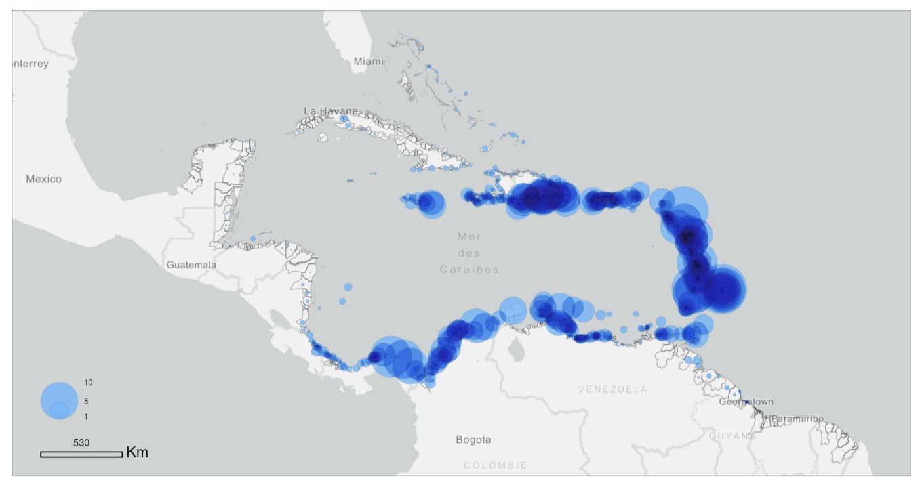
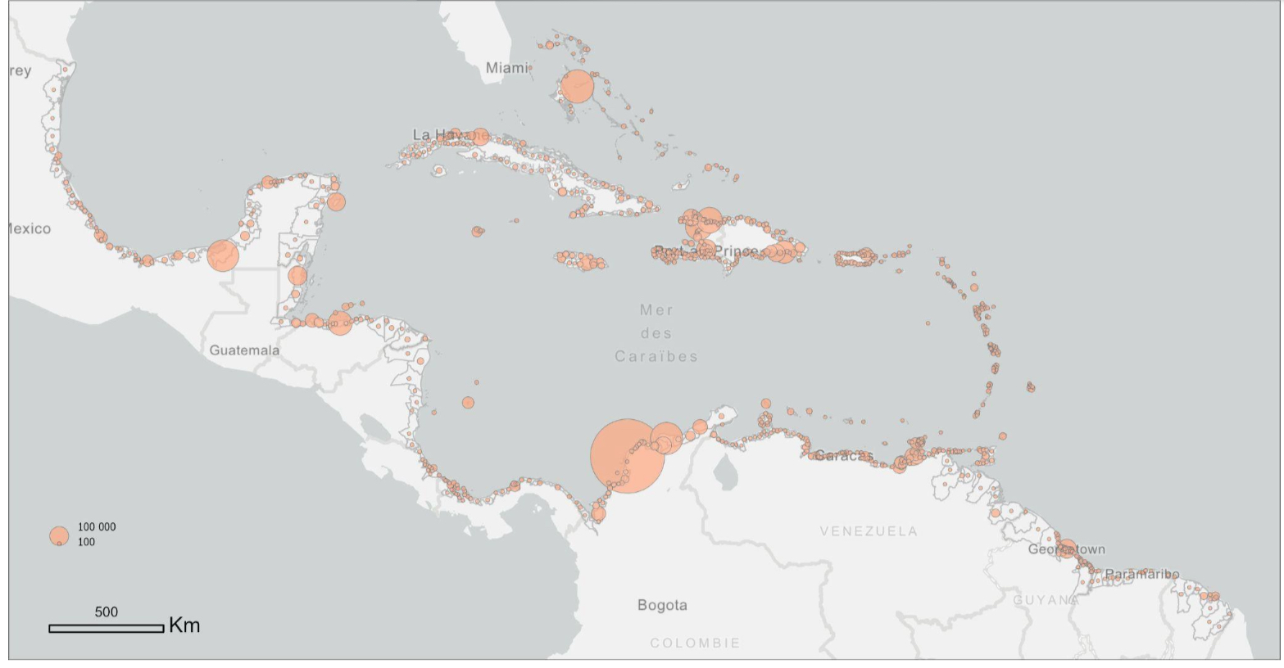
Maximum tsunami height
Population

Slide 27
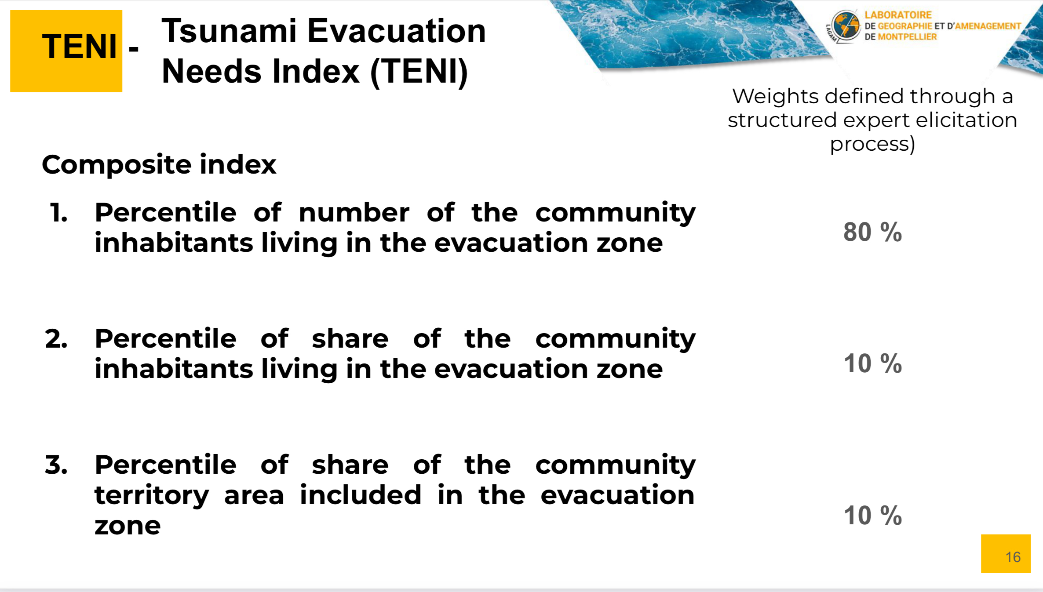

Slide 28
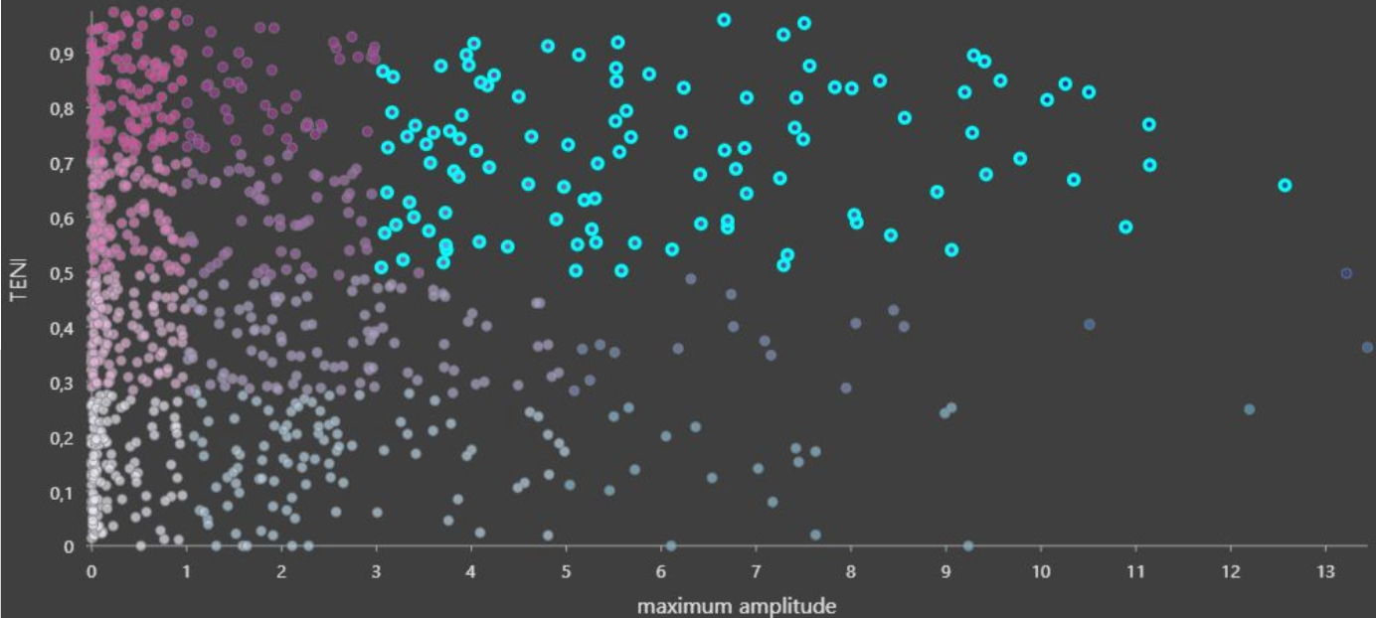
Tsunami Evacuation Needs Index
Tsunami maximum amplitude (m)

Slide 29
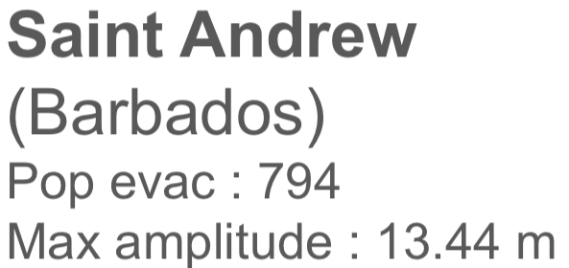
Tsunami Evacuation Needs Index
Tsunami maximum amplitude (m)

Slide 30
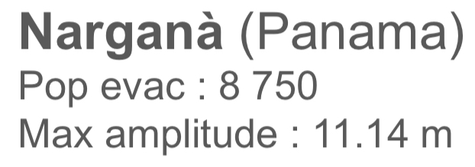
Tsunami Evacuation Needs Index
Tsunami maximum amplitude (m)

Slide 31
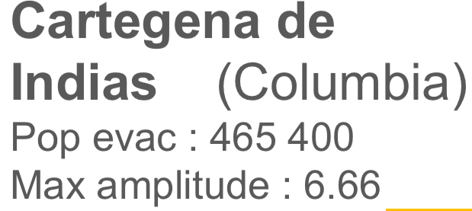
Tsunami Evacuation Needs Index
Tsunami maximum amplitude (m)

Slide 32
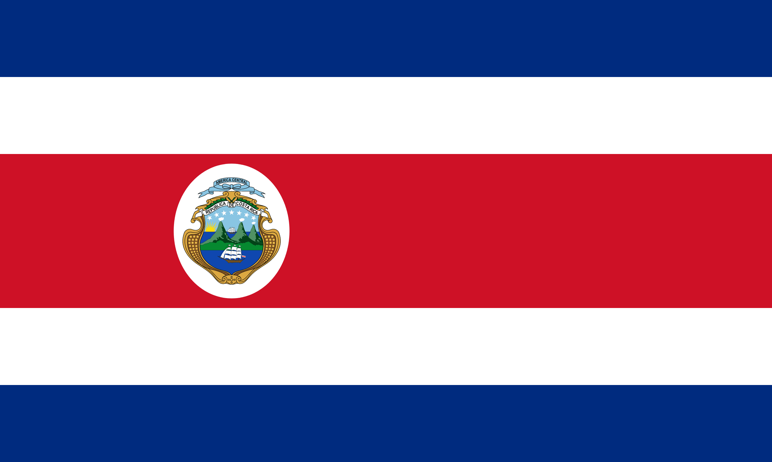

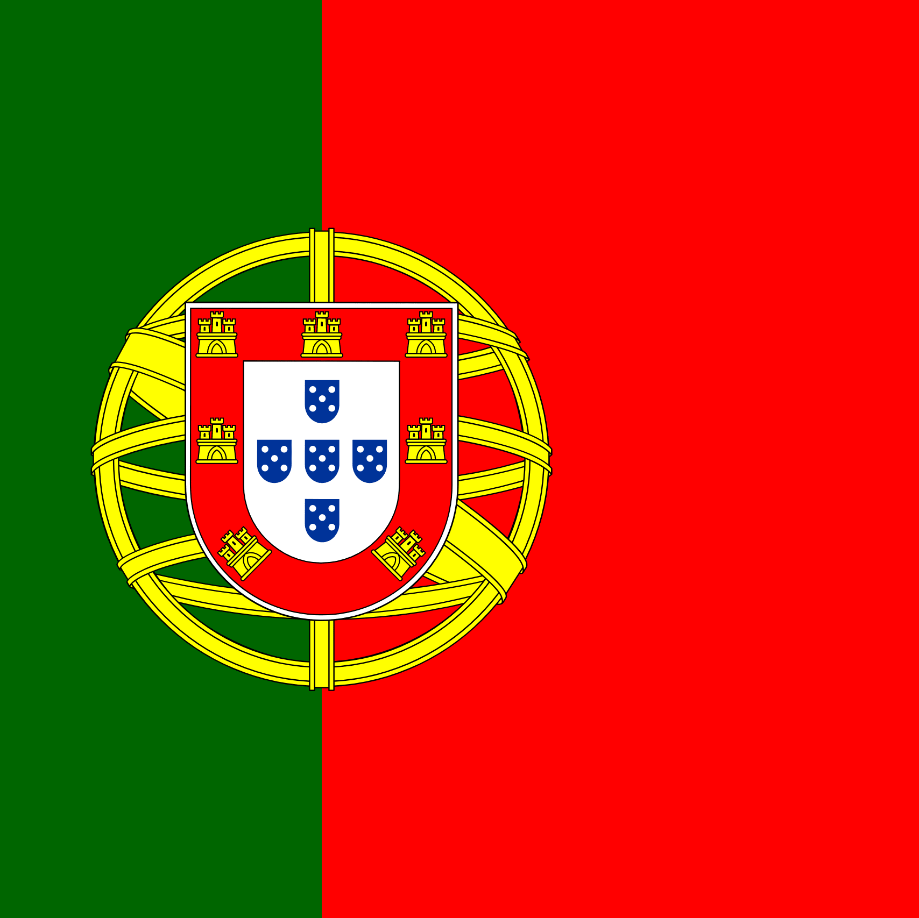





UN Ocean Decade Tsunami Programme Scientific Committee
Annex to Dec. A-31/3.4.1
Terms of reference of the Scientific Committee for the Ocean Decade Tsunami Programme
The Scientific Committee has an advisory role for the duration of the Ocean Decade Tsunami Programme (referred to as the programme).
Membership:
• Four (4) members nominated by the each of the TOWS-WG Task Teams;
• Three (3) members nominated by the TOWS-WG on the basis of their scientific expertise;
Annex to Dec. A-31/3.4.1 (cont.)
• All members will serve for a period of two years and would be eligible for renewal once.
• In selecting Expert Members, due consideration will be given to geographic, generational and gender balance.
2024-2025
Silvia Chacon
Chairperson (a.i.)
Christa von Hillebrandt
Maria Ana Baptista
Harkunti Pertiwi Rahayu
David Coetzee
Silvia Chacon
Yuelong Miao
(appointed Feb 2025)
Helene Hebert
Yutaka Hayashi
Michael Angove
Sergio Barrientos
Alexander Rabinovich
BRIAN WILLIAMS
Manager

Slide 33
Work Programme and Membership
For the 2026-2027 term, two members can renew their membership
Available spots:
  3 to be proposed by TT-DMP
  2 to be proposed by TT-TWO
  3 scientists be proposed by TOWS-WG Chairperson

