Slide 1


TR
World Tsunami Awareness Day 2024
Regina Khanbekova
Campaigns and Community, UNDRR
21 February 2025

Slide 2

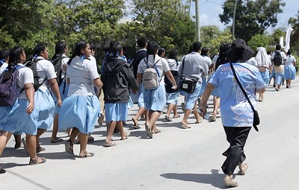
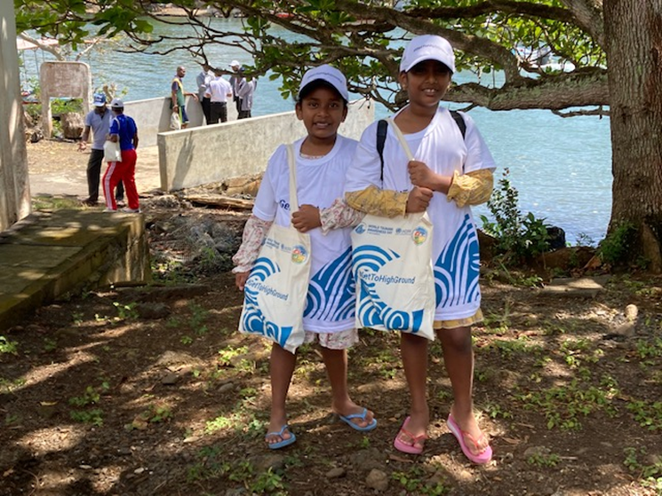
2024 World Tsunami Awareness Day
“Empowering the next generation with the lessons of the 2004 Indian Ocean Tsunami”
WTAD 5 November every year
Purpose: raise tsunami awareness and share innovative approaches to risk reduction
Notes:
Increasing disasters, many of them driven and exacerbated by climate change, threaten the well-being of children.
According to UNICEF, approximately one billion children worldwide are at extremely high risk due to climate impacts, including climate-related disasters. In 2022, the number of children affected by flooding in Chad, Gambia, Pakistan and Bangladesh was the highest in over 30 years. Beyond the risk of death and injury, children in the aftermath of a disaster face cascading impacts such as disruptions in schooling, nutrition, and healthcare and protection issues.
To protect children from disasters, countries must consider their vulnerabilities and needs when designing national and local disaster risk reduction strategies. It is equally important that children be empowered and provided “the space and modalities to contribute to disaster risk reduction,” as called for in the Sendai Framework for Disaster Risk Reduction 2015-2030.
This is particularly relevant in the context of the global push to expand early warning systems under the UN Secretary-General’s Early Warnings for All initiative. Empowering children, especially through education, can enable them to protect themselves and to become agents of change in their families and communities by sharing what they learned.
The 2024 theme
To achieve the goal of the Sendai Framework of reducing global disaster risks and losses, the theme of the International Day for Disaster Risk Reduction (IDDRR) 2024, which falls on 13 October, will be on the role of education in protecting and empowering children for a disaster-free future. The theme is aligned with the upcoming Summit of the Future, planned for September 2024, where ‘youth and future generations’ will be one of its five priorities.
Disaster risk reduction and recovery | UNICEF
Over 27 million children at risk as devastating floods set records across the world (unicef.org)

Slide 3


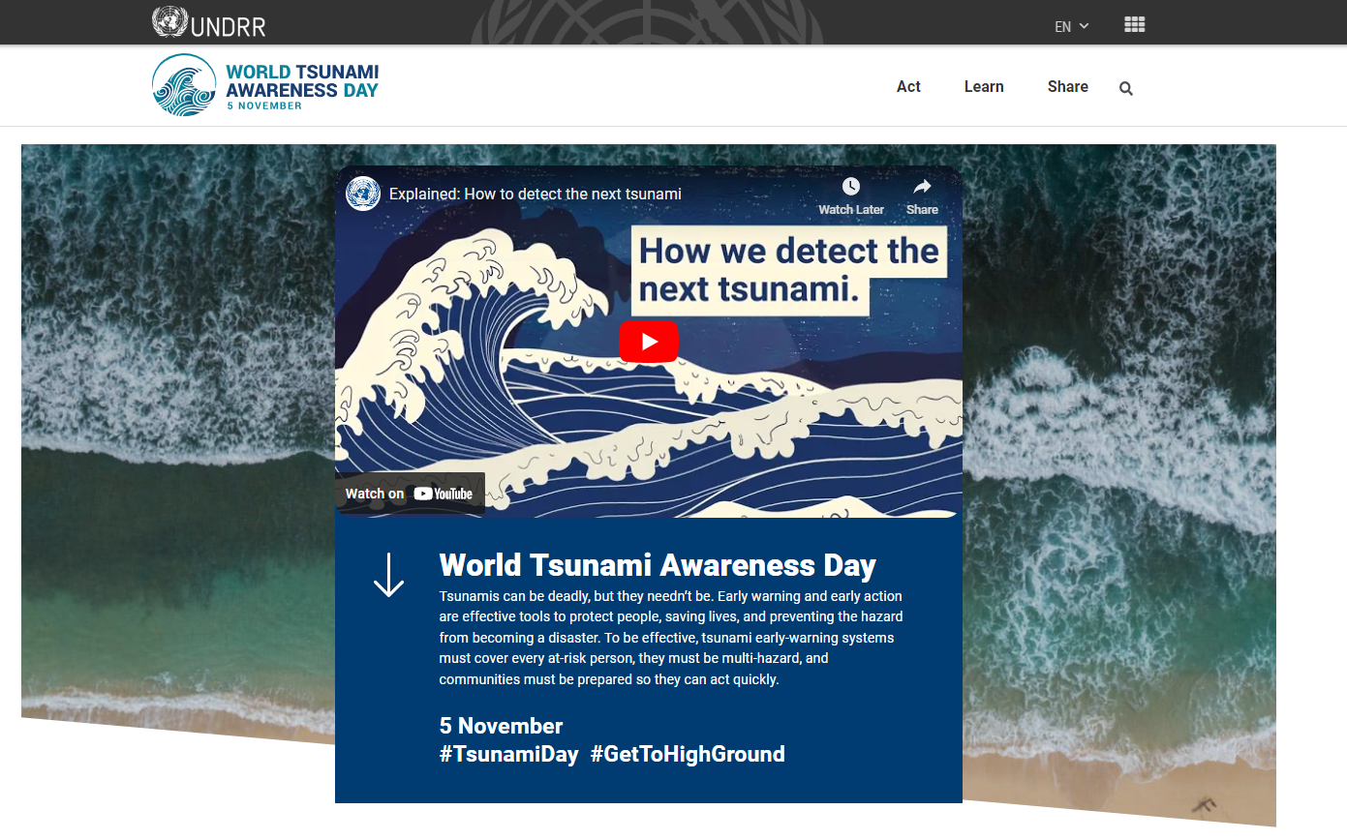
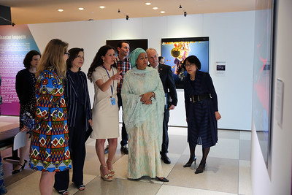
World Tsunami Awareness Day Overview
Connects high level political support to real change making people safer
Bolstering political support: : Part of Sendai Framework implementation; Early Warnings for All Action and Ocean Decade; 20th anniversary of Indian Ocean tsunami events
Mobilizing communities to #GetToHighGround activations, Tsunami United project engaging 400 + schools, High School Students Summit
National and local action: new/revised strategies on DRR tsunami risk, updated evacuation routes, new tsunami warning sensors and warning systems installed
Increased Media coverage: Asia Broadcasting Union
Partnership with UNESCO IOC and UN Family and beyond
Digital advocacy: social media strategy

Slide 4

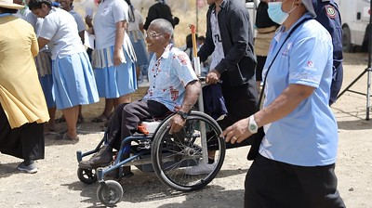
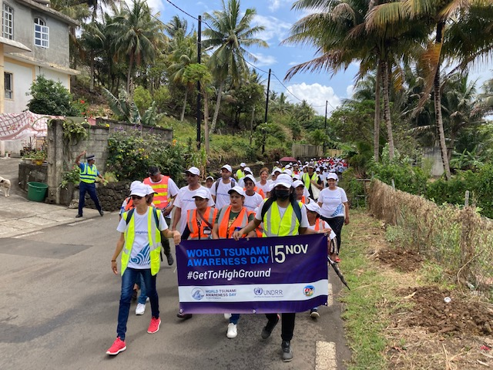
Thank you for the great collaboration!
#GetToHighGround Campaign mobilizing action globally
#GetToHighGround- with UNESCO IOC, public facing campaign engaging citizens to run/walk the tsunami evacuation routes. Focus on inclusion and leave no one behind
Since 2022, events in Indonesia, Seychelles, Tonga, Cook Islands, Barbados, Fiji, Mauritius, Portugal, Samoa, Ecuador, and more.
Boosts implementation: new/revised strategies on DRR/tsunami risk, updated evacuation routes, new tsunami warning sensors and warning systems installed

Slide 5


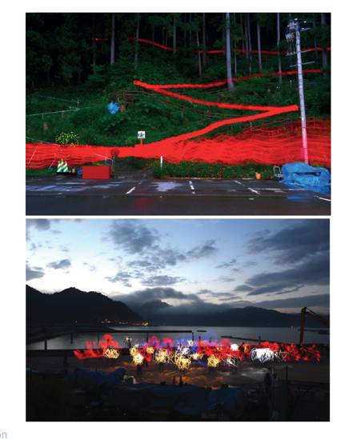
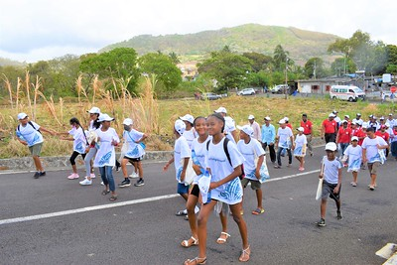
World Tsunami Awareness Day 2024
20th anniversary of Indian Ocean
Social media: incl website, customizable cards and 6 tsunami videos – social reach 1 million
Art Exhibition “Tsunami: Sea Change for Resilience” (Geneva, Paris, Manilla, New York)
#GetToHighGround activation: issuing joint invitation call to the Member States and co-organizing the campaign activations, in 2024 in Banda Aceh, Indonesia in line with the UNESCO-IOC Global Tsunami Symposium: Reflection of the Two Decades of the Indian Ocean Tsunami 2004
Tsunami United Project: series of educational webinars on tsunami and DRR resilience for youth and children in the region of the Indian Ocean, engaging 19 countries, 59 schools, 439 students, teachers and administrators
High School Students Summit in Japan's Kumamoto prefecture on 23 and 24 October, 526 students

Slide 6
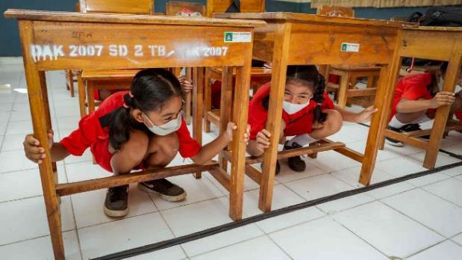
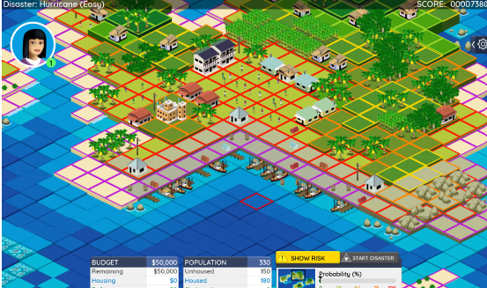
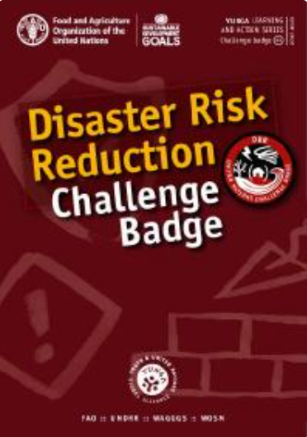

Activation!
The IDDRR Activation toolkit proposes a menu of options with games, comics, educational resources and more
Play and learn to Stop Disasters! The Stop Disasters online game teaches children how disasters including tsunami risk strike and prevention save lives.
The new Disaster Risk Reduction Scout Badge includes tsunami risk and educates children and young people on disasters.

Slide 7
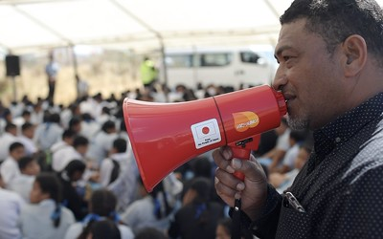

UNDRR 2025
Priorities
Safe schools (GP2025 Ministerial session on #SafeSchools)
Early Warnings for All
Innovative financing for disaster risk reduction
Calendar 2025
10th anniversary of the Sendai Framework for Disaster Risk Reduction, March
Expo 2025, April 13 – October 13
Global Platform for Disaster Reduction, 2-6 June, Geneva

Slide 8
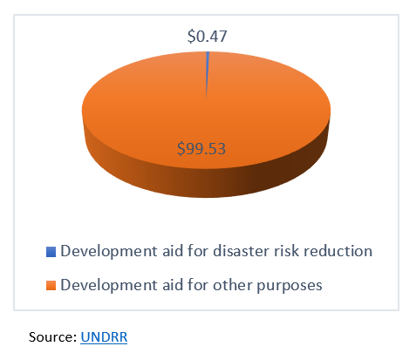
IDDRR 2025 – Innovative Financing for DRR
Why Innovative Financing for DRR?
Current actions are not commensurate with the scale of the DRR challenge – the rapid accumulation of disaster risk that is systemic, interconnected and cascading.
For every $100 spent on total development aid between 2010-2018, as little as 47 cents were allocated for disaster risk reduction.

Slide 9
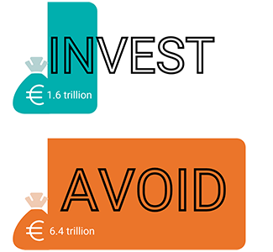
IDDRR 2025 – Innovative Financing for DRR
How can Innovative Financing help to prevention mitigates loss?
Global investments of €1.6 trillion in appropriate disaster risk reduction strategies could avoid losses of €6.4 trillion.
In low- and middle-income countries, investing in more resilient infrastructure yields US $4 in benefit for each $1 invested.
Just 24 hours warning of a coming storm or heat wave can cut the ensuing damage by 30 percent. Spending US $800 million on such systems in developing countries would avoid losses of $3–16 billion per year.

Slide 10
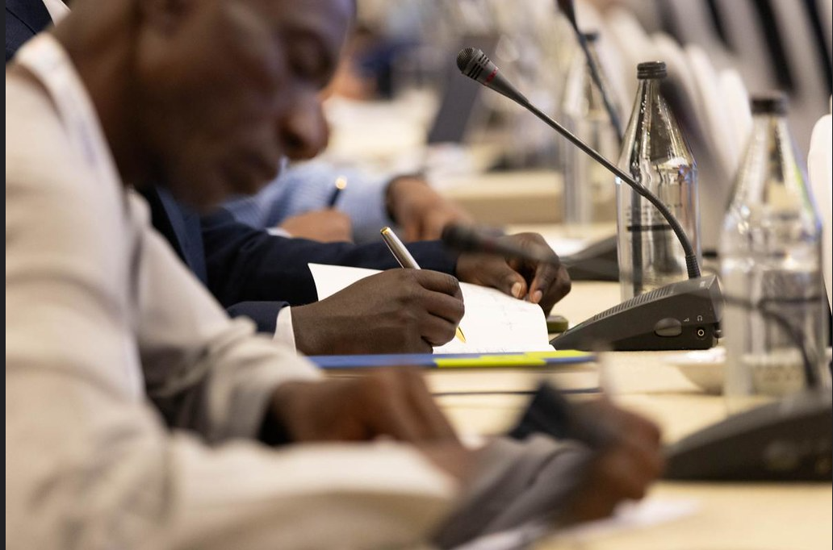
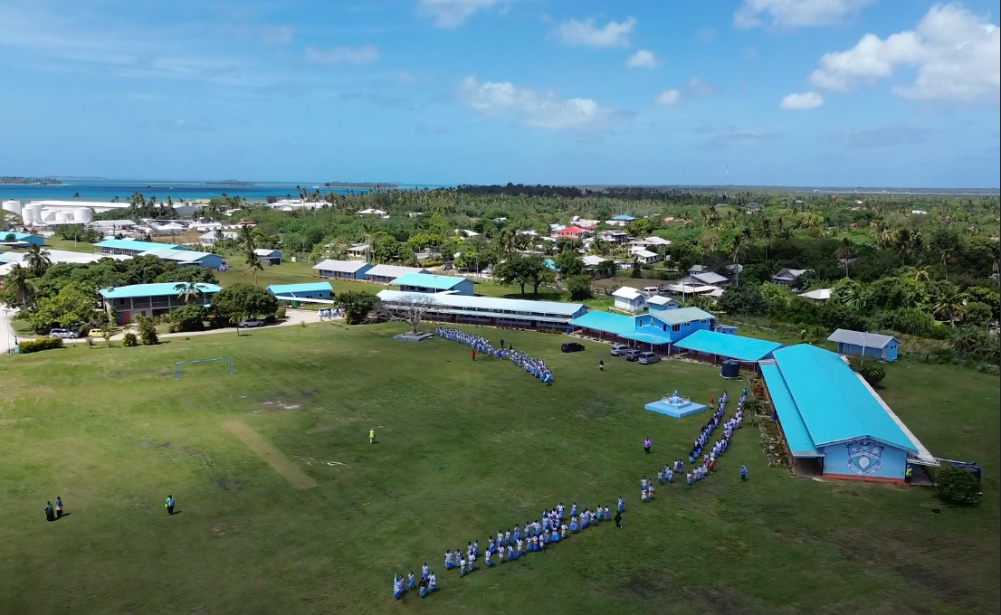
IDDRR 2025 – Innovative Financing for DRR
Call for Action
1. Overhaul regulatory environment and strengthen oversight
Mainstreaming of disaster risk into public and private investment:
Ensure financial institutions and banks align their strategies, operations and activities with the Sendai Framework:
Creating an enabling environment for effective insurance
2. Build the evidence base
Track prevention financing
Conduct risk-sensitive budget reviews:
Increase use and application of risk and financial data
3. Implement new and innovative financing models
Promote blended financing and introduce prevention in bonds
Establish a pipeline for disaster and climate resilient infrastructure investment

Slide 11
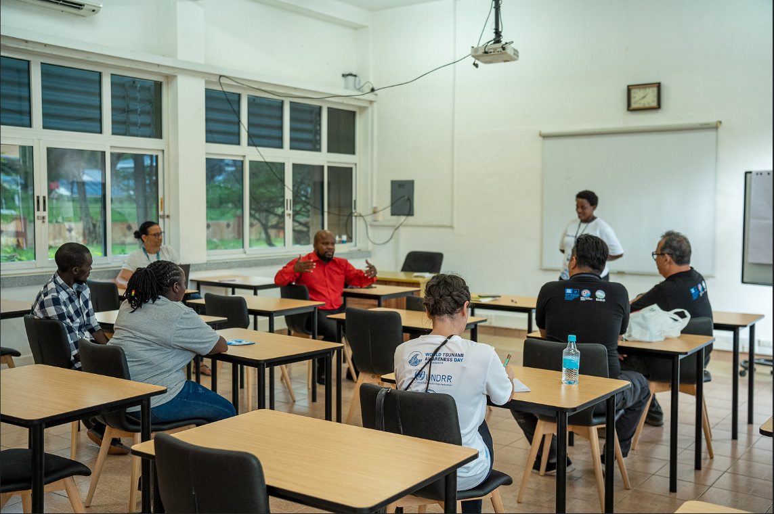
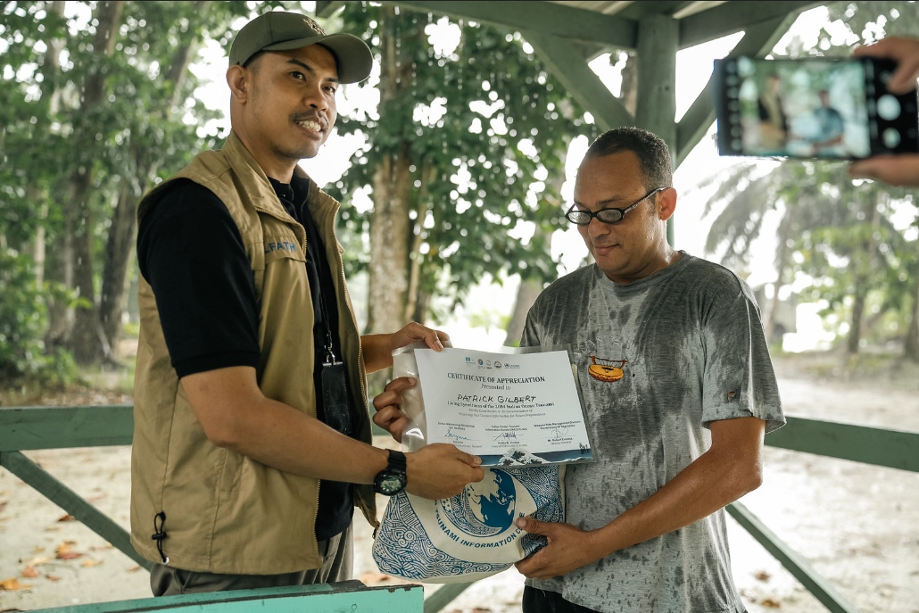
2025 Partnership Proposals with UNESCO IOC
World Tsunami Awareness Day 2025 Theme Co-development
Tsunami Ready Programme + Get to High Ground Campaign
Making Cities Resilient Program

Slide 12

Thank you!
Regina Khanbekova (regina.khanbekova@un.org)
UN Office for Disaster Risk Reduction

