Slide 1
2.2.2 WMO Report
TOWS-WG XVIII Paris France, 24-25 February 2025
D. WYATT, MAR/WMO
24 February 2025

Slide 2

New WMO Executive Management (2024 to 2027)
75th Anniversary in 2025
  Secretary-General
  Prof. Celeste Saulo
  (Argentina)
  Deputy Secretary-General
  Ms. Ko Barrett
  (USA)
  Assistant Secretary-General
  Mr. Thomas Asare
  (Ghana)

Slide 3




Second WMO-IMO Symposium on Extreme Maritime Weather
(London, UK, 23-26 Sept. 2024)
Need for more observations, both in quantity and spatially, to enhance model data for better forecasts and improved early warnings;
Encourage collaboration and leverage of resources to accelerate the development of the S-41x product specifications documentation to enable the generation of compatible datasets for testbed trials;
01
02
03
04
Consideration of engagement and collaboration activities to address user requirements and concerns in a cascading global, regional and national approach to ensure that specific differences are acknowledged and addressed, particularly in support of Marine Environmental Emergency Response (MEER) and SAR operations.
Consideration of capacity development and training opportunities;
3

Slide 4
Oceanic Rolling Review of Requirements
The Oceanic Earth System Application Category (ESAC) led by IOC - part of the WMO Rolling Review of Requirements (RRR)
  Ocean forecasting and real-time monitoring
  Coastal forecasting
  Oceanic climate monitoring and services
  Tsunami Monitoring and Detection (Yuji Nishimae)
  Marine Environmental Emergency Response
  Maritime Safety (ports to open ocean)
  Ocean Biogeochemical Cycles
Gap Analysis and Statement of Guidance is being drafted for review in 2025 once available

Slide 5
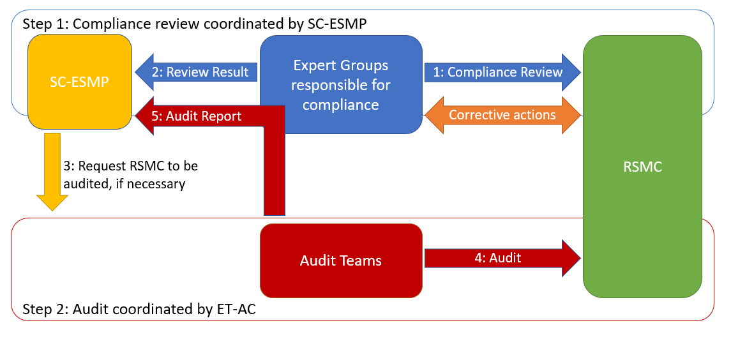
WIPPS Compliance review Overview
Seamless WMO Integrated Processing and Prediction System (WIPPS) approach
To improve operational services from National Met and Hydro Services (NMHSs)
two-step approach : Compliance Review and Audit
Centres for Numerical Ocean Wave Predictions under review in 2025 (Melbourne, Montreal, Tokyo, Toulouse)
5

Slide 6

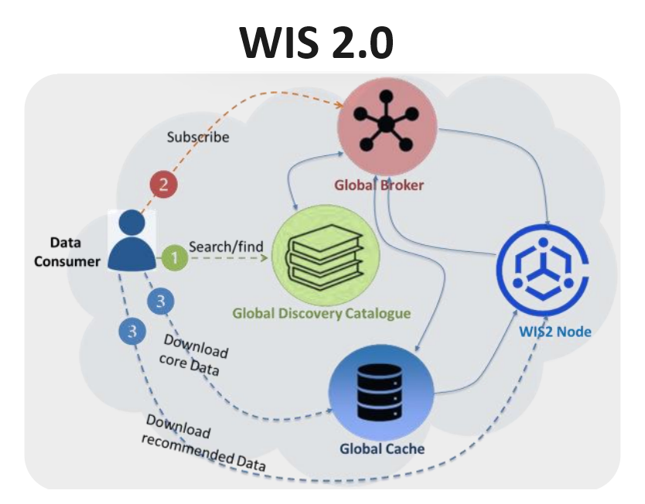
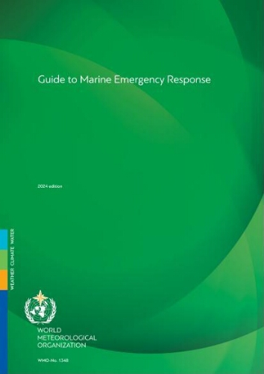
Other touchpoints
Early Warnings for All (EW4All) – now a standing UN initiative
  Technical Regulations on Early Warning Services
  WMO Cataloguing of Hazardous Events – marine & coastal hazards highlighted
  Tsunami Early Warnings (TEW) are encouraged to be CAP compliant
WIS:
  WIS 2.0 officially launched
Marine Services Course
  Buenos Aires, Argentina (4-8 November 2024) and
  Bridgetown, Barbados (2-11 December 2024)
Technical Guidance
  TOOFS Guide review – working with ETOOF/GOOS for synergies
  Guidance on weather driven long ocean waves – in development
  Guide Marine Emergency Response (WMO No. 1348), 2024

Slide 7
Key Events ahead
ET-WCHMER-1, Tokyo, Japan, 17-19 March 2025
SERCOM-Ext, online, 18-20 March 2025
EC79, Geneva, 16-20 June 2025
Cg-Ext, Geneva, 20-24 October 2025
SERCOM-4, 2026 (TBC); INFCOM-4, 2026 (TBC)

Slide 8
Thank you.

