Slide 1
Agenda 2. REPORTS FROM PARTICIPANT BODIES
Report from the ICG/PTWS
TOWS-WG XVIII Session
24 - 25 February 2025
NISHIMAE Yuji
ICG/PTWS Chair

Slide 2
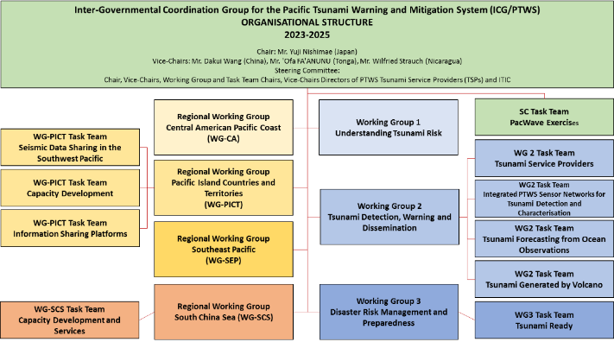
ICG/PTWS Organizational Structure (since September 2023)
Chair: Mr. Yuji Nishimae (Japan)
Vice-Chairs: Dr. Dakui Wang (China), Dr. Wilfreid Strauch (Nicaragua), Mr. ‘Ofa Fa’anunu (Tonga)
Dissolved Task Teams;
Task Team on UN Ocean Decade,
Task Team on Future Goals and Performance Monitoring,
WG2 Task Team on the Minimum Competency Levels for National Tsunami Warning Centre (NTWC) Operations Staff
Established Task Teams;
WG2 Task Team on Tsunami Generated by Volcanoes (TGV)
WG2 Task Team on Forecasting from Ocean Observations (TT-FOO)
WG3 Task Team on Tsunami Ready
Pacific Island Countries and Territories Working Group Task Team on Information Sharing Platforms
Notes:
The PTWS organization structure was changed a little. Three task teams ware dissolved and four task team have been established and one chairperson and three vice-chairpersons were elected as the PTWS officers.

Slide 3
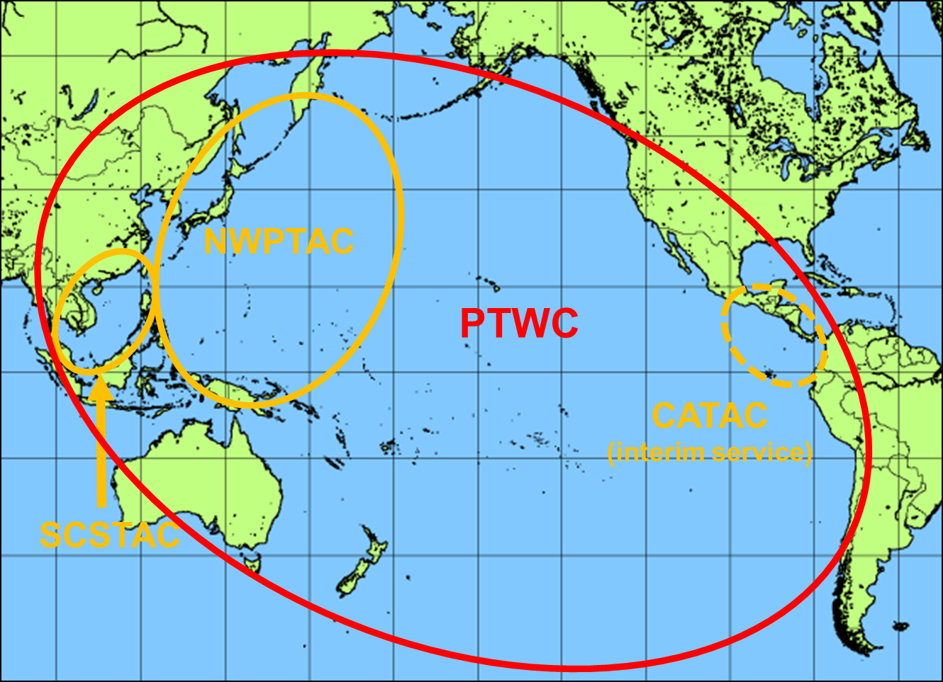
Four Tsunami Service Providers
Tsunami Service Providers in the Pacific
Four Tsunami Service Providers
Pacific Tsunami Warning Center (PTWC) operated by USA
Northwest Pacific Tsunami Advisory Center (NWPTAC) operated by Japan
South China Sea Tsunami Advisory Center (SCSTAC) operated by China
Central America Tsunami Warning Center (CATAC) operated by Nicaragua
The CATAC is fully operated (24hours/7days) on the interim service.

Slide 4
Related Events to the ICG/PTWS since February 2024
Date | Event | Venue
26 - 27 March 2024 | ICG/PTWS Steering Committee Meeting | Online
10 May 2024 | Seventh Meeting of the ICG/PTWS Regional Working Group on Tsunami Warning and Mitigation System in the Central America Region (ICG/PTWS WG-CA-VII) | Managua, Nicaragua
13 – 14 May 2024 | Pacific Island Country and Territories (PICT) Tsunami Ready Workshops | Port Vila, Vanuatu
14 – 17 May 2024 | Expert Meeting on Tsunami Sources, Hazards, Risk and Uncertainties Associated with Vanuatu, San Cristobal and New Britain Subduction Zones | Port Vila, Vanuatu
12 July 2024 | PTWS Working Group 3 Task Team Tsunami Ready Meeting | Online
30 – 31 July 2024 | Solomon Islands Tsunami Ready Workshop | Solomon Island
19-30 August 2024 | ITIC Training Programme on Tsunami Early Warning Systems and the PTWC Enhanced Products, Tsunami Evacuation Planning and Tsunami Ready Programme (ITP-TEWS-Chile) | Valparaiso, Chile
1 September – 30 November 2024 | Exercise Pacific Wave 2024 (PacWave24)
16 – 20 September 2024 | ICG/PTWS Steering Committee Meeting | Honolulu, Hawaii, USA
07 – 08 November 2024 | Twelfth Meeting of the ICG/PTWS Regional Working Group on Tsunami Warning and Mitigation System in the South China Sea Region (ICG/PTWS-WG/SCS-XII) | Jakarta, Indonesia

Slide 5
Meetings attended by the Chair since February 2024
Date | Meeting
26 March 2024 | ICG/PTWS Steering Committee (online)
23 April 2024 | ICG/PTWS Officers Meeting (online)
6 May 2024 | ICG/CARIBE-EWS XVII Session (online)
24 – 28 June 2024 | IOC EC 57 Session (in person)
16 – 20 September 2024 | ICG/PTWS Steering Committee (in person)
11 – 15 November 2024 | 2nd Global Tsunami Symposium (in person)
17 -19 November 2024 | ICG/IOTWMS-XIV Session (online) (Dr Dakui Wang attended on behalf of Chair)
27 – 29 November 2024 | ICG-NEAMTWS XIX Session (online)

Slide 6
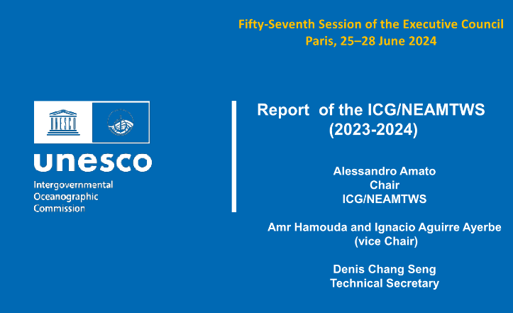
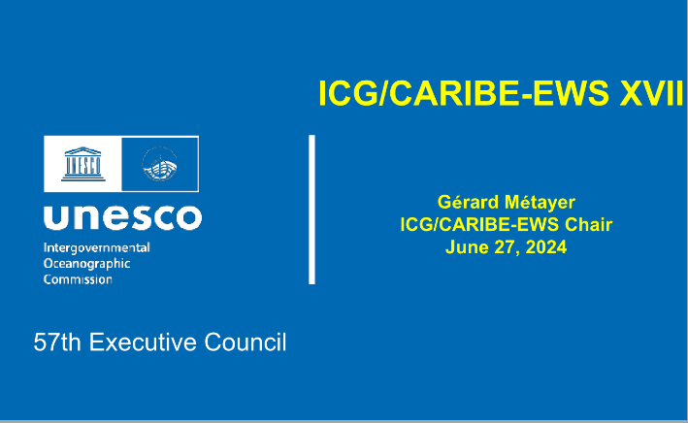
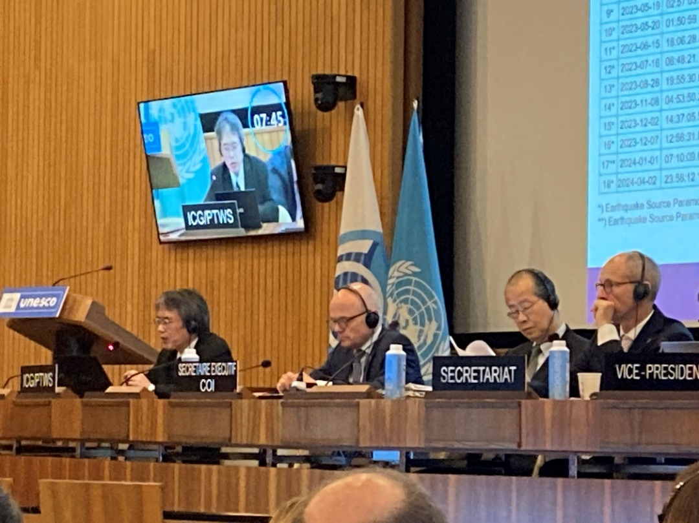


IOC EC 57th Session (25 June to 28 June 2024)
ICG and | Session | Reporter
ICG/CARIBE-EWS | XVII Session | Dr. Regina Browne on behalf the Chair
ICG/NEAMTWS | XVIII Session | Dr. Alessandro Amato
ICG/PTWS | XXX Session | Mr. Yuji Nishimae
TOWS-WG | XVII Session | Dr. Srinivasa Kumar Tummala
Notes:
I attended the IOC EC 57th session in June 2024 to report outcomes of the ICG/PTWS 30th Session.
Two important things related to the ICG/PTWS were decided in the IOC EC 57th session.

Slide 7
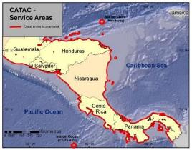
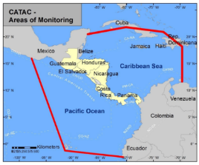
Start of the official full functional operation of the Central America Tsunami Advisory Center (CATAC)
Recommendation ICG/PTWS-XXX-6
Decides to admit the start of the official full functional operations of CATAC, starting after the IOC governing body meeting in 2024, with the specific starting date to be decided after the coordination with the ICG/CARIBE-EWS
Recommendation ICG/CARIBE-EWS-XVII.8
Recommends CATAC to continue with the implementation of EEW methods for the acceleration and improvement of the tsunami warning for Central America.
Recommends the use of additional methods for the transmission of CATAC’s products to its users.
Recommends that CATAC continues full functionality in an interim manner to be able to support the National Tsunami Warning Centers (NTWCs), Tsunami Warning Focal Points 18 (TWFPs), and emergency management authorities of Central America in addressing those challenges,
Further recommends the consideration of CATAC as a TSP in its XVIII Session in 2025 to enable the IOC Assembly to consider the final admission of CATAC as TSP in June 2025
Notes:
The CATAC has provided member states of Central America with tsunami information in an interim manner.
The PTWS decided to admit the start of the official full functional operations of CATAC in PTWS-XXX session.
The ICG/CARIBE-EWS recommended the consideration of CATAC as a TSP in its XVIII Session in 2025 to enable the IOC Assembly to consider the final admission of CATAC as TSP in June 2025.
Therefore, the official full functional operations of CATAC as the TSP in the PTWS would start after the IOC Assembly next year.

Slide 8
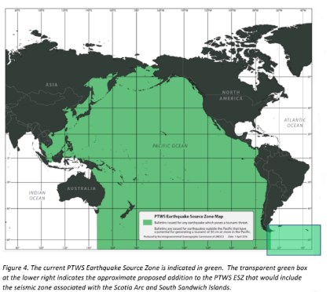
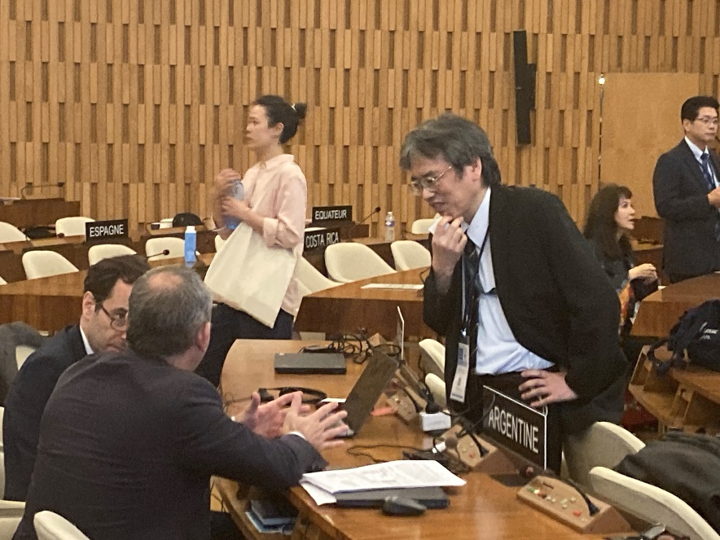
Expansion of the ICG/PTWS Earthquake Source Zone
Recommendation ICG/PTWS-XXX.3
Decides to expand the PTWS Earthquake Source Zone to include an area from 63º to 52º south latitude and from 72º to 18º west longitude to include the Scotia Arc and its adjacent seismic zones.
Adopted decision about the ESZ
The related paragraph to the Recommendation ICG/PTWS-XXX.3 was deleted.
Notes:
(i) the concerns of ICG/PTWS regarding the seismic activity in the Scotia Arc region as reflected in the Executive Summary of the ICG/PTWS-XXX (IOC/ICG/PTWS-XXX/3s);
(ii) that tsunami bulletins are issued by the PTWC for the ICG/CARIBE-EWS and ICG/PTWS for earthquakes in the Scotia Arc and its adjacent seismic zones for events fulfilling certain criteria as reflected in the IOC Technical Series, 130, ‘Tsunami Watch Operations-Global Service Definition Document’;
(iii) the need for the active engagement of Argentina with the ICG/CARIBE-EWS and ICG/PTWS regarding Argentinian Search and Rescue (SAR) and NAVAREA VI coordination responsibilities;
Notes:
Argentina disagreed with the PTWS proposal regarding the expansion of the PTWS earthquake source zone.
PTWS chair and IOC and relevant countries had informal consultation in order to reach the consensus.
As a result of the consultation, PTWS proposal for the expansion was deleted and some notes were added.

Slide 9
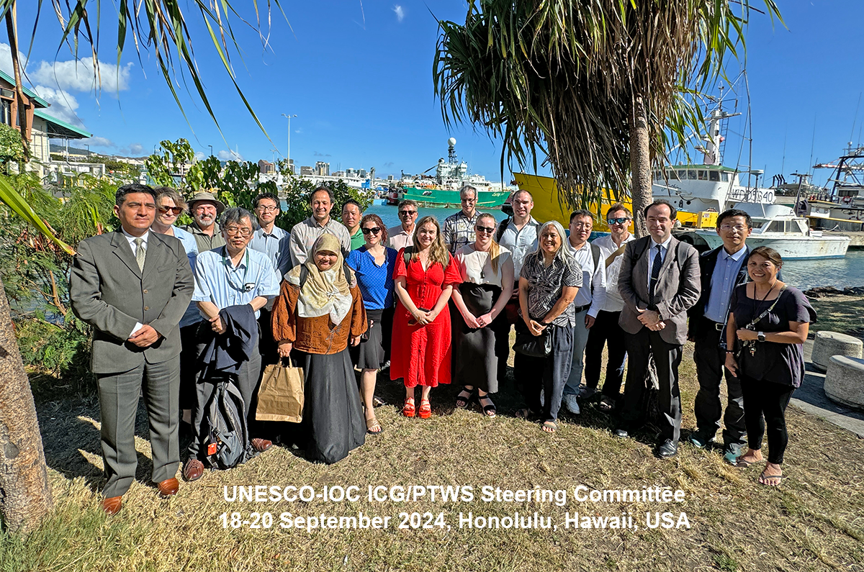
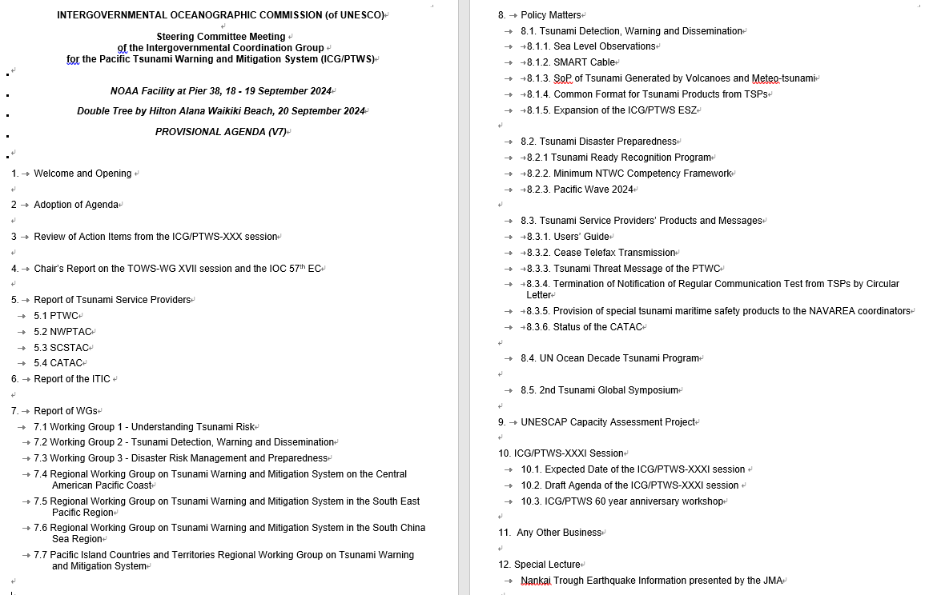
ICG/PTWS Steering Committee Meeting
Date:16 - 17 September TT and WG meeting
18 - 20 September SC meeting
Venue; Honolulu, Hawaii, USA

Slide 10
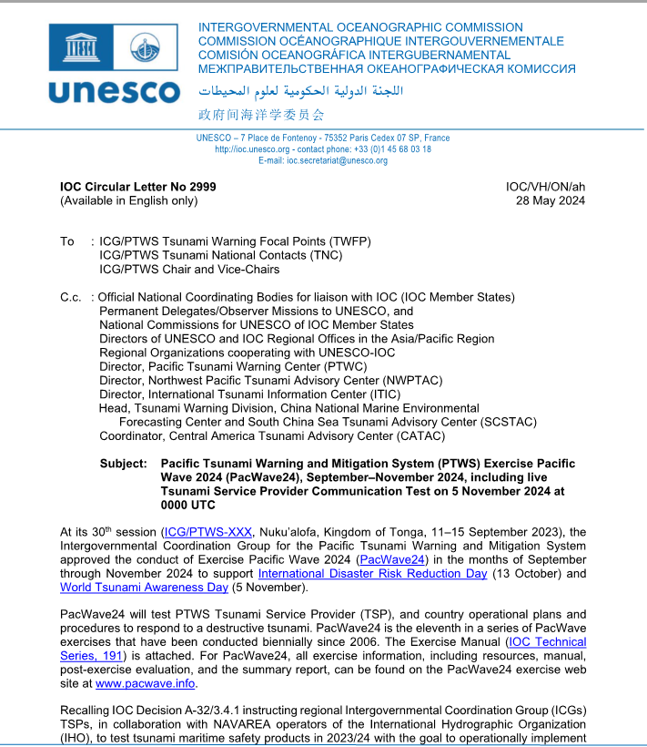
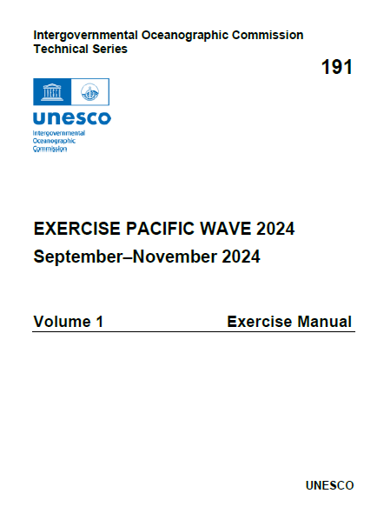
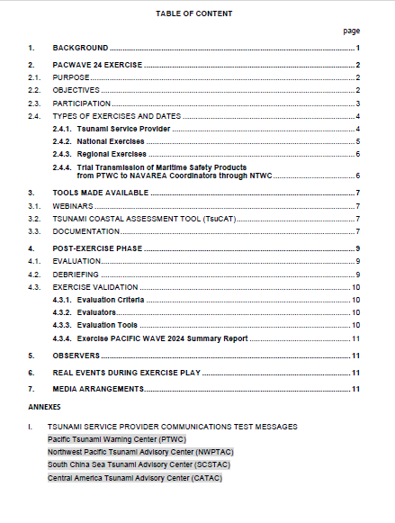

IOC Circular Letter No 2999 and the Exercise Manual (IOC Technical Series, 191)

Slide 11
Timeline Milestones (1)
KEY DATES
31 August 2024 | Deadline for PTWS Regional Working Groups to inform TSPs if products needed, copied to ITIC
1 September – 30 November 2024 | PacWave24 Member State national exercise
2 weeks before Regional Exercise (5 Nov.) | TSP products available on regional exercise webpage
5 November 2024 (0000 UTC) | Live TSP Communications Test
5 November 2024 (0100 UTC) | Live NAVAREA Coordinators Communication Test from PTWC through concerned NTWC
4 November 2024 | Pacific Island Countries and Teritories Regional Exercise
21 November 2024 | South East Pacific Regional Exercise
.

Slide 12
Timeline Milestones (2)
KEY DATES
15 December 2024 | Deadline for Member States to complete and submit online PacWave24 Post-Exercise Evaluation Surveys for: • Live TSP Communication Test •Live NAVAREA Coordinators Communication Test •National Exercise •Regional Exercise
15 December 2024 | Deadline for Submission of Regional Exercise Reports. •PICT Regional Exercise •SEP Regional Exercise
10 days prior to ICG/PTWS-XXXI (April 2025) | Draft PacWave24 Summary Report shared with Member States
30 June 2025 | Final PacWave24 Summary Report published and posted at http://www.pacwave.info/

Slide 13
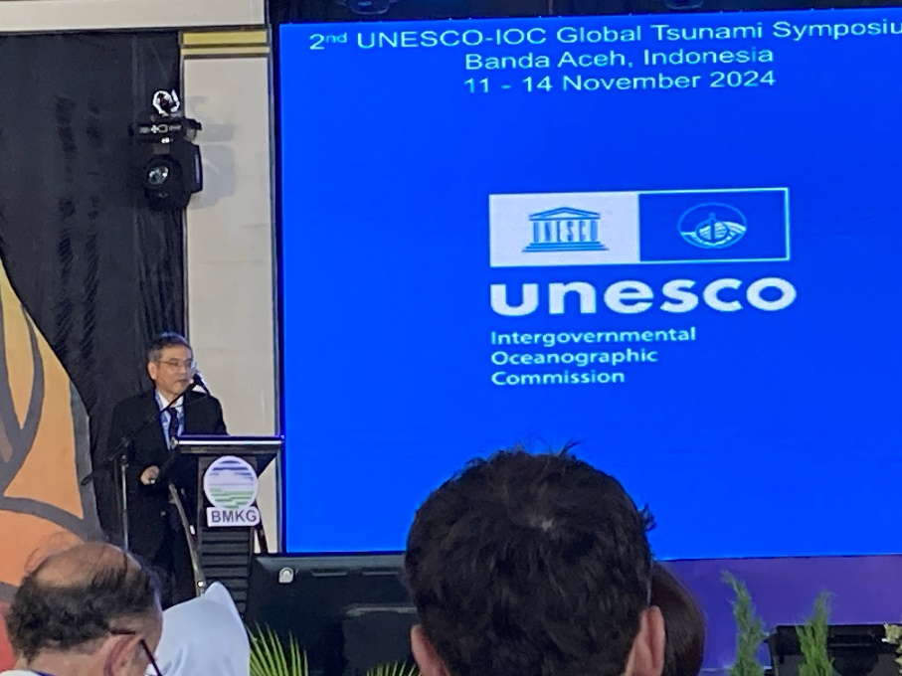
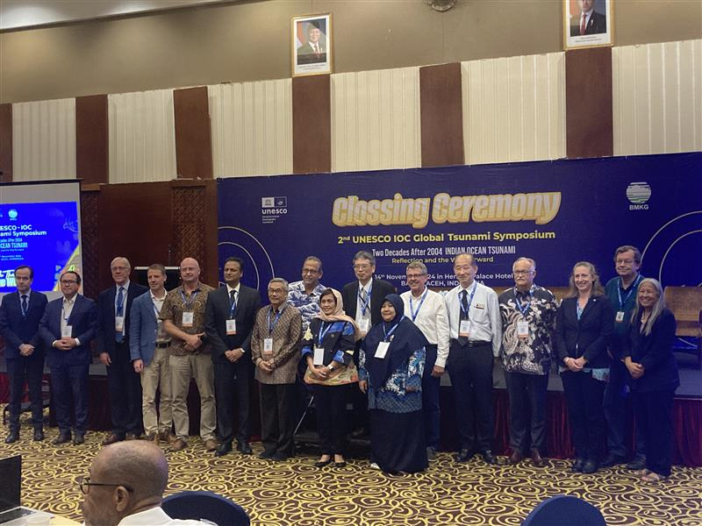
2nd Global Tsunami Symposium (11 – 14 November 2024)
Participants related to the ICG/PTWS
Mr. Yuji Nishimae (Chair)
Dr. Dakui Wang (Vice-Chair)
Dr. Charles McCreely (PTWC Director)
Dr. Laura Kong (ITIC Director)
Dr. Ocal Necmioglu (Technical Secretary)

Slide 14


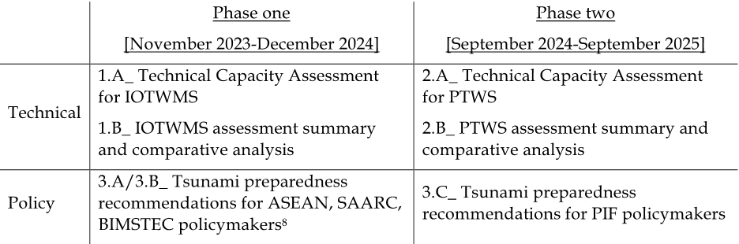
ESCAP Tsunami Preparedness Capacity Assessment
The key objectives of this assessment have been identified as follows:
To evaluate the existing capacity of the UNESCO-IOC Indian Ocean Tsunami Warning and Mitigation System (IOTWMS) (Phase I) and Pacific Tsunami Warning and Mitigation System (PTWS) (Phase II) and highlight the progress made since 2004 IOT and subsequent assessments.
To identify specific gaps and capacity development requirements at regional and national levels for strengthening the technical and policy aspects of the tsunami warning and mitigation systems in the region.
To provide recommendations for the next strategic phase of ESCAP's Trust Fund for Tsunami Disaster and Climate Preparedness, aiming to address the identified gaps through regional cooperation and mainstreaming science.
Output of the assessment

Slide 15
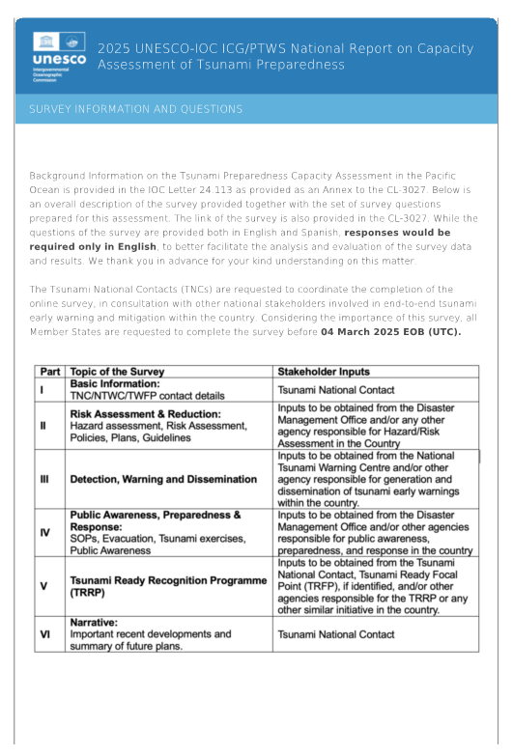
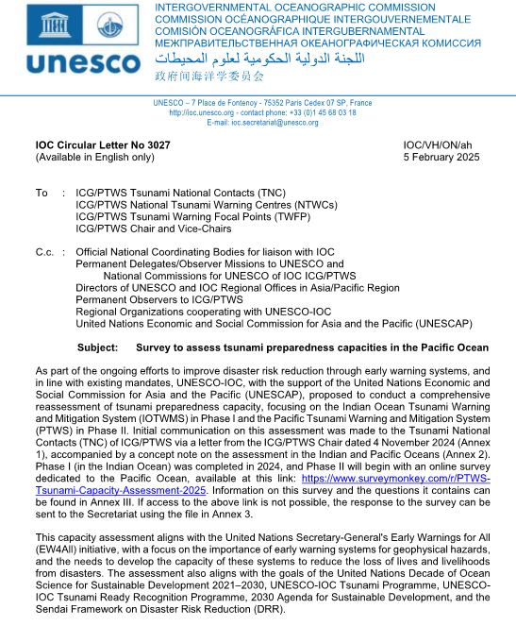
IOC CL No.3027 dated on 5 February
Questions and Answers for Survey by 4 March
ICG/PTWS XXXI
in April in Beijing
Validation Workshop in May in Manila
IOC/UNESCO 32nd Assembly in June
Technical report and Policy Report to be distributed to ICG/PTWS Member States in October
ESCAP Tsunami Preparedness Capacity Assessment (Timeline)
Steering Committee members will attend
Draft Technical Report and its Summary will be made available
A preliminary compilation of the survey results will be presented

Slide 16
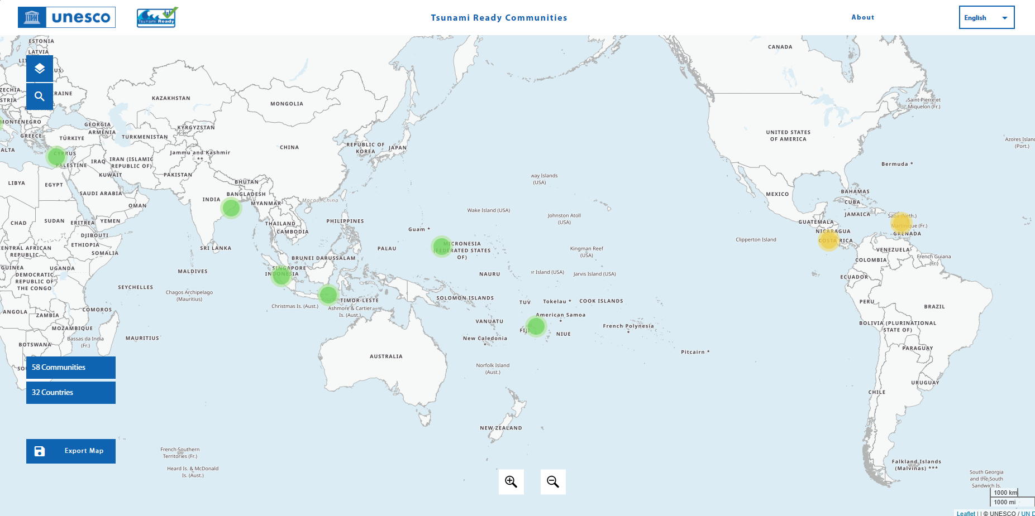
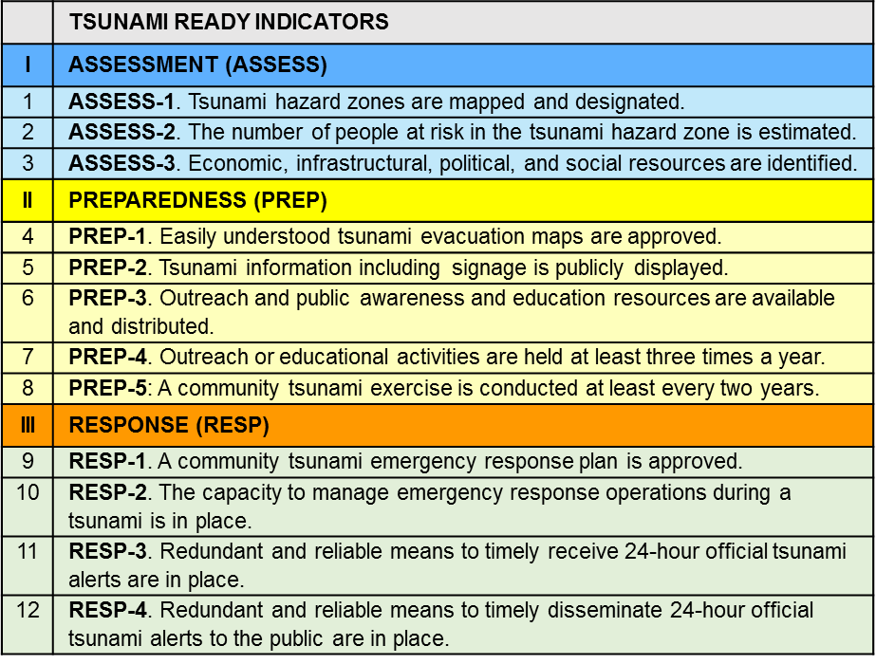
Promoting for the IOC Tsunami Ready Recognition Programme
58 communities
32 countries
Equivalent approach guideline will be submitted to the ICG/PTWS XXXI
Notes:
In addition to the development of tsunami early warning systems, awareness and preparedness are indispensable for reducing the risk of tsunamis. The IOC Tsunami Ready Recognition Programme plays a crucial role in this regard.
The number of certified Tsunami Ready communities is still small, but grows steadily. Increasing certified Tsunami Ready communities is a key point. We would like to continue efforts for raising the number of certification communities for promoting Tsunami Ready Recognition Programme and achievement of the goal of the UNDP.

Slide 17
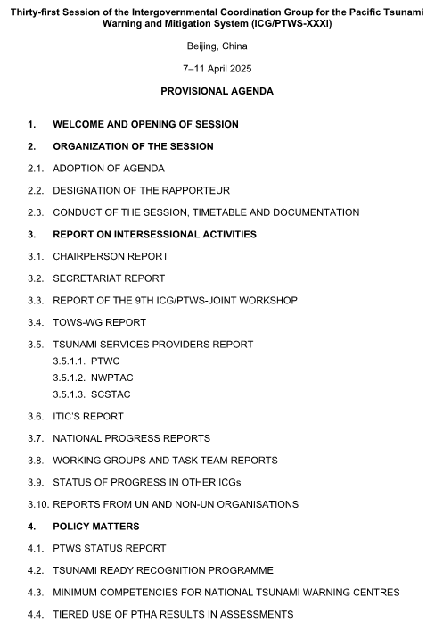
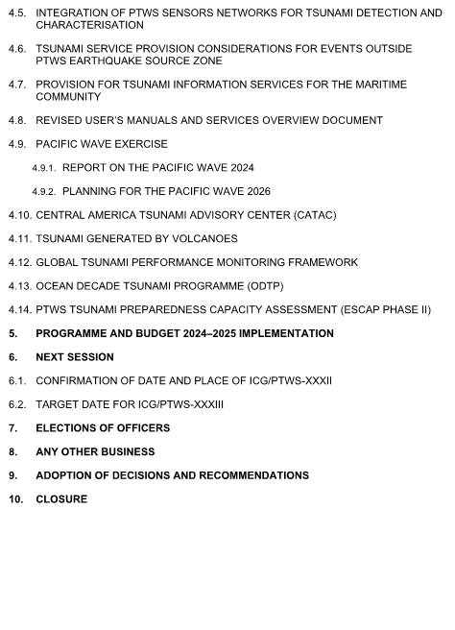

ICG/PTWS XXXI session and Joint Tsunami Workshop (April 2025, Beijing)
ICG/PTWS XXXI Session
Date: 8 – 11 April
Venue: Beijing, China

Slide 18
9th ICG/PTWS – IUGG JTC Joint Tsunami Workshop
60th Anniversary of the ICG/PTWS - Past and Future -
1 April (Online)
Aims
7 April (Hybrid)
Aims
Guide 5-year research and development strategy for detection, monitoring and forecasting through:
1) Investigating challenges to achieving Decade forecasting goals
2) Exploring emergent data technologies to achieve Decade forecasting goals
3) Exploring emergent forecasting technologies to achieve Decade forecasting goals
4) Exploring impact-based forecasting including challenges faced when forecasting inundation and time-dependence
1) Recognition of contributions of 60 years of PTWS
2) Prospective of the future of PTWS
3) Tsunami DRR within the context of the IODTP – lessons from 60 years

