Slide 1
Pacific Tsunami Warning Center
CARIBE-EWS
Significant Events
2/1/24 – 2/15/25
Chip McCreery
Director, PTWC

Slide 2
Only Two PTWC Product-Level Events .
PRELIMINARY EARTHQUAKE PARAMETERS
---------------------------------
* MAGNITUDE 6.8
* ORIGIN TIME 1650 UTC NOV 10 2024
* COORDINATES 19.8 NORTH 77.0 WEST
* DEPTH 13 KM / 8 MILES
* LOCATION CUBA REGION
PRELIMINARY EARTHQUAKE PARAMETERS
---------------------------------
* MAGNITUDE 7.6
* ORIGIN TIME 2323 UTC FEB 8 2025
* COORDINATES 17.8 NORTH 82.5 WEST
* DEPTH 33 KM / 20 MILES
* LOCATION NORTH OF HONDURAS

Slide 3
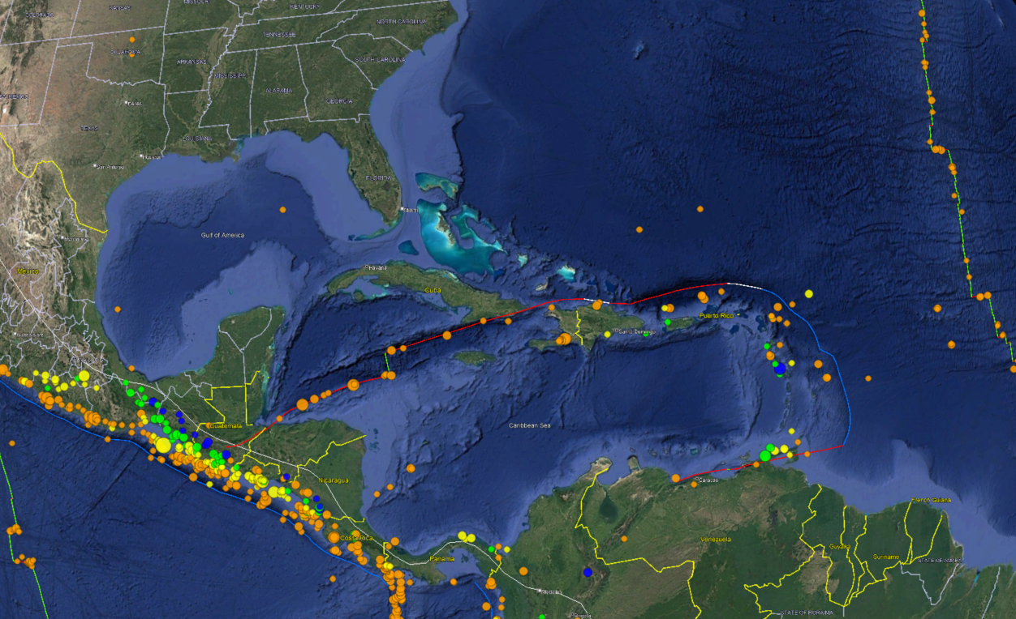
Epicenter of 02/08/2025 23:23 UTC Mw 7.6 Earthquake

Slide 6
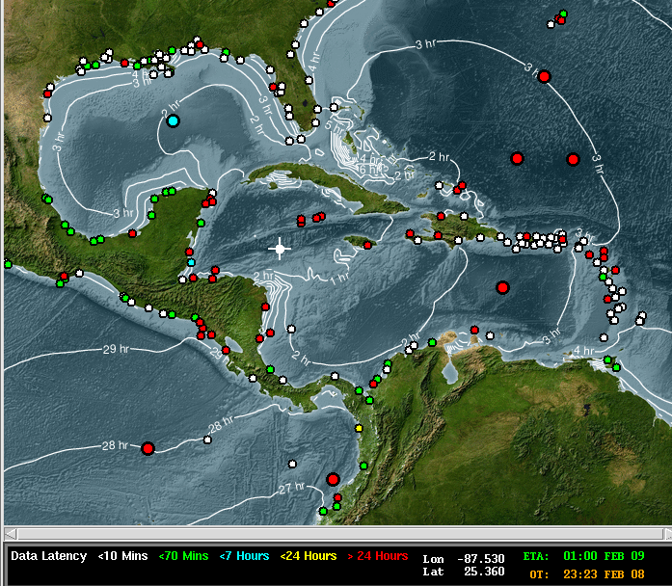
02/08/25 Cayman Islands Event – Epicenter, Tsunami Travel Times, and Sea Level Stations

Slide 8
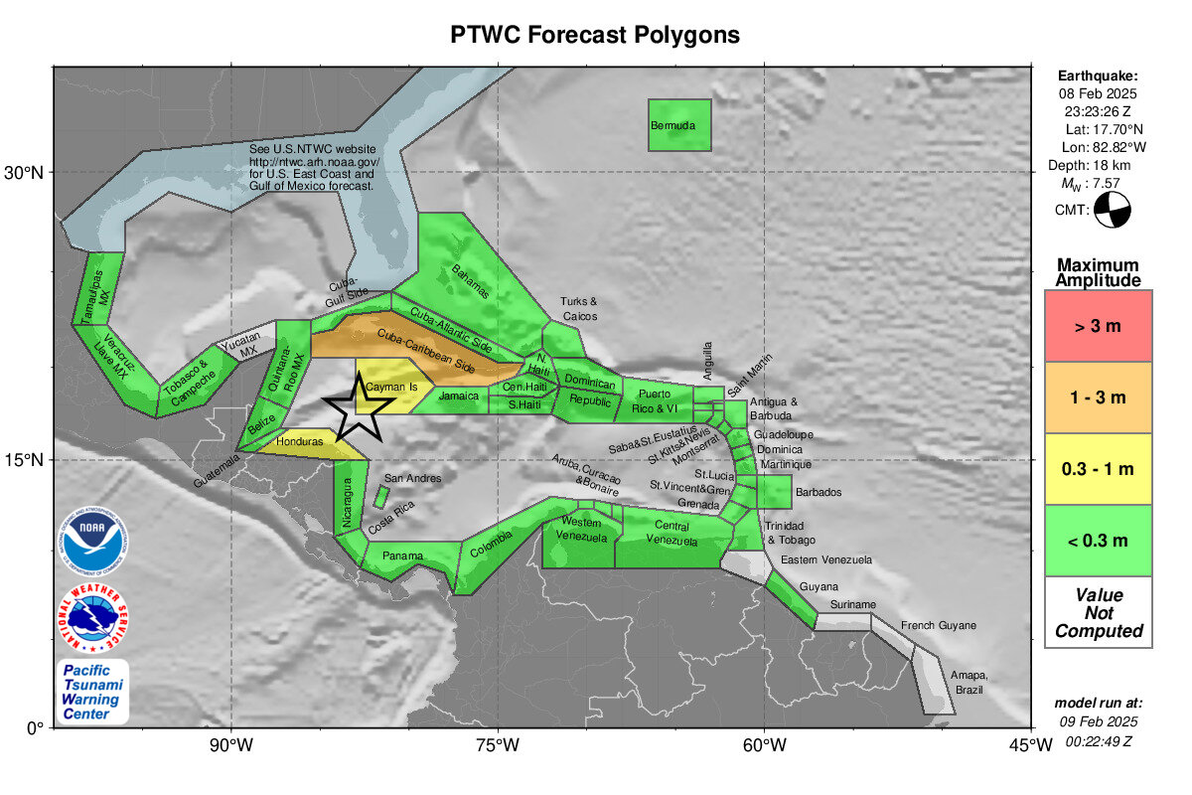
02/08/25 Cayman Islands Event

Slide 9
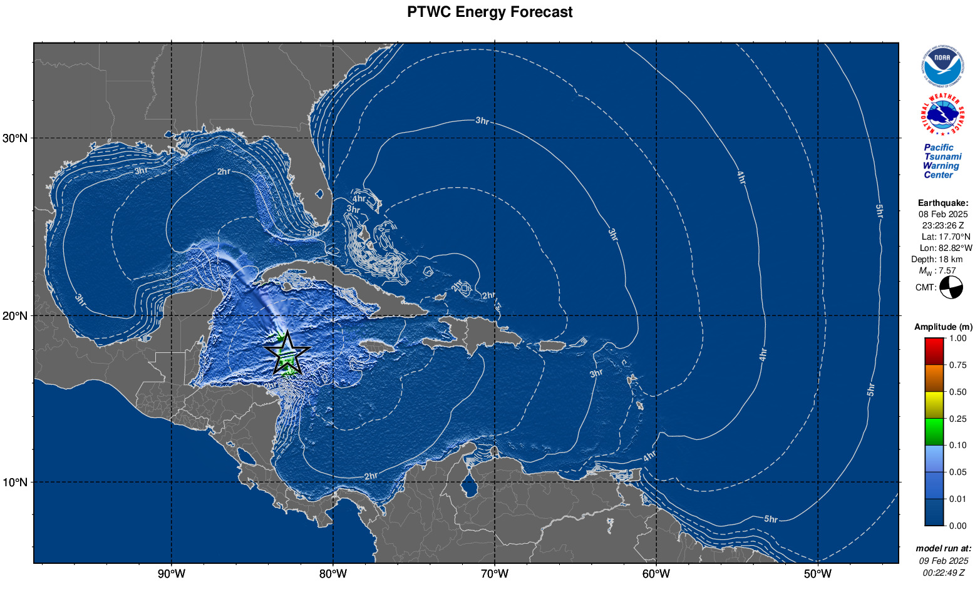
02/08/25 Cayman Islands Event

Slide 10
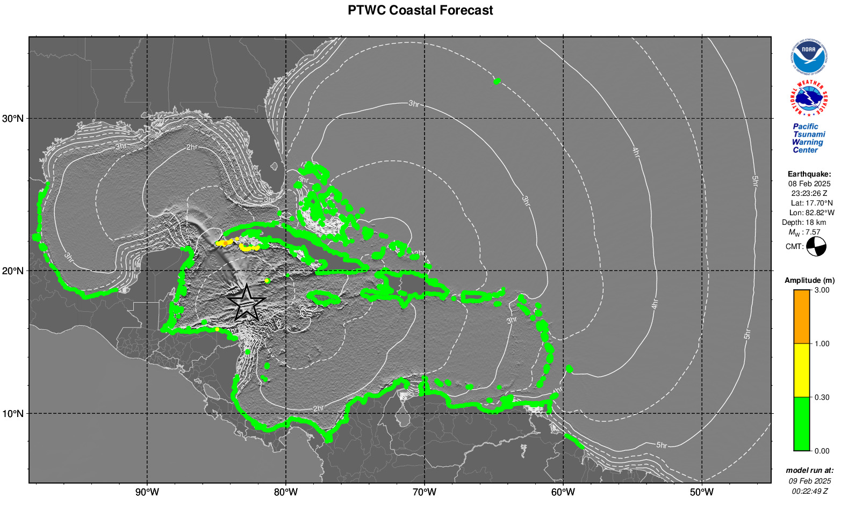
02/08/25 Cayman Islands Event

