Slide 1
NEAMTWS Significant Tsunami Events – 2024
Alessio Piatanesi & Helene Hebert
TOWS-WG Joint Session of TT TWO and TT DMP
Unesco, Paris, 20 February 2025

Slide 2
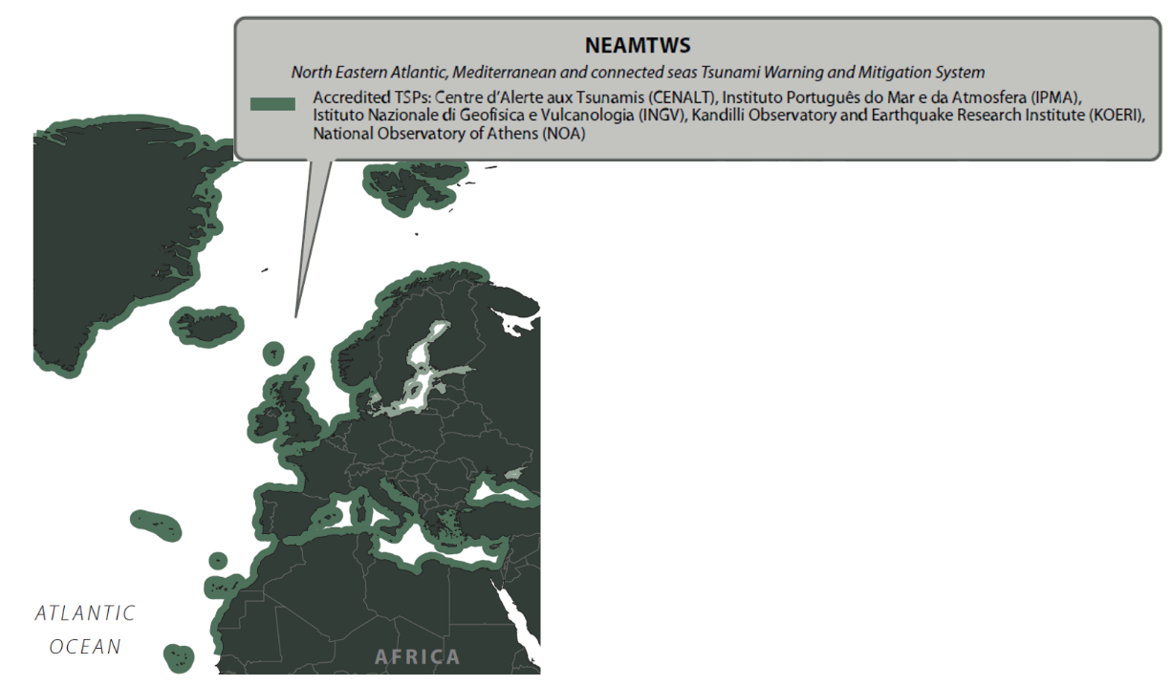
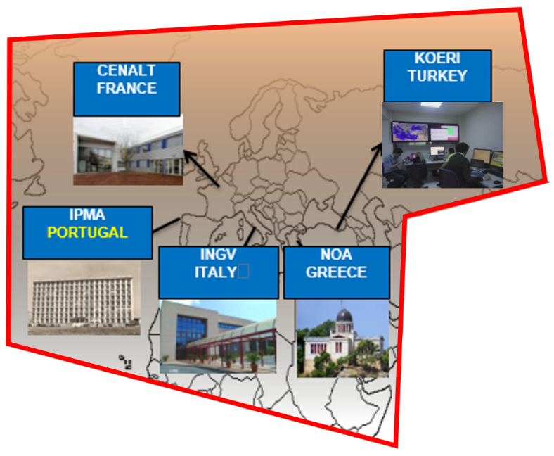
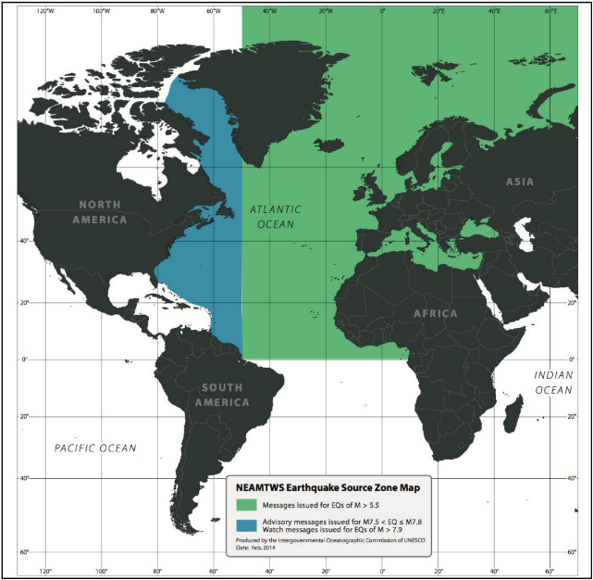
NEAMTWS
5 accredited TSPs
IOC, 2020
IOC, GSDD, 2016

Slide 3
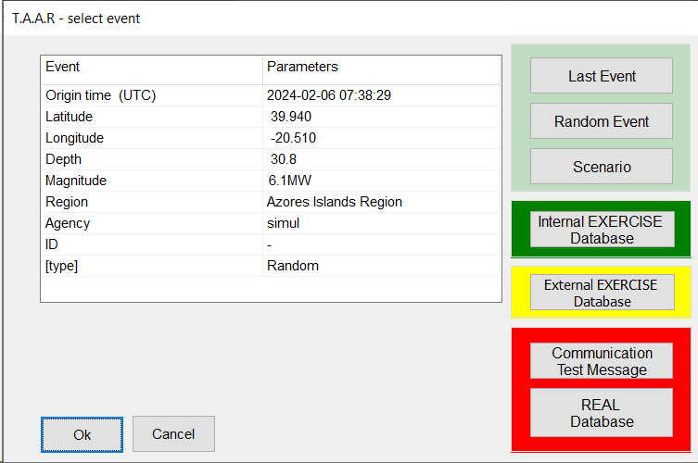

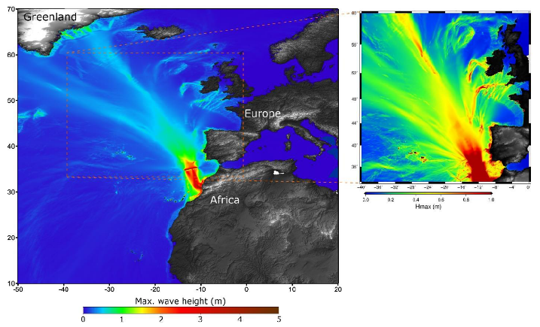
Exercises
Monthly communication tests (Tuesday)
  Concern on no response from some MS
  Capacity to receive warning in case of real events
  Statistics on telecom
NEAMWave Exercise
  Next NEAMWave scheduled on Spring 2026
  NEAMWave23
    Scenario NE Atlantic (Portugal, France)
    Scenarios Mediterranean (Italy, Greece, Turkey)
IPMA

Slide 4
2024 Events
10 earthquakes (11 in 2023)
  7 NE Atlantic (4 in 2023)
  3 East Mediterranean (2023 : 7 →3 central, 4 East)
Information level only
  February 6, 2023: Watch level, and one aftershock M 6.3 – Advisory level
Magnitudes 5.5 to 6.0

Slide 5
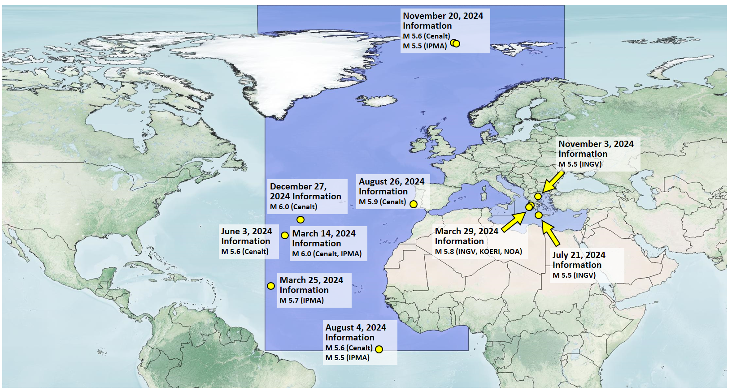
NEAMTWS 2024 Events

