Slide 1


Ocean Decade Tsunami Programme
Research, Development & Implementation Plan
&
ICG/IOTWMS Initiatives
Presentation to the ODTP-SC 5 Meeting - Agenda Item 6.0
Srinivasa Kumar, Pattabhi Rama Rao, Yuelong Miao, Harkunti Rahayu
Paris, France
16 – 17 January 2025

Slide 2
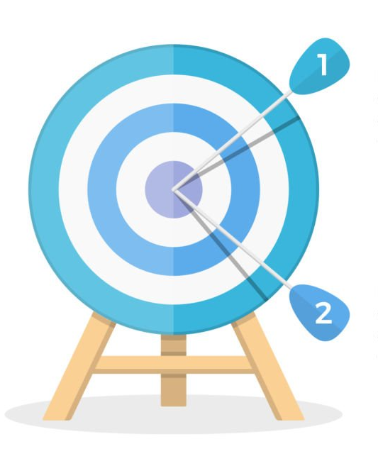
UN Ocean Decade Tsunami Programme
Key Elements
Tsunami Risk Knowledge
Tsunami Detection, Analysis and Forecasting
Warning, Dissemination and Communication
Preparedness and Response Capabilities
Capacity Development, SIDS and LDCs, Multi-hazard Framework
Governance and Pathways to Implementation
To develop the warning systems’ capability to issue actionable and timely tsunami warnings for tsunamis from all identified sources to 100% of coasts at risk
100% of communities at risk be prepared and resilient to tsunamis by 2030 through programmes like the IOC-Tsunami Ready Recognition Programme (TRRP)
The Scientific Committee developed the draft 10-Year Research, Development and Implementation Plan for the Ocean Decade Tsunami Programme which was presented and endorsed at the IOC Assembly in June 2023
Notes:
Expand Existing Observation Systems to fill the Gaps – Optimal Sensor Grid Design From Angove, M., Gledhill, K., Bill Fry., Christopher Moore., Tummala, S., 2024 (pers)
Deploy new technologies – SMART
Wider Data Access, Availability & Analysis for Data from SL, Sesimic, GNSS Systems
Collection of Coastal Topo/Bathy Data
All NTWCs have access to Data, Tools, Communications Systems, SOPs & Training
TR Communities – TRRP, Equivalency, TR Coalition

Slide 3
UN Ocean Decade Initiatives related to ODTP
4th Science Committee for the UN-ODTP Meeting Summary
Title subtitle
ODTP
Communities of Practice
Capacity Development Facility
Collaborative and Coordination Centres
Initiatives to be endorsed under ODTP
Coordination with ICGs
Collaboration in other programmes
2nd UNESCO-IOC Global Tsunami Symposium
2nd UN Ocean Decade Conference
EW4ALL
Voluntary groups of endorsed Decade Actions
CDFs to support institutions/individuals involved in Ocean Decade, especially SIDs & LDCs and ECOPs
Role of TICs
Optimal Sensor Grid Design
Mechanism to report progress made at each ICG w.r.t to ODTP goals. Align with global Tsunami Performance Monitoring Framework
Establish connection with DCCs/DCOs actions (DCC-PICT, DCC-PRED, DCC-CR, DCC-IOR) which include AI/ML, Digital Twins etc. linked through TT-TWO
Relevant national projects to be submitted and endorsed (SMART cable, NZ DART Project, IOTWMS Capacity Assessment Project etc). Need granularity and communication through multiple means (DCU/TSR/ICGS/NDCs etc.). Released 7th Call for Action

Slide 4
ICG/IOTWMS Decisions related to ODTP
    Decisions ICG/IOTWMS Steering Group (Feb 2024, Hyderabad)
Vice-chairs to develop a strategy to utilise UNOD opportunities, mapping existing and new ICG Work Programme
Work Programme of the ICG/IOTWMS and its working groups to integrate the ODTP-RDIP
WG3 should initiate collaboration with DCC-CR based at University of Bologna, Italy
Secretariat to ensure capacity assessment and status reporting activities of the ICG/IOTWMS provide baseline information to identify progress and gaps implementing the ODTP-RDIP
Secretariat work with ICG/IOTWMS and Member States (including private sector) to identify projects and programmes that could address gaps identified in the upcoming 2024 IOTWMS Capacity Assessment of Tsunami Preparedness
Secretariat to provide advice and guidance for future “Calls for Action” of the Ocean Decade.
Chairs of TOWS-WG and ICG/IOTWMS to confirm if tsunami warning and mitigation is in the scope of the UN EW4AL
    Follow on Decisions by the ICG/IOTWMS Session (Nov 2024, Jakarta)
Include the instructions from 57th Session of the IOC EC, and the recommendations from TOWS-WG XVI and XVII in the work plans of the ICG for the next inter-sessional period
Instructs the Steering Group, Working Groups and Task Teams to consider the recommendations of the ODTP RDIP, IOWave23, 2024 Capacity Assessment and 2nd Global Tsunami Symposium into their work plans.
Extend the TSP services to include tsunamis generated by non-seismic and complex sources
Establish a new WG-2 intersessional Task Team on New/Emerging Technologies for Observations and Forecasting
Request Steering Group to supervise the work of the Task Team to finalise the MTS 2025-2030 by early half of 2025;

Slide 5
ICG/IOTWMS Actions related to ODTP Objectives
Objective 1: To develop the warning systems’ capability to issue actionable and timely tsunami warnings for tsunamis from all identified sources to 100% of coasts at risk
UNESCAP Project on the Makran Subduction Zone – PTHA, Tsunami Early Warning Chains and TR Implementation (Ph-3)
UKRI India Project on People-Centred Early Warning for Indian Coastlines (PCTWIN) – Submitted as Decade Action
INCOIS Project on Submarine Cabled Observatory near Andaman & Nicobar Islands - Submitted as Decade Action
Completed 2024 Capacity Assessment of Tsunami Preparedness - identify the Capacity Gaps and Priorities
Warning Procedures developed / under development – Non-seismic tsunamis, Maritime bulletins
WG-2 + Task Team to work on Optimal Network Design, New Observation Technologies , Modelling & Forecasting Methods, KPIs
Objective 2: 100% of communities at risk be prepared and resilient to tsunamis by 2030 through programmes like the IOC-Tsunami Ready Recognition Programme (TRRP)
22 Communities in Indonesia recognized as IOC-UNESCO Tsunami Ready
26 Communities in India recognized as IOC-UNESCO Tsunami Ready
18 IOTWMS Member States nominated Tsunami Ready Focal Points
TEMPP Training planned at INCOIS, Hyderabad during 09-20 March 2025 to enhance capacities of IOTWMS Member States to implement IOC-UNESCO Tsunami Ready
WG-1 + WG-3 to prepare guidelines for TR Critical Infrastructure and inclusive SOPs

Slide 6
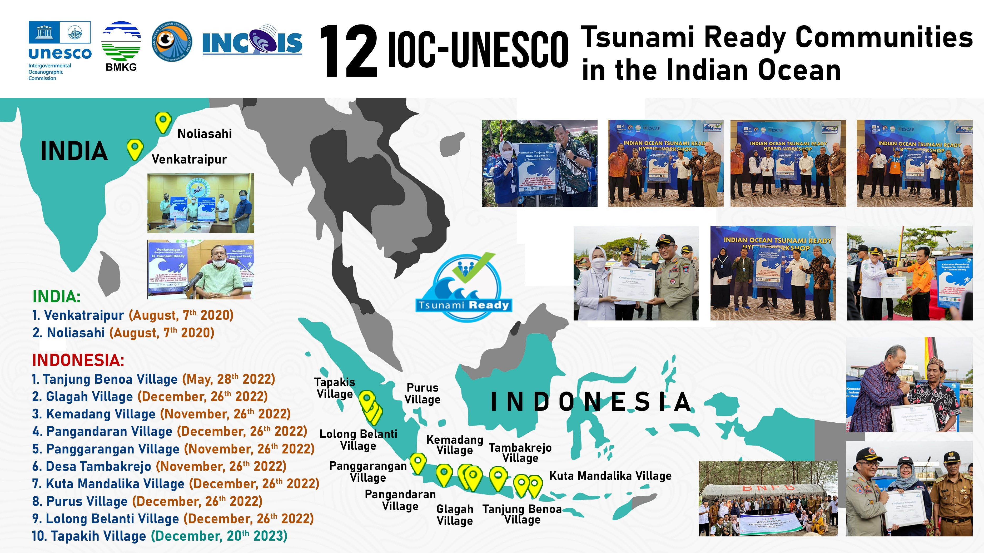
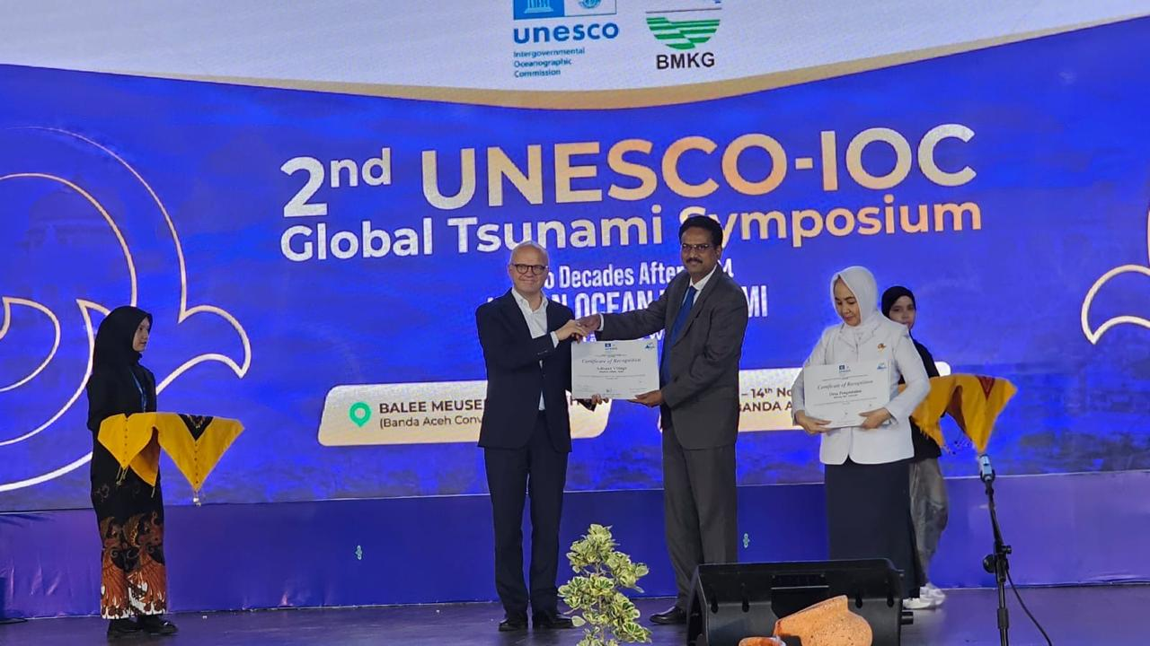
48
36 New communities of India [24] and Indonesia (12) were recognized as Tsunami Ready at the 2nd UNESCO-IOC Global Tsunami Symposium

Slide 7
THANK YOU

