Slide 1
Ocean Decade Endorsed Actions - ICG/PTWS
Ocean Decade Tsunami Programme (Programme)
The Nippon Foundation-GEBCO Seabed 2030 Project (Programme)
Global Real-time Early Alarm for Tsunami (GREAT) (Project)
Open Access to GTS Project (Project)
Sea Level Station Monitoring Facility (Project)
SMART Subsea Cables (Project)
Decade Collaborative Centre for Coastal Resilience (Contribution)
Promote Seabed 2030 and Ocean Mapping (Contribution)
US Tsunami Contributions to IOC Tsunami PT 1 (Contribution)
US Tsunami Contributions to IOC Tsunami PT2 (Contribution)

Slide 2
ICG/PTWS Decisions/Actions related to ODTP
    Decisions of ICG/PTWS XXX (Sep 2023, Nuku’alofa - Tonga)
Decided to dissolve the Task Team on UN Ocean Decade and recommended strengthening the mandate and ability of the Steering Committee to deliver on the Decade goals by modifying its Terms of Reference, noting the need for coordination between the ICG/PTWS and its working groups in order to fulfil the UN ODTP goals for the PTWS, the strong leadership and strategic oversight required to implement the UN ODTP, and recognising that the Steering Committee has responsibility for strategic direction and coordination across all PTWS activities, including Ocean Decade (7)
Agreed to support a scientific meeting of experts on the New Hebrides Trench (an Expert Meeting on Tsunami Sources, Hazards, Risk and Uncertainties Associated with Vanuatu, San Cristobal and New Britain Subduction Zones, 14 - 17 May 2024, Vanuatu) (2/Objective-1)
Recommended WG2 continue to work closely with the JTF for SMART Cables and the IUGG GTEWS_Oceania project to utilize monitoring data from these efforts when they become available (3/Objective-1)
Recommended the TT on Integrated Networks develop a framework based on the UN ODTP-RDIP to create a pathway by which Member States can contribute instruments, data, telemetry, etc., to support the UN ODTP tsunami detection, measurement and forecasting goals within the PTWS (3/Objective-1)
Approved the Minimum Competency Framework and welcomed the ITIC proposal to pilot it through the development and conduct of a training course during the intersessional period, and report back on its outcome to the Thirty-first Session of the ICG/PTWS (5/Objective-1)
PacWave22 was organized during 2022/09-2022/11 with the participation of 28 Member States (Communication Test) and conduct of refional/national exercises 19 Member States and 3 Territories.
2. Risk Knowledge 3. Detection, Analysis and Forecasting of Tsunamis and Associated Hazardous Consequences
4. Warning, Dissemination and Communication 5. Preparedness and Response Capabilities 6. Capacity Development 7. Governance

Slide 3
ICG/PTWS Decisions/Actions related to ODTP
    Decisions of ICG/PTWS XXX (Sep 2023, Nuku’alofa - Tonga)
Decided to establish a WG2 TT on Tsunami Forecasting from Ocean Observations (TT-FOO), to investigate the use of TEW strategies based on direct ocean observations from available and emerging technologies to address the challenges of forecasting non-earthquake tsunamis (3/Objective-1)
Decided to establish a WG2 TT to explore options for developing alternative warning strategies for tsunamis generated by volcanoes (TT-TGV) (3/Objective-1)
Recommended the PTWC to finalize necessary preparations to provide special tsunami maritime safety products specifically for ships for all NAVAREA Coordinators in the Pacific and in the Southwest Atlantic (e.g. NAVAREAs VI, X, XI, XII, XIII, XIV, XV, and XVI) to transmit to the NTWCs to be forwarded to the NAVAREA Coordinators of their countries, or upon their request directly to the NAVAREA Coordinators in the absence of a NTWC (4/Objective-1)
Established a Task Team for Tsunami Ready under WG3 (5/Objective-2)
Recommended WG3 develop formal guidance for ICG/PTWS on the application of the proposed Tsunami Ready Equivalency Approach, led by WG3 TT on Tsunami Ready, in consultation with Regional Working Groups (5/Objective-2)
Recommended the latest version of the Global Performance Monitoring Framework be presented at the next TOWS-WG for endorsement of the global adoption by all ICGs (7/Objective-1 and 2)
Decided to admit the start of the official full functional operations of CATAC, starting after the IOC governing body meeting in 2024, with the specific starting date to be decided after the coordination with the ICG/CARIBE-EWS (3,4,7/Objective-1)
2. Risk Knowledge 3. Detection, Analysis and Forecasting of Tsunamis and Associated Hazardous Consequences
4. Warning, Dissemination and Communication 5. Preparedness and Response Capabilities 6. Capacity Development 7. Governance

Slide 4
ICG/PTWS Decisions/Actions related to ODTP
    Decisions of ICG/PTWS SC (Sep 2024, Honolulu - USA)
ICG/PTWS Steering Committee decided to endorse the involvement of PTWS in the Phase II of the IOC/ESCAP Tsunami Capacity Assessment Project, as supported by the Trust Fund for Tsunami, Disaster and Climate Preparedness. The project will be implemented during 2025/01-2025/09. (2-7/Objective-1 and 2)
The key objectives of the exercise are as follows:
  To evaluate the existing capacity of the UNESCO-IOC Pacific Tsunami Warning System (PTWS) and highlight the progress made since 2004 IOT and subsequent assessments.
  To identify specific gaps and capacity development requirements at regional and national levels for strengthening the technical and policy aspects of the tsunami warning and mitigation systems in the region.
  To provide recommendations for the next strategic phase of ESCAP's Trust Fund for Tsunami Disaster and Climate Preparedness, aiming to address the identified gaps through regional cooperation and mainstreaming science.
    Survey will be conducted in 2025/02 and an evaluation workshop is being planned for 14-16 May 2025 in Manila, Philippines.
2. Risk Knowledge 3. Detection, Analysis and Forecasting of Tsunamis and Associated Hazardous Consequences
4. Warning, Dissemination and Communication 5. Preparedness and Response Capabilities 6. Capacity Development 7. Governance

Slide 5
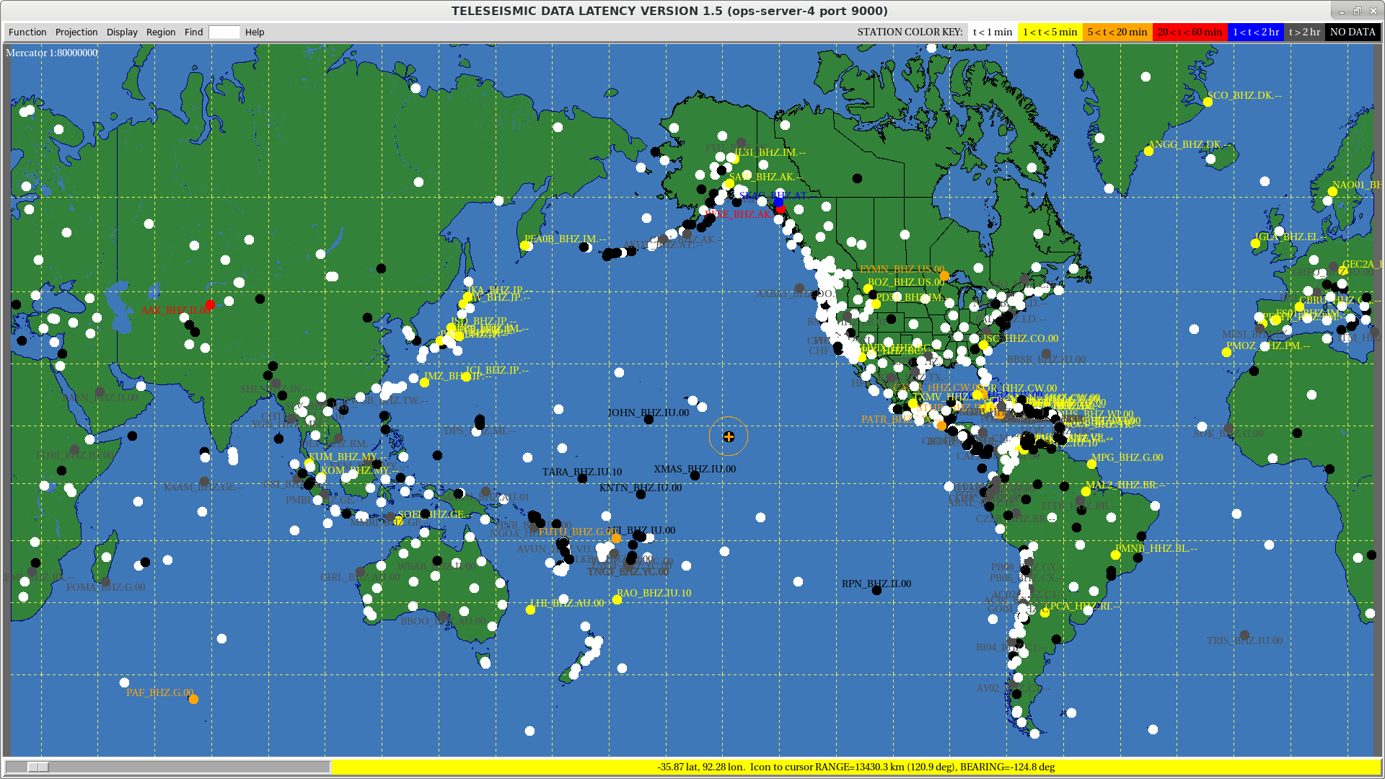
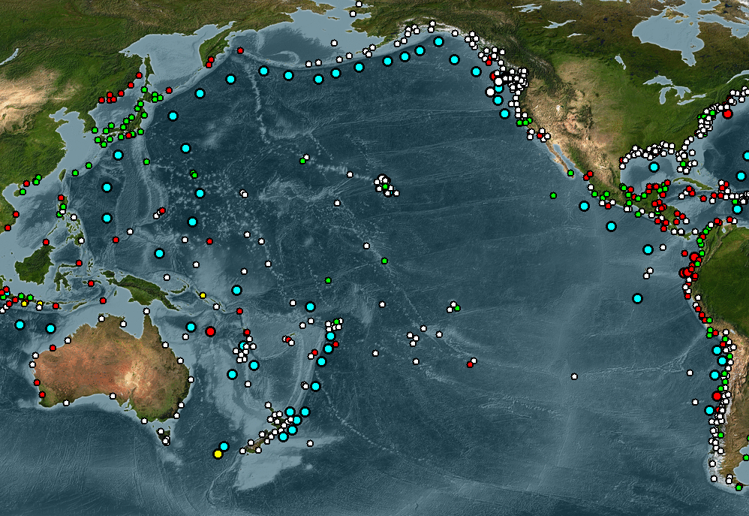
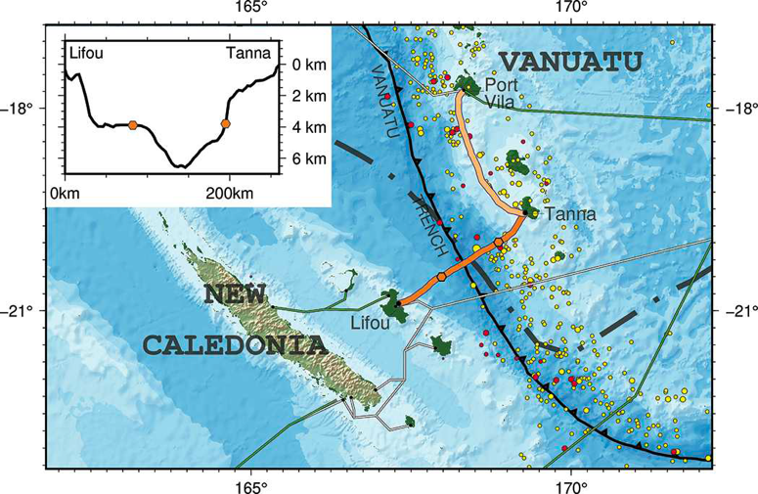
ICG/PTWS Seismic & Sea-Level Network

Slide 6
ICG/PTWS Decisions/Actions related to ODTP
    Vanuatu Expert Meeting (14-17 May 2024, Port Vila – Vanuatu)
The Expert Meeting on Tsunami Sources, Hazards, Risk and Uncertainties Associated with Vanuatu, San Cristobal and New Britain Subduction Zones brought together 23 experts (14 in-person/9 virtual) and 7 observers (6 in-person/1 virtual) from 10 Intergovernmental Coordination Group for the Pacific Tsunami Warning and Mitigation System (ICG/PTWS) Member States (Australia, France, Fiji, Japan, Indonesia, New Zealand, Papua New Guinea, Solomon Islands, USA and Vanuatu). The purpose of this Expert Meeting was to quantify earthquake sources that can generate dangerous tsunamis and to directly support community hazard assessments and evacuation planning that are part of the implementation of the Tsunami Ready Recognition Programme in the Pacific Islands Countries and Territories (PICTs) (2/Objective-1)
    ITP-Hawaii-Chile 2024 (19-30 August 2024, Valparaiso - Chile)
ITIC Training Programme on Tsunami Early Warning Systems and the PTWC Enhanced Products, Tsunami Evacuation Planning and Tsunami Ready Programme (ITP-Hawaii-Chile-2024) was organized by ITIC, SHOA and IOC/TSR. (6/Objective 1 and 2)
The ITP-TEWS-Chile used SHOA (Chile) as a working example of an end-to-end tsunami warning and mitigation system, following the same format at the ITP-Hawaii, where Hawaii is used as a working example with PTWC as its warning centre.
33 Trainees from 19 Member States (10 PTWS, 6 CARIBE-EWS, 2 IOTWMS, Argentina)
2. Risk Knowledge 3. Detection, Analysis and Forecasting of Tsunamis and Associated Hazardous Consequences
4. Warning, Dissemination and Communication 5. Preparedness and Response Capabilities 6. Capacity Development 7. Governance

Slide 7
ICG/PTWS Progress in TRRP
    SIDS
In 2024, Fiji and Solomon Islands again updated their National Tsunami Ready Board due to turnover of Senior Officials and on-going discussion underway for set up National Tsunami Ready Board in Tonga, Vanuatu, Kiribati and Cook Islands.
In collaboration with ITIC-Hawaii, National Disaster Management Office (NDMO), Solomon Islands Meteorological Service (SIMS) and Geological Service Division (GSD) conducted a National Tsunami Ready Stakeholders Workshop in Honiara, Solomon Islands on 23-24th July 2024. In collaboration with ITIC a Tsunami Ready planning meeting conducted in Port Villa, Vanuatu with the participation of Fiji, Solomon Islands and Vanuatu.
Fiji, Tonga, Vanuatu and Solomon Islands, developed inundation and evacuation maps. In Fiji, the Tsunami Inundation maps, and evacuation maps now incorporated into the school and community Tsunami Response Plan. Fiji now incorporates the tsunami hazard and evacuation map with the Tsunami Response Plan into the School Disaster Risk Management and Response Plan (SDRMRP). This will inform the review and update of Fiji Schools DRR Handbook. School tsunami response plans were developed for selected schools in Fiji and Tonga.
In 2024, Fiji, Vanuatu and Tonga reviewed and updated their National Tsunami Warning SOPs.
Pohnpei and Chuuk States of Federated States of Micronesia, Majuro (Marshall Islands), and Republic of Palau have been recognized as Tsunami Ready.
2. Risk Knowledge 3. Detection, Analysis and Forecasting of Tsunamis and Associated Hazardous Consequences
4. Warning, Dissemination and Communication 5. Preparedness and Response Capabilities 6. Capacity Development 7. Governance

Slide 8
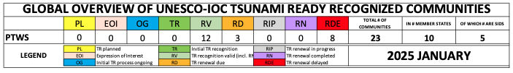
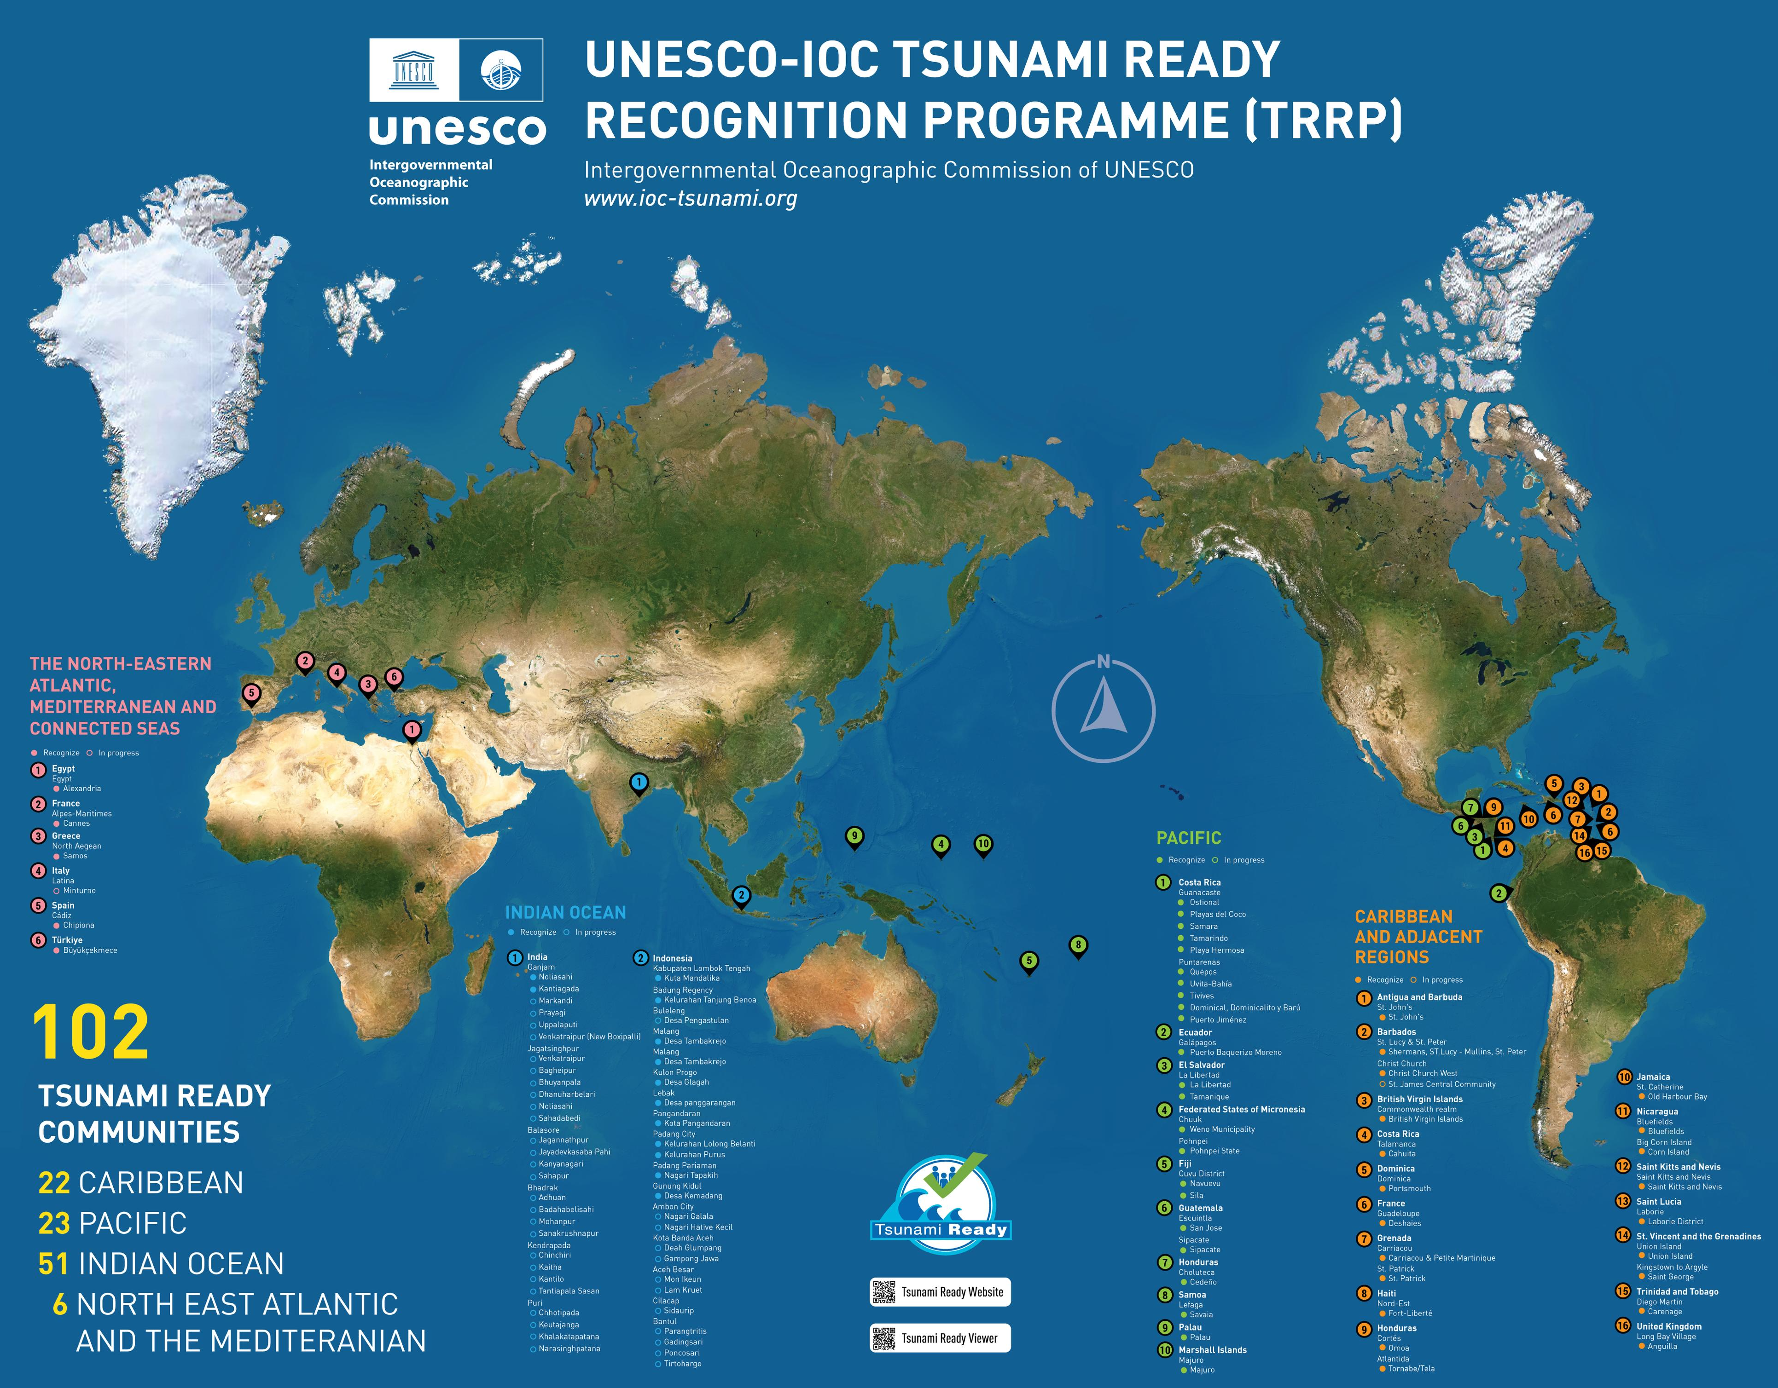
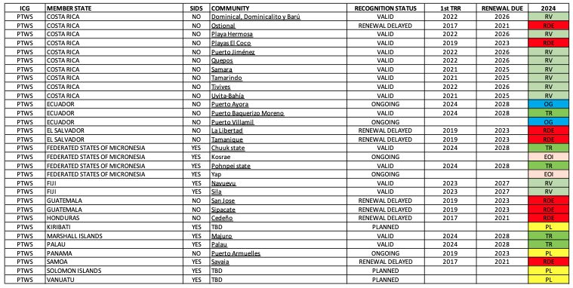
ICG/PTWS Progress in TRRP
Costa Rica (10)
Ecuador (1)
El Salvador (2)
FSM (2)
Fiji (2)
Guatemala (2)
Honduras (1)
Marshall Islands (1)
Samoa (1)
Palau (1)

