Slide 1
ODTP-SC-V-2025
2d. Update on current work programme of
TOWS-WG Task Team on
Tsunami Watch Operations
Öcal Necmioğlu
TTTWO Technical Secretary

Slide 2
TT-TWO Online Meeting 24 October 2024
1. Review of Global Service Definition Document (GSDD)
2. TOWS-WG TT-TWO Action Status
3. Agenda for the next TOWS-WG TT-TWO
4. Definition of meteotsunami (Report of the WMO-IOC JCB)
5. WMO Rolling Review of Requirements (WMO-RRR)
WMO-RRR requires a submission of tsunami variables (parameters) to be defined in WMOs Observing Systems Capability Analysis and Review Tool OSCAR. Initial parameters were defined as (tsunami) wave amplitude, wave period, arrival time of the initial wave, arrival time of the maximum wave, arrival time of last significant wave, inundation parameters (runup height, flow depth, inundation distance). After a series of meetings with the WMO and GOOS, it was decided to keep only direct/instrumentally measured tsunami amplitude as a parameter to be included (note that sea-level is defined as a separate parameter and arrival times are considered as associated parameters). A description, impact and solutions for gap analysis has been provided (with reference to ODTP, highlighting the need for high-resolution/near-real time tide-gauge and offshore buoy data in regions under high tsunami risk (Pacific, Indian, Caribbean, North-Eastern Atlantic, Mediterranean and its Connected Seas) with priority areas as known coverage gaps (in alphabetical order: Aegean Sea, Caribbean Sea (West, North and South-East), Indian Ocean (East and North), North Africa, Philippine Sea, Solomon Sea, South China Sea, Timor Sea, and Yellow Sea). Other tsunami related parameters can be included to OSCAR in the future.

Slide 3
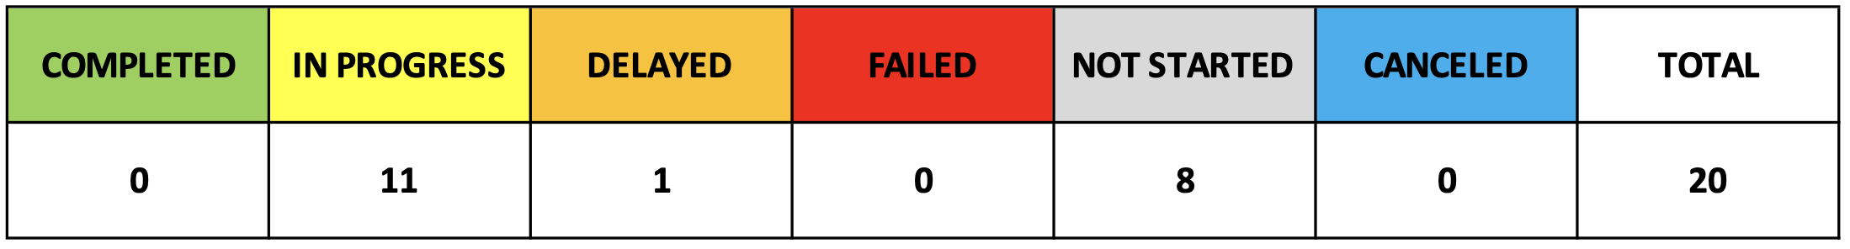
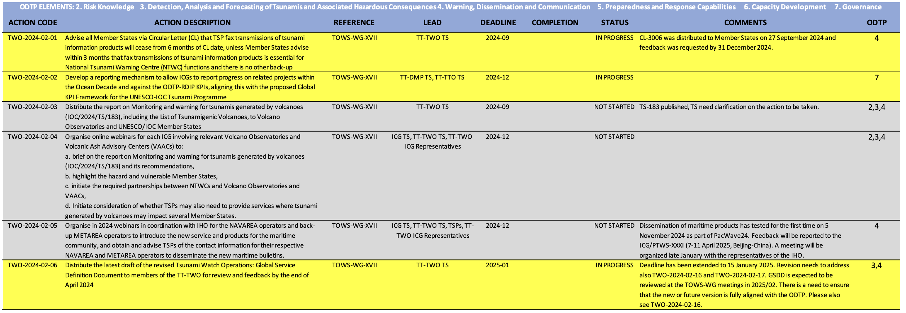
TT-TWO Status of Actions

Slide 4
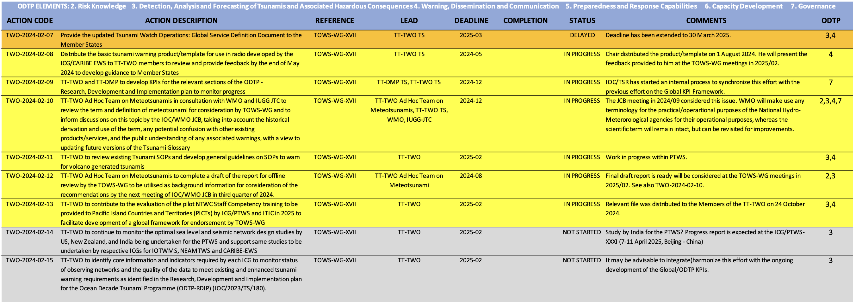
TT-TWO Status of Actions

Slide 5
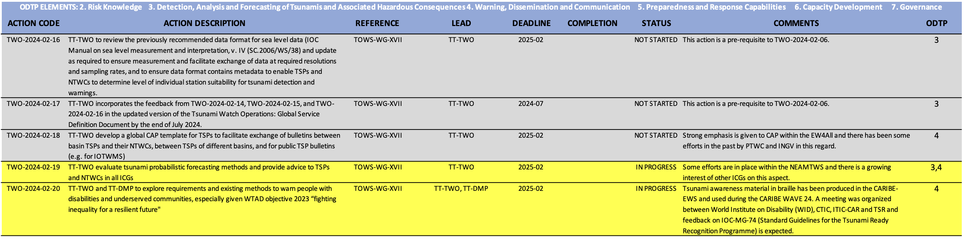
TT-TWO Status of Actions

