Slide 1
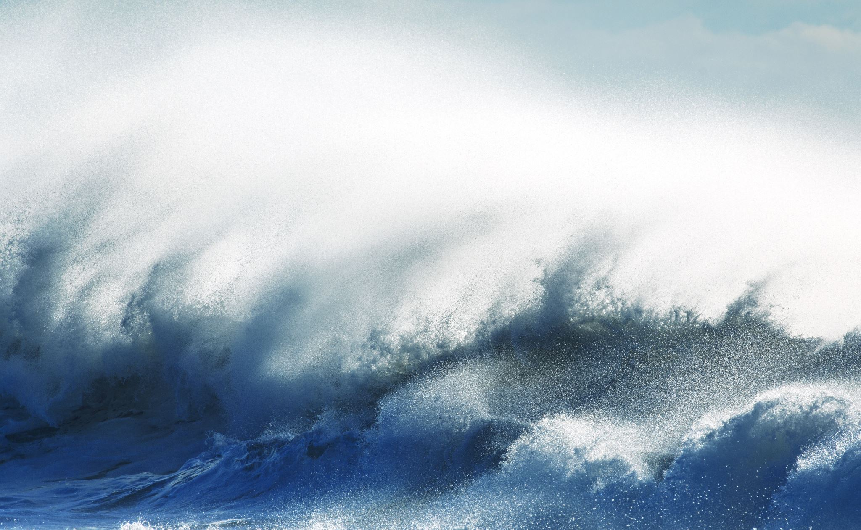
2024 Ocean Decade Conference,
Call for Decade Actions No. 07/2024
New Actions and Identifying Gaps for
ODTP Scoping of Call for Decade Actions No. 08/2024
Tsunami Resilience Section
UNESCO-IOC

Slide 2
Project (1):- FACING AND ADDRESSING OCEAN HAZARDS TOGETHER
FOCUS: HAZARD / RISK KNOWLEDGE/GOVERNANCE AND COMMUNICATION
Challenge 6: Coastal Resilience
Institution: Ocean University of China
Host: ODTP
Lead: Rui Bao
Country: China
Budget: 500,000 USD
Summary:
The project “Facing and Addressing Ocean Hazards Together” (FACT) is to engage more renowned international marine scientists and individuals concerned about the oceans, including science enthusiasts, especially young people, to form a scientific community; jointly carry out relevant international exchanges and cooperation to address potential marine disasters and propose response measures. The FACT will Organize regular forums to disseminate conclusions and early warnings from the scientific community to the public, influencing decision-makers on major ocean affairs and helping them make informed and impactful decisions in responding to marine Hazards.
Start and End: 01/01/2025 -31/12/2029
Basin: North Pacific Ocean, South Pacific Ocean. Indian Ocean, Arctic Ocean, Mediterranean Sea

Slide 3
Project (2):- EPOS THEMATIC CORE SERVICES TSUNAMI
FOCUS: RISK KNOWLEDGE, WARNING & DESSIMINATION /RESEARCH AND ITS PRACTICAL APPLICATIONS- HIGH-QUALITY AND FAIR DATA, SERVICES, AND SCIENTIFIC PRODUCTS )
Challenge 6: Coastal Resilience
Institution: GFZ German Research Centre for Geosciences
Host: ODTP
Lead:Andrey Babeyko
Country: Germany
Budget: 660,0000
Summary:
In February 2024, 18 European institutions from 11 countries signed a Consortium Agreement to establish Thematic Core Services TSUNAMI (https://tsunamidata.org and https://www.epos-eu.org/tcs/tsunami) under the auspices of EPOS-ERIC (European Plate Observing System, https://epos-eu.org). The mission of TCS-TSUNAMI is to promote tsunami research and its practical applications by providing open access to high-quality and FAIR data, services, and scientific products for a broad range of stakeholders, including researchers, disaster risk management and early warning practitioners, private sector, etc. The products and services (currently over 40) are defined in four categories: Pillar 1 – Support to Tsunami Service Providers; Pillar 2 – Tsunami-related datasets and observations; Pillar 3 – Numerical tools and workflows for tsunami simulations; Pillar 4 – Hazard and risk products.
Start and End:15/02/2024 -14/02/2030
Basin:North Atlantic Ocean, Mediterranean Sea, Black Sea, Marmara Sea

Slide 4
PROJECT (3):- SUSTAINING AGITHAR TOWARDS A GLOBAL TSUNAMI MODEL
FOCUS: RISK KNOWLEDGE/ PROBABILISTIC TSUNAMI HAZARD AND RISK ASSESSMENT
Challenge 6: Coastal Resilience
Institution: Universität Hamburg, Dept. of Mathematics, Hamburg, Germany
Host: ODTP
Lead:Jörn Behrens
Country: Germany
Budget: 120,000
Summary:The COST Action AGITHAR (running from 2019 through 2023) developed community standards and best practices for probabilistic tsunami hazard and risk assessment, necessary for preparedness, mitigation, and planning for tsunami disaster risk reduction. These practices will form the basis for the Global Tsunami Model (GTM) network of experts, organized in an association with a sustained business model, giving advice to public entities and decision makers, insurance and reinsurance industry, port authorities, and other diverse stakeholders.
Start and End:01/11/2023-1/10/2024
Basin:North Atlantic Ocean, Mediterranean Sea

Slide 5
PROJECT (4) : SCALING-UP AND STRENGTHENING THE RESILIENCE OF COASTAL COMMUNITIES IN THE NORTH-EASTERN ATLANTIC AND MEDITERRANEAN REGIONS TO THE IMPACT OF TSUNAMIS AND OTHER SEA LEVEL-RELATED COASTAL HAZARDS (COASTWAVE 2.0) APPROVED 18 DEC 2024
FOCUS: RISK KNOWLEDGE, MONITORING AND DETECTION, WARNING & DESSIMINATION, PREPAREDNESS AND RESPONSE–CAPACITY DEVELOPMENT
Challenge: Coastal Resilience
Institution: IOC
Host: UN31. The Ocean Decade Tsunami Programme
Lead: Denis Chang Seng
Country: France
Budget: 1.5 Million
Summary: The CoastWAVE project Phase-II (CostWAVE 2.0) is aimed at Scaling-Up and Strengthening the Resilience of Coastal Communities in the North-Eastern Atlantic and Mediterranean Regions to the Impact of Tsunamis and Other Sea Level-Related Coastal Hazards. It will build collective and common capacities in tsunami hazard assessment and evacuation mapping using probabilistic approaches. It will track changes in the level of tsunami awareness and risk perceptions. It will install additional tsunami detection, monitoring and alerting systems and scale up UNESCO-IOC Tsunami Ready Recognized communities in existing and new countries. A key outcome is to engage and create dialogues with multi-stakeholders and users involved in coastal resilience in a multi-hazard/risk context with the aim to create shared prevention and resilient preparedness for ocean related hazards to reduce their impact through better understanding and integration of tools, strategies and polices
Start and End: 1 July 2024-1 July 2026
Basin: NEAM

Slide 6
PROJECT (5): INCOIS SUBMARINE CABLE MULTI-PARAMETER OBSERVATORY
FOCUS: MONITORING AND DETECTION / SMART CABLE-SUSTAINABLE OBSERVATION
Challenge: Coastal Resilience
Institution: INCOIS, University College London (UCL), London and Indian National Centre
Host: ODTP
Lead: Srinivas Kumar?
Country: India
Budget:5959835
Summary:
This proposed initiative, the “INCOIS Submarine Cabled Multi-Parameter Observatory (ISCO)”, aims to undertake long-term observation of various oceanographic and geophysical parameters for climate research as well as operational applications related to tsunami and storm surge early warning system. The ISCO project is designed to include the installation of a submarine cable approximately 150 km in length, situated west of Wandoor in the Andaman & Nicobar Islands. The infrastructure will comprise two science nodes along the cable, equipped with oceanographic and geophysical sensors positioned at water depths ranging from 2000 to 2500 meters. Additionally, a landing station will be established at the INCOIS observatory in Wandoor, with a control center for real-time data acquisition and monitoring at the INCOIS headquarters in Hyderabad. This observatory is expected to play a transformative role in understanding the dynamic processes occurring in the ocean, particularly in relation to seismic activity and its potential to trigger tsunamis. As INCOIS being the lead implementing agency for this project, we are keen to explore opportunities for collaboration and seek endorsement from international bodies such as the UNESCO-IOC. We believe that such partnerships will be instrumental in leveraging global expertise and ensuring the successful implementation and operation of this observatory. Also, we would like to take your consent before applying for the opportunity of Ocean Decade endorsement for the ISCO. Upon your positive feedback, we can proceed towards the formal submission of the request to be endorsed.
Start and End:, 4 years
Basin: N-Indian Ocean

Slide 7
Project (6) : Tsunami Ready Odisha (TRO)
FOCUS: RISK KNOWLEDGE, PREPARDENESS AND RESPONSE/ CAPACITY DEVELOPMENT
Challenge: Coastal Resilience
Institution: INCOIS
Host: ODTP
Lead: Srinivas Kumar?
Country: India
Budget: 67335
Summary: Focusing on fully on “Tsunami Ready Recognition Programme” implementation in all coastal villages of Odisha, TRO is fully aligned with the Ocean Decade Tsunami Program (ODTP, UN-31), by emphasizing community resilience, multi-hazard early warning system and integration of scientific knowledge into practical applications for coastal protection. Working in close synergy with IOC-UNESCO’s ICG/IOTWMS and IOTIC, these members play key role in participatory approach for advising on implementation, ensuring that the project’s objectives are closely aligned with the IOC initiatives. The primary objective of this initiative is to improve the preparedness of coastal communities in Odisha, ensuring they are well-equipped to respond to tsunami risks and reduce potential losses. Through participatory methods and local involvement, Odisha State Disaster Management Authority (OSDMA), in coordination with INCOIS, is implementing the TRRP in all coastal villages of Odisha.
Start and End:?
Basin: Indian Ocean

Slide 8
PROJECT (7) : PEOPLE CENTRED TSUNAMI EARLY WARNING FOR INDIA
FOCUS: RISK KNOWLEDGE, MONITORING AND DETECTION, WARNING & DESSIMINATION, PREPAREDNESS AND RESPONSE–CAPACITY DEVELOPMENT
Challenge: Coastal Resilience
Institution: INCOIS
Host: ODTP
Lead: Srinivas Kumar
Country: India
Budget: 2840150
Summary: The United Nations has called for global coverage of early warning systems, recognizing tsunamis as among the deadliest natural disasters. The objectives of PCTWIN are aligned with the pillars of people centred early warning: improving disaster risk knowledge; improved detection, observation, and forecasting; advancements in communication; increased preparedness. It advances the research through creating knowledge base of tsunamigenic sources in the Indian Ocean, rapid source characterization by incorporating geodetic data and promoting forecast towards Probabilistic Tsunami Forecasting. It also focuses on inclusive and participatory methods for increasing community preparedness. This is facilitated by synergies with UNESCO initiatives in the Indian Ocean region such as the Tsunami Ready. It complements the Tsunami ready indicators by introducing markers measuring the inclusivity of the tsunami response plans devised by the local communities and engagement of the private sector.
Start and End:15.02.2024- 15.02..2028
Basin: Indian Ocean

Slide 9
CONTRIBUTION (1) : DEVELOPMENT OF COMPREHENSIVE TSUNAMI SOFTWARE (Approved 8 Jan 2025)
FOCUS: RISK KNOWLEDGE/ HAZRAD ASSESSMENT/ TOOLS
Challenge: Coastal Resilience
Institution: Tokushima University
Host: ODTP
Lead: Toshitaka Baba
Country: Japan
Summary: This action will contribute to the UN 31 Ocean Decade Tsunami Programme. The aim of this action is to develop comprehensive tsunami calculation software that will be available free of charge on the Internet. The software will include two-dimensional shallow water equations commonly used in tsunami hazard assessment. In addition, it can calculate dispersive tsunamis. Parallelized tsunami calculations are possible on laptops as well as on supercomputers. We can predict not only seismic tsunamis, but also non-seismic tsunamis caused by, for example, submarine landslides and volcanic eruptions. User-friendly input/output interfaces are provided.
Start and End: 01/01/2025 - 31/12/2030
Basin: Global

Slide 10
7 new actions (projects)
1 Contribution

Slide 11
Focus by ODTP Components
  61% Hazard/Risk Knowledge
  9% only Warning and dissemination

Slide 12
ODTP Related Investments (Call 7)
17,587320 USD
~17.6 Mill USD

