Slide 1

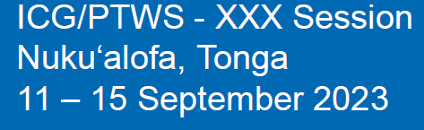
Report of ICG/PTWS Task Team on FUTURE GOALS AND PERFORMANCE MONITORING
YUELONG MIAO (AU) for
Taks Team Chair SARAH-JAYNE MCCURRACH (NZ)

Slide 2
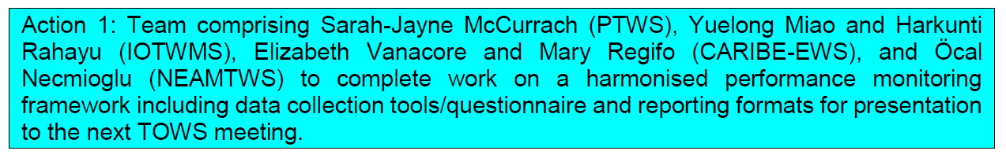
What is this Task Team?
2015 PTWS formed a Task Team to initiate the development of the PTWS Framework for Future Goals and Performance Monitoring or simply the "Performance Framework"
2018 A matured version is ready for review and share with other ICGs.
2018/19 Other ocean basins tested the draft PTWS Performance Framework and believed also relevant to them.
2019 ICG/PTWS tasked the task team to refine the framework by working with other ICGs and following the 2019 survey.
2019 TOWS-WG established a Task Force aimed for global adoption of the Framework
2021/22 Effectively the TOWS-WG Task Force took over the ICG/PTWS TT tasks, led by two Co-Chairs of SARAH-JAYNE MCCURRACH (NZ) and MARY RENGIFO (COL)
2022/23 Final Version ready for TOWS-WG endorsement and global adoption but TOWS-WG did not discuss.
Confused? It can be.

Slide 3
ICG/PTWS-TT FUTURE GOALS & PERFORMANCE MONITORING
TERMS OF REFERENCE (ToRs)
Work with all IOC-ICG’s to develop a consistent Global Framework for Goals and Performance Monitoring of Tsunami Warning & Mitigation Systems.
Work with all IOC-ICG’s to establish a performance baseline with the means to accurately identify shared activities, opportunities and resources required to help meet the identified goals.
Ensure a Global Framework for Goals and Performance Monitoring is aligned with the
  • Sendai Framework for Disaster Risk Reduction
  • United Nations Decade of Ocean Sciences for Sustainable Development – A Safe Ocean
  • IOC Tsunami Programme
  • Tsunami Ready Programme
  • ICG/PTWS Strategy 2022-2030
Develop material to support implementation and ongoing use of a Global Framework for Goals and Performance Monitoring. This must include clear expectations for all ICG Member States, guidance, and standards.
Present a model to all IOC-ICG’s for the ongoing monitoring and evaluation of the Framework, to ensure the process and delivery is sustainable. This must include a process for all ICGs to detail gaps, opportunities, and improvements in regard to their evaluation against a Global Framework for Goals and Performance Monitoring.
Develop an online survey aligned with a Global Framework for Goals and Performance Monitoring. The survey must be easily accessible to all Member States, comprehensive and fair, with the ability to develop ‘real-time’ evaluations.

Slide 4
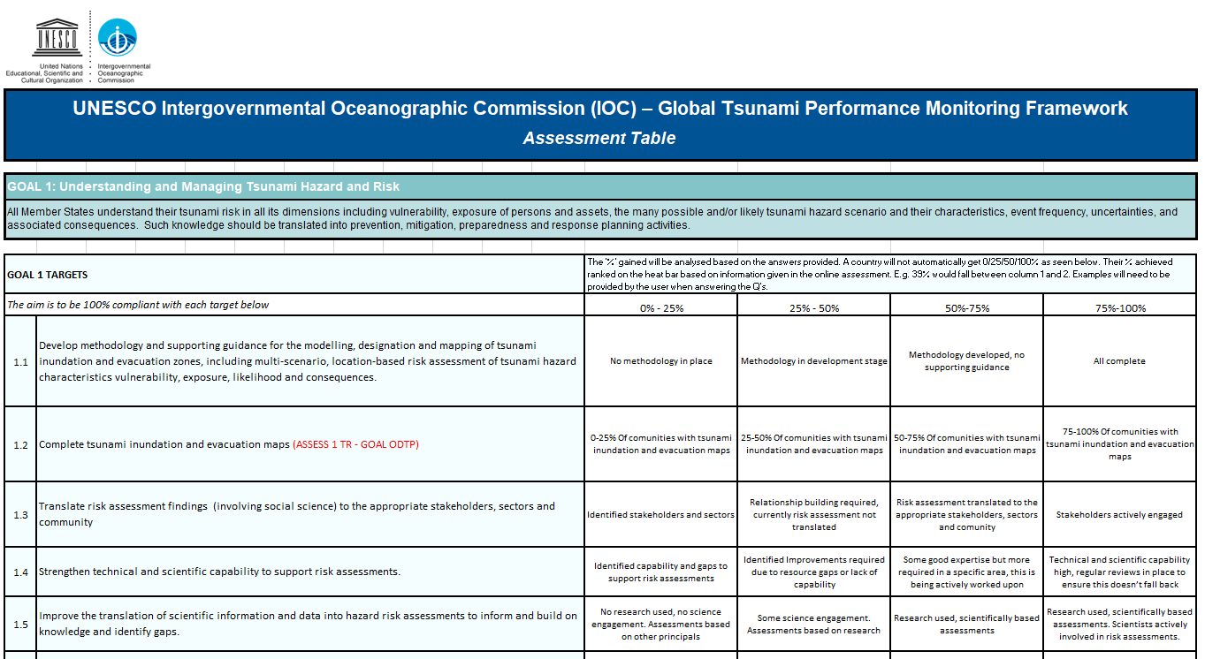
What's in the IOC GLOBAL PERFORMANCE MONITORING FRAMEWORK?
The global performance monitoring framework, which includes data collection tools/questionnaire and reporting formats, is now available.
Notes:
The pandemic has provided an example of how probabilities of occurrence for disaster events have needed to be rapidly described and communicated to communities, who are in turn, making risk-based decisions on information provided by governments and officials. This is something the PTWS can reflect on when assessing our work programmes going forward, notably regarding the communication of tsunami hazard and risk.
The first assessment round completed by Member States, resulted in several suggestions for improvements in the framework model and the associated online survey. Given the TOWS KPI Task Team is developing a ‘Global IOC KPI Framework’ (linked closely to Inter-ICG Task Team on Disaster Management and Preparedness), to improve the consistency of all ocean basin performance, it was agreed all feedback would be taken into the development of the new local framework, rather than amending the PTWS KPI Framework. This is because we anticipate the Global IOC KPI Framework will replace the PTWS KPI Framework.

Slide 5
GLOBAL GOALS & TARGETS
Goals:
  GOAL 1: Understanding and Managing Tsunami Hazard and Risk
  GOAL 2: Tsunami Detection, Warning & Dissemination
  GOAL 3: Enhancing tsunami preparedness for effective community response
  GOAL 4: Tsunami event response and recovery
  GOAL 5: Global ocean coordination, cooperation and partnerships (Working Group/ICG Leaders Only)
Expectations are to:
  Monitor and evaluate against this framework
  Provide yearly reports via the annual ICG meeting structures
  Participate in annual meetings/workshops on global basin assessments, presenting gaps, opportunities and improvements regarding the framework evaluation.
  Prioritize actions in order to improve tsunami risk management in each ICG
.

Slide 6
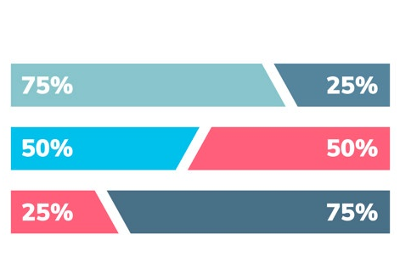
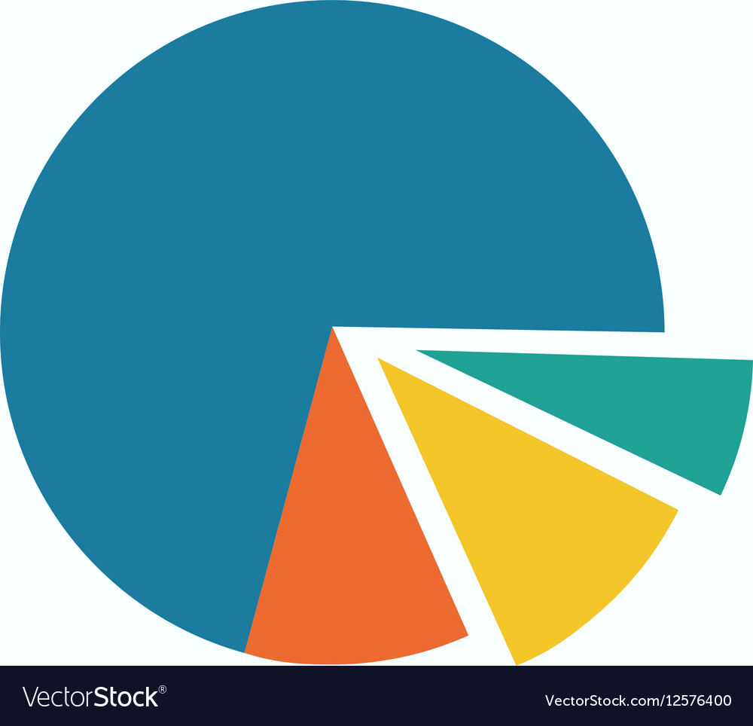
GLOBAL FRAMEWORK ACCESS
Web-based Portal
Hosted on IOC site
Algorithm functionality
Real-time graphs
Fair and ethical
Easy, accessible and simple (yet comprehensive) National, ICG and Global reporting
ACTIONs
Coordinate with the Chief of Tsunami Unit and develop requirements for building the web portal (almost done).
Procure a qualified web developer to build the portal.
Work with the developer to build the fit-for-purpose portal for all ICGs to use.
.

Slide 7
Recommendations to ICG/PTWS XXX
Notes the presentation of the Task Team on Future Goals and Performance Monitoring;
Notes the developed final version of the global performance monitoring framework ready for TOWS-WG endorsement;
Decides to dissolve the named Task Team for the ICG/PTWS ;
Recommends the PTWS members for the TOWS-WG TT DMP to ensure the latest version of the Framework be presented at the next TOWS-WG for endorsement of the global adoption by all ICGs;
Recommends the TT DMP to work with the IOC Tsunami Unit to develop the web portal.

Slide 8
Melo e Lelei!

