Slide 1
Awareness Learning Activity
Create Awareness Material
ITIC TRIANING PROGRAMME 2024
VALPARAÍSO - CHILE

Slide 2

JULIO CASTRO - CHILE

Slide 3
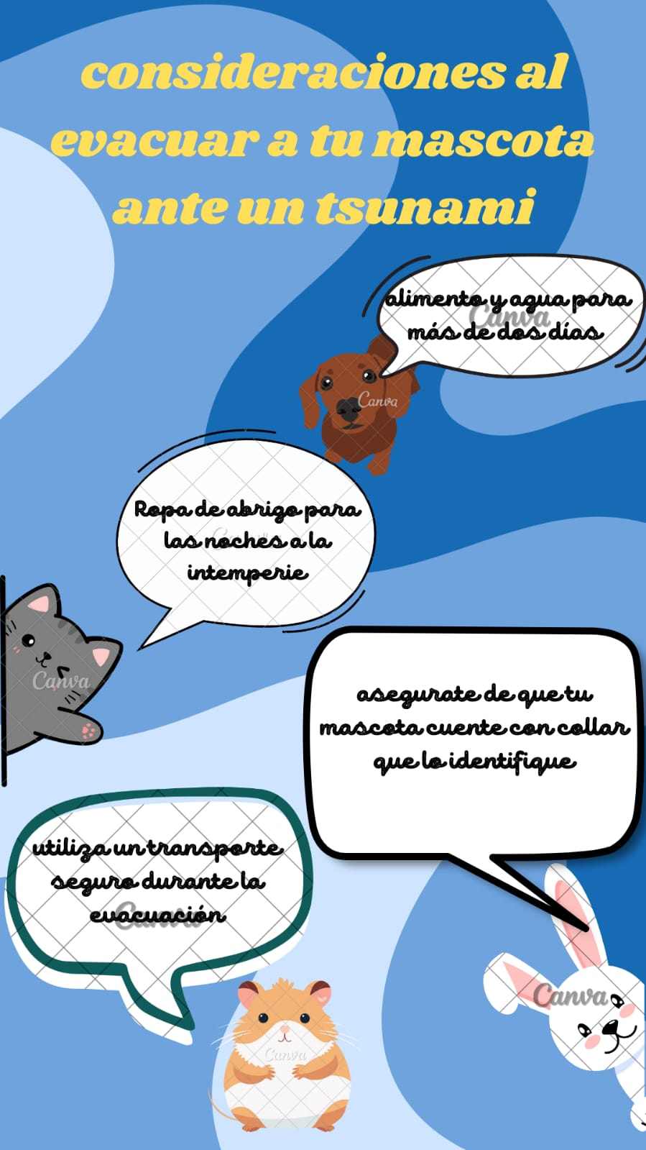
JAIME CORALES - CHILE

Slide 4
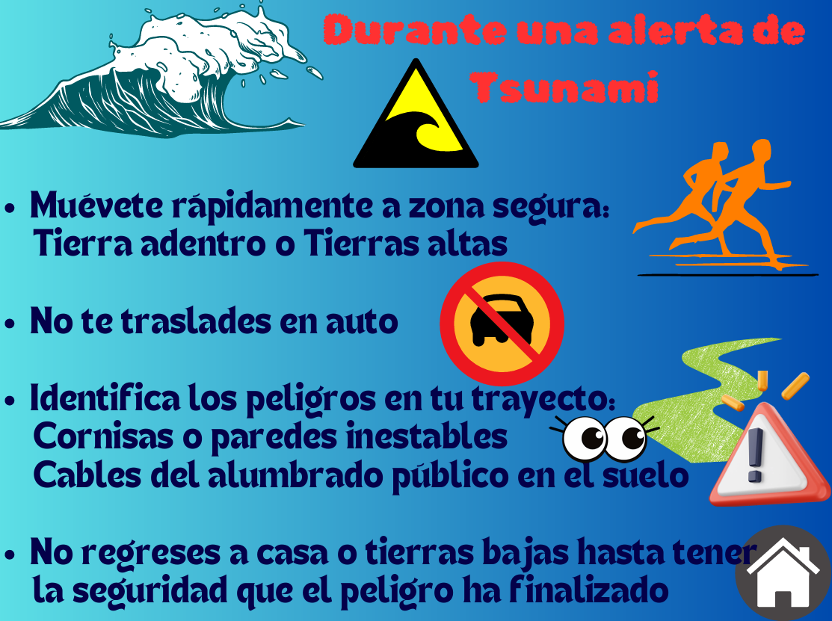
JASNA HARO- CHILE

Slide 5
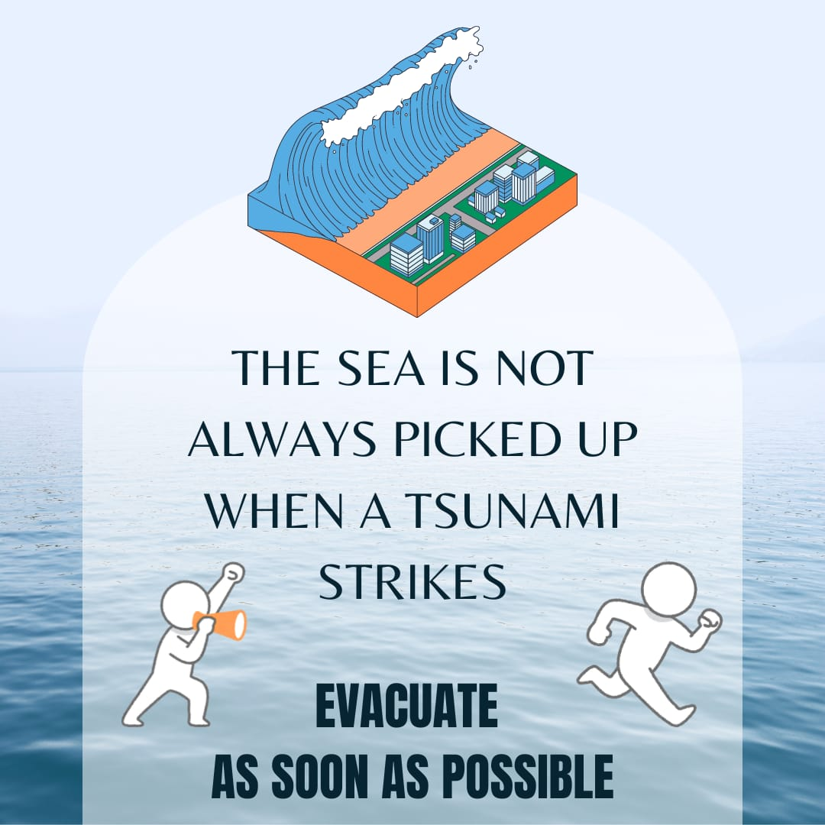
CLAUDIA COLLAO - CHILE

Slide 6
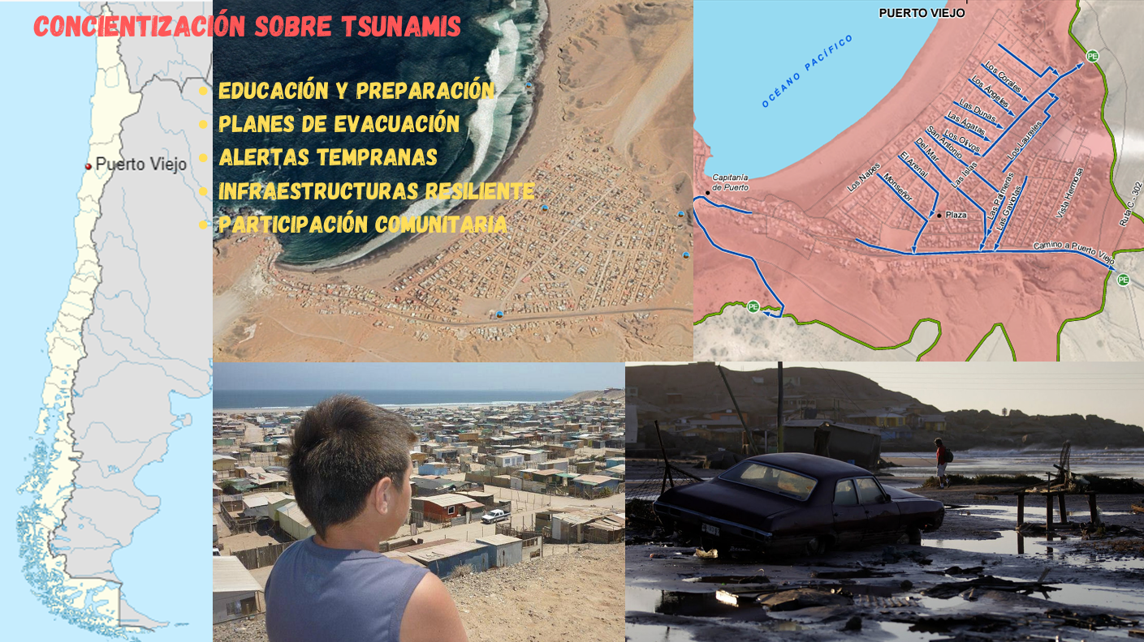
CÉSAR NÚÑEZ - CHILE

Slide 7

ALEJANDRO MARABOLI-Q - CHILE

Slide 8

ALEJANDRO MARABOLI-Q - CHILE

Slide 9

CAROLINA HENRÍQUEZ- CHILE

Slide 10

CAROLINA HENRÍQUEZ- CHILE

Slide 11
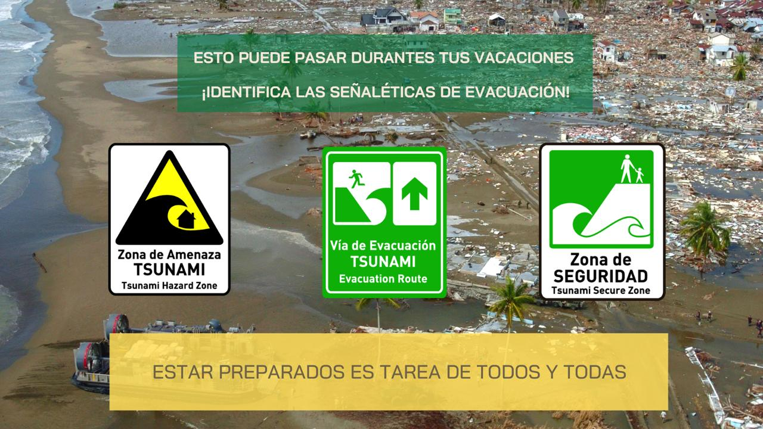
RODRIGO ASENJO - CHILE

Slide 12

MUHAMMAD HARVAN - INDONESIA

Slide 13
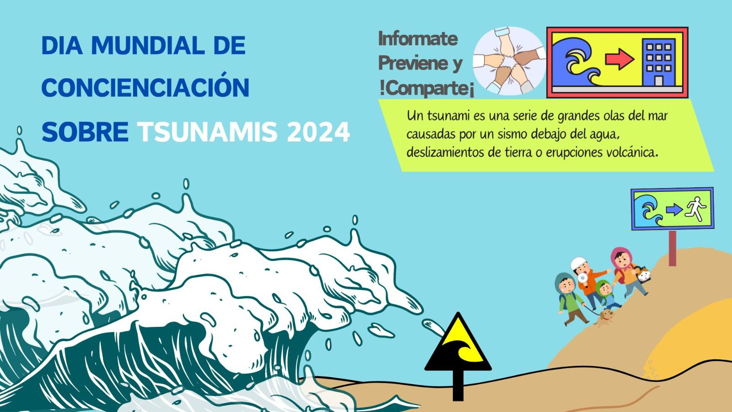
DULCE CALAN - GUATEMALA

Slide 14
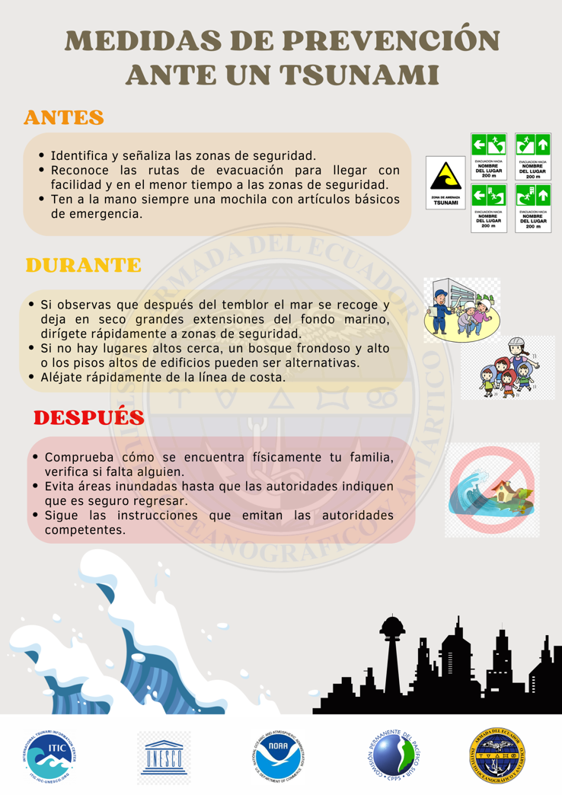
CHRISTIAM GÓMEZ- ECUADOR

Slide 15

STEVEN AGUILERA - ECUADOR

Slide 16

DENISSE LLACUACHAQUI - PERÚ

Slide 17
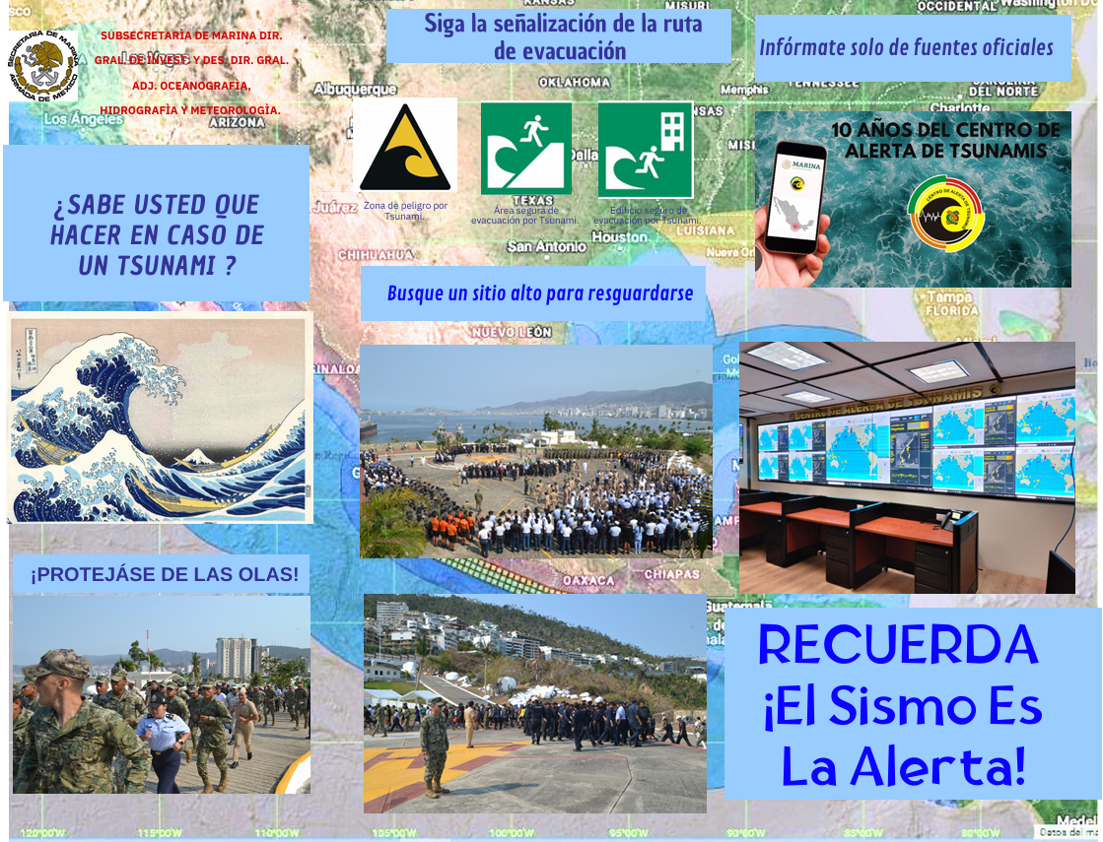
JURITZI PÉREZ - MÉXICO

Slide 18

WILBERTH FORERO - COLOMBIA

