Slide 1
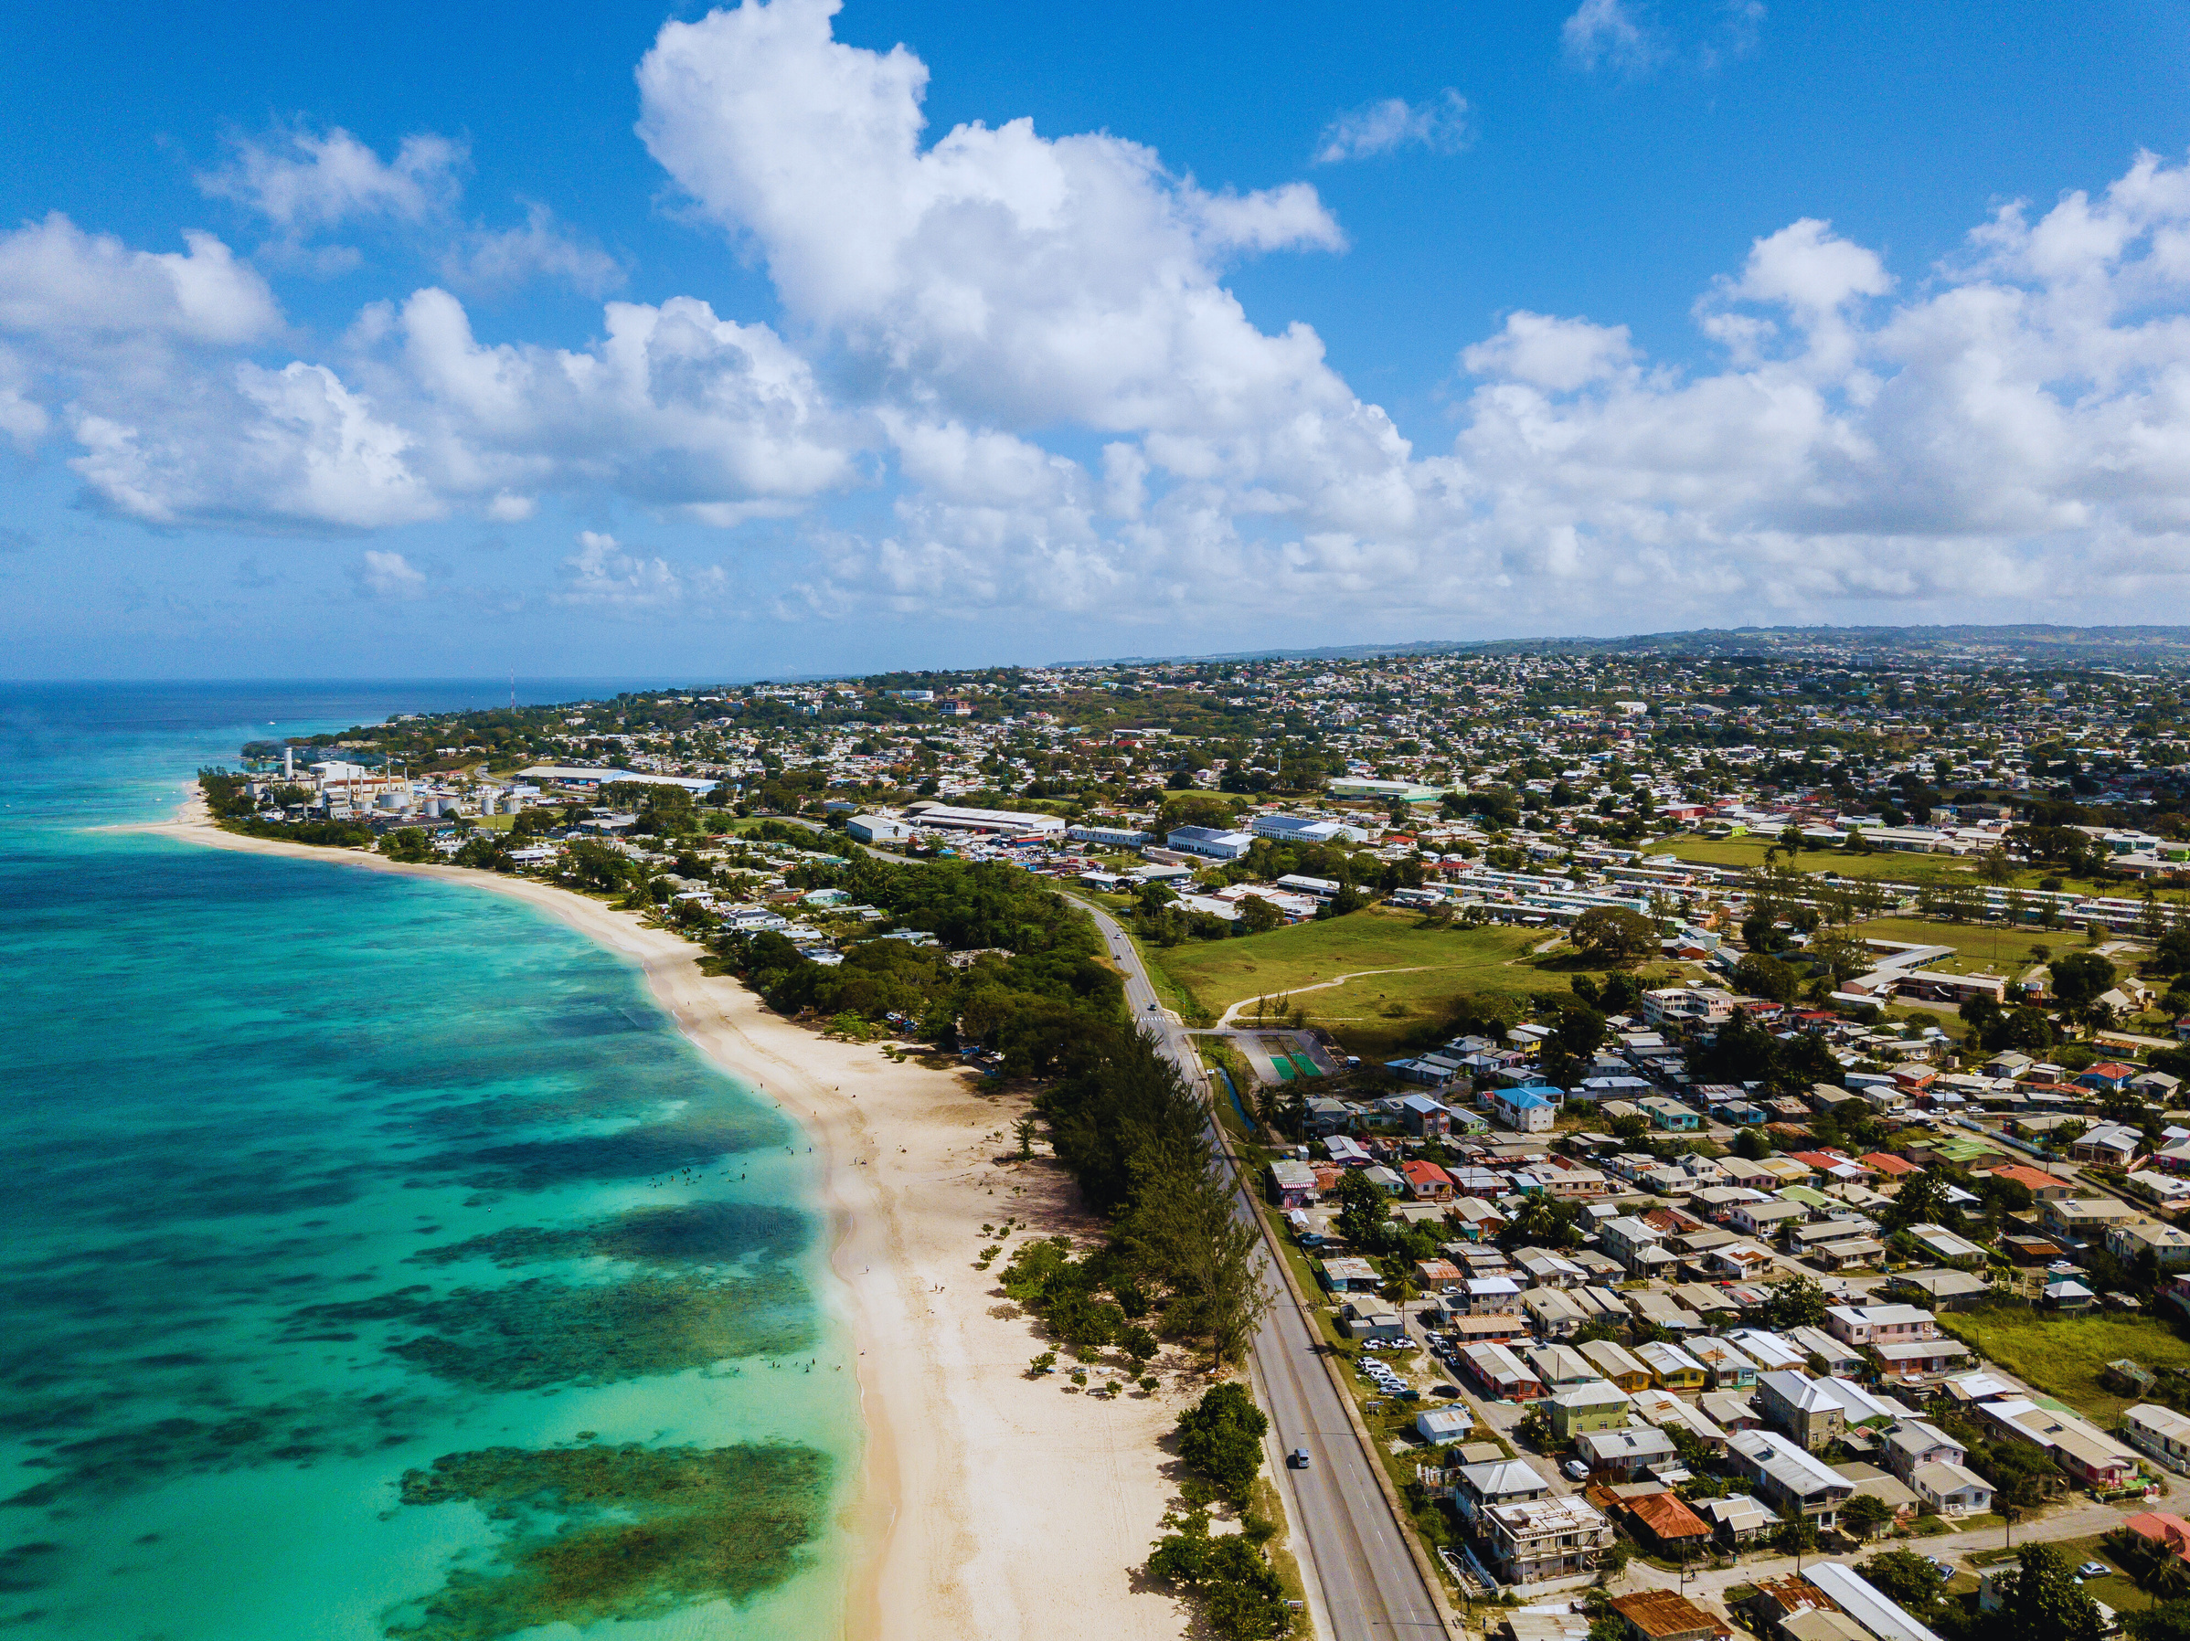

Barbados‘ National Progress Report 2023
Intergovernmental Coordination Group For The Tsunami And Other Coastal Hazards Warning Systems For The Caribbean And Adjacent Regions
17th Session
May 6-9, 2024
Nicaragua
Created by: The Barbados Team
Presented by: Danielle Howell

Slide 2
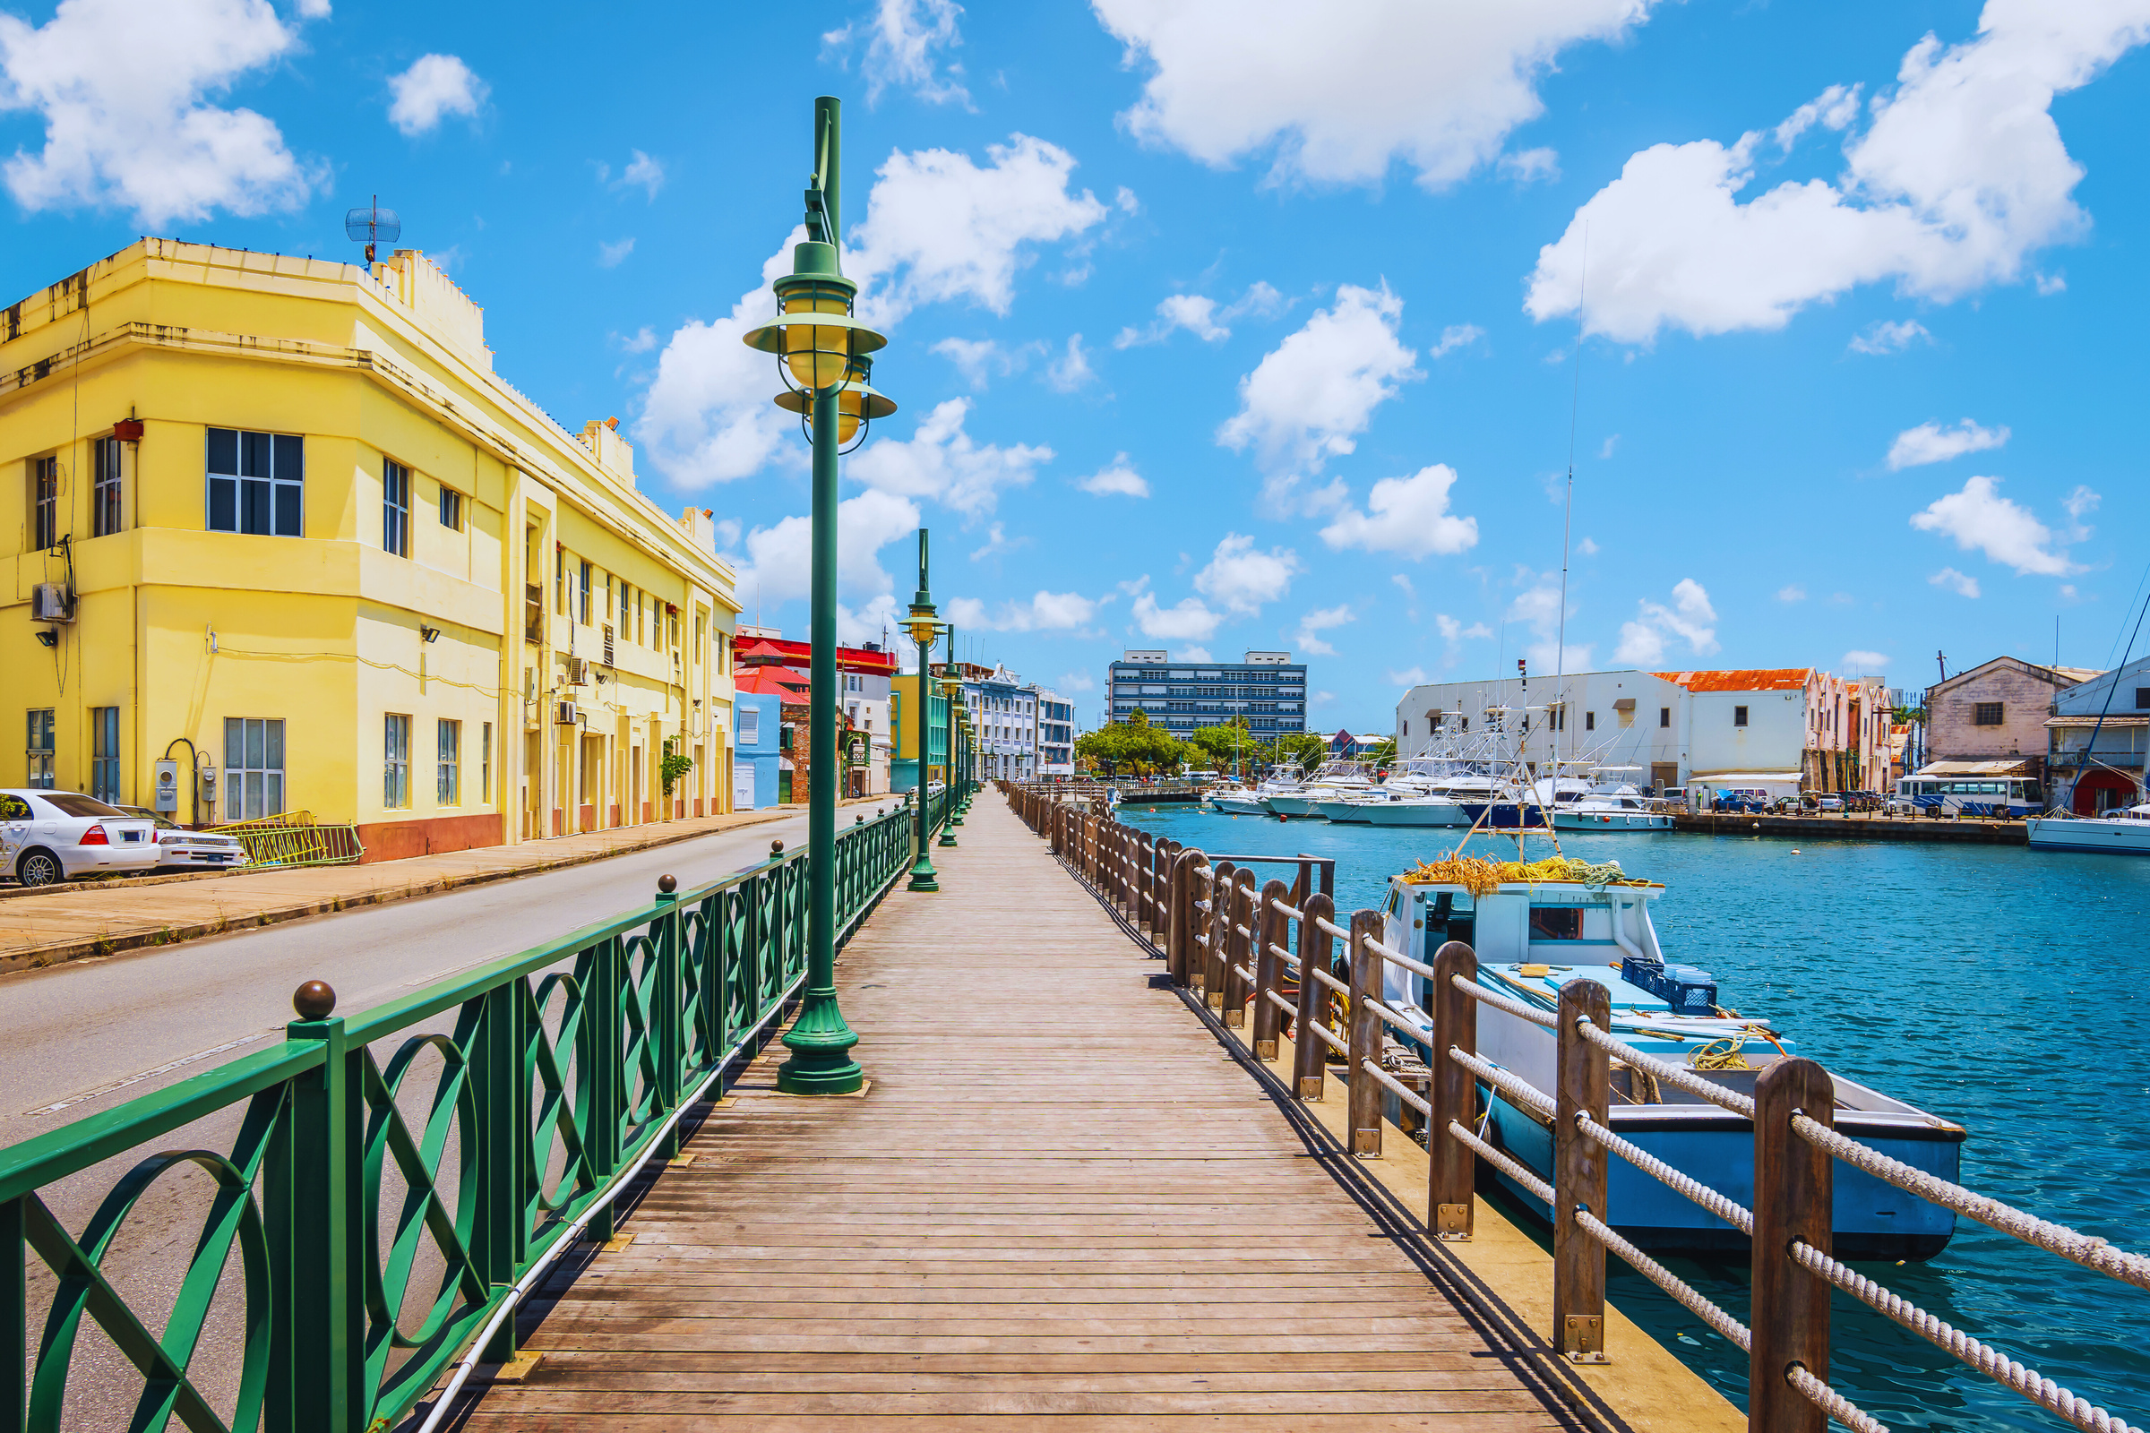




THE BARBADOS TEAM
THE TECHNICAL STANDING COMMITTEE ON COASTAL HAZARDS (TSCCH)
CONTENT
PRIORITY AREAS OVER THE LAST YEAR
FUTURE PLANS

Slide 3




The Barbados Team
Dr. Leo Brewster – Director of Coastal Zone Management Unit (CZMU) and Tsunami National Contact (TNC). Represents Barbados in the coordination of international tsunami warning and mitigation activities.
Mr. Sabu Best – Director of Barbados Meteorological Services (BMS), Tsunami Warning Focal Point/Warning Centre. The 24 x 7 contact person, who is available at the national level for rapidly receiving and issuing tsunami event information (such as warnings).
Ms. Kerry Hinds – Director of the Department of Emergency Management (DEM) and Tsunami Advisor. Manages Tsunami Mitigation in Barbados along with Dr. Leo Brewster.

Slide 4
The Technical Standing Committee on Coastal Hazards (TSCCH)
THE COASTAL ZONE MANAGEMENT UNIT (CZMU)
CO-CHAIR
THE DEPARTMENT OF EMERGENCY MANAGEMENT (DEM)
CO-CHAIR
Hazard Detection & Monitoring
Hazard Assessment, Modelling & Protocols
Warning Communications & Dissemination
Public Information & Education
Evacuation
BMS
CZMU
MIST
BGIS
TBPS
CZMU
BGIS
BGIS
CZMU
BFS
PDO
BMS
FISHERIES
DEM
FISHERIES
MIST
COMMUNITY REP.
BDF/BCD
MIST
MIST
COMMUNITY REP.
MYSC
BMS
TBPS
TBPS
BPI
BBSA
MFEI
TBPS
TBPS
BDF/BCG
MTIT
MTIT
PDO
BFS
METVT
BDF/BCG
METVT
BL&P
DEM
NCC
BARNUFO
BCCI
MTWWR
BHTA
BFS
BCD
CIMH
MHAI
MENB
NCC
CDEMA

Slide 5
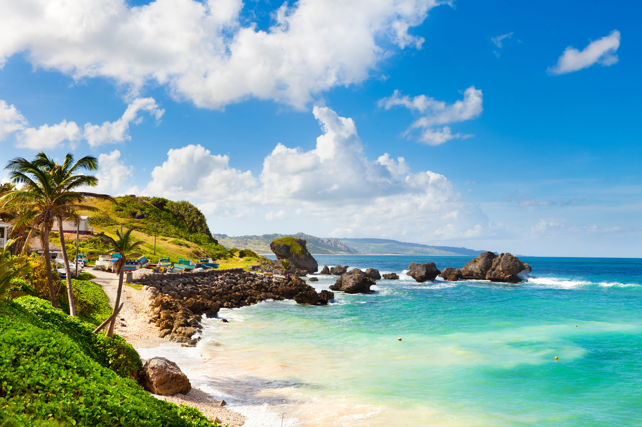
PRIORITY AREAS OVER THE LAST YEAR

Slide 6
UPDATE TO THE NATIONAL SEA LEVEL NETWORK
Station Name | Location | Latitude | Longitude | Sensors
Port St. Charles | St. Peter Northwest Coast | 13.263 | -59.6446 | Tide Gauge (working)Radar Sensor (working)Aqua Bubbler (working)Pressure Level(working) LIVE FEED
Barbados Coast Guard | St. Michael | Not provided | Not provided | Radar Sensor(working)
Bridgetown Port | St. Michael | 13.108 | -59.629 | Sea Level Station (Decommissioned)
Consett Bay (x2) | St. John | 13.17994 | -59.4664 | Radar Sensor(working)
Speightstown | St. Peter | 13.25025 | -59.64089 | Radar Sensor(working)
Oistins | Christ Church | 13.0706 | -59.547 | Radar Sensor(offline)
Holetown | St. James | 13.18712 | -59.63523 | Radar Sensor(offline)
Bridgetown | St. Michael | 13.11135 | -59.63141 | Radar Sensor(working)

Slide 7
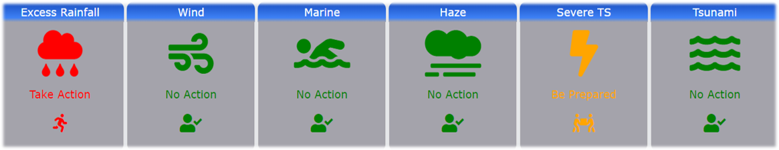
GLOBAL TSUNAMI RECOGNITION
In 2020-2023 period the TSCCH was significantly impacted by COVID-19. However, the TSCCH was able to convene virtually and achieve the Tsunami Ready designation for Shermans to Mullins and start the process for achieving Tsunami Ready designation for two new coastal segments.
  Barbados, under the guidance of TSCCH, achieved its first Global Tsunami Ready Recognition for the area Shermans, St. Lucy to Mullins in St. Peter in June 2020.
2020
2021
The BMS impacted-based forecasting was followed by the introduction of the BMS Insights Application for smart phones in 2021.
In 2022, Barbados launched the Tsunami Ready initiative for two communities, Porters to Holders Hill, St. James and Garrison, St. Michael to Rendezvous, Christ Church. Barbados.
2022

Slide 8
GLOBAL TSUNAMI RECOGNITION
  The decision was made to undertake the Tsunami Ready Recognition by constituency boundaries to eradicate any communities being omitted.
  The St. James Central project was extended from Porters, St. James to Batts Rock, St. Michael.
  The community of St. James Central completed the criteria to be recognized as Tsunami Ready but awaits official recognition status.
  Barbados is in the process of starting the Renewal of Tsunami Ready Recognition for the communities from Shermans, St. Lucy to Mullins, St. Peter.
  In September 2023, the community of Christ Church West (Garrison, St. Michael to Rendezvous, Christ Church) achieved their Tsunami Ready Recognition.
2023
2024

Slide 9
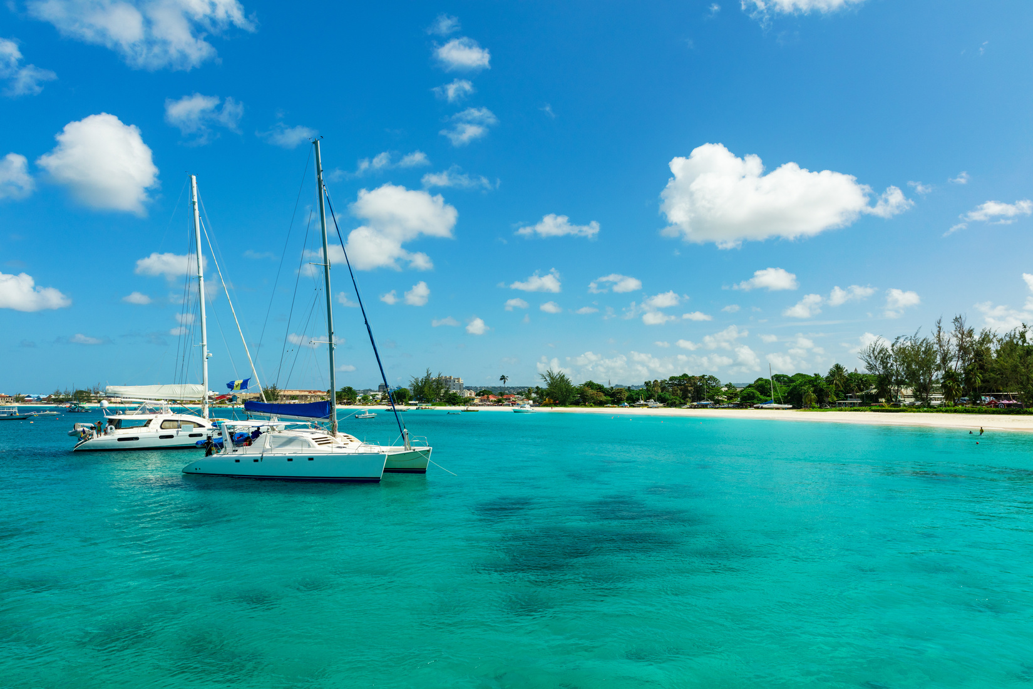
Present
Upgrades are constantly made to improve its operability.
Expansion to the capacity and reach by :
    Four to Eighteen Radio Stations.
    Ten broadcasting has signed MOUs.
Future
Continuity in upgrading
Work is being done between DEM, Ministry of Innovation, Science and Smart Technology and the Telecommunications Unit to support the upgrade.
Common Alerting Protocol: Mass Notification System

Slide 10
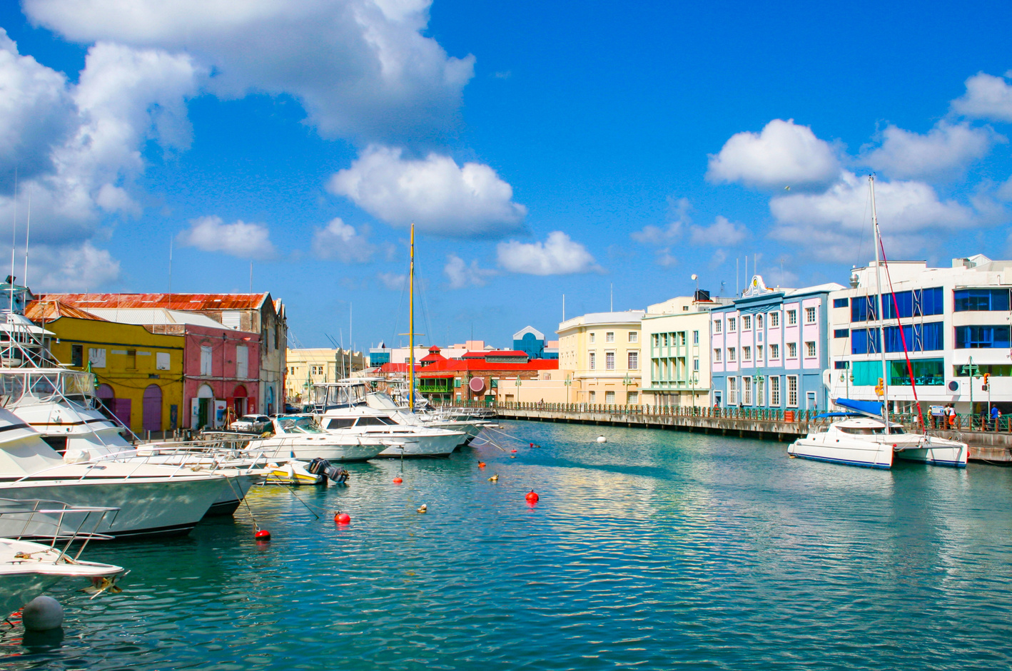
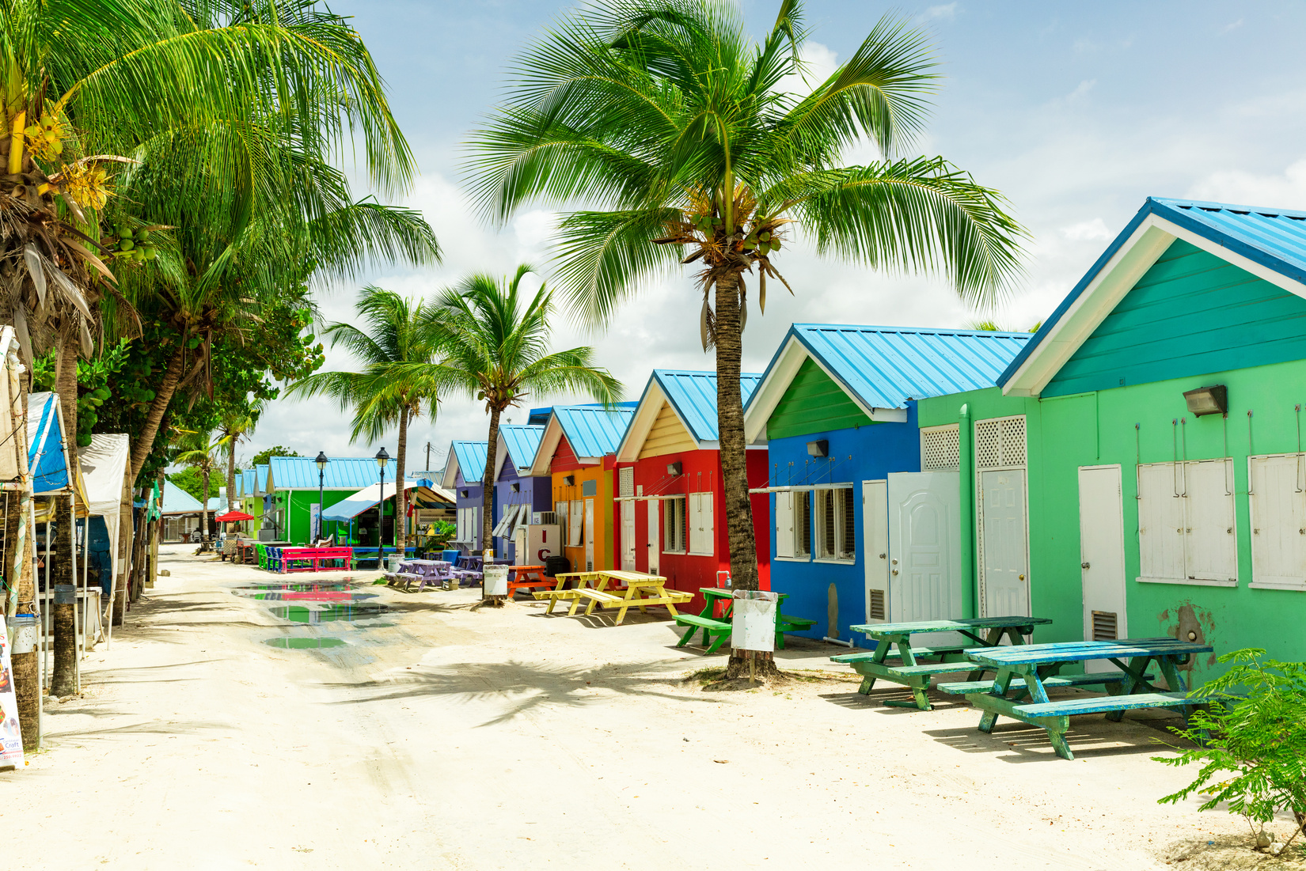
NATIONAL TSUNAMI PUBLIC AWARENESS PROGRAMME
The Barbadian population has been kept abreast of tsunami and other coastal hazards through public awareness and education activities which targeted coastal communities, the Tourism Sector stakeholders, the Insurance Agencies, the disabled community, school population and the general public during the period April 2023 - March 2024.

Slide 11
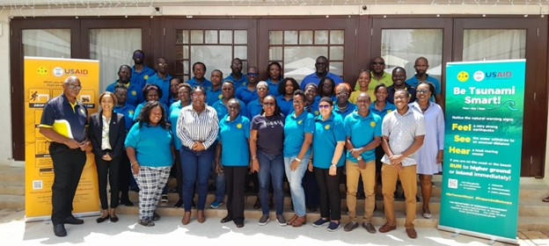
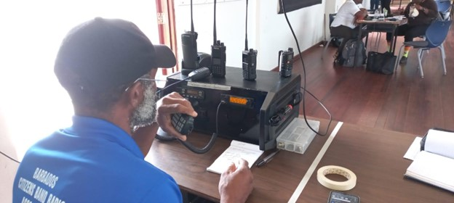
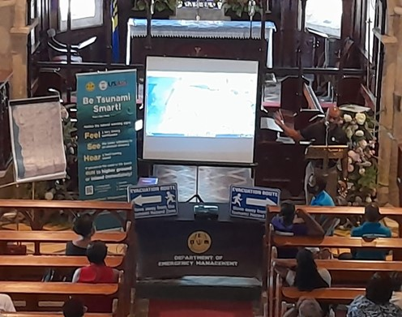
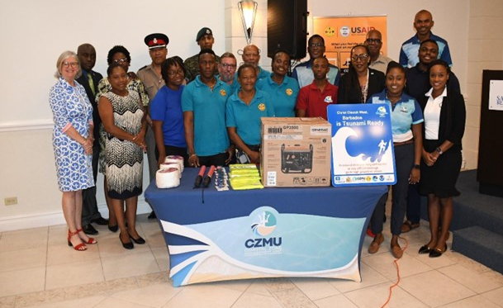

Slide 12
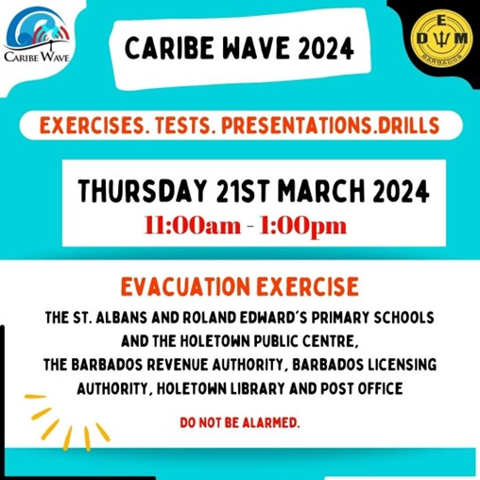
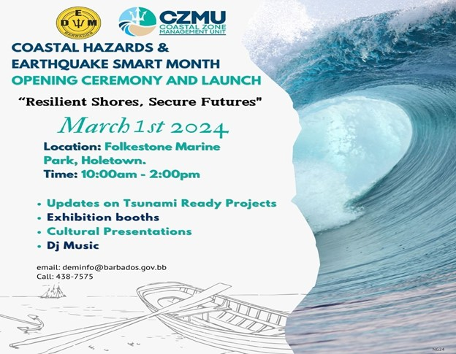
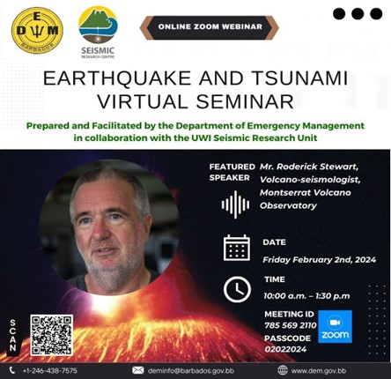

Slide 13
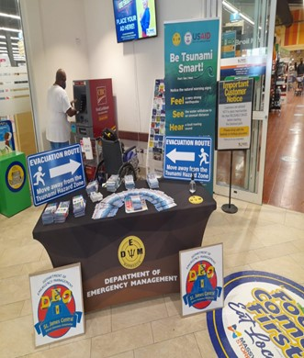
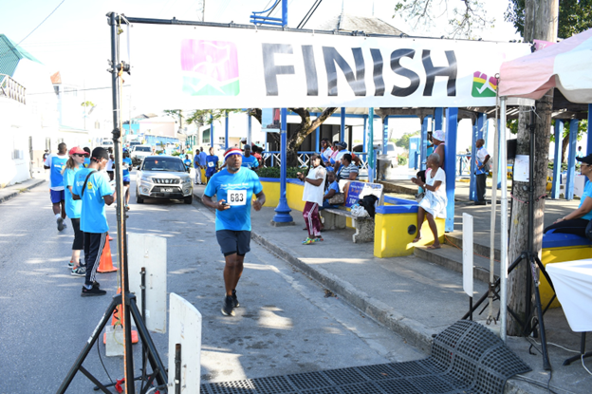
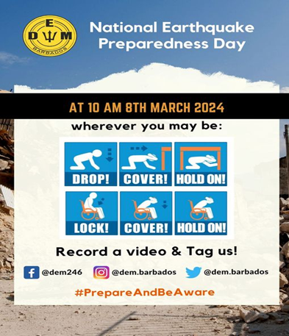

Slide 14
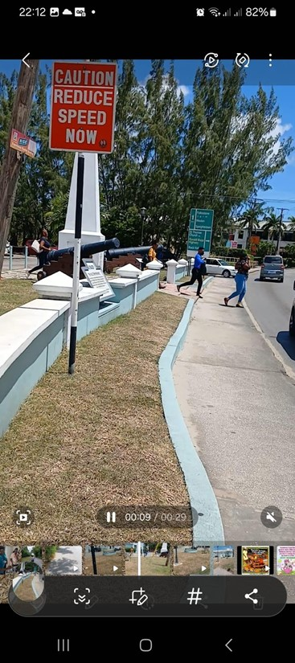
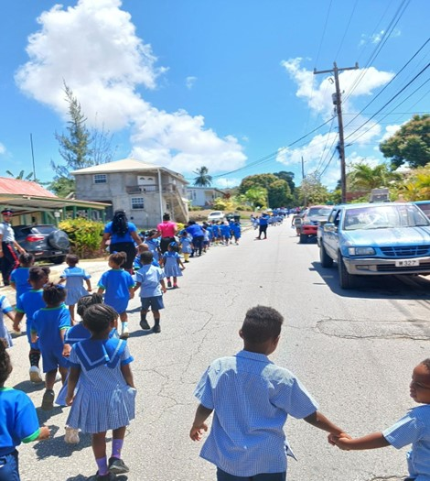
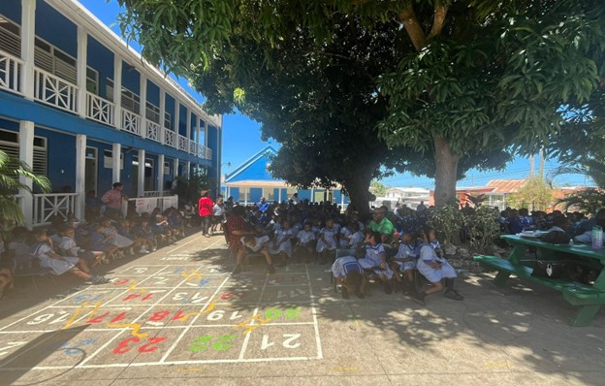
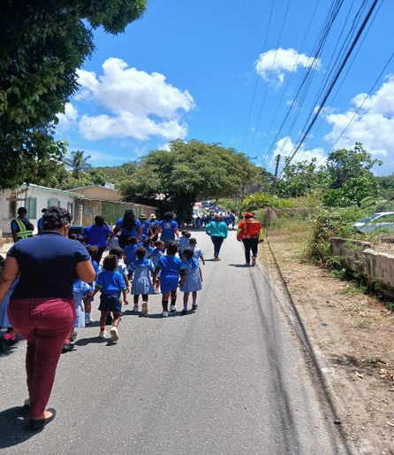
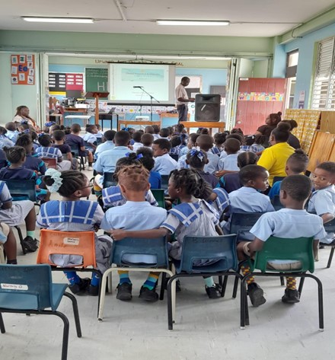
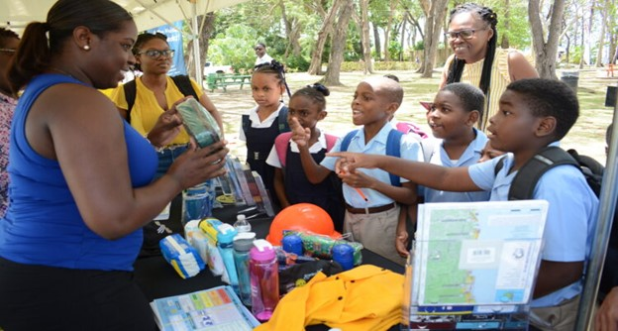
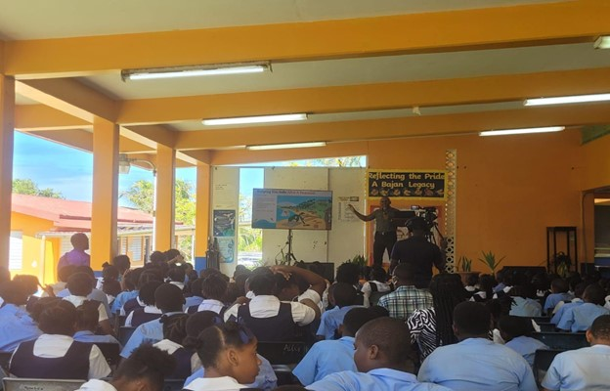

Slide 15
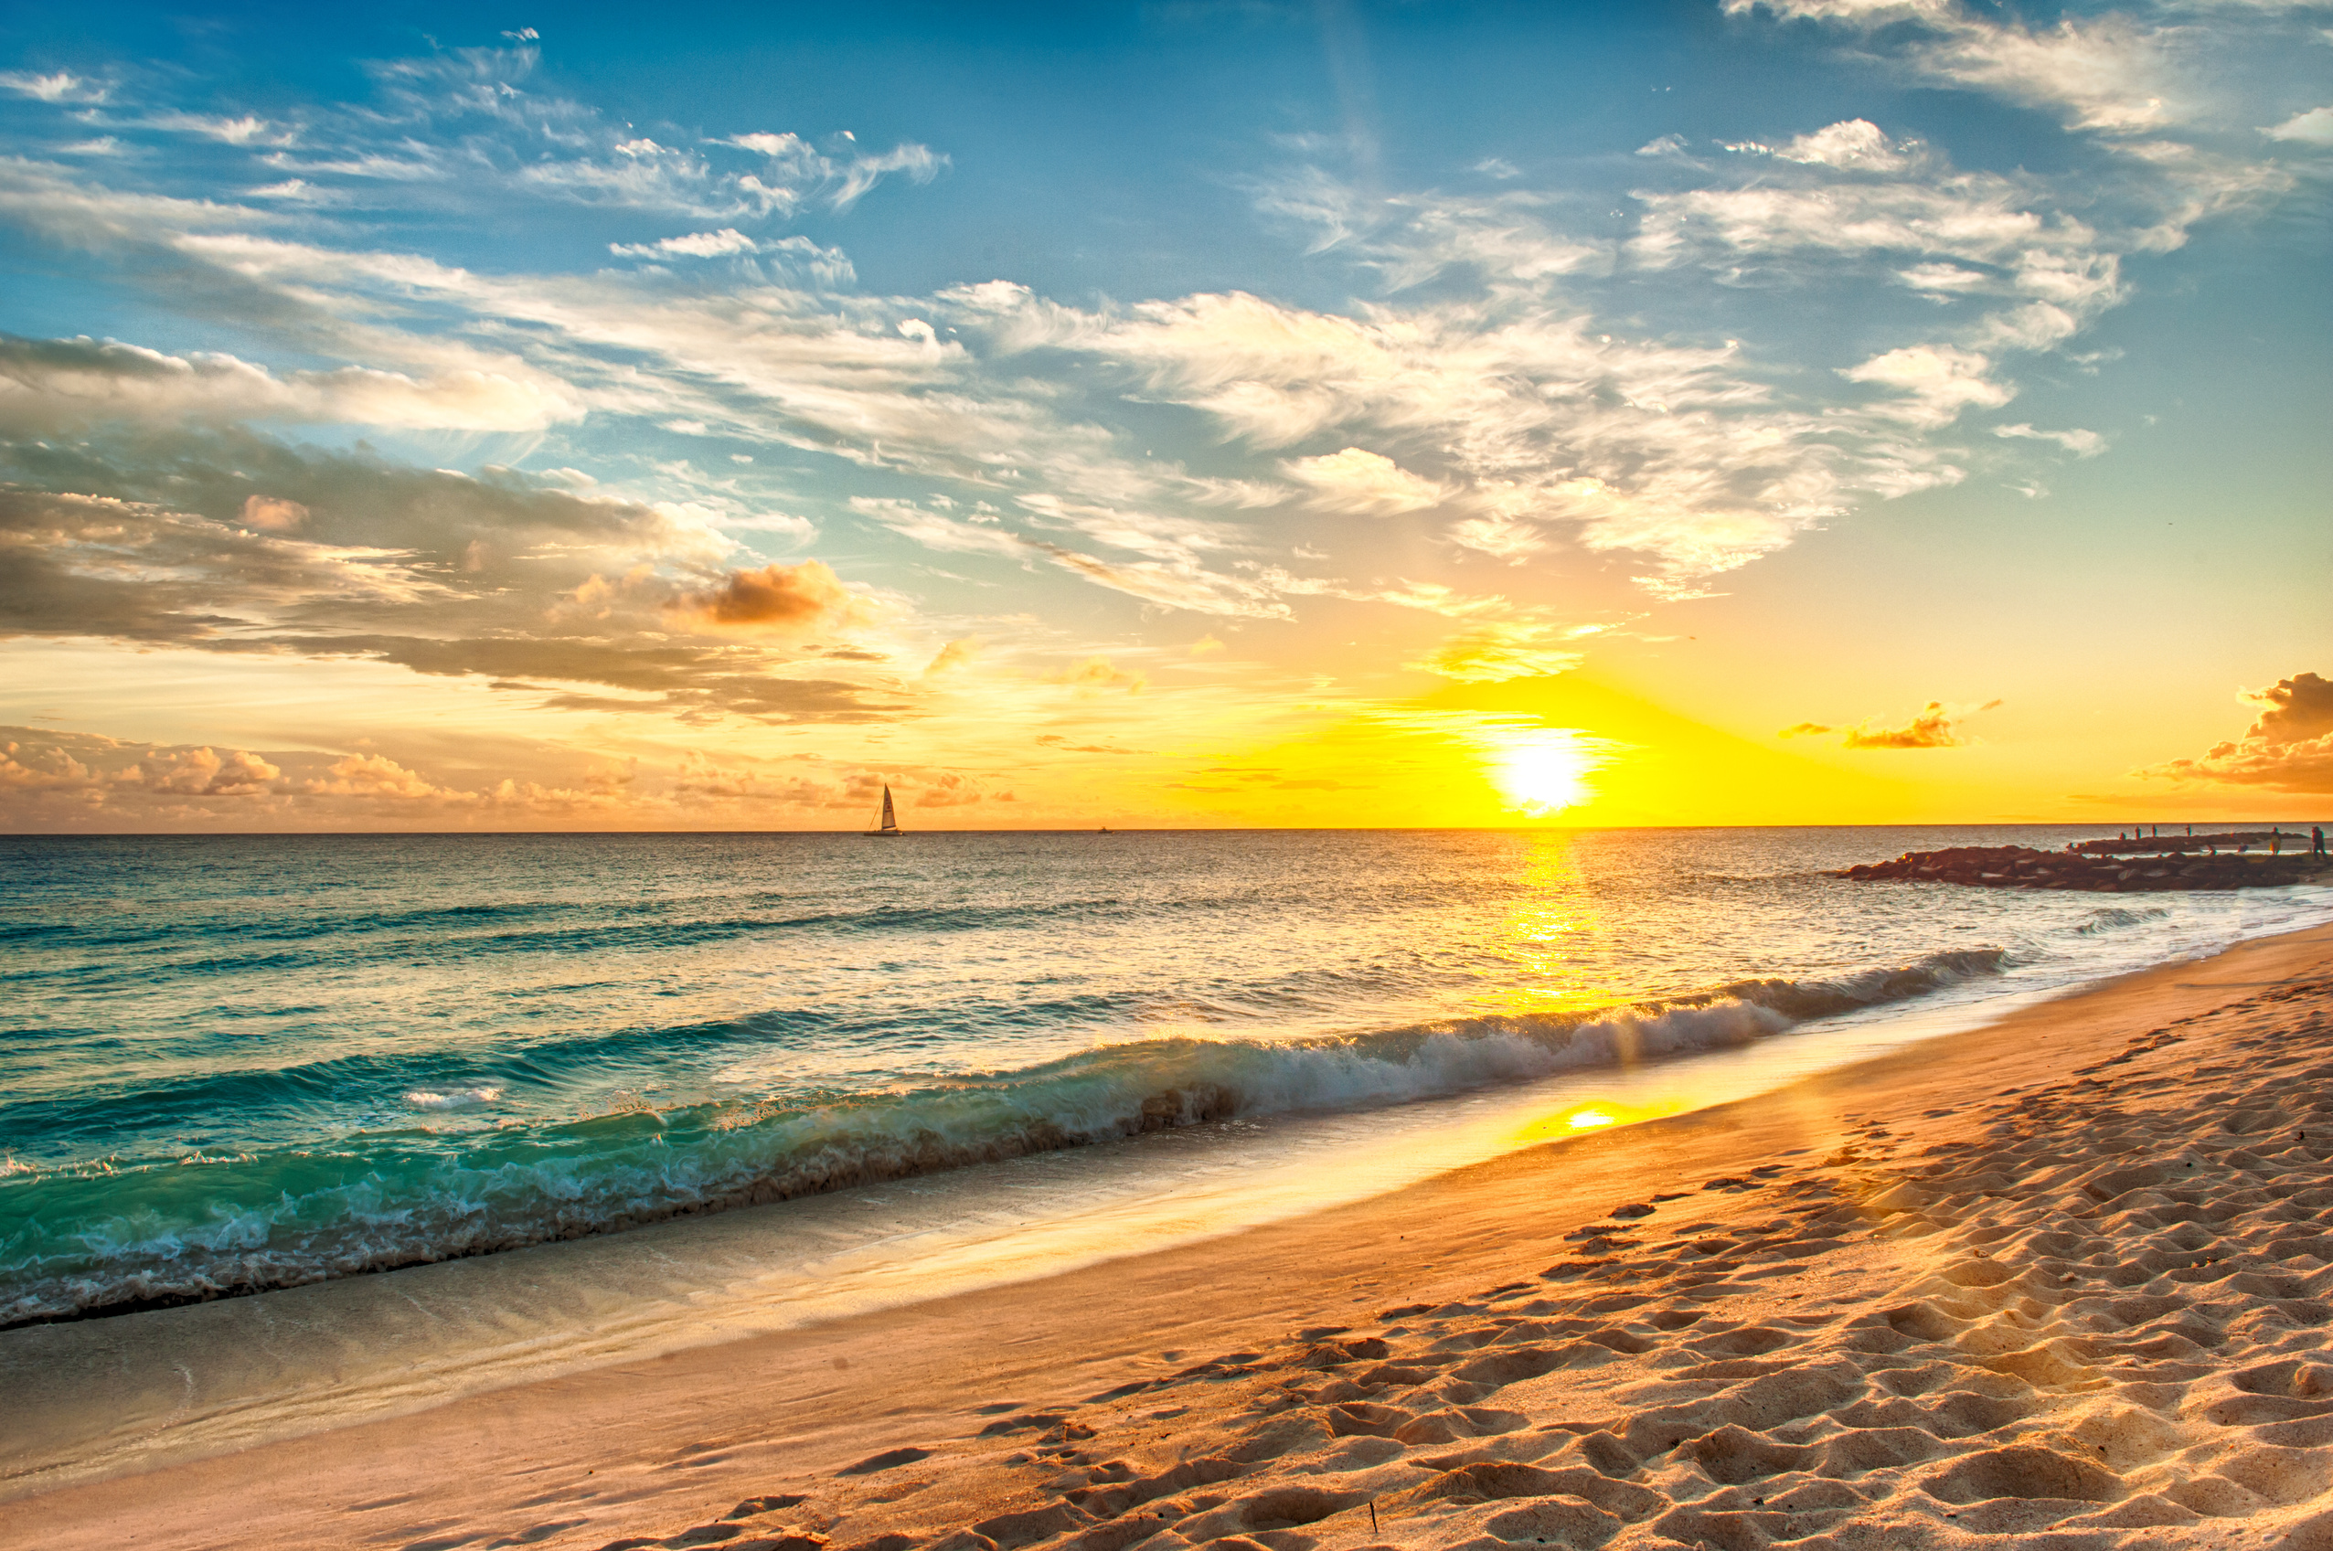
Continue updating SOP and Protocols.
Continued testing, use and updating of CAP and BMS Insight app
FUTURE PLANS
The National Hazard Mitigation Committee was established and continue providing support for National tsunami and coastal hazard program.
Continue implementing National Coastal Risk Information and Planning Platform (NCRIPP)
Continue updating and producing an island-wide Tsunami Inundation and evacuation map for Barbados.

Slide 16
Barbados continues to support the Caribbean Tsunami Information Center (CTIC) as host country.
Continue working with communities to encourage increased levels of preparedness.
FUTURE PLANS
Continue the implementation of the Coastal Community Vulnerability Assessments.
Continue to implement the Tsunami Ready Programme in more Coastal Communities.
Continued works on Detection Systems such as training, capacity building and the maintenance of equipment to ensure its fully functioning.

Slide 17

THANK YOU FOR
LISTENING

