Slide 1

3.3. Report of the Caribbean Tsunami Information Centre (CTIC)
ICG/CARIBE EWS XVII 06-09 2024, Nicaragua
Alison Brome (Programme Officer, CTIC)

Slide 2
Presentation Outline
Brief Status on CTIC activities 2023 – 2024
Challenges and Considerations
CTIC Recommendations

Slide 3
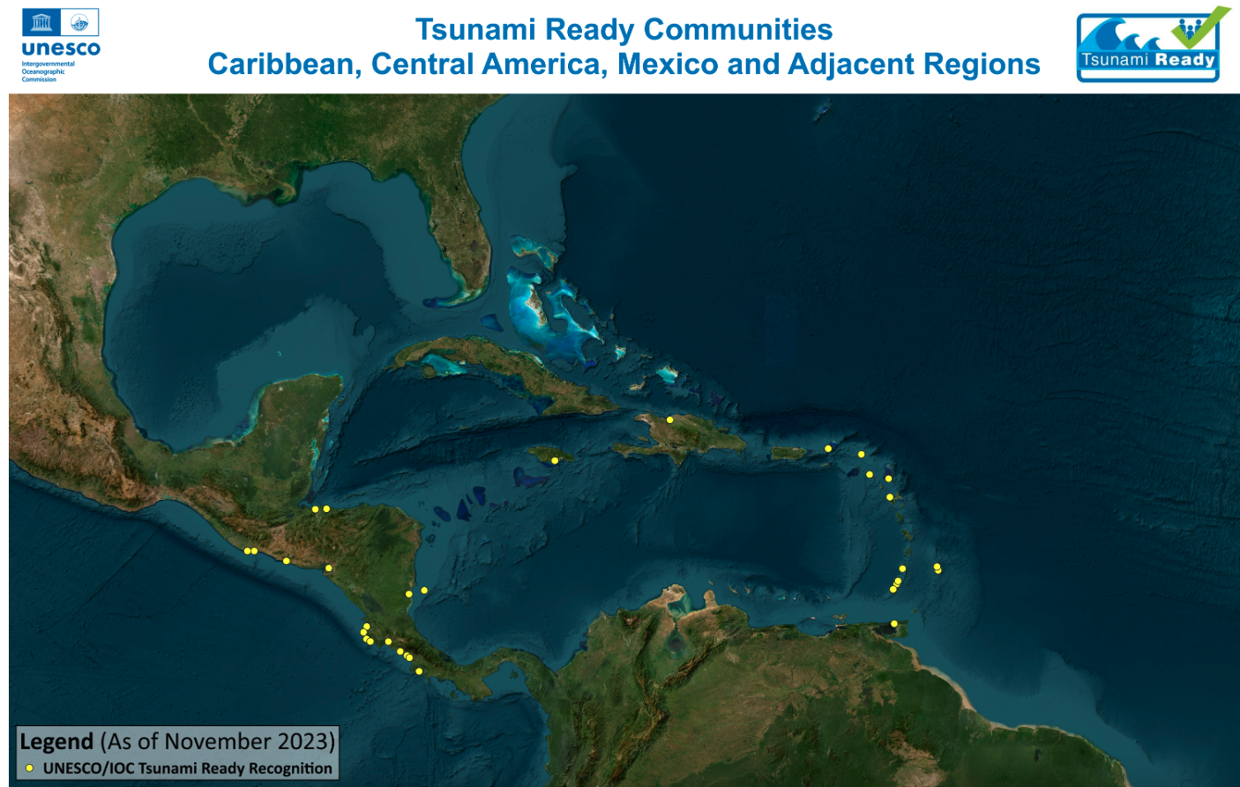

Notes:
Anguilla, Antigua and Barbuda, Barbados, British Virgin Islands, France, Grenada, Haiti, Honduras, Jamaica, Nicaragua, St. Kitts & Nevis, St. Vincent and the Grenadines, Trinidad and Tobago
In process – Anguilla, Antigua and Barbuda (Barbuda ), Barbados (Porters. St. James to Lazaretto, St. Michael), Dominica (Portsmouth), Dominican Republic (Puerto Plata and Sabana Grande de Palenque), Grenada (Point Salines to St. George’s City), Honduras (Cedeno & Omoa), Jamaica (Port Maria), Saint Lucia (Laborie), Trinidad and Tobago (Mayaro Village)

Slide 4
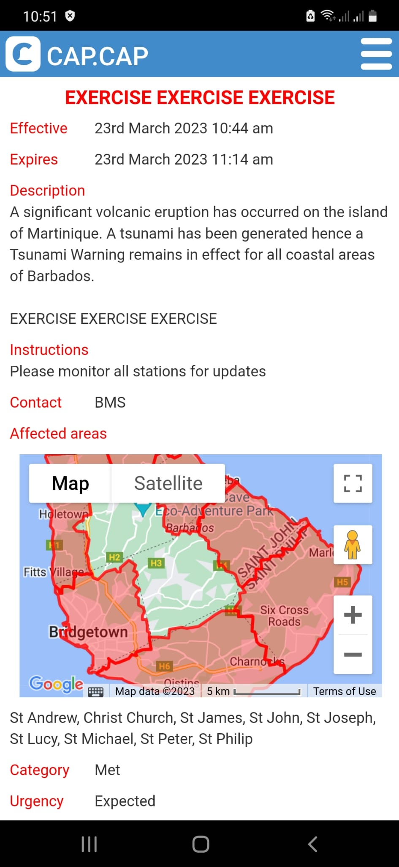
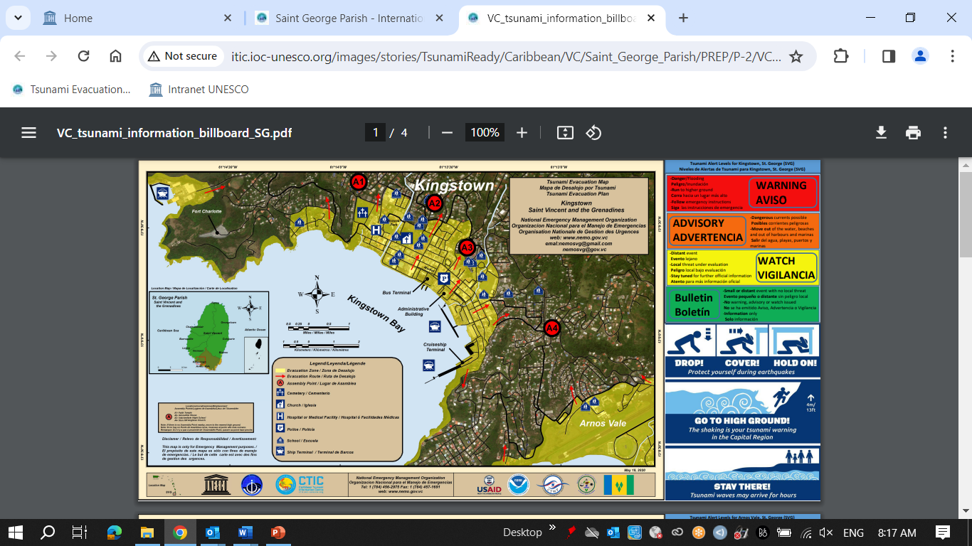
UNESCO/IOC Tsunami Ready Communities 2023
http://itic.ioc-unesco.org/index.php?option=com_content&view=category&layout=blog&id=2280&Itemid=2806
Deshaies, Guadeloupe, FRANCE: 01 June 2023, Self-funded
Saint George Parish, ST. VINCENT AND THE GRENADINES: 25 August 2023, ITIC-CAR USAID/BHA
Christ Church West, BARBADOS: 04 September 2023, ITIC-CAR USAID/BHA

Slide 5
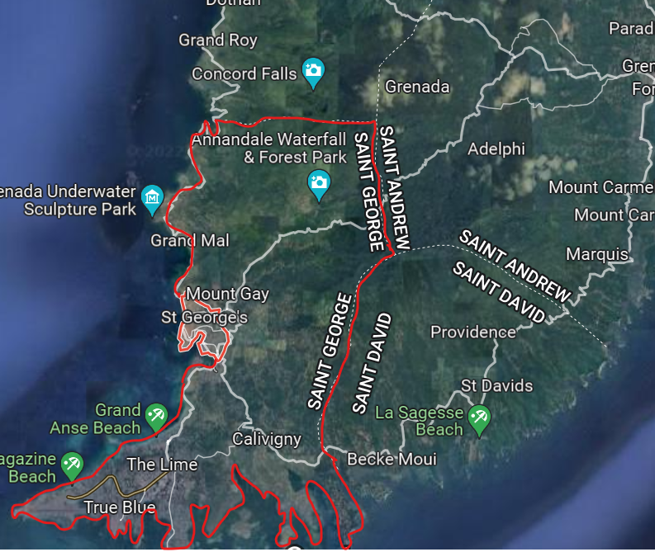
UNESCO/IOC CARIBE EWS Project, Grenada
Project Name: Strengthening Capacities for Tsunami Early Warning in Grenada
Donor: Government of Australia, Port of Spain Direct Aid Program & UNESCO/IOC
Project Scope: Public Awareness and Education for Saint George Parish, Tsunami Ready nomination for St. George’s City to Point Salines
Billboard signs to be installed & EOP tested for CARIBE WAVE 2024 & to be revised
TR ceremony to be scheduled

Slide 6
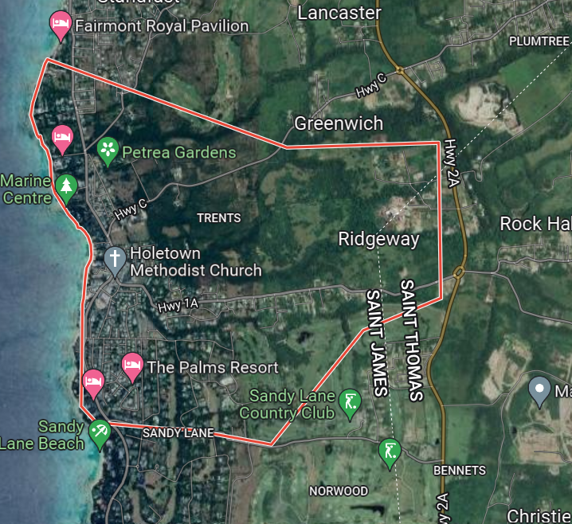
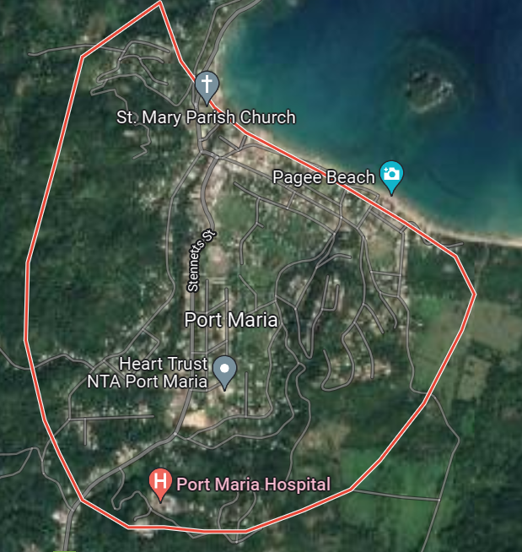
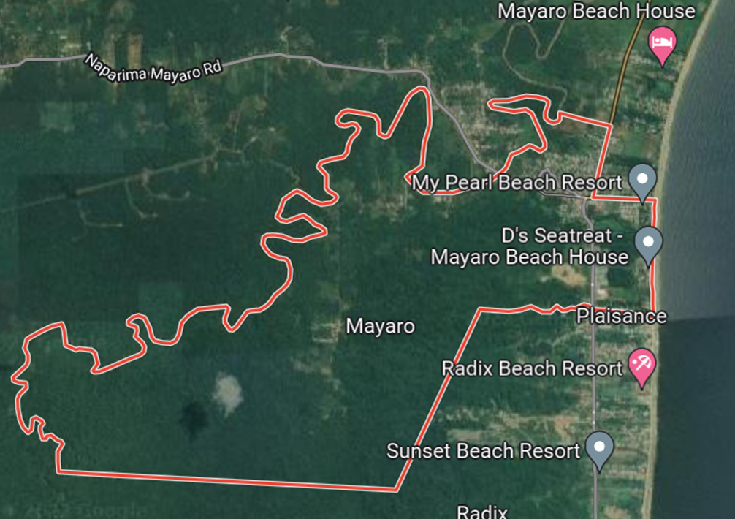
UNESCO/IOC CARIBE EWS NORAD Project Communities
Porters, St. James to Lazaretto, St. Michael, Barbados
Port Maria, St. Mary, Jamaica
Mayora Village, Mayaro–Rio Claro County, Trinidad and Tobago
Project Name: Towards a Safer Ocean in the Caribbean through Tsunami Ready Communities
Donor: Norwegian Agency for Development Cooperation (NORAD)
Funding: NORAD: 170,000, UNESCO: 30,000
Evacuation map completed for Barbados, National Consultants hired, Emergency Operations Plans drafted for all communities
Public awareness and Education undertaken in communities
Procurement of signage and equipment, testing and community trainings to be conducted for all communities, inundation and evacuation mapping for Trinidad & Tobago and Jamaica to be undertaken

Slide 7
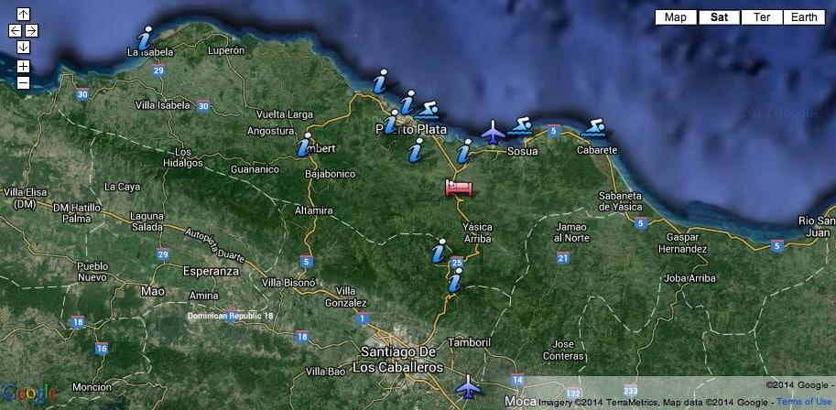
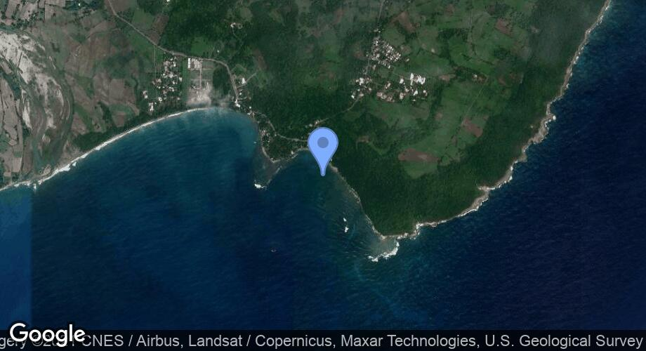
UNESCO/IOC CARIBE EWS Project, Dominican Republic
Puerto Plata and Sabana Grande de Palenque, Dominican Republic
Puerto Plata
Sabana Grande de Palenque
Tsunami Ready programme advanced in both communities through previous project funding
Letter of support received from Municipality of Palenque
UNESCO/IOC to resume discussions with national and community authorities to finalise requirements including mapping, re-installation of signage etc.

Slide 8
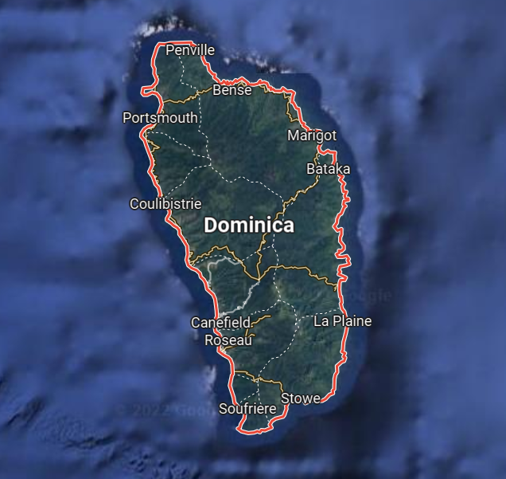
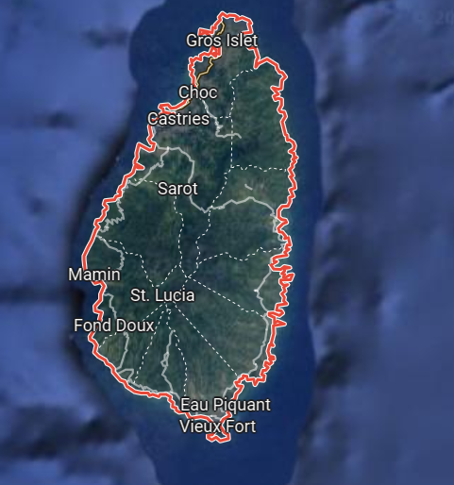
ITIC-CAR USAID/BHA Project Communities 2022 - 2023
Lead Implementing Agency: ITIC CAR
Laborie, Saint Lucia
Portsmouth, Dominica
Dominica – Portsmouth Council submitted its application to the TNC with all documentation in December. 2023, signage installation only remaining requirement to be fulfilled prior to submission of application to IOC
Saint Lucia – signage installation is only remaining requirement to be fulfilled prior to preparation of documentation and submission of application to IOC

Slide 9
ITIC-CAR USAID/BHA Project Communities 2023 - 2024
Lead Implementing Agency: ITIC CAR
ANGUILLA (TERRITORY-WIDE RENEWAL):
Project Launch – week of 11 March 2024
Tsunami Ready Committee established
Tsunami hazard assessment/modeling – discussions re: access and data reconfiguration etc. underway
PAE materials initiated
ANTIGUA AND BARBUDA (BARBUDA):
CTIC convened discussions with national authorities 12-14 December 2023
Barbuda proposed as TR community
ITIC & National Authorities initiate discussion re: data, modelling
HONDURAS, RENEWAL (OMOA, TORNABE/TELA):
Signage, updated evacuation map, SOPs required
Identification and collection of date and resources ongoing
TR documentation and resources for Tornabe/Tela to be provided by IOC

Slide 10
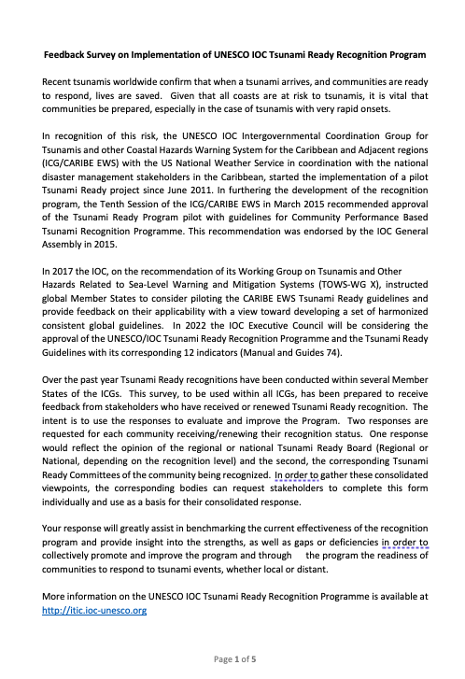
TR Evaluation Survey
The TR-TT prepared an Evaluation Survey
For TR Recognized Communities
Approved in ICG-XVI
We recommend:
  The introduction at the other ICGs
  The translation to SP &FR
  Administration by WG4, TRS/IOC/UNESCO-CTIC

Slide 11
Horizon Tsunami Ready Community Renewals Required in 2024
Antigua and Barbuda – St. John’s City
Barbados – Shermans, St. Lucy to Mullins, St. Peter
Grenada – parishes of St. Patricks & Petite Martinique and Carriacou
Haiti – Fort Liberte
Nicaragua – Corn Islands & Bluefields
St. Vincent and the Grenadines – Union Island
Trinidad and Tobago – Carenage

Slide 12
CTIC Activities Cont’d
CARIBE WAVE 2024 – CTIC supported Exercise planning, implementation and evaluation in conjunction with the CARIBE WAVE Task Team
CTIC Brochure – revision of English & Spanish versions with ITIC-CAR
CTIC Website – full integration into IOC management structure
Distribution of PAE products and support Member States outreach and capacity building initiatives
CTIC MOU with Government of Barbados – renewed 2024 – 2029 (signing in progress)
WTAD 2023 – in association with UNDRR and national authorities facilitated a national capacity building workshop for community stakeholders in Barbados. CTIC encouraged Member State activities and documentation

Slide 13
CTIC Activities Cont’d
Support to UNESCO Cluster Office, Kingston in advancing MOU with CDEMA

Slide 14
Considerations & Challenges
Emerging – social science & behavoural change, integration of disabled and vulnerable (youth, women, indigenous groups, poor)
Ocean Decade goals and targets – number of at-risk coastal communities supported
EWS 4ALL – Integration of CTIC, TR Programme and regional leadership. Need for sustained preparedness activities for tsunamis & deepening existing mechanisms and exploration of new opportunities to facilitate the integration of impacts and risks associated with other coastal hazards within CARIBE EWS
Institutional hosting arrangements between Government of Barbados and IOC-UNESCO strengthened by MOU renewal and duration extension from 3 to 5 years
CTIC Resource (financial and human) Constraints - impacting performance and service levels to Member States and partners and sustainability in respect to implementation of TR projects and mobilizing interests, development of public awareness and education materials, evaluations
CTIC Governance and Collective Ownership requires enhancement to support improvement on performance and service levels to Member States and partners and foster sustainability

Slide 15
Recommendations to ICG/CARIBE EWS XVII
Notes the significant actions of the CTIC to mitigate the impacts of tsunamis and other coastal hazards in the Caribbean and Adjacent Regions during the April 2023 to April 2024 period, and the associated report.
Notes with appreciation the strong cooperation between the CTIC, ITIC-CAR, ICG/CARIBE EWS, Tsunami Ready Task Team and Working Group 4 particularly in relation to the implementation of the Tsunami Ready Programme, WTAD, the dissemination and development of outreach and educational resources, support to Ocean Decade initiatives and the achievement of indicators
Acknowledges the good collaboration between the CTIC and the CARIBE WAVE Task Team in planning, promoting, executing and evaluating the annual CARIBE WAVE Exercise.
Notes the strengthening of the CTIC hosting agreement with the Government of Barbados as well as the financial and resource constraints faced by CTIC, and the need for strategic governance and ownership initiatives to address sustainability.
Notes the funding and human resource constraints faced by CTIC and implications for performance of the institution
Recommends deeper cooperation between CTIC, ICG/CARIBE-EWS WG 4, CARIBE WAVE Task Team and partners including UNDRR, CDEMA, CEPREDENAC, UWI to support Member State preparedness and resilience.

Slide 16
Recommendations to ICG/CARIBE EWS XVII Cont’d
Encourages Member States to commemorate the World Tsunami Awareness Day (WTAD) on November 5, and share their activities.
Recommends continued work on WTAD 2023 with the UNDRR, UNESCO/IOC, ICG/CARIBE EWS WG 4 and Member States to coordinate CARIBE-EWS activities.
Recognises the current work of the CTIC on the review and development of framework and partnership agreements with regional organisations in particular.
Recommends that the CTIC continues to pursue the formalization of agreements to provide a sustainable framework for technical cooperation.
Recommends a strategic review of the CTIC Governance structure including the constitution and role of the CTIC Board, and the role of ICG/CARIBE EWS in identifying and supporting the implementation of resource mobilization, staff, partnerships and other frameworks to enhance the ownership and sustainability of the CTIC.

Slide 17
Recommendations to ICG/CARIBE EWS XVII Cont’d
Recommends a strategic review of the staffing resources needed to ensure adequate capacity at the CTIC to effectively execute and implement the programmatic an project activities to support the ICG/CARIBE EWS and EWS ALL frameworks.
Urges ICG/CARIBE EWS Member States to make contributions to the IOC Special Account and provide human resources under various arrangements including long and short term internships to support the work of the CTIC.
Recommends that CTIC continues to work with the IOC Secretariat, CARIBE EWS Member States and partners to develop a strategic plan to guide the resource mobilization and staffing efforts of the CTIC

Slide 18




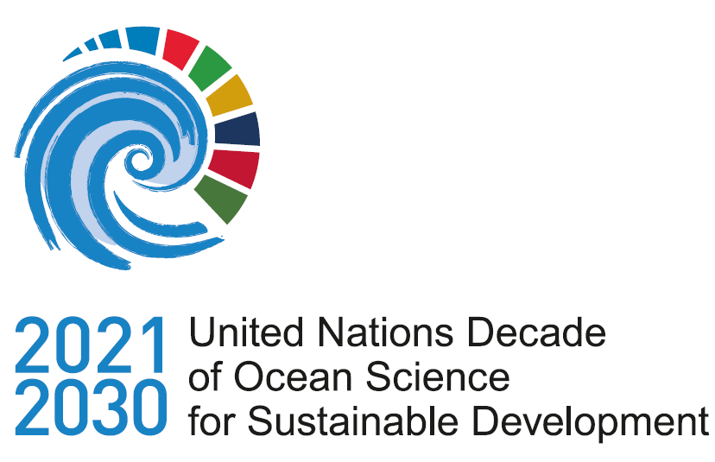

Thanks for your attention
a.brome@unesco.org

