Slide 1
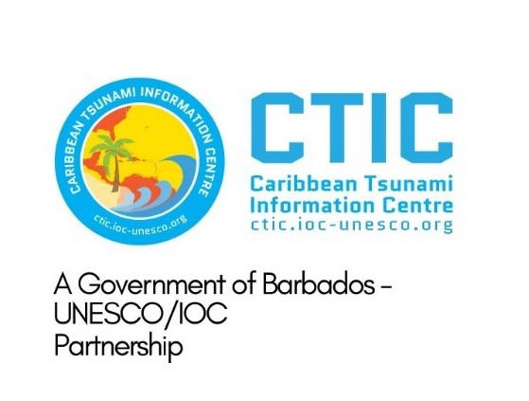





ICG/CARIBE-EWS XVII
3.9 CARIBE WAVE 2024
Summary
Antonio Aguilar
CARIBE WAVE Vice Chair, FUNVISIS, Venezuela
Gisela Báez-Sánchez
CARIBE WAVE Vice Chair, Puerto Rico Seismic Network, USA
Supported by:
Christa G. von Hillebrandt-Andrade
Manager, ITIC Caribbean Office
ICG CARIBE EWS WG III Chair
Kimberly Maisonet Gonzalez
Student Contractor
ITIC Caribbean Office
May 2, 2024

Slide 2
Objectives
Summary of CARIBE WAVE 24
Survey results

Slide 3
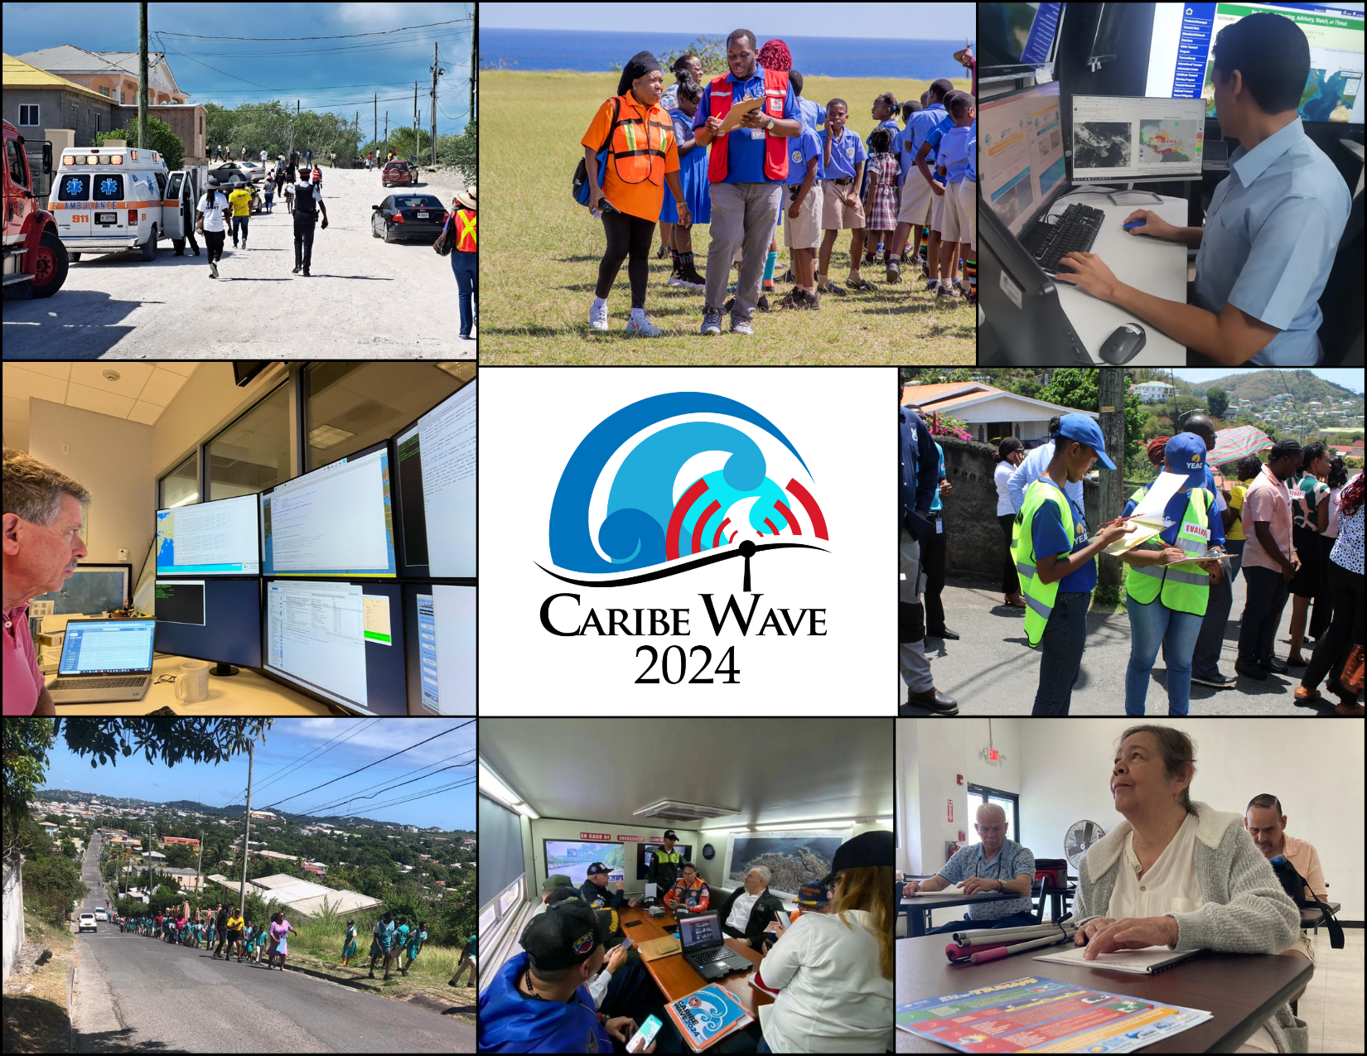
CARIBE WAVE 2024
CARIBE WAVE 24 was held on 21 March 2024. Member States and Territories chose from the two scenarios (Puerto Rico Trench and Panama) and decided if any additional activity would be carried out.
In the Caribbean and Adjacent Regions, 46 Member States and Territories participated with a total of over 475,147 people engaged (according to TsunamiZone.org).
The participation of MS represents a rate of 96% (up from 94% in 2023).
b
From left to right, top to bottom, is Turks and Caicos, St. Kitts and Nevis, Panama, PTWC, Grenada, Antigua and Barbuda, Venezuela, and Puerto Rico.
a
#CARIBEWAVE #TSUNAMIREADY

Slide 4
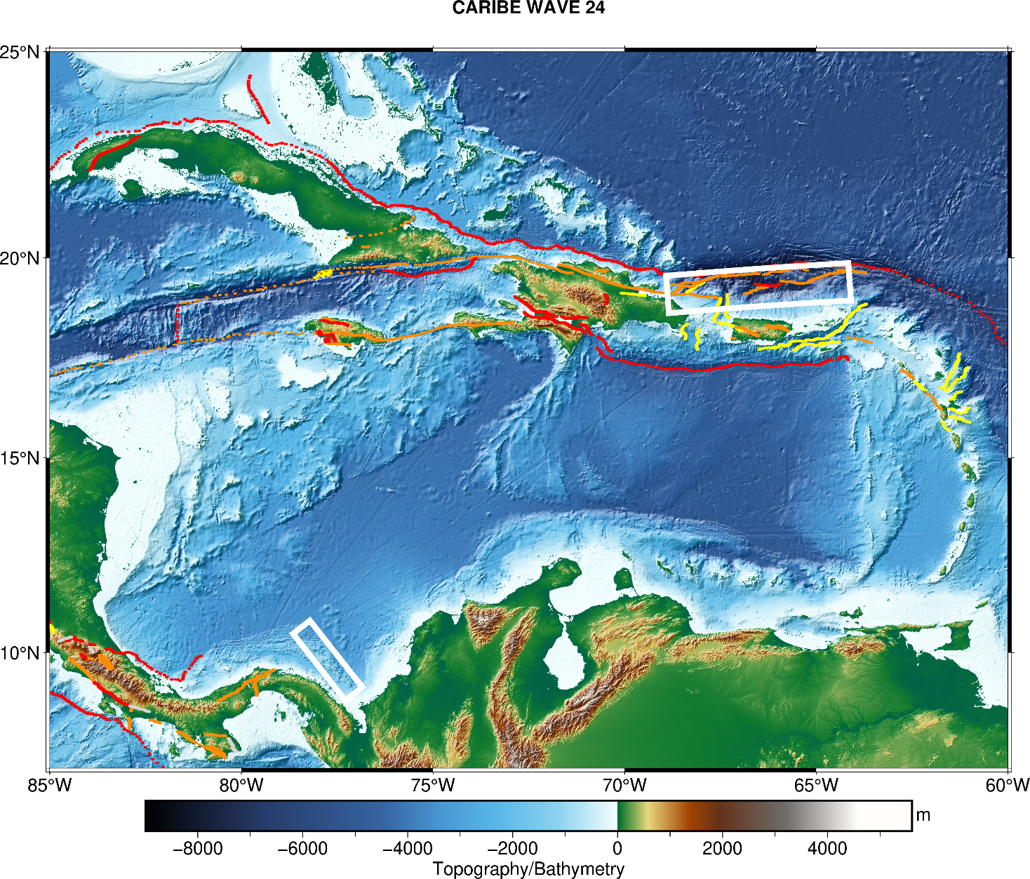
CARIBE WAVE 24
Earthquake and Tsunami Scenarios
Puerto Rico Trench
Panama
Scenario | Origin Time | Mw | Epicenter
Puerto Rico Trench | 15:00:00 UTC 21 March 2024 | 8.7 | 19.25ºN, 66.5ºW
Panama |  | 8.47 | 9.80ºN, 77.75ºW

Slide 5
Timeline
ACTION | TIMELINE
Circular Letter Issued by IOC to MS | ✓ October 2023 (late)
Handbook Draft Circulated among ICG CARIBE EWS, TWFP/NTWC contacts and TT CARIBE WAVE 24 | ✓ November 2023
Deadline for Comments | ✓ December 2023
Exercise Handbook Available Online | ✓ December 2023
1st Webinar CW (Overview, PTWC Products) | ✓ 23 January 2024 – English ✓ 24 January 2024 – Spanish ✓ 25 January 2024 – French
2nd Webinar CW (Update, Communication Methods, Registration, Questionnaire, Uploading Pictures/Videos ) | ✓ 27 February 2024 - English ✓ 28 February 2024 - Spanish ✓ 29 February 2024 – French
Countries Indicate Selected Scenario | ✓ 7 March 2024
Exercise | ✓ 21 March 2024
Hot-Wash | ✓ 2 April 2024
Exercise Evaluation Due | ✓ 11 April 2024 (late)
Final Draft Caribe Wave 24 Report 19 April 2024

Slide 6
Goals / Metrics
Goals | 2016 Results | 2017 Results | 2018 Results | 2019 Results | 2020 Results | 2021 Results | 2022 Results | 2023 Results | 2024 Metrics | 2024 Results
TWFP receive the dummy message | 84% | 95% | 100% | 89% | 97% | 97% | 91% | 97% | 100% | 100%
Participation of Member States of ICG/CARIBE-EWS with designated focal warning point | 100% | 100% | 97% | 100% | 92% | 98% | 100% | 94% | 100% | 96%
Community involvement (including agencies beyond TWFP) | 73% | 82% | 77% | 66% | 38% | 56% | 43% | 41% | 95% | 79%
Number of participants* | 332,812 | 679,985 | 643,403 | 793,353 | 4,622 | 333,518 | 413,281 | 422,913 | +10% | 467,685
Countries who participate submit exercise questionnaire | 100% | 100% | 91% | 82% | 92% | 95% | 100% | 93% | 100% | 80%
Members State and territories are satisfied with exercise |  |  |  | 82% | 76% | 96% | 88% | 97% | 100% | 100%

Slide 7
Participation
*Number taken from TsunamiZone.org for cases where countries did not report number of participants in the survey.
Country |  | Participants according to Member States | Participants according to Tsunami Zone
Antigua and Barbuda |  | 7,034* | 7,034
Aruba |  | 27,000 | 7,190
Bahamas |  | 0* | 0
Barbados |  | 500 | 872
Belize |  | 2* | 2
Brazil |  | 13* | 13
Colombia |  | 50 | 43
Costa Rica |  | 120 | 124
Cuba |  | 200 | 0
Curacao |  | 20 | 50
Dominica |  | 19* | 19
Dominican Republic |  | 1,500 | 808
France |  | 173,823 | 173,823
Grenada |  | 14,724* | 14,724
Guatemala |  | 1,500 | 27
Guyana |  | 1,240 | 10
Haiti |  | 40 | 322
Honduras |  | 0* | 0
Jamaica |  | 85 | 555
Mexico |  | 11,000 | 658
Country |  | Participants according to Member States | Participants according to Tsunami Zone
Netherlands (Bonaire, Saba, Sint Eustatius, other) |  | 40 | 41
Nicaragua |  | 30* | 30
Panama |  | 1,240 | 10,784
Saint Kitts and Nevis |  | 2,100* | 2,100
Saint Lucia |  | 313* | 313
Saint Vincent and the Grenadines |  | 35 | 203
Sint Maarten |  | 0 | 25
Suriname |  | 0* | 0
Trinidad and Tobago |  | 450* | 450
United Kingdom | Anguilla | 51* | 51
 | Bermuda | 324 | 324
 | British Virgin Islands | 4,000 | 634
 | Cayman Islands | 25 | 7,424
 | Montserrat | 0* | 0
 | Turks and Caicos | 10* | 10
United States | Puerto Rico | 135,952 | 136,111
 | US Virgin Island | 23,672 | 23,672
Venezuela |  | 60,573 | 86,701
TOTAL |  | 467,685 | 475,147

Slide 8
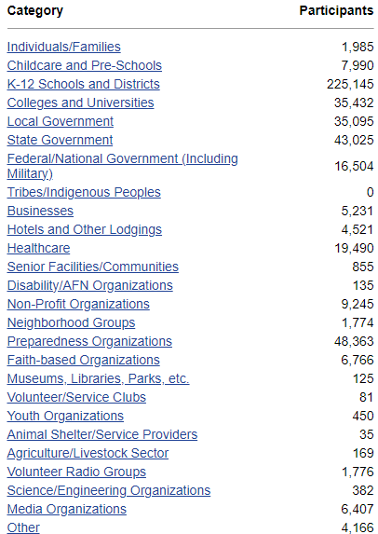
TsunamiZone Participation Categories

Slide 9
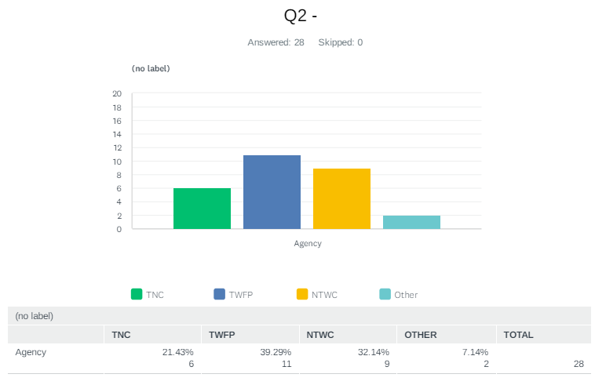
Evaluation Form
The questionnaire contained 39 questions for participating countries to provide feedback on the exercise.
Deadline was extended until made available until April 15.
Responses from 80% of participating MS and territories. A total of 28 surveys were completed from thirty-seven of the forty-eight Member States and Territories.

Slide 10
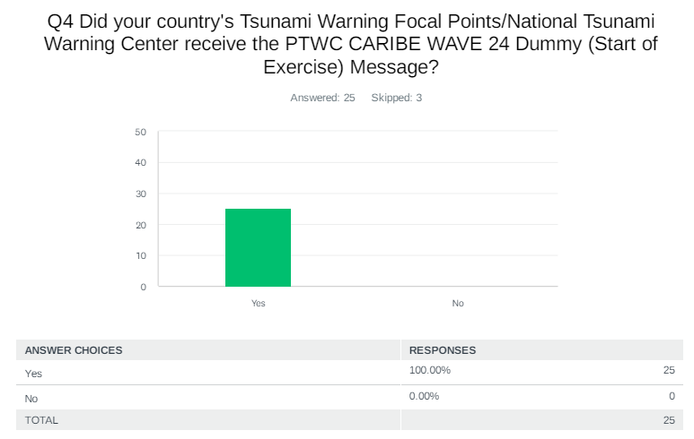
Evaluation Form – Dummy Message
The PTWC issued the “dummy” (start of exercise) message on March 21, 2021, at 1500 UTC and disseminated over all its standard broadcast channels.

Slide 11
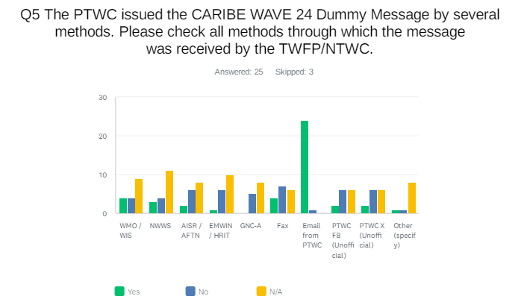
Evaluation Form – Dummy Message
As in past years, the most common methods to receive the Dummy message were the Email. Fax and WMO Information System (GTS) were also methods where several countries received the message.

Slide 12
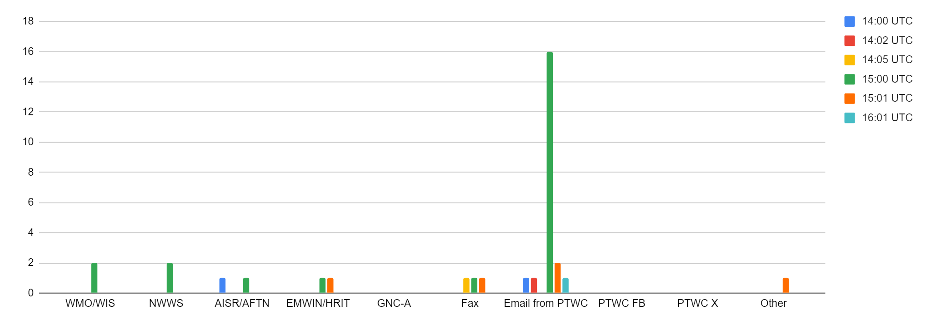
Evaluation Form – Dummy Message
The time at which the PTWC message was received by the TWFP/NTWC in the different systems.
The majority stated that they received the dummy message aat 1500 UTC with only a few reporting delays and others reporting the time as 1400 UTC.
It is crucial to seek other communication systems to avoid messages delays.

Slide 13
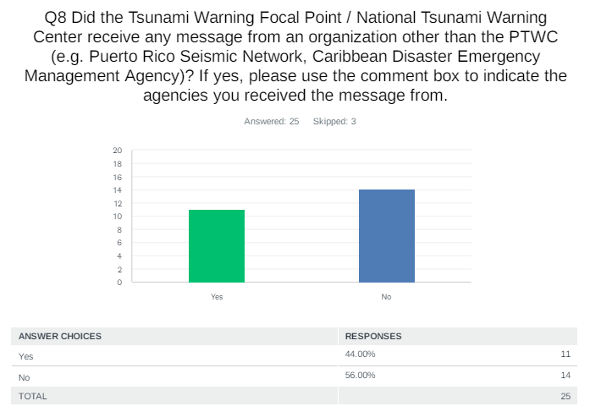
Evaluation Form - Dummy Message
Costa Rica: Comisión Nacional de Prevención del Riesgo y Atención de Emergencia (CNE) Sistema Nacional de Monitoreo de Tsunamis (SINAMOT)
Dominican Republic & US Virgin Islands: PRSN
Guatemala & Panama: CATAC
Jamaica: CDEMA
UK - Cayman Islands: HMCI
USA - Puerto Rico: PRSN and NWS-San Juan Forecast Office
Venezuela: El Servicio Sismológico Venezolano

Slide 14
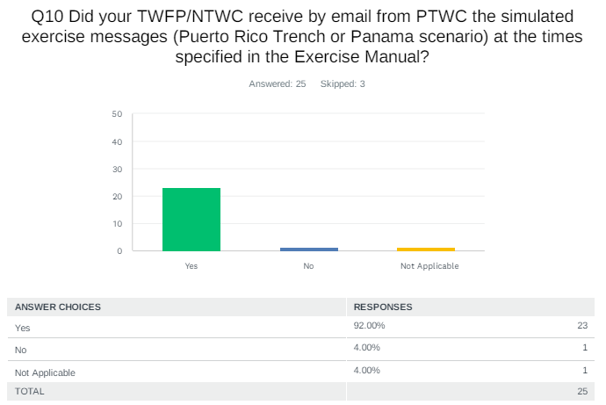
Evaluation Form - Threat Messages
Colombia: we received Inicial tsunami threat 3 minutes before the timeline and tsunami bulletin 2 after 6 minutes
Haiti: Exact on AISR and WMO, but no on email for the dummy message
Panama: The messages from PTWC were on time and in order, but the messages from CATAC were not.
UK - British Islands: Message were prompt as well as the phone calls
USA - US Virgin Islands: Times were in local (AST) for the USVI

Slide 15
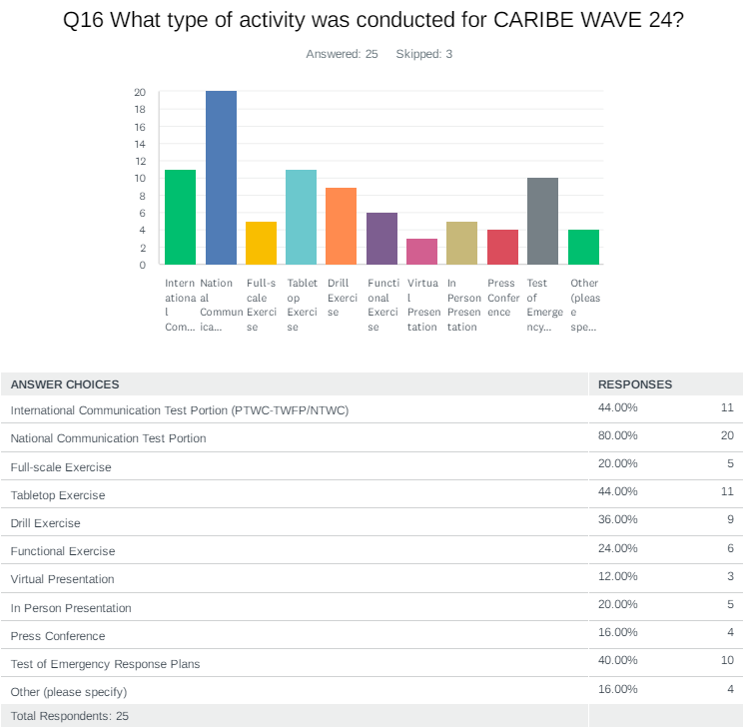
Evaluation Form – Type of Participation

Slide 16
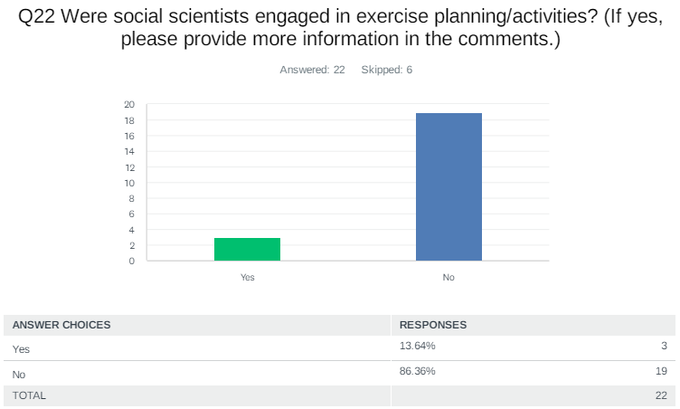
Evaluation Form – Social Scientists Engagement
Costa Rica: Raul Ortega, Psychologist
Jamaica: The exercise was planned by the ODPEM
Panama: They were members of institutions part of the "Comité Nacional de Tsunami de Panamá".
Venezuela: Yes, several geological scientists, seismologists, geophysicists and environmental scientists debated the effects of the earthquake and tsunami.

Slide 17
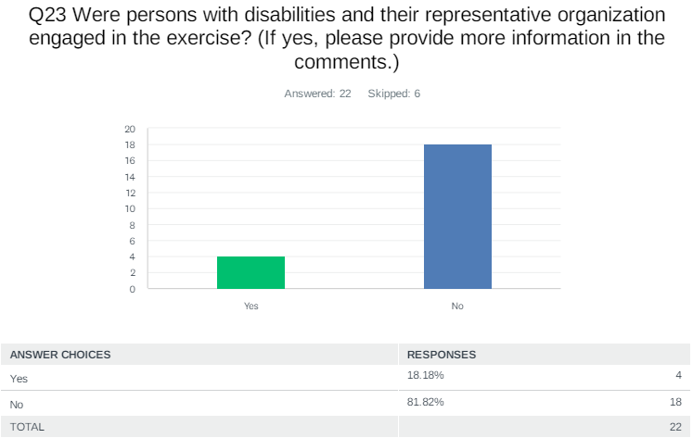
Evaluation Form – People with Disability
St. Vincent and the Grenadines: However some persons with a few injuries participated in full
UK - Anguila: Though we did not target this group, messages were sent out to the general public. Once they received these messages the assumption is they would use assistive technology to access these messages.
UK - British Virgin Islands: These institutions were engaged prior to the exercise to ensure they are knowledgeable of their procedures.
US - Puerto Rico: Individuals from Centro Sor Isolina Ferre
USA - US Virgin Islands: Shared by the Government House ADA Coordinator to their contacts within the USVI.
Venezuela: In Funvisis and DNPC there are people with disabilities and they participated in the exercise

Slide 18
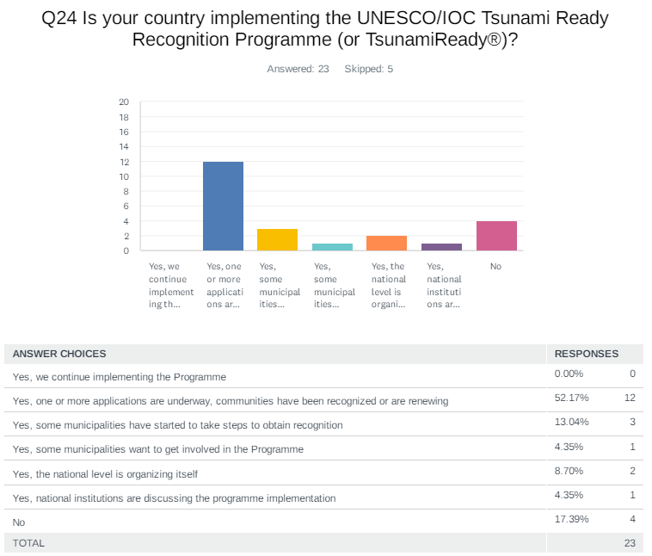
Evaluation Form – Tsunami Ready
According to Member States and Territories, there are about 68 communities recognized for TsunamiReady® or Tsunami Ready.

Slide 19
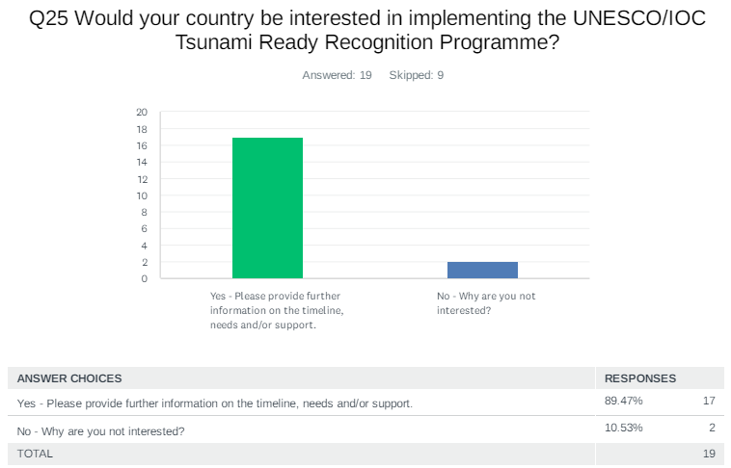
Evaluation Form – Tsunami Ready
The results indicated that 89% of the countries are interested in implementing Tsunami Ready, with 114 as total number of target communities to be recognized.

Slide 20
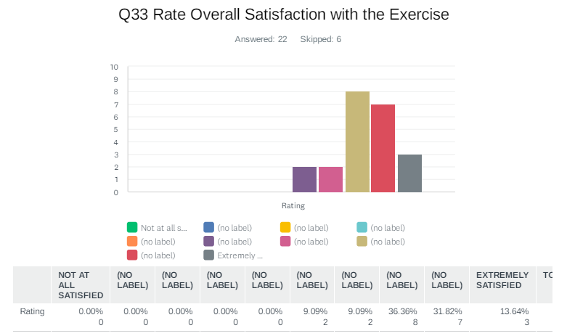
Evaluation Form – Exercise Satisfaction
Curacao: Exercise served as an eyeopener for the members of the NDMO
France: One remark: the schedule of the exercise might be sooner in the morning, so that the wave arrival does not occur during lunch time (which is problematic for schools)
Panama: The CARIBE WAVE Exercises are great, but we as a country have many things to improve.

Slide 21
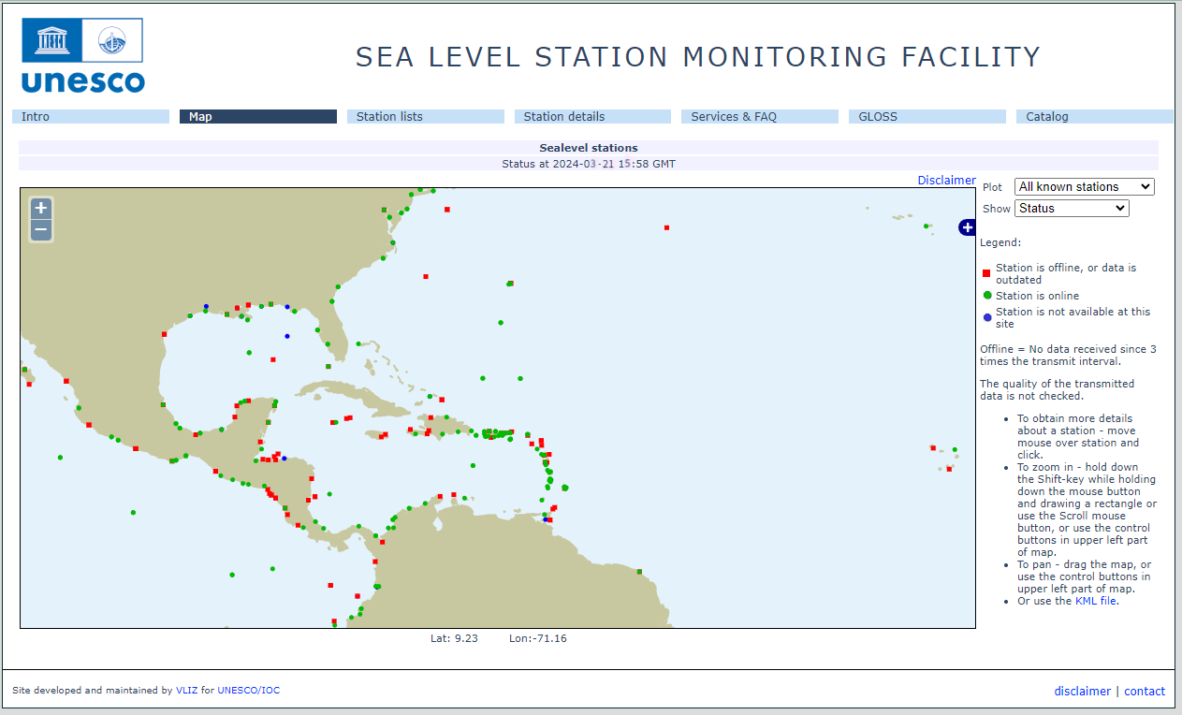
Status of Sea Level Stations during the exercise
Western Muertos Trough scenario
Northern Panama scenario
The PTWC provided simulated forecasted maximum wave heights for 100 CARIBE EWS stations in the simulated bulletins.
Only about 66% of these sea level stations were online on the IOC Sea Level facility during the exercise period.

Slide 22
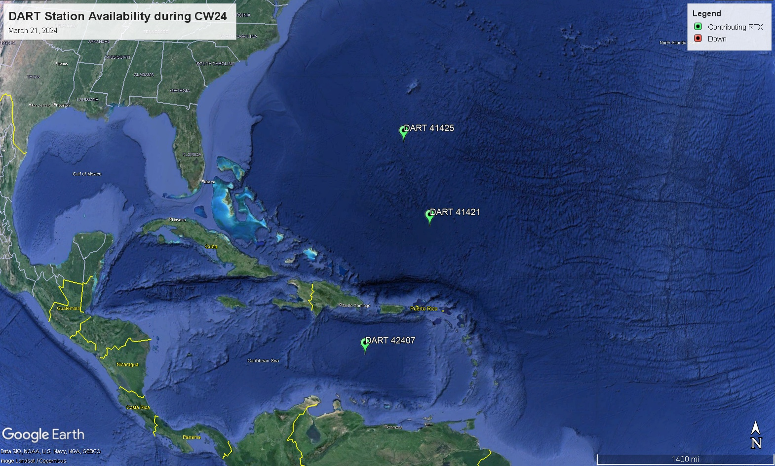
Status of DART’s
3 DART stations were streaming data in the Caribbean and Atlantic through the National Buoy Center during the day of the exercise.

Slide 23
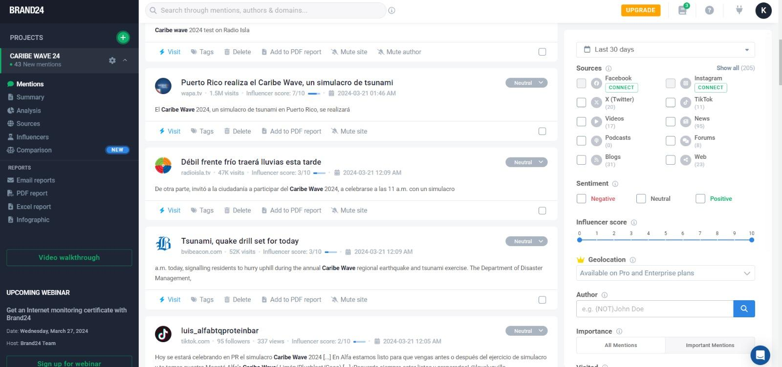
Media Arrangements
There were difficulties obtaining exact metrics with the hashtag tracker Brand24 due to changes in Instagram and Facebook's terms and conditions.
However, it was noted that there was less social media presence than previous exercises, but the presence was still relatively large.
The CARIBE WAVE 24 Media Report includes an overview of different countries’ publications on their exercises.

Slide 24
CARIBE WAVE 24 Task Team
Persona | Teléfono # | Correo electrónico
Antonio Aguilar CARIBE WAVE Vice Chair, FUNVISIS, Venezuela | +58 4168009876 | antoniodesastres@gmail.com
Gisela Báez-Sánchez CARIBE WAVE Vice Chair, Puerto Rico Seismic Network, USA | 1-787-833-8433 | gisela.baez1@upr.edu
Gerard Metayer, CARIBE EWS Chair, Service Maritime et de Navigation Haiti | 509-48 93 7805 | gerard_metayer@yahoo.fr
Frederic Dondin Chair WG 1 Risk Knowledge | 1868 6624659 | fredericdondin@gmail.com
Elizabeth Vanacore, PRSN Chair WG 2 Tsunami Detection, Analysis and Forecasting and Scientific Expert Puerto Rico Trench Scenario | 1-787-833-8433 | elizabeth.vanacore@upr.edu
Christa von Hillebrandt-Andrade; Chair WG 3 Tsunami Warning Dissemination and Communication, Deputy Director/ITIC-CAR | 1-787-249-8307 | christa.vonh@noaa.gov
Silvia Chacón-Barrantes Chair WG 4 Preparedness, Readiness and Resilience | 506-830-96690 | silviach@una.ac.cr
Alberto Lopez Scientific Expert – Puerto Rico Trench Scenario | 1-787-833-8433 | alberto.lopez3@upr.edu
Nestor Luque Scientific Expert – Panama Scenario | 507-523-5562 | nestor.luque@up.ac.pa
Elizabeth Riley Director CDEMA | 246-434-4880 | elizabeth.riley@cdema.org
Claudia Herrera Melgar Executive Secretary CEPREDENAC | 502-2390-0200 | iajche@cepredenac.org memendez@cepredenac.org
Lt. Colonel Daniel Polinacci Chief EMIZ Antilles | 596-596-393-937 | daniel.polinacci@martinique.pref.gouv.fr
Charles McCreery, PTWC | 1-808-689-8207 | charles.mccreery@noaa.gov
Emilio Talavera CATAC | 505-22492761 | emilio.talavera@ineter.gob.ni
David Wald, USGS; Kristin Marano Scientific Experts – Earthquake Impact Products | 1-303-273-8441 303-273-8602 | wald@usgs.gov kmarano@usgs.gov
Ocal Necmioglu Technical Secretary CARIBE EWS | 33-1-45683980 | o.necmioglu@unesco.org
Alison Brome Director CTIC | 246-243-7626 | a.brome@unesco.org

Slide 25
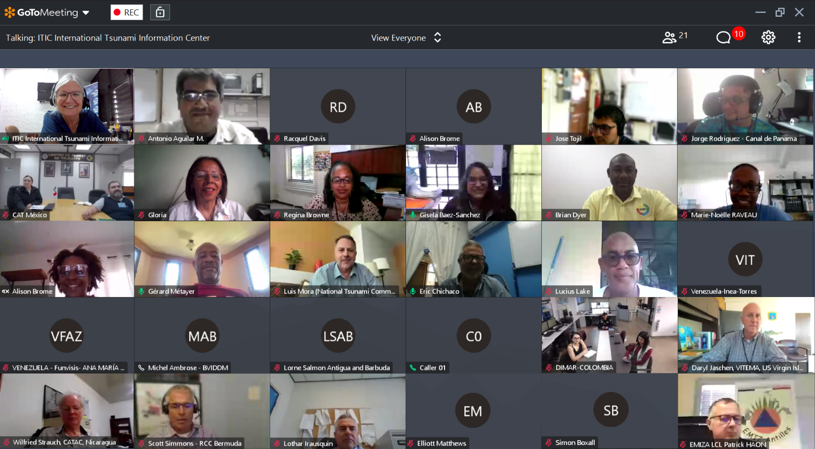
Hot-Wash
After the exercise, the CARIBE WAVE 24 Task Team organized a post-exercise “hot-wash” webinar to permit Member States and Territories discuss and provide feedback on the exercise in an open forum on April 2, 2024.
Some of the feedback was on the successful reception of the dummy messages, but some delays in CATAC simulated products via email. The exercise also helped Emergency Managers identify gaps in communication and to adjust their Standard Operating Procedures. Many schools, businesses/hotels, and government officials participated.
Future CARIBE WAVE exercise scenarios were discussed during the webinar, the ICG CARIBE EWS participants agreed with the ICG XVI recommendation to use of the Jamaica 1692 Port Royal earthquake, and the 1755 earthquake in Lisbon, Portugal as scenarios for 2025.

Slide 26
Resources
Manual and Guides 86: Multi-Annual Community Tsunami Exercise Programme Guidelines for the Tsunami and Other Coastal Hazards Warning System for the Caribbean and Adjacent Regions.
PTWC Enhanced Products and Staging for the Caribbean and Pacific, English
IOC Manuals “How to plan, conduct and evaluate tsunami exercises” and “Module on Tsunami Exercise” are useful resources.
CARIBE WAVE 2011 through 2024 Handbooks
CARIBE WAVE 2013 through 2023 Final and Media Report
PTWC Communications Plan for the Caribbean
Questions on the exercise can be addressed to the members of the CARIBE WAVE 24 Task Team.

Slide 27
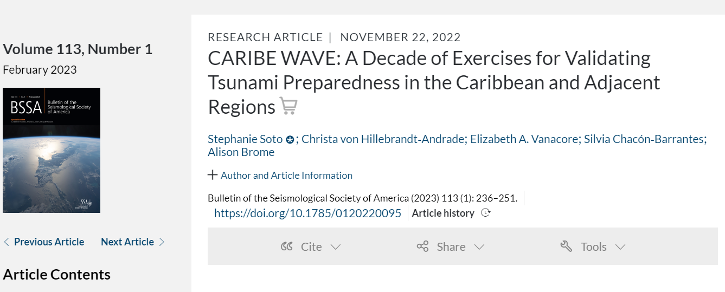
Publication on CARIBE WAVE

Slide 28
Questions, Comments
Thank You!
christa.vonh@noaa.gov

