Slide 1
WMO Report
17th session of the IOC Intergovernmental Coordination Group for the Tsunami and Other Coastal Hazards Warning System for the Caribbean and Adjacent Regions
Sarah Grimes, Hassan Haddouch, Nadao Kohno, Rodney Martinez
Managua, Nicaragua
06-10 May 2024

Slide 2
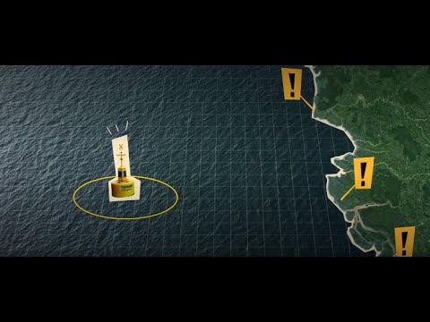

Met Services & Tsunami EWS
Multiple roles:
>35% Meteorological Services globally are Tsunami Service Providers – operational 24/7
Even more Meteorological services back up the National Service Provider, and/or support with infrastructure
In some regions, majority of NMHS are involved in tsunami early warning process eg. 80% NMHS in the Pacific Islands
How do National Meteorological and Hydrological Services and WMO support Tsunami Early Warnings?

Slide 3
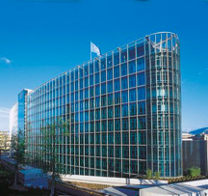
WMO & Tsunami EWS
WMO support NMHS, to strengthen their efforts in tsunami early warning, and maximise
efficiencies
2 Key areas where WMO supports the tsunami EWS process:
  Infrastructure, especially via the WMO Information System (WIS), and observations
  Early Warning Services, especially to strengthen the last mile of communication
Recap of relevant WMO structures:
SERCOM (SC-MMO* & SC-DRR), INFCOM*, Research Board* (*IOC rep)
WMO-IOC Joint Collaborative Board:
  Co-Chairs: India PR (WMO), Srinivasa Kumar (IOC )
  Services Members: TOWS WG Chair (IOC), Chair SC-MMO (WMO)
  WMO-IOC Strategy (2021 –2025) approved by WMO & IOC, 2021

Slide 4


WMO Information System (WIS) WIS 2.0
NCs / DCPCs are going to implement a WIS2 Node to exchange data in WIS2
The WIS2 Node shares data from an HTTPS service and sends notifications to MQTT subscribers
No need to provide access to all the users in the world, only to some WIS2 Global Services
WIS2 node is the component to provide data and associated metadata
WIS2 node replaces the GTS Message Switching System
Global
Services
Downloads data
Receives notifications of new data
Subscribes to
WIS2 node

Slide 5
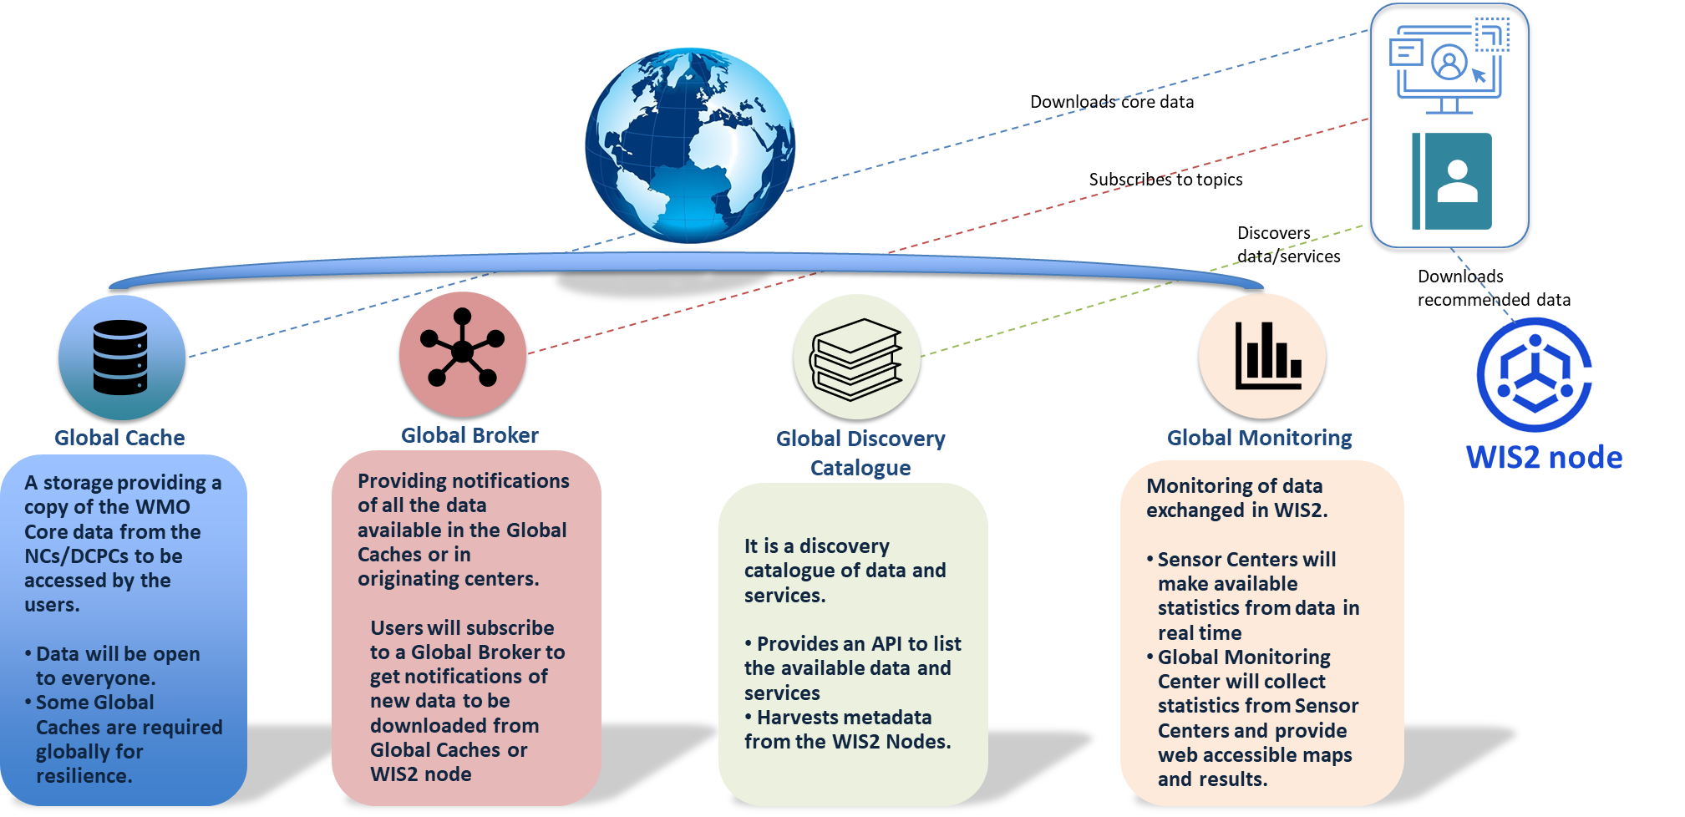
Global Services

Slide 6
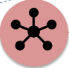






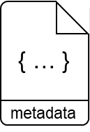

WIS2 in a box: What is it?
WIS2 in a box is a reference implementation of a WIS2 Node
  MQTT
  HTTP
Software (not hardware)
Publishing facility/capability compliant to WIS 2.0 Architecture
  Provides basic data transformation
  Can integrate with existing data management systems
Global Broker
subscribe
notification
of new data
notification
of new data
Data
Consumer
subscribe
download
Message Broker
Core Data
WIS2 Node
Recommended
6

Slide 7

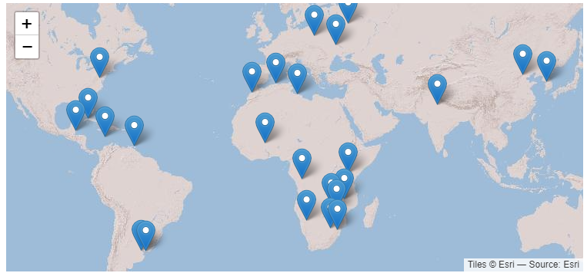
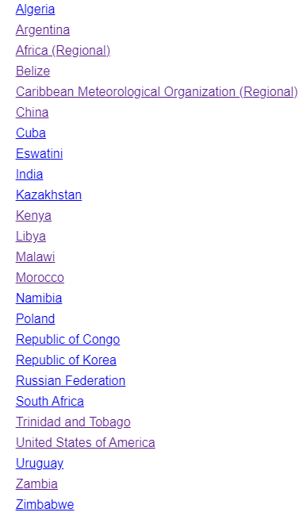
WIS2 in a box
gitHub repositories and docs
Code: https://github/wmo-im/wis2box
Documentation: https://docs.wis2box.wis.wmo.int
Demo: https://demo.wis2box.wis.wmo.int
Discussion Forum : github.com/wmo-im/wis2box/discussions
Apache license version 2.0
Permissions
Commercial use
Distribution
Modification
Patent use
Private use
Conditions
License and copyright notice
State any changes
Limitations
Liability
Trademark use
Warranty

Slide 8
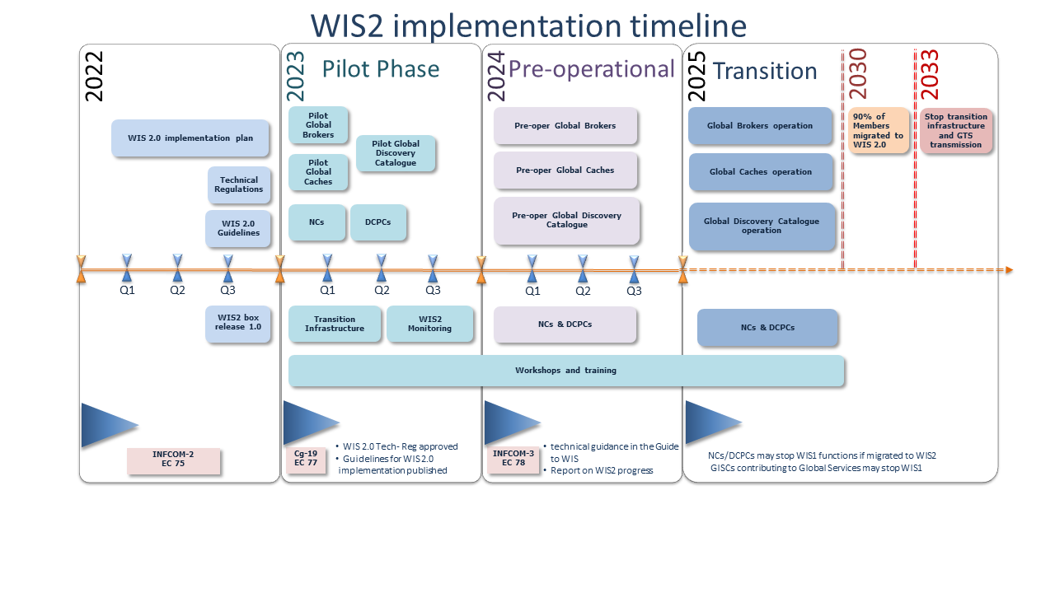

Slide 9
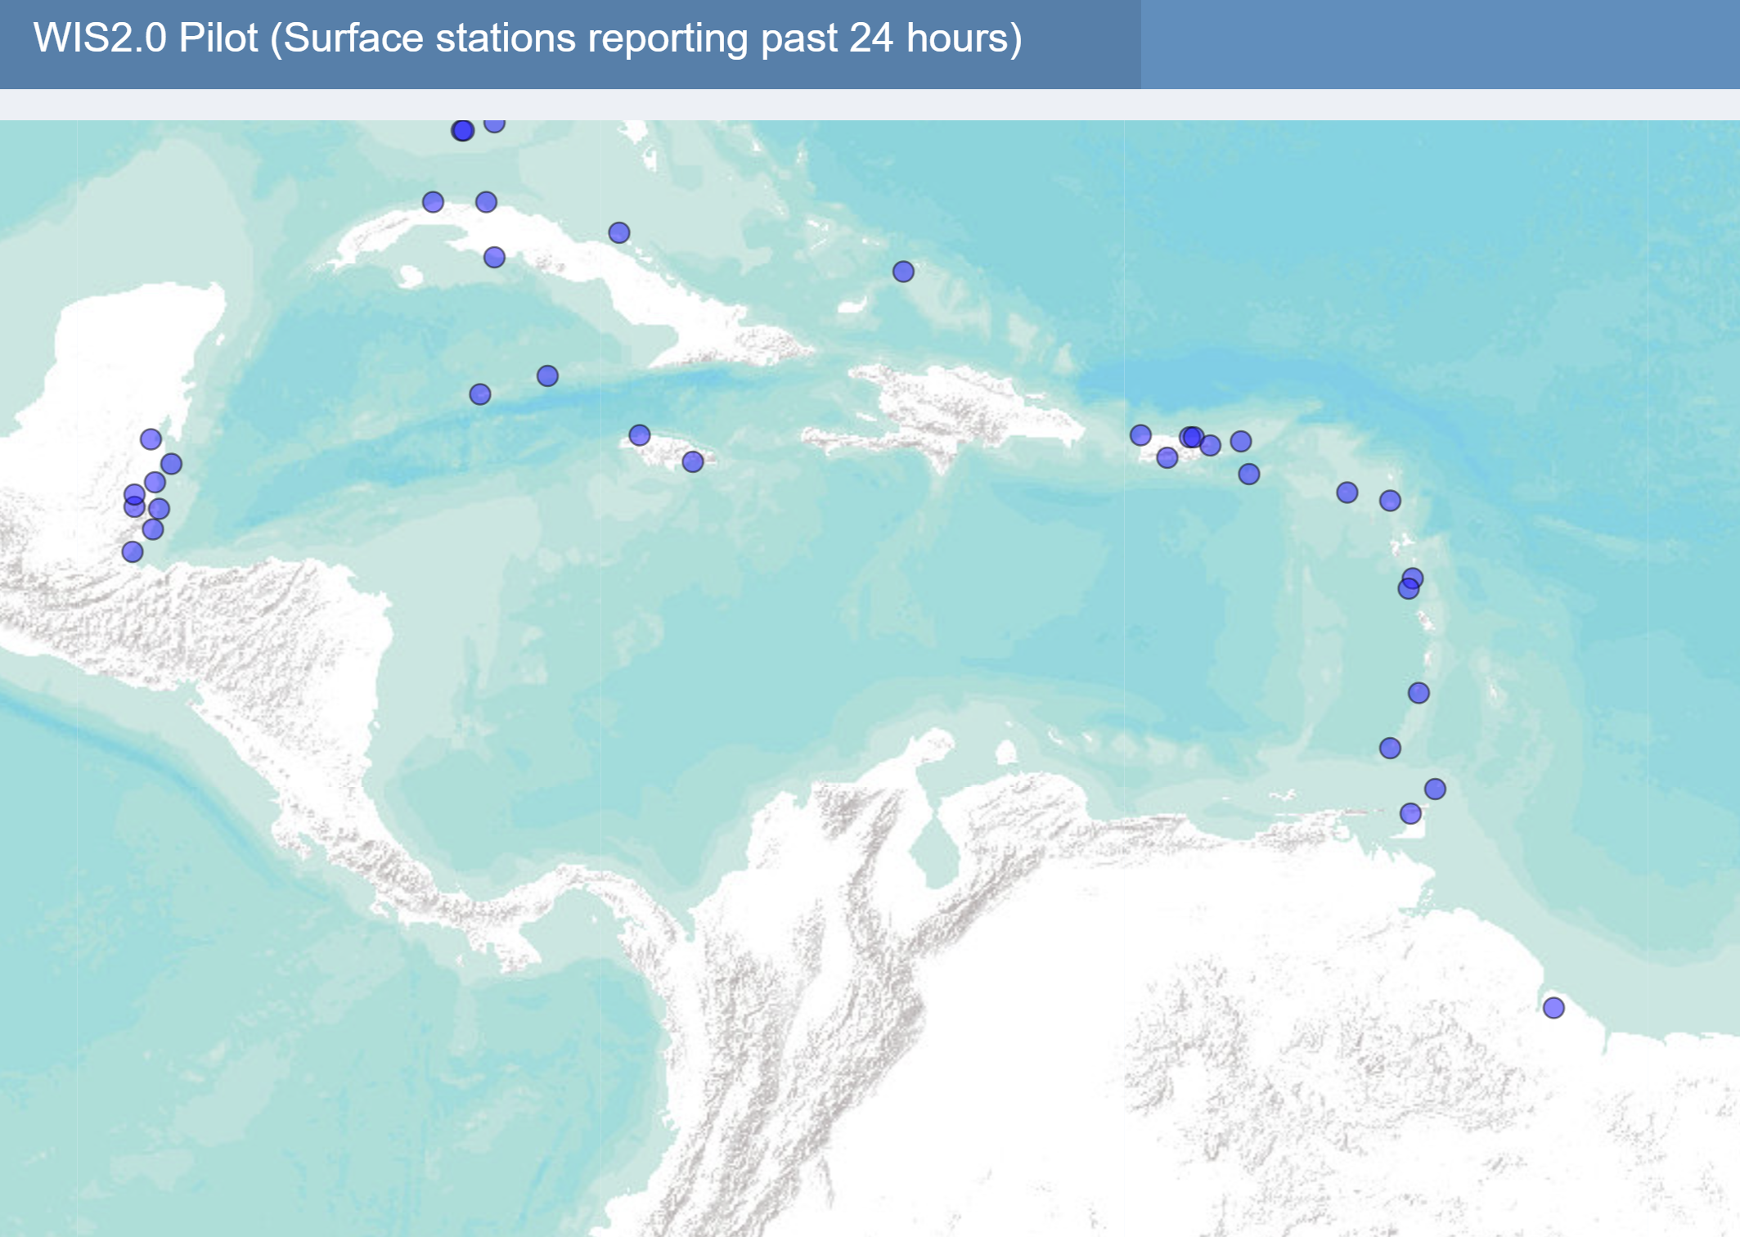

Caribbean“WIS2Box Node” and National Nodes
November 09, 2023
CMO Members among global leaders using WIS2 to share data
11 of 16 Members are currently sharing data using BUFR format on WIS2.0 in real time
every hour (10-year gap closed?)
Belize, Trinidad and Tobago created national WIS2 nodes
Barbados, Saint Lucia, BVI, Anguilla, Montserrat
Source: CMO

Slide 10
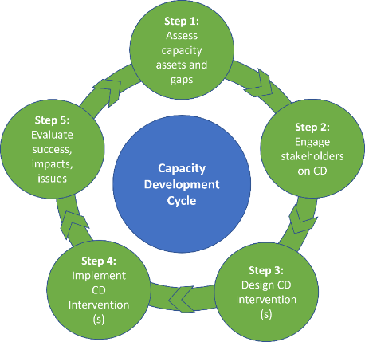
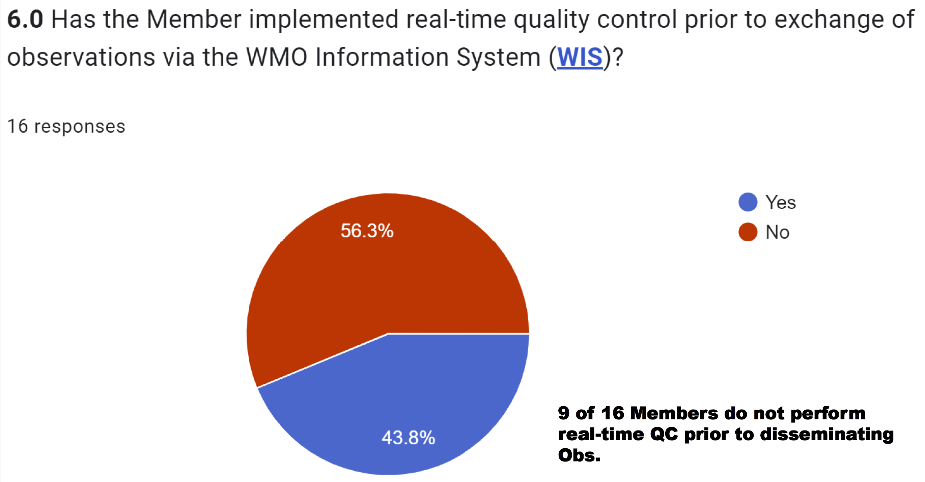

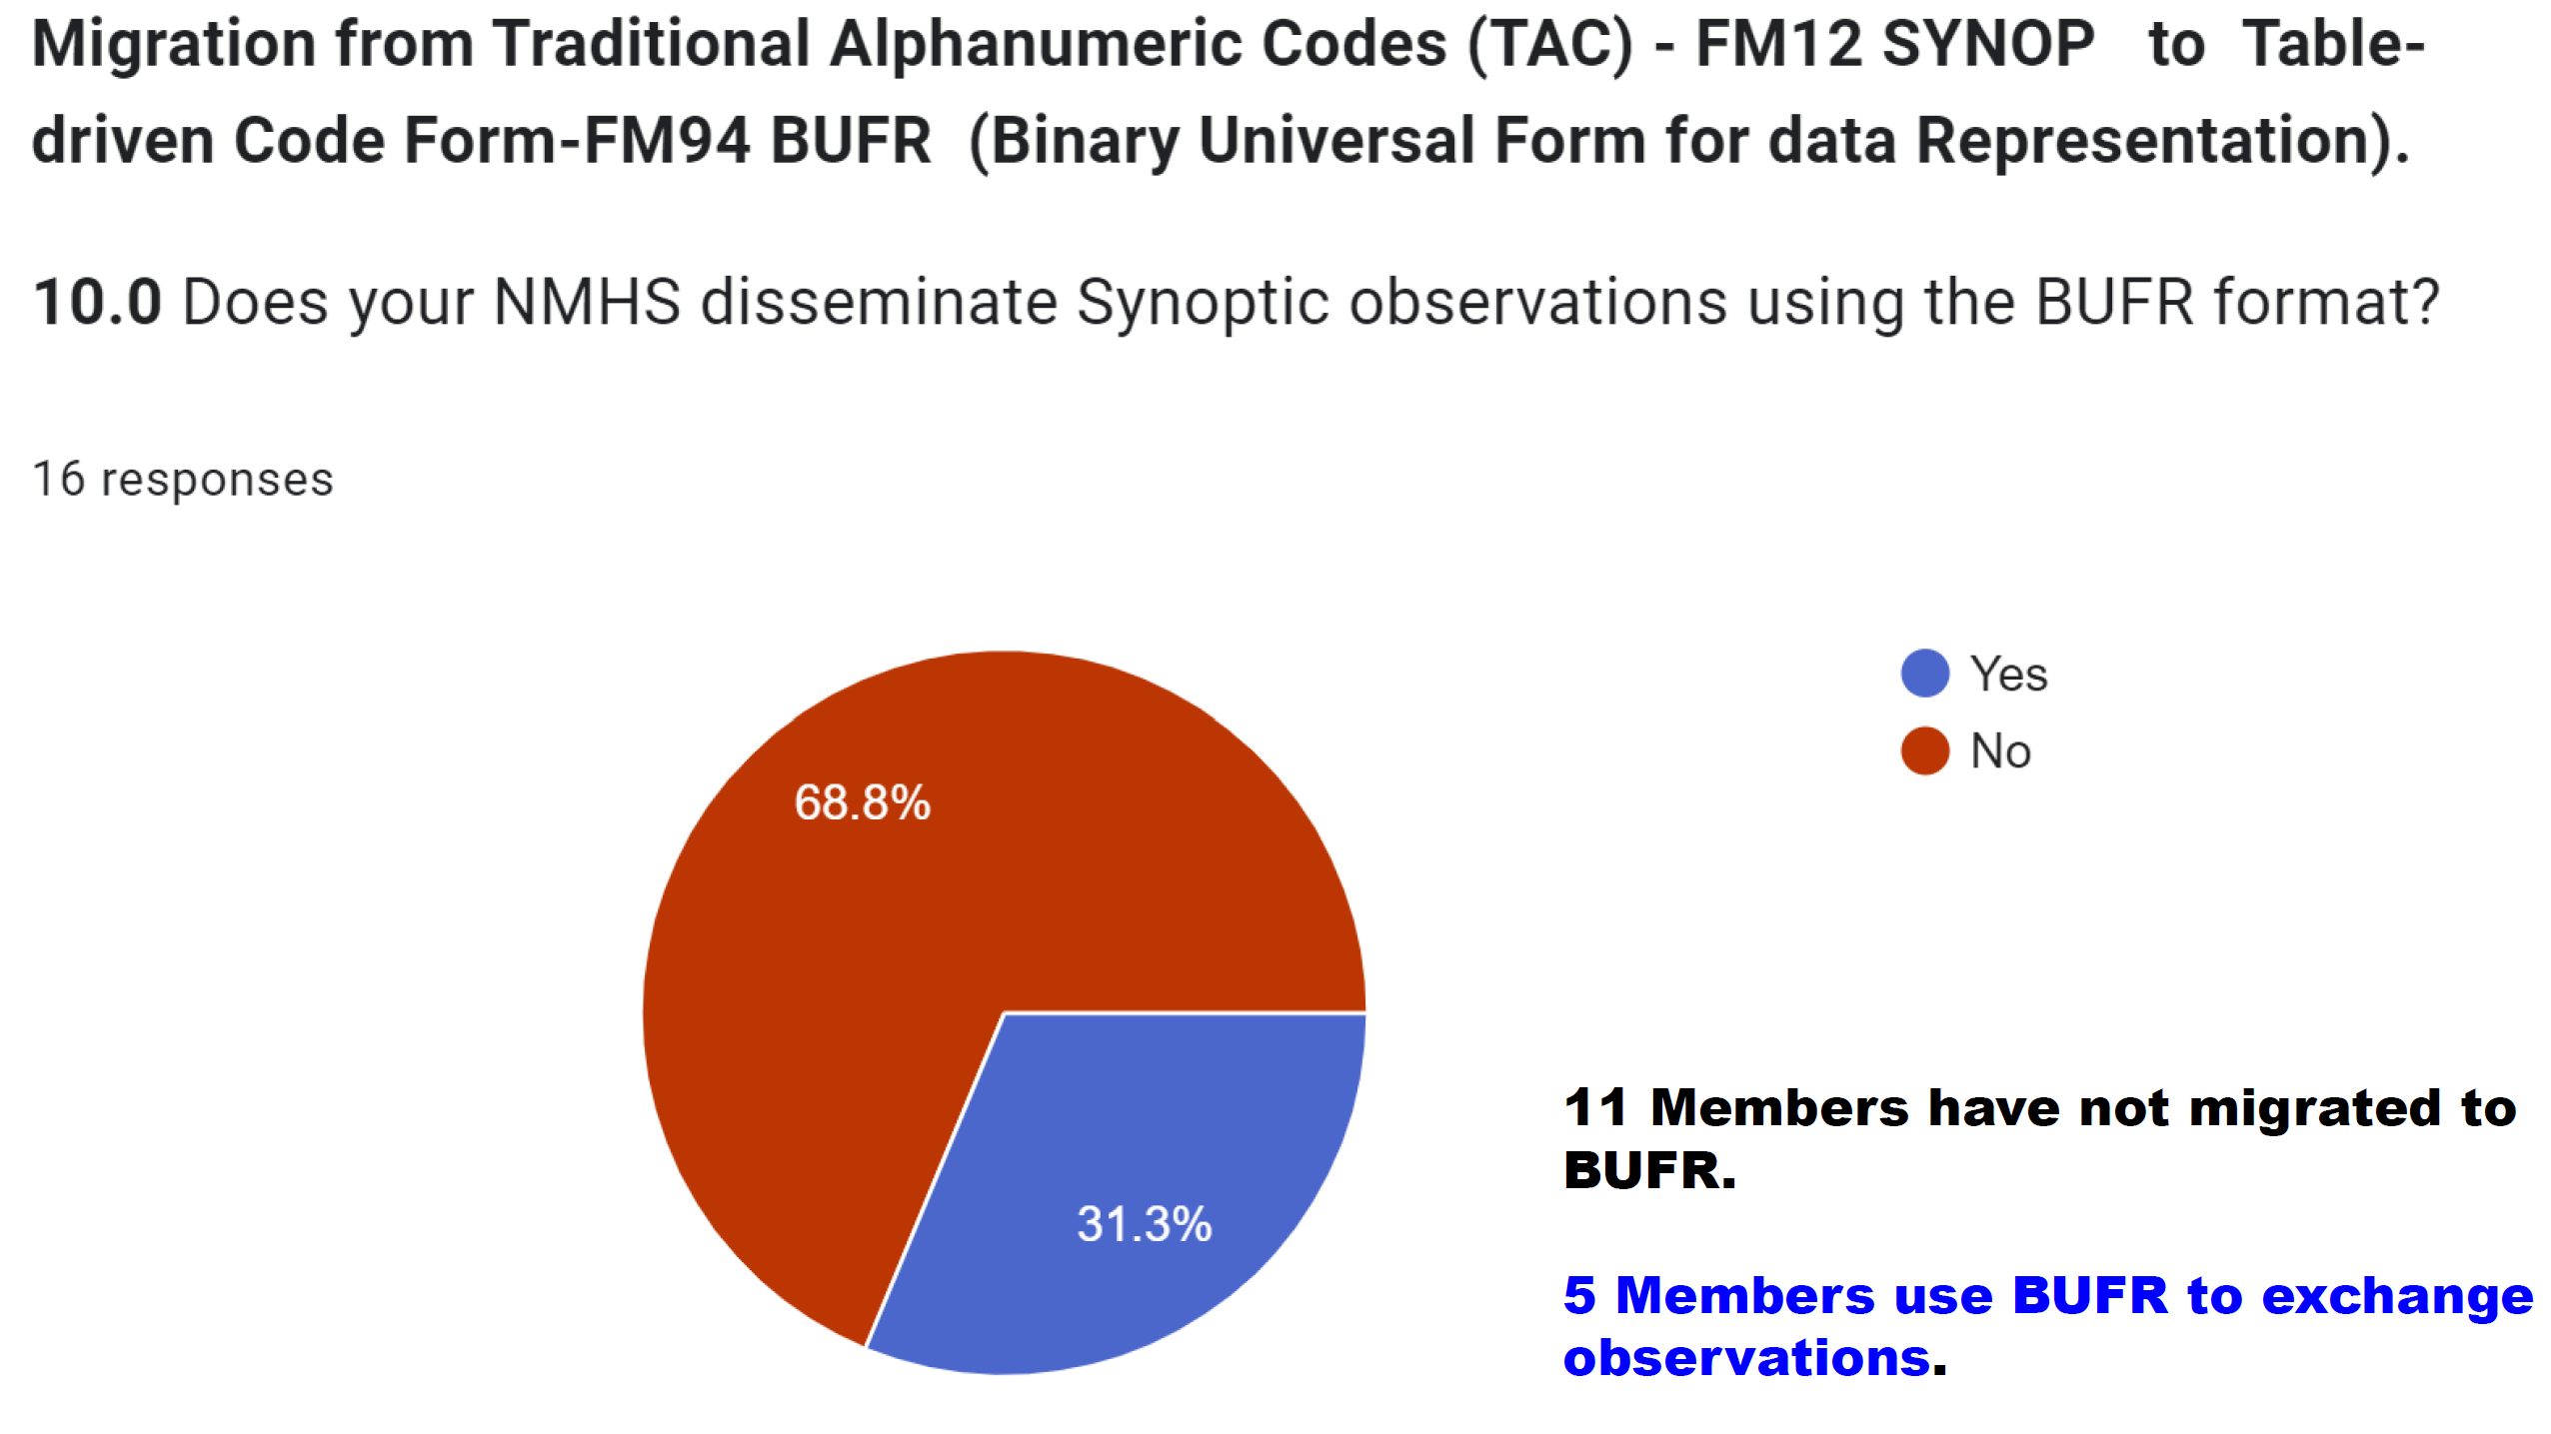
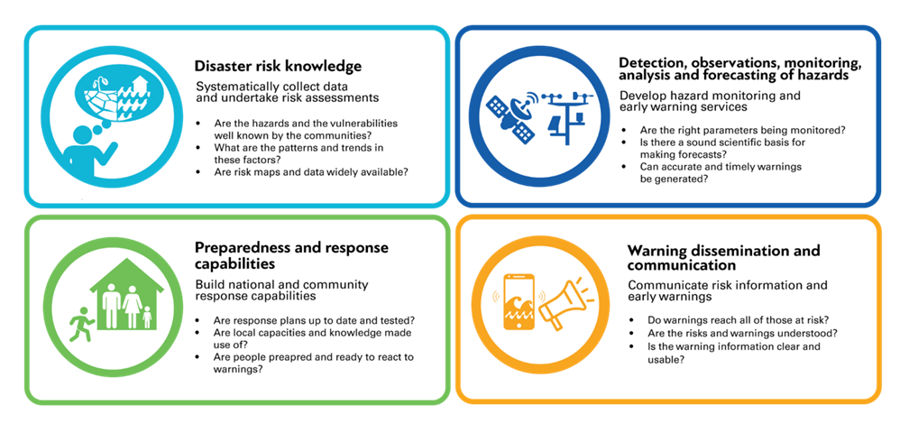
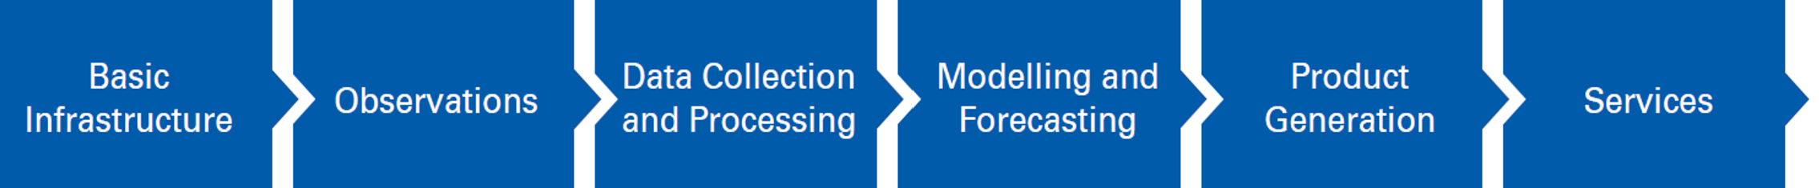
WIS2Box Implementation Linked to EW4All
November 09, 2023
Linkage to EW4All

Slide 11
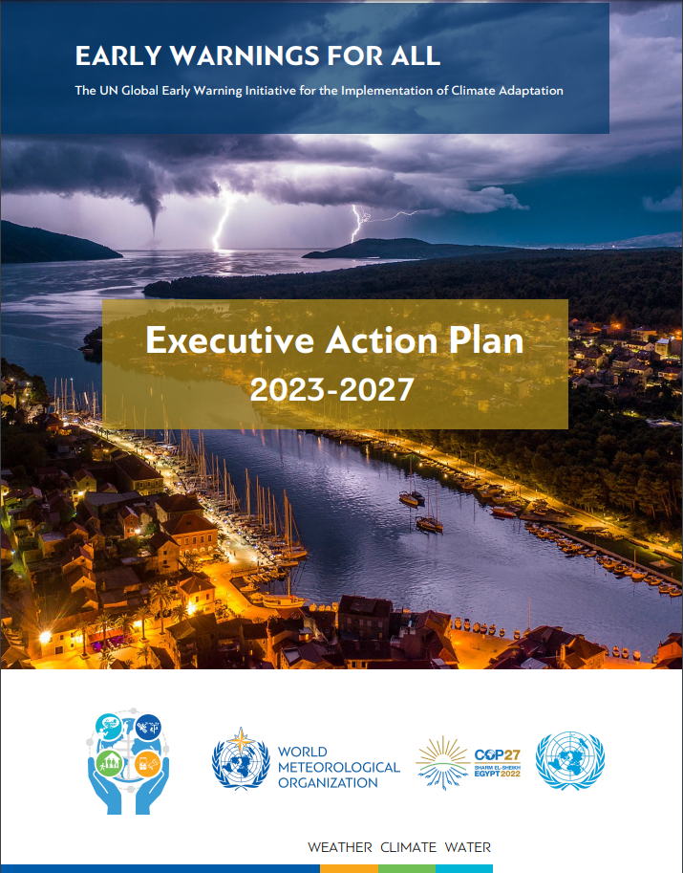
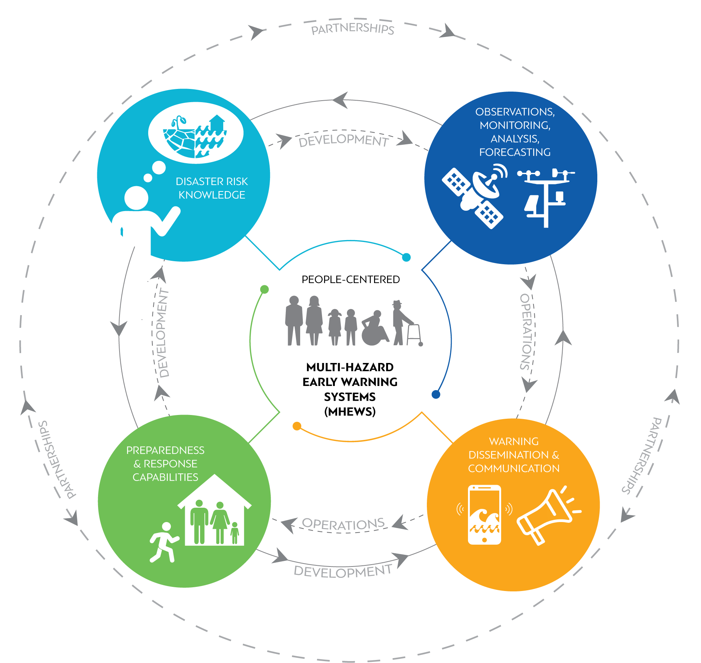
Early Warnings for All Initiative
UN SG
Announced on World Met Day 2022
Action Plan developed by WMO
Launched at COP-27 (Nov 2022)
https://public.wmo.int/en/earlywarningsforall

Slide 12
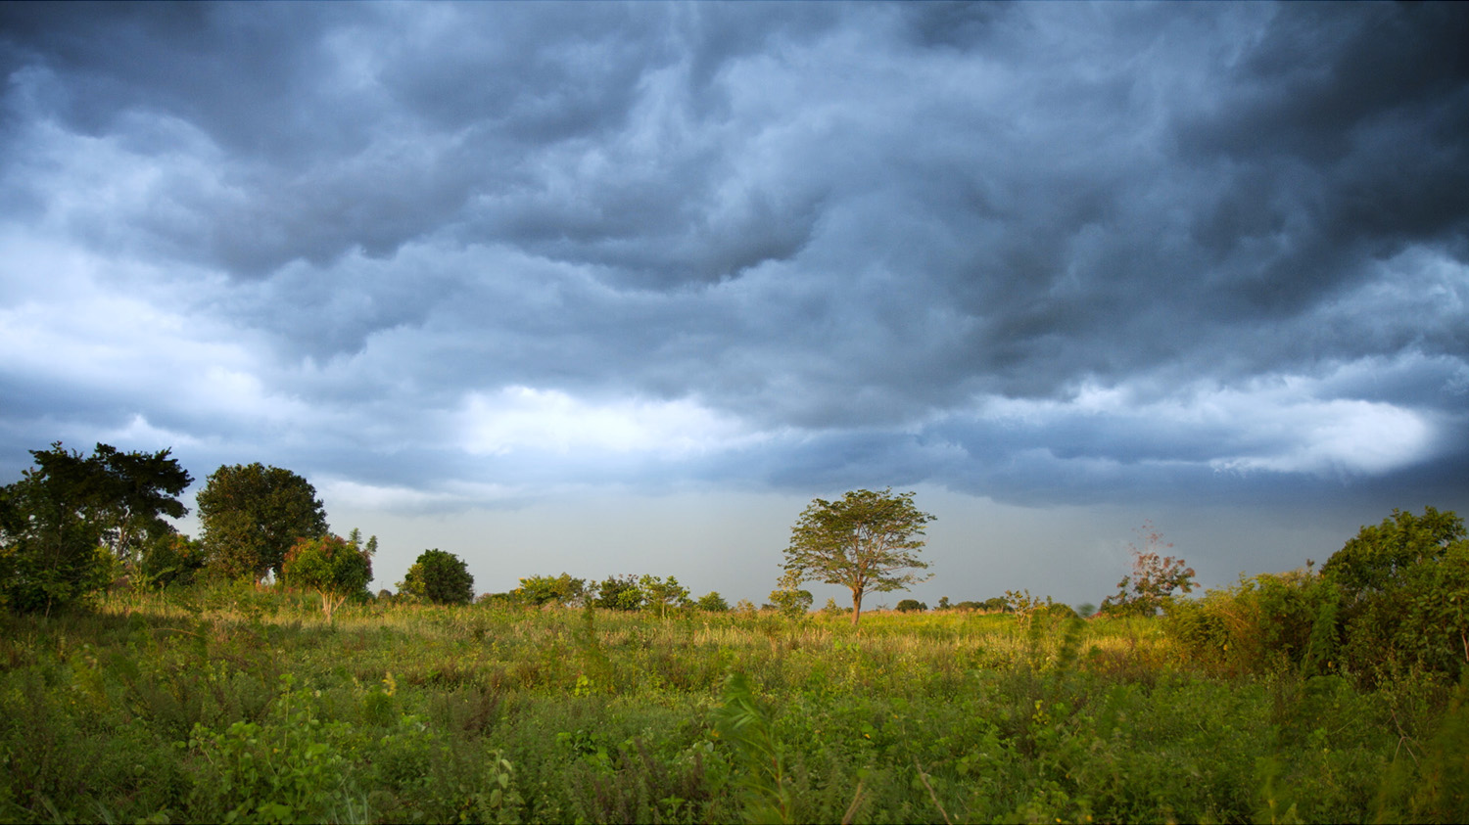
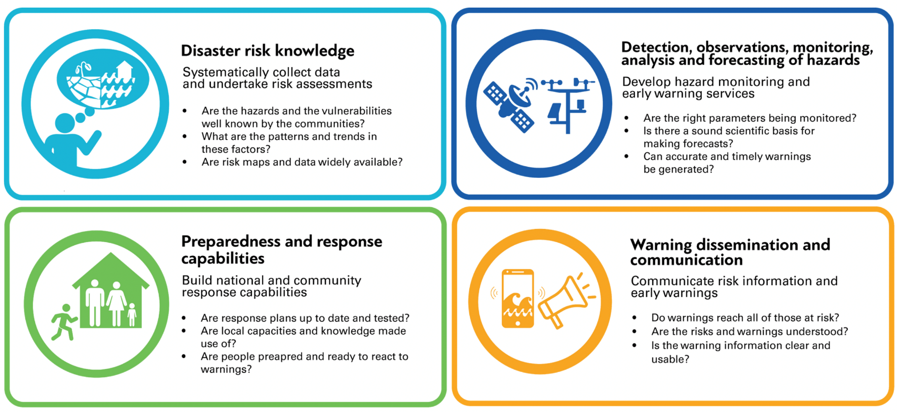
Early Warnings for All: Structure & Objectives
Notes:
The EW4All Initiative comprises four Pillars, in line with the four components of an end-to-end multi-hazard early-warning system: risk knowledge, observation and forecasting, communication and response.
Pillar 1: To be effective, EWS need to be contextualised and targeted through up-to-date, reliable and granular risk knowledge, including: assessments of hazards, vulnerabilities and exposure; applying a gender-lens and including indigenous and local knowledge. Significant shortcomings persist globally, from lack of data collection and assessments to lack of legislation and governance frameworks for risk information.
Pillar 2: In the forecasting area, many countries lack the capacity to incorporate an impact-based approach to forecasting and still have challenges in accessing, analysing and translating prediction model outputs into actionable warning messages.
Pillar 3: Considering warning dissemination and communication, the uptake of modern information technologies is lagging and even with more traditional methods (such as radio and mass media), there are still challenges in terms of inclusivity and reaching the most vulnerable.
Pillar 4: Having preparedness and response plans and capabilities, including at local government level is vital for responding to the hydro-meteorological warnings. Currently, less than half of the countries which have EWS in place have such plans and capacities available.

Slide 13

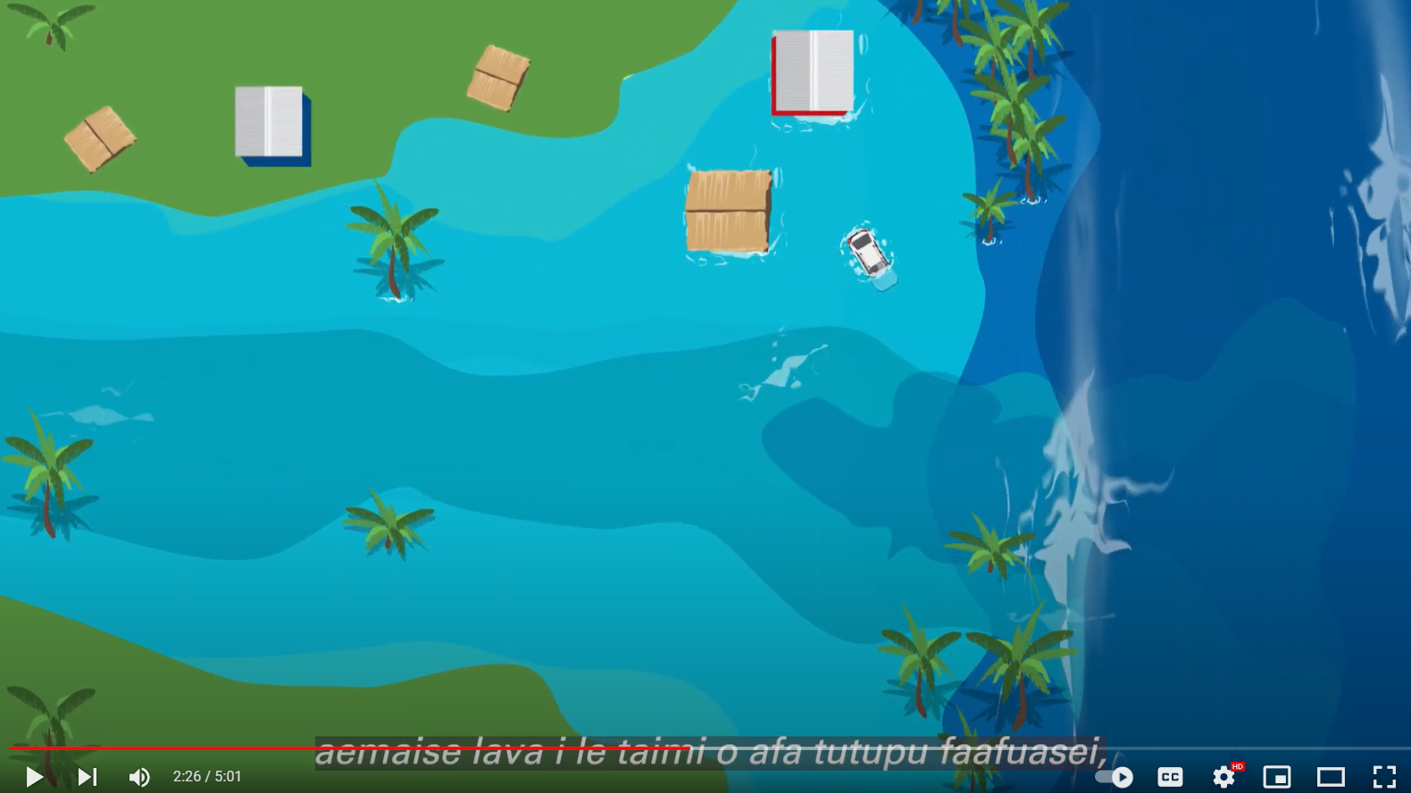
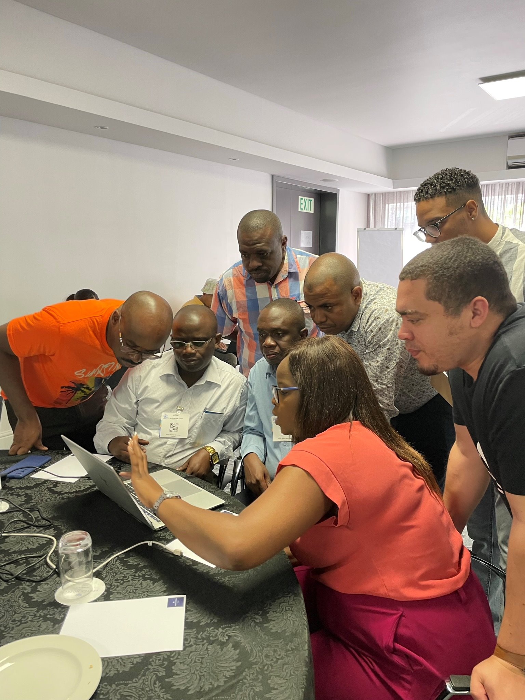
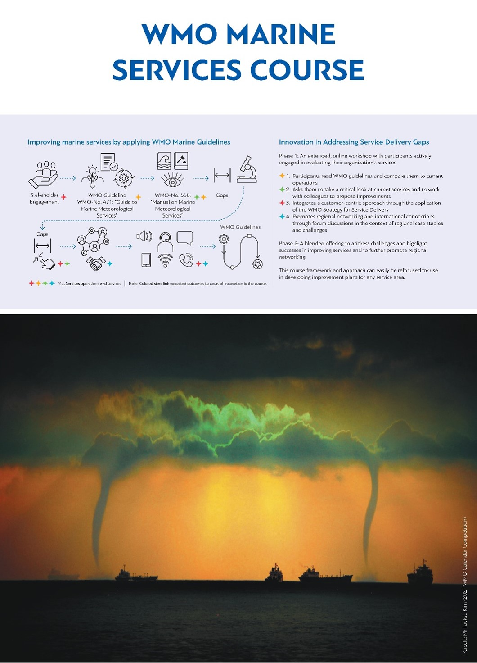
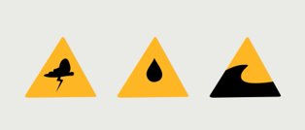
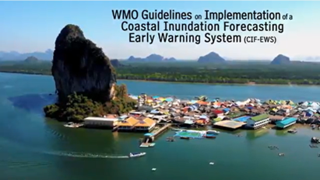
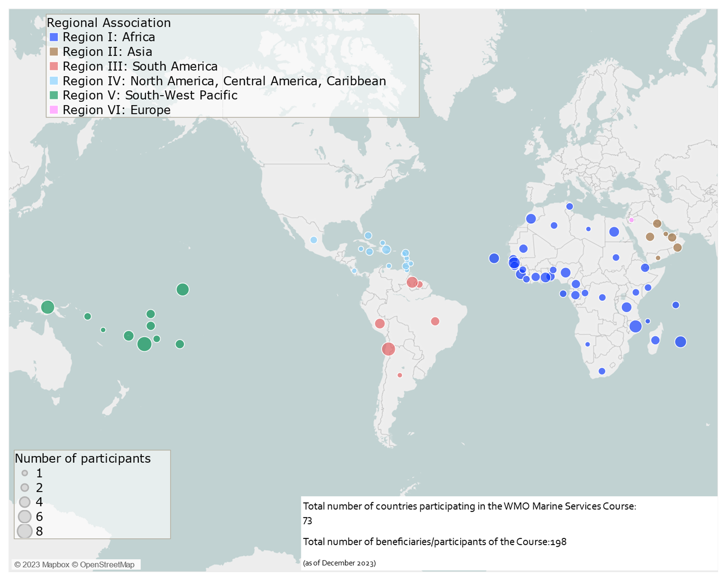
Other touchpoints
CAP – encouraging NMHS to use this, where appropriate for TEWs
Coastal Inundation (and links to MHEWS/tsunami)
  WMO 1293 Coastal Inundation Guidelines & video, published
  Awareness videos – local languages – Pacific, Caribbean: coastal inundation, value of ocean buoys
METAREAS/NAVAREAS - joint hazard response
Marine Competency Toolkit
WMO Marine Services Course:
  Completed: Pacific Islands (Tsu session), Africa (En.)
  Partially Completed – Africa (Fr). Arabic, Caribbean,
  South America (Spanish)
  Other regions in 2024

Slide 14
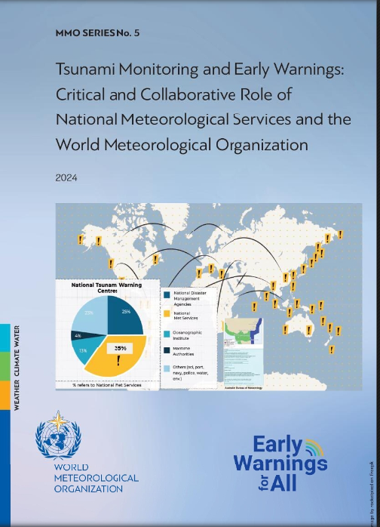
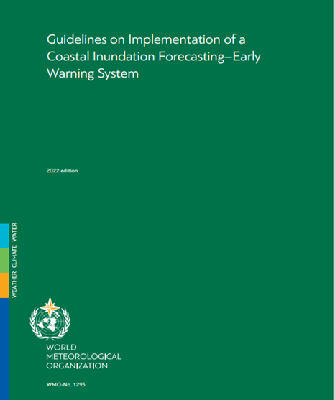

Slide 15

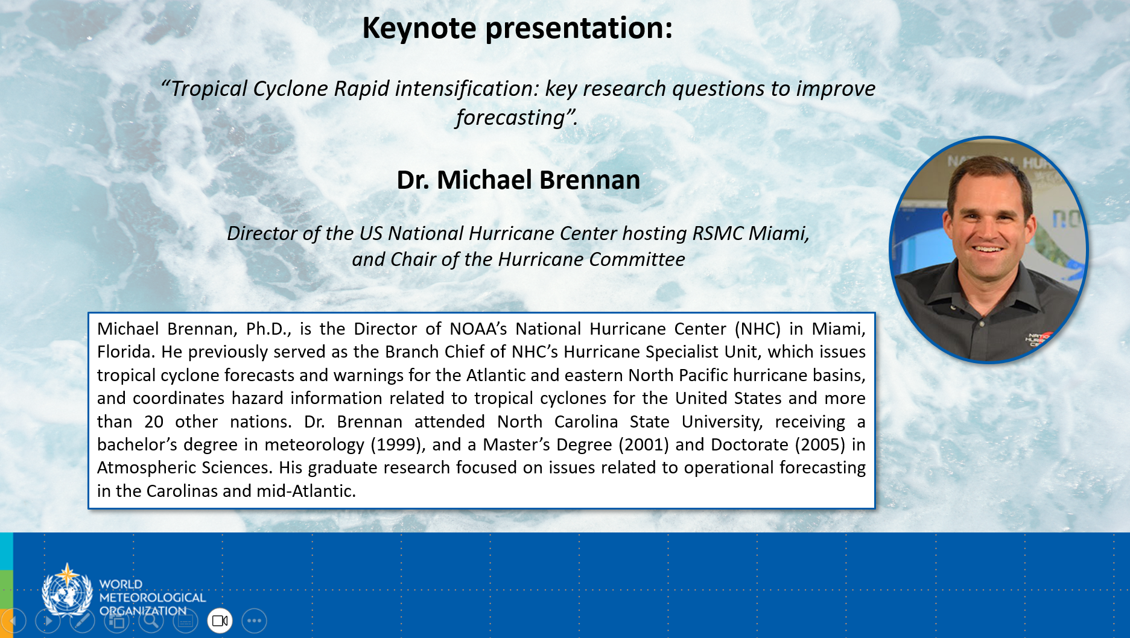
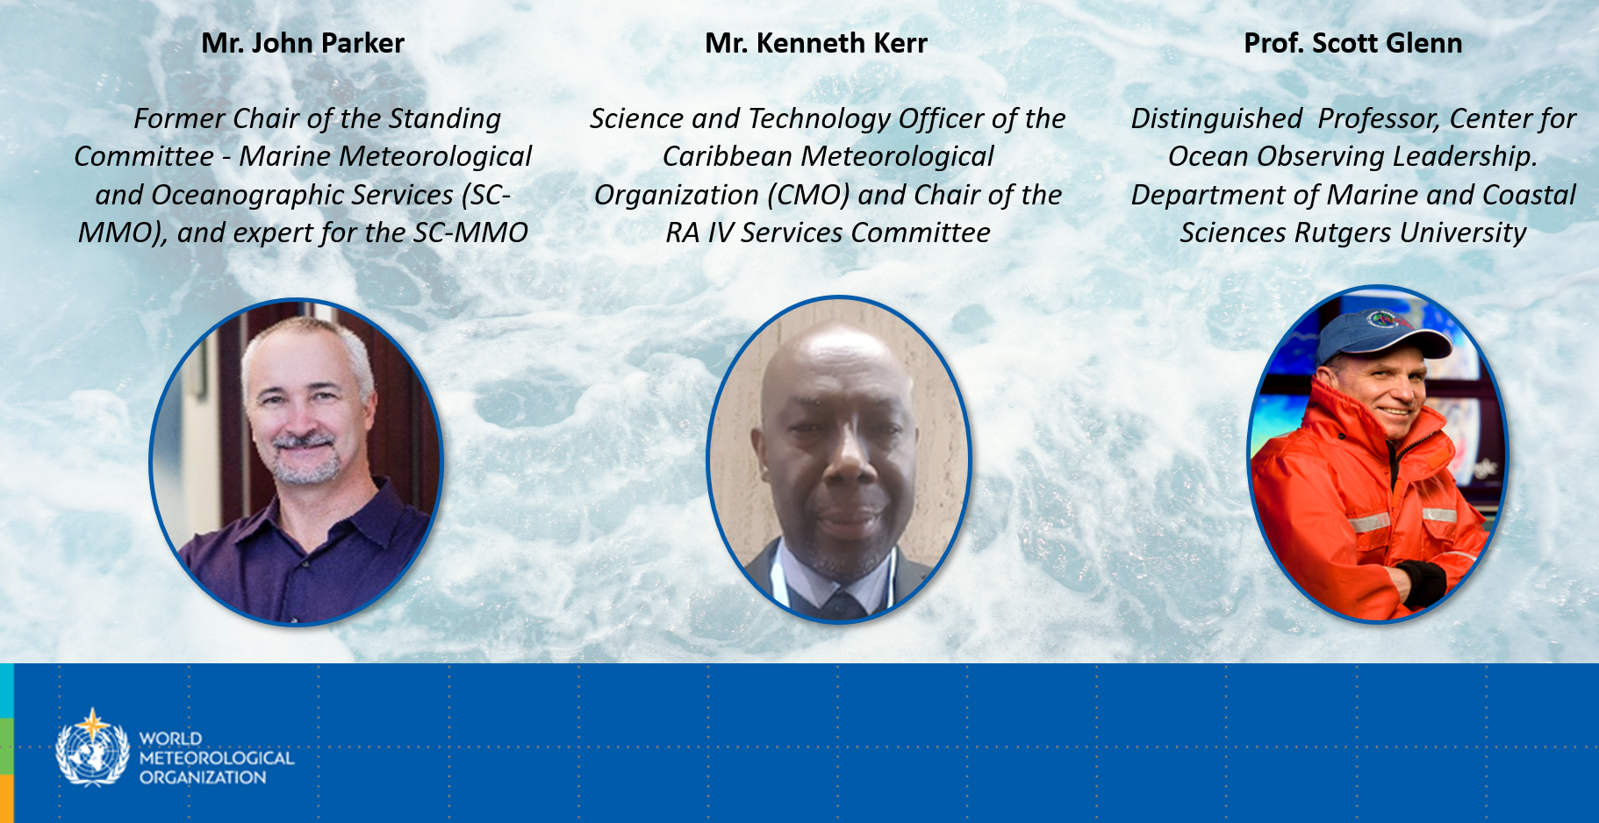
The Ocean panel was organized during the 46th Hurricane Committee session in Panama. It was attended by 70 participants, including 27 RA IV Committee Members (mostly in-person), observers from Spain and Portugal, CIMH representatives, Chairs of other RA IV subsidiary bodies, invited guests, online participants, and WMO Secretariat staff.
Presentations are available in this FOLDER and recording are available HERE.

Slide 16
Long Range Waves otherwise known as
'Meteo-tsunami'
Atmospheric forcing of a long range wave (non seismic, atypical) defined as 'tsunami-like'.
Driven by air-pressure disturbances mostly associated with fast-moving weather events.
Progressive waves limited to tsunami frequency band of wave periods (2 mins to 2 hours)
NMHS are principally responsible for providing early warnings for weather driven coastal hazards (eg storm surges, swell, waves etc) via their operational weather forecasting areas
Weather warnings, including coastal hazards, need to be easily understood by the public
Japanese terminology:
  Tsu + nami = Port and Harbours + waves (historically)
  Tsunami = technical term for long waves generated by earth movement
  Abiki = local name for long range waves driven by air pressure disturbance

Slide 17
Long Range Waves otherwise known as 'Meteo-tsunami' - status since TOWS WG 2023
Operational Framework:
WMO experts and secretariat have been contributing to the ad-hoc Task Team for Meteotsunami – the investigation continues with focus on early warnings and operational framework for such events.
Term and Definition:
WMO has concerns about the term and definition of 'meteotsunami' which is 'tsunami-like'
The situation is complicated with various opinions from different communities eg science, academic, tsunami, and operational meteorologists
WMO is committed to gathering the views of Members, and working with TOWS WG, to consider the best way forward to clarify the term and definition, while ensuring the public interest and safety at the coast is paramount.
WMO-IOC JCB
WMO has requested to the WMO-IOC JCB, that 'meteo-tsunami' is raised for discussion, to clarify the roles and responsibilities of WMO and IOC, and how best to support Members. This is likely scheduled for Q3, 2024.

Slide 18
2024 events of interest
EW4ALL - various events
WMO-IOC JCB – Next week (online) and Q3 (face to face)
WMO EC-78 (self-assessment results for WMO-IOC JCB)
WMO Marine Competency – test pilots
WMO Marine Services Course
  Phase 2 Face to Face – Caribbean (English/Spanish), South America (Spanish)
  Phase 1 (online) - SE Asia (English)

Slide 19
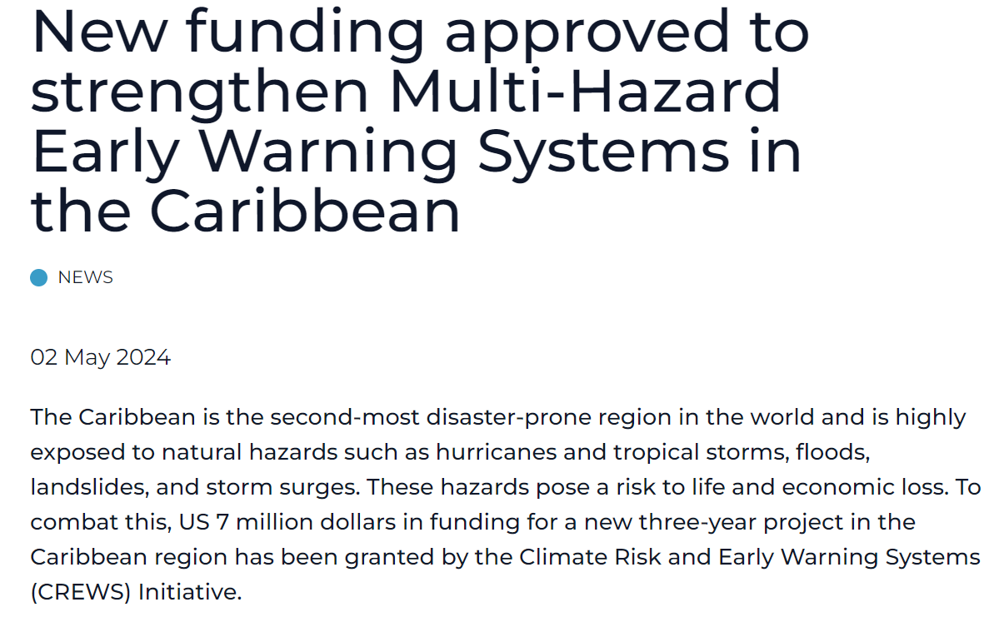


CREWS 2.0 APPROVED!

Slide 20

Gracias
Thank you
Merci
^{wmo.int}

