Slide 1
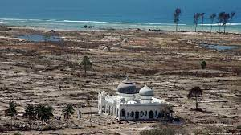
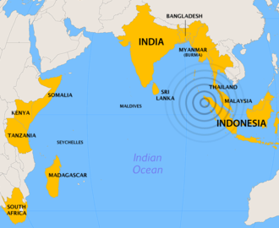
2nd UNESCO IOC Global Tsunami Symposium
“Two Decades After 2004 Indian Ocean Tsunami: Reflection and the Way Forward”
Monday 11th - Thursday 14th November 2024
in BANDA ACEH, INDONESIA

Slide 2
PRE-EVENT International Workshop Venue: USK Banda Aceh | 2nd UNESCO IOC Global Tsunami Symposium Venue: Banda Aceh Convention Hall (11 – 14 November, 2024) |  |  |  | POST-EVENT ICG IOTWMS XIV Session Venue: Banda Aceh or BMKG Jakarta
Hosted by IABI in collaboration with TDRMC, IGI | Day 1 (11 Nov 2024) | Day ( 12 Nov 2024) | Day 3 (13 Nov 2024) | Day 4 (14 Nov 2024) | Hosted by BMKG
Hosted by IABI in collaboration with TDRMC, IGI Location: USK | Opening Ceremony | Session 3 | All Day Excursion | Session 7
 |  | Session 4 |  | Session 8
 | Lunch Break (12:00 – 14:00) | Lunch Break (12:00 – 14:00)
 | Session 1 | Session 5 |  | Closing Ceremony
 | Session 2 | Session 6
Side Events: Exhibitions, Posters, Ignite Stages and “Rumah Resilience Indonesia” located at Banda Aceh Convention Hall | Side Events: Exhibitions, Rumah Resilience Indonesia, Posters, and Ignite Stages

Slide 3
2nd UNESCO IOC Global Tsunami Symposium
“Two Decades After 2004 Indian Ocean Tsunami: Reflection and the Way Forward”
Monday 11th - Thursday 14th November 2024
in BANDA ACEH, INDONESIA

Slide 4
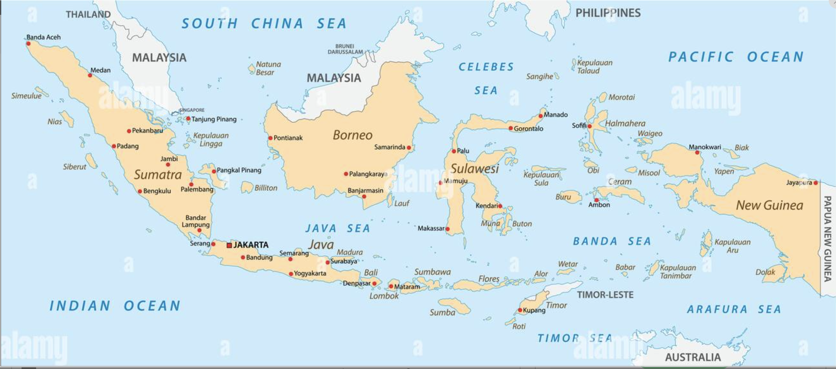
Location of Banda Aceh Indonesia
How to get there:
Via Jakarta (all domestic flight)
Via KL – Malaysia using Air Asia

Slide 5
Aims
To commemorate two decades after 2004 Indian Ocean Tsunami
To reflect what has been achieved in two decades
To identify gaps, challenges and priorities for tsunami early warning
To identify synergy with global challenges and coherence with global commitments
To gather global tsunami community

Slide 6
Scopes
Session 1 to 8 open to public
Invited speakers for the sessions will be nominated/selected by POC, i.e., global and local prominent academia, engineers, practician, politician and public figures.
Anticipated 800 participants
Each session will be chaired by 1 Chair Session supported by 1 Rapporteur + 1 Timekeeper
Chair Session and Rapporteur will be nominated by POC
Exhibitions, Poster Sessions, Ignites Stage, Rumah Resilience and local elementary school drawing competition will be organized by collaboration of BMKG, Government of Banda Aceh, IABI, USK, IGI.
Global Video Competition for youth (high school) will be organized by IOTIC
Local School Children Art Drawing ”tsunami resilience” organized by IABi and USK
Open access edited book “Two Decades After 2004 Indian Ocean Tsunami: Reflection and the Way Forward”, drawing upon inputs from each session - editor HPR, DA and RH
Extensive promotion has been started in January 2024

Slide 7
Host
Government of Indonesia – BMKG (Host)
UNESCO IOC - Tsunami Resilient Section (Co-host)
IUGG (International Union of Geodesy and Geophysics) – Joint Tsunami Commission (Co-host)

Slide 8
Steering Committee
To guide the Programme Organizing Committee on the substance of symposium: the themes, topics, programme, expertise and speakers, etc.
Government of Indonesia:
  Head of BMKG: Prof. Dwikorita Karnawati
  Head of BNPB: Letjen Suharyanto
  Representative of Ministry of Foreign Affairs: (TBD)
UNESCO Jakarta Office:
  Director and Representative: Ms. Maki Katsuno-Hayashikawa
UNESCO IOC:
  Tsunami Resilient Section: Mr. Bernardo Aliaga
IUGG-JTC:
  Chair of Join Tsunami Cooperation: Prof. Tanioka
GDRC:
  Prof. Dilanthi Amaratunga
  Prof. Richard Haigh
Notes:
We are also currently discussing other potential members for the steering committee

Slide 9
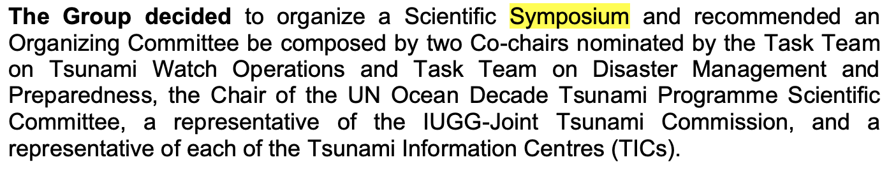
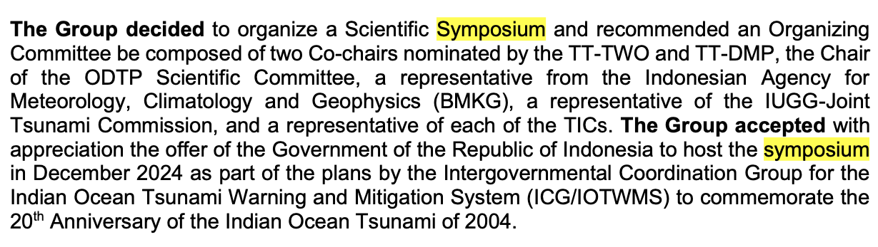
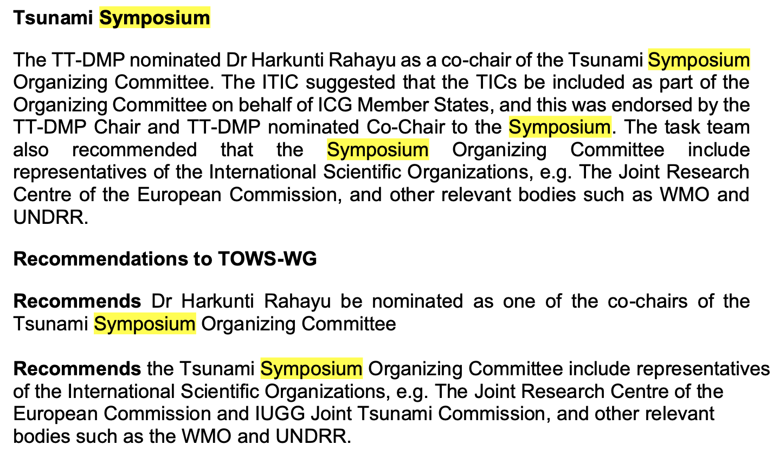
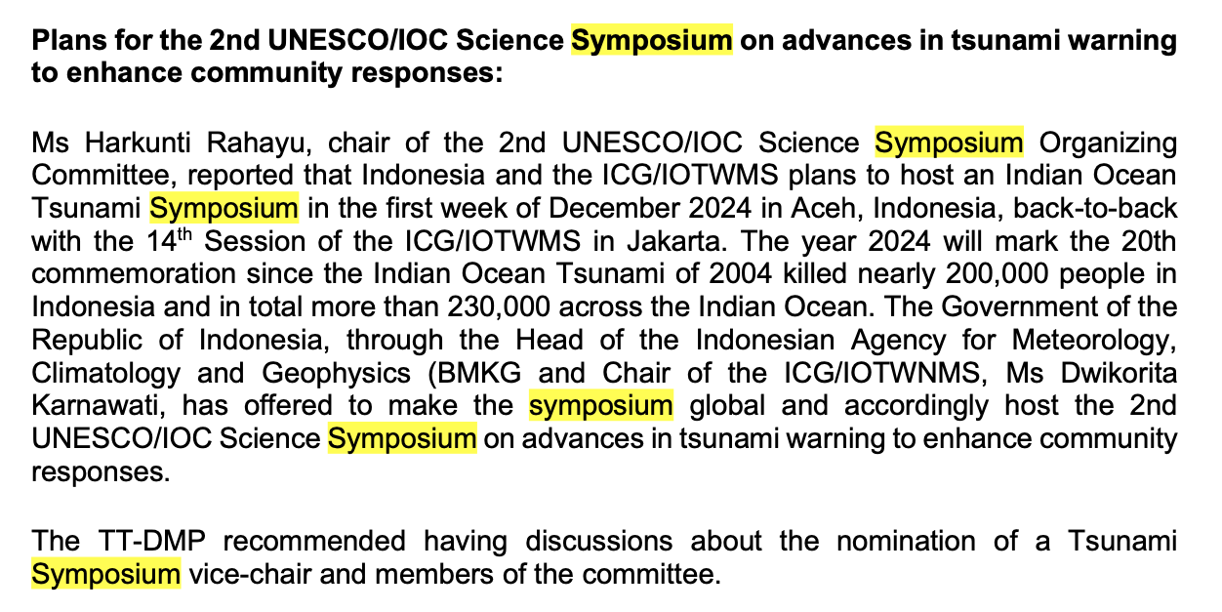
TOWS WG XV and XVI on Global Tsunami Symposium
TOWS WG XV, 2022
TOWS WG XVI, 2023
Notes:
We are also currently discussing other potential members for the steering committee

Slide 10
Programme Organizing Committee
To coordinate and organize the 2nd Global Tsunami Symposium on the detailed planning of the program and agenda
Co-Chair : Dr Harkunti Rahayu (UNESCO IOC-TOWS WG-TTDMP)
Co-Chair: Dr. Yuji Nishimae (UNESCO IOC-TOWS WG-TTWO)
Members:
  Dr. Srinivasa Kumar Tummala (Chairperson of the Scientific Committee for the UN Ocean Decade Tsunami Programme - SC-ODTP)
  Mr. Hanif Andi (Deputy of Geophysics of BMKG)
  Mr. Rick Bailey (Secretariat of ICG/IOTWMS)
  Dr. Laura Kong (International Tsunami Information Centre)
  Denis Chang-Seng (Northeast Atlantic and the Mediterranean Seas TIC)
  Allison Broom (Caribbean Tsunami Information Centre)
  Ardito M Kodijat (Indian Ocean Tsunami Information Centre)
  Ms Suci Dewi Anugrah
  Nora Gale (Secretariat of ICG/IOTWMS)
  IUGG rep

Slide 11
Programme Organizing Committee
(request approval from TOWS WG)
To coordinate and organize the 2nd Global Tsunami Symposium on the detailed planning of the program and agenda
Chair : Dr Harkunti Rahayu (UNESCO IOC-TOWS WG-TTDMP)
Vice Chair 1: Dr. Yuji Nishimae (UNESCO IOC-TOWS WG-TTWO)
Vice Chair 2: Ms. Suci Dewi Anugrah (BMKG)
Members:
  Dr. Srinivasa Kumar Tummala (Chairperson of the Scientific Committee for the UN Ocean Decade Tsunami Programme - SC-ODTP)
  Mr. Hanif Andi (Deputy of Geophysics of BMKG)
  Mr. Rick Bailey (Secretariat of ICG/IOTWMS)
  Dr. Laura Kong (International Tsunami Information Centre)
  Denis Chang-Seng (Northeast Atlantic and the Mediterranean Seas TIC)
  Allison Broom (Caribbean Tsunami Information Centre)
  Ardito M Kodijat (Indian Ocean Tsunami Information Centre)
  IUGG rep
  Nora Gale (Secretariat of ICG/IOTWMS)
  (tbd)

Slide 12
National
Committee Indonesia
to coordinate, support, and manage the technical arrangement and organization of the symposium nationally and in Banda Aceh (In collaboration with Programme Organizing Committee - POC)
Advisor: Deputy of Geophysics
Head of Technical Committee : Director of Earthquake and Tsunami
Members:
Mitigation Division and other Division of Center for Earthquake and Tsunami BMKG
Intl Cooperation BMKG
Public Affairs Division BMKG
Communication and Networks Division BMKG
Aceh Geophysical Station BMKG
Regional Centre Medan BMKG
BNPB (NDMO)
Indonesian Ministry of Foreign Affairs
BPBA Province Nangroe Aceh Darussalam (LDMO)
BPBA Kota Banda Aceh (LDMO)

Slide 13
Agenda of 2nd Global Tsunami Symposium
(11-14 November 2024)
 | Day 1 (11 Nov 2024) | Day (12 Nov 2024) | Day 3 (13 Nov 2024) | Day 4 (14 Nov 2024)
Morning (09:00–12:00) | Opening Ceremony | Session 3 | All Day Excursion | Session 7
 |  | Session 4 |  | Session 8
Lunch Break (12:00 – 13:30)
Afternoon (13:30–16:30) | Session 1 | Session 5 |  | Closing Ceremony
 | Session 2 | Session 6
Side Events: Exhibitions, Posters, Ignite Stages and “Rumah Resilience Indonesia” | Side Events: Exhibitions, Posters, Ignite Stages and “Rumah Resilience Indonesia”

Slide 14
Day 1 Morning:
Opening Ceremony
Opening Ceremony’
Indonesian Anthem
Prayer
Moment of Silent (Video) + eyewitness
Opening Performance (Saman Dance)
Remarks
Welcoming Remarks
  Governor of Nangroe Aceh Darussalam Province
  Head of BMKG
  ADG/ES of UNESCO-IOC (If not attending, Director of UNESCO Office Jakarta).
  IUGG Representative
  The UN Resident Coordinator for Indonesia (TBC)
  Special Representative of the Secretary-General for Disaster Risk Reduction (TBC)
Opening Remark
  Coordinating Minister for Maritime and Investment (TBC)
Keynote Speech by the Newly Elected President (TBC)
Group Photo
Press Conference

Slide 15
Day 1 Afternoon:
Plenary Session
Session I: Review of the Tsunami Warning and Mitigation Systems over the past 2 decades (150 min - invited speakers) → UNDRR videos
Learning from Mega Tsunamis : 2004 Indian Ocean Tsunami and 2011 Tohoku Tsunami @ 15 min (30 mins)
Panel on history of IOTWMS (Past and present chairs ICG/IOTWMS, PTWC rep, JMA Rep, UNESCAP, UNDRR rep (30 mins total)
Gaps, challenges, and priorities in tsunami risk, detection, warning and dissemination, awareness and preparedness including the needs for disruptive technologies (AI and 4.0) (current four ICG Chairs… 10mins each)
Session 2: Non-Seismic Tsunami in response to UN ODTP UN Ocean Decade Tsunami Programme (30 min - invited speakers) → Stromboli Volcanoes videos 3 min (Denis Cheng)
Progress, gaps and emerging challenges of detecting and warning for tsunamis generated by non-seismic sources
Developing awareness and preparedness of communities for tsunamis generated by non-seismic sources

Slide 16
Day 2 Morning:
Plenary Session
Session 3: Tsunami Hazard and Risk Assessment (90 min - invited speakers)
Evaluating seismic and non-seismic generated tsunami hazards (3 speaker)
Identifying communities at-risk (3 speaker)
Session 4: Tsunami Detection, Warning and Dissemination (90 min - invited speakers)
How to we Enhance Timeliness and Accuracy of Tsunami Warnings? (3 speaker)
How do we Ensure Tsunami Warnings Reach all in the community? (3 speaker)

Slide 17
Day 2 Afternoon:
Plenary Session
Session 5: Achieving 100% Communities at Risk to be Prepared for and Resilient to tsunami by 2030 (90 min - invited speakers)
Progress of UNESCO IOC Tsunami Ready recognition programme (3 speaker)
Synergizing Tsunami Ready with national programmes for tsunami preparedness (3 speaker)
Tsunami Ready Coalition (2 speaker)
Session 6: Other Critical Issues (90 min - invited speakers) 7 speaker
Social and Humanities perspective in Tsunami Science and Tsunami Early Warning System
Critical infrastructure ready for tsunami: design, implementation, and maintenance
Tsunami Disaster Governance, Policy, and Justice
Mainstreaming DRR into Urban Planning
MHEWS
Cascading and compound hazards, systemic risk

Slide 18
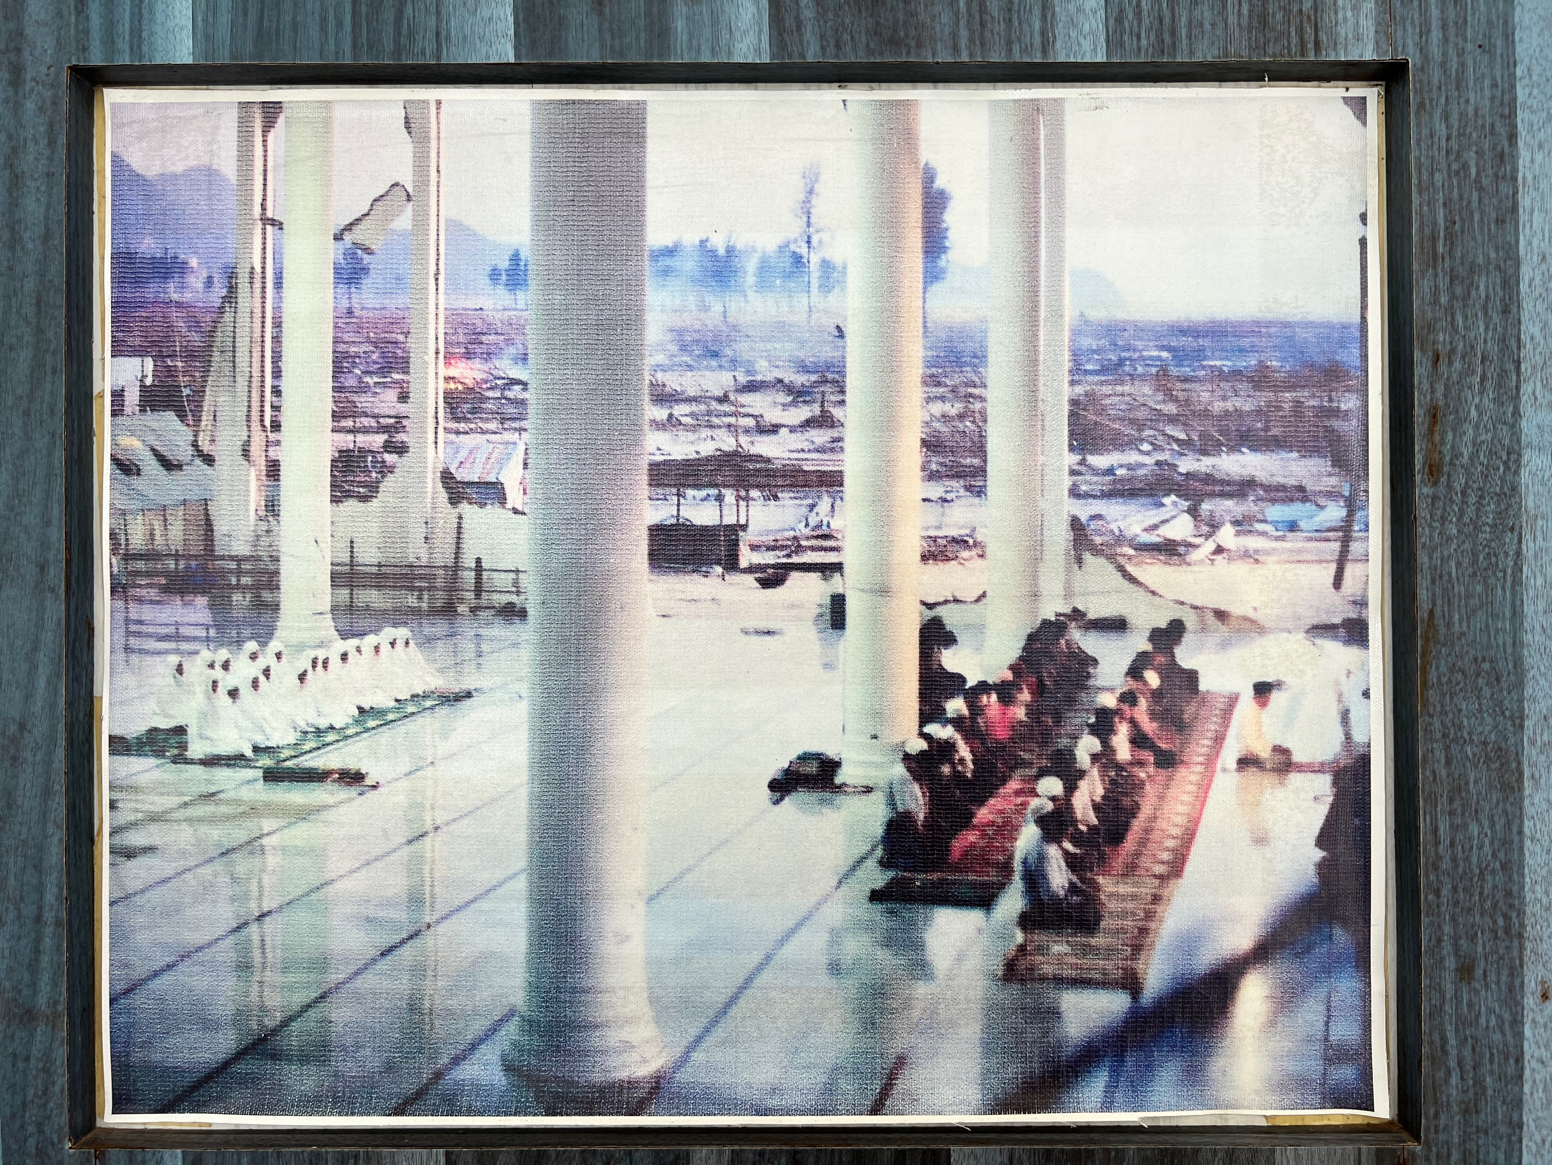
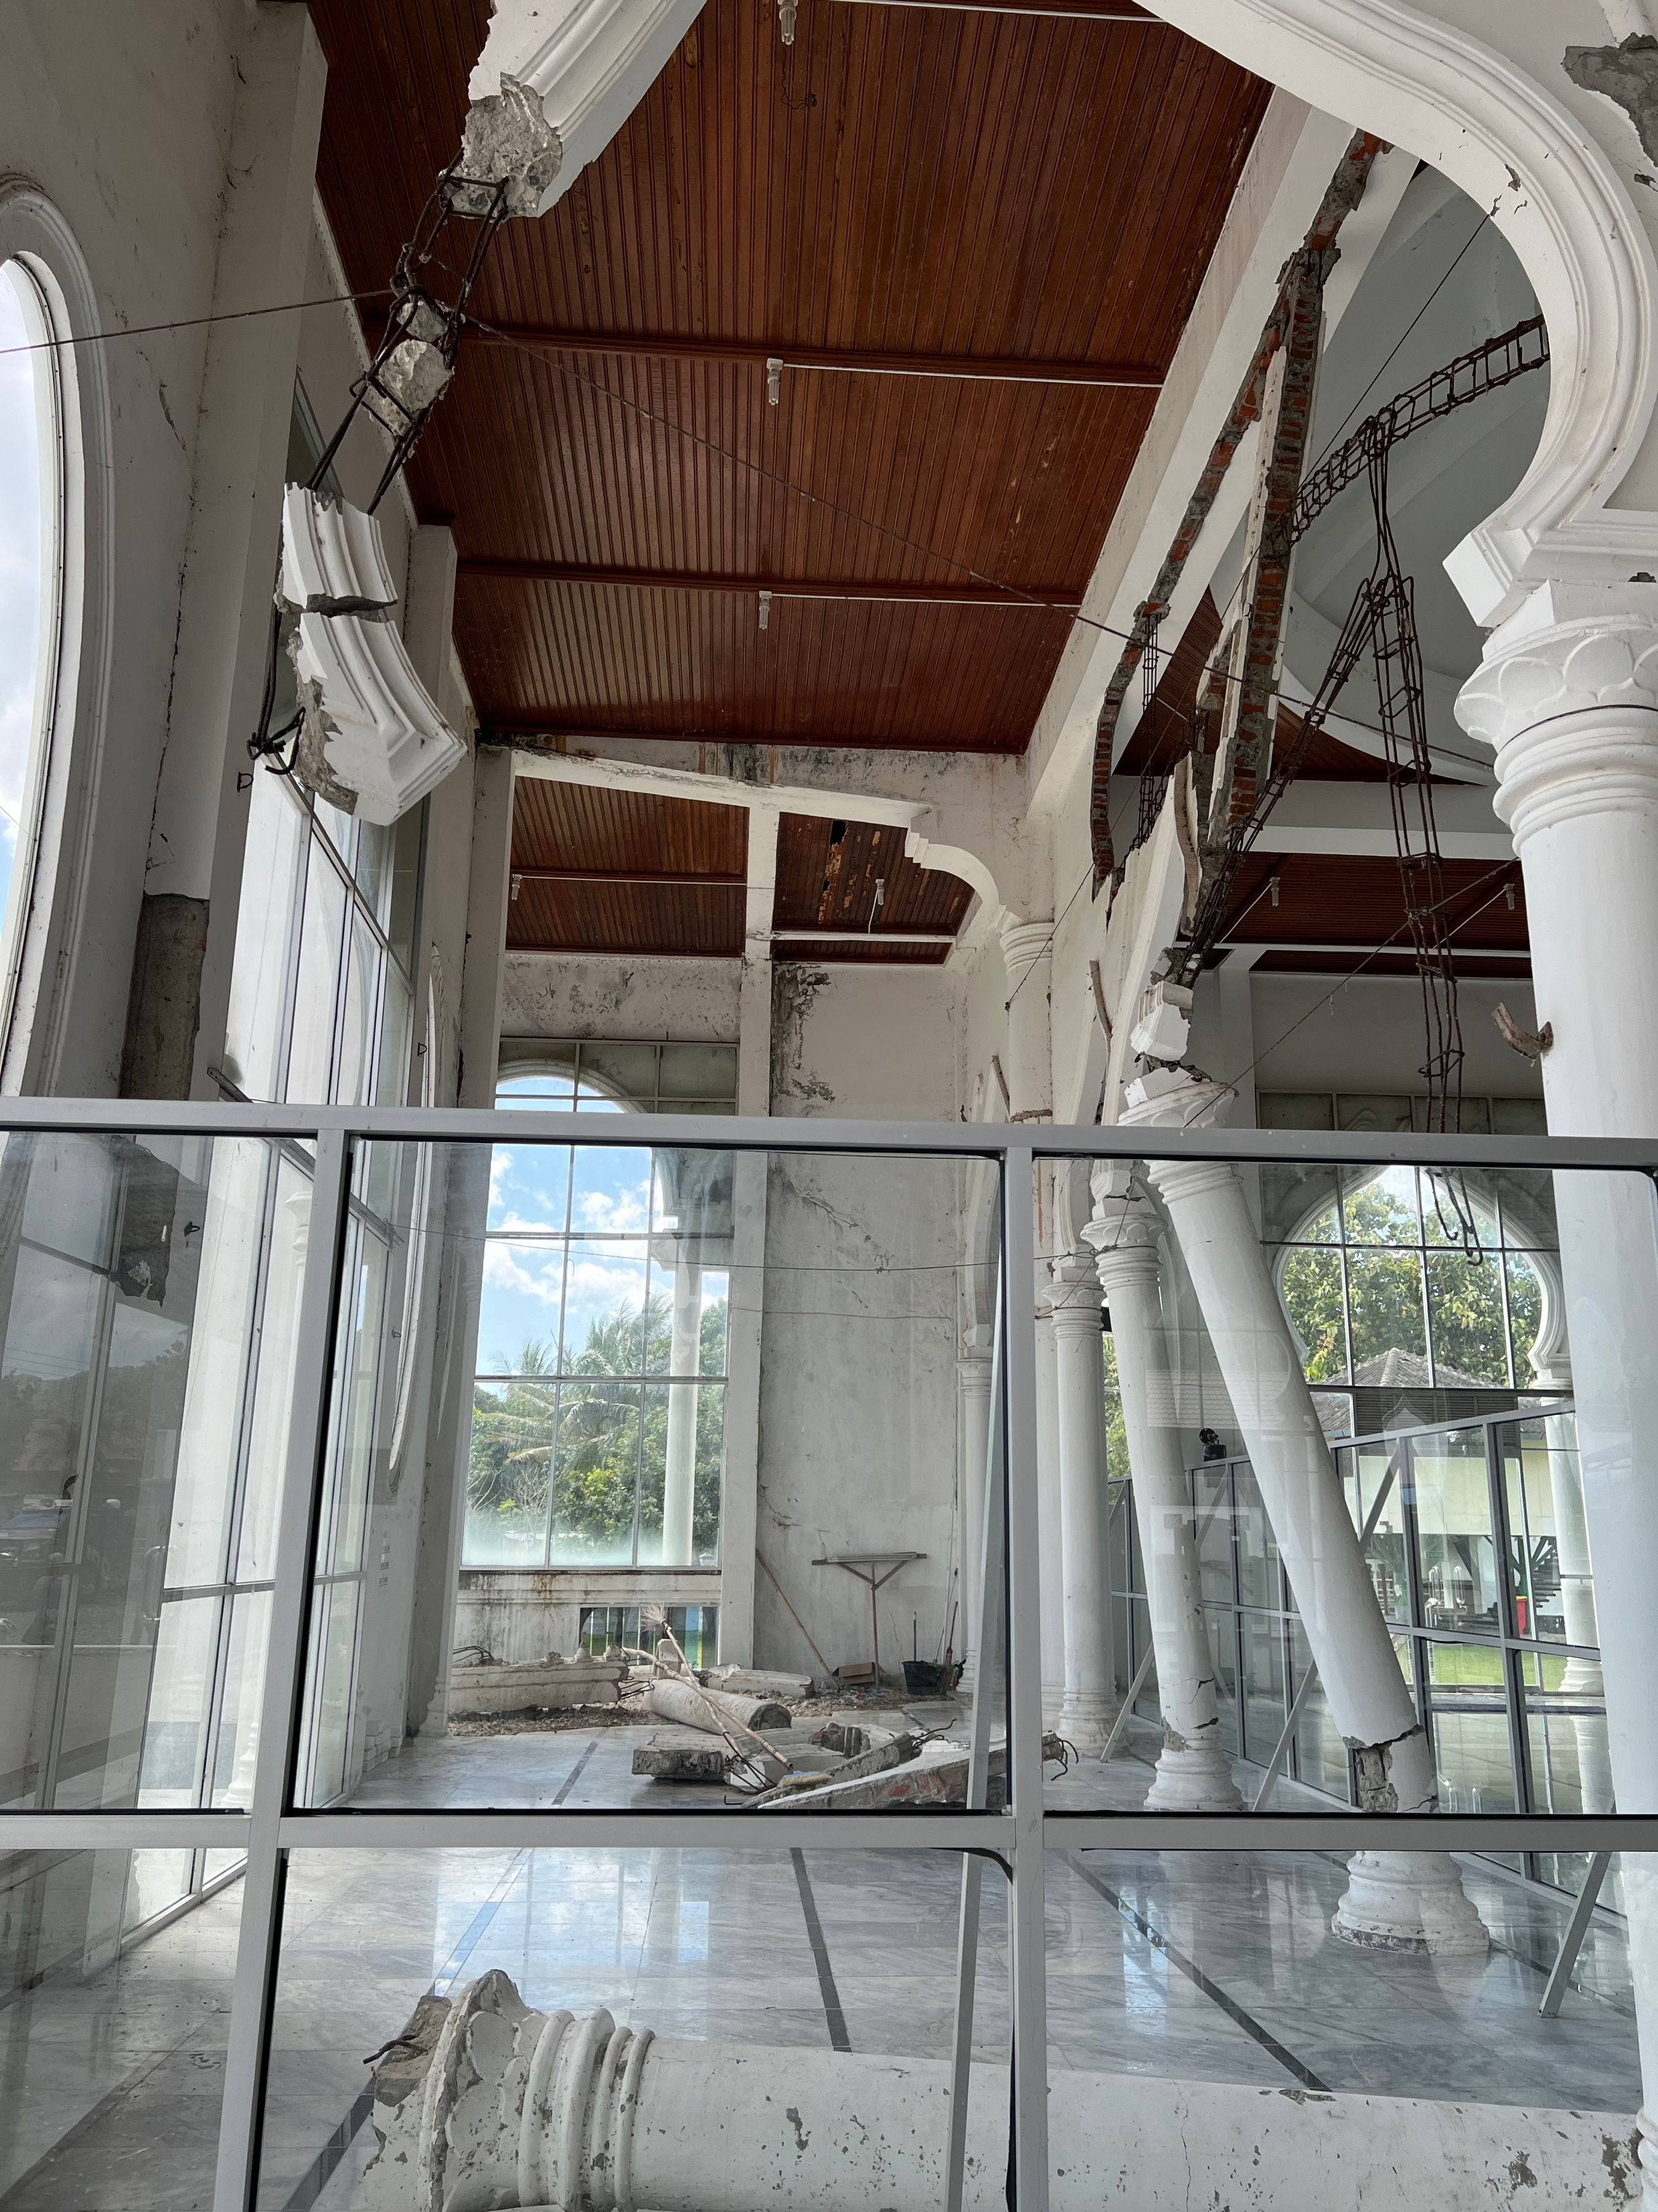
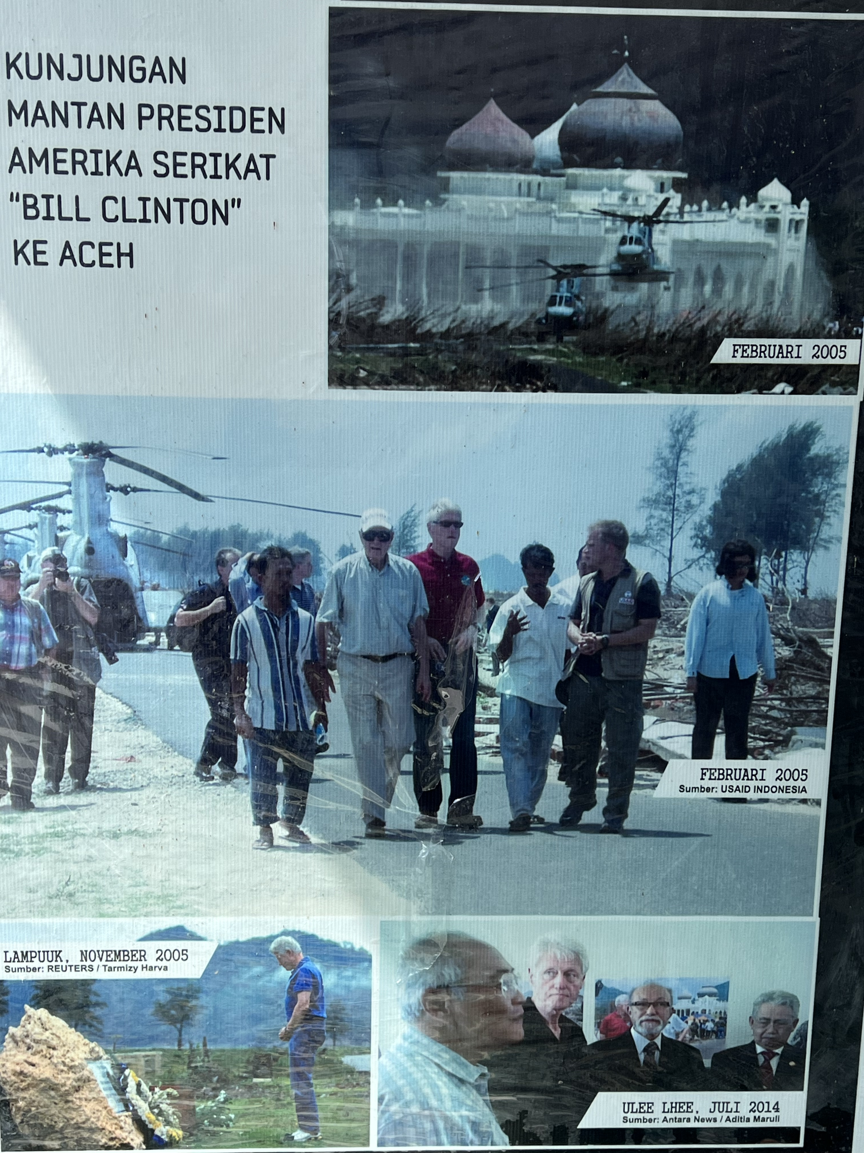
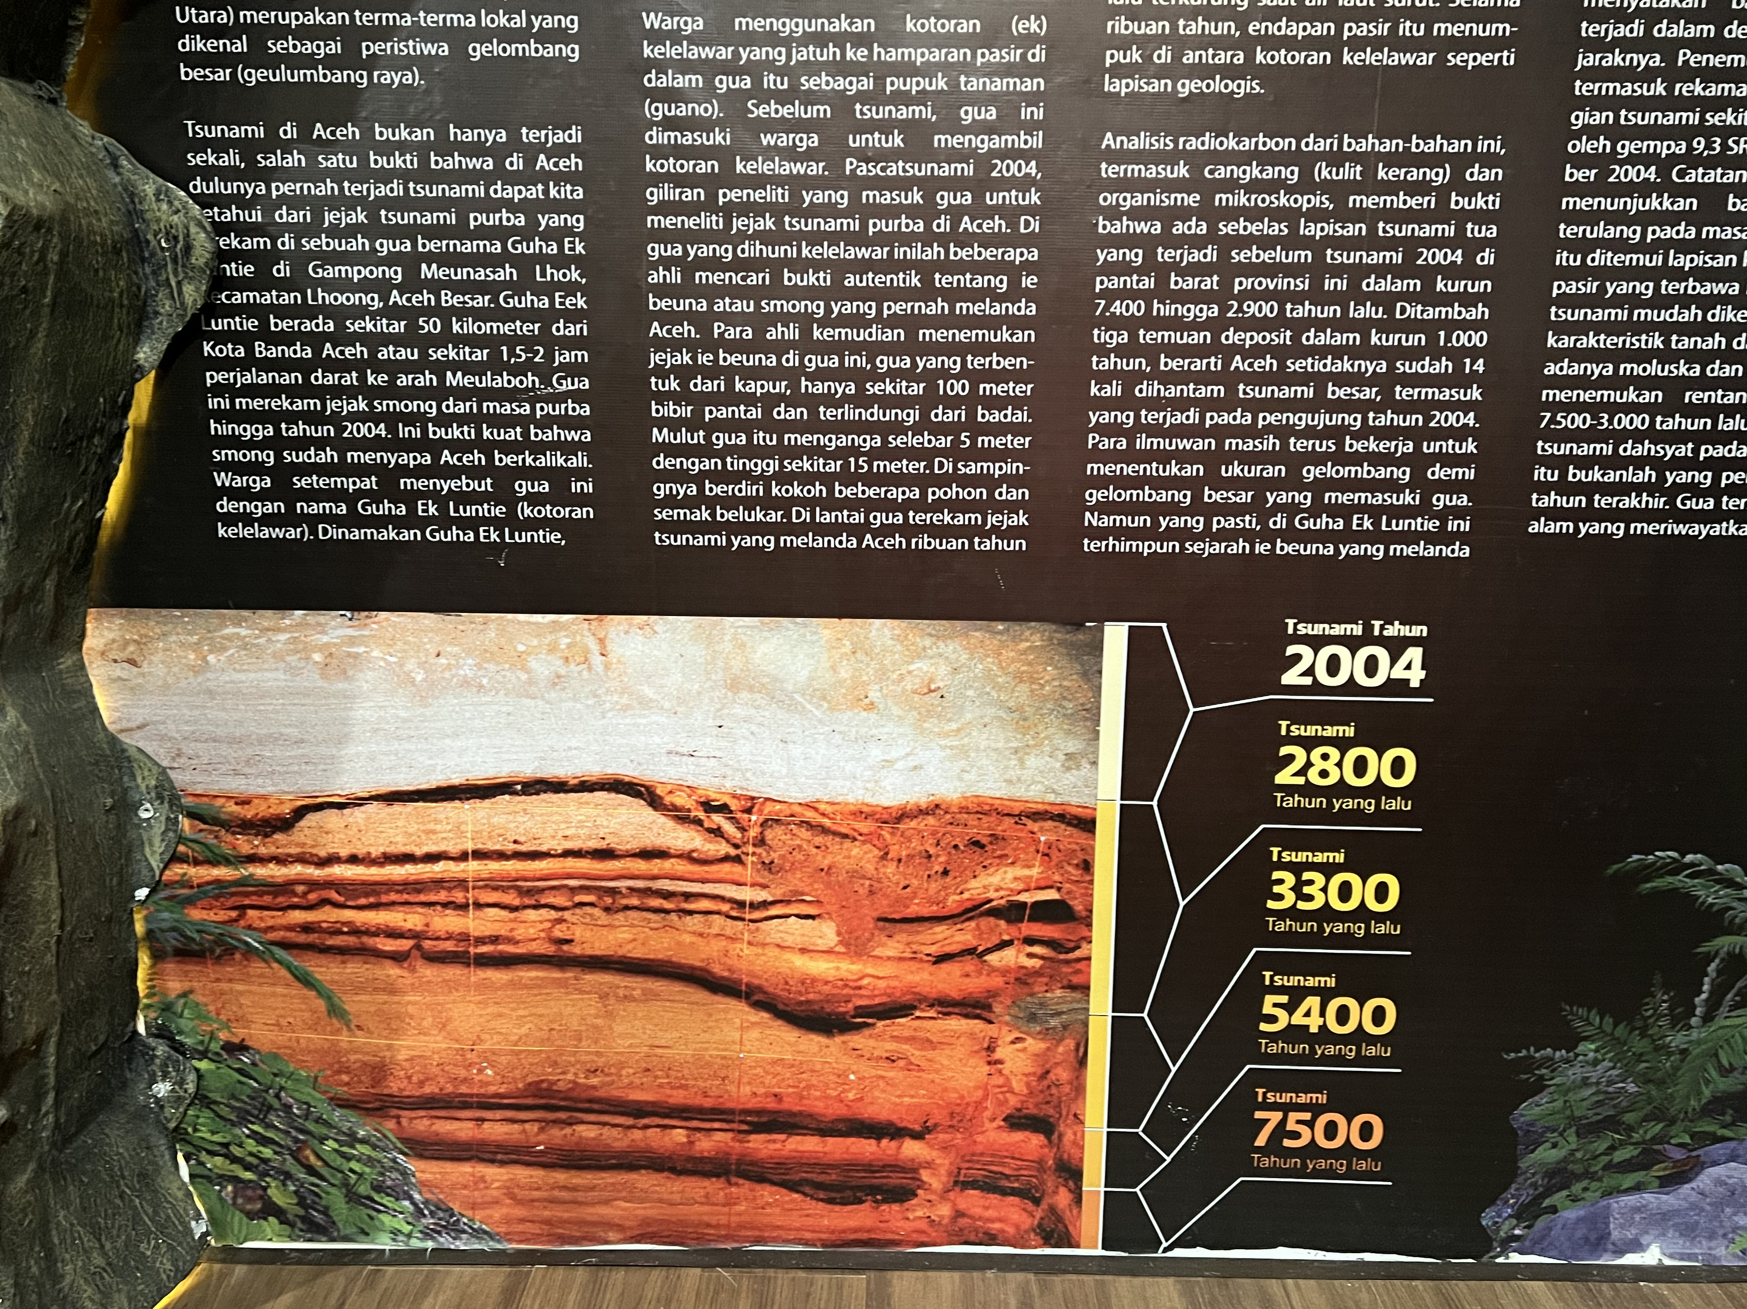
Day 3:
Excursion
All Day Excursion
Museum Tsunami Aceh
Affected area: Lampuu
Tsunami Ready Village: Inauguration Tsunami Ready and Tsunami Drill
…

Slide 19
Day 4 Morning:
Plenary Session
Session 7: … (90 min - invited speakers)
Contributions of TEWS to global initiatives: UN Ocean Decade, SDGs, SFDRR, COP28, EWS4ALL, MCR2030
Session 8: Wrap up /Synthesis/Way Forward
An outcome document, drawing upon achievements, gaps, challenges, and priorities from each session, including pre-event → 7 session moderators present brief summaries → input for the draft Banda Aceh Declaration
Round Table Discussion on Way Forward (Chairs and TIC representatives each ICG, IUGG expert, Chair ODTP Science Committee)

Slide 20
Day 4 Afternoon:
Closing Ceremony
Closing Ceremony
Indigenous Story-Teller – Pak Ngah
Hand-over price to the Indian Ocean Youth Tsunami Conversation and Campaign (IOYTCC) Winners (4 Indian Ocean competition regions)
Winner announcement for best poster presentation
Winner announcement for school children art/drawing competition
Closing Remark:
  Head of BMKG
  Representative of the Local Government
  Representative of UNESCO IOC
  Representative of the Government (Officially Closed the event)
  Banda Aceh Declaration (in one powerful sentence
Press Conference

Slide 21
Registration
One registration for all events → website unesco ioc or BMKG or others? → discuss with Bernado
Question to Bernado about speaker logistic transportation
BMKG expect co-sponsorship for accommodation for invited speakers
BMKG will provide snacks and coffee for Day 1, Day2 and Day 3
Lunch for Day 1 and Day 2: paying at the stalls at the exhibition
BMKG will provide full meals for Day4
BMKG will host gala dinner for Day 3 evening for invited by participants
BMKG will provide transportation and snack Day 3 tour

Slide 22
Venues of Main Events
Day 1 and Day 2: Banda Aceh Convention Hall
Day 4: Hermes Hotel

Slide 23
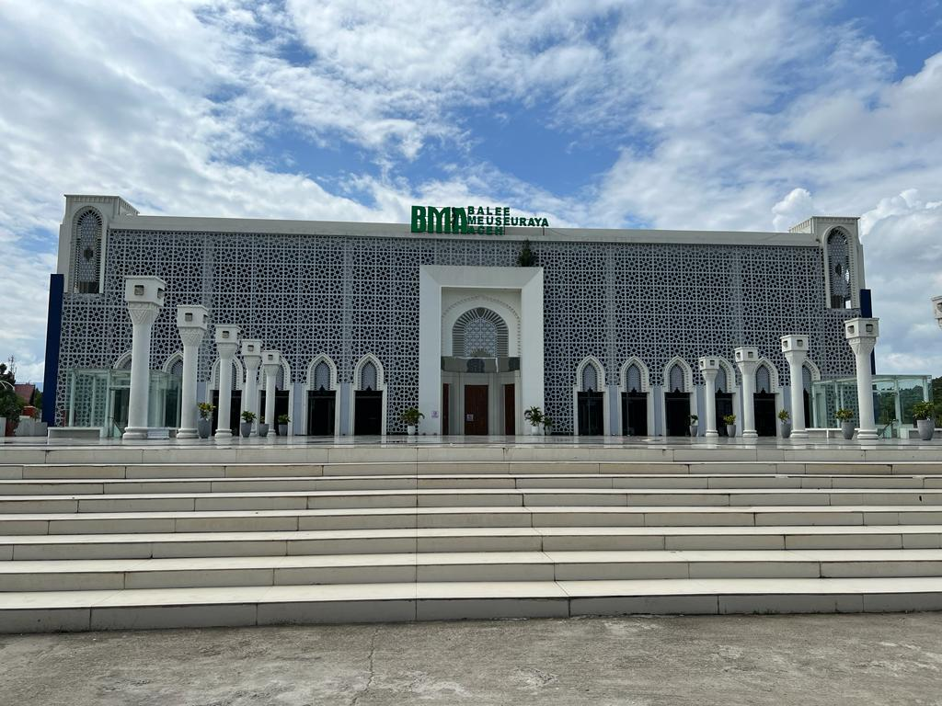
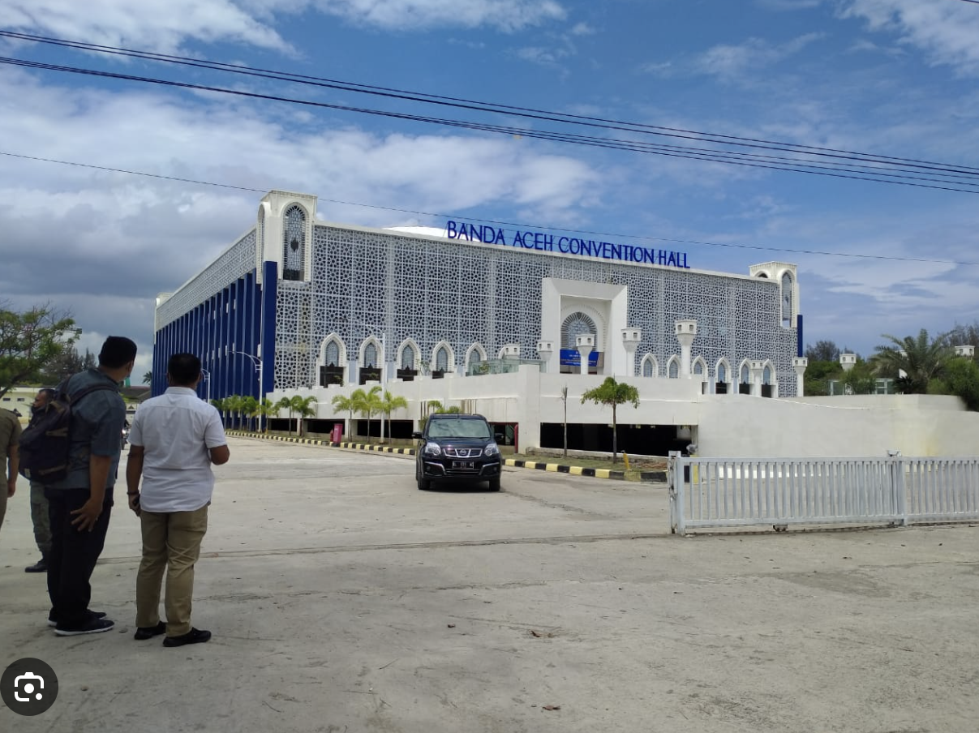
Main Event
11-12 November 2024
Banda Aceh Convention Hall
Opening, Closing, Plenary and Side event activities
Capacity:1,000 people

Slide 24
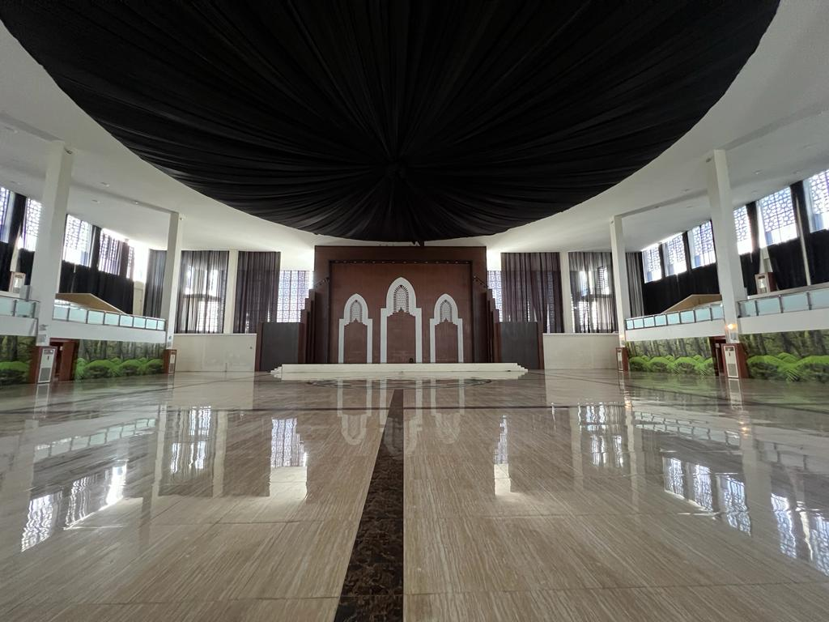
Main Event
11-12 November 2024
Banda Aceh Convention Hall
Opening, Closing, Plenary and Side event activities
Capacity:1,000 people

Slide 25
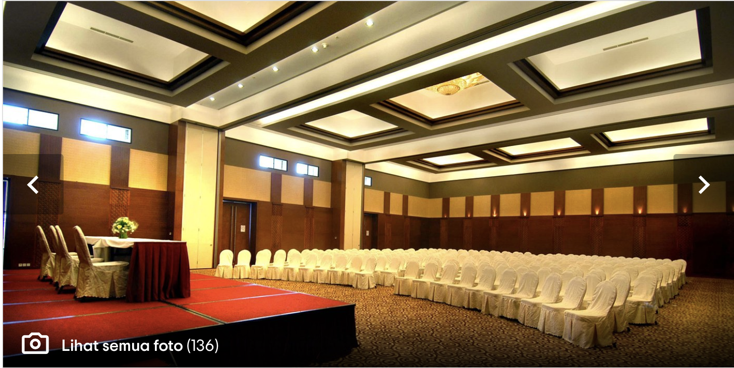
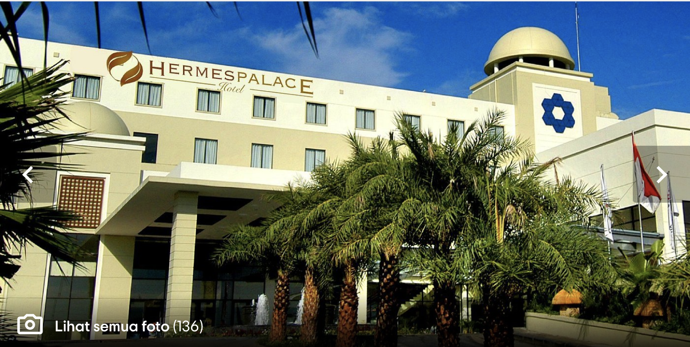
Main Event
14 November 2024
Hermes Hotel
Session 7 & 8 and Closing Ceremony
Capacity: 200 people

Slide 26
Side-Events:
Ignite Stage, Booth and Poster Exhibition
Date: 11 – 14 November 2024
Venue: Banda Aceh Convention Hall

Slide 27
Side-Event:
The side event using the concept of Rumah Resiliensi (Resilient House) “small expo from us to us”
Aims to provide platform for
  Tsunami open to public to participate for Global Tsunami Symposium
  and DRR players to show product, result, and innovation on Tsunami Mitigation, Tsunami Preparedness, Tsunami Awareness, Tsunami Early Warning, etc.
  Youth and young professionals (i.e. early career researcher and scientist) to showcase their research and activities on Tsunami Risk Reduction
  For donor and sponsors to participate and showcase their engagement in the symposium

Slide 28
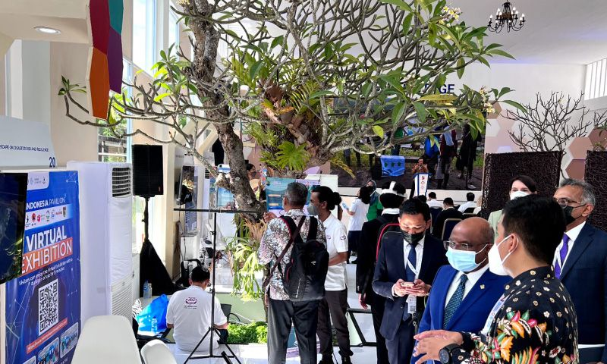
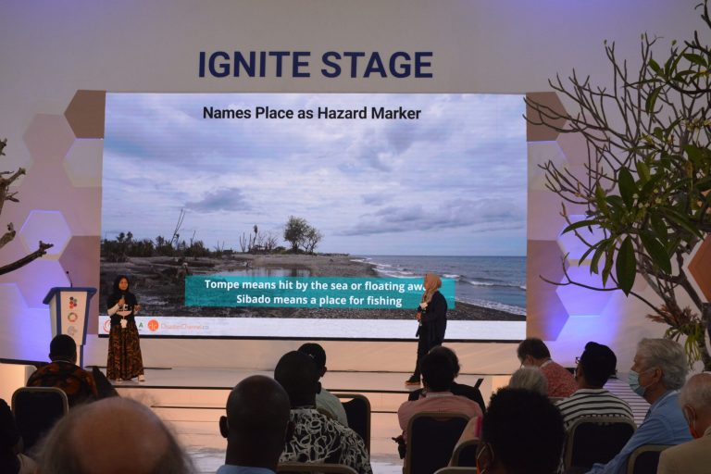
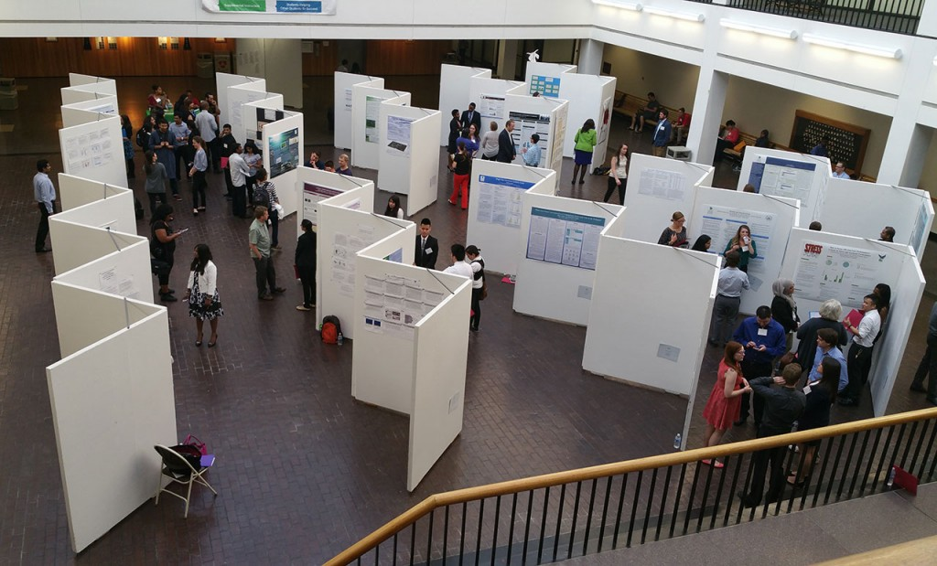
Side Events:
9-12 November 2024
1. Exhibitions
2. Ignite Stage: for invited
institutions/organization
experts/celebrities/public figures
tsunami survivors
Schedule: During Coffee Breaks, Lunch Breaks and 1 hour after the end of day of the main event activities
4. Booth Display:
winner of Banda Aceh local school art drawing competition
Winner of Video competition
3. Poster Session: open to public to participate for Global Tsunami Symposium

Slide 29
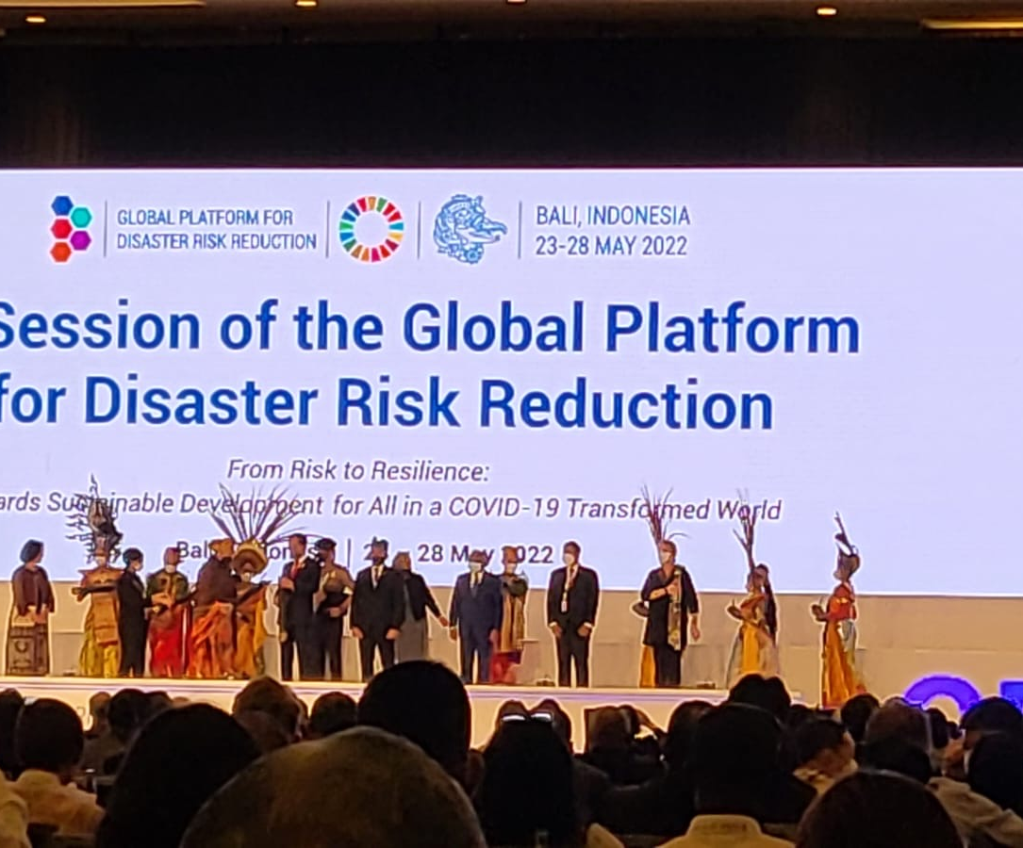
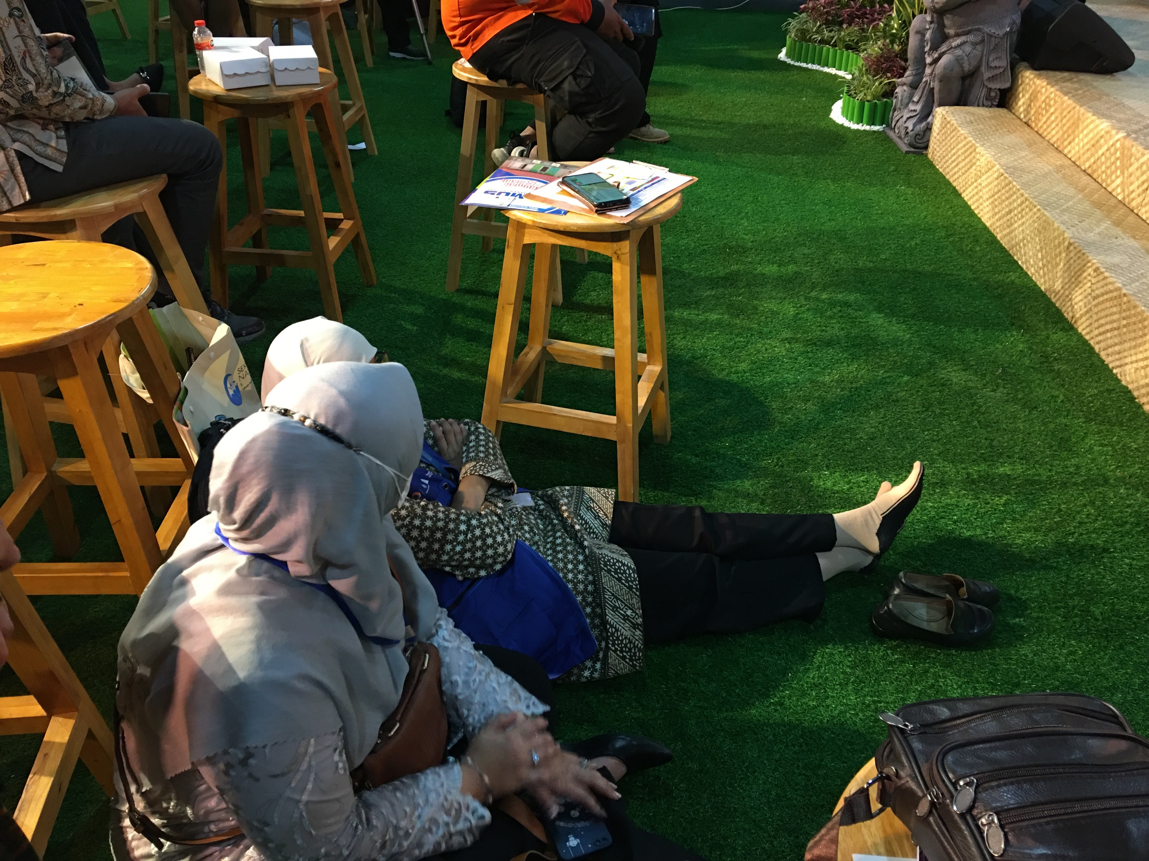
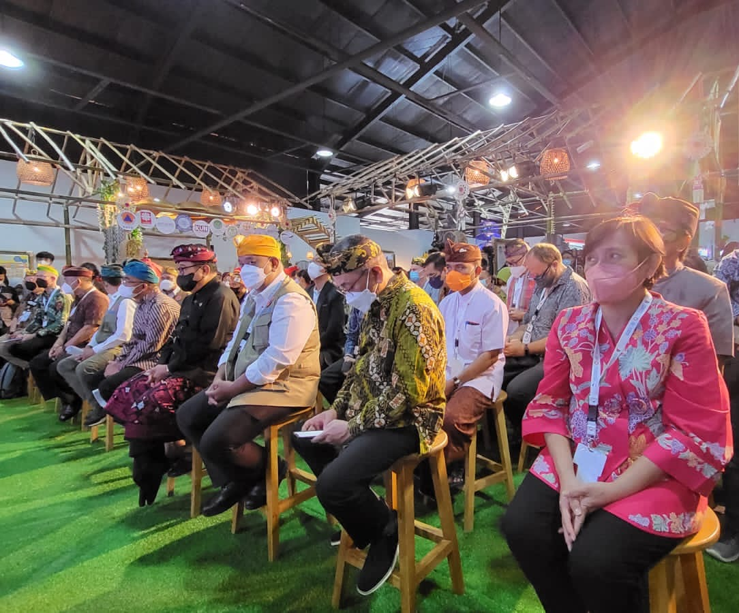
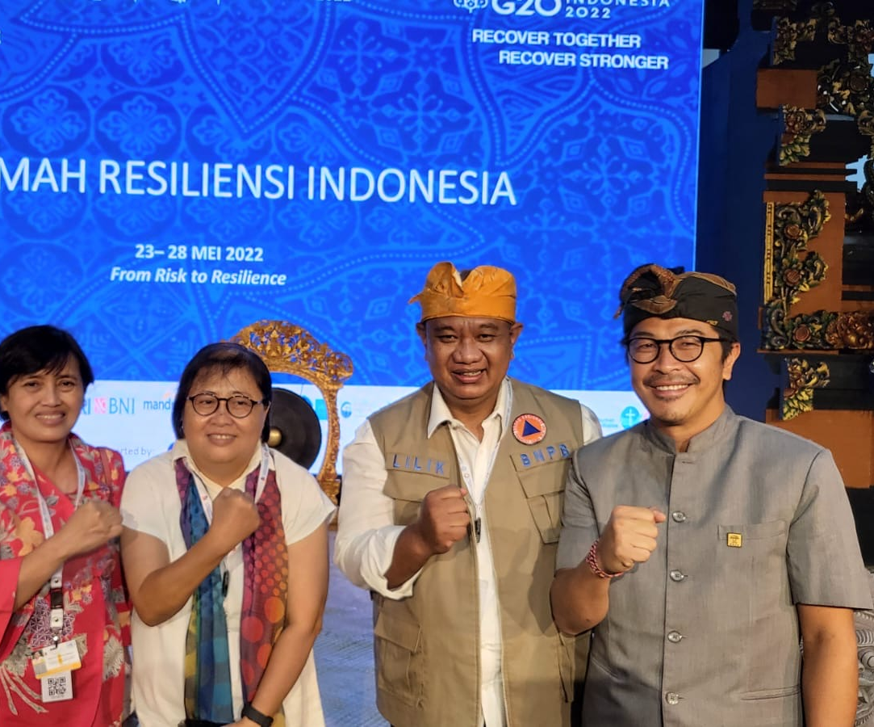
Example of Rumah Resiliensi Indonesia @GPDRR

Slide 30
Exhibition Venue
9-12 November 2024
Banda Aceh Convention Hall
Outdoor Tents surrounding the Convention Hall area

Slide 31
Hotel and Accommodations

Slide 32
Hotels
Alternatives Hotel for Delegation/Participants
Hermes Hotel (4 star)
Kyriad (4 star)
Many 3 star hotels

Slide 33
Pre-Event: International Scientific Workshop
Hosted by IABI collaborated with TDRMC – USK and IGI

Slide 34
Pre-Event: International Scientific Workshop
9-10 November 2024
Aims:
  To commemorate 2 decades post 2004 Tsunami
  To conduct PIT IABI 2024 collaborate with AIWEST
  To accommodate International and National Public to present their works/thoughts before participate the UNESCO IOC Global Symposium
Scope:
  Call for papers for Scientific Workshop
  Pre event scientific workshop Book of abstracts, Indexing proceedings, Special issue of journals
  Open to global scientific and practician communities

Slide 35
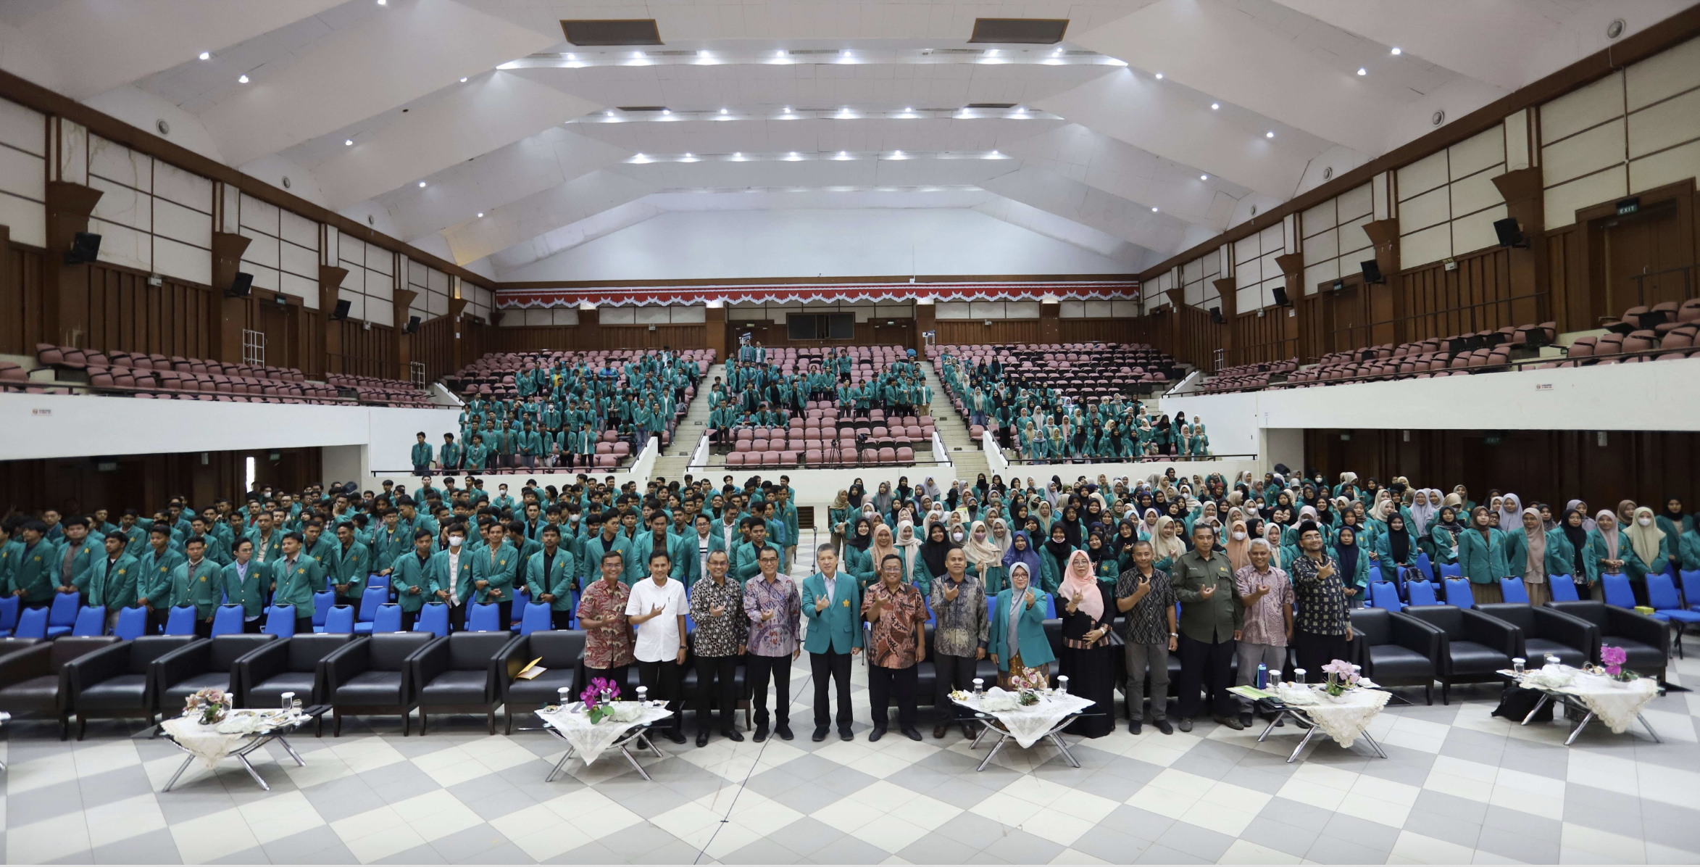
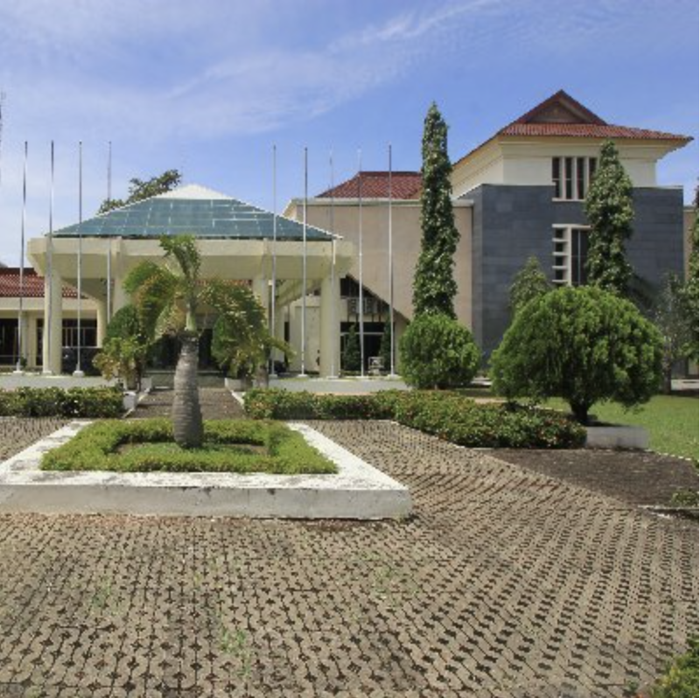
Pre-Event Venue
9-10 November 2024
AAC Dayan Dawood Auditorium –
University of Syiah Kuala
Capacity: 1,000 people

Slide 36
Preparation done

Slide 37
Preparation Done
Follow up Meeting after TOWS WG Meeting March 2023
Discussed with Prof Dwikorita (Head of BMKG), Prof Syamsul Maarief (Former Head of BNPB/NDMA) (March 2023)
Discussed with BMKG and BNPB core team (March and April)
Discussed with IABI (April 2023)
Meeting with Prof Tanioka (May 2023)
Meeting with IABI and IGI (August 2023)
Meeting with BMKG, IOTIC, University Syiah Kuala, Government of Aceh (September 2023)
Hand over PIT IABI from UB in 2023 to USK 2024 (27-28 November 2023)
Symposium Technical Meeting with BMKG, BNPB, IOTIC, and Ministry of Foreign Affairs (8 December 2023)
Online meeting with Program Organizing Committee
Site Visit to Banda Aceh by Chairs (HPR and SA) and BMKG team (20 December 2024)
Several meeting conducted in January 2024 online and offline

Slide 38
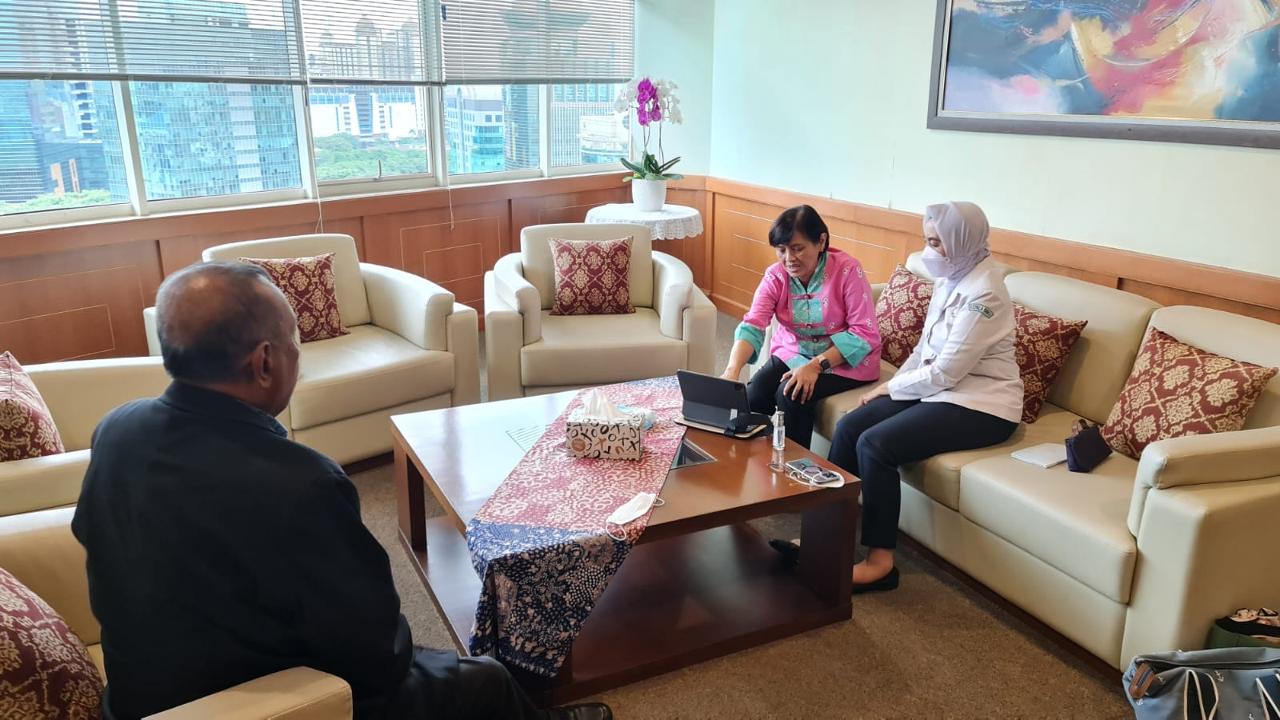
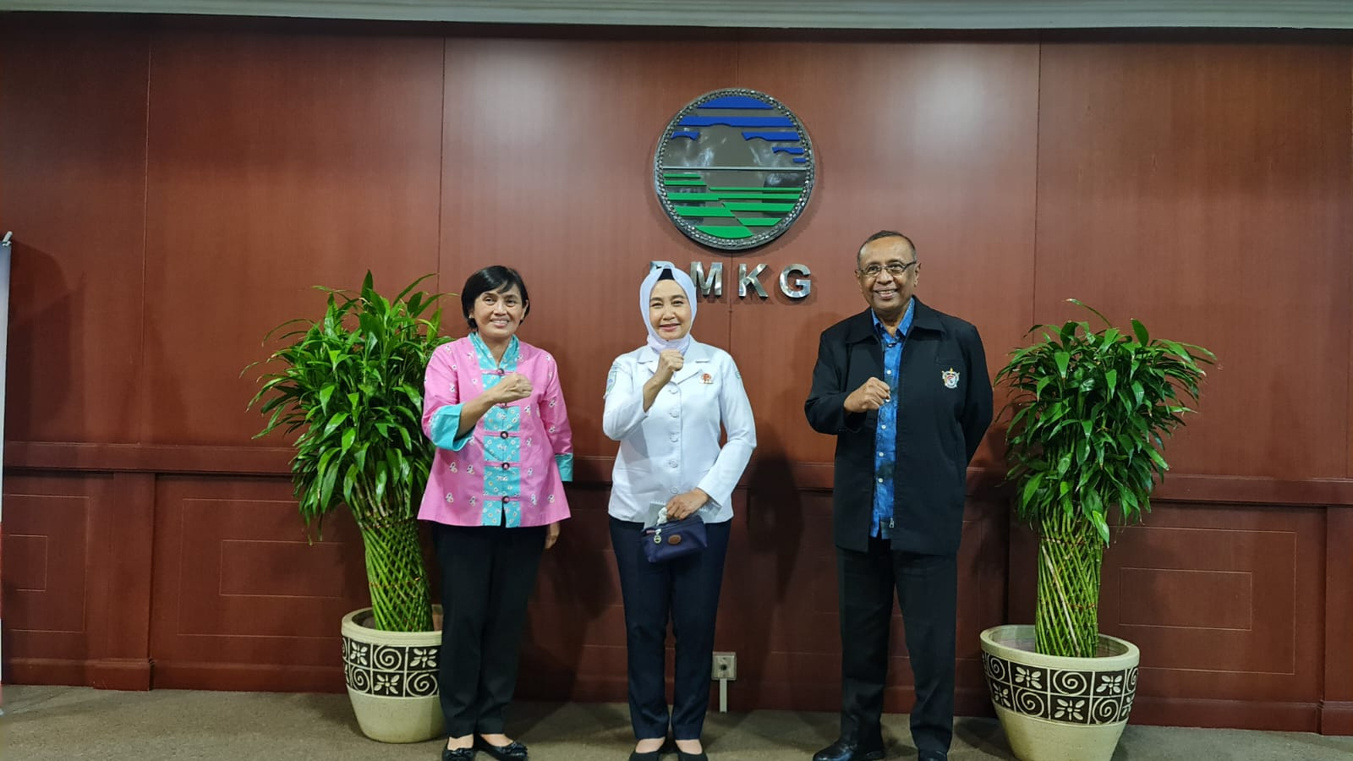
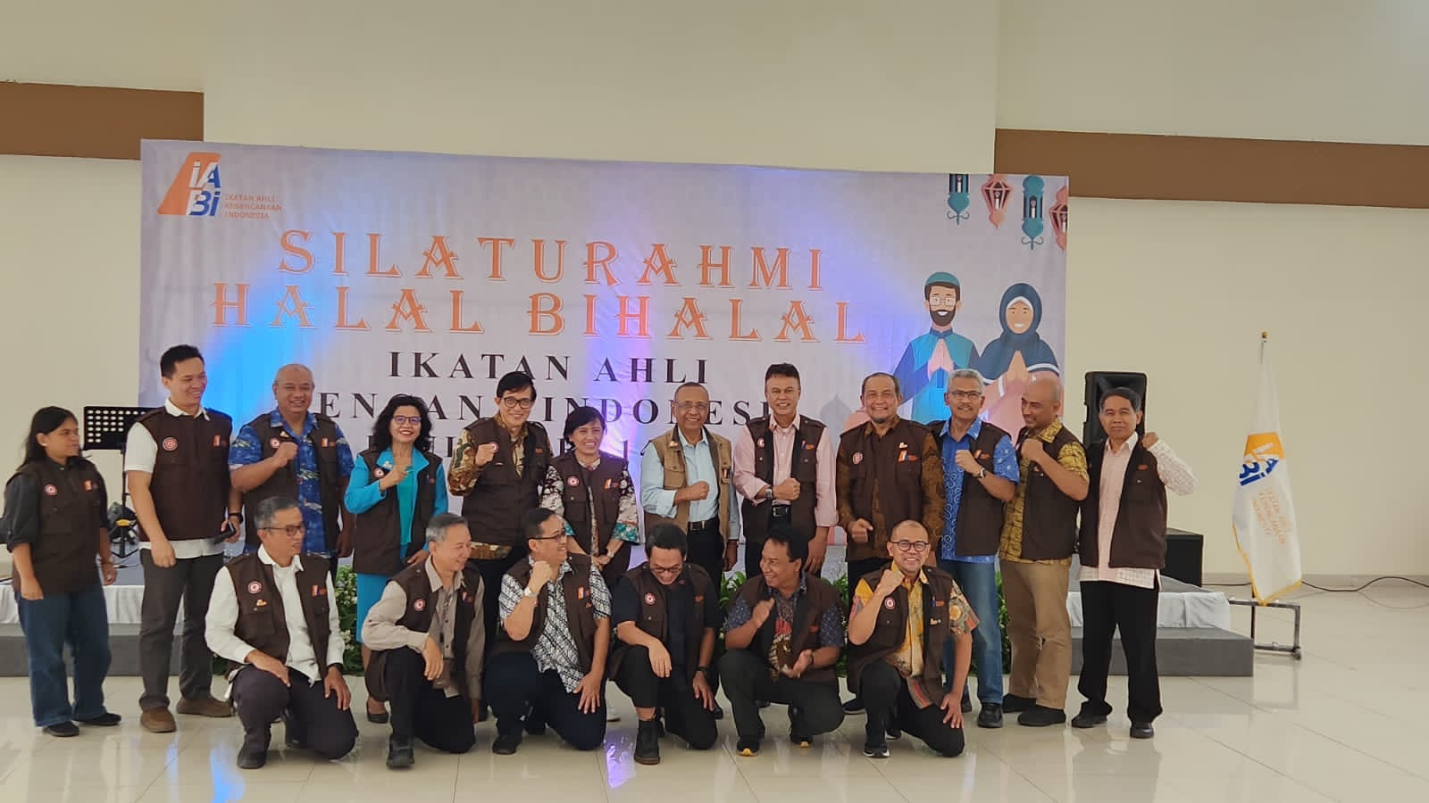
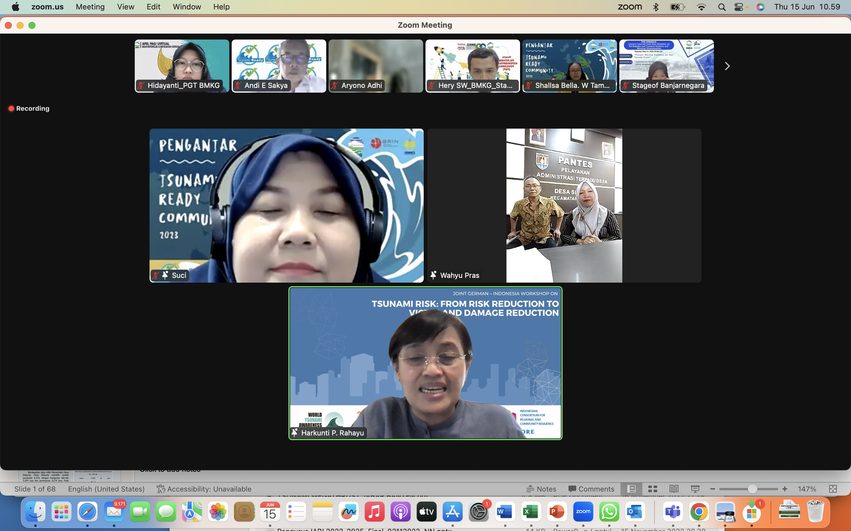
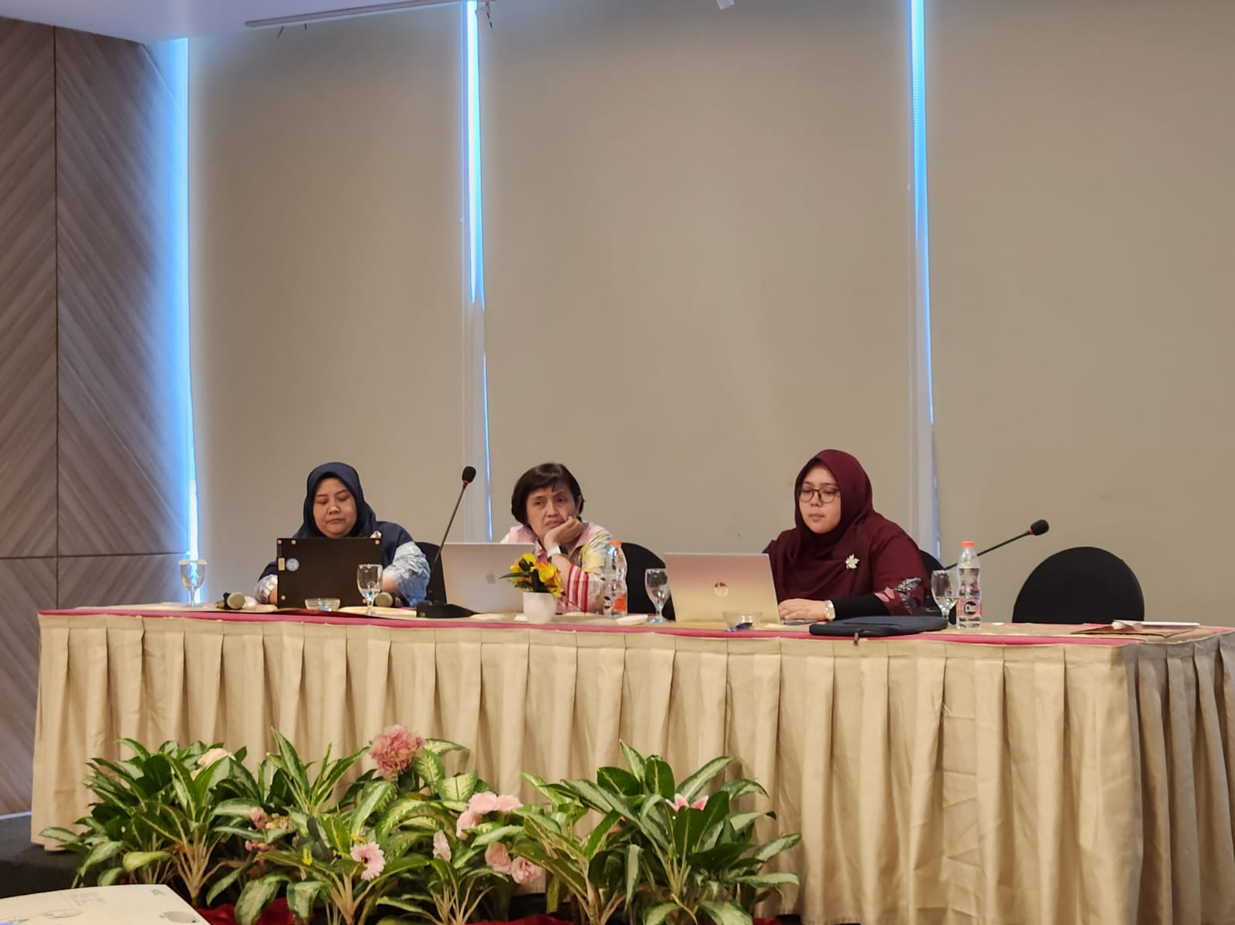
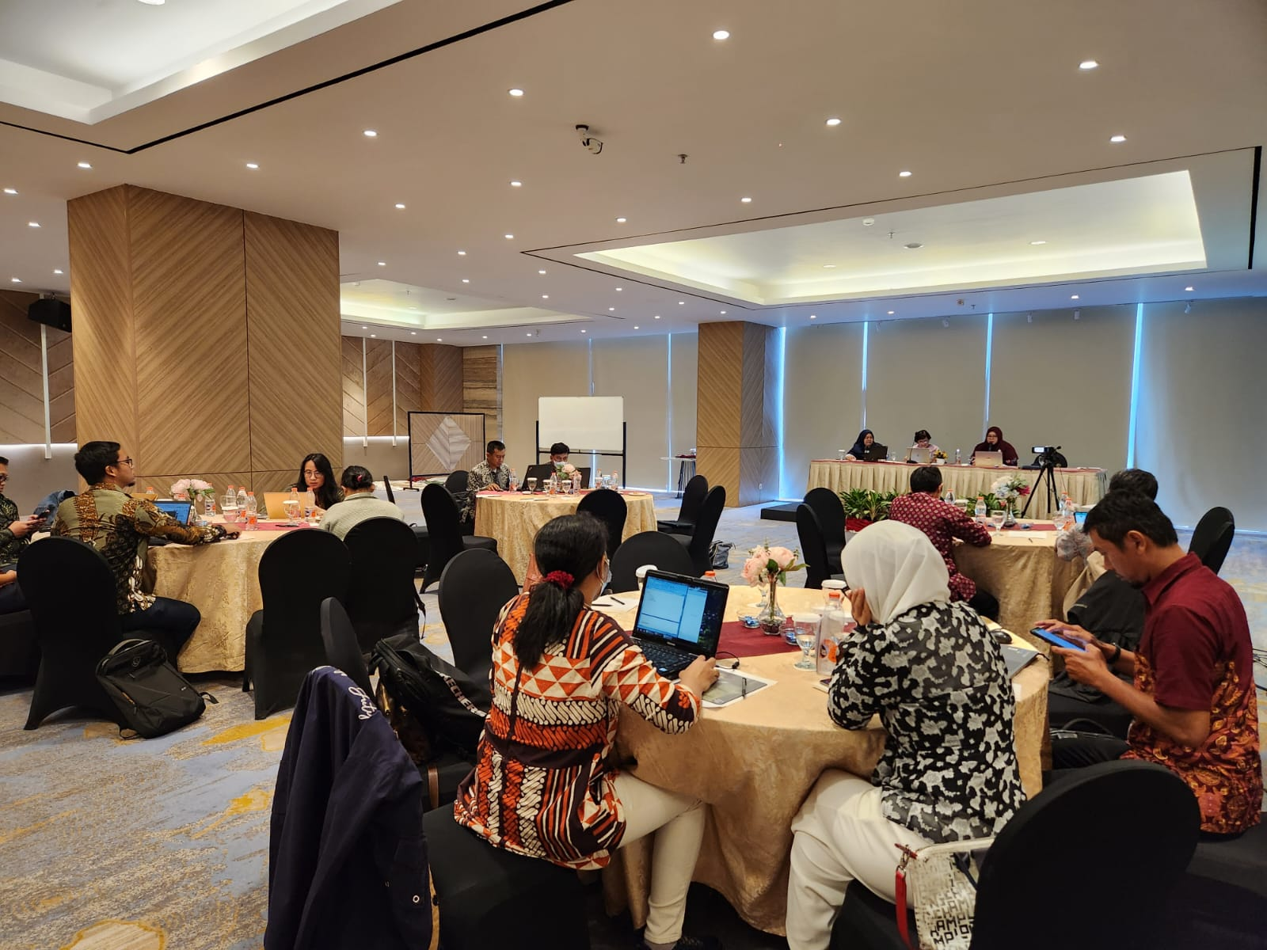
Preparation Meetings
March 2023
April 2023
August 2023
8 December 2023

Slide 39
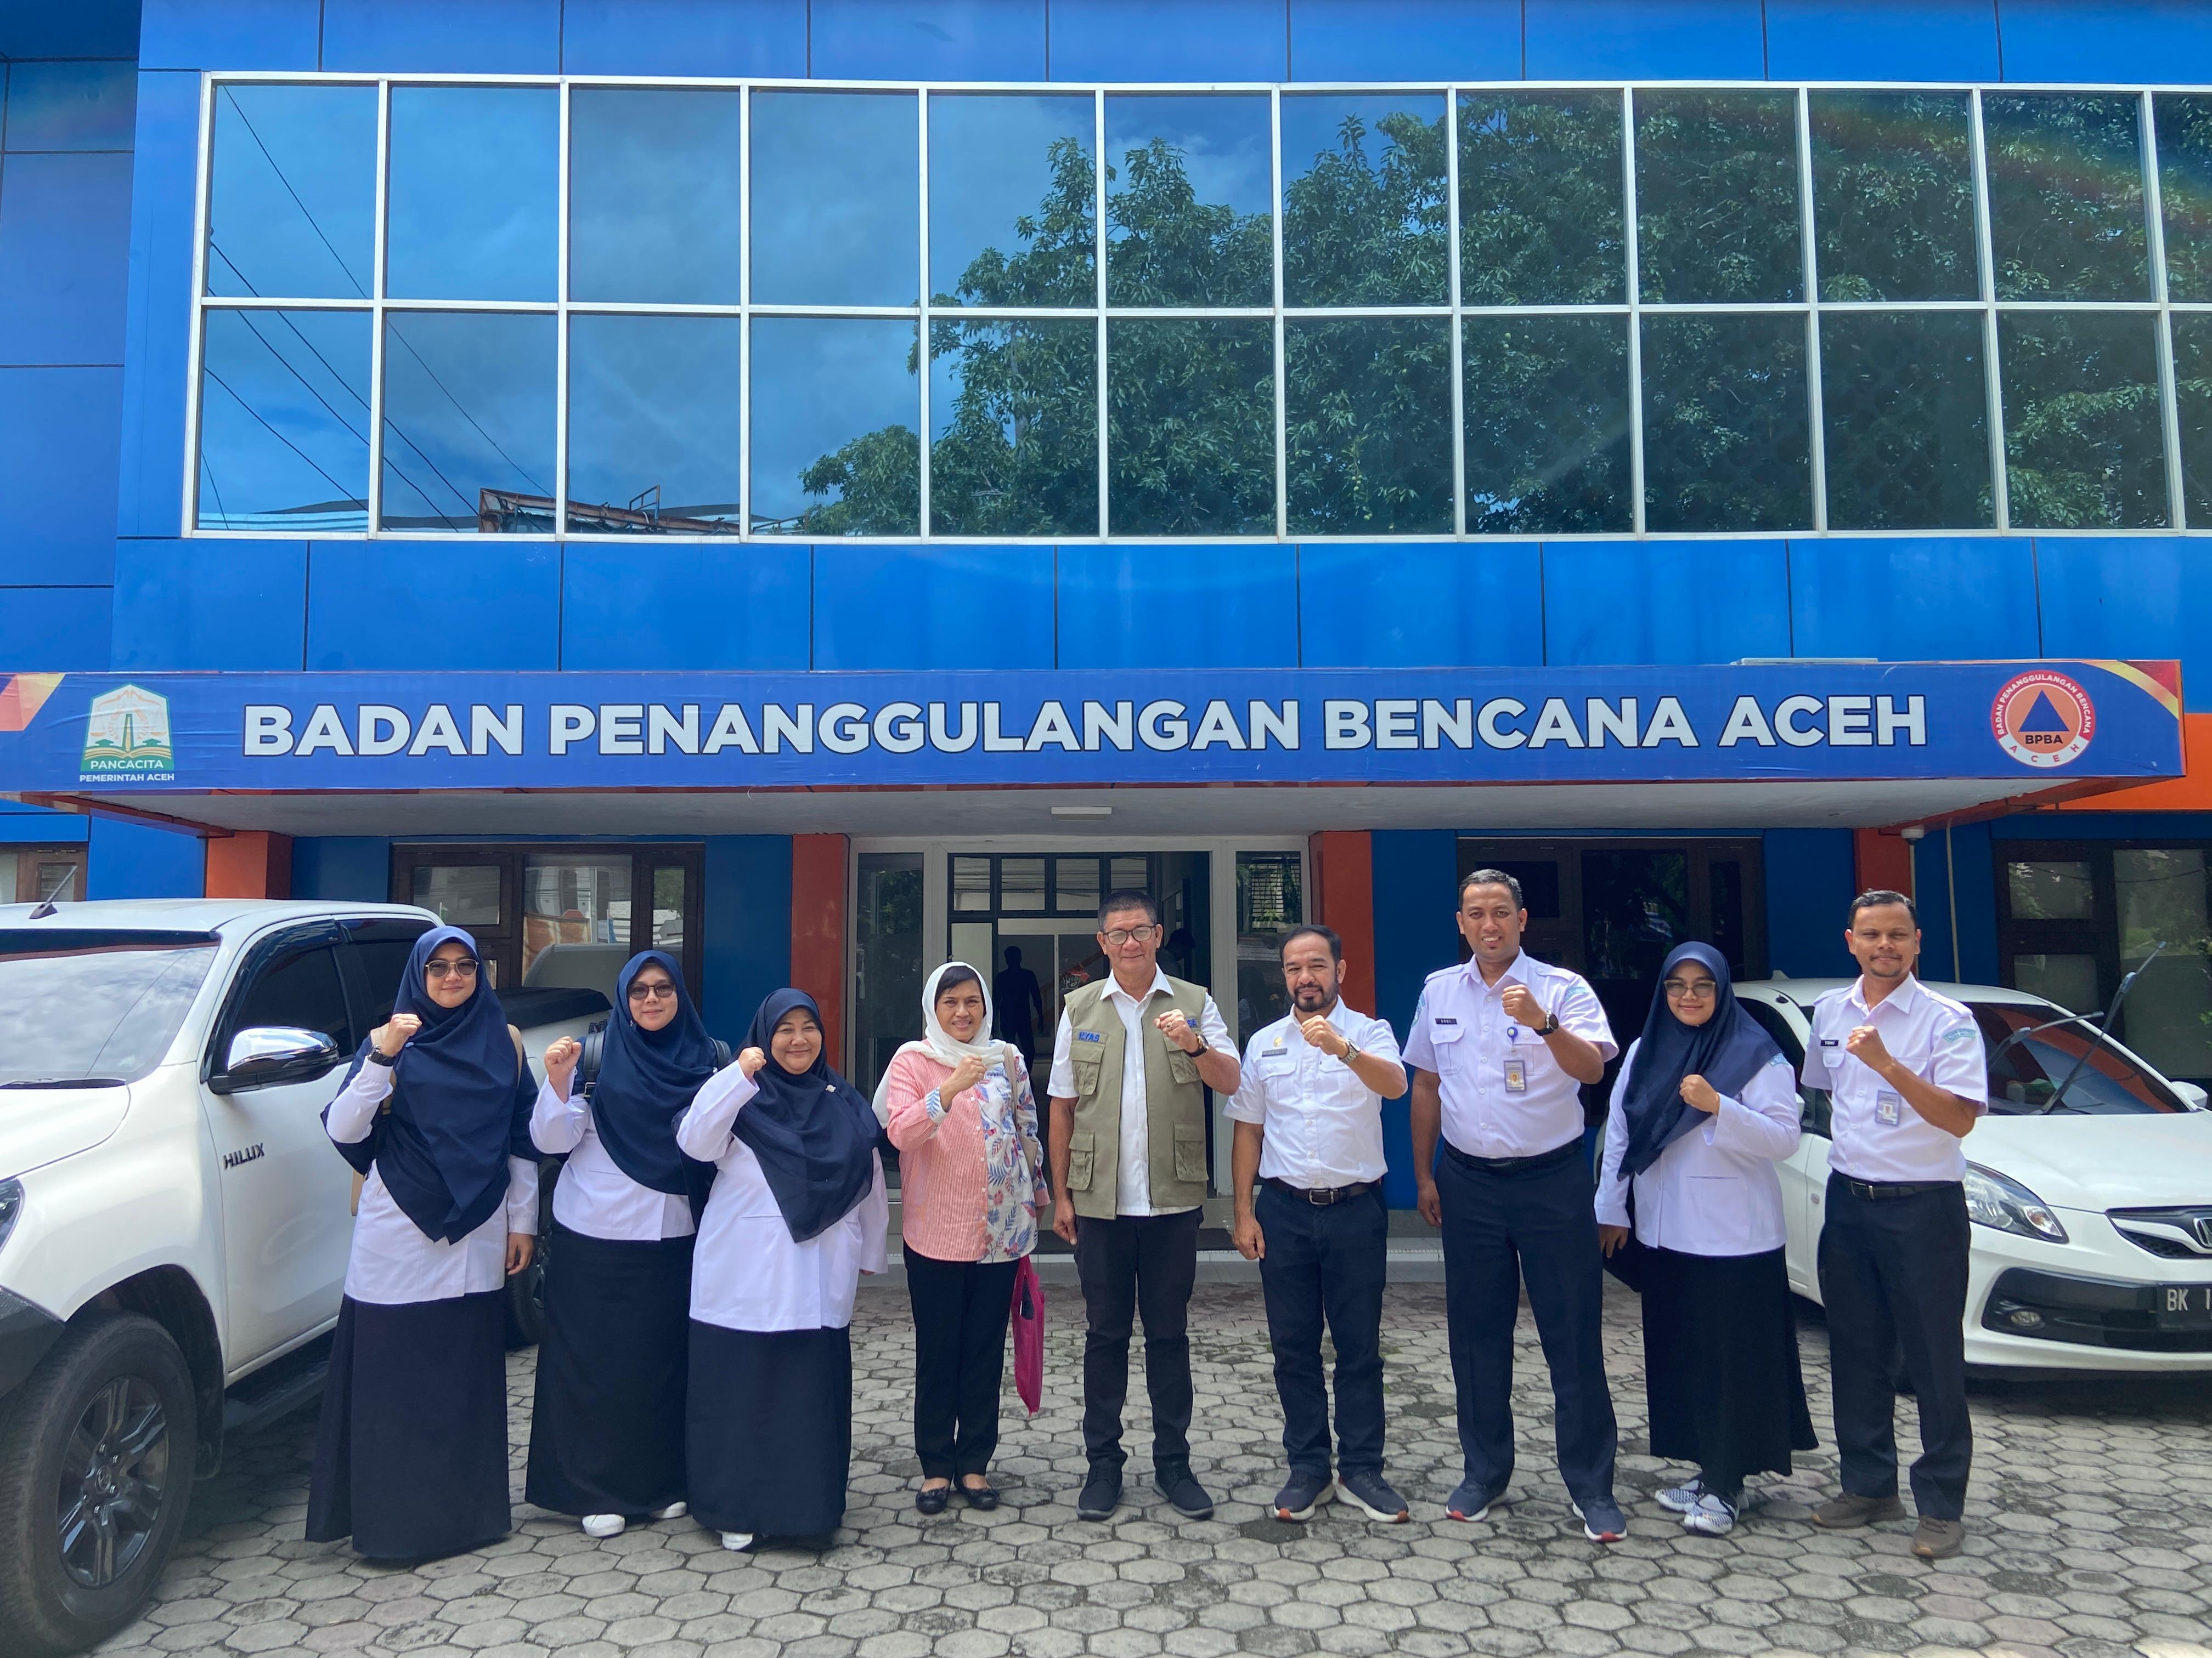
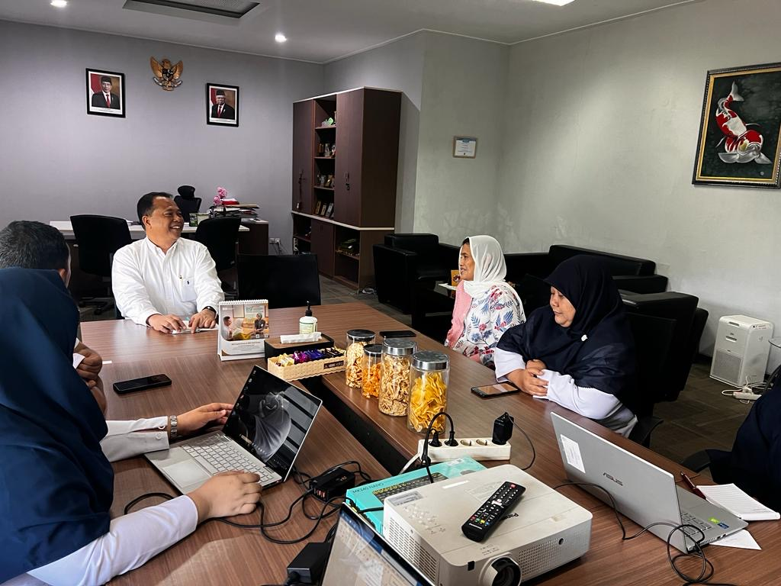
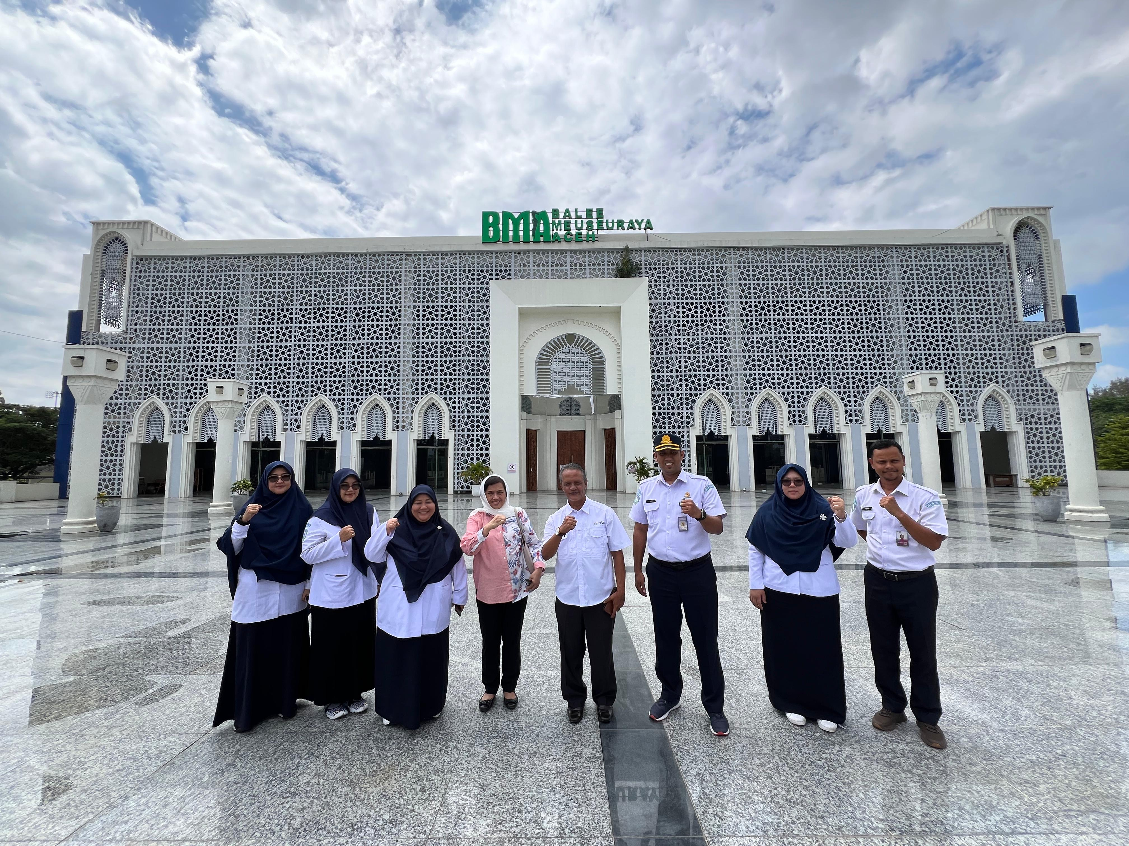
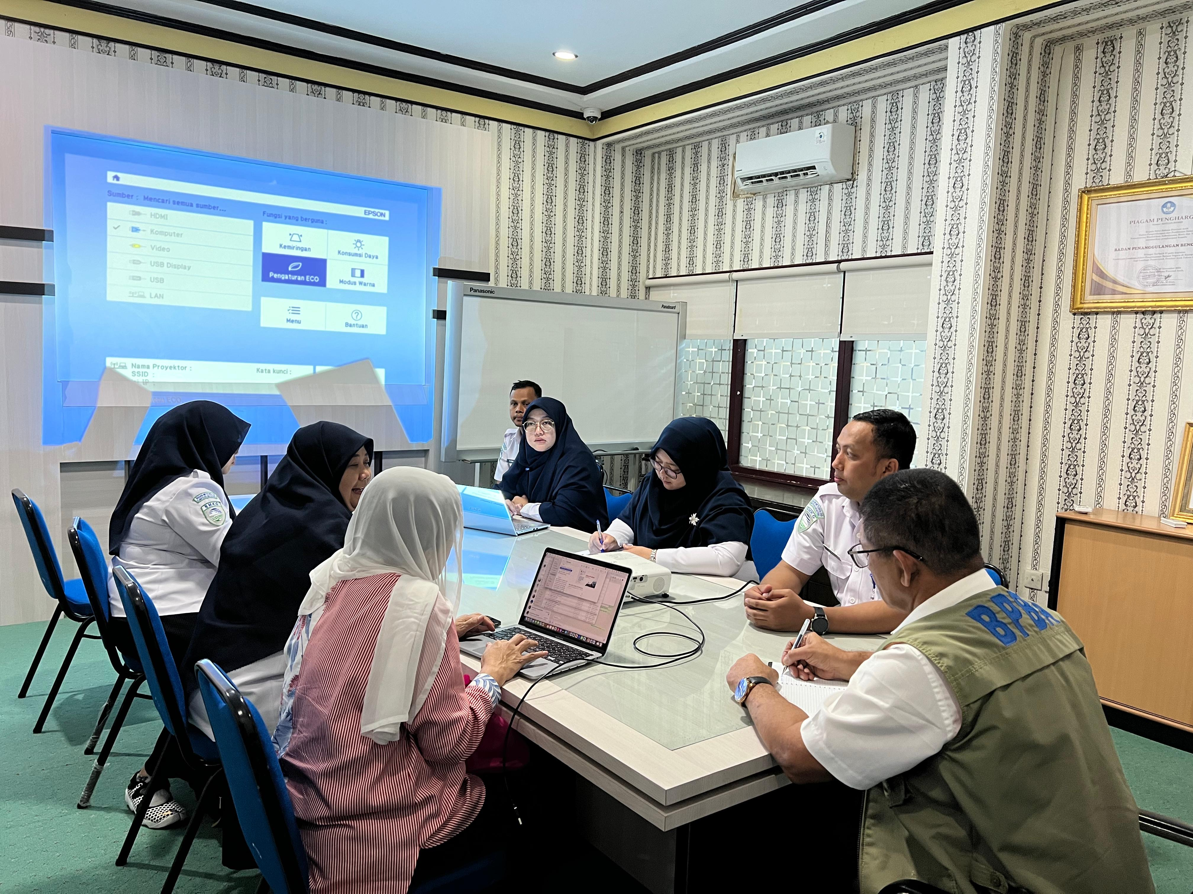
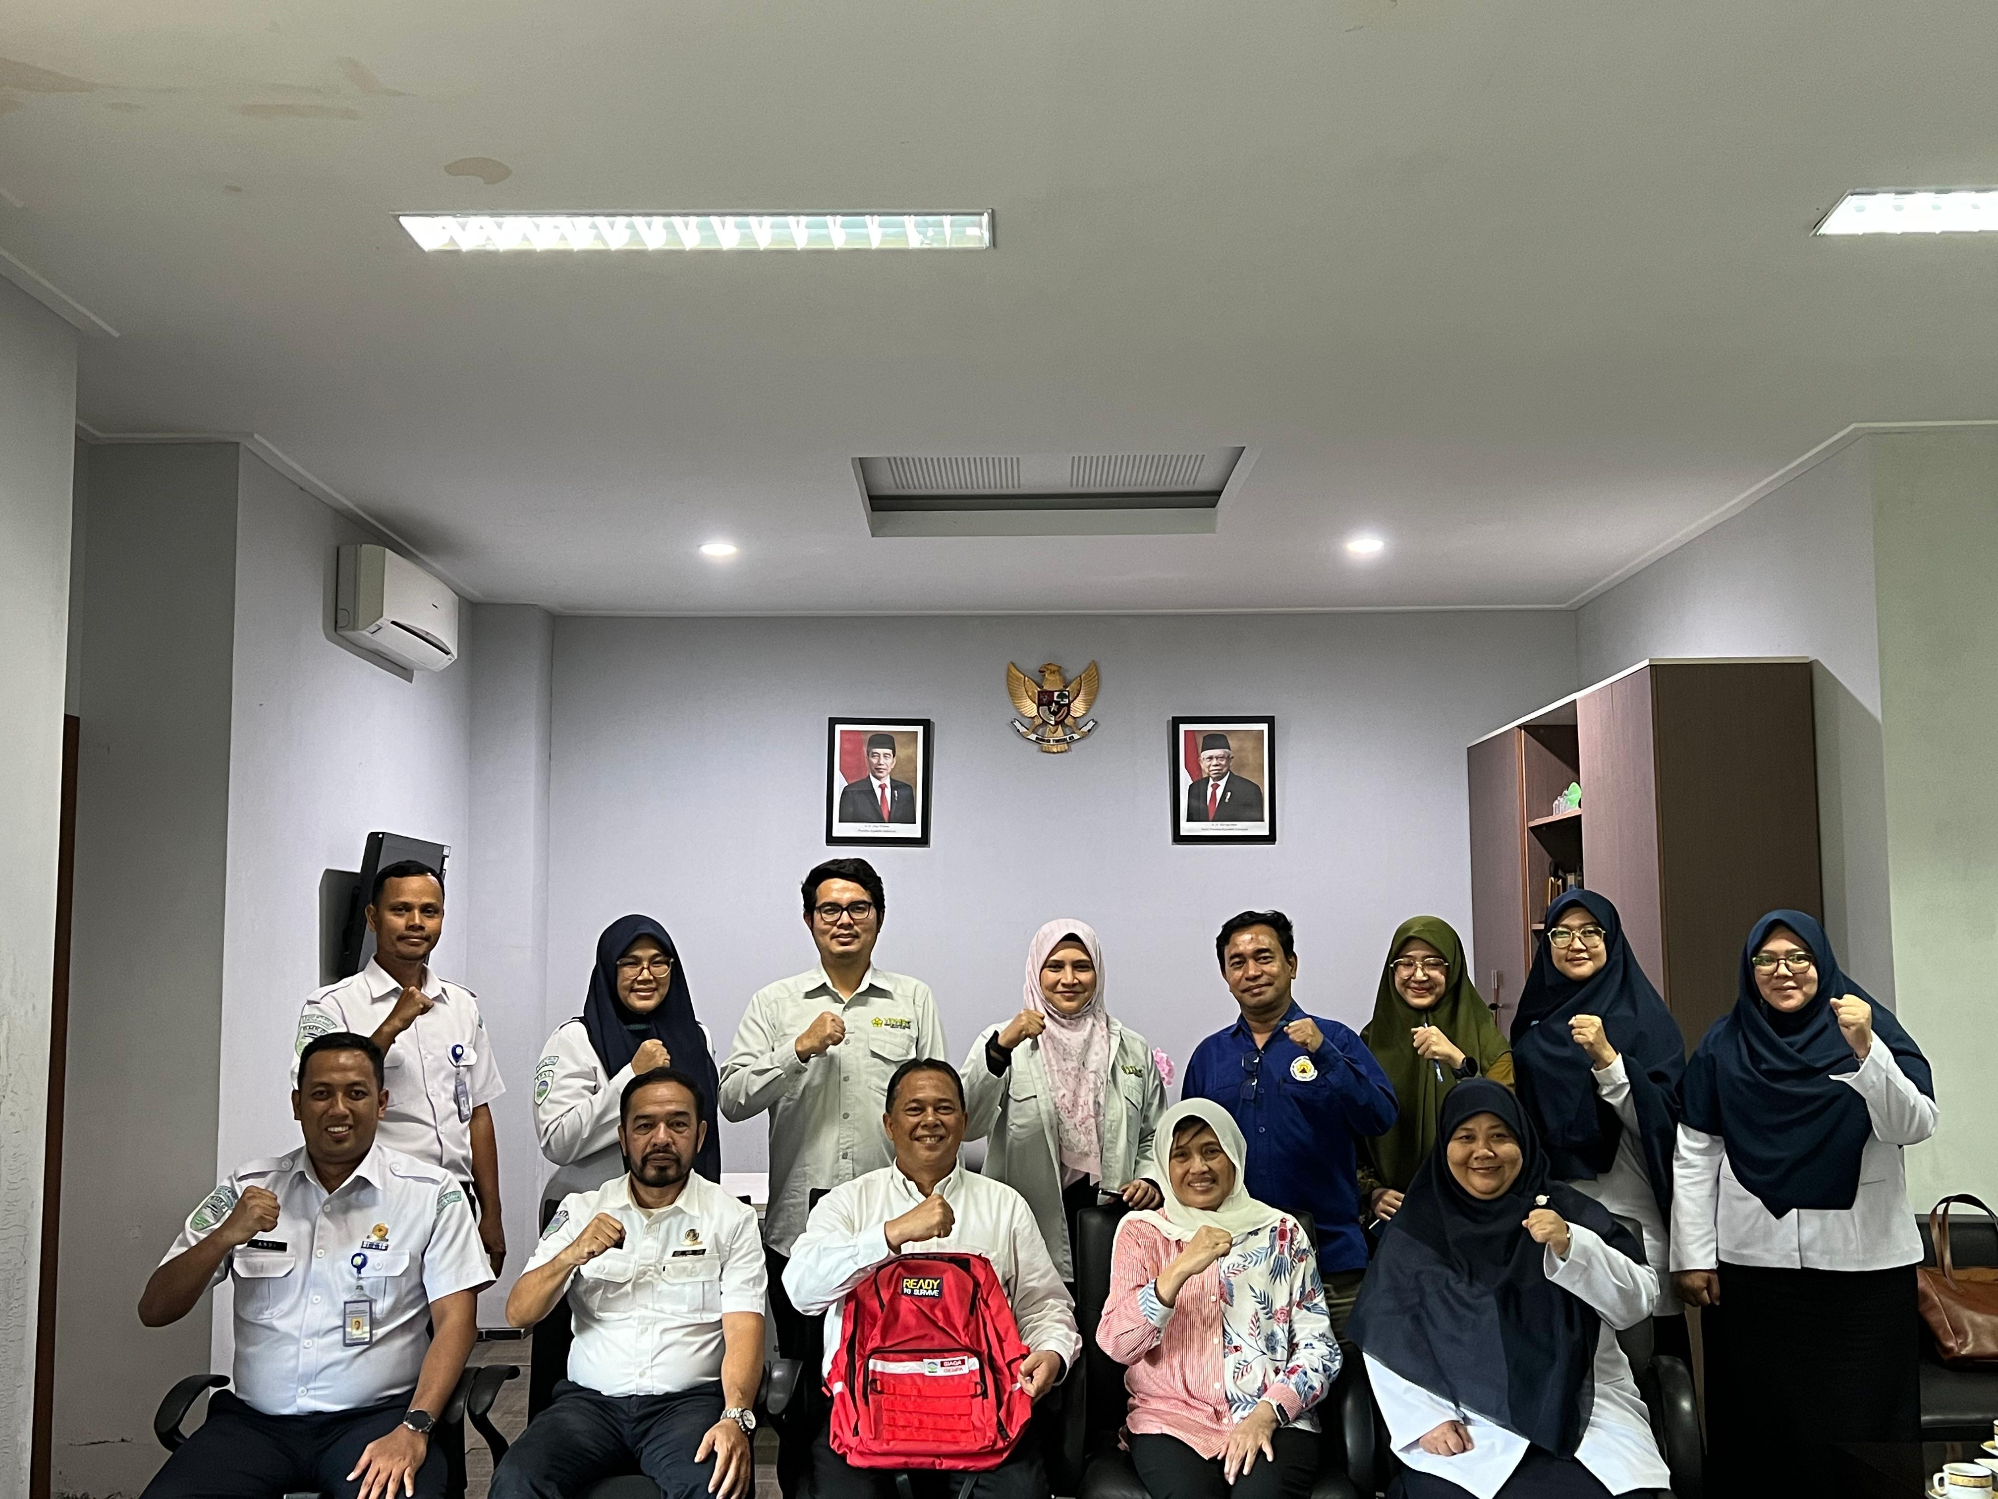
Courtesy Local Governments and Site Visits
(19-21 December 2024)
Courtesy to Vice Rector of USK and TDRMC
Courtesy to Vice Rector of USK and TDRMC

Slide 40
Socialization Presentation for the Symposium
Steering Group online meeting (January 2024)
UN ODTP meeting in UNESCO Headquarter Paris, 25-26 January 2024
ICG/CARIBE EWS Midterm Officers Meeting - Day 2 – online 2 February 2024
Indian Ocean Decade Conference in Hyderabad India – offline 2 February 2024
ICG/NEAMTWS-XVIII - Eighteenth Session of the Intergovernmental Coordination Group for the Tsunami Early Warning and Mitigation System in the North- Eastern Atlantic, the Mediterranean and connected Seas - online 7 February 2024 (today)

Slide 41
Post Event:
UNESCO IOC/ICG IOTWMS XIV
In BMKG Jakarta / Banda Aceh
16-19 November 2024 (tbd with Chair of ICG IOTWMS)

