Slide 1
Report from the ICG/PTWS
TOWS-WG XVII Session
22 – 23 February 2024
NISHIMAE Yuji
ICG/PTWS Chair

Slide 2
Significant Events in the Pacific from January 2023 to February 2024

Slide 3
Significant Earthquakes from January 2023 to February 2024 ( M>7.0)
NO | Date | time | latitude | longitude | depth | mag | magType | Places | Max. tsunami height (m)
1* | 2023-01-09 | 17:47:35.037Z | -7.06 | 130.01 | 105 | 7.6 | mww | Pulau Pulau Tanimbar, Indonesia | 0.09*
2* | 2023-04-24 | 00:41:55.894Z | -29.96 | -177.84 | 47 | 7.1 | mww | Kermadec Islands, New Zealand | 0.11*
3* | 2023-05-10 | 16:02:00.334Z | -15.63 | -174.49 | 210 | 7.6 | mww | 82 km WNW of Hihifo, Tonga | No Tsunami
4* | 2023-05-19 | 02:57:03.172Z | -23.21 | 170.74 | 18 | 7.7 | mww | southeast of the Loyalty Islands | 0.61*
5* | 2023-05-20 | 01:50:59.158Z | -23.04 | 170.56 | 27 | 7.1 | mww | southeast of the Loyalty Islands | 0.14*
6* | 2023-06-15 | 18:06:28.572Z | -22.99 | -177.11 | 179 | 7.2 | mww | 274 km SW of Houma, Tonga | No Tsunami
7* | 2023-07-16 | 06:48:21.158Z | 54.39 | -160.76 | 25 | 7.2 | mww | 106 km S of Sand Point, Alaska | 0.15*
8* | 2023-08-28 | 19:55:30.875Z | -6.79 | 116.52 | 500 | 7.1 | mww | 180 km NNE of Gili Air, Indonesia | No Tsunami
9* | 2023-11-08 | 04:53:50.283Z | -6.42 | 129.55 | 10 | 7.1 | mww | Banda Sea | No Tsunami
10* | 2023-12-02 | 14:37:05.568Z | 8.49 | 126.35 | 51 | 7.6 | mww | 12 km N of Hinatuan, Philippines | 0.32*
11* | 2023-12-07 | 12:56:31.002Z | -20.60 | 169.29 | 54 | 7.1 | mww | 116 km S of Isangel, Vanuatu | 0.08*
12** | 2024-01-01 | 07:10:09.692Z | 37º 29.7’ N | 137º 16.2’ E | 16 | 7.6 | Mjma | Noto Peninsula, Japan | 5.8 ** (run-up height, post tsunami survey by the JMA)
*) Earthquake Source Parameters by USGS
**) Earthquake Source Parameters by Japan Meteorological Agency
Tsunami height by;
*: NGDC/WDS Global Historical Tsunami Database
**: Japan Meteorological Agency

Slide 4
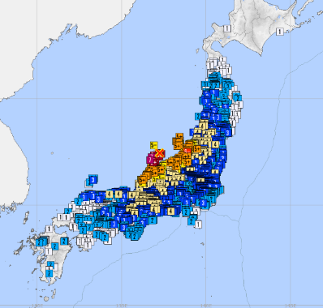
No.12: 1st January, 2024 Noto Peninsula
Origin time (UTC) | Latitude | Longitude | Depth | Magnitude
1-Jan.-2024 07:10:22.5 | 37º 29.7’ N | 137º 16.2’ E | 16km | 7.6
Date and Time (UTC) | PTWC | Tsunami warnings and advisories by the JMA
1-January-2024 07:12 |  | Tsunami warnings and Tsunami advisories were issued based on JMA’s magnitude 7.4.
1-January-2024 07:21 | Tsunami Threat Message #1
1-January-2024 07:22 |  | Major tsunami warning was issued to the NOTO AREA, ISHIKAWA PREF. based on the moment magnitude 7.6 obtained by the CMT analysis.
1-January-2024 07:56 | Tsunami Threat Message #2
1-January-2024 08:57 | Tsunami Threat Message #3
1-January-2024 09:49 | Tsunami Threat Message #4
1-January-2024 11:07 | Final Tsunami Threat Message
1-January-2024 11:30 |  | Major tsunami warning was downgraded to Tsunami warning.
1-January-2024 16:15 |  | All tsunami warnings was downgraded to tsunami advisories.
2-January-2024 01:00 |  | All tsunami warnings and advisories were lifted.
(source parameters determined by the JMA)
Distribution of seismic intensities
Statistics of damages from the Fire and Disaster Management Agency
(as of 8 February, 2024)
Casualties: 1,532 (fatalities: 241)
Damaged buildings and houses : 41,479 (completely destroyed: 5,691)

Slide 5
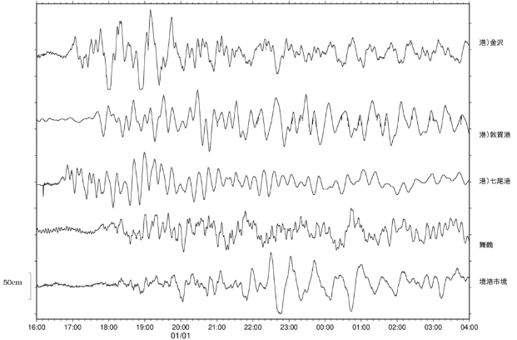
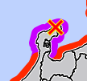
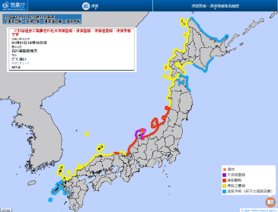
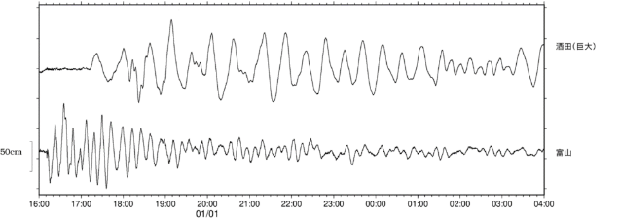
Tsunami records observed at coastal tide gauges
:maximum height
1 Kanazawa
2 Tsuruga-ko
3 Nanao-ko
3
4 Maizuru
1
7
5 Sakaiminatoshi-sakai
JST
6 Sakata
6
4
7 Toyama
5
JST
2
The violet, red, and yellow bars indicate the time when the Major Tsunami Warning, Tsunami Warning, and Tsunami Advisory, respectively, were issued.

Slide 6
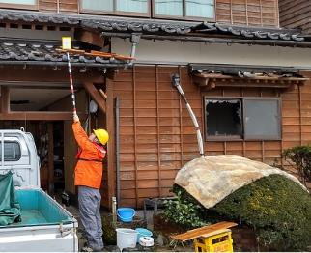
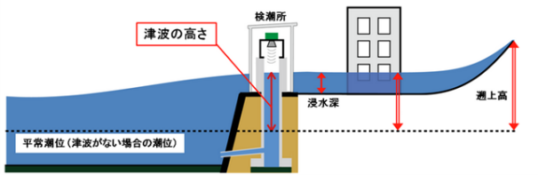
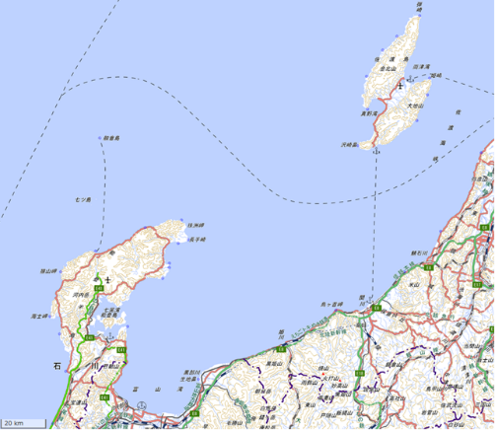
Post field surveys of run-up height conducted by the JMA
Surveys of height B
Observed tsunami height
Sea Level (No tsunami)
Surveys of height A
Points where Major Tsunami Warning issued
Points where Tsunami Warning issued
12
 | Height | Survey
1 | 4.7m | A
2 | 2.2m | A
3 | 1.3m | A
4 | 4.0m | A
5 | 3.1m | A
6 | 1.7m | B
7 | 2.7m | A
8 | 2.9m | A
9 | 4.3m | A
10 | 1.8m | A
11 | 2.4m | B
12 | 2.9m | A
 | Height | Survey
13 | 3.8m | A
14 | 1.9m | A
15 | 1.5m | B
16 | 1.4m | A
17 | 4.5m | B
18 | 5.8m | B
19 | 2.9m | B
14
13
8
9
7
6
19
10
5
18
4
17
1
16
3
2
11
15
地理院地図を加工して作成

Slide 7
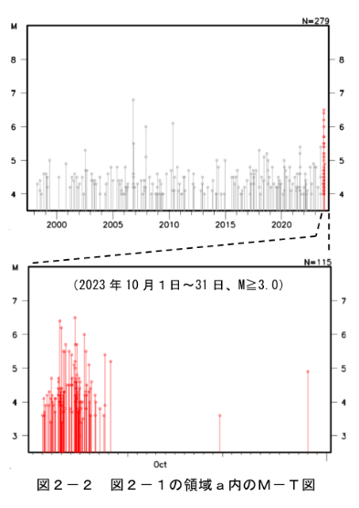
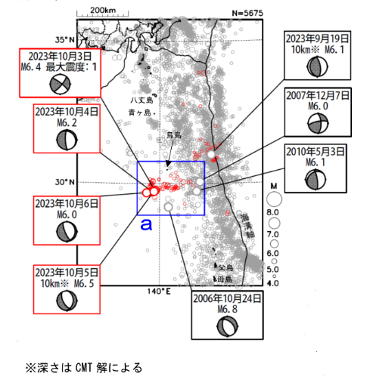

Earthquake and tsunamis activities around Torishima Island in early October, 2023
focal depth based on CMT analysis
Earthquakes determined by the JMA from 1 Oct, 1997 to 31 Oct, 2023 (M≥4.0, depth≤150km)
Red circles denote earthquakes which occurred on October 2023.
Temproral changes of magnitude of the earthquakes in the area a

Slide 8
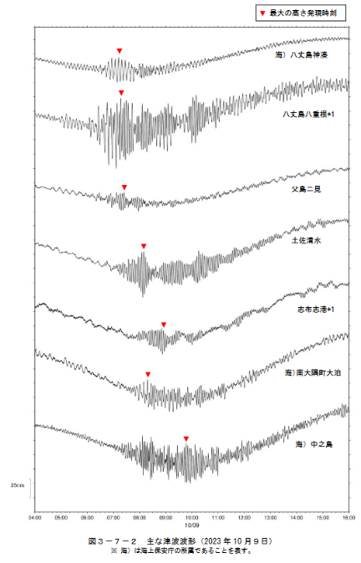
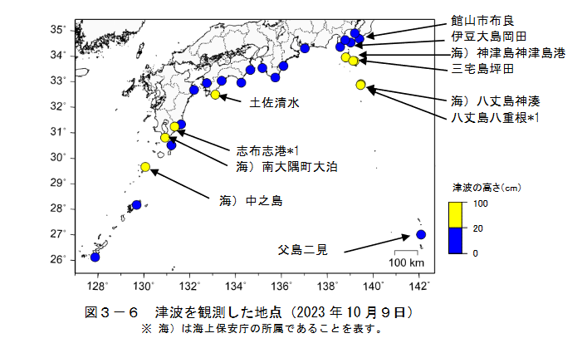

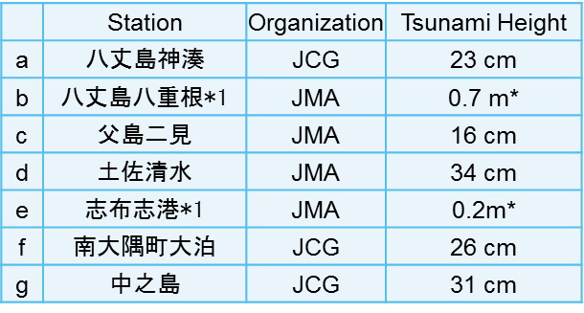
Earthquakes and Tsunamis around Torishima Island in early October, 2023
(Strange Tsunami on 8th October)
a
d
a
b
b
e
f
c
g
Tsunami Height (cm)
c
d
Tsunami height observed at coastal tide gauges
e
f
g
* indicates the tsunami height observed by a huge tsunami gauge.
Tsunami records observed at tide gauges

Slide 9
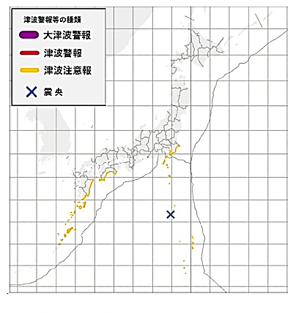
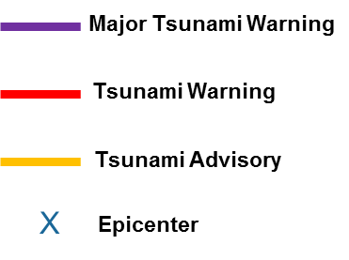
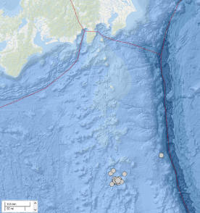
Earthquakes and Tsunamis around Torishima Island in early October, 2023
(Tsunami advisories issued to the event on 8th October)
Date and Time (UTC) | JMA | PTWC
8-October-2023 21:40 | Tsunami advisories issued.
8-October-2023 22:26 | Tsunami advisories updated.
8-October-2023 22:44 | Tsunami advisories updated.
8-October-2023 22:51 | Tsunami advisories updated.
8-October-2023 23:24 | Tsunami advisories updated.
8-October-2023 23:39 |  | Tsunami Information Statement #1
9-October-2023 21:40 | All Tsunami advisories lifted.
Tsunami advisories issued to the event on 8 October
Earthquakes determined by the USGS on 8 October (M≥4.0, depth≤30km)

Slide 10
ICG/PTWS-XXX Session in Tonga in September 2023

Slide 11
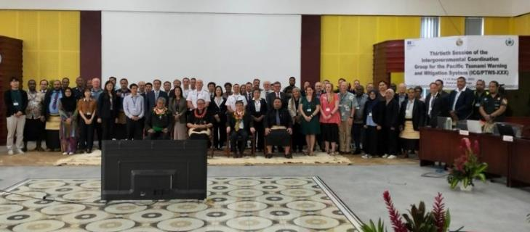
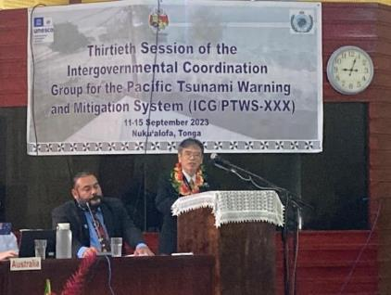
The Thirtieth Session of the ICG/PTWS (ICG/PTWS-XXX)
Venue: Nuku’alofa in Kingdom of Tonga
Date：12th - 15th September, 2023
18 Member States
8th JOINT ICG/PTWS– IUGG JOINT TSUNAMI COMMISSION TECHNICAL WORKSHOP
(11th September, 2023)

Slide 12
8th JOINT ICG/PTWS– IUGG JOINT TSUNAMI COMMISSION TECHNICAL WORKSHOP (11th September, 2023)
Understanding and lessons learned from the tsunami generated by the Hunga Tonga-Hunga Ha'apai volcano eruption on 15 January 2022 for development of Tsunami Warning and Mitigation System for tsunamis generated by volcanoes and other non-seismic sources
Session 1: Overview of tsunami caused by eruption of the Hunga Tonga-Hunga Ha’apai volcano on 15 January 2022
Session 2: Mechanism of tsunami generation for HTHH
Session 3: Lessons and learned on tsunami warning and mitigation
Session 4: Panel Discussion Theme: How can we predict and mitigate for tsunami generated by volcanoes?

Slide 13
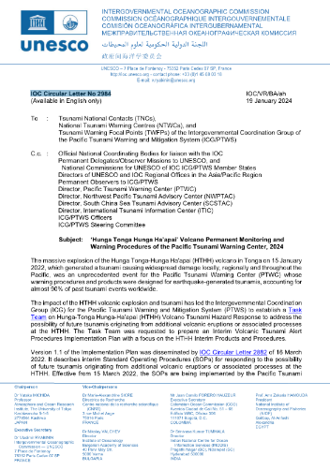
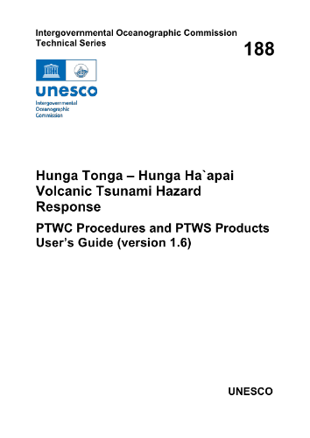
PTWS responses to15 January 2022, Hunga Tonga-Hunga Ha'apai Volcanic Eruption and Tsunami
Hunga Tonga-Hunga Ha'apai Volcano erupted on 15 January 2022.
Tsunami waves were observed at not only near tide gauges but also distant tide gauges.- Larger than 1 meter in California of USA, Chile, Japan.
PTWS held Debrief meetings three times; 20 January, 3, 10 February, 2021.
PTWC provides special products for a HTHH volcano generated tsunami in March, 2022
17 August, 2022: User’s Guide Published (CL-2902) for the interim products
Implementation Plan and Users Guide was officially endorsed at the ICG/PTWS 30th Session, 2023
Hunga Tonga Hunga Ha’apai’ Volcano Permanent Monitoring and Warning Procedures of the Pacific Tsunami Warning Center was published (IOC CL-2984 dated on 19 January, 2024) as IOC TS 188.

Slide 14
Recommendations adopted in the ICG/PTWS-XXX
Recommendation ICG/PTWS-XXX.1: ICG/PTWS Governance
Recommendation ICG/PTWS-XXX.2: Understanding Tsunami Risk
Recommendation ICG/PTWS-XXX.3: Tsunami Detection, Warning and Dissemination
Recommendation ICG/PTWS-XXX.4: TSP Messages for the Maritime Community
Recommendation ICG/PTWS-XXX.5: Disaster Risk Management and Preparedness
Recommendation ICG/PTWS-XXX.6: Start of Operation of Central America Tsunami Advisory Center (CATAC)
Recommendation ICG/PTWS-XXX.7: Minimum competency levels for National Tsunami Warning Center (NTWC) operations staff
Recommendation ICG/PTWS-XXX.8: UN Decade of Ocean Science for Sustainable Development (2021 – 2030)

Slide 15
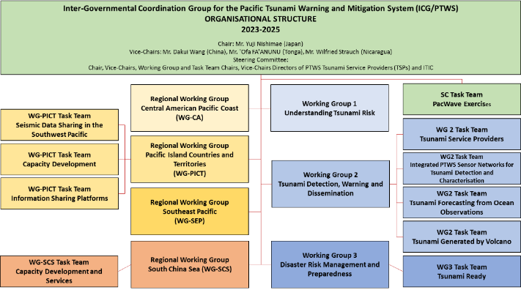
ICG/PTWS Organizational Structure (Recommendation ICG/PTWS-XXX.1)
Chair: Mr. Yuji Nishimae (Japan)
Vice-Chairs: Dr. Dakui Wang (China)
Dr. Wilfreid Strauch (Nicaragua)
Mr. ‘Ofa Fa’anunu (Tonga)
Dissolved Task Teams;
Task Team on UN Ocean Decade,
Task Team on Future Goals and Performance Monitoring,
WG2 Task Team on the Minimum Competency Levels for National Tsunami Warning Centre (NTWC) Operations Staff
Established Task Teams;
WG2 Task Team on Tsunami Generated by Volcanoes (TGV)
WG2 Task Team on Forecasting from Ocean Observations (TT-FOO)
WG3 Task Team on Tsunami Ready
Pacific Island Countries and Territories Working Group Task Team on Information Sharing Platforms

Slide 16
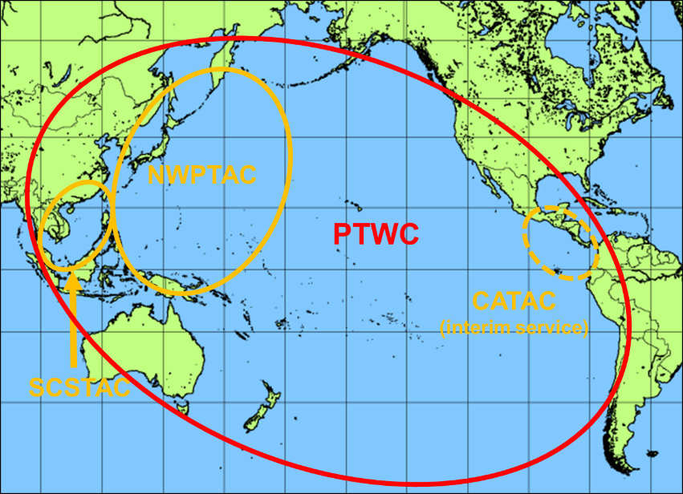
Four Tsunami Service Providers
Tsunami Service Providers in the Pacific
Four Tsunami Service Providers
Pacific Tsunami Warning Center (PTWC) operated by USA
Northwest Pacific Tsunami Advisory Center (NWPTAC) operated by Japan
South China Sea Tsunami Advisory Center (SCSTAC) operated by China
Central America Tsunami Warning Center (CATAC) operated by Nicaragua
The CATAC is fully operated (24hours/7days) on the interim service.

Slide 17
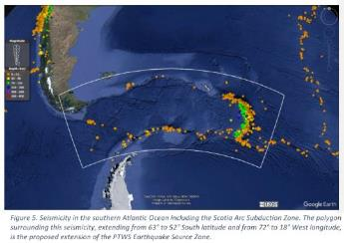
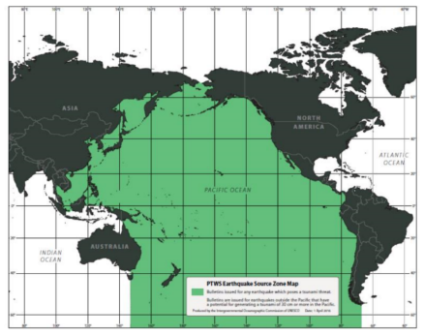
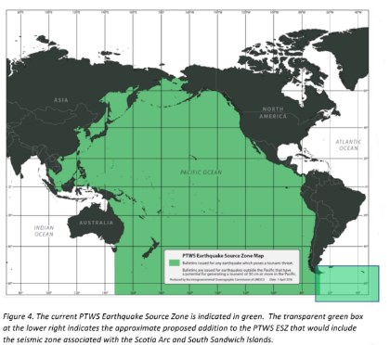
Expansion of the ICG/PTWS Earthquake Source Zone
(Recommendation ICG/PTWS-XXX.3)
Decision in the ICG/PTWS-XXX session
Decides to expand the PTWS Earthquake Source Zone to include an area from 63º to 52º south latitude and from 72º to 18º west longitude to include the Scotia Arc and its adjacent seismic zones.

Slide 18
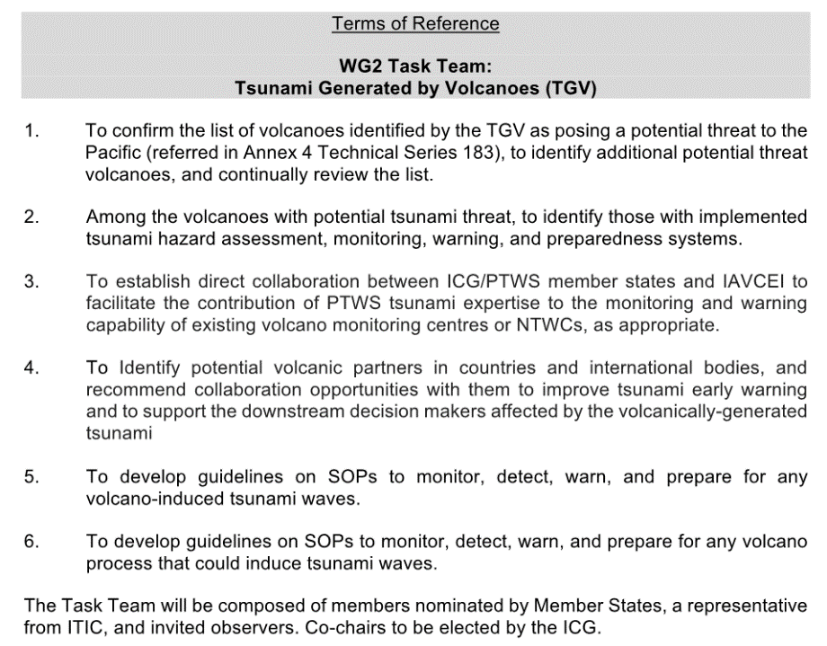
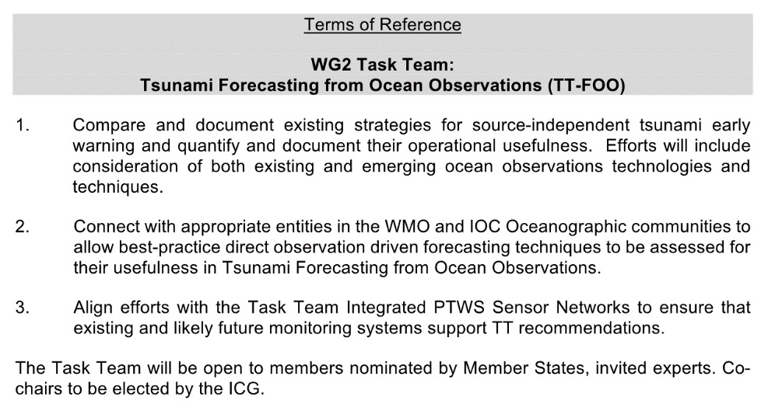
Establishment of Task Teams for Tsunami Forecasting under the WG2 (Recommendation ICG/PTWS-XXX.1 and ICG/PTWS-XXX.3)
The first objective of the Ocean Decade Tsunami Progrmamme is to develop the warning systems’ capability to issue actionable and timely tsunami warnings for tsunamis from all identified sources to 100 percent of coasts at risk.
WG2 Task Team on Tsunami Generated by Volcanoes (TGV)
WG2 Task Team on Forecasting from Ocean Observations
(TT-FOO)

Slide 19
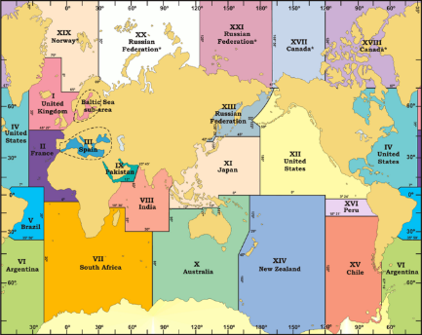
TSP Messages for the Maritime Community
(Recommendation ICG/PTWS-XXX.4)
Recommendation ICG/PTWS-XXX.4
Recalling the TOWS-WG approved the proposal on TSP Messages for the Maritime Community and requested the ICGs to consider the proposal for implementation in their respective basins in the TOWS-WG XII session,
Recalling IOC Assembly instructs the regional Intergovernmental Coordination Groups (ICGs) TSPs in collaboration with NAVAREA operators of the International Hydrographic Organization (IHO) test the tsunami maritime safety products in 2023/24, with a view to operationally implementing them in 2024-2025 in IOC Decision A-32/3.4.1,
Noting necessity of coordination with the IHO with regard to provision of tsunami maritime safety products,
Affirming that the Pacific basin is covered by seven NAVAREAs and NAVAREA coordinators,
Noting the NTWCs of some member states have provided the information to the tsunami at near coasts,
Considering differences of tsunami threat to vessels or ships offshore and near the coasts,
Noting recommendations from the WG2,
Recommends the PTWC to finalize necessary preparations to provide special tsunami maritime safety products specifically for ships for all NAVAREA Coordinators in the Pacific and in the Southwest Atlantic (e.g. NAVAREAs VI, X, XI, XII, XIII, XIV, XV, and XVI) to transmit to the NTWCs to be forwarded to the NAVAREA Coordinators of their countries, or upon their request directly to the NAVAREA Coordinators in the absence of a NTWC,
Requests the PTWS Steering Committee to finalise its decision at its next meeting on the provision of these products for a period of testing to be followed by a full operational implementation by the PTWC in 2024-2025,
Recommends the PTWC to finalize necessary preparations to provide special tsunami maritime safety products specifically for ships for all NAVAREA Coordinators in the Pacific and in the Southwest Atlantic (e.g. NAVAREAs VI, X, XI, XII, XIII, XIV, XV, and XVI) to transmit to the NTWCs to be forwarded to the NAVAREA Coordinators of their countries, or upon their request directly to the NAVAREA Coordinators in the absence of a NTWC,

Slide 20
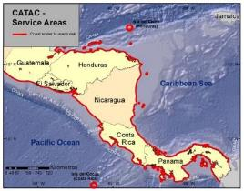
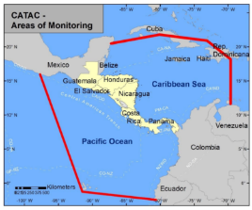
Start of Operation of Central America Tsunami Advisory Center (CATAC)
(Recommendation ICG/PTWS-XXX.6)
Recommendation from the ICG/CARIBE-EWS-XVI
The ICG recommended the start of CATAC's full functionality in an interim manner for the Caribbean coast of Central America, starting in June 2023 (as already decided by the Intergovernmental Coordination Group for the Pacific Tsunami Warning and Mitigation System (ICG/PTWS-XXIX) for the Pacific coast of Central America, as from December 2021).
The ICG further recommended the consideration of Central America Tsunami Advisory Centre (CATAC) as a Tsunami Service Provider (TSP) at its 17th session in 2024 to enable the IOC Executive Council to consider the final admission of CATAC as TSP in June 2024.
Recommendation ICG/PTWS-XXX-6
Decides to admit the start of the official full functional operations of CATAC, starting after the IOC governing body meeting in 2024, with the specific starting date to be decided after the coordination with the ICG/CARIBE-EWS

Slide 21
Minimum competency levels for National Tsunami Warning Centre (NTWC) operations staff (Recommendation ICG/PTWS-XXX.7)
Recommends the approval of the PTWS National Tsunami Warning Centre competencies, framework, and training requirements, as described in IOC ICG/PTWS-XXX Working Document (Agenda 4.5) Report from the Task Team on the Minimum Competency Levels for National Tsunami Warning Centre (NTWC) Operational Staff.
Framework -2 Tiers (1. TSP Products, 2. TSP + National analyses)
NTWC Staffing Role 1: Tsunami incident controller (or manager)
This tier 1 role requires a comprehensive understanding of tsunami causes and impacts, expert interpretation of TSP products, and competent performance of all key national warning procedures.
NTWC Staffing Role 2: Tsunami incident assistant
This tier 2 role requires a basic understanding of tsunami causes and impacts, simple interpretation of TSP products, and ability to perform some tasks of the national warning procedures.
Minimum Competencies
Core science knowledge
Advanced science knowledge
Core operational competency
Advance agency competency
Training Requirements
An NTWC Competency Programme should
Include a NTWC Staffing Profile, including positions, qualifications, and capabilities,
Establish standardized training modules, covering science, operational, and agency competencies, that have measureable assessments, performance criteria, and/or tests.

Slide 22
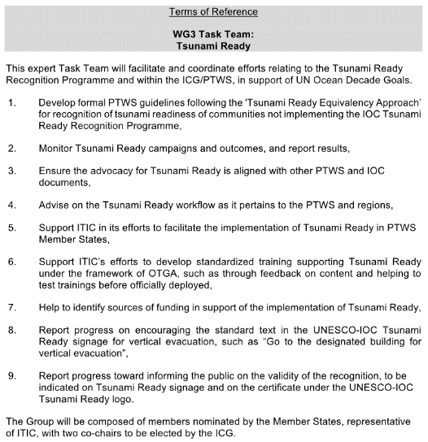
IOC/UNESCO Tsunami Ready Recognition Program
(Recommendation ICG/PTWS-XXX.1 and ICG/PTWS-XXX.5)
Establishment of Task Teams for Tsunami Ready under the WG3
The second objective of the Ocean Decade Tsunami Programme is that 100 percent of communities at risk to be prepared and resilient to tsunamis by 2030 through efforts like the IOC-UNESCO Tsunami Ready Recognition Programme.
20 communities of 8 countries has been certified as of January, 2024
Honduras (1)
Costa Rica (10)
Samoa (1)
Guatemala (2)
Panama (1)
Ecuador (1)
El Salvador (2)
Fiji (2)

Slide 23
Future Events for the ICG/PTWS
ICG/PTWS Steering Committee Meeting
Venue and Date:
Online meeting will be held in March and in-person meeting will be planned.
ICG/PTWS 31th Session
  Venue: Beijing, China
  Date: April, 2025
Exercise Pacific Wave 2024
  September to November, 2024 to support IDDRR (13 Oct. 2024) and WTAD (5 Nov. 2024)
  Live Communications Test from the PTWS TSPs on 5 November

