Slide 2
ICG/CARIBE-EWS-XVI
TOWS-WG-XVII
Gérard Métayer
ICG/CARIBE-EWS Chair
February 22, 2024

Slide 3
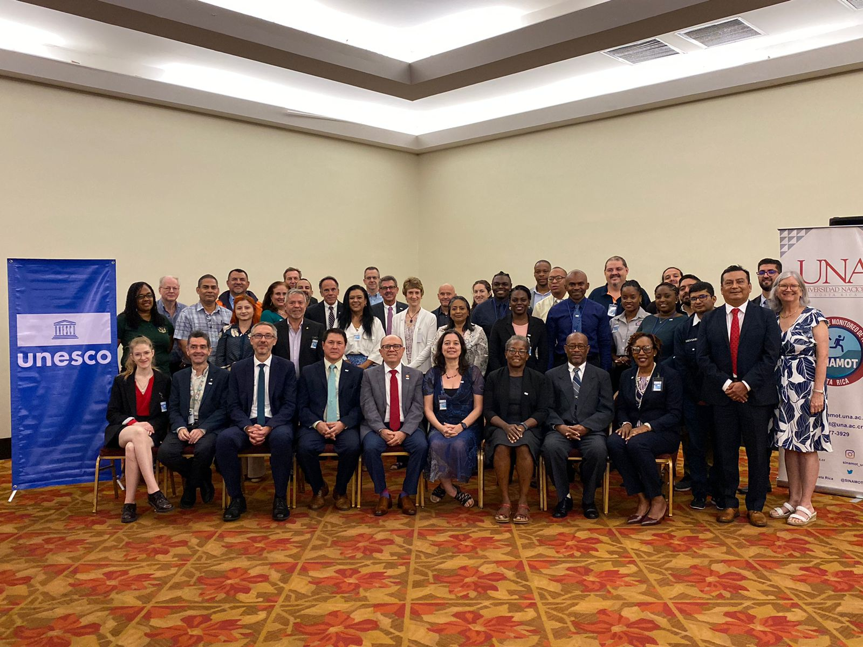
ICG/CARIBE-EWS-XVI meeting
Costa Rica, 25-28 April, 2023
19/48 MS and Territories
4 observers
Next Meeting
  May 6-10, 2024: USVI ?
  Country nomination open

Slide 4
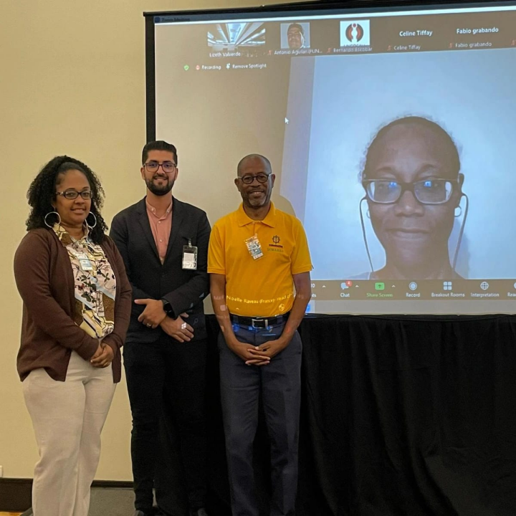
New officers elected
Chair
Gérard Métayer
(Haiti)
Vice Chairs
Regina Browne
(USVI)
  Marie-Noëlle Raveau
  (France-Martinique)
  Anthony Murillo
  (Costa Rica)

Slide 5

ICG/CARIBE-EWS XVI
Costa Rica
April, 25-28, 2023
Reports from some Member States and Territories
Barbados, Colombia, Costa Rica, Dominica, France, Guatemala, Mexico, Nicaragua, Panama,
Saint Lucia, Saint Vincent and Grenadines, USA, Venezuela.
Communication and alert mechanisms. SOPs and country protocols
Re-Alignment of Working Groups. New UNESCO/IOC Tsunami Ready guidelines
Ocean Decade Tsunami Program. Current and future projects
Caribe Wave exercises. Implementation Plan. Recommendations to IOC

Slide 6
Working Groups Re-Alignment/Task Team
Previous WGs:
WG 1: Monitoring and Detection Systems
WG 2: Hazard Assessment
WG 3: Tsunami Related Services
WG 4: Preparedness, Readiness and Resilience

Slide 7
Working Groups Re-Alignment/Task Team
Re-Alignment with Ocean Decade and Sendai Action Framework
WG 1: Risk Knowledge (previous WG 2)
WG 2: Tsunami Detection, Analysis and Forecasting (previous WG 1 + parts of WG 3)
WG 3: Warning Dissemination and Communication
WG 4: Preparedness, Response Capabilities and Resilience
TT CARIBE WAVE
Previous WGs:
WG 1: Monitoring and Detection Systems
WG 2: Hazard Assessment
WG 3: Tsunami Related Services
WG 4: Preparedness, Readiness and Resilience

Slide 8
Tsunami Service Providers
More Tide Stations are needed, and DART buoys (repair)
Strategy to monitor volcanoes that could generate tsunamis
9 tsunami event reports were generated, of these 3 were of significant size
(Sandwich Islands, Haiti, Hunga Tonga Hunga Ha’ apai)
Pacific Tsunami Warning Center (PTWC)

Slide 9
Support of Japan International Cooperation Agency (JICA), UNESCO, EWARNIC
in the process of establishing CATAC
April 2024: Start with Japan International Cooperation Agency (JICA) project
CARIBE-EWS-XVI recommends full operation in interim mode from June 2023
And the session XVII will consider approval of CATAC as TSP
Tsunami Service Providers
Central AmericaTsunami Advisory Center (CATAC)

Slide 10
Caribbean Tsunami Information Center
(CTIC)
Partnership of the Government of Barbados and UNESCO/IOC
Supported by International Tsunami Information Center-Caribbean Office
Recommends a deeper cooperation between CTIC and ITIC-CAR, WG 4, UNDRR
to support Members States Preparedness and Resilience
Need to expand support for Tsunami Ready Recognition Program
Requests the Member States to provide greater support through financial
and human resources

Slide 11
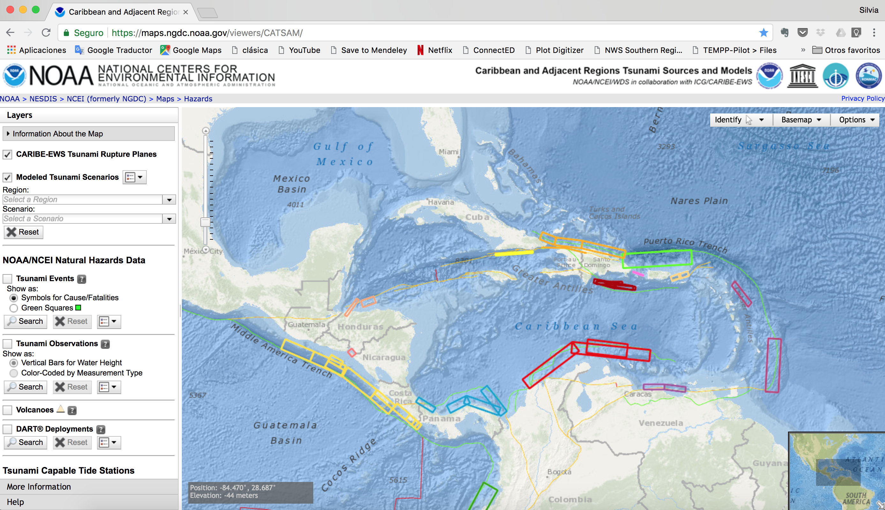
CATSAM: Caribbean and Adjacent regions Tsunami Sources And Models

Slide 12
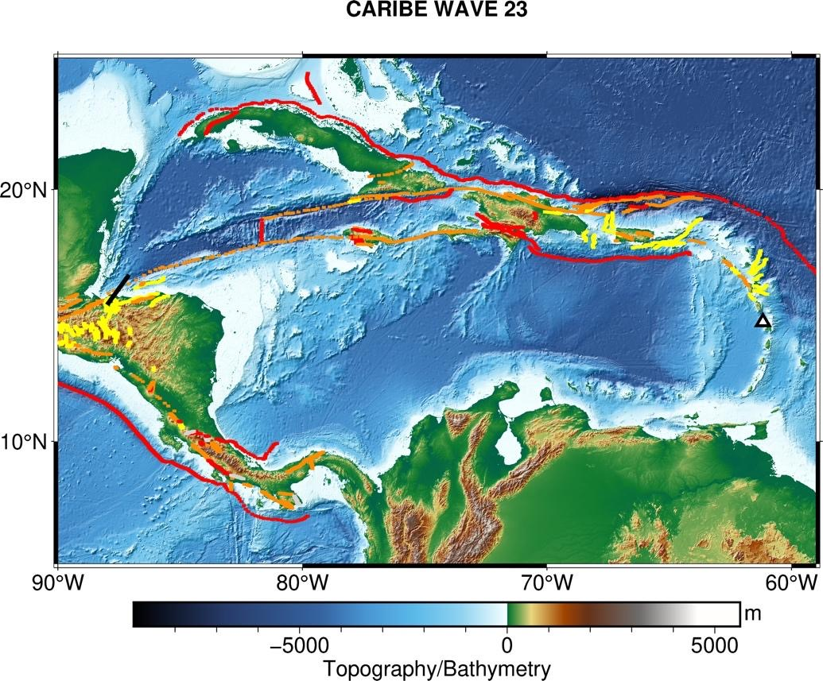
CARIBE WAVE 23
March 23, 2023 14:00 UTC
2 scenarios
  Honduras Gulf
  Mount Pelee eruption
720,000 people participated
Kick’em Jenny
NPDB

Slide 13
CARIBE WAVE 24
CARIBE WAVE 25
March 21, 2024 15:00 UTC
2 scenarios
  Puerto Rico Trench
  1882 North Panama Deformed Belt
2 Possible Scenarios
1692 Jamaica Scenario
1755 Lisbon Scenario

Slide 14
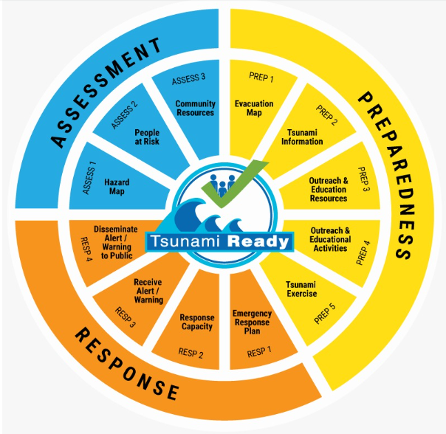
UNESCO IOC TSUNAMI READY RECOGNITION PROGRAMME Established in 2022
Standard Guidelines for the Tsunami Ready Recognition Program, UNESCO IOC TS 74

Slide 15
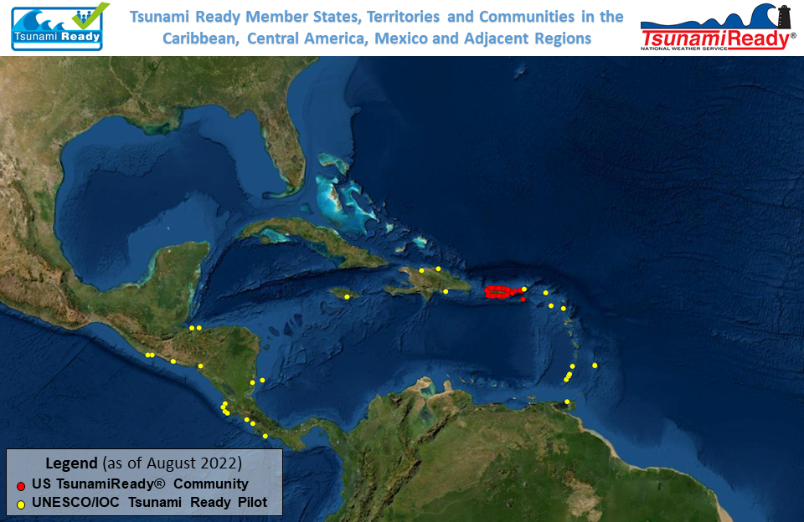
17 countries and territories have/implementing Tsunami Ready
34 UNESCO/IOC Tsunami Ready Communities/Countries/Territories:
21from Atlantic side and 13 from Pacific
9 UNESCO/IOC Tsunami Ready Communities and 2 renewals in Progress
49 US TsunamiReady communities in Puerto Rico and USVI

Slide 16
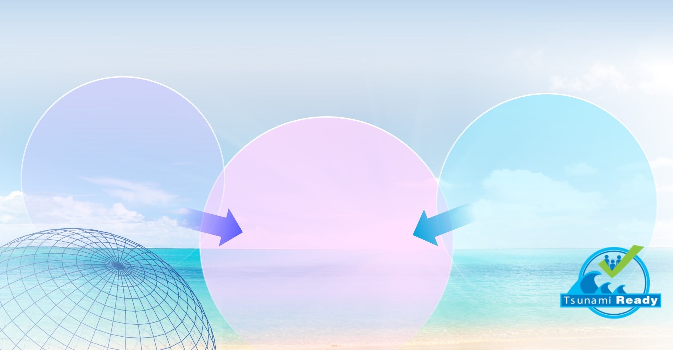


OCEAN DECADE TSUNAMI PROGRAMME
Seeking Major Advances in SCIENCE and PREPAREDNESS
RESILIENCE!
1. Real-time impact forecasts
with
2. Deep community preparedness.
Observation and analysis Technologies
low-uncertainty
Comprehension
& community
preparedness
IOC Tsunami Ready

Slide 17

OCEAN DECADE TSUNAMI PROGRAMME:
THE MAIN SOCIAL OUTCOME
BY
2030
TO MAKE
100%
OF COMMUNITIES AT RISK OF TSUNAMI PREPARED FOR AND RESILIENT TO TSUNAMIS

