Slide 1
IPMA National Tsunami Warning Center and TSP - Status
Fernando Carrilho
ICG/NEAMTWS, Paris
06-08 February2024

Slide 2
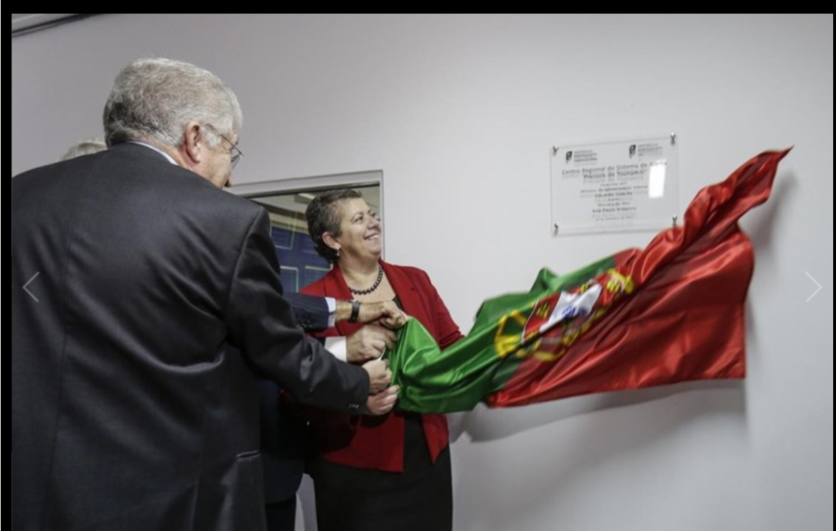
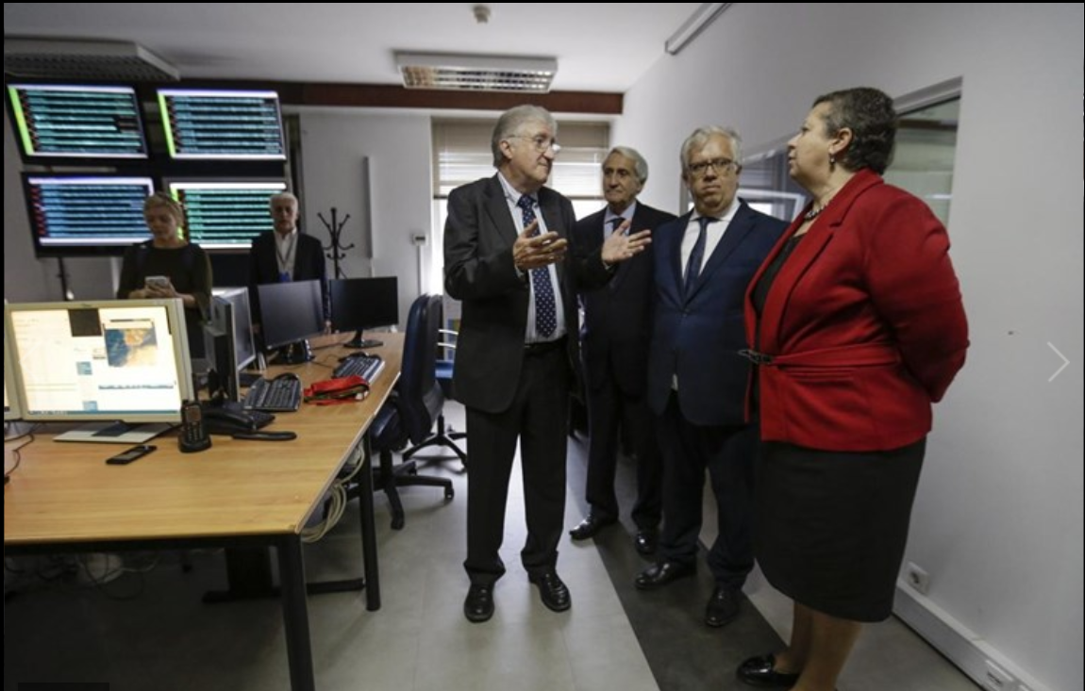
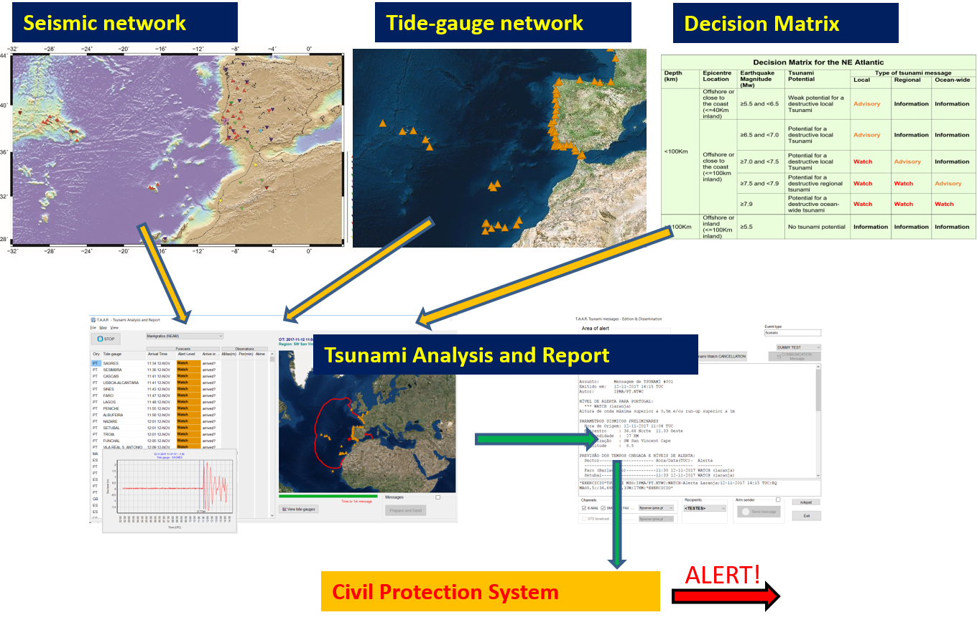
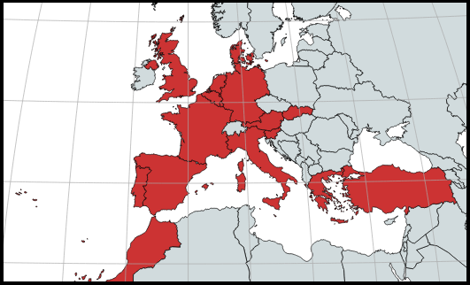
PT.NTWC
NTWC – November 2017
CTSP - January 2018
Accreditation as TSP on 2019
Subscribers:
Portugal, Spain, France, Morocco, Germany, UK, Denmark, Turkey, Italy and Greece
JRC, IOC, ERCC

Slide 3
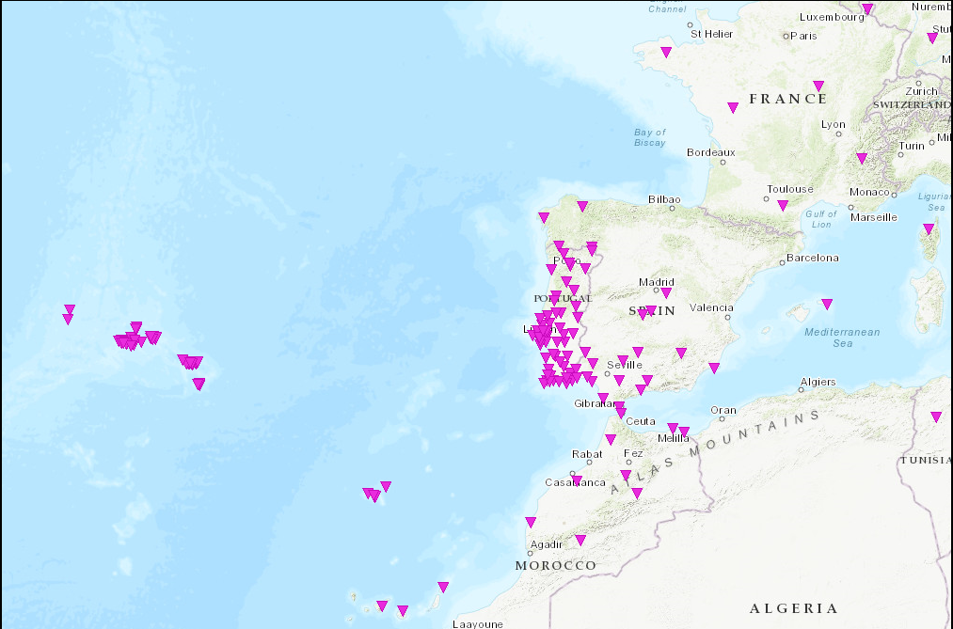
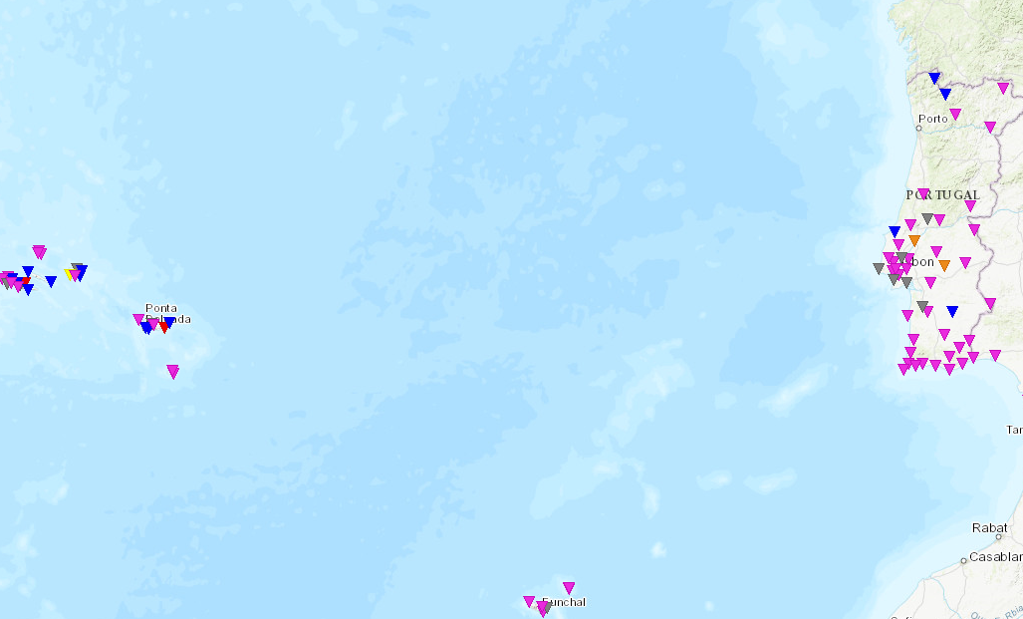
Seismic Network
VSAT
Internet
MPLS
IPMA broadband network (+ SM sensors co-located)
IPMA short-period network (+ SM sensors co-located)
IPMA/IST strong-motion network
Real-time, Internet (mobile, mini-link, fiber optic) & VSAT connection
Complemented with stations from other agencies: Portugal, Spain, Morocco, France and CTBTO (Internet, VPN and MPLS);
83 Broadband, 28 short-period and 97 accelerometers (real-time)
Broadband / Short-period
VSAT
Internet
Strong-motion

Slide 4
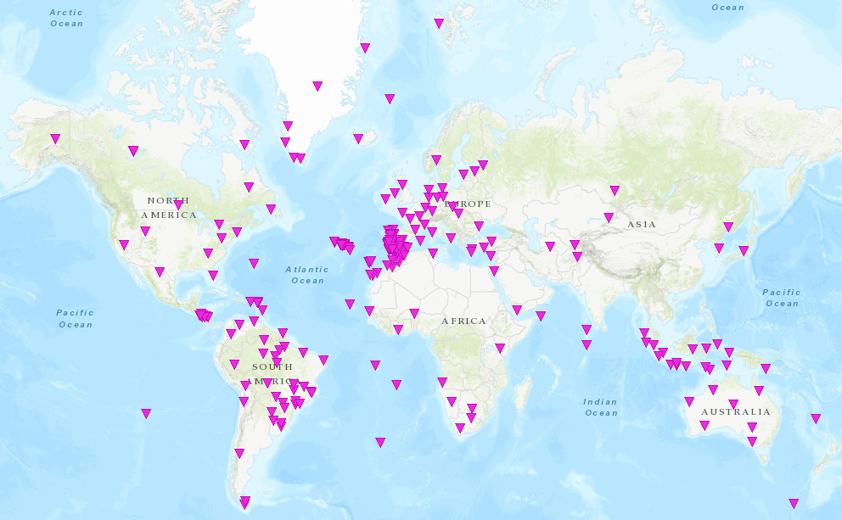
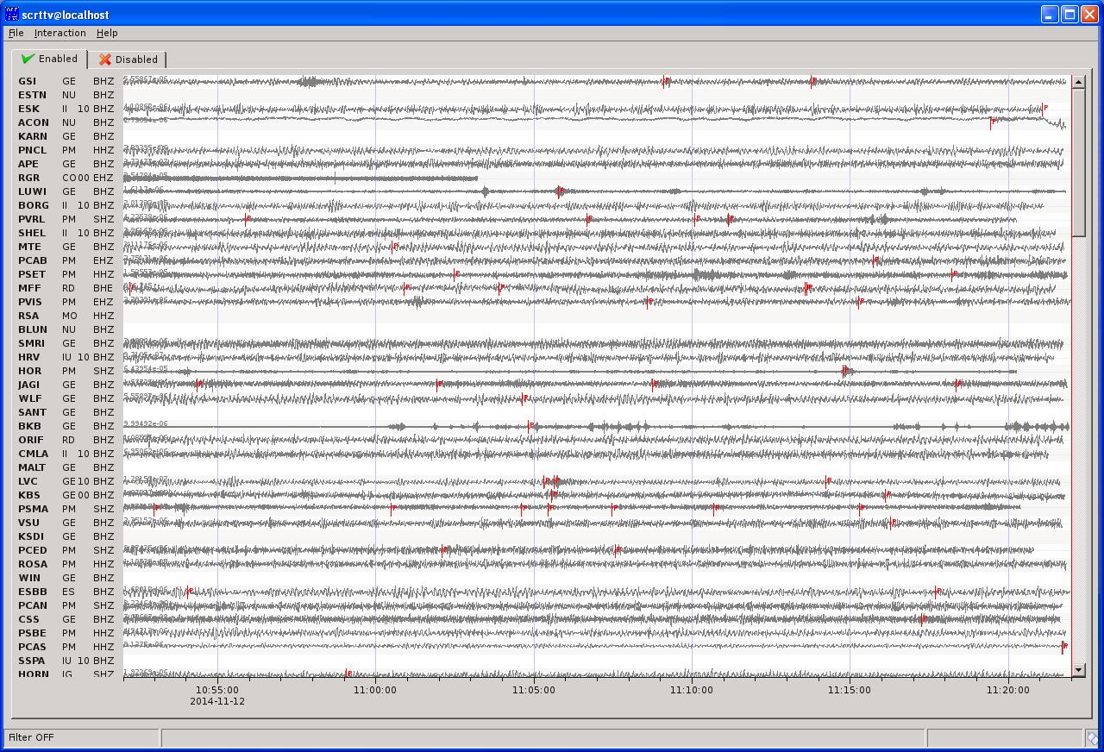
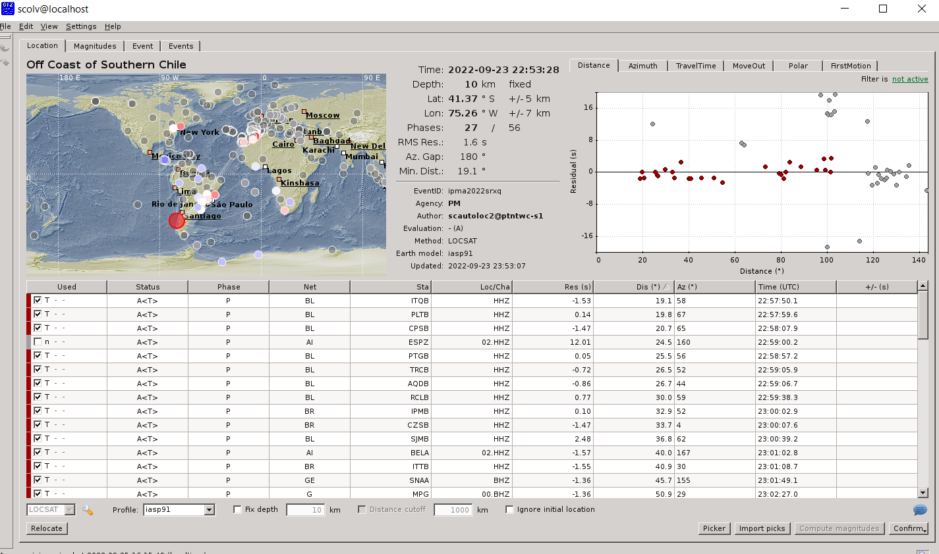
SeiscomP – Global Seismic Monitoring
Fast locations
Fast MW evaluations

Slide 5
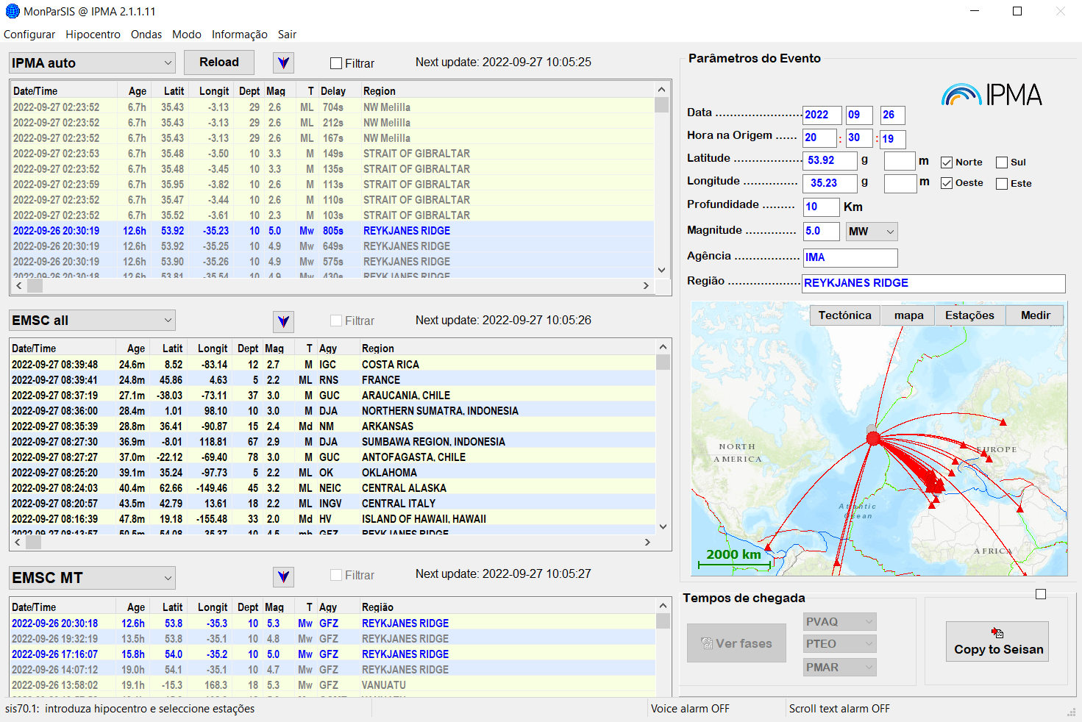
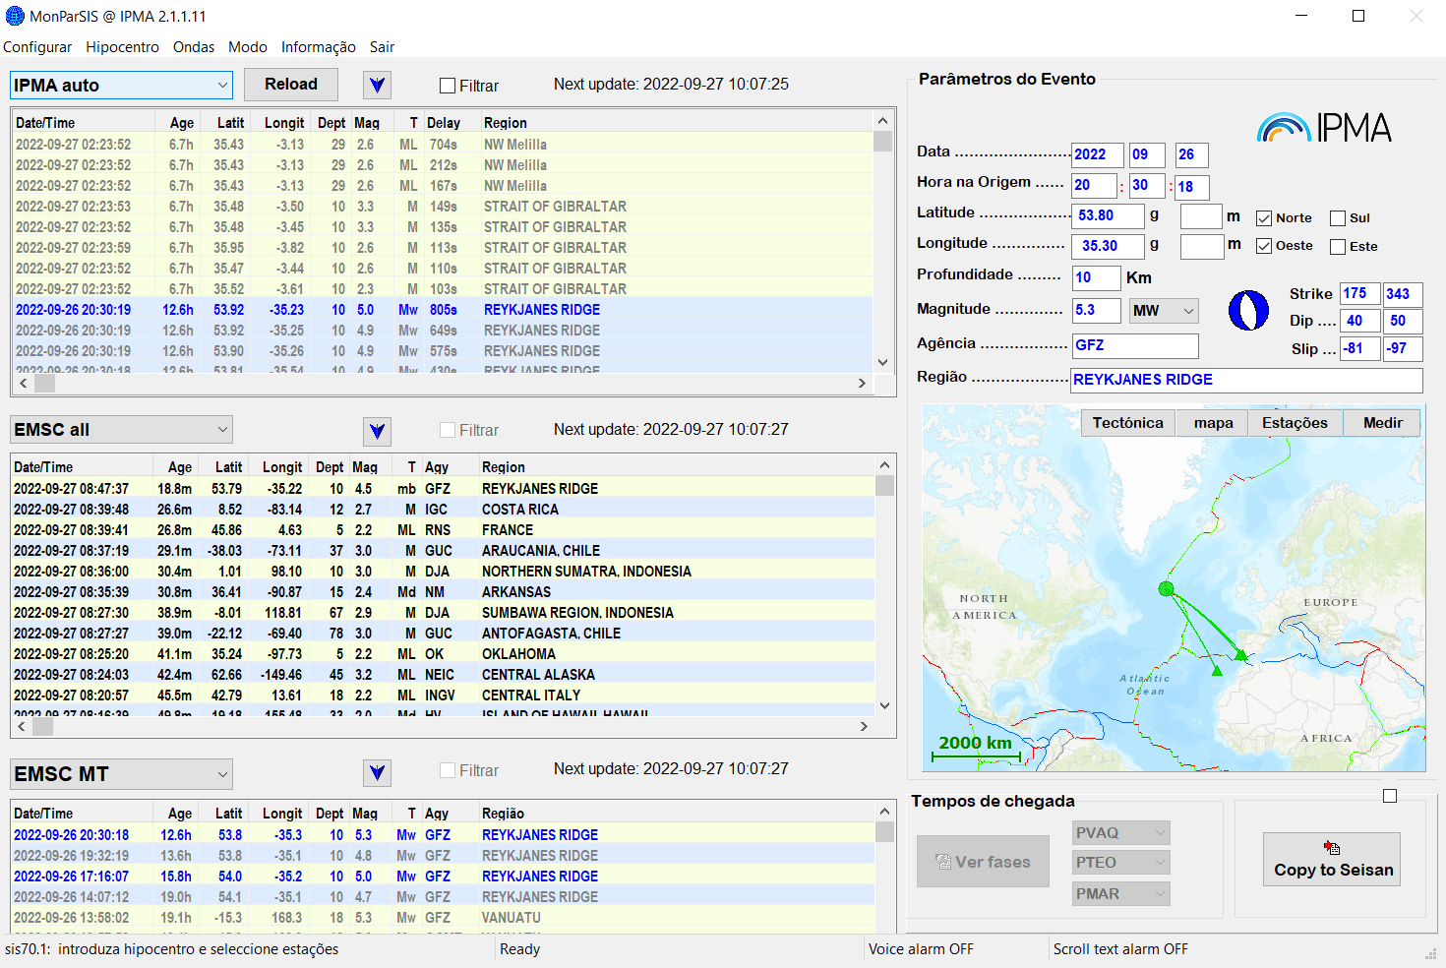
Seismic Monitoring
IPMA Automatic solutions
Other agencies solutions
(hypocenters/Mags/MT)

Slide 6
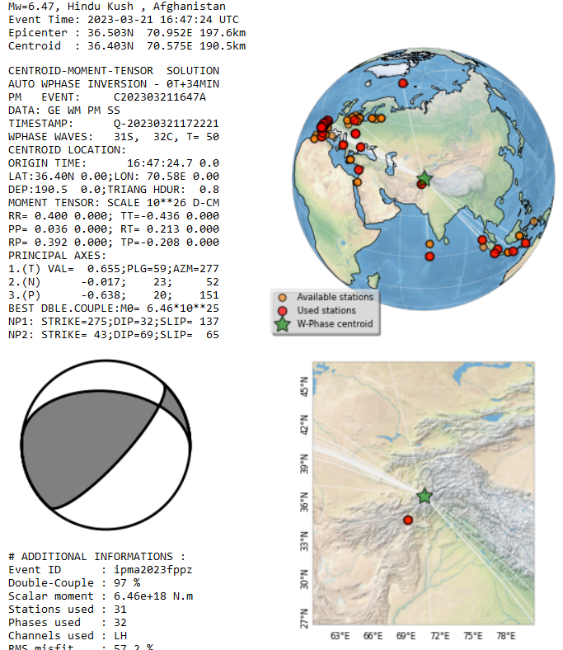
Seismic Monitoring
IPMA Automatic Mw & CMT
W-Phase method
Implemented on Seiscomp
in late Feb2023
Contribution:
(Luis Rivera & Anthony Jamelot)

Slide 7
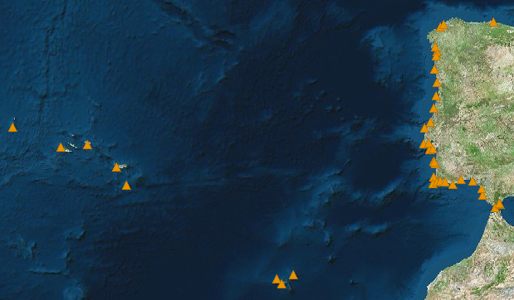
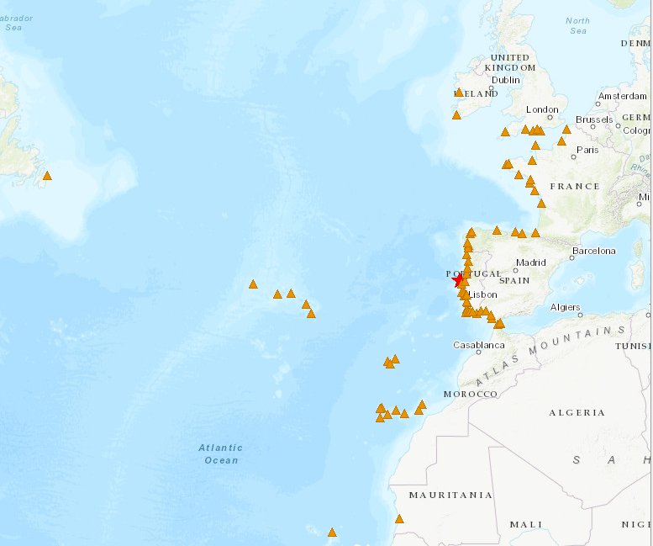

Tide-gauge network
Internet
MPLS
Internet
MPLS
71 stations
El Jadida
Sources:
CENALT, seiscomp/MPLS (SHAUM stations)
IH, webservice/Internet (Instituto Hidrográfico)
JRC, webservice/Internet
EMSO-PT/UBI/IPMA, webservice/Internet
DGT sites, webservice/Internet (Direção geral do Território)
IGN seiscomp/Internet (Puertos del Estado stations)
Instituto Hidrográfico
Puertos Del Estado (via IOC & IGN)
Direção Geral do Território
CNRST (via CNRST & JRC)
JRC (ipma & ign support)
IOC

Slide 8
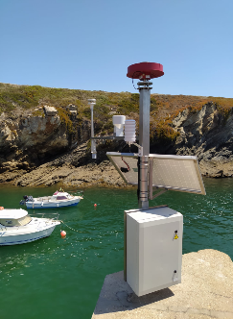
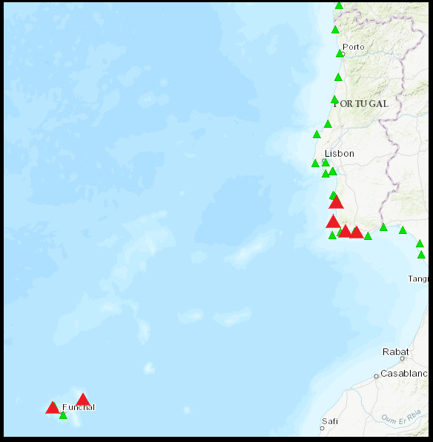
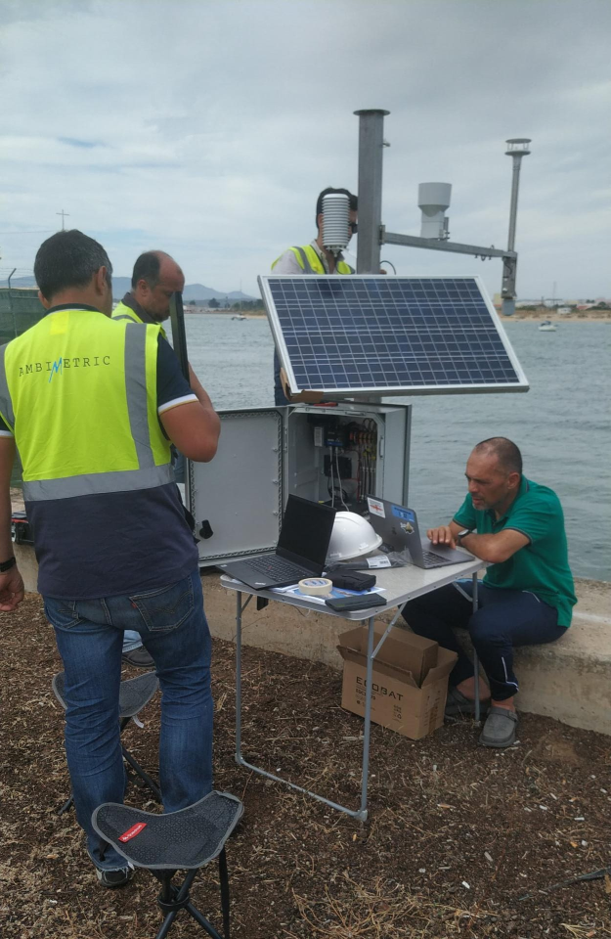
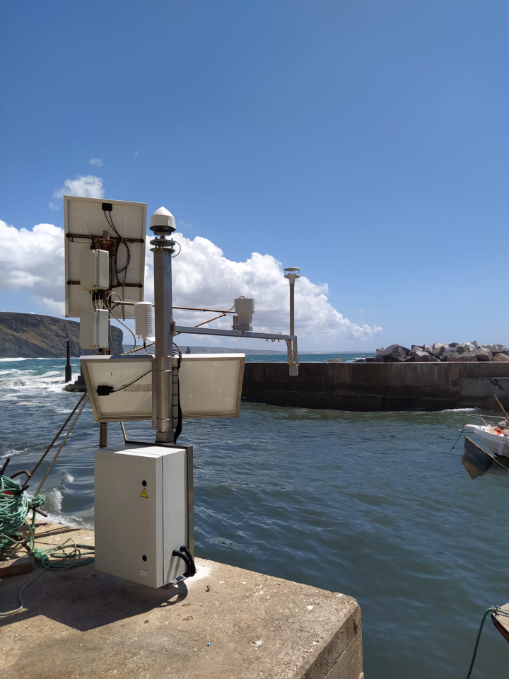
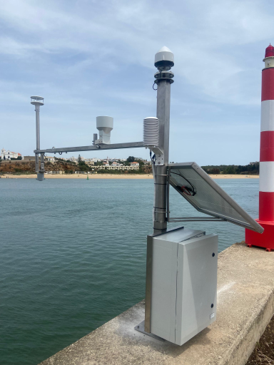
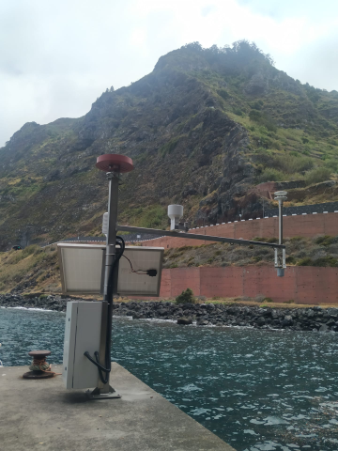
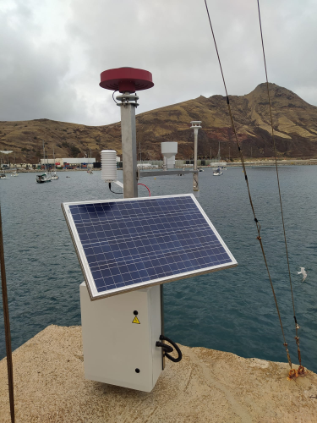
EMSO-PT
MultiParameter Stations
Porto Covo
Albufeira
GNSS
Tide-Gauge
Meteo
Atmospheric Pressure
Temperature
Humidity
Wind
Arrifana
Portimão
Solar Power
Mobile Internet
Local buffer
University of Beira Interior
Instituto Português do Mar e Atmosfera
Porto Moniz
Porto Santo

Slide 9
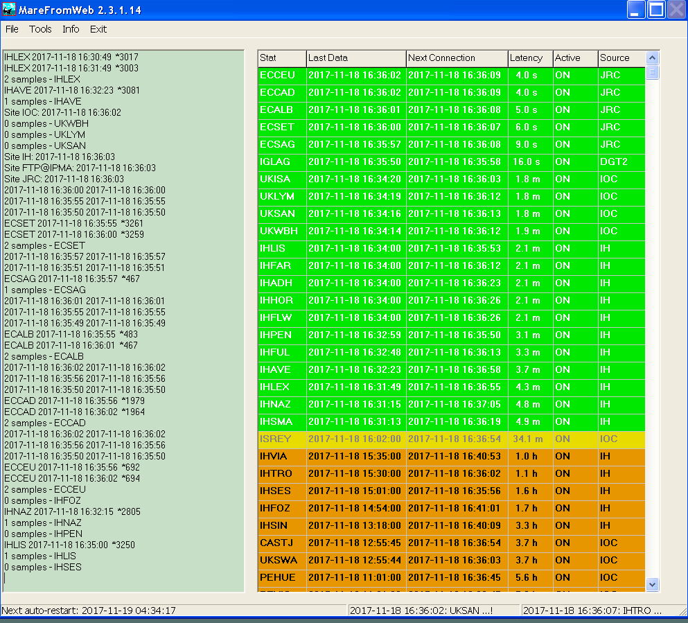
Tide-gauge data acquisition
and management
DGT
sites
IH
dataservice
JRC
dataservice
EMSO-PT/UBI/IPMA
ftp
IOC dataservice
CENALT
seiscomp
IGN
seiscomp
MareFromWeb
TREMOR01
Seiscomp

Slide 10
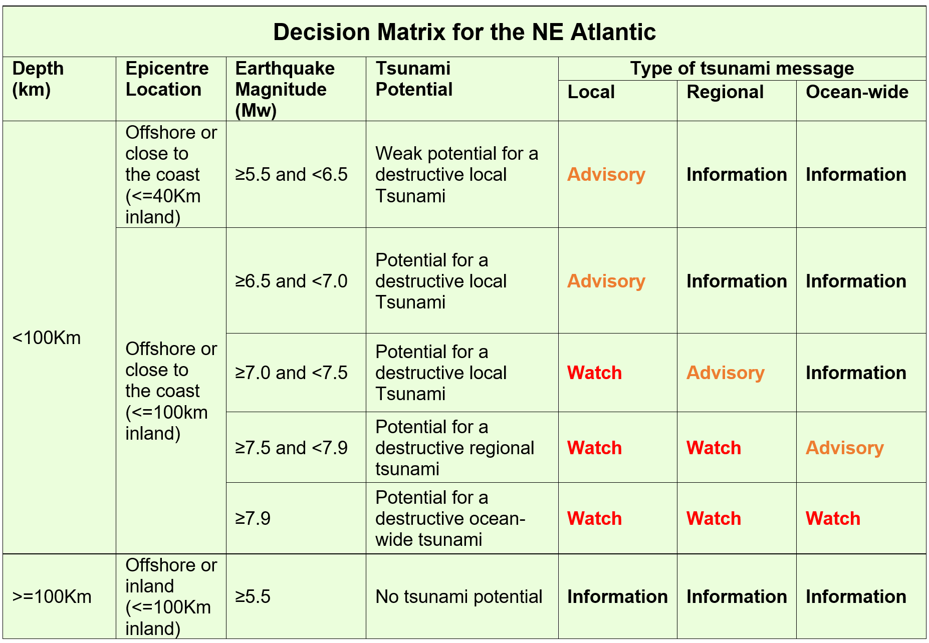
Decision Matrix

Slide 11
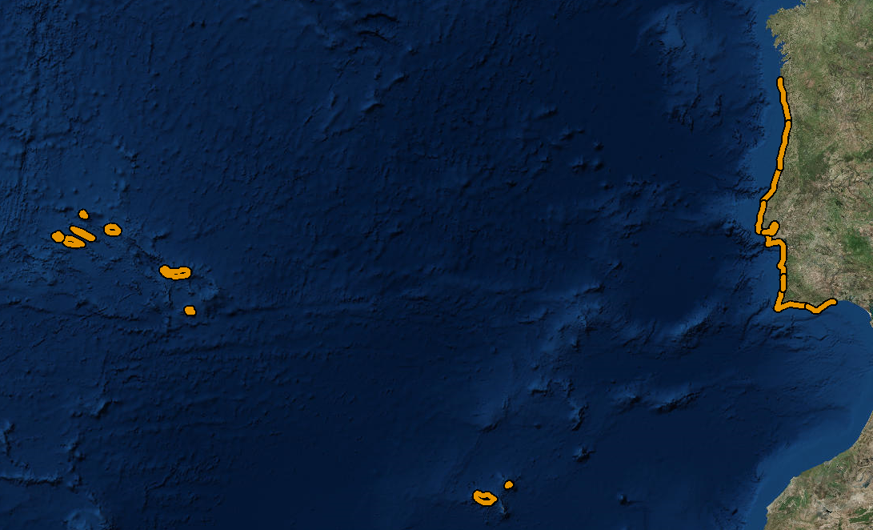
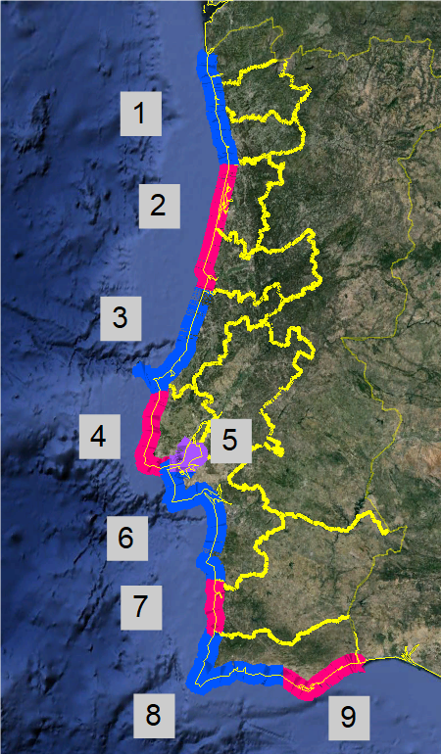
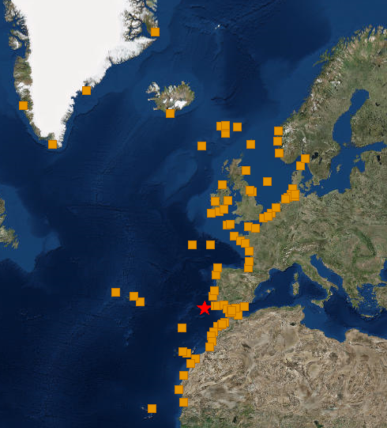
Forecast coastal segments (national)
Forecast points (regional)
Regional NEAM level
Islands
10-11. Madeira & Porto Santo
12-20. Azores islands
Mainland
1. Viana-Braga-Porto
2. Aveiro-Coimbra
3. Leiria
4. Lisboa Atlântico
5. Estuário Tejo
6. Setúbal
7. Beja
8. Faro Barlavento
9. Faro Sotavento
National level

Slide 12
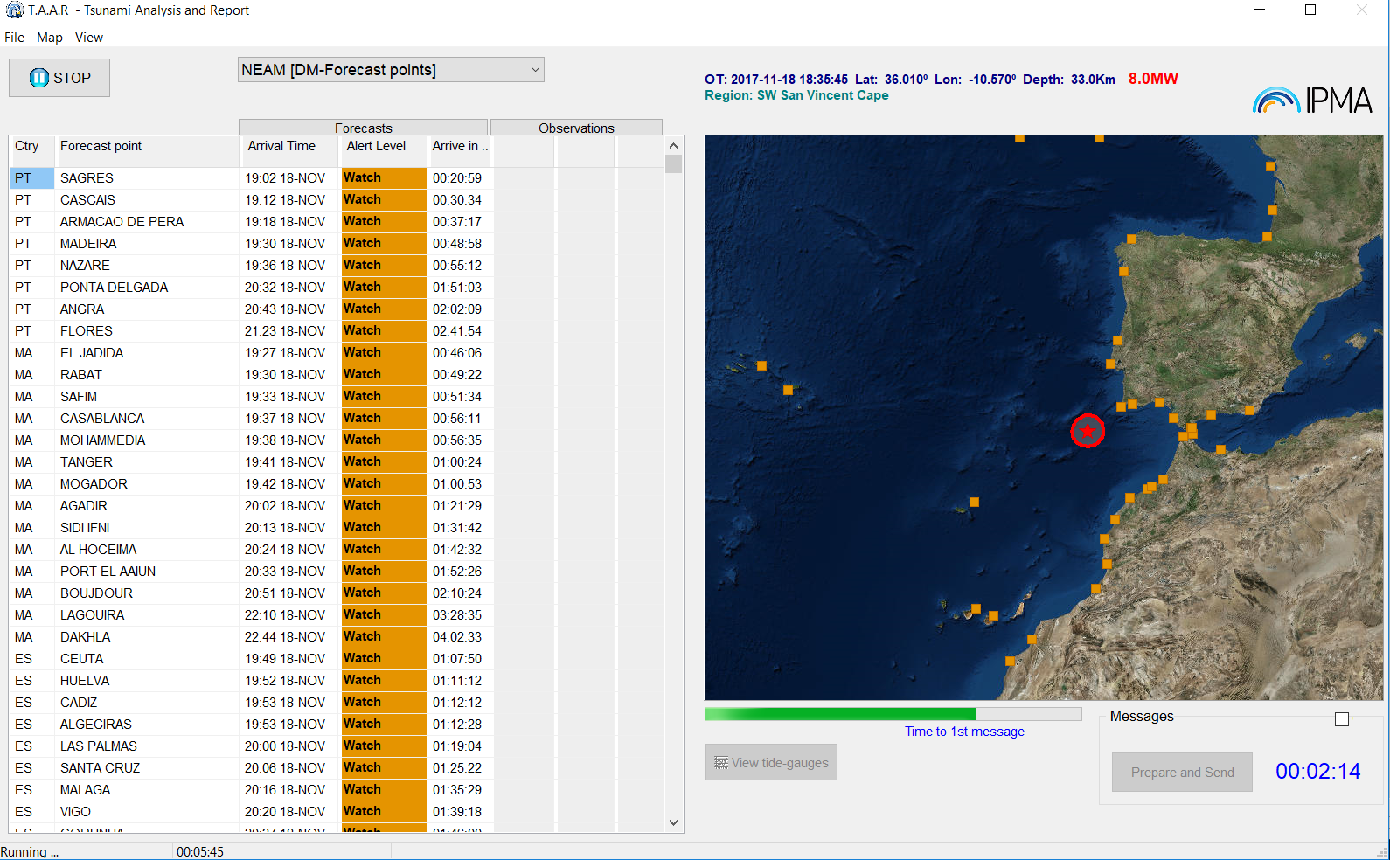
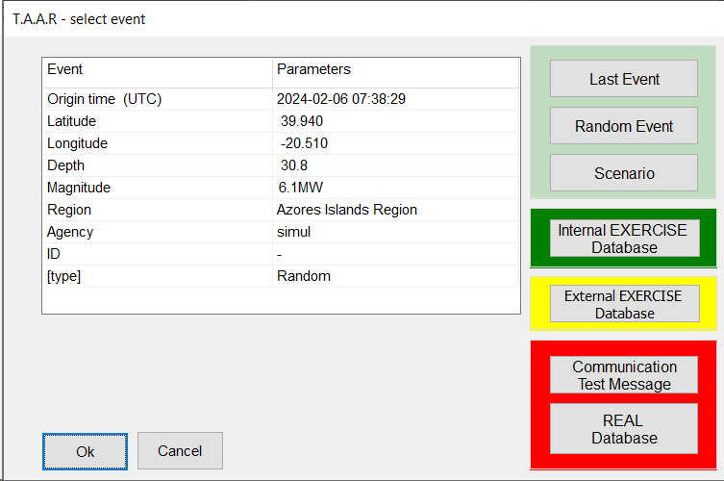
TAAR – Tsunami Analysis And Report
Testing purposes
(include random full scenarios)
Internal Exercise Mode
Exercise Mode
(Neamwave21, others)
Real events and
Communication tests

Slide 13
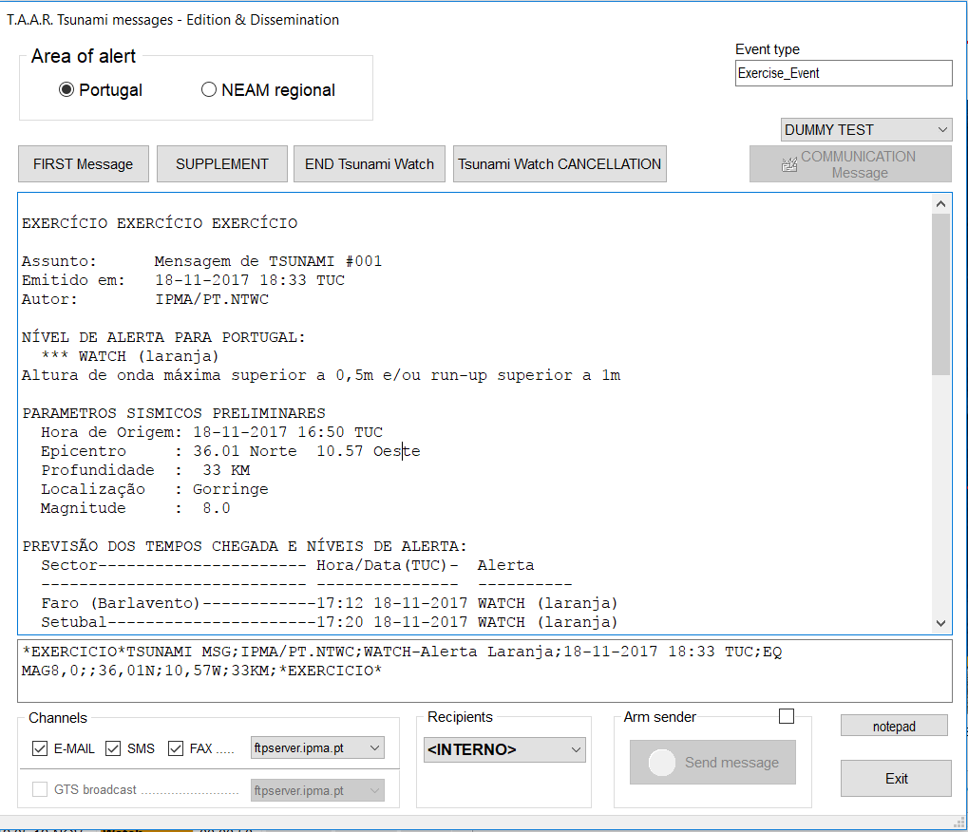
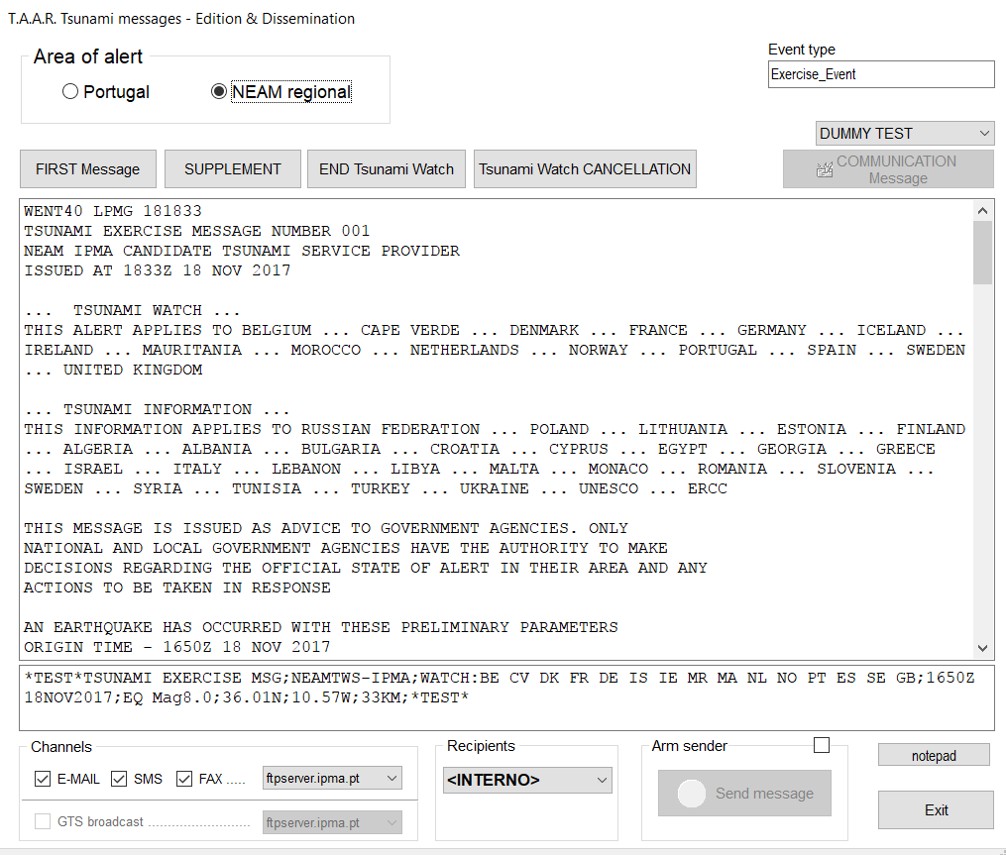
TAAR – Tsunami Analysis And Report
EMAIL
FAX
GTS
EMAIL
FAX
SMS
SMS

Slide 14
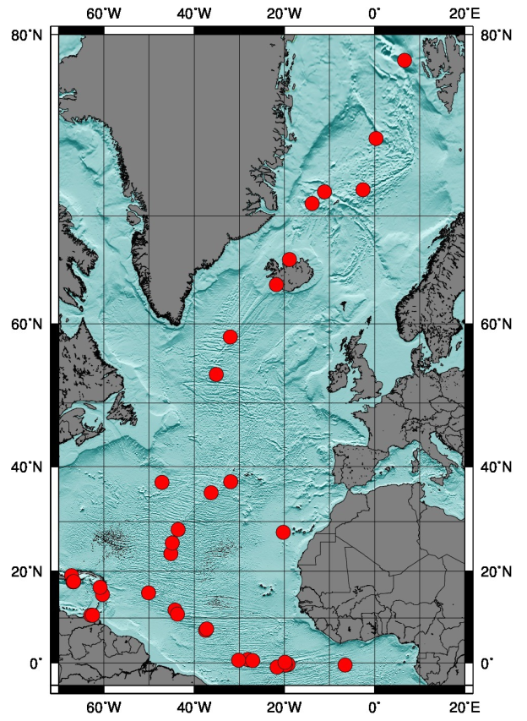
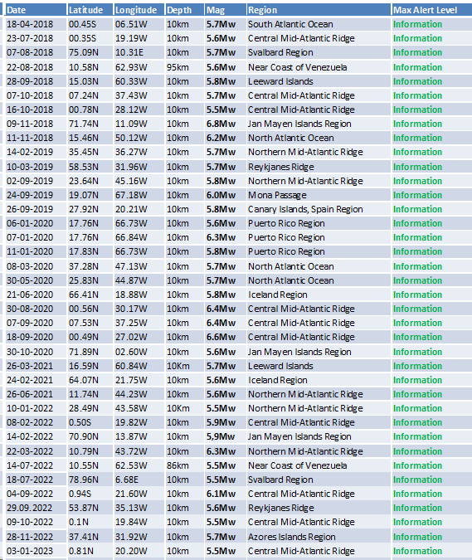
Regional level – TSP for NE Atlantic
38 Tsunami messages issued:
38 events

Slide 15
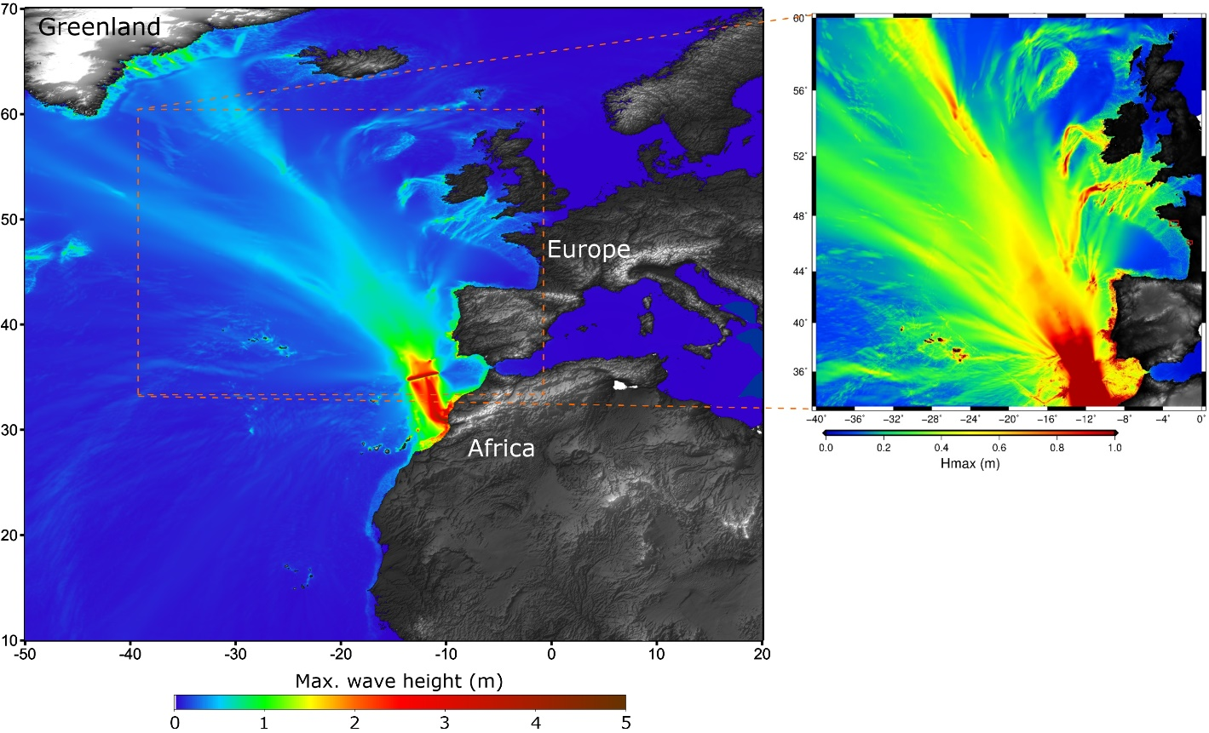
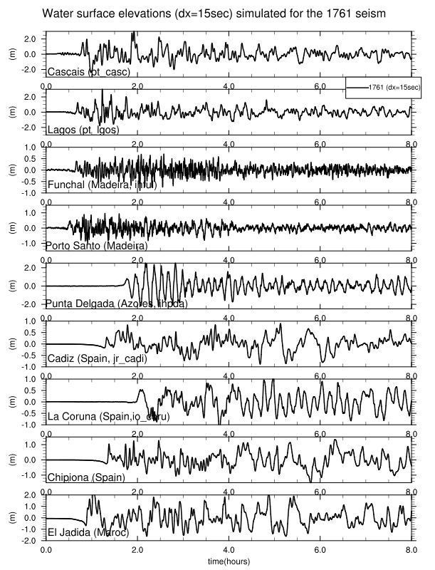
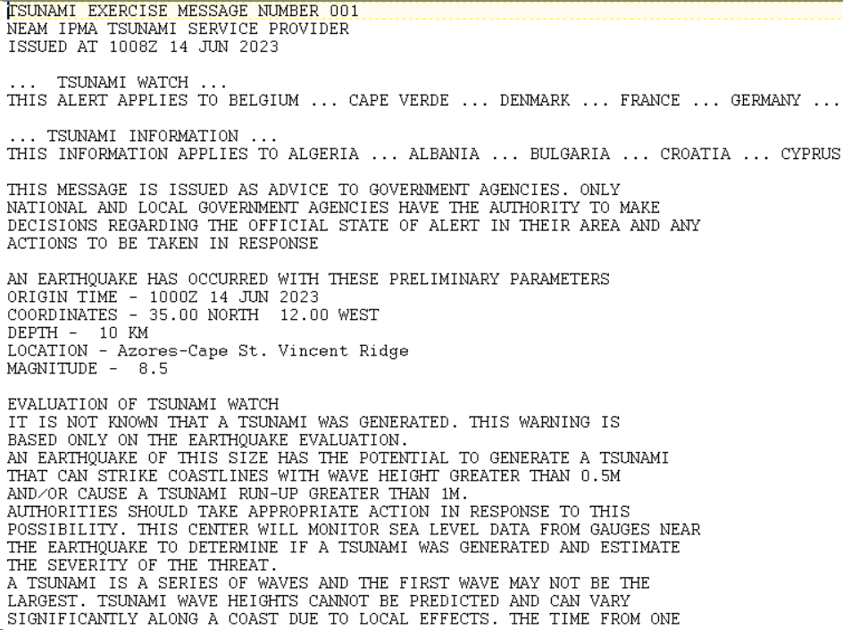
NEAMWave2023
based on the 1761 event, Mw8.5
Joint Scenario between IPMA and CENALT

Slide 16
NEAMWave2023
IPMA
DGAM,
MRCC
CNEPC
(national)
CREPC
(regional)
CSREPC
(sub-regional)
SMPC’s
Lisbon
Setúbal
Portimão
Internal units
Other entities
(infrastructure networks)
SMPC’s
and
Fire Departments

Slide 17
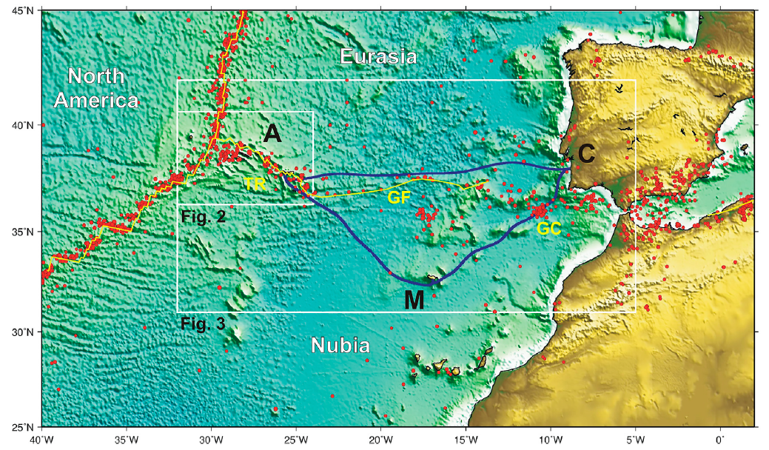


Atlantic SMART CAM
New Submarine Cable Ring connecting PT Mainland-Azores-Madeira –
opportunity for a SMART system (SMART CAM)

Slide 18
SMART CAM timeline
1. July 2017. Due to the expected end of life for 2024 (with a Ring configuration) of the actual CAM Ring, ANACOM called attention to the sector that timely preparations would need to be made for the replacement of the current CAM Ring (critical infrastructure that assures domestic traffic between Portugal mainland and Azores and Madeira Islands).
2025
14
2024
2023
13
2022
9
12
10
11
2021
7
8
2020
6
2019
4
5
3
2018
2
1

Slide 19
SMART CAM timeline
7. July 2021. IPTelecom delivered to the Government a proposal of business case and a list of specifications of the new CAM Ring as a SMART Cable (“SMART CAM” to facilitate).
LEA dialoged with telecom Sub. Cable suppliers, Sensor suppliers as well as telecom operators.
2025
14
2024
2023
13
2022
9
12
10
11
2021
7
8
2020
6
2019
4
5
LEA investigated the advantages of the New CAM Ring for environment, tsunami and seismic detection.
LEA delivered to IP Telecom a full packet of SMART specs. for the New CAM Ring.
3
2018
2
1

Slide 20
SMART CAM timeline
12. December 2022. IP launches the SMART Atlantic CAM RfT.
Next steps:
13. Since 3rd quarter of 2023. Pending Signature of contract.
14. 2025/2026. SMART Atlantic CAM will be operational.
2025
14
2024
2023
13
2022
9
12
10
11
2021
7
8
2020
6
2019
5
~154 M€ (Telecom + Observer)
20 repeaters instrumented (accelerometer, BB seismometer, APG and thermometer)
3
4
2018
2
1

Slide 21

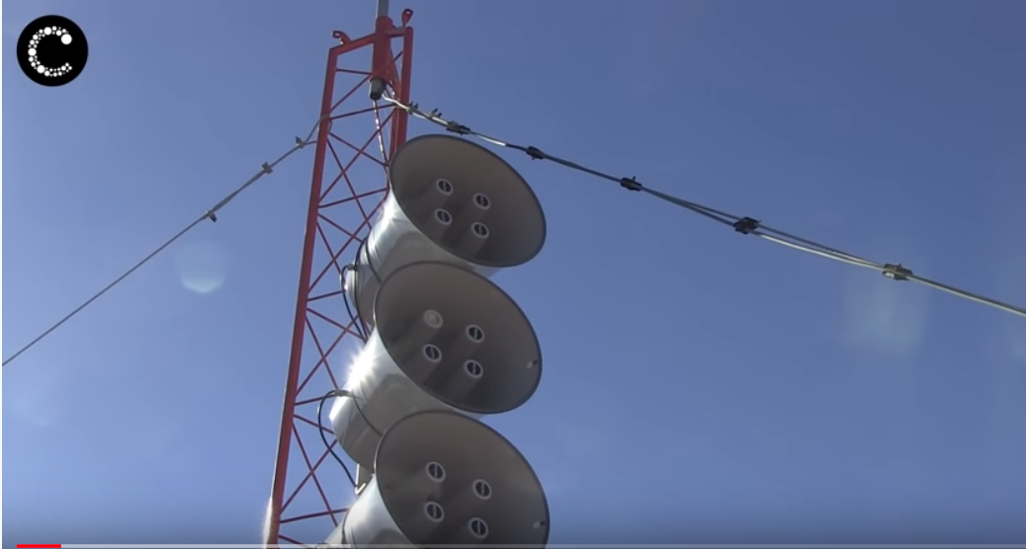
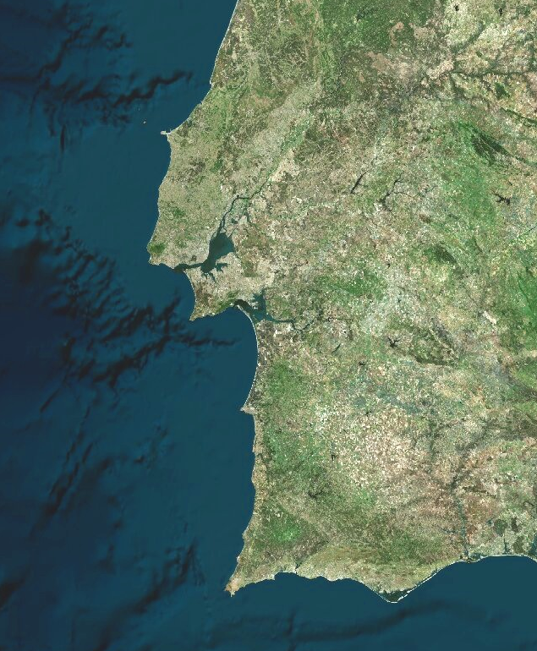

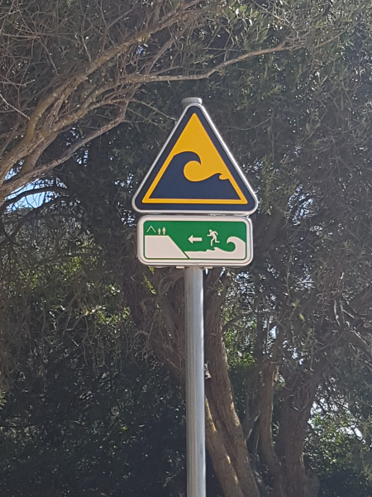
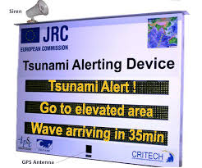
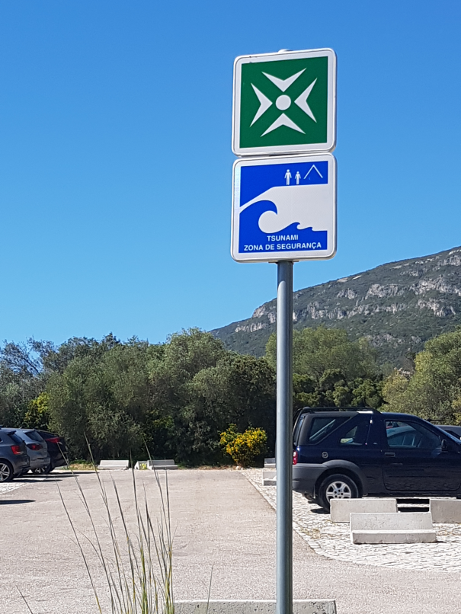

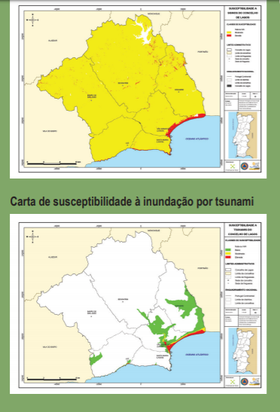

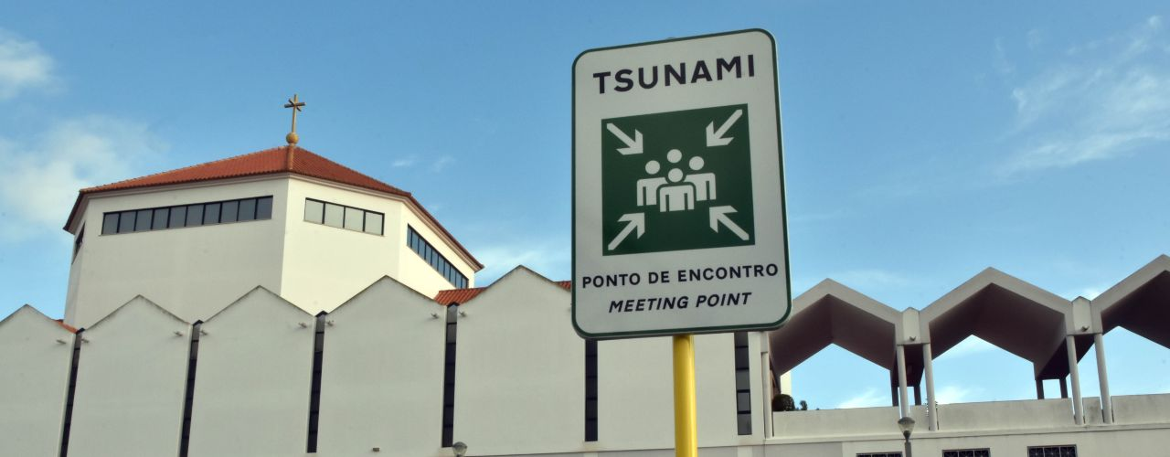

“Tsunami Ready” Initiatives
(Lourinhã)
Lisbon
Cascais
(Sesimbra)
Setúbal
Lagos
Portimão
Loulé

Slide 22
Thank you for your attention

