Slide 1
Emergency Warning Satellite Service
Eric Guyader, European Commission, Galileo and EGNOS programme
Eric.Guyader@ec.europa.eu
UNESCO, IOC/ICG/NEAMTWS XVIII Session • Paris, 6-8 February 2024

Slide 2
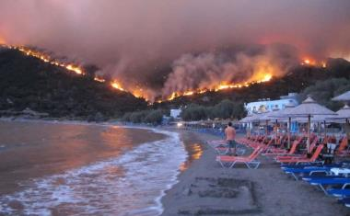
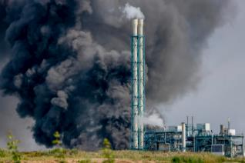
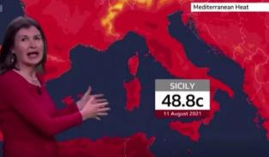
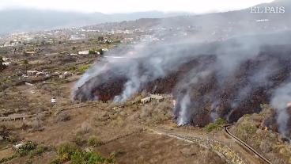

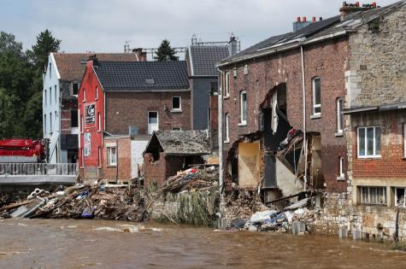
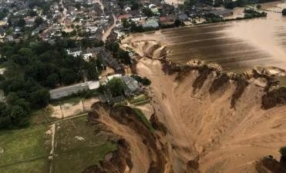
HAZARDS

Slide 3
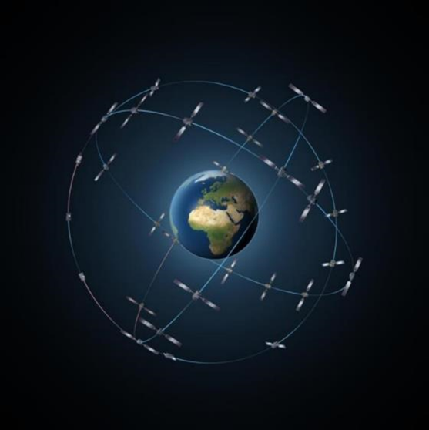
GALILEO
‒ 28 satellites in orbit
‒ Remarkable performance
‒ Operational services, or in roll-out phase
‒ Strong link with users, market and industry
‒ Modernization on-going

Slide 4
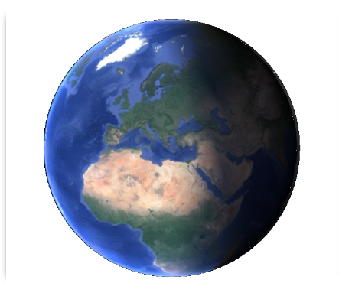
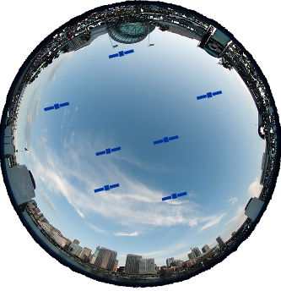
PERSPECTIVES
Satellite visibility from ground
Visibility from 1 satellite

Slide 5
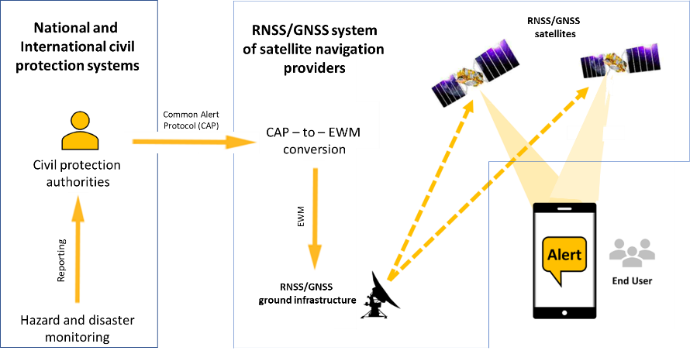
SERVICE CONCEPT

Slide 6

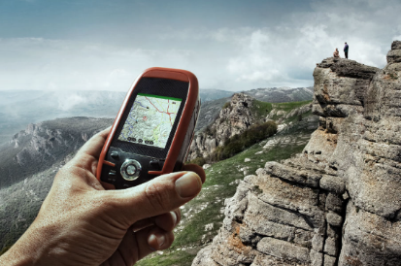

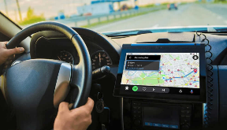
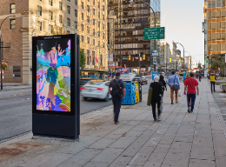
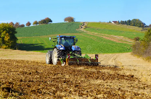

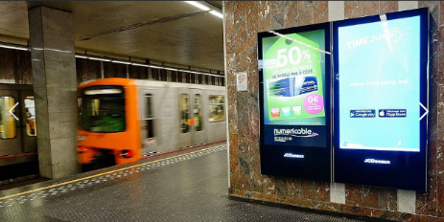
TARGET AUDIENCE

Slide 7
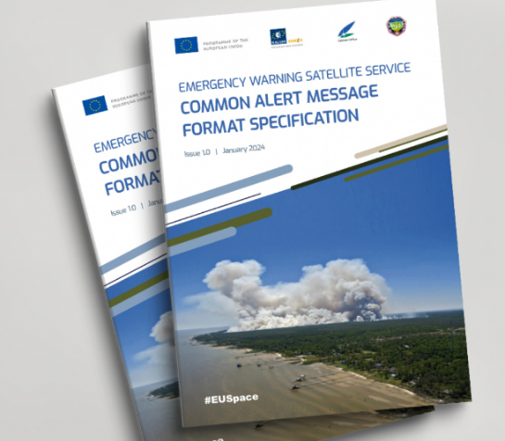
COMMON ALERT MESSAGE FORMAT
‒ The “dictionary” of EWSS
‒ Co-authored by European Commission and Japan Cabinet Office
‒ Used to code alert in GNSS signals
‒ Useful for national authorities, manufacturers and GNSS Provider
‒ Published on 24 January 2024
‒ All text libraries of the alert message translated in 24 languages
gsc-europa.eu/sites/default/files/sites/all/files/EWSS-CAMF_v1.0.pdf

Slide 8
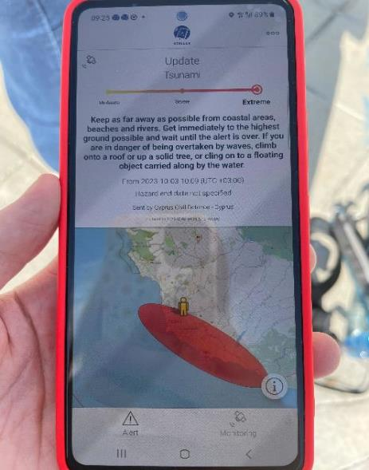
WARNING CONCEPT
Type of alert
Type of hazard
Severity of hazard
Instruction
Chronology of hazard
Originator of alert
Alert area (ellipse)
YOUR POSITION

Slide 9
STATE OF PLAY AND NEXT STEPS
In-field demonstration campaign concluded
  4 sites: FR, DE, CY, BE/LU
  Different scenarios each time: industrial incident, tsunami + forest fire, floods, cross-border situation
  Civil protection authorities from 16 EU MS represented
  Final workshop 10-11 April 2024
Declaration initial service: 2025
  Service concept mature, industrial contracts on-going for implementation
  Service provision scheme under definition (terms and conditions of use)
Adoption by EU MS civil protection services
  Connection to Galileo, observation phase, integration in national PWS
Adoption by end users
  Marketing, standards, EU grants
  Dialogue with receiver and device manufacturers

Slide 10
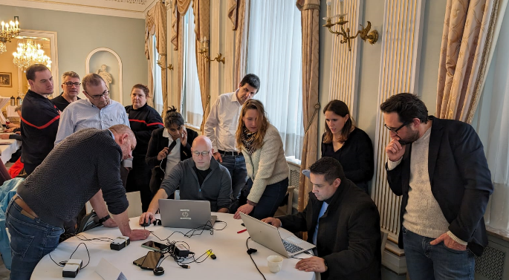
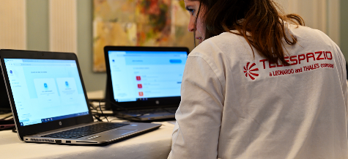
ALERT GENERATION
© 2024 European Commission , credit Cl M Cauwe

Slide 11
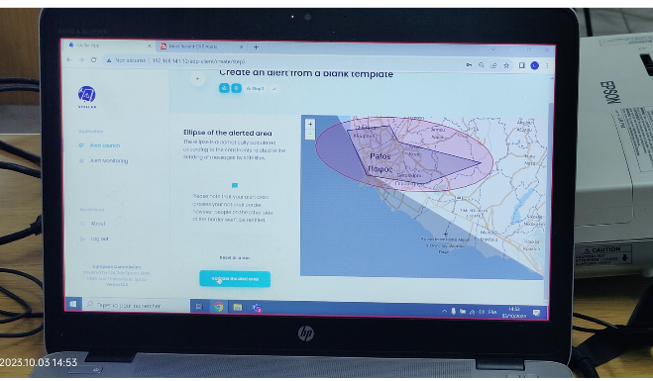
GEOGRAPHICAL ALERT AREA

Slide 12
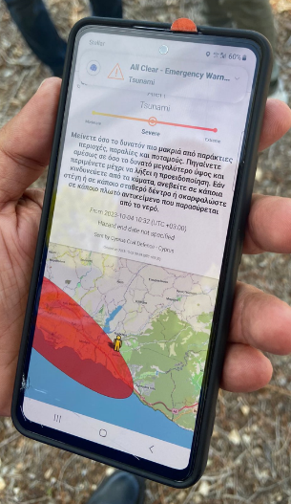
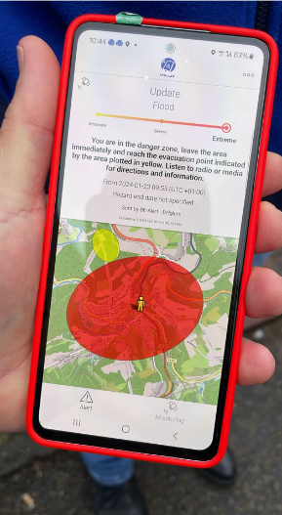
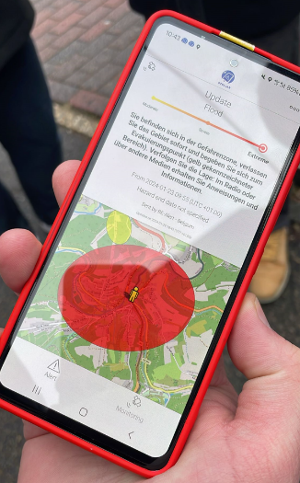
EXAMPLES OF WARNINGS 1
Automatic language selection, based on device’s language setting

Slide 13
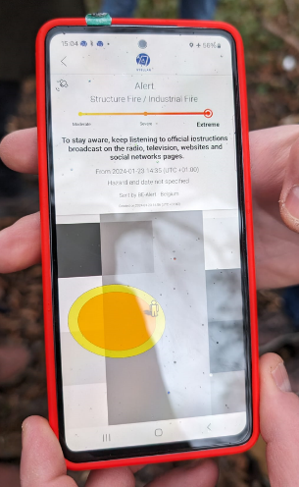
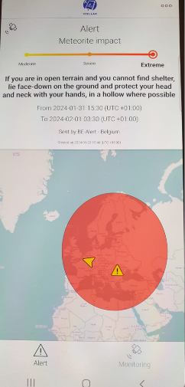
EXAMPLES OF WARNINGS 2
No network connection
Largest ellipse size

Slide 14
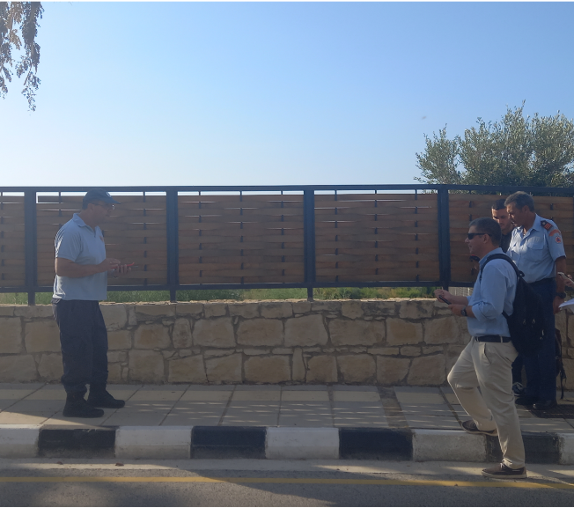
GEOFENCING
IN
Notified
OUT
Not notified
Limit of alert area

Slide 15
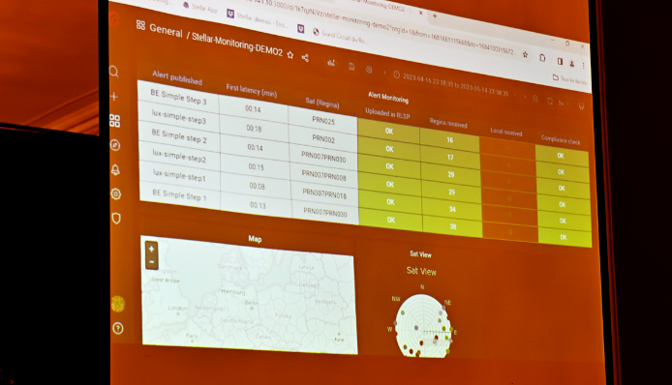
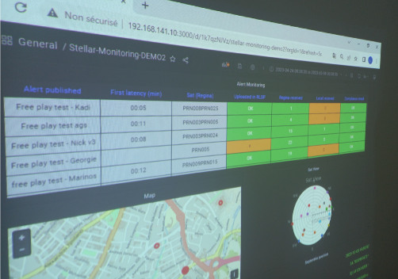
TIME TO DISSEMINATE
© 2024 European Commission , credit Cl M Cauwe

Slide 16
THANK YOU
http://ec.europa.eu/galileo

