Slide 1



4th Meeting of Scientific Committee for the UN Ocean Decade Tsunami Programme (ODTP-SC)
25-26 January 2024, Paris, France
Ocean Decade Endorsed Actions Related to Challenge 6 and the Ocean Decade Tsunami Programme (ODTP)
Denis Chang Seng, PhD
Programme Specialist
ICG/NEAMTWS Technical Secretary
IOC-UNESCO

Slide 2
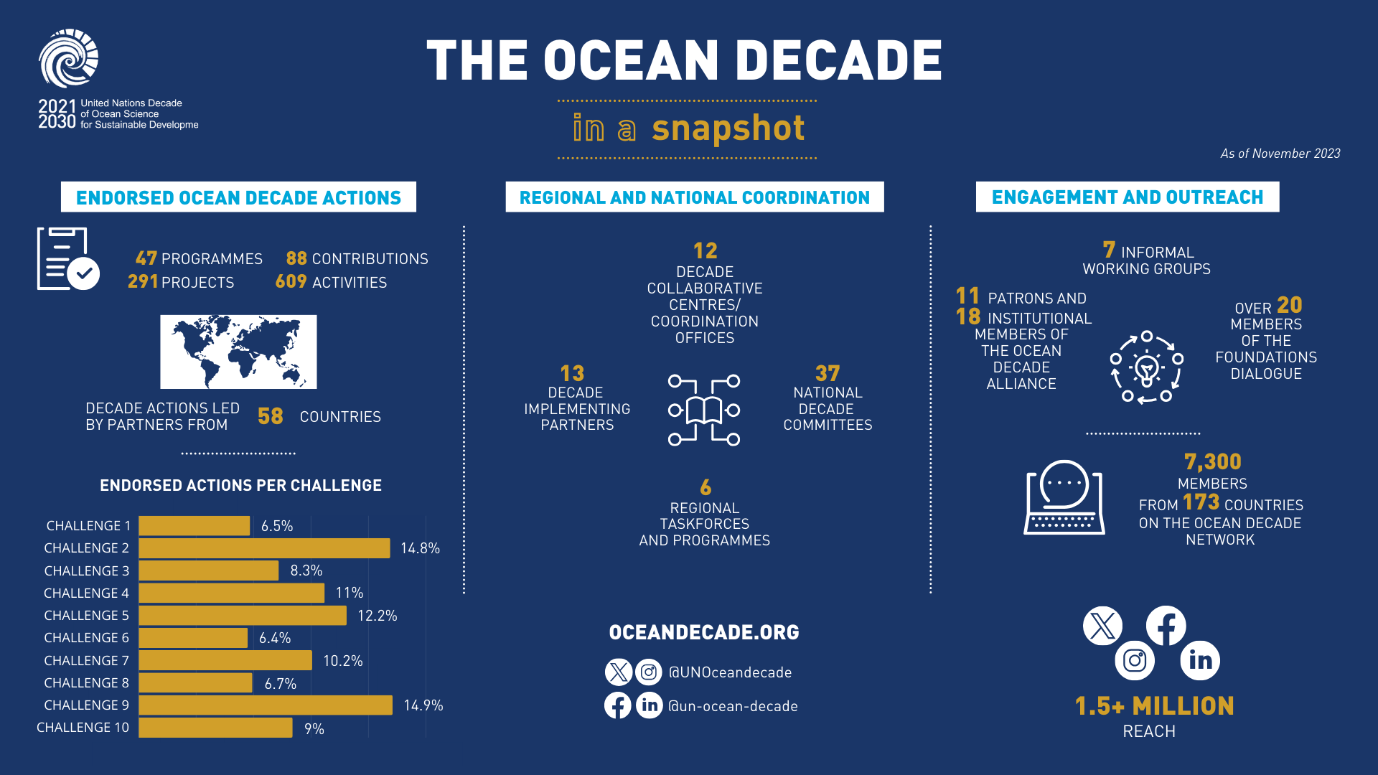

Snapshot November 2023
NOVEMBER 2023

Slide 3

Endorsed Decade Actions
Overview of Agenda
48 Programmes | 294 Projects | 89 Contributions
Lead institutions in 58 countries => low leadership from SIDS and LDCs
Five Calls for Decade Actions completed
Call for Decade Actions 06/2023 currently open with focus on co-design ideas from Africa and Caribbean SIDS

Slide 4
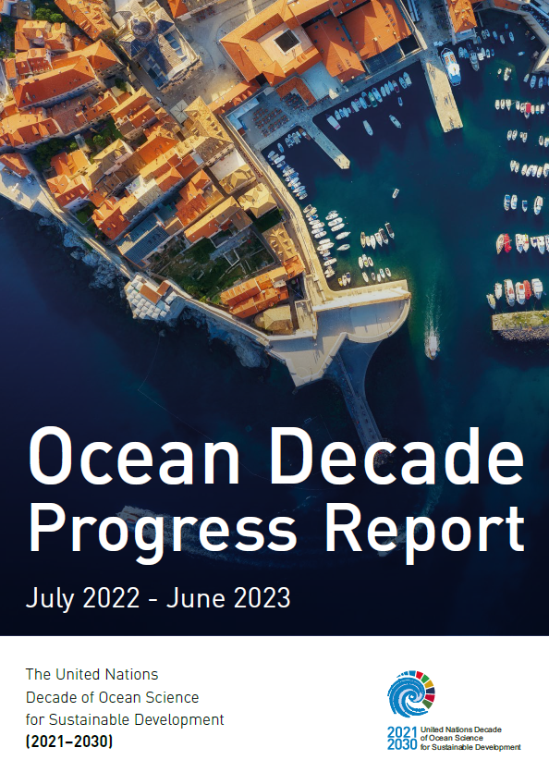
Key Statistics from Ocean Decade Progress Report
July 2022 – June 2023
Decade Action leads:
39% North America
30% Europe
14% Asia-Pacific
4% Africa
3% SIDS

Slide 5
Ocean Decade Endorsed Actions Related to
Costal Resilience Challenge 6 and ODTP
Programme (1) : UN 31 The Ocean Decade Tsunami Programme (Bernardo Aliaga, IOC, All basins)
Project (1): 201 Tsunami Potential Coastal Area of Indonesia Mountain Anak krakatau, Banten, Sunda Straint, Indonesia (Sugeng Pribadi, BMKG, Indonesia, Indian Ocean)
Project (2): 138.2 Integrating Coastal Hazard Warning Systems for TAC (Christa G. Von Hillebrandt-Andrade,IOC CARIB, North Atlantic Ocean/ Caribbean Sea)
Project (3)UN27 CoastWAVE-Strengthening the Resilience of Coastal Communities in the Northeast Atlantic, Mediterranean Region to the Impact of Tsunamis and Other Sea Level-Related Coastal Hazards (Denis Chang Seng, IOC, NEAM)
Project (4) : 10.4 Global Real-time Early Alarm for Tsunami (GREAT) (Usama Kadri, Cardiff University, All basins)
Project (5) :44.4 Sea Level Station Monitoring Facility (Francisco Hernandez, Belgium, All basins)
Project (6): Tsunami & Climatic Risk Reduction at Protected Areas in Costa Rica (Silvia Chacon-Barrantes, National University of Costa Rica, North Pacific / CARIB Sea)
Contribution (1) :Decade Collaborative Centre for Coastal Resilience (Nadia Pinardi, University of Bologna, N/A)
Contribution (2) : 143.2 Open Access to GTS Project (Open-GTS Project) (Kevin Kevin O'Brien, NOAA Pacific Env Lab, USA, Most basins, except NEAM)
Contribution (3) : US Tsunami Contributions to IOC Tsunami PT1 (Mike Angove, NOAA, Most basins)
Contribution (4) : US Tsunami Contributions to IOC Tsunami PT2 (Laura Kong, NOAA, Most ocean, except NEAM)
Contribution (5) : Capacity Building (National Institute of Oceanography and Fisheries (NIOF), NEAM and Red Sea)
Tsunami Resilience Section, 2024

Slide 6
Costal Resilience Challenge 6 and other Challenges with Links to ODTP: 11
Programme: 1 (ODTP)
Projects: 6
Contributions: 5
Mix Challenges (1, 3, 5, 7, 8, 9,10)
  Challenge 1: Understand and beat marine pollution
  Challenge 3: Sustainably feed the global population
  Challenge 5: Unlock ocean-based solutions to climate change
  Challenge 6: Coastal Resilience
  Challenge 7: Ocean Observations
  Challenge 8: Digital Representation of the Ocean
  Challenge 9: Capacity Development
  Challenge 10: Behaviour Change
Tsunami Resilience Section, 2024

Slide 7
Endorsed Decade Actions
Overview of Agenda
48 Programmes | 294 Projects | 89 Contributions
Tsunami Resilience Section, 2024

Slide 8
  All Basin Actions : 5
  Specfic Basin Actions: Only 2 (NEAM, Indian Ocean)
  Connected Basins Actions: 4 (North Atlantic, Caribbean, North Pacific , North Med and Red Sea)
Tsunami Resilience Section, 2024

Slide 9
Endorsed Actions Across TEWS Elements
Tsunami Resilience Section, 2024

