Slide 1
IOC DG ECHO CoastWAVE Project
Key Achievements Challenges and Opportunities on the Implementation of CoastWAVE Project and Tsunami Ready Programme In NEAM Region
CoastWAVE Project
Progress on Component 1
Risk Perception and Tsunami Ready
5th February 20224
Denis Chang Seng, PhD
Programme Specialist
ICG/NEAMTWS Technical Secretary
CoastWAVE Project Responsible Officer
Tsunami Resilience Section
Global Ocean Observing System
IOC UNESCO

Slide 2




IOC UNESCO EU DG ECHO CoastWAVE Project
Sep 2021-June 2024
Strengthening the Resilience of Coastal Communities in the North East Atlantic, Mediterranean Region to the Impact of Tsunamis and Other Sea Level-Related Coastal Hazards
ENDORSED UN OCEAN DECADE PROJECT

Slide 3
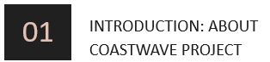

IOC-UNESCO EU DG-ECHO
CoastWAVE PROJECT
Tsunami Ready Recognized Communities
Alerting Systems
Detection & Monitoring Systems
Risk Perception & Communication
Objectives:
Adopt Global Tsunami Ready Standards and Guidelines and pilot Tsunami Ready at 7 communities in 7 countries within ICG/NEAMTWS.
Supply and install tsunami detection and alerting equipment in selected NEAMTWS countries
Evaluate the effectiveness, compatibility, performance, and benefits of the “Inexpensive Device for Sea Level” (IDSL) network in NEAMTWS countries
At the end of the project selected communities will have:
Improved understanding of tsunami and sea-level related risks;
Better communication strategies to govern sea-level related risk,
Recognized Tsunami Ready communities (7);
An improved framework for the sustainability of the existing Inexpensive Device for Sea Level (IDSL) Network.

Slide 4
Project Components
Component 1: Adapt Global Tsunami Ready Standards and Guidelines and pilot Tsunami Ready within the framework of the NEAMTWS.
1
Component 2: Supply and install tsunami detection and alerting equipment in selected NEAMTWS countries
2
Component 3:Evaluate the effectiveness, compatibility, performance and benefits of the "Inexpensive Device for Sea Level" (IDSL) network in NEAMTWS countries and secure its sustainability.
3

Slide 5
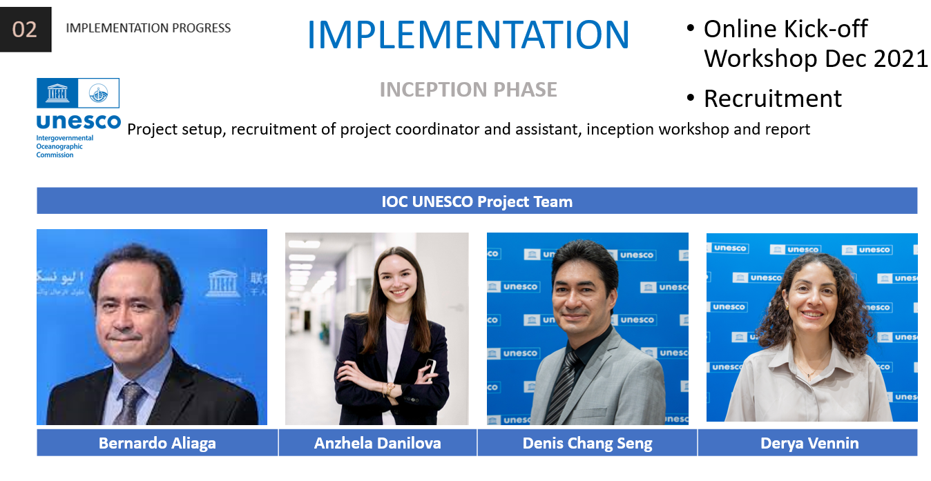
INCEPTION PHASE
Project setup, recruitment of project coordinator and assistant, inception workshop

Slide 6
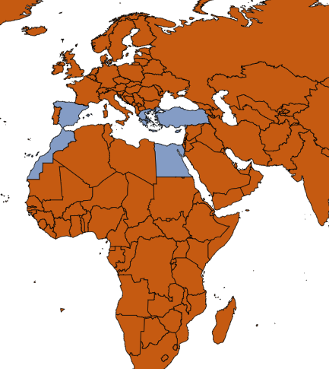
Project Countries:
Malta
Cyprus
Greece
Turkiye
Egypt
Morocco
Spain

Slide 7








The 8
Project Partners
KHALID EL KHALIDI
DIDEM CAMBAZ
AMR HAMOUDA
KHALID EL KHALIDI
COORDINATOR-
UCD
PARTNER-UCD
PARTNER-KOERI
PARTNER-NIOF
NIKOS KALLIGERIS
AHMET YALCINER
IGNACIO AYERBE
PAULINE GALEA
SYLVANA PILIDOU
PARTNER-NOA
PARTNER-METU
PARTNER-IHCANTABRIA
PARTNER-
UM
PARTNER-
GSD

Slide 8
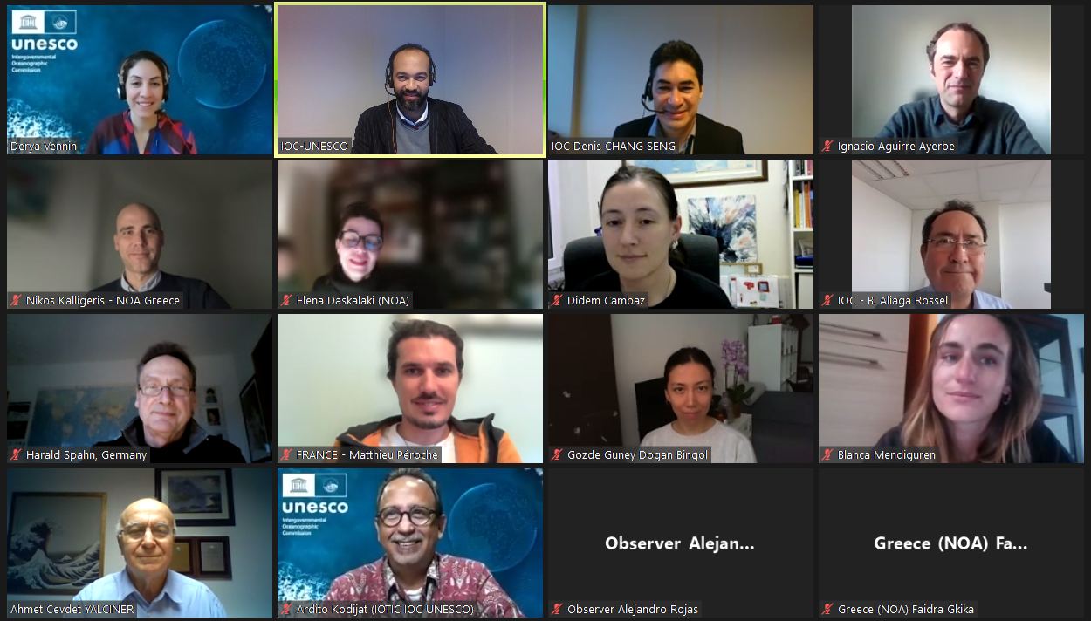
COMPONENT 1 (Risk Perception and Tsunami Ready)
9 Project Activities
Activity
Activity 1 Online survey to assess needs and requirements and in-country support for Tsunami Ready programme Activity 2 Regional workshop of national stakeholders, including CPD representatives | The organization of the kick-off workshop in December 2021 and a Tsunami Ready online workshop in February 2023 for project countries led to the completion of activity 1 and 2
Activity 3 Drafting and publication of NEAMTWS Tsunami Ready Guidelines | IOC-UNESCO publication of Manual and Guide MG 74 titled "Standard Guidelines for the Tsunami Ready Recognition Programme." | M & G 74 will be officially adopted by Member States during the IOC-UNESCO ICG/NEAMTWS XVIII Session, Paris, France, 6-8 February 2024

Slide 9
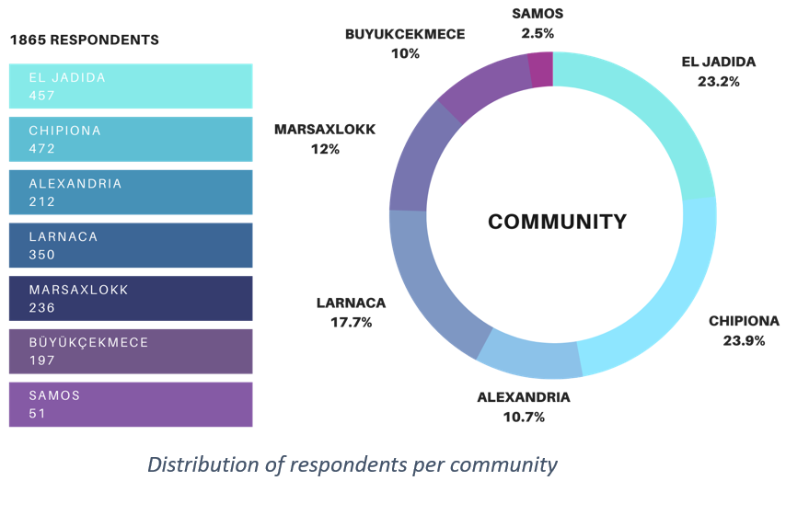
Activity
Activity 4 Develop concept note, identify target communities design survey protocol, socialise survey in target communities | IOC Prepared literature review and concept note Consultative online meetings Reviewed survey questions Identified survey communities (TR) Identified survey target groups, and methods of distribution of the questionnaire. Adapted survey questions according to local needs, Translated survey into four official languages (French, Spanish, Arabic and Greek)
Activity 5 Conduct the survey, Focus Group Discussions and other data collection activities and analyse the results | Project countries conducted survey and analyzed results | 1865 people participated
Activity 6 Prepare report, translate into Arabic and circulate to partner agencies, target communities and ICG/NEAMTWS WG4 | National Reports prepared Synthesis Report under review | IOC Technical Series and a Brochure

Slide 10
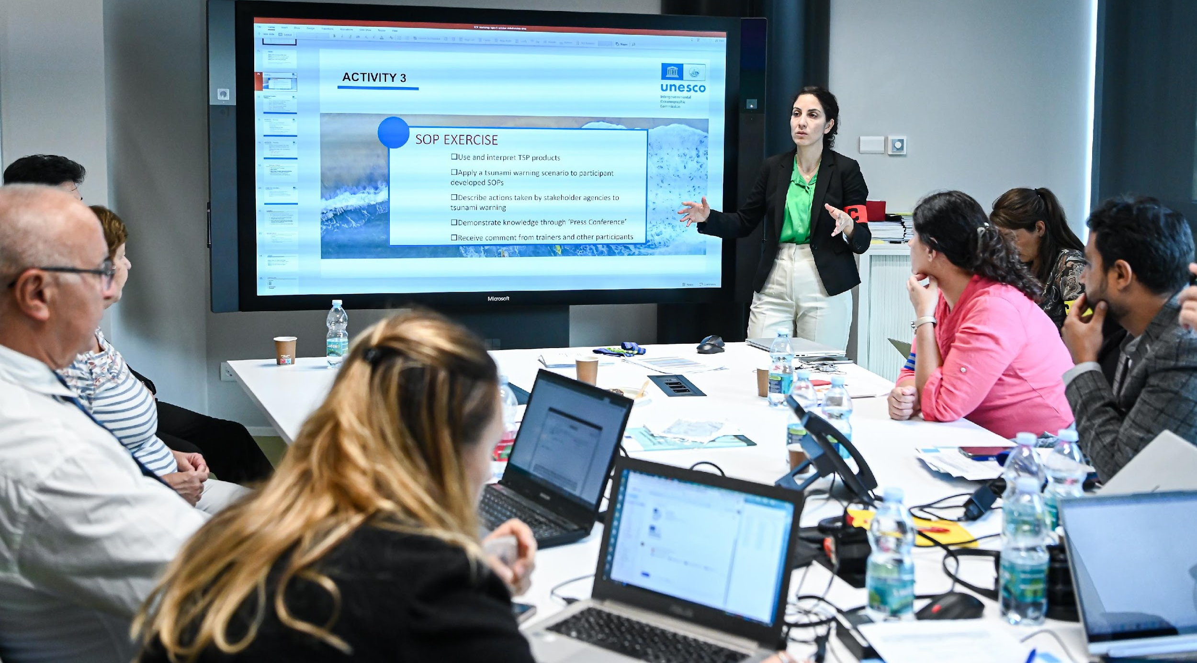
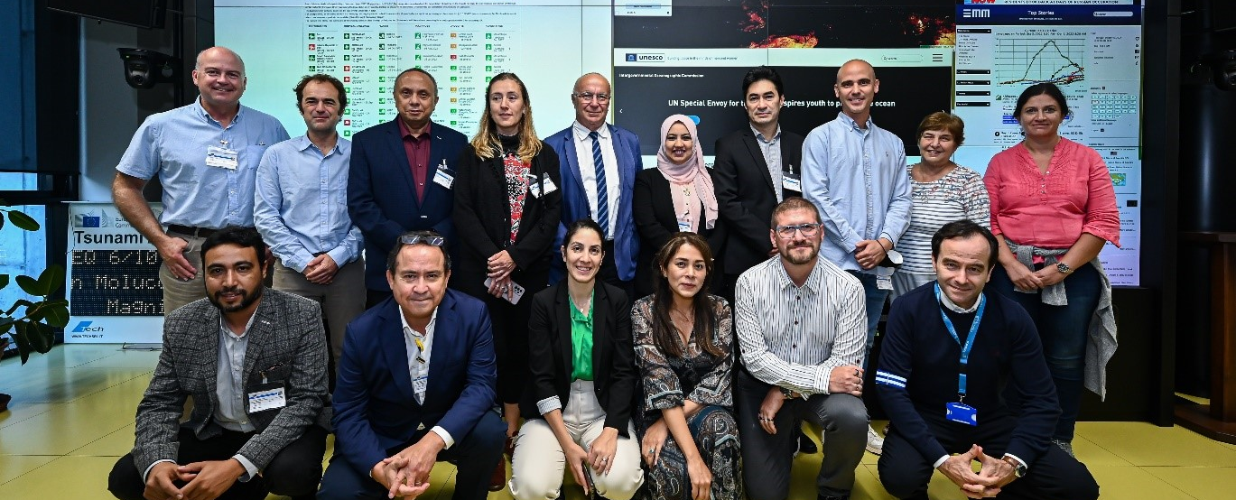
Activity 7 National to community level tsunami awareness and Standard Operating Procedures workshop in Cyprus, Egypt, Greece, Malta, Morocco, Spain and Turkey | First regional training workshop in NEAM region on SOP co-organized by IOC UNESCO and JRC in Ispra, Italy, October 2022
 | National workshops also conducted in project countries

Slide 11
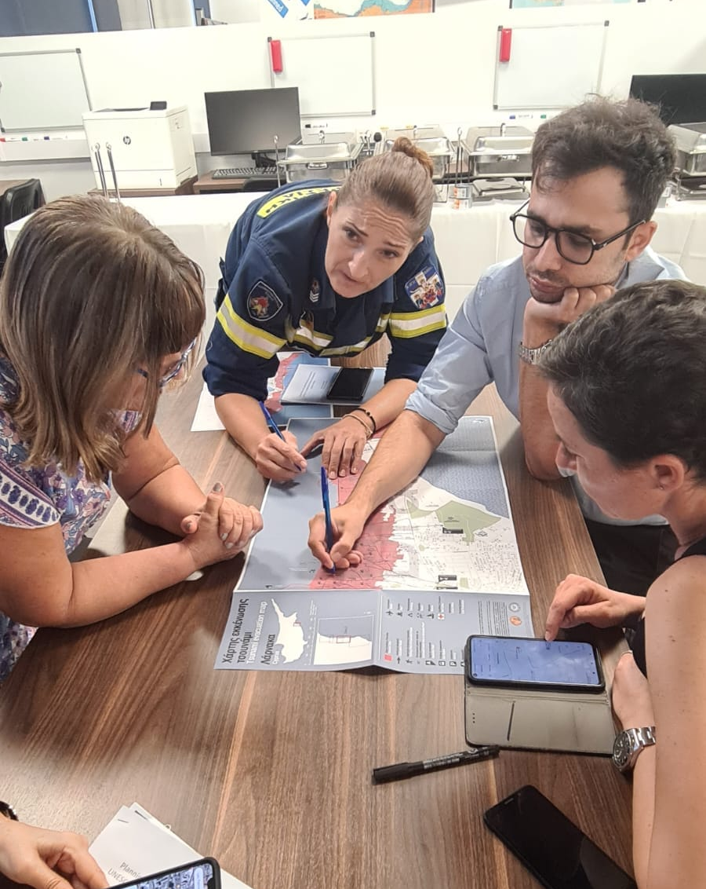
Training and workshops
Activity 8
Inundation maps and evacuation route maps for Tsunami Ready pilot sites in Cyprus, Egypt, Malta, Morocco and Spain
National workshops on tsunami hazard and evacuation mapping ( e,g Stakeholders in Larnaka Town Gathered to Decide on the State-of-the-Art (PTHA) Mapping Tools for Tsunami Evacuation)

Slide 12

Activity 9
Implementation of Tsunami Ready
I | ASSESSMENT (ASSESS) | Progress
1 | ASSESS-1. Tsunami hazard zones are mapped and designated | Yes
2 | ASSESS-2. The number of people at risk in the tsunami hazard zone is estimated | Yes
3 | ASSESS-3. Economic, infrastructural, political, and social resources are identified | Yes
II | PREPAREDNESS (PREP)
4 | PREP‑1. Easily understood tsunami evacuation maps are approved | Ongoing
5 | PREP‑2. Tsunami information is publicly displayed | Ongoing
6 | PREP‑3. Outreach and public awareness and education resources are available and distributed | Yes
7 | PREP‑4. Outreach or educational activities are held at least three times a year | Ongoing
8 | PREP‑5: A community tsunami exercise is conducted at least every two year | Yes
III | RESPONSE (RESP)
9 | RESP-1. A community tsunami emergency response plan (ERP) is approved | Ongoing
10 | RESP-2. The capacity to manage emergency response operations during a tsunami is in place | Ongoing
11 | RESP-3. Redundant and reliable means to timely receive 24-hour official tsunami alerts are in place | Yes, improving
12 | RESP-4. Redundant and reliable means to timely disseminate 24-hour official tsunami alerts to the public are in place | Developing
All PROJECT countries have completed at least 10 of the 12 TR Indicators
5 project countries out of 7 have already established NTRB
All project countries have developed tsunami education materials and raised awareness on tsunami
All project countries participated in NEAMWave23 Exercise

Slide 13
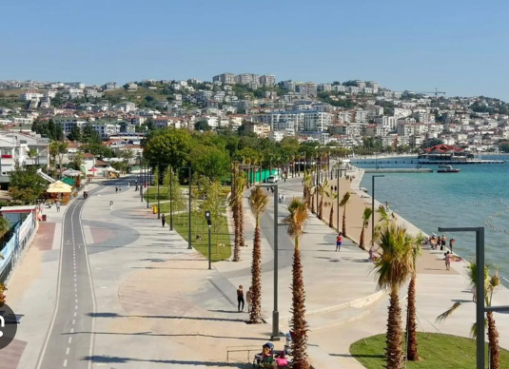
New Development
Secretariat has received the first CoastWAVE project Tsunami Ready Recognition application for Büyükçekmece Pilot District, Istanbul , Türkiye. [3 Feb 2024]

Slide 14
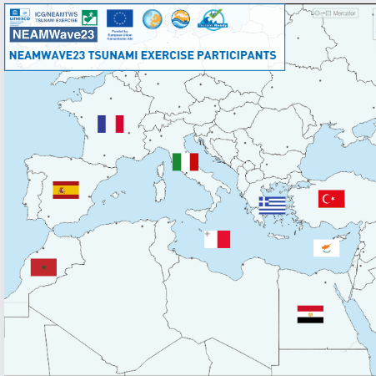
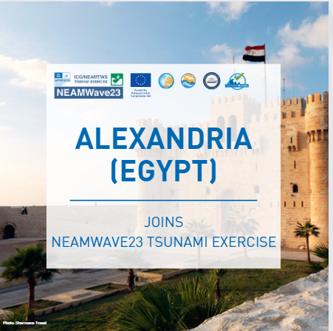
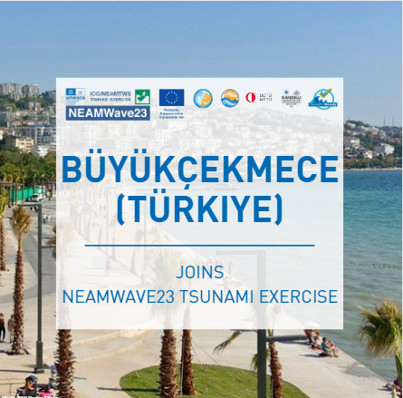
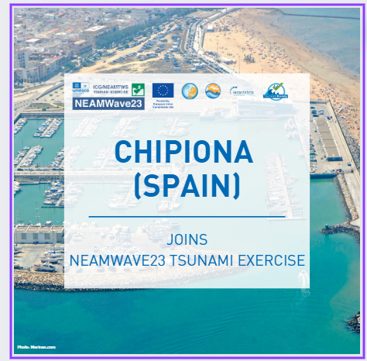
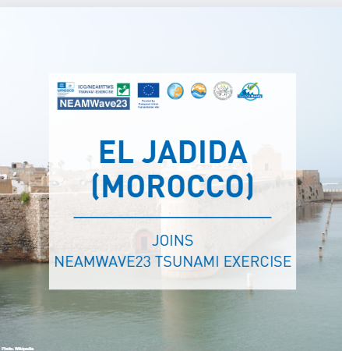
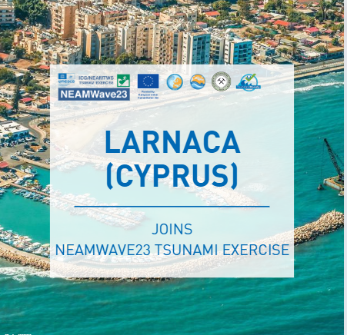
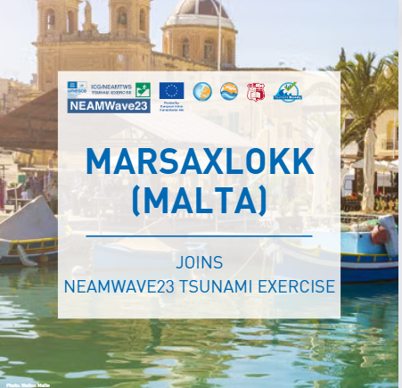
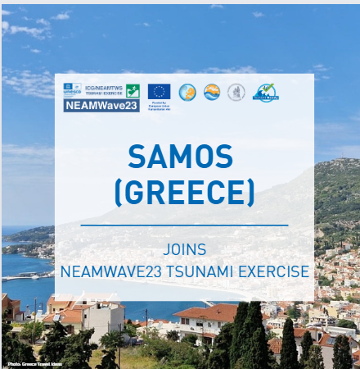
NEAMWave23
This year WTAD event is highlighted by the regional wave exercise (NEAMWave23), 6-7 Nov 2023
For the first time, this year's NEAMWave 23 exercises included communities actively working towards becoming "Tsunami Ready" under the IOC DG ECHO CoastWAVE project being implemented in seven project countries.

Slide 15
Challenges and Opportunities
Recruit experience consultant to coordinate and support activities, e.g. studies and assessments (low survey response countries).
Project partners and MS collaborating on rather complex analysis/activity. PTHA Mapping Tools for Tsunami Evacuation in Larnaka -a model to replicate.
Greater involvement of Civil Protection Agencies from the beginning
Document experiences in implementing TR. Improve M & G 74 (Rev)

Slide 16
THANK YOU

