Slide 1
Tsunami Ready in Italy
Towards the UNESCO recognition
Alessandro Amato
with Lorenzo Cugliari, Silvia Filosa, Laura Graziani,
Fabrizio Romano, Cecilia Valbonesi
Centro Allerta Tsunami - Istituto Nazionale di Geofisica e Vulcanologia

Slide 2
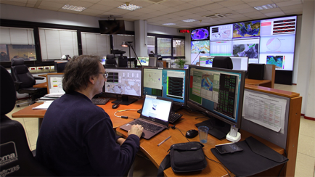
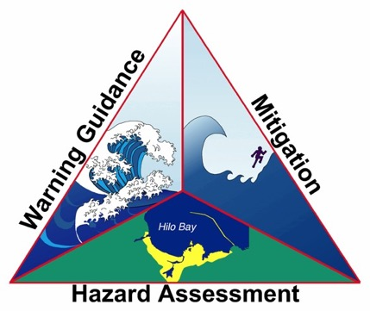
The Italian Tsunami Warning System: Three main tasks
To guarantee the Surveillance Service for Tsunami Alerts in the Mediterranean as a NEAM Tsunami Service Provider
To assess the (seismic) Tsunami Hazard for the Italian Coasts
To contribute increasing awareness on tsunami risk

Slide 3
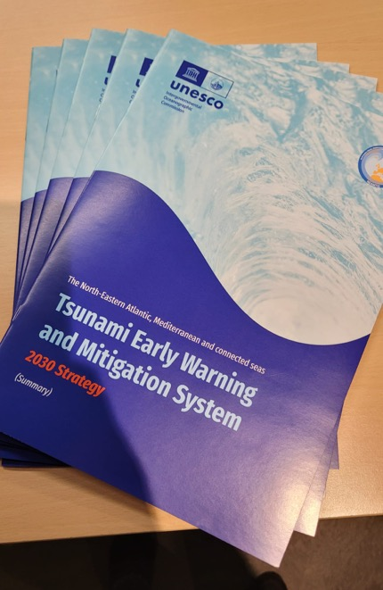
Tsunami Ready in the 2030 NEAMTWS Strategy
The Three Pillars of the NEAM Strategy:
Hazard and Risk assessment
Warning and dissemination
Awareness and response
Pillar 3 strategic Objective: Roll out the “Tsunami Ready” initiative in coastal communities
Implementation of IOC-UNESCO Tsunami Ready Recognition Programme (TRRP) across the NEAM region in partnership with other international organizations, first tested and applied to some pioneering local coastal communities in each country
A specific TR Task Team in WG4 of the NEAMTWS

Slide 4

What is Tsunami Ready?
Tsunami Ready is a virtuous model for tsunami risk mitigation aimed at increasing coastal populations’ and tourists’ resilience;
TR is a collaborative effort to meet a standard level of tsunami preparedness through the fulfilment of a set of established indicators.
TR promotes education and learning processes to reduce the "last mile" gap;
The Tsunami Local Committee implies a mixed top-down / bottom-up risk management process, involving citizens at every level;
The TR international guidelines guarantee a valuable benchmark for decision-makers and cautionary standards for civil protection officers in charge of risk management.
Tsunami Ready recognition does not mean that a community is tsunami proof; rather, it is an acknowledgement and recognition that a community has adopted mitigation measures to cope with their tsunami risk.

Slide 5
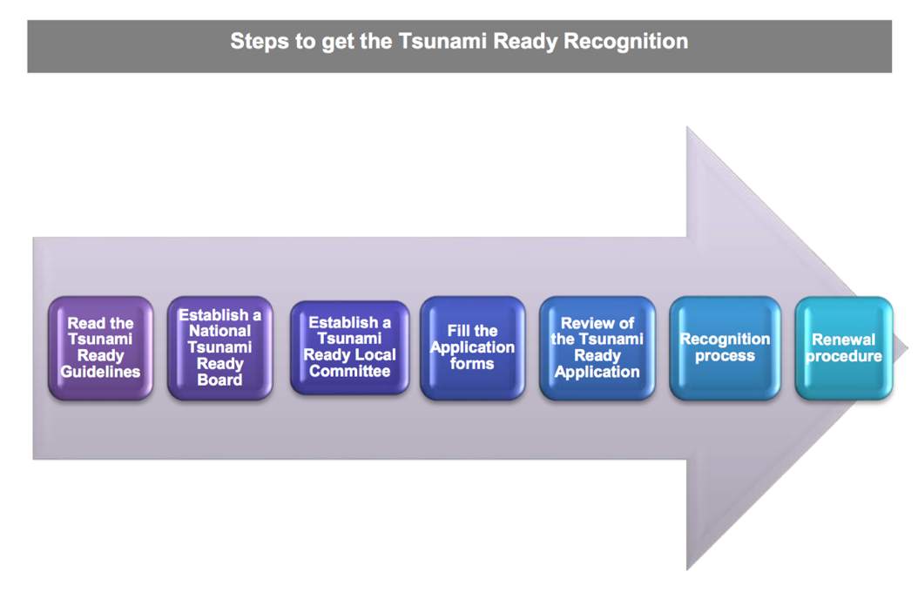




Steps towards Tsunami Ready in Italy in 3 pilot sites (2020-2023)
2020-21
Minturno
Palmi
Marzamemi
2021
NTRB
2023
Otranto
Stromboli
2024: Minturno
Forms filled and sent to the NTRB

Slide 6

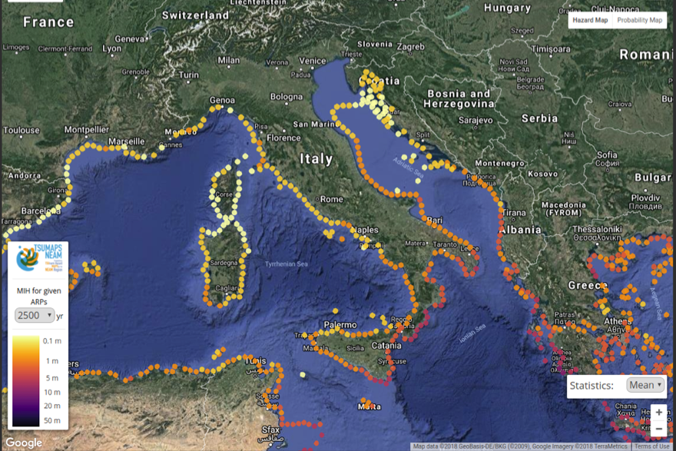
The three (+2) Italian pilot sites
Italian National Tsunami Ready Board: May 4, 2021
Stromboli volcano, Tyrrhenian sea
Pop. 450 / n,000 (summer)
High Hazard
In progress: July 2023
Minturno, Latium
Pop. 19,700
Medium-Low Hazard
Local TR Board: 03/2021
Otranto, Apulia
Pop. 5,769
Adriatic - High Hazard
Local TR Board: 10/2023
Palmi, Calabria
Pop. 17,000
Medium-High Hazard
Local TR Board: 12/2020
Marzamemi-Pachino, Sicily
Pop. 376 / 21,000
Ionian - High Hazard
Local TR Board: 04/2021

Slide 7
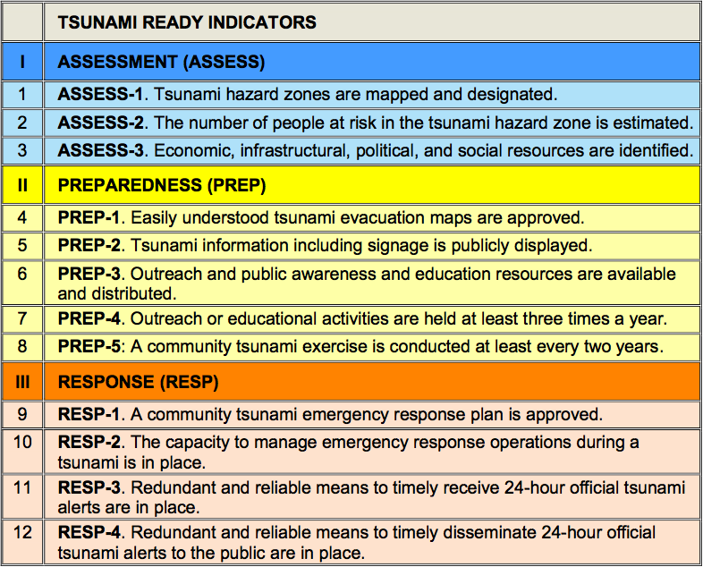
Advancement as of April 2023
PALMI
90
100
100
30
100
30
30
100
100
100
100
100
MINTURNO
90
100 /50
100
50
100 / 30
60
100
n.a.
80
100
100
90
PACHINO-MARZAMEMI
90
80
100
n.a.
100
n.a.
30
100
50
80
70
50

Slide 8
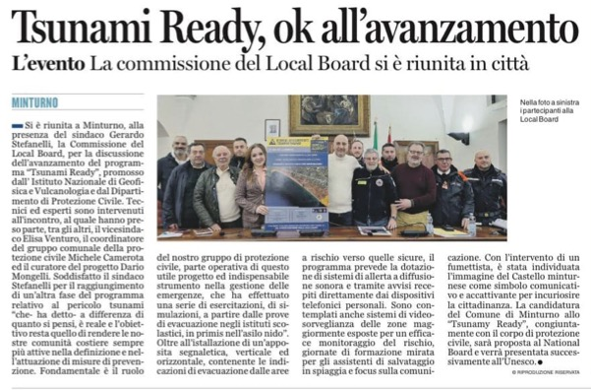
Minturno
January 17, 2024: joint meeting TRLC + TRNB
January 23, 2024: TR forms delivered to TRNB
Tsunami Ready, ok to the advancement
The event The Local Committee meets in the city
Latina oggi, Jan. 20, 2024

Slide 9
Minturno / key points
A 3-yr long, continuous cooperation between local authorities and scientific / CP institutions
The presence of a DM expert in charge of the process and an active local CP coordinator
Funds allocated by the municipality (~ 50K)
New powerful sirens covering the whole coastal area
Updated CP plan for tsunami risk
Signage
Events (school/nursery drills, INR campaigns, lessons at schools…)

Slide 10

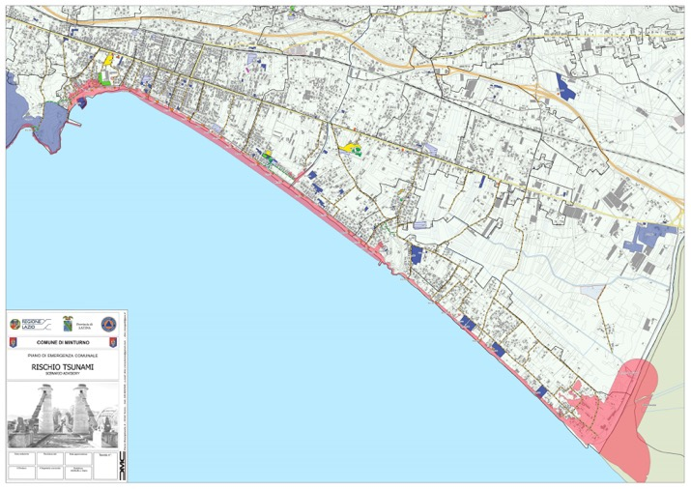
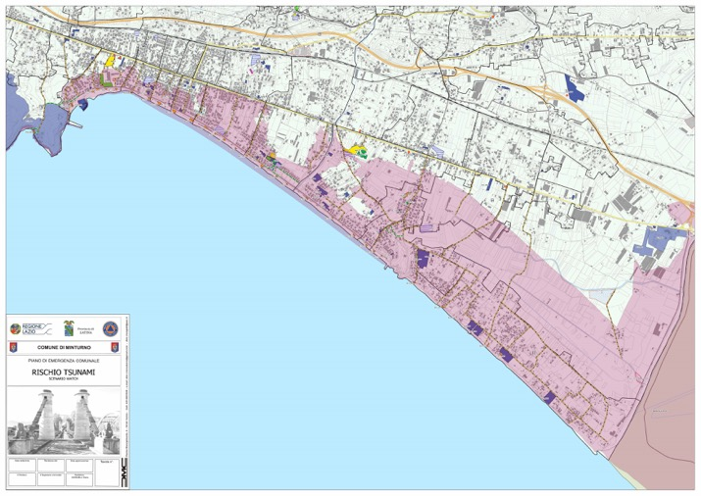
Minturno / inundation zones
ARANCIONE (ADVISORY)
ROSSA (WATCH)

Slide 11
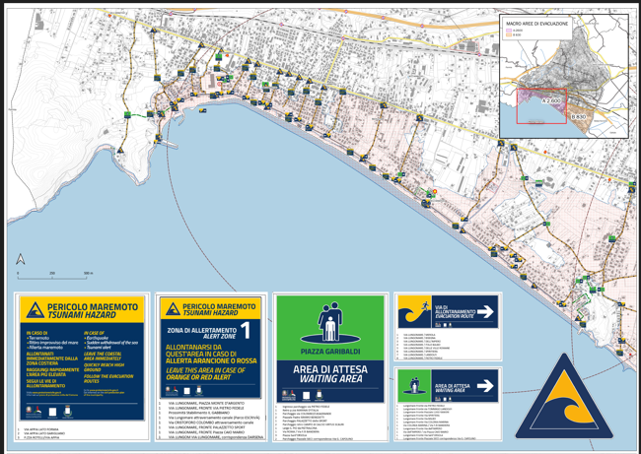
Minturno / signage deployed

Slide 12

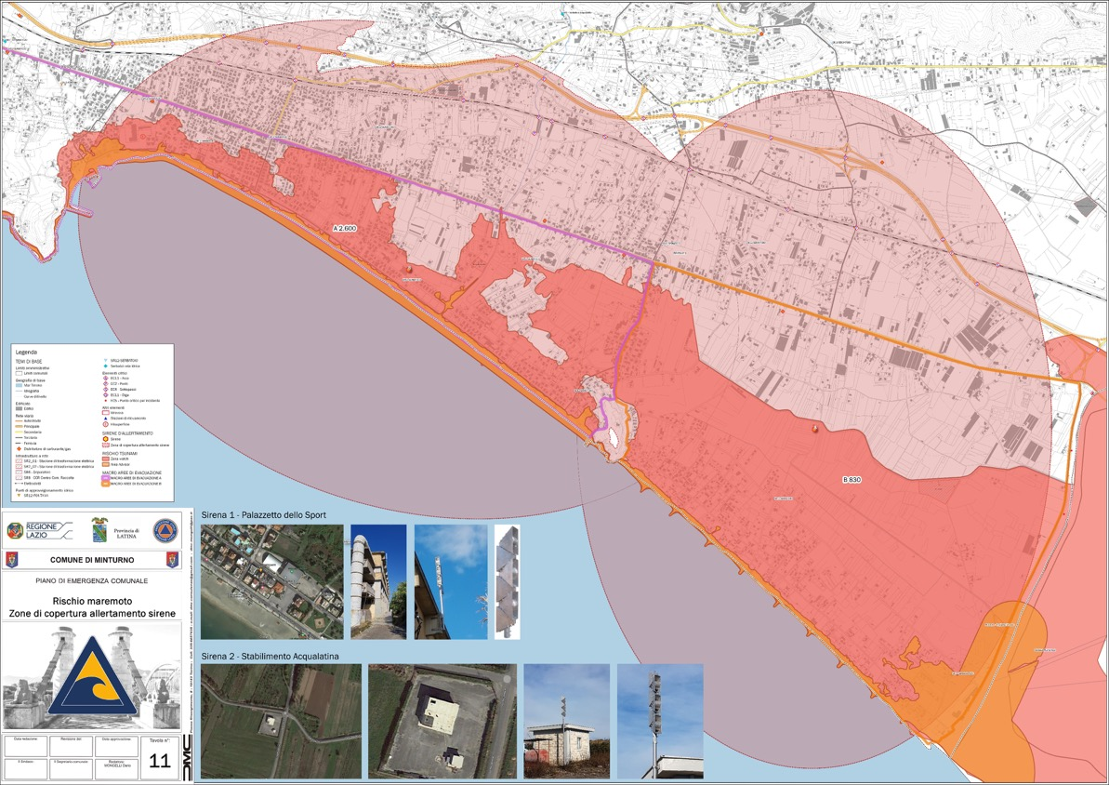

Minturno / sirens coverage

Slide 13
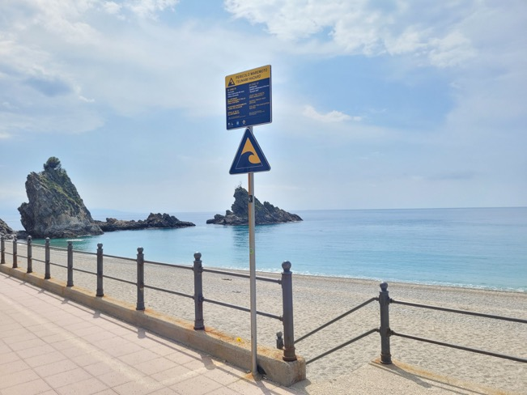
Palmi / key points
An autonomous decision of facing the tsunami risk before TR
The presence of a very active local coordinator (local police chief)
Funds allocated by the municipality (+10K€)
Signage (2022) and new sirens (end of 2023)
Schools lessons
App

Slide 14
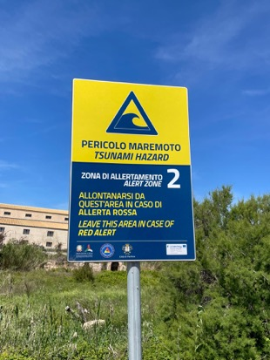
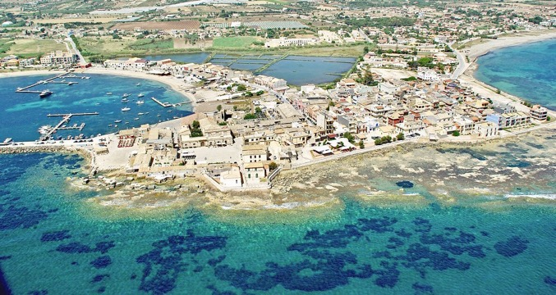
Marzamemi / key points
A small coastal community in a large municipality
Local CP plan with tsunami (2021)
Target of an Interreg project (Sicily-Malta-Universities-INGV)
Signage installed
Tsunami drill with media coverage (2022)
Future

Slide 15
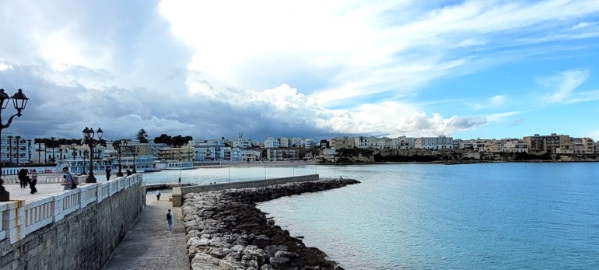
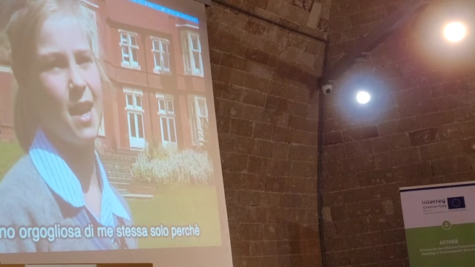
Otranto / key points
Decision to participate to TR by the prefecture commissioner confirmed by the new Mayor (2023)
Regione Puglia push with INGV (AETHER project)
Feasibility study of a future local hazard assessment
Lessons/School

Slide 16
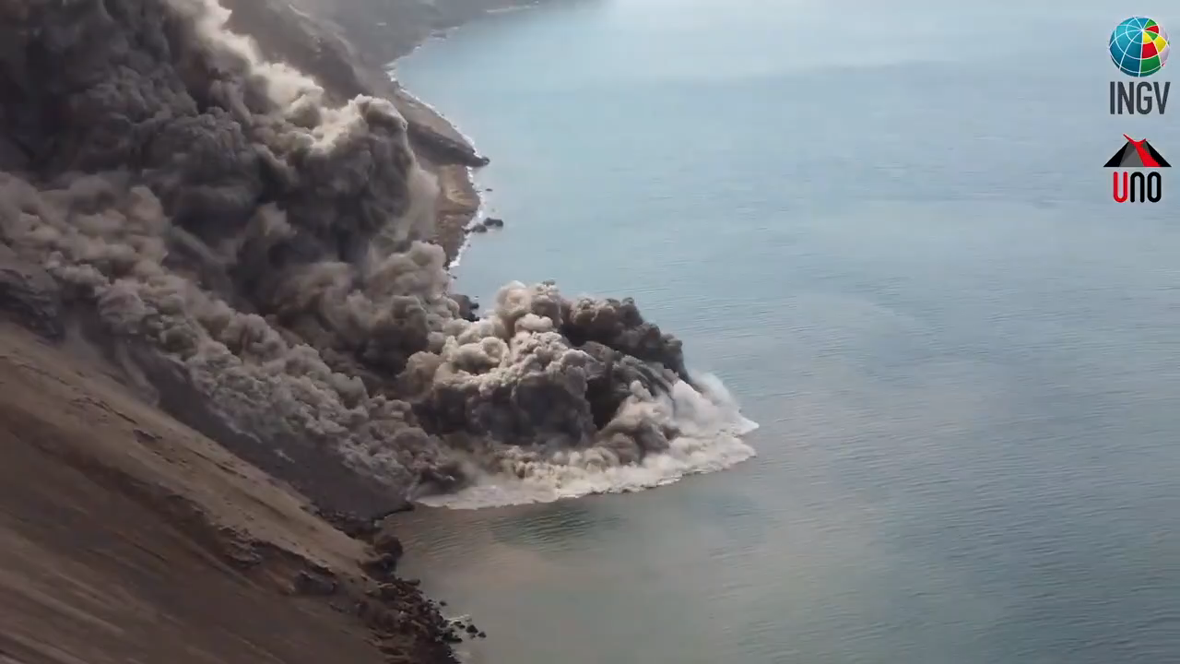
Stromboli

Slide 17
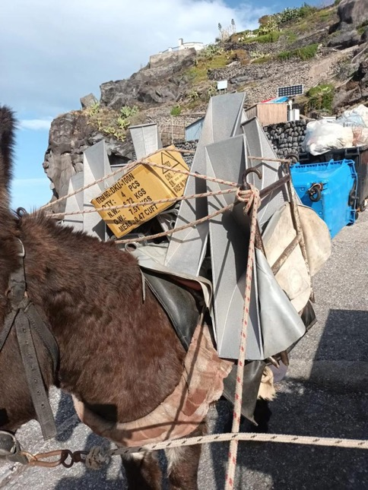
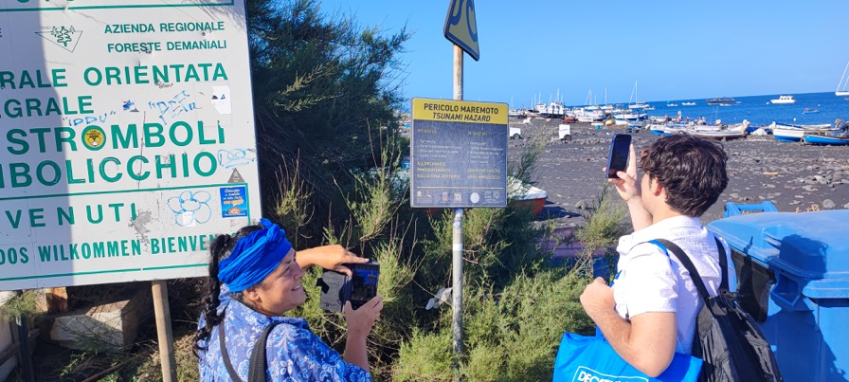
Stromboli / key points
Mayor’s decision (2023)
Risks on the volcano are obvious (more the volcanic ones)
New sirens (2024)
Signage (to be improved)
INGV info point on the island
Local TWS with automatic activation of sirens, SMS, email etc. (to be improved) – in progress
Tourists’ risk perception study (2023)
700 questionnaires

Slide 18
Strengths (how we involve Mayors and local authorities)
A clear strategy with a finite number of objectives (12)
The international (IOC-UNESCO) framework limits the sphere of possible liability of local authorities and collaborators /scientists
Inducement to the risk education for young citizens (schools)
Inducement to formation and information for the population, including the attitude towards a self protective approach
Motivation for a multi-risk approach

Slide 19
Problems / criticalities
Careful definition of the inundation areas (need for detailed DTM and local scale modelling) see NEXT SLIDE
Bureaucracy (Mayor’s election, complex purchase procedures, …)
Funding (specific resources not available, must be allocated)
Lack of experienced local staff (often)
Competition with other more frequent hazards (floods, storms, fires, earthquakes) and local problems (traffic, streets conditions, seaside facilities management, …)
Difficulty in spreading TR to tens/hundreds coastal localities without a continuous support by scientific and CP experts (reaching the Ocean Decade target of 100% within 2030???) – need for a strategy

Slide 20
ASSESS-1
Tsunami hazard maps mapped and designated
According to the TR guidelines (doc 74):
The primary source for mapping potential tsunami hazard zones is inundation modelling, which illustrates expected areas to be flooded by the tsunami. The result of an inundation modelling study is the tsunami inundation map depicting the tsunami hazard zone. If models are unavailable, other acceptable sources include guidance from tsunami experts from technical agencies, universities, or consultants. These modelling and mapping efforts should follow national and/or international standards.
….
Tsunami hazard zone maps are used as a base for tsunami evacuation mapping and planning.
Notes:
For communities with no modelling, a “baseline tsunami zone” can be used. Storm surge modelling can also be used as a guide for this purpose.
(UNESCO IOC Manuals and Guides, 82, 2020)

Slide 21
ASSESS-1
Tsunami hazard maps mapped and designated
Possible solutions:
Local study with accurate PTHA assessment, choice of probabilities / ARP (by DMs), definition of inundation/hazard areas ---> local planning / evacuation zones (Larnaca-style)
Regional/national assessment (common prob. and ARP values for the whole country / region), definition of inundation/hazard areas ---> local planning / evacuation zones (Italy cases)
Expeditive methods (scenario-based, storm surge?, etc.)
Criticalities:
The first approach is the best but it is hardly applicable to thousands of municipalities (timing, lack of data and resources)
The second approach is more applicable (once there are the basic information) but also requires the help of external experts (disaster management offices, universities, academics, researchers and consultants)
The third is the easiest one but also the most critical (subjective choices, likely wrong decisions, etc.)

Slide 22
Thanks alessandro.amato@ingv.it www.cat.ingv.it
SHORT VIDEO…
Notes:
As testified by this Factsheet, for about 15 years we have been building the NEAMTWS

