Slide 1

IOC-UNESCO DG ECHO COASTWAVE PROJECT MEETING
February 5, 2024, Paris
Greece

Slide 2
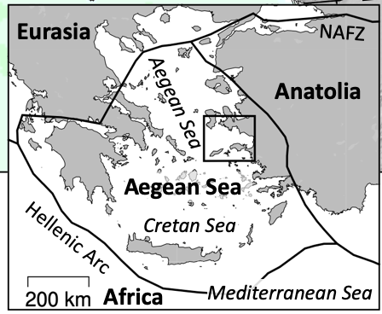
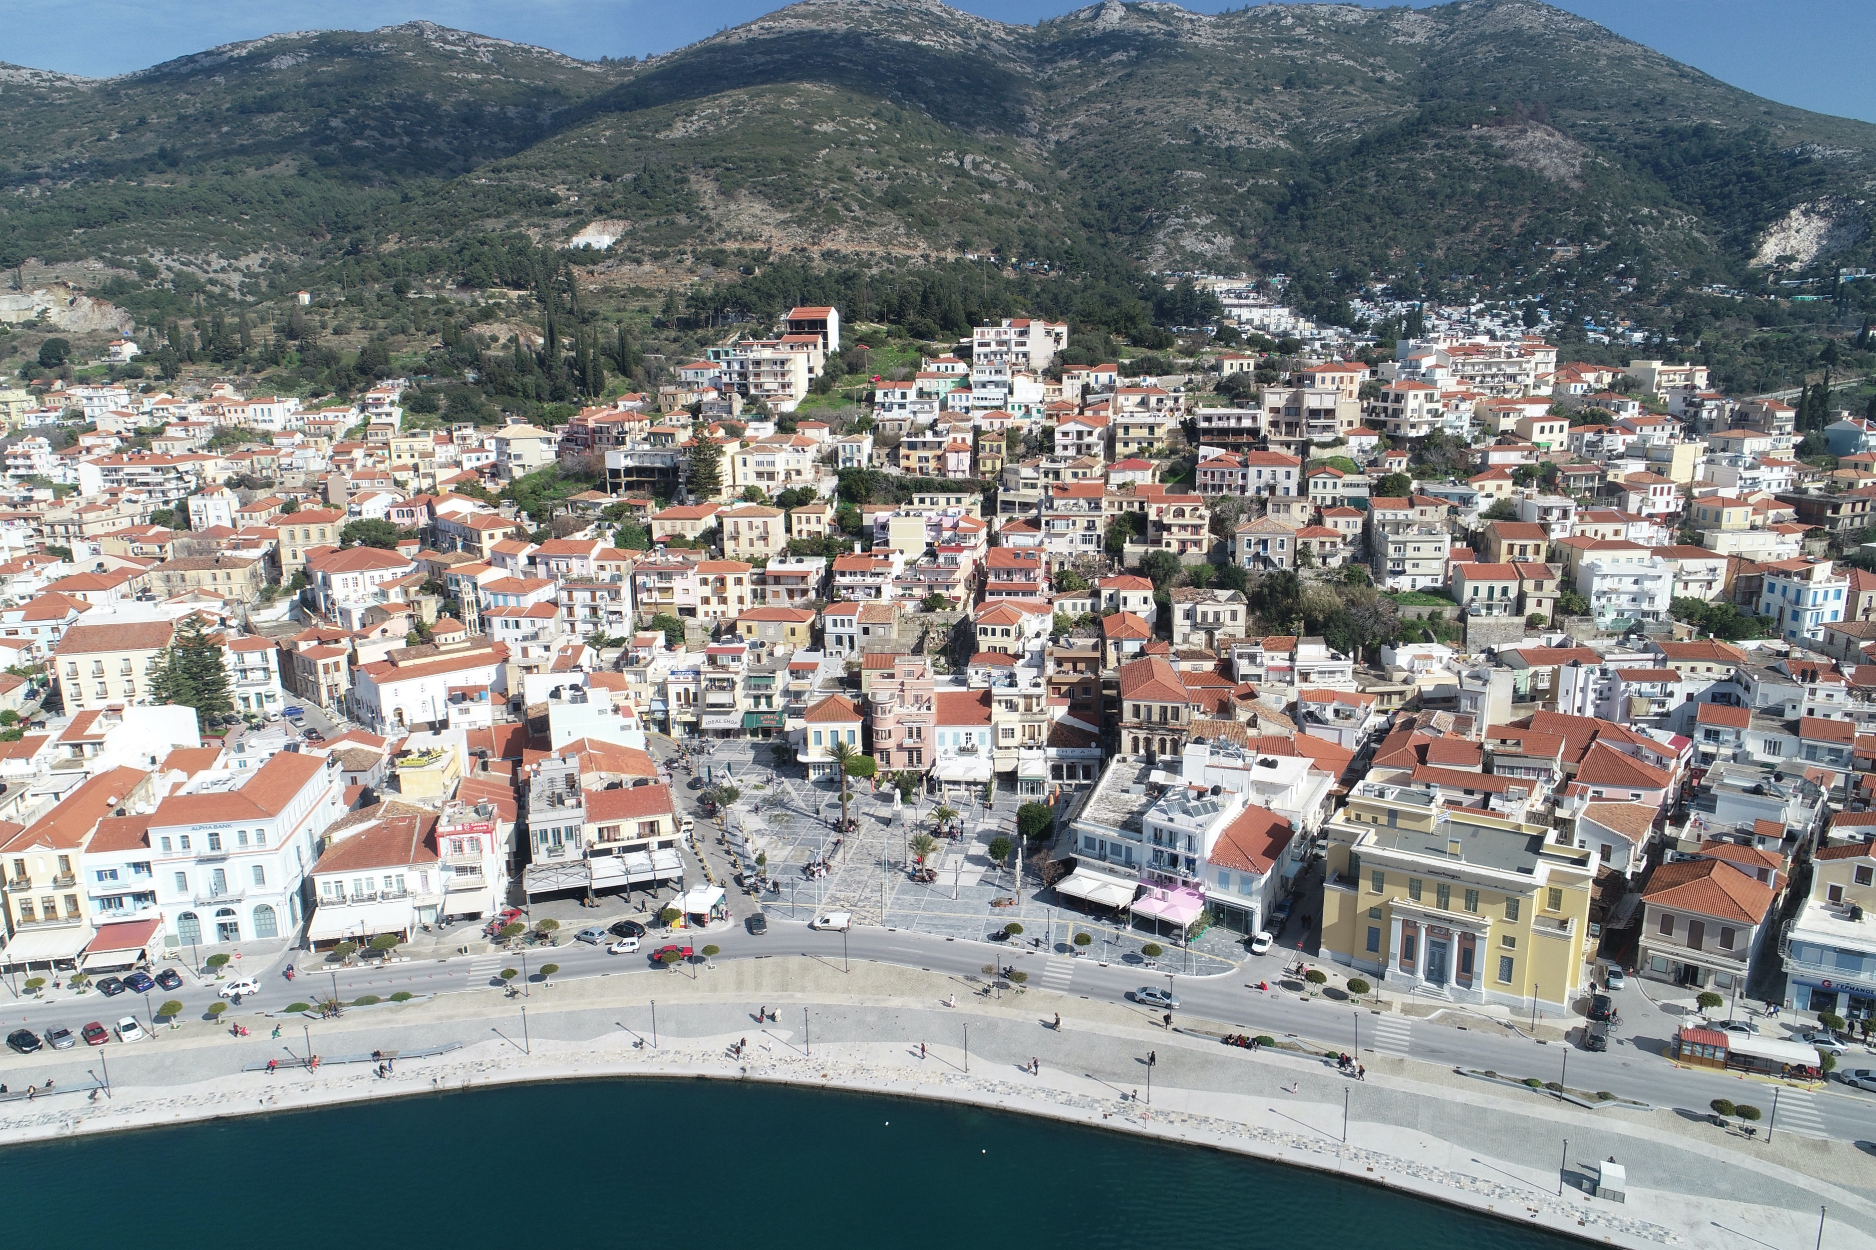
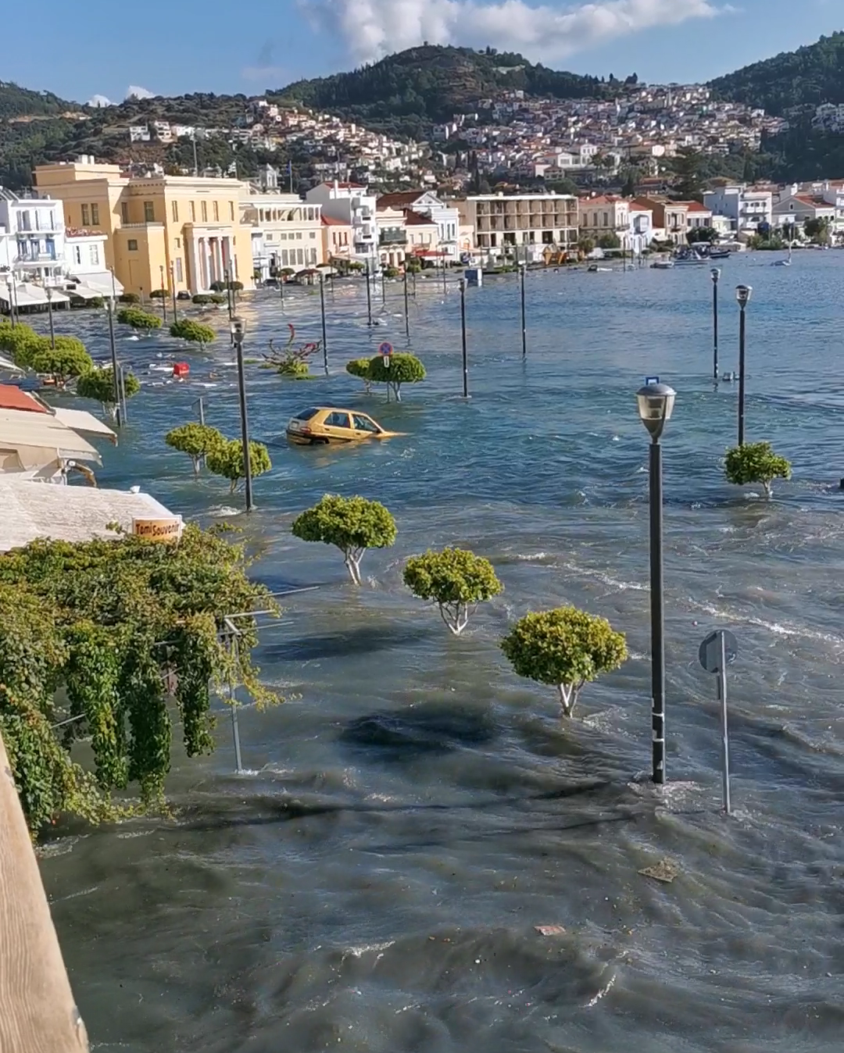
Location of TRRP application in Greece
Samos
The town of Samos
Administrative capital of the Municipality of Eastern Samos
Largest town of the island of Samos
Population of 6191 (census of 2011)
Coastal infrastructure include a port and a marina
Samos was impacted by the 2020 Samos-Aegean tsunami

Slide 3
CoastWAVE-GR project timeline
November 2021
August 2022
October 2022
February 2023
May 2023
June
2023
Municipality
Approves
TRRP
application
CoastWAVE project
start
Kick-off meeting in Samos
Local SOP workshop and awareness activity
Tsunami educational activity in local schools
Workshop on development of tsunami inundation and evacuation maps
October
2023
November
2023
November
2023
January
2024
February
2024
Local SOP workshop and exercise preparation meeting
Local elections
NEAMWave23 and SamosWAVE23-CW exercises
Change of local administration
This meeting

Slide 4
Tsunami Ready Indicators
I | ASSESSMENT (ASSESS)
1 | ASSESS-1. Tsunami hazard zones are mapped and designated.
2 | ASSESS-2. The number of people at risk in the tsunami hazard zone is estimated.
3 | ASSESS-3. Economic, infrastructural, political and social resources are identified.
II | PREPAREDNESS (PREP)
4 | PREP-1. Easily understood tsunami evacuation maps are approved.
5 | PREP-2. Tsunami information including signage is publicaly displayed.
6 | PREP-3. Outreach and public awareness and education resources are available and distributed.
7 | PREP-4. Outreach or educational activities are held at least three times a year.
8 | PREP-5. A community tsunami exercise is conducted at least every two years.
III | RESPONSE (RESP)
9 | RESP-1. A community tsunami emergency response plan is approved.
10 | RESP-2. The capacity to manage emergency response operations during a tsunami is in place.
11 | RESP-3. Redundant and reliable means to timely receive 24-hour official tsunami alerts are in place.
12 | RESP-4. Redundant and reliable means to timely disseminate 24-hour official tsunami alerts to the public are in place.

Slide 5
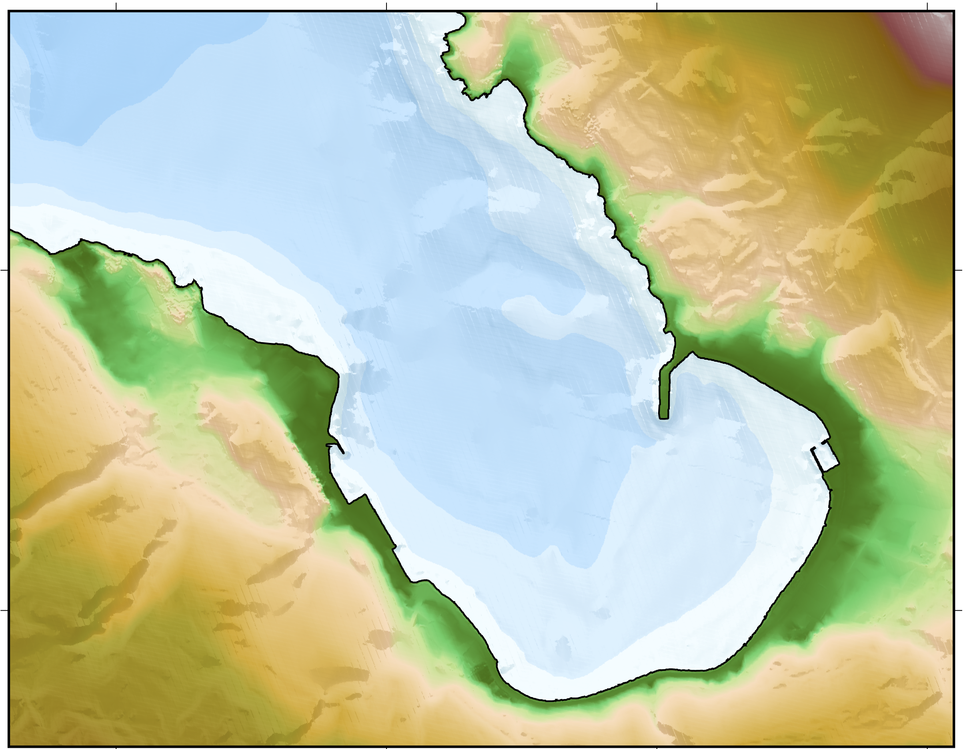
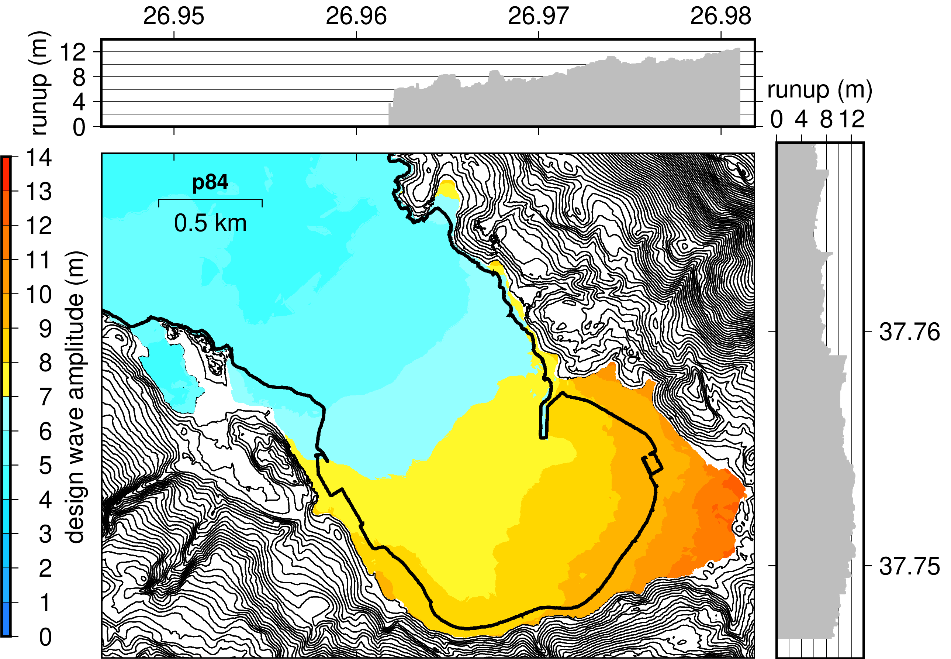
ASSES-1. Development of tsunami inundation map
Kaystrios fault discretization
Zonal 2,500 yr ARP M_{w} = 7.6
DEM with
2.4 m cell size
Chios-Cesme fault discretization
Zonal 2,500 yr ARP M_{w} = 7.5
Inundation zone at the 84th percentile of aleatoric uncertainty due to variable slip distribution.

Slide 6
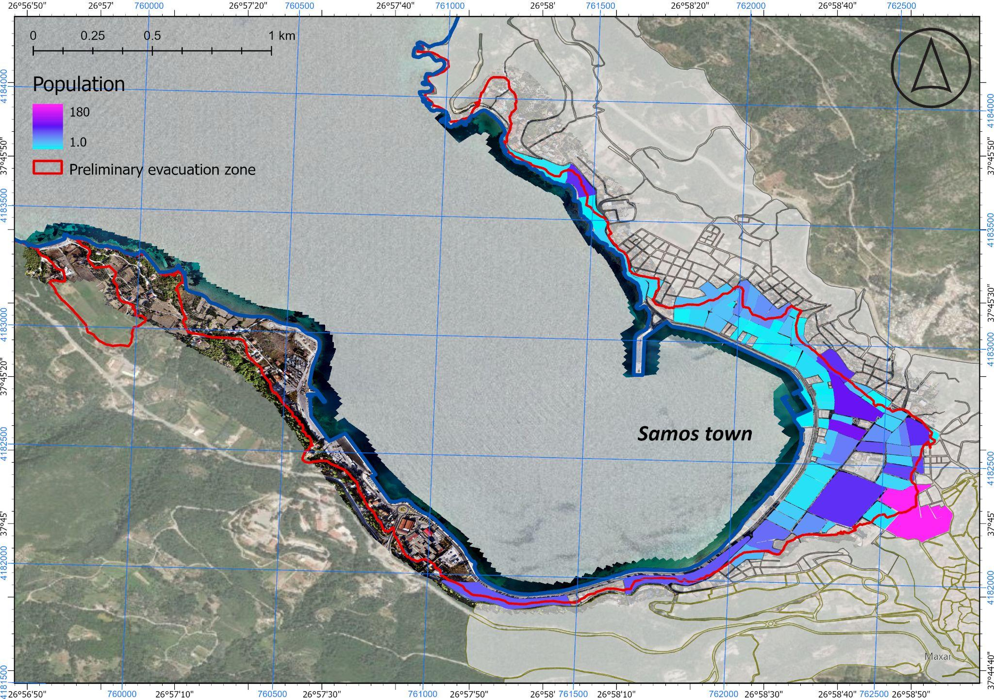
ASSES-2. Number of people at risk in tsunami hazard zone
  Collection and processing of available information from the Hellenic Statistical Authority.
  Information on visitors not available specifically for the town of Samos.
  Next steps: finalize the analysis on this TRRP indicator.
Census population within the tsunami inundation zone

Slide 7
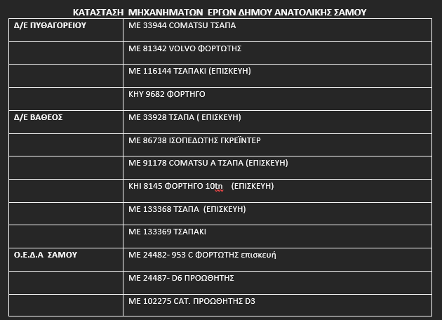
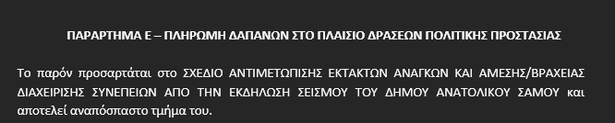
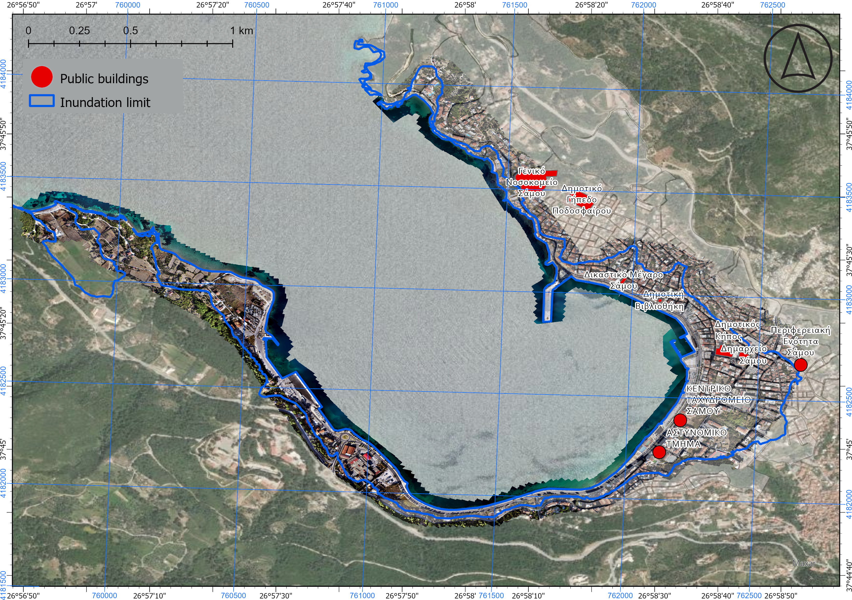
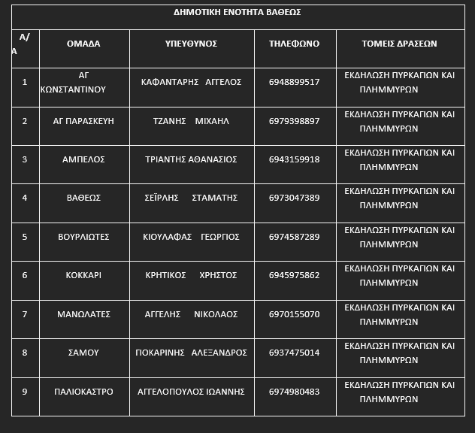
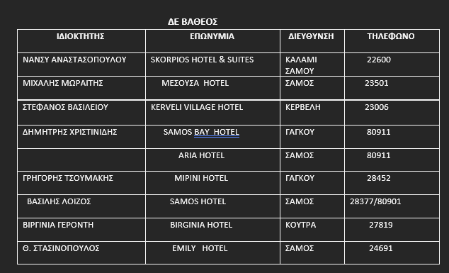
ASSES-3. Economic, infrastructural, political and social resources
  The relevant information has been collected.
  Next steps: combine information to make final tables and maps.
Description of economical resources
List of infrastructural resources
List of volunteer organizations
List of hotels

Slide 8
Tsunami Ready Indicators
I | ASSESSMENT (ASSESS)
1 | ASSESS-1. Tsunami hazard zones are mapped and designated.
2 | ASSESS-2. The number of people at risk in the tsunami hazard zone is estimated.
3 | ASSESS-3. Economic, infrastructural, political and social resources are identified.
II | PREPAREDNESS (PREP)
4 | PREP-1. Easily understood tsunami evacuation maps are approved.
5 | PREP-2. Tsunami information including signage is publicaly displayed.
6 | PREP-3. Outreach and public awareness and education resources are available and distributed.
7 | PREP-4. Outreach or educational activities are held at least three times a year.
8 | PREP-5. A community tsunami exercise is conducted at least every two years.
III | RESPONSE (RESP)
9 | RESP-1. A community tsunami emergency response plan is approved.
10 | RESP-2. The capacity to manage emergency response operations during a tsunami is in place.
11 | RESP-3. Redundant and reliable means to timely receive 24-hour official tsunami alerts are in place.
12 | RESP-4. Redundant and reliable means to timely disseminate 24-hour official tsunami alerts to the public are in place.

Slide 9
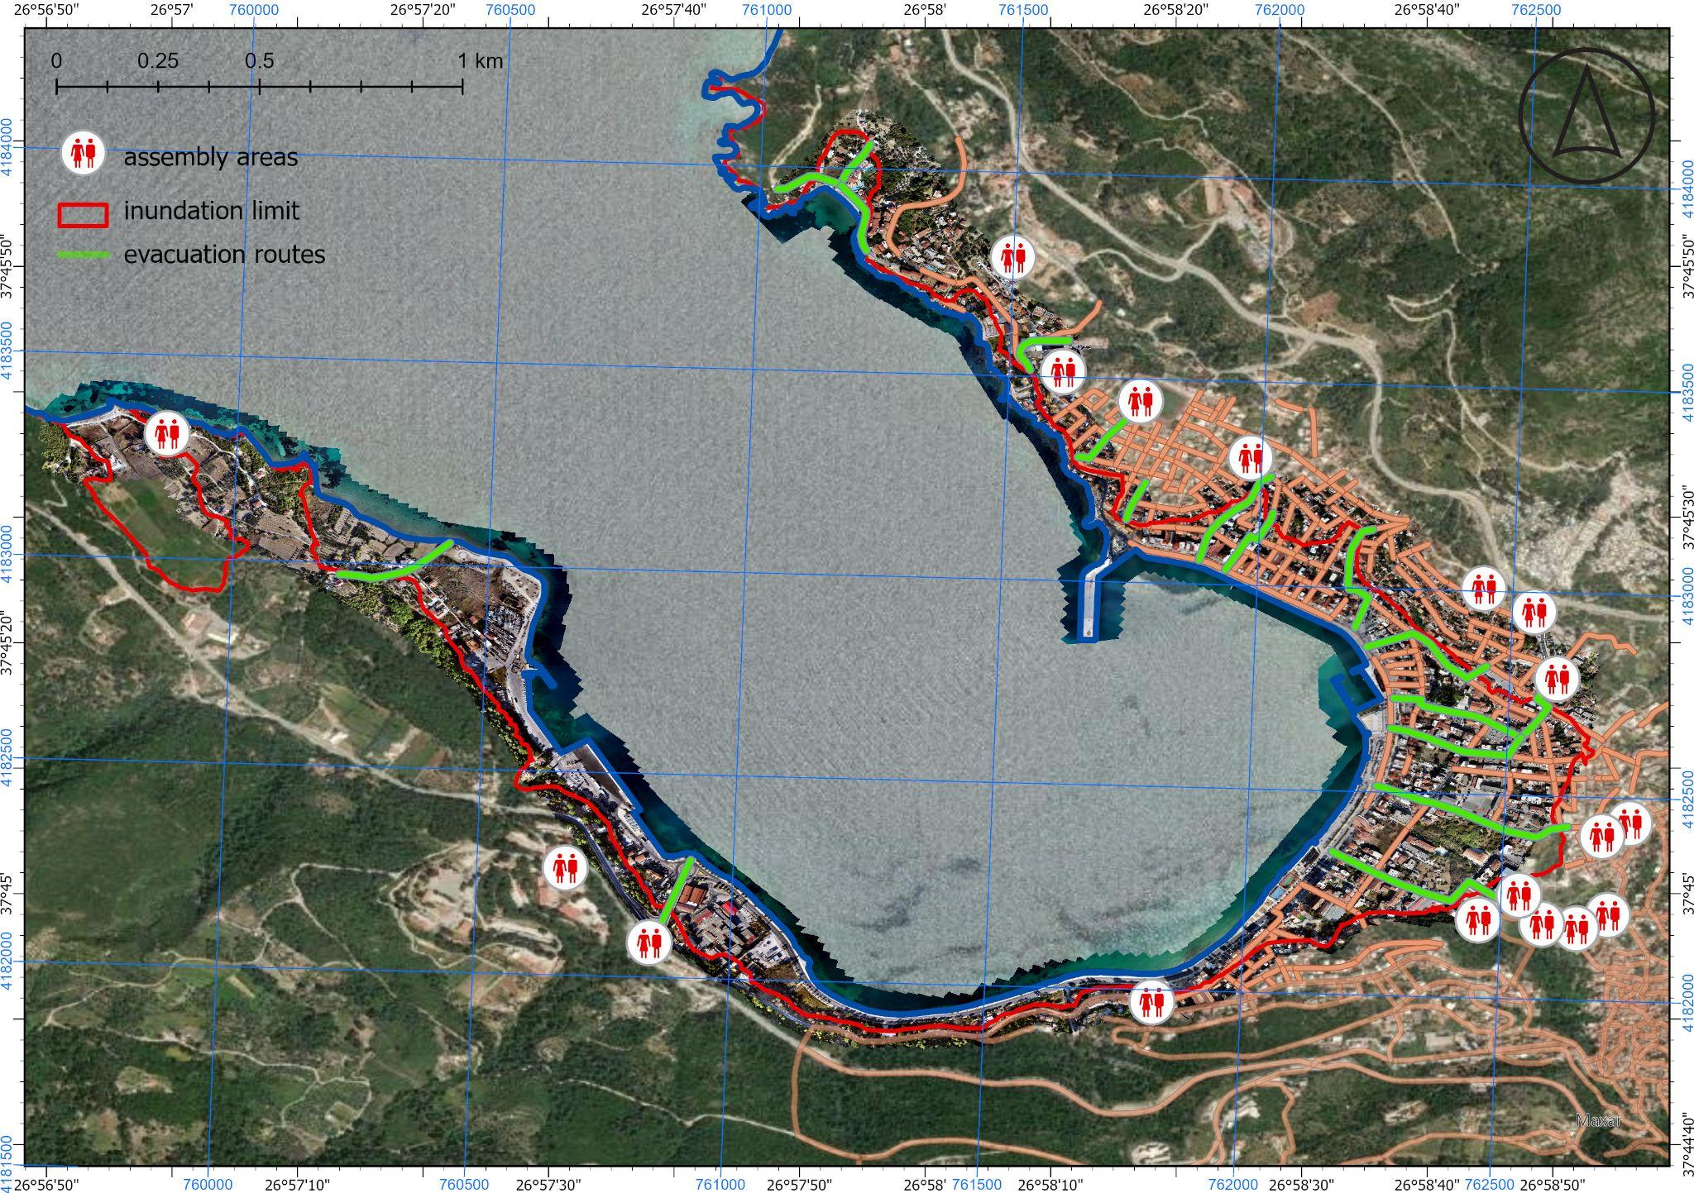
PREP-1. Tsunami evacuation map
  A first draft of the tsunami evacuation map was presented to local stakeholders in June 2023.
  Difficulty in identifying safe evacuation routes away from seismically vulnerable buildings.
  Next steps: collaborate with local Civil Protection to finalize and approve map.
Proposed tsunami evacuation map

Slide 10

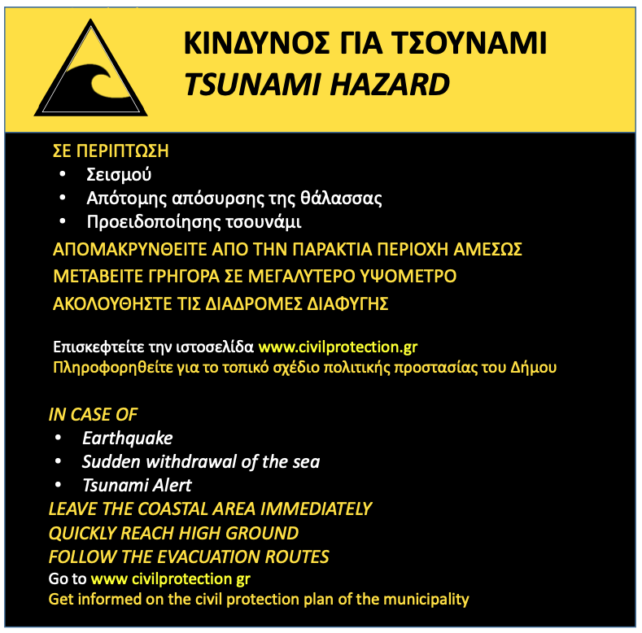
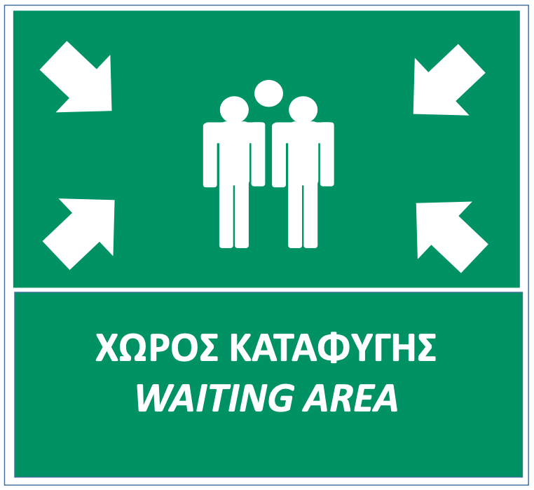
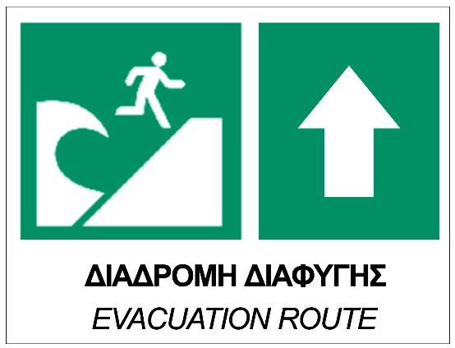
PREP-2. Tsunami information including signage
  The signage design developed through the Tsunami Last Mile project (in Kos) will be used.
  Tsunami evacuation map needs to be finalized/approved to procure signage order and installation.
  The tsunami evacuation map will be included in brochures to be developed.
  Next steps: finalize tsunami evacuation map in collaboration with Municipality.

Slide 11
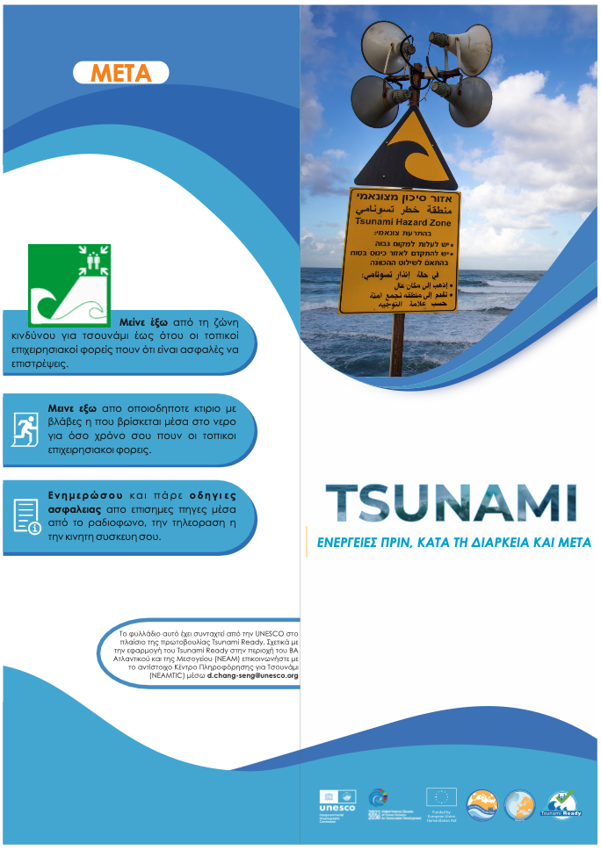
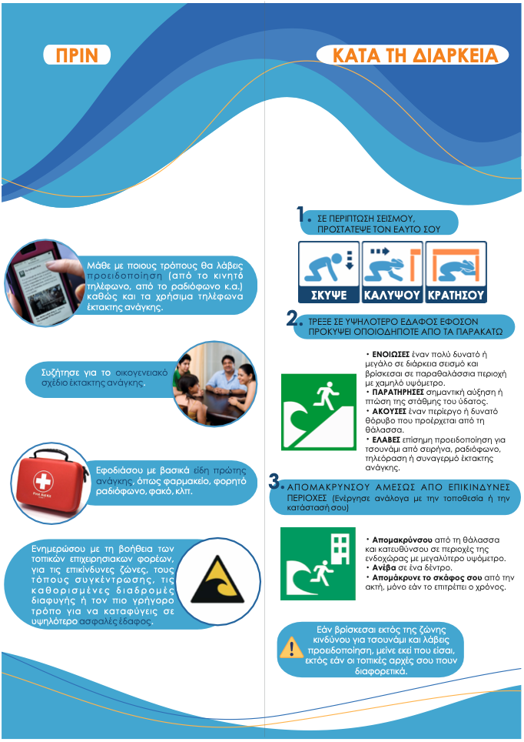
PREP-3. Outreach and public awareness and education resources
  The brochures developed by IOC-UNESCO within the CoastWAVE project were translated to Greek and were disseminated during the local exercise.
  Next steps: More brochures will be developed, including a brochure on the TRRP and one including the local tsunami evacuation plan in Samos.

Slide 12
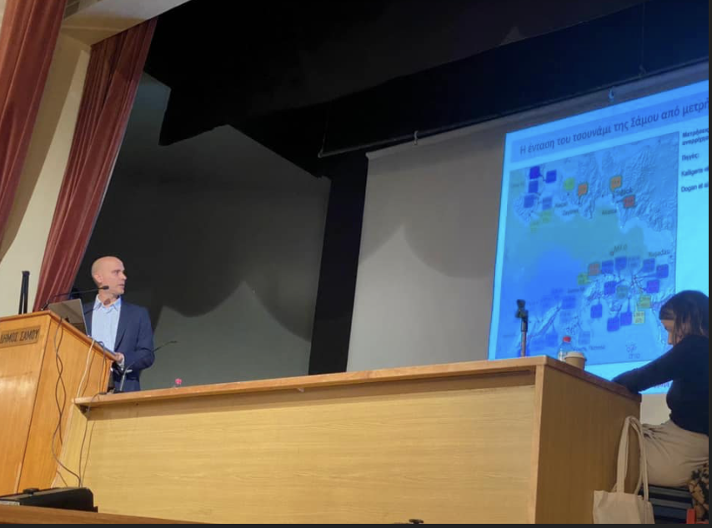
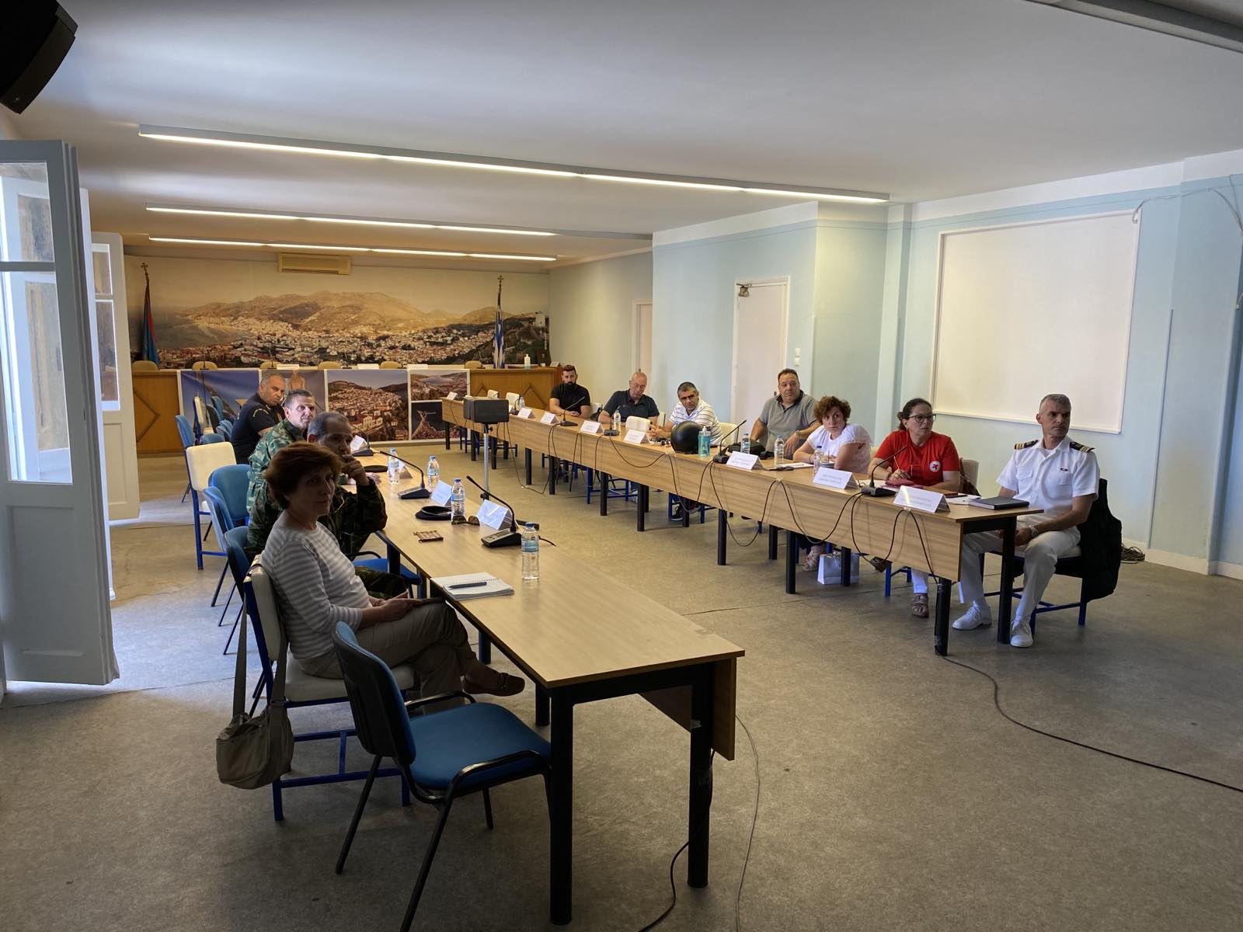
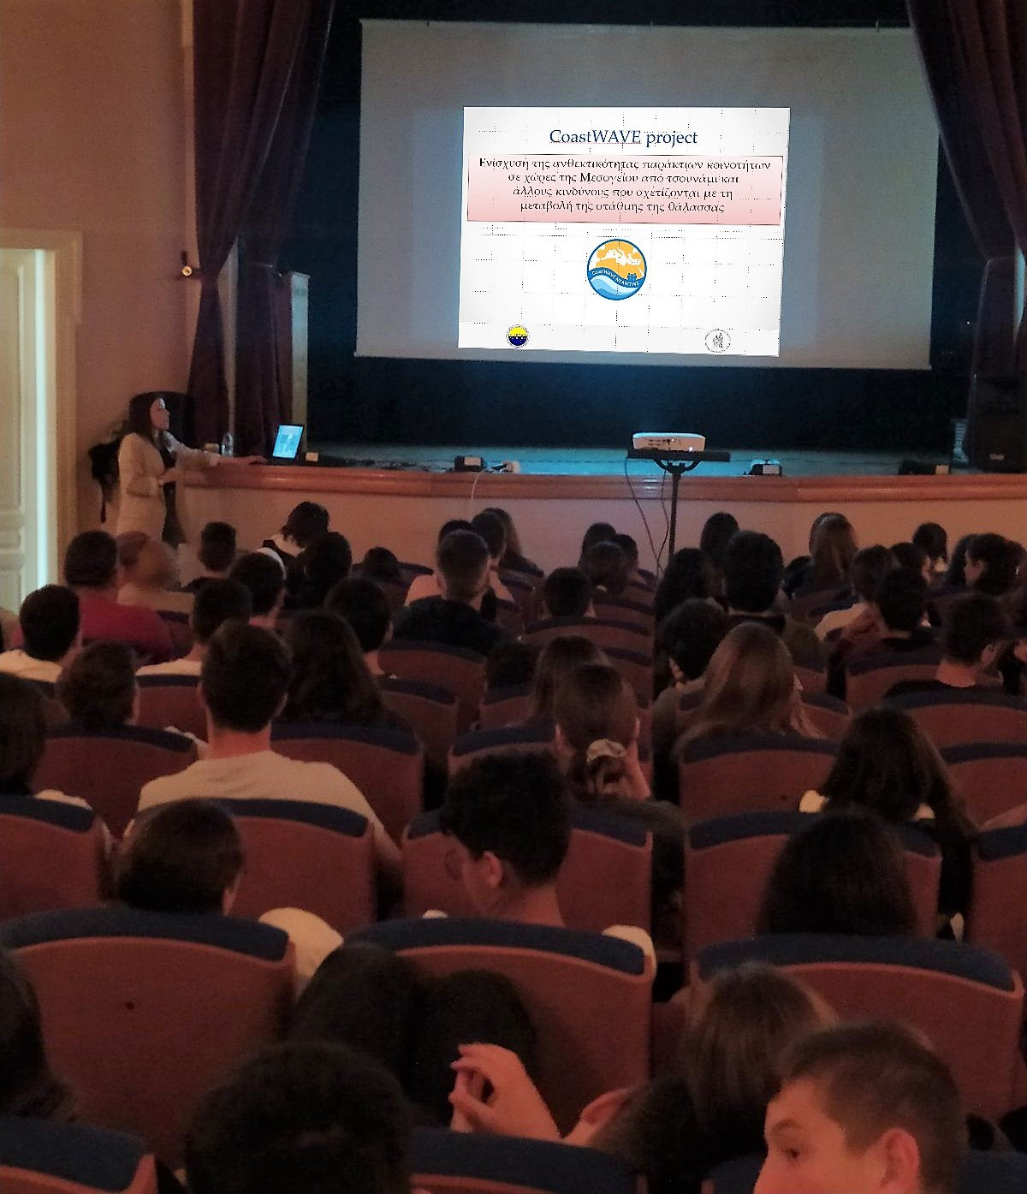
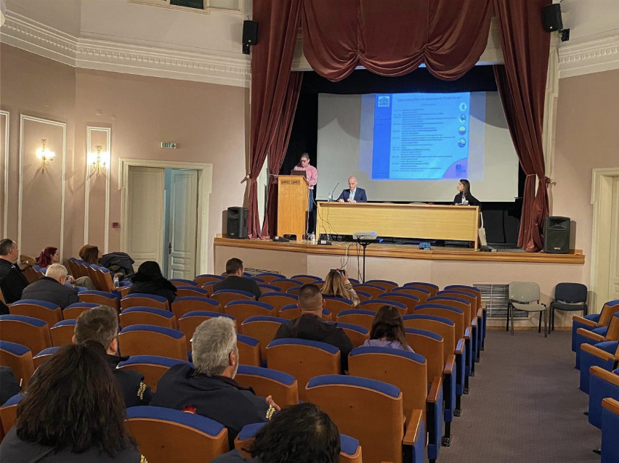
PREP-4. Outreach and educational activities
Tsunami awareness (and project) activity for the general public
Tsunami educational activity for two schools of Samos
Local SOP workshops
Feb. 2023
June 2023
May 2023
  An event, open to the public, will be organized in 2024 to present project outcomes and results.

Slide 13
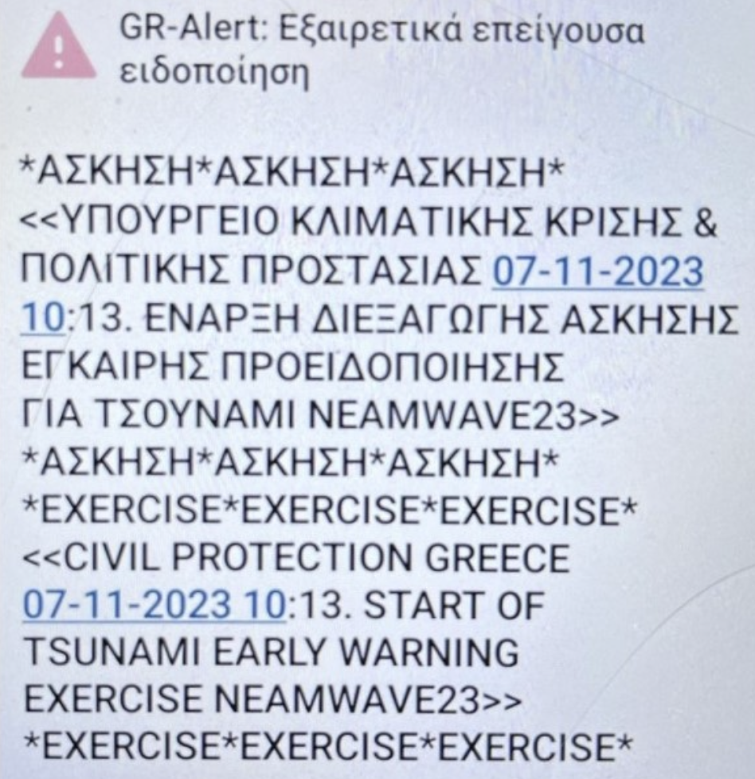
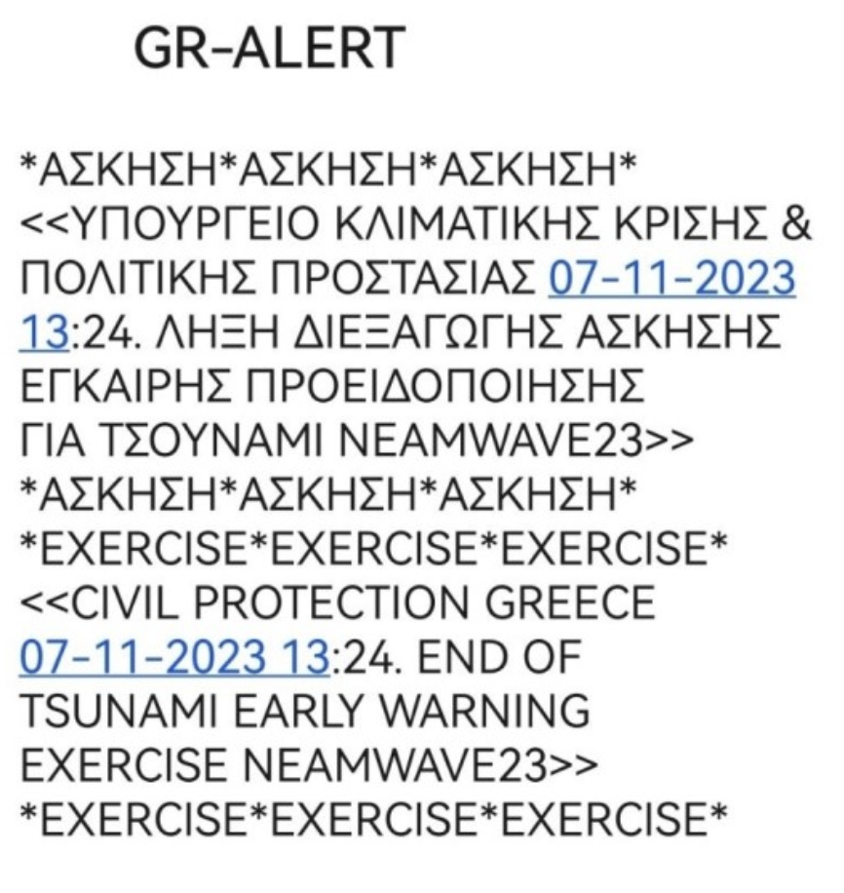
PREP-5. Community tsunami exercise
  Greece participated in Phase A of the NEAMWave23 through NOA-HLNTWC who transmitted the alert messages as TSP and received the messages of CAT-INGV and KOERI as TWFP of the NEAMTWS.
  Greece also participated in Phase B of the NEAMWave23 through the upstream and downstream components of the tsunami warning chain. In the downstream component, NOA-HLNTWC’s messages were disseminated to national operational centers, but also at the Prefectural level and locally to Samos for the needs of the local TTX. Cell broadcast messages were also disseminated locally within the framework of NEAMWave23 and the local TTX.

Slide 14

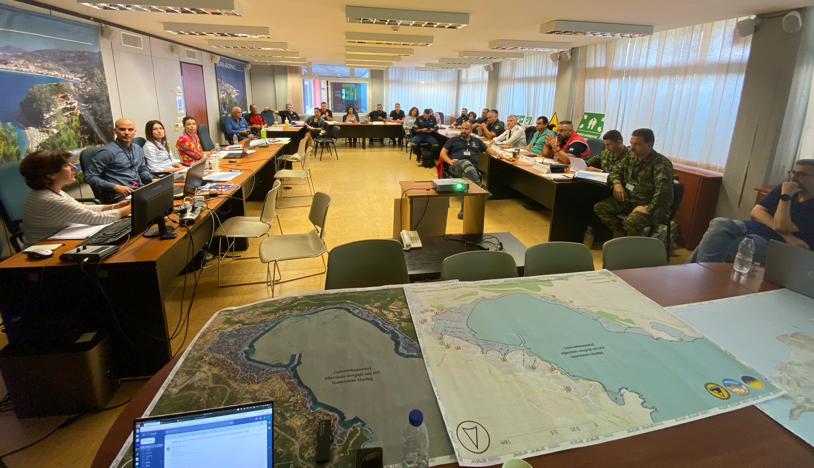
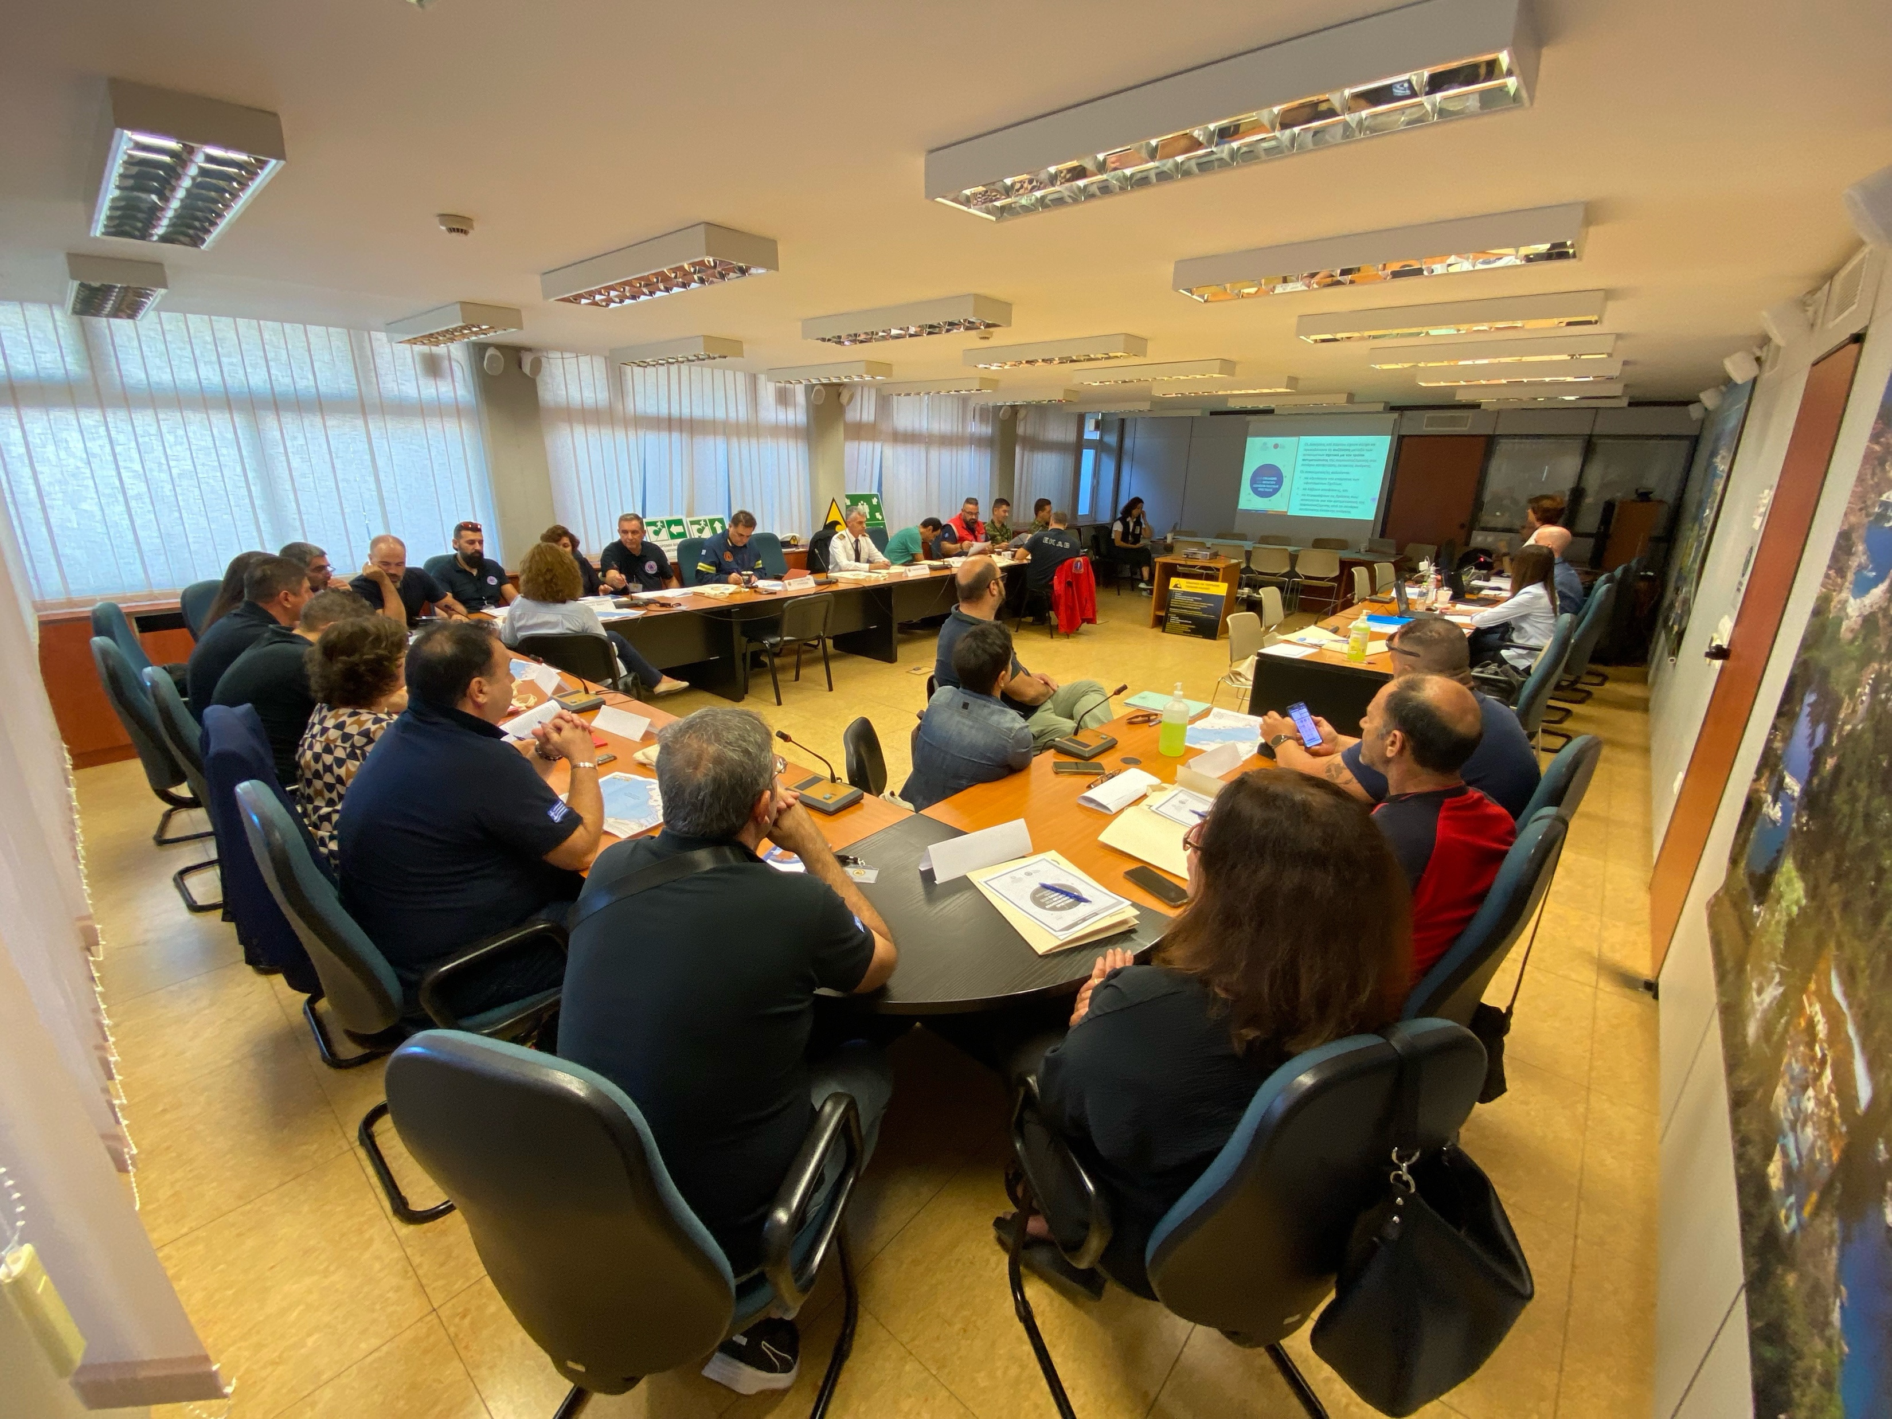
SamosWAVE23-CW – local TTX in Samos
  The local TTX organized by the Greek CoastWAVE team and the Municipality of Eastern Samos involved personnel from the Prefecture of North Aegean, the Municipality of Eastern Samos, the local emergency services, the Greek Army, and the local education sector.
  The aim of the local TTX was to:
    Test the local emergency and tsunami evacuation plans for the city of Samos prepared within the framework of the CoastWAVE project;
    Test the transmission and reception mechanisms for tsunami messages;
    Promote preparedness for earthquakes and tsunamis.

Slide 15
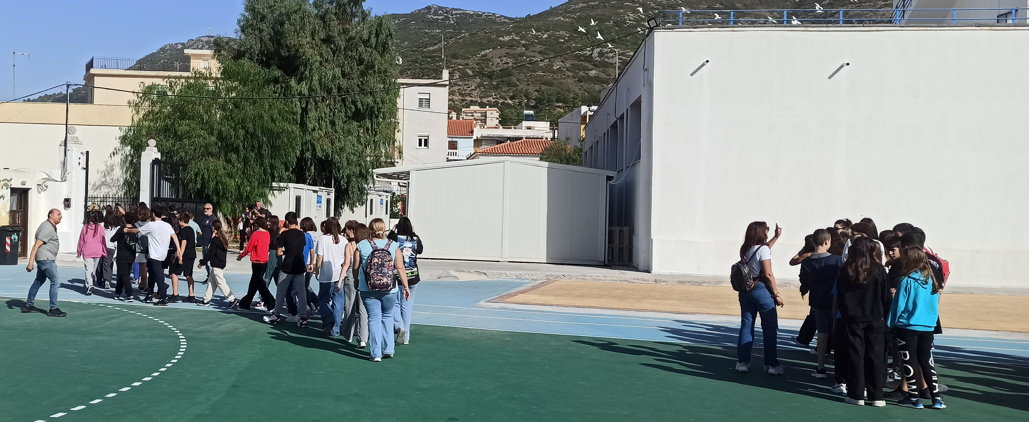
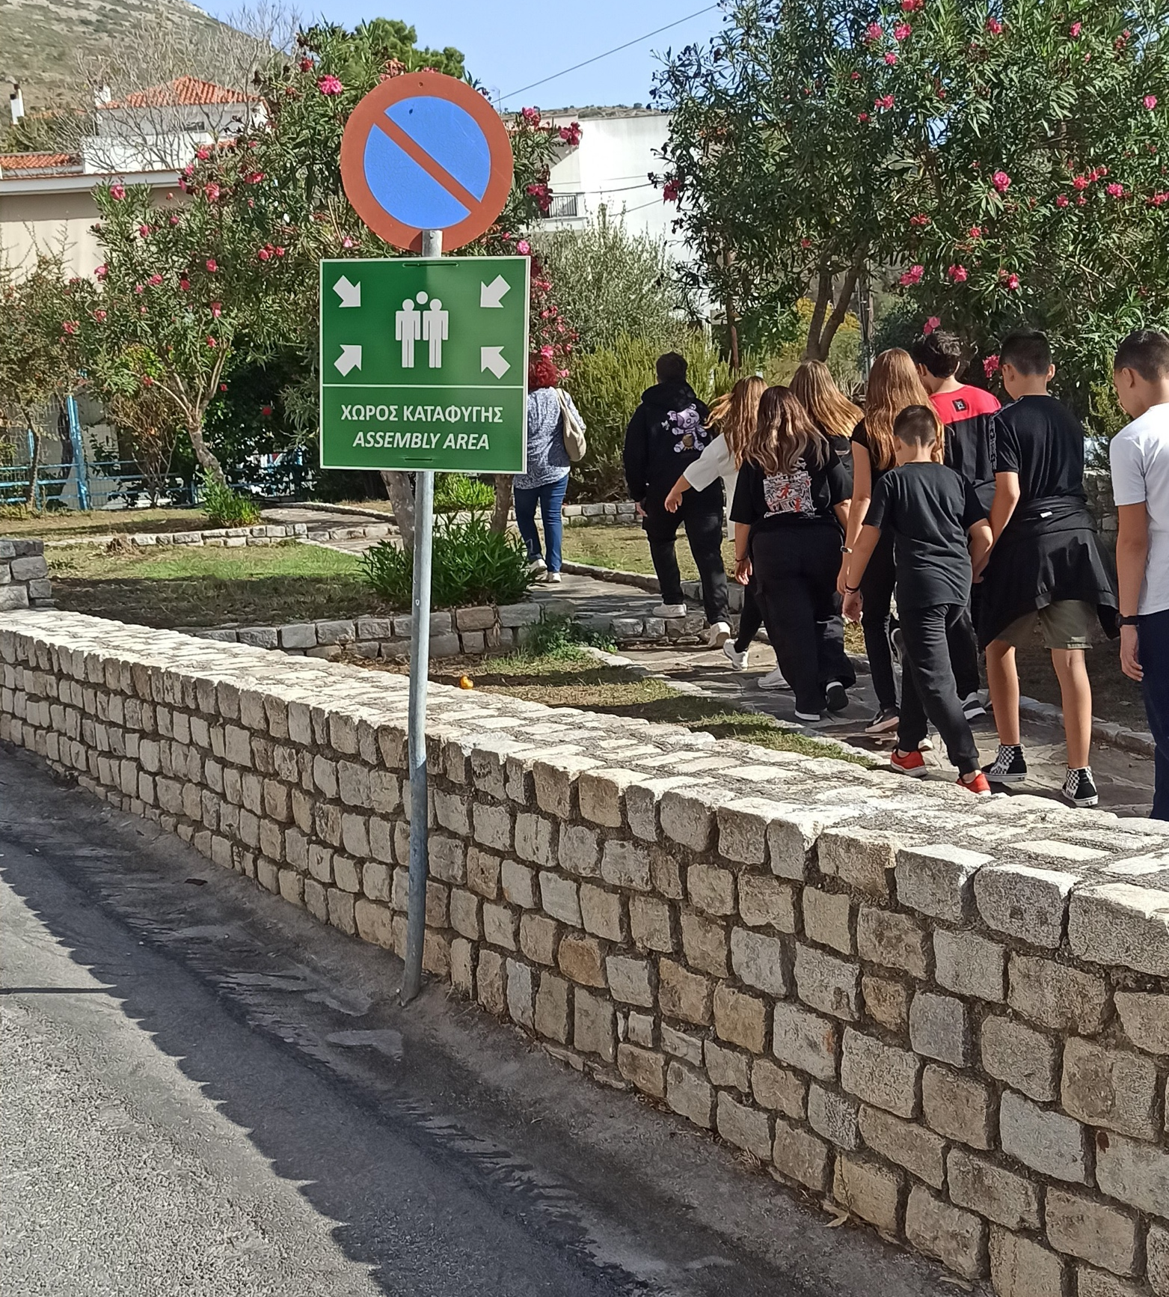
SamosWAVE23-CW – school drill in Samos
  The school drill involved two schools of Samos, namely the 1st experimental high school of Samos and the 2nd high school of Samos. The pupils were asked to follow the school protocol for earthquakes, and following the receipt of the tsunami warning through the cell broadcast message to move to the closest assembly area through a predefined escape route.
  The aim of the school drill was to
    Test the school emergency plan for earthquakes and the tsunami evacuation plan for the city of Samos prepared within the framework of the CoastWAVE project;
    Promote preparedness for earthquakes and tsunamis.

Slide 16
SamosWAVE23-CW – evaluation
  The evaluation of the design and implementation of the exercise was very positive.
  Emergency management and coordination at a local level are mainly based on personal relations and unofficial communications (i.e. personal mobile phones). While this could be proved resilient, informal networks may exclude some key actors, stakeholders and organizations from the decision-making process, thus creating conflicts and mis-trust.
  For efficient tsunami preparedness, more stakeholders must be engaged (health and welfare institutions, etc.). However, public participation and cooperation between a wider group of organizations at a local level remain a challenge.
  Tsunami messages are issued promptly and the General Secretary of Civil Protection (GSCP) is notified in less than 10 minutes, however downstream dissemination of messages needs improvement.
  Earthquake emergency planning for schools needs to consider also tsunamis therefore official national guidelines for schools must be improved.

Slide 17
Tsunami Ready Indicators
I | ASSESSMENT (ASSESS)
1 | ASSESS-1. Tsunami hazard zones are mapped and designated.
2 | ASSESS-2. The number of people at risk in the tsunami hazard zone is estimated.
3 | ASSESS-3. Economic, infrastructural, political and social resources are identified.
II | PREPAREDNESS (PREP)
4 | PREP-1. Easily understood tsunami evacuation maps are approved.
5 | PREP-2. Tsunami information including signage is publicaly displayed.
6 | PREP-3. Outreach and public awareness and education resources are available and distributed.
7 | PREP-4. Outreach or educational activities are held at least three times a year.
8 | PREP-5. A community tsunami exercise is conducted at least every two years.
III | RESPONSE (RESP)
9 | RESP-1. A community tsunami emergency response plan is approved.
10 | RESP-2. The capacity to manage emergency response operations during a tsunami is in place.
11 | RESP-3. Redundant and reliable means to timely receive 24-hour official tsunami alerts are in place.
12 | RESP-4. Redundant and reliable means to timely disseminate 24-hour official tsunami alerts to the public are in place.

Slide 18
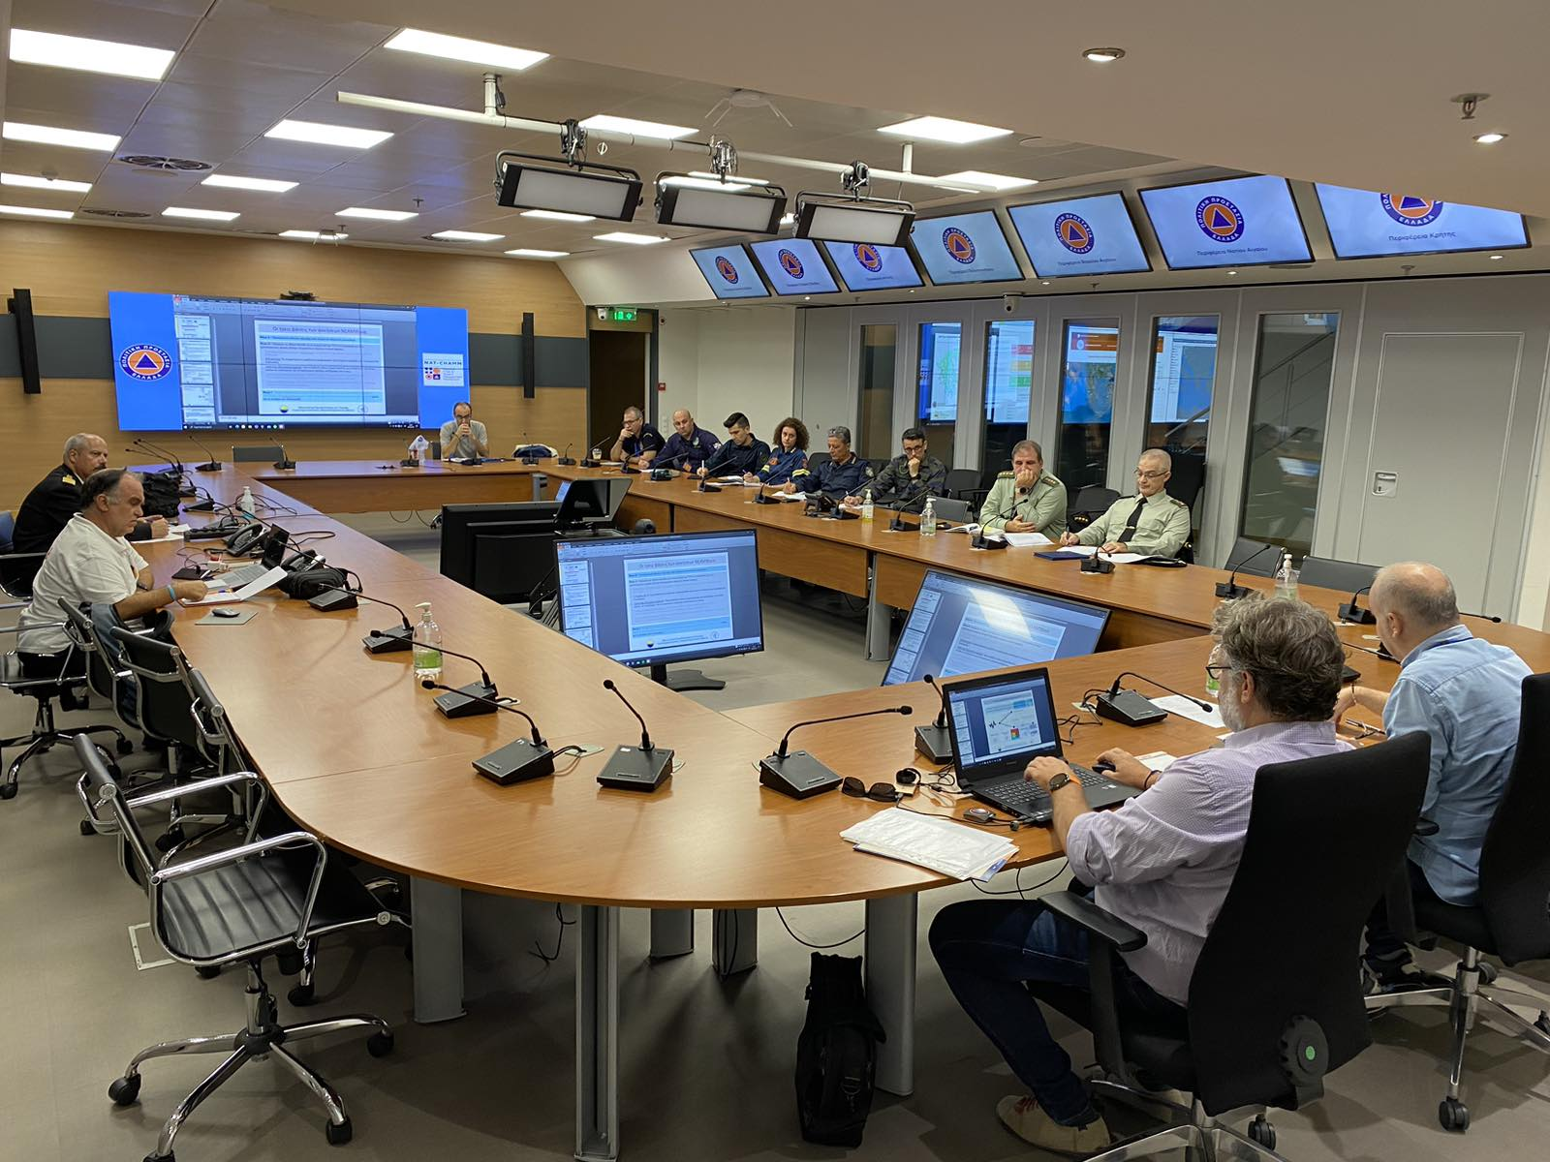
RESP-1. Community tsunami emergency response plan
  Local SOP workshops organized: February, June and October 2023
  National SOP workshop: October 2023.
  Local tsunami SOPs have been drafted and shared with the Municipal Civil Protection office for feedback.
  Next steps: collaborate with the Municipality towards finalizing the document.
Local SOP workshop
National SOP workshop

Slide 19

RESP-2. Capacity to manage emergency response
  It includes prerequisites from other TRRP indicators.
  The capacity to manage emergency response operations was and will be assessed through the community exercises.
  Next steps: document the capacity to manage emergency response operations, also based on the progress made in the other TRRP indicators.

Slide 20
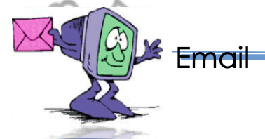
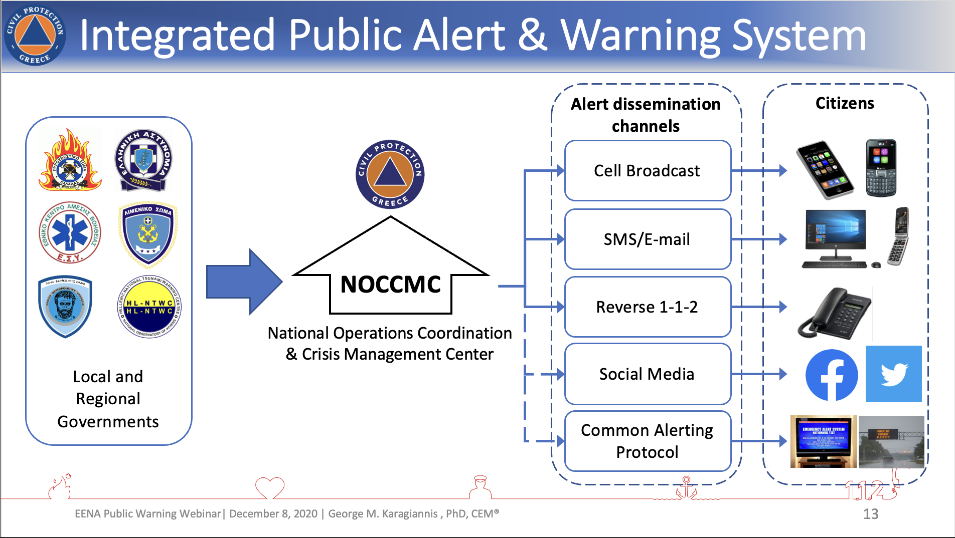
RESP-3. Receive 24-hour tsunami alerts
National
CPA
Local DMOs
1
NTWC
2-3

Slide 21

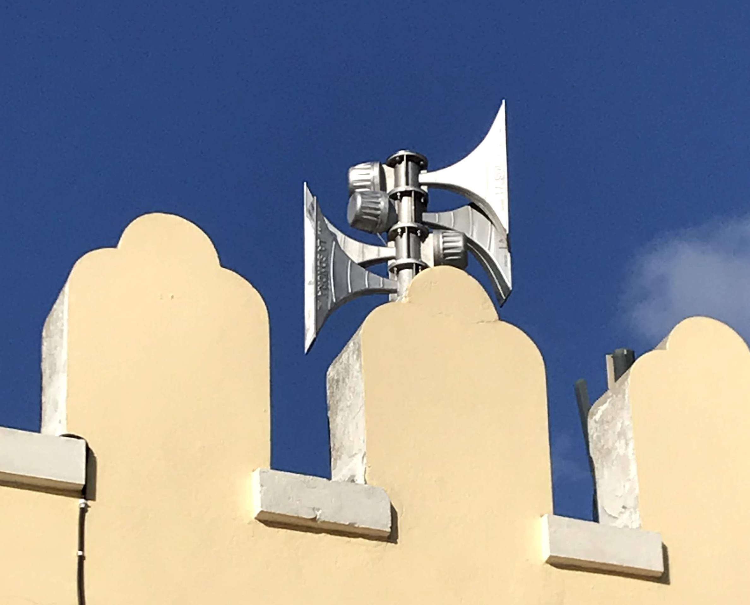
RESP-4. Disseminate 24-hour tsunami alerts
1
2
3
Loudspeakers on emergency vehicles
Local siren

Slide 22
Greece- brief summary
  National Tsunami Ready Board has been established.
  The local tsunami inundation and evacuation maps have been developed – pending approval.
  Tsunami awareness activities have been organized and conducted.
  Local and national SOP workshops have been conducted, and local SOPs have been drafted.
  A local (TTX and school drill) exercise was conducted in parallel with NEAMWave23.
  The tsunami evacuation map needs to be finalized in collaboration with the Municipality.
  Procure the order and installation of signage.
  Organize local event to present project outcomes and results.
  Finalize SOPs in collaboration with the Municipality.

Slide 23
Greece – implementation challenges
  Local stakeholders reluctant to acknowledge and act upon tsunami risk – willingness to actively engage in TRRP implementation is especially relevant to the long-term sustainability.
  Change of administration.
  Due to the historic character of the city (old buildings, irregular urban plan etc.), Due to the historic character of the city (old buildings, irregular urban plan etc.), in some areas it is challenging to find safe and adequate tsunami evacuation routes and emergency assembly areas and emergency assembly areas.
  Local plans need to integrate tsunami hazard and the national civil protection plan must be adjusted to support this.

Slide 24

SamosWAVE23-CW

