Slide 1

Intergovernmental Coordination Group for the Tsunami Early Warning and Mitigation System in the North – eastern Atlantic, the Mediterranean and Connected Seas (ICG/NEAMTWS – XVIII)
Report from the Italian Civil Protection Department
Chiara Paniccia and Arianna Minicocci – Office of the operational director for emergency coordination
chiara.paniccia@protezionecivile.it
arianna.minicocci@protezionecivile.it

Slide 2

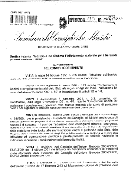
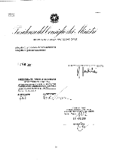
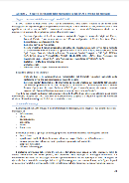
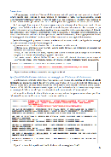
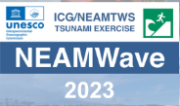




RECENT ITALIAN ACTIVITIES
ON TSUNAMI RISK
AN.CE.
 | Prime Minister's Directive: Establishment of the National Earthquake-Generated Tsunami Warning System - SiAM | Directions to the Components and Operational Structures of the National Civil Protection Service for updating civil protection planning for tsunami risk | Exe Sisma dello Stretto | Exe NEAMWave23
2013 | 2017 | 2018 | 2022 | 2023 | 2024
«I Don’t take Risks» campaign |  |  |  | The comic strip

Slide 3
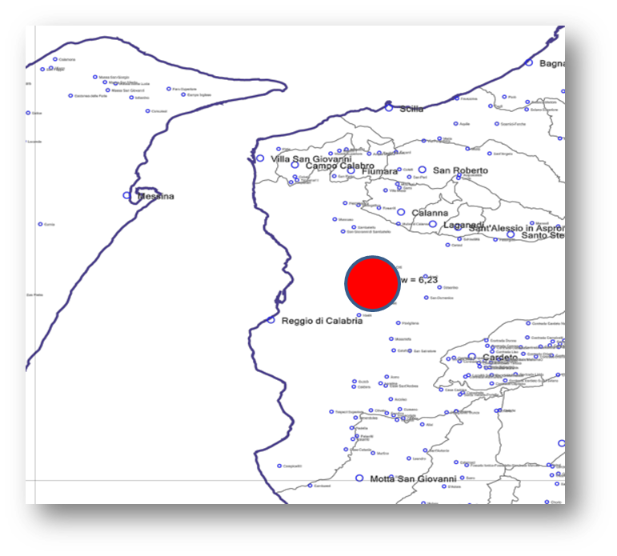
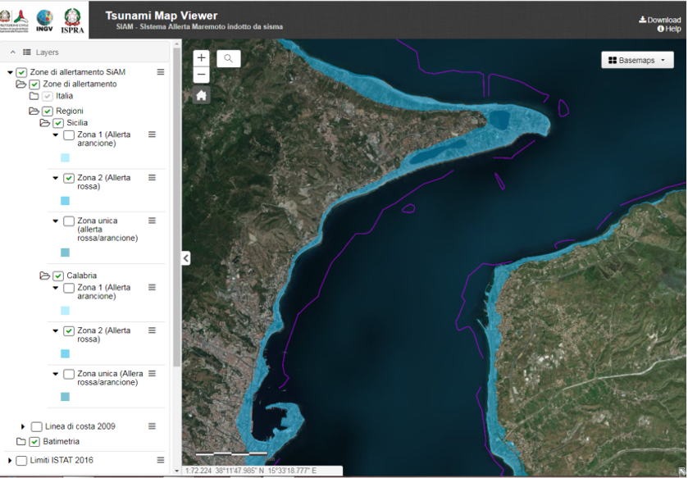
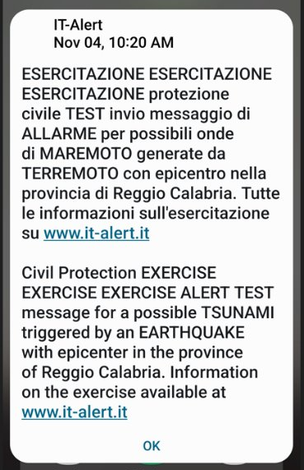
«Exe Sisma dello Stretto 2022»
National Full Scale exercise, 4 -6 November 2022
HISTORICAL REFERENCE EVENT
Stretto di Messina earthquake
January 16, 1975
Ml= 5.5
Test of the IT-Alert system with tsunami risk message delivery
SIMULATED EVENT
Magnitude of the event: Mw = 6.2 - Ml= 6
Epicentral intensity = 9
SiAM PLATFORM
TSUNAMI MESSAGES SENDING
Notes:
SiAM
Aggiornamento anagrafica
Problema tecnologico
IT-alert
2° occasione per far conoscere it-alert alla popolazione

Slide 4

THE ITALIAN
TSUNAMI WARNING SYSTEM
The SiAM technology platform disseminates the messages to the addresses of the different institutions of the civil protection national system, which are listed in a CEntralised Register (ANCE).
The SiAM platform is able to send the alert in a few minutes
For NEAMWAVE23 a total of:
About 3000 text messages (sms, email and Interactive Voice Response activated for the exercise) with the SiAM technology platform
ANCE's update of the SiAM platform was implemented during Neamwave 23

Slide 5






Public alert system «IT-alert»
IT-alert is a public alert system that, in cases of imminent or ongoing major emergencies and disasters, allows providers of mobile communication services to disseminate public alerts to affected end-users by transmitting messages called 'IT-alert messages'.
When the system becomes operational, the events in the field of civil protection, that have been foreseen at the moment by the Directive of 7 February 2023 for the use of IT-Alert, are the following:
Making citizens aware of the test dates, how the system will work, and make sure they can identify the message sound and visual identity. Make them complete a predefined and anonymous questionnaire in order to collect informations especially on any possible system malfunctioning during the tests.
Goals of the testing and communication campaign of 2023
Making IT-alert known as a new public alert system. At this stage, the risks and behaviors have not been detailed yet;
Heavy rainfall
(ongoing)
Tsunami generated by earthquake
Collapse of a big dam
Relevant accidents in industrial plants
(dlgs 105/2015)​
Volcanic activity (Vesuvio, Campi Flegrei, Vulcano, Stromboli)​
Nuclear accidents or radiological emergencies
Notes:
It-alert allertamento al cittadino

Slide 6
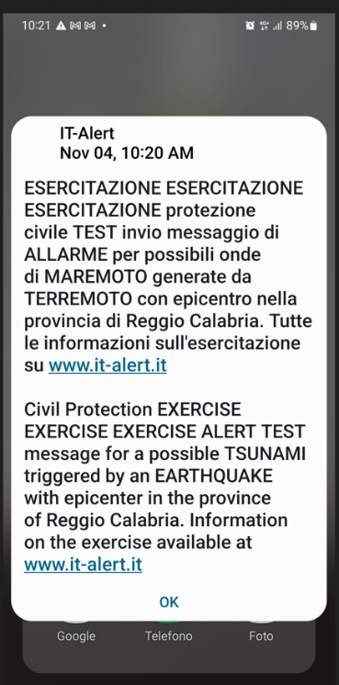
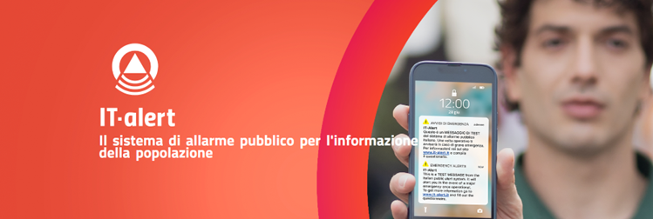
Public alert system «IT-alert»
Testing phase
2022- 2023
Exe «Sisma dello Stretto 2022» rischio maremoto
November 4, 2022
Message Sending Test to all citizens in 2023 - First phase
Message sending test to all citizens in 2023​ - Second phase​
June 28 - Toscana
June 30 - Sardegna
July 5 – Sicilia
July 7 - Calabria
July 10 – Emilia Romagna
September 12 - Friuli Venezia Giulia, Campania e Marche​
September 14 – Piemonte, Puglie e Umbria
September 26 - Abruzzo e Provincia autonoma di Trento
October 21 - Provincia Autonoma di Bolzano
September 19 – Molise, Lombardia e Basilicata
September 21 - Veneto e Valle d’Aosta
September 27 – Lazio e Liguria

Slide 7
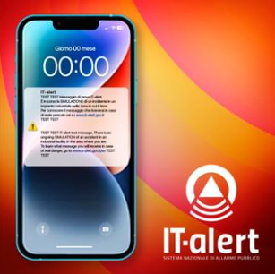
Public alert system «IT-alert»
RISK SCENARIOS Testing phase
2023 - 2024
Major accident in industrial plants
Big dam collapse
Nuclear accident
December 19 – Puglia e Veneto
January 22 - Piemonte
January 23 - Toscana
January 24 - Calabria, Campania, Emilia-Romagna e Sardegna
January 25 – Basilicata, Friuli-Venezia Giulia
January 26 - Abruzzo
January 30 - Liguria
December 20 - Emilia-Romagna, Lombardia e Sardegna
January 25 – Campania e Provincia Autonoma di Bolzano
January 31 - Marche
February 6 - Lazio

Slide 8
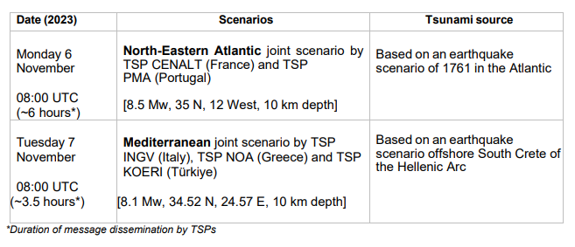
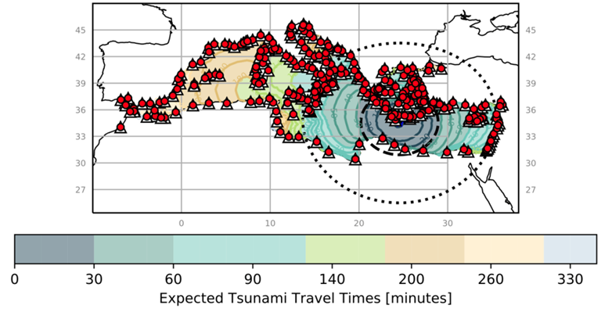
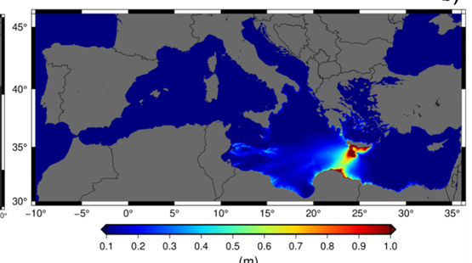
NEAMWave23 exercise
November 7, 2023
6–7 November 2023
Tsunami Exercise of the Tsunami Early Warning and Mitigation System in the North-Eastern Atlantic, the Mediterranean and Connected Seas (NEAMTWS)
SiAM platform test with message delivery to all addresses in the Centralised Data Center – ANCE
ANCE contact details checking

Slide 9

«I DON’T TAKE RISKS»
Io non rischio (I don't take risks, IDTR) is a communication campaign that promotes the sharing of information between citizen and citizen. It is a training process which, through a cascade model, potentially involves all citizens.
The campaign aims to do prevention activities all year round, with many initiatives in the area, through IDTR365
Experts Trainers Volunteers Citizens
Volunteers live and work on their own territory, they know it and in turn are known by local institutions and citizens.
This closeness and sharing represents one of the main values of Io non rischio campaign.

Slide 10
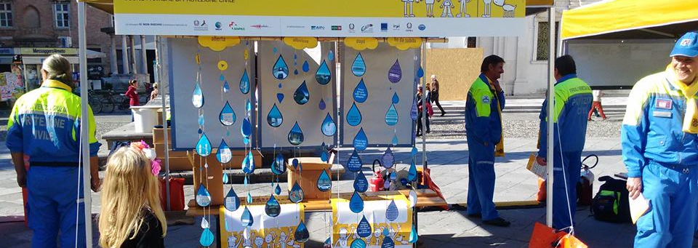
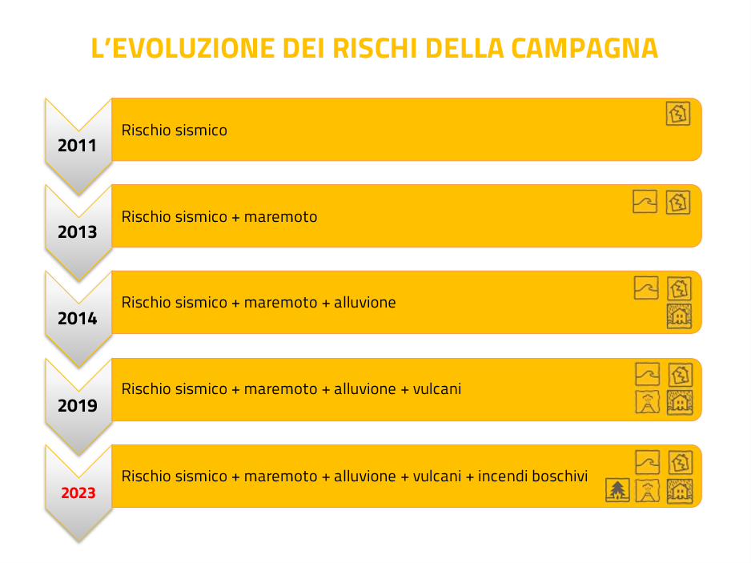


«I DON’T TAKE RISKS» OBJECTIVES
Two main objectives →
to inform and involve citizens in the process of knowledge and risk mitigation; and, in the process,
to expand the training of civil protection volunteers.
13 editions →
tens of thousands of volunteers trained,
hundreds of thousands of citizens involved.
And thanks to the digital approach these numbers could grow much faster.
The evolution of the campaign
2023 campaign
754 squares
588 municipalities
927 associations
7000 volunteers

Slide 11

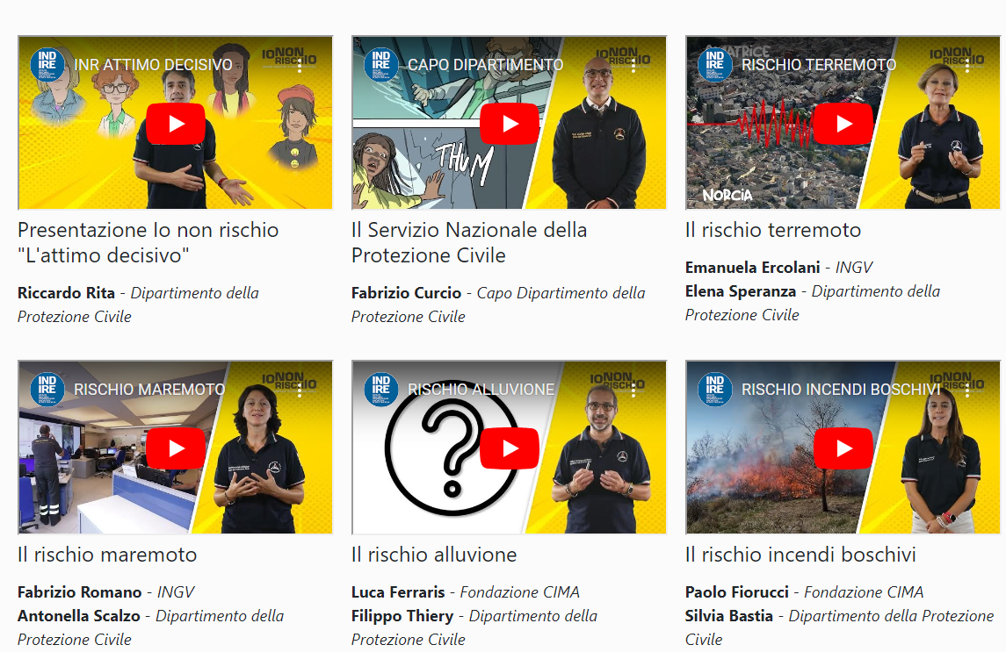
multimedia content for students and video lessons for teachers
2023 - THE COMIC STRIP
THE DECISIVE MOMENT

Slide 12

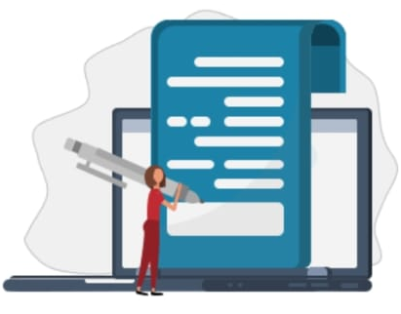



FINAL REMARKS
During the exercises, some critical issues on technological aspects (delays or non-receipt of messages) were raised, but these were solved by our IT department.
The exercises helped to keep the focus of the Institutions on the tsunami risk.​
While the SIAM platform is an targeted for the Institutions, I DO NOT TAKE RISK campaign, organization of exercises, the comic strip and IT-alert messages delivery are useful tools to reach the population
The communication test allowed to verify the updating of the contacts in the ANCE database

Slide 13
THANK YOU FOR YOUR ATTENTION!
Report from the Italian Civil Protection Department
Chiara Paniccia and Arianna Minicocci – Office of the operational director for emergency coordination
chiara.paniccia@protezionecivile.it
arianna.minicocci@protezionecivile.it

