Slide 1
TSUNAMI RESEARCH and EDUCATION PROVIDED BY THE NATIONAL INSTITUTE FOR EARTH PHYSICS, ROMANIA
Presenter: Partheniu Raluca,
Researcher at NIEP
NEAMTWS XVIII, Paris, France, 6th - 8th February 2024

Slide 2
SUMMARY
INTRODUCTION
VARIOUS STUDIES AND PROJECTS
EDUCATIONAL MATERIALS (INTERNAL AND/OR TRANSLATED)
CONCLUSIONS
ACKNOWLEDGEMENT
CONTRIBUTION
Researchers: Partheniu Raluca, Moldovan Iren Adelina, Constantin Angela, Diaconescu Mihail, Ionescu Constantin, Victorin Toader, Tolea Andreea, Ghita Cristian
Public Relations: Dragan Mihaela
IT / Technical support : Manea Liviu, Palangeanu Lucian, Murat Edvin
NEAMTWS XVIII, Paris, France, 6th - 8th February 2024

Slide 3
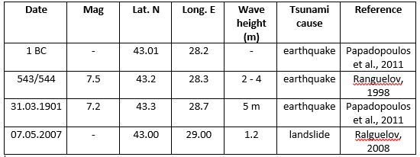
INTRODUCTION
The National Institute for Earth Physics (NIEP) is the leading institution for seismology in Romania, doing acquisition and monitoring of the seismic, geophysical and geodetic data.
NIEP is Tsunami National Contact (TNC) and Tsunami Warning Focal Points (TWFP) of Romania for the Intergovernmental Coordination Group for the Tsunami Early Warning and Mitigation System in the North-eastern Atlantic, the Mediterranean and connected seas (ICG/NEAMTWS), participating at annual meetings and taking part in different tsunami exercises. We intend to become Tsunami Service Provider (TSP) in the future.
NIEP is also part of the Global Tsunami Monitoring (GTM) group.
NIEP is using The Global Earthquake Monitoring Processing Analysis (GEMPA) software, with its tsunami related section Tsunami Observation and Simulation (TOAST).
16 years of experience in tsunami research (since 2007), with a total number of 7 tsunami past projects, 2 projects still active, and also numerous connected activities.
The Black Sea area is known for past tsunami activity, with 22 evidenced events.
4 of these events in Shabla area, affecting the Romanian
and Bulgarian shores.
NEAMTWS XVIII, Paris, France, 6th - 8th February 2024

Slide 4
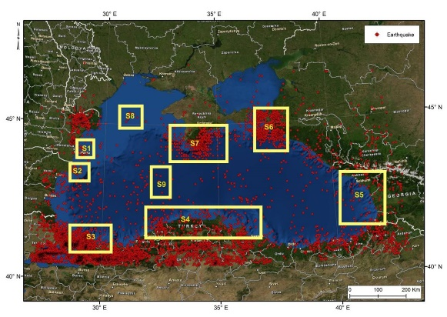
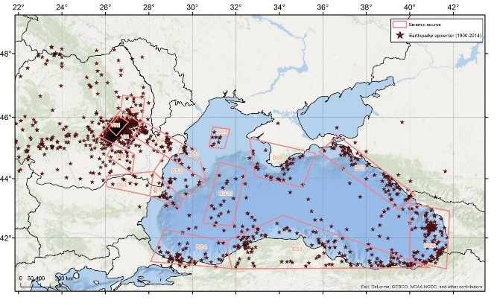
INTRODUCTION
The most known tsunami was generated on 31st of March 1901, when an earthquake of Mw 7.2 triggered tsunami waves up to 5 m heights (Papadopoulos et al., 2011). The most recent event was triggered by a submarine landslide on 7th of May 2007. and lead to 1.2 m waves (Ranguelov, 2008).
Multiple approaches in seismic source zonation were accomplished in the framework of different projects and articles by NIEP personnel (Diaconescu M. et al. 2007, Moldovan I.A. et al. 2017).
NEAMTWS XVIII, Paris, France, 6th - 8th February 2024

Slide 5
VARIOUS STUDIES AND PROJECTS
NIEP started approaching tsunami research since 2007, through numerous studies in past national and international projects, listed herein:
Multidisciplinary researches on natural hazards. Case study: tsunami type phenomenon in the Black Sea (PROFET) - National Project
Set-up and implementation of key core components of a regional early-warning system for marine geo-hazards of risk to the Romanian-Bulgarian Black Sea coastal area (MARINEGEOHAZARD) - Regional Project
Black Sea Earthquake Safety Net(work) (ESNET)- Regional Project
Global Tsunami Informal Monitoring Service (GTIMS) & Global Tsunami Informal Monitoring Service 2 (GTIMS 2) - International Projects
Assessment, Strategy And Risk Reduction for Tsunamis in Europe - Black Sea (ASTARTE) - International Project
All Risk Integrated System Towards the Holistic Early-Warning (ARISTOTLE) - International Project
Accelerating Global Science in Tsunami Hazard and Risk Analysis (AGITHAR) - International Project
Two active projects:
Long term multi-hazard ARISTOTLE-ENHSP (continuously since 2016)- International Project
The Research Center For Climate Change Due To Natural Disasters And Extreme Weather Events (REACTIVE) - National Project
Other projects and activities only emphasize the tsunami phenomena but are more educational and/or based on different subject: Mobile Earthquake Exhibition (MOBEE), The Otherwise School Program, Researchers’ Night, Romanian Seismic Educational Network (ROEDUSEIS), “Increasing The Research Capacity In The Field Of Seismology Engineering At The Seismological Observatories And Stations Within The National Seismic Network” (CRESCENTO).
NEAMTWS XVIII, Paris, France, 6th - 8th February 2024

Slide 6
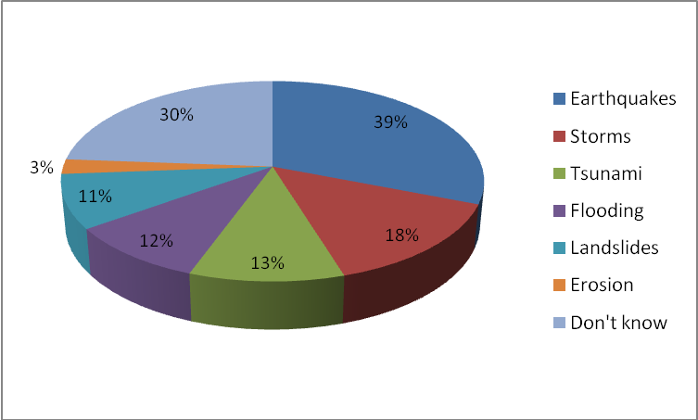
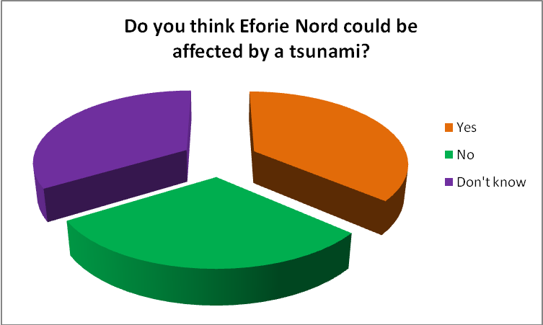
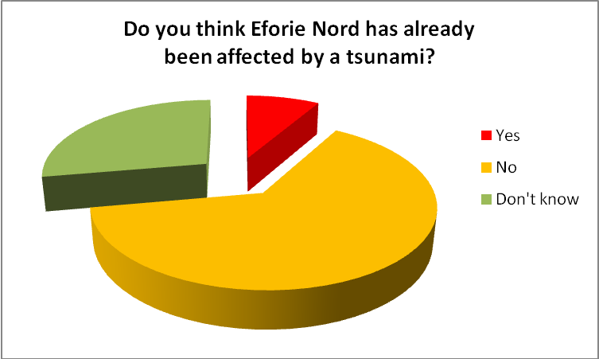
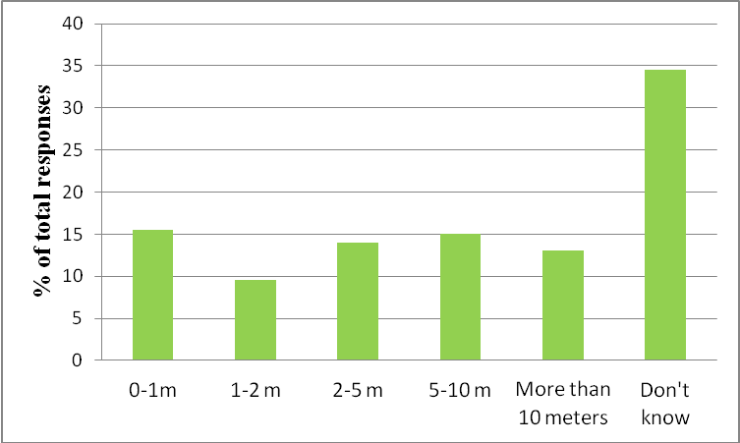
VARIOUS STUDIES AND PROJECTS
The most relevant project for tsunami resilience and education/dissemination was ASTARTE –> some
results are displayed bellow
Hazards that could affect Eforie Nord
Supposed wave heights in case of a tsunami
NEAMTWS XVIII, Paris, France, 6th - 8th February 2024

Slide 7
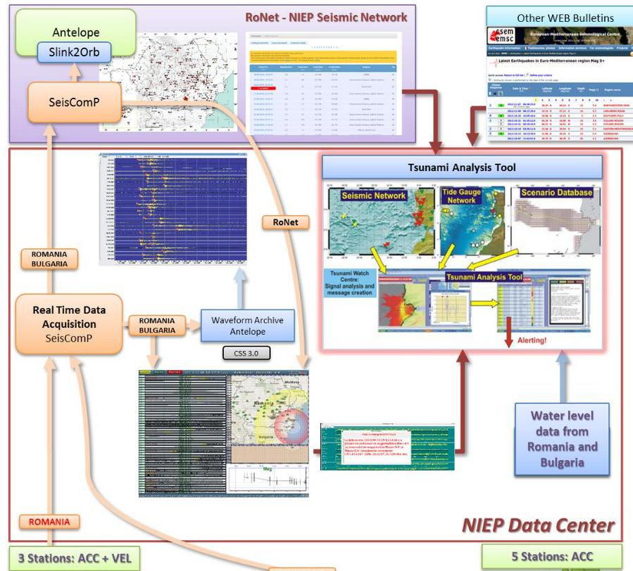
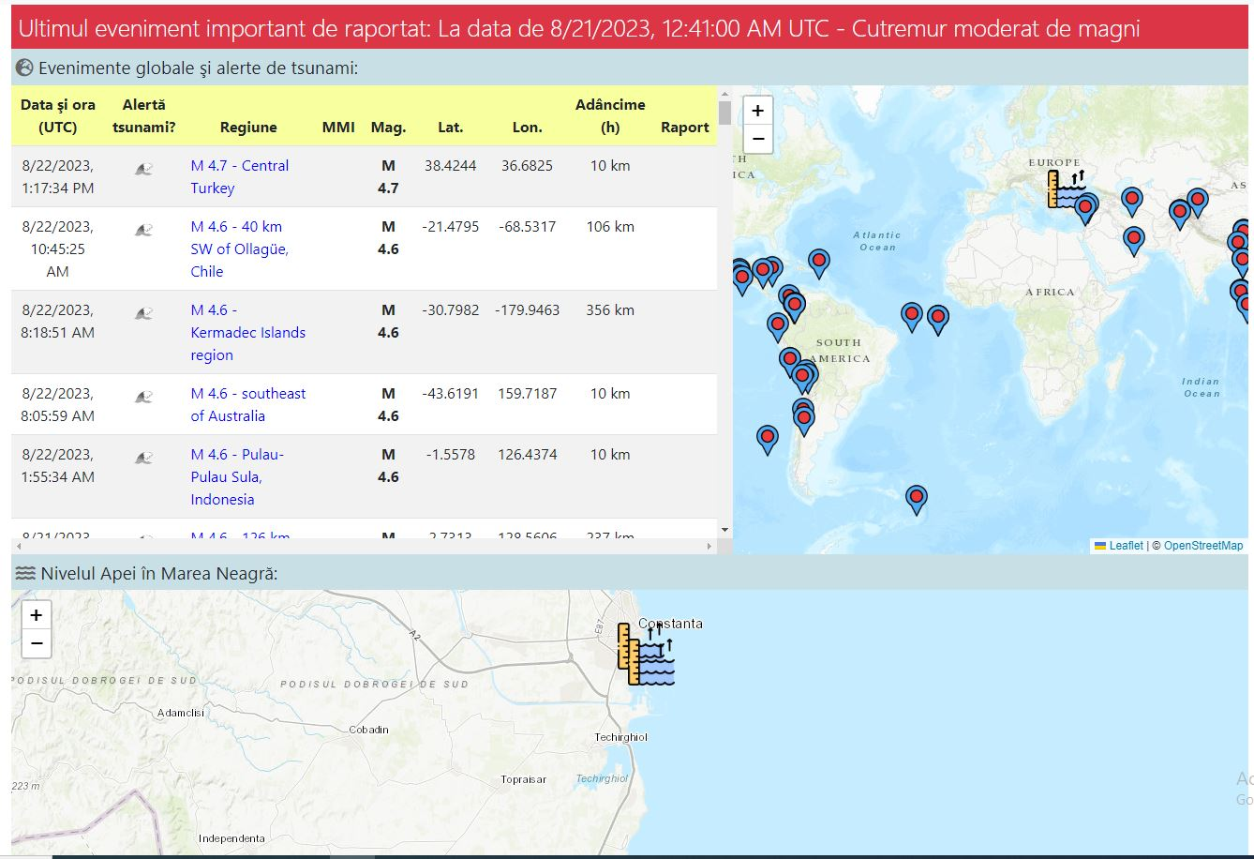
VARIOUS STUDIES AND PROJECTS
A tsunami warning system was implemented in 2013 in the framework of MARINEGEOHAZARDS project (workflow -> right image) and a specific related website was available starting with 2016 (left image) http://ctwc.infp.ro/index.php
Using this system and attached website, we monitor
the worldwide and Black Sea tsunami activity.
NEAMTWS XVIII, Paris, France, 6th - 8th February 2024

Slide 8
VARIOUS STUDIES AND PROJECTS
Black Sea level monitoring is accomplished through real time measurements, using sea level radars (at Constanta and Mangalia) and water pressure sensors (at Constanta).
Geobs is a real time database of geophysical observation (radon, air ionization, CO2 and CO, Black Sea level, magnetic field, meteorological information, infrasound, ULF - VLF radio data, telluric currents, atmospheric static electricity etc.), displayed and sent at 5 minute intervals.
http://geobs.infp.ro/echipamente.php
Geobs is used in two national projects: PhENOMeNAL (Virtual Platform for collecting and interactive analysis of multidisciplinary Geophysical Data) and AFROS (Analysis and Forecasting of Romanian Seismicity).
The instalation and maintenance of the sea level stations is accomplished in the framework of the REACTIVE project (The Research centEr for climAte Change due to naTural dIsasters and extreme weather eVEnts) part of the DTEClimate project, funded by the Recovery and Resilience National Plan supported by the European Commission
Some related scientific articles are listed below:
Toader V., Ionescu C., Moldovan I., Palangeanu L. (2022), “geobs”, Mendeley Data, V2, doi: 10.17632/28kv3gsgcz.2
Ghita, C.; Tuta, L.; Moldovan, I.A.; Ionescu, C.; Nicolaescu, M. FastICA Algorithm Applied on Black Sea Water-Level Ultrasound Measurements. Atmosphere 2022, 13, 1973. https://doi.org/10.3390/atmos13121973
Partheniu R., Ghita C., Victorin T., Nastase E., Muntean A., Murat E., Moldovan I. A., Ionescu C., Monitoring the Black Sea natural hazards using new technology and equipment, Romanian Reports in Physics, 71, 704, 2019
NEAMTWS XVIII, Paris, France, 6th - 8th February 2024

Slide 9
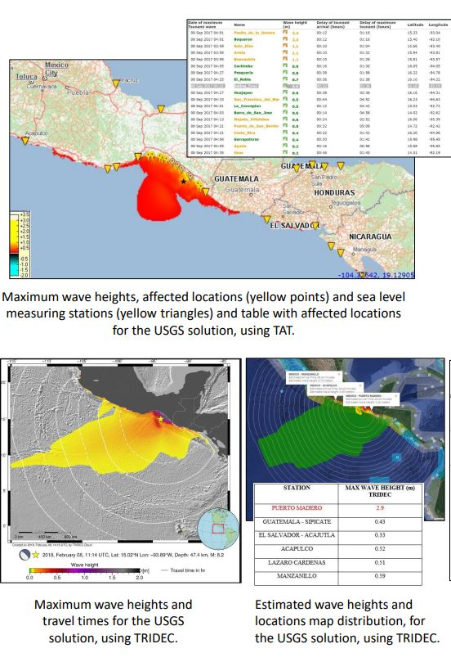
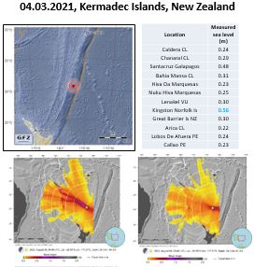
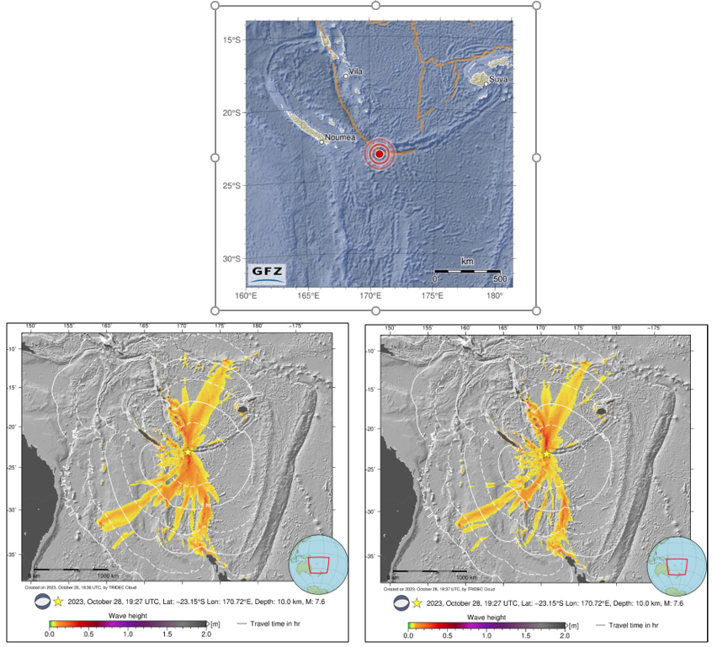
VARIOUS STUDIES AND PROJECTS
Tsunami modeling simulations for worldwide events, using Tsunami Analysis Tool (TAT) and TRIDEC Cloud software.
MEXICO EARTHQUAKE
8.09.2017, MW 8.1
LOYALTY ISLAND EARTHQUAKE 19.05.2023, MW 7.6
MAX MEASURED WAVES: 0.61 M (NOAA), 0.52 M (ITIC))
NEAMTWS XVIII, Paris, France, 6th - 8th February 2024

Slide 10
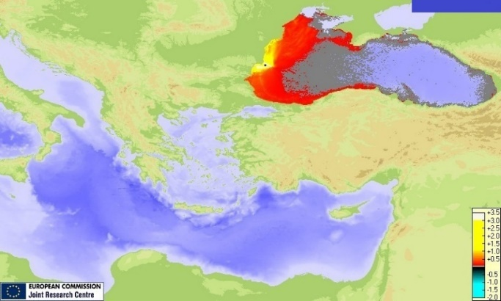
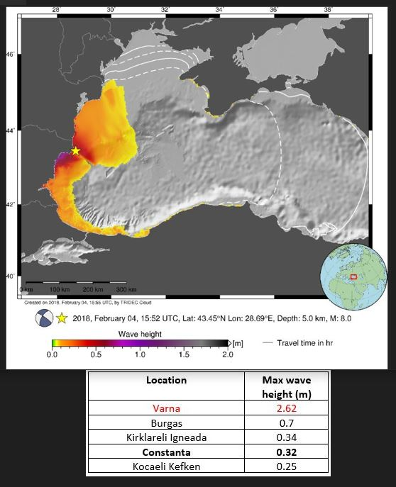
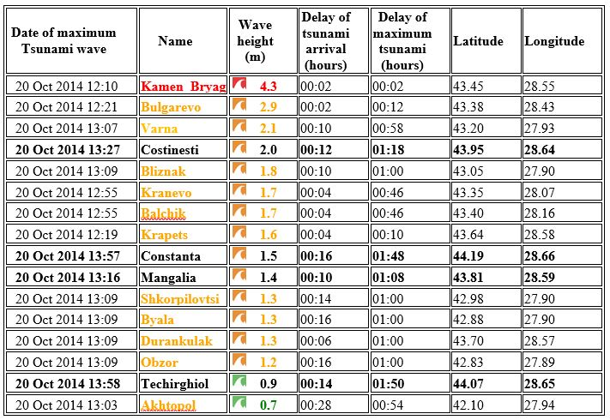
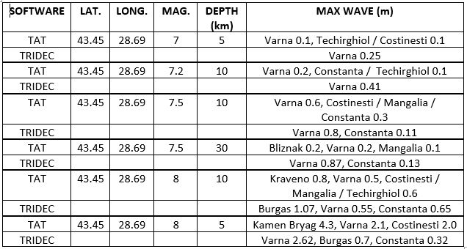
VARIOUS STUDIES AND PROJECTS
Comparison of tsunami modeling for Black Sea area, using TAT and TRIDEC Cloud software.
NEAMTWS XVIII, Paris, France, 6th - 8th February 2024

Slide 11
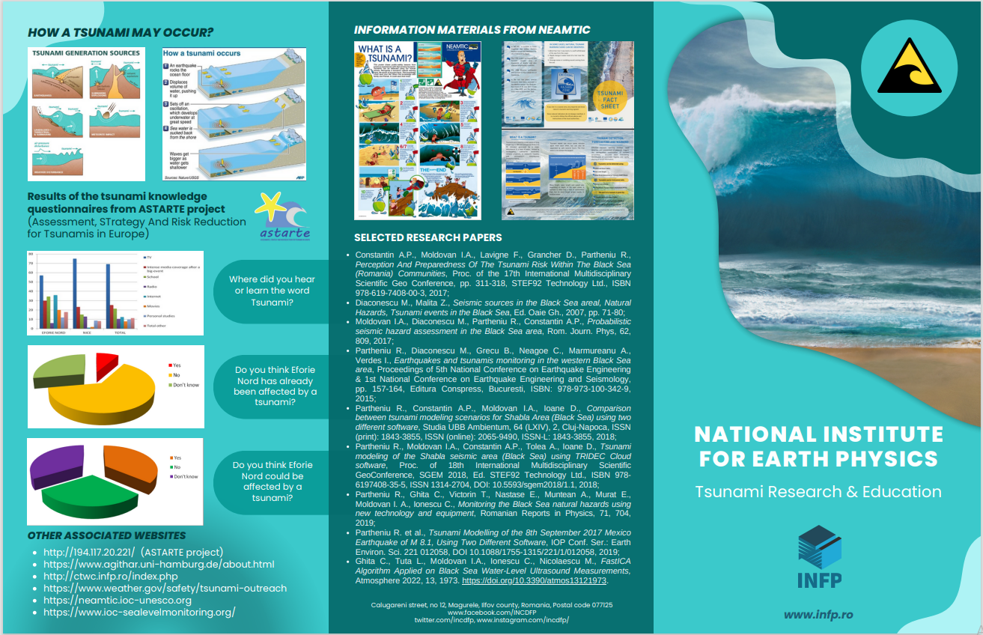
EDUCATIONAL MATERIALS
INTERNAL EDUCATIONAL MATERIALS
One general flyer regarding NIEP’s tsunami activity was structured, both in Romanian and English.
Two different roll-ups were also developed (only in English), one with educational purpose and one based on research.
NIEP TSUNAMI FLYER
(FRONT SIDE)
NEAMTWS XVIII, Paris, France, 6th - 8th February 2024

Slide 12
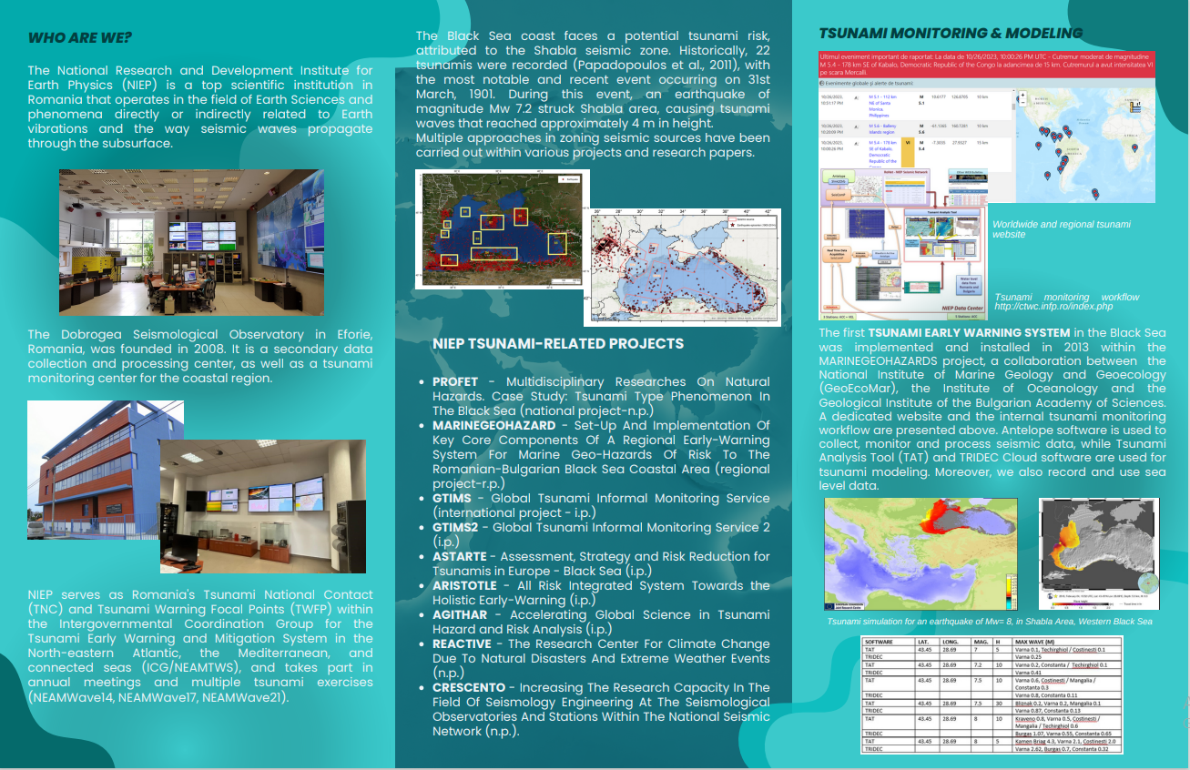
EDUCATIONAL MATERIALS
INTERNAL EDUCATIONAL MATERIALS
The two roll-ups were not displayed due lack of space and possibly repeatable content (pictures, graphics, maps, text).
NIEP TSUNAMI FLYER
(BACK SIDE)
NEAMTWS XVIII, Paris, France, 6th - 8th February 2024

Slide 13
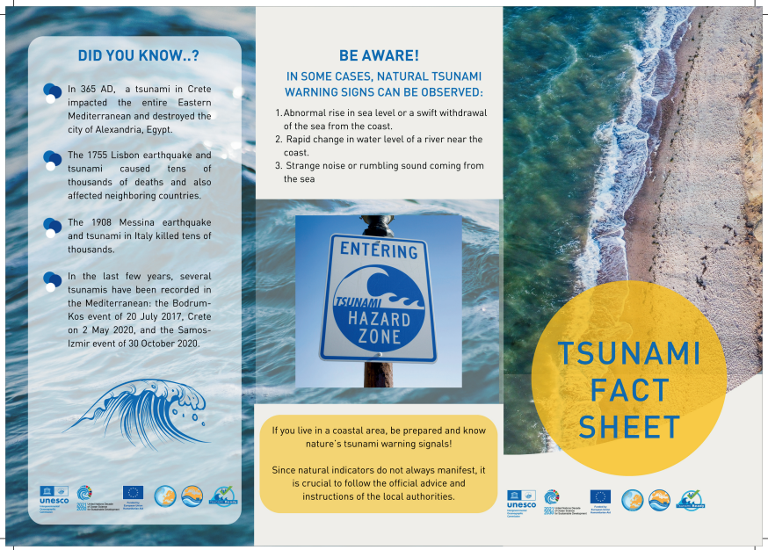
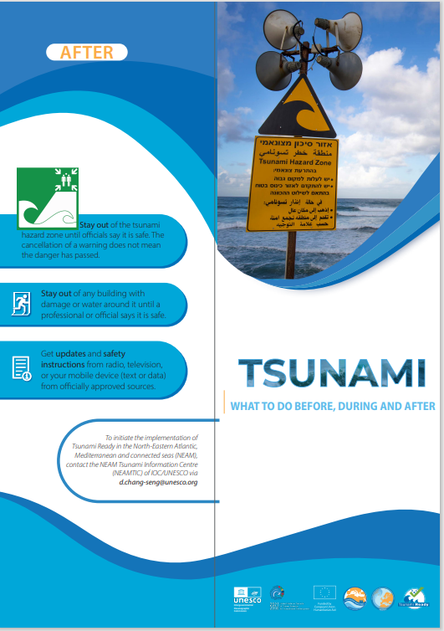
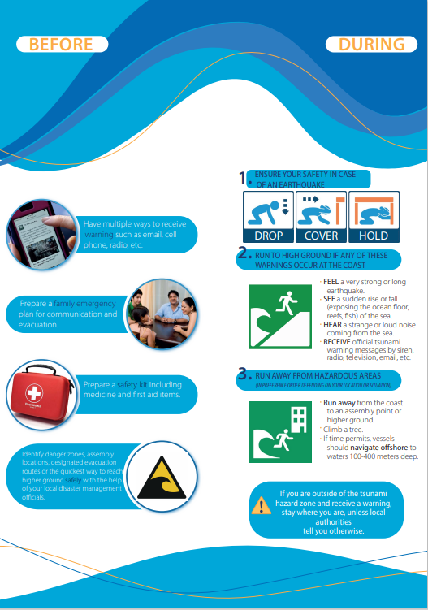
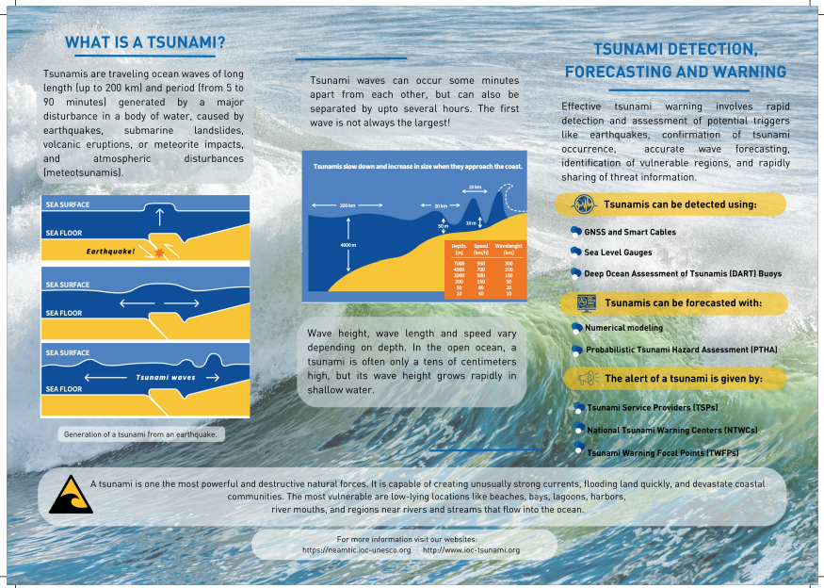
EDUCATIONAL MATERIALS
NEAMTIC MATERIALS -> Two NEAMTIC flyers have also been translated in Romanian.
NEAMTWS XVIII, Paris, France, 6th - 8th February 2024

Slide 14
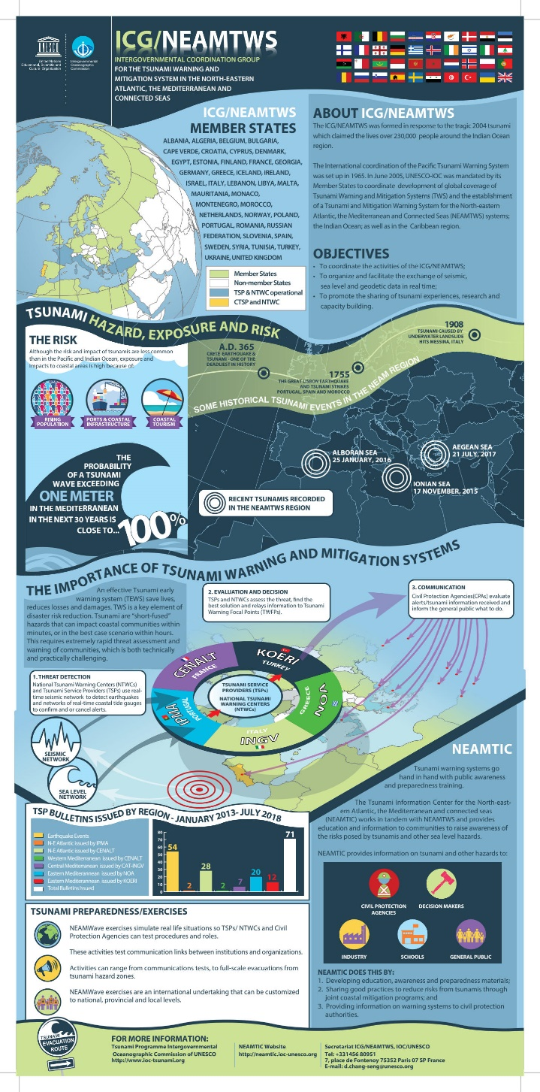
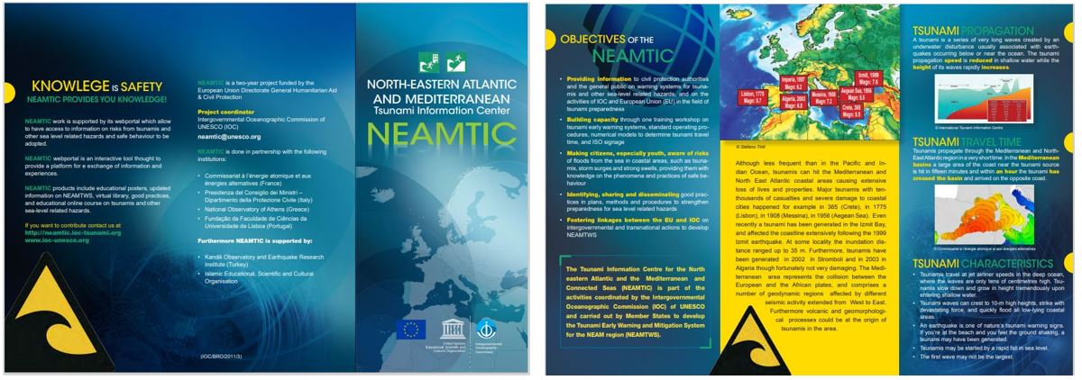
EDUCATIONAL MATERIALS
NEAMTIC MATERIALS
One NEAMTIC flyer (left - down images) and one NEANTWS poster/roll-up (right image) have also been translated in Romanian.
The whole text is translated, but the final formats in Romanian are not finalized yet, due to specific format of NEAMTIC/NEAMTWS (in transition).
NEAMTWS XVIII, Paris, France, 6th - 8th February 2024

Slide 15
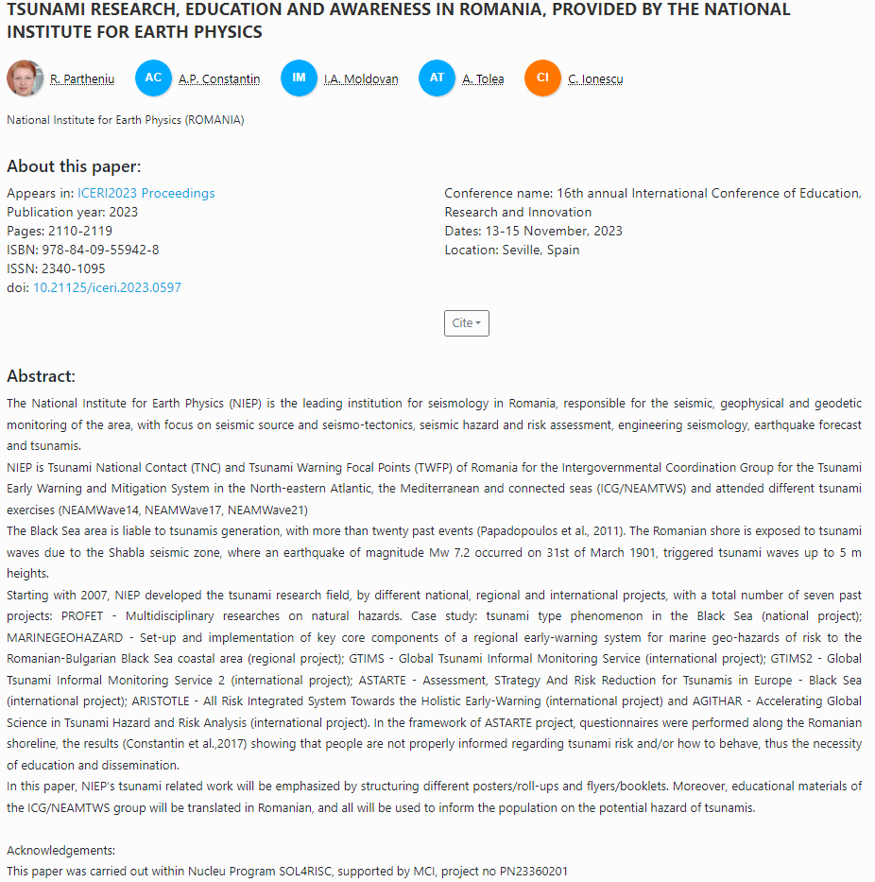
TSUNAMI RELATED PAPERS (PRESENTATIONS/ARTICLES) 2023
Partheniu R., Tiganescu A., Placinta A.O., Recent worldwide tsunamis (2020-2023) - comparisons between modeling and measurements, poster, accepted for publication in Proceedings 8th World Multidisciplinary Earth Sciences Symposium WMESS 2023
Partheniu R., Tiganescu A., Comparısons between tsunamı measurements and sımulatıons, for recent worldwıde events (2020-2023), oral presentation, GEOSCIENCE 2023, accepted for publication as Book Chapter
Partheniu R., Diaconescu M., Radulescu V., Pop I.C., Tsunamı modelıng and ınundatıon for Shabla area, Black Sea, poster, GEOSCIENCE 2023
Partheniu R., Diaconescu M., Moldovan I.A., Constantin A.P., Craiu A., Constantinescu E., Ionescu C., More than 15 years of tsunami research at the National Institute for Earth Physics, Book of Abstracts, 30th Anniversary GeoEcoMar
WORK IN PROGRESS
Partheniu R., Tiganescu A., Tolea A., Dinescu R., Comparison between tsunami modelling and measurements for the M 7.7 earthquake from 19th of May 2023 in Loyalty Islands
Partheniu R., Diaconescu M., The 7.2 M earthquake from 1st of March, Shabla area, Black Sea
NEAMTWS XVIII, Paris, France, 6th - 8th February 2024

Slide 16
IN STEAD OF CONCLUSION…
The tsunami related activity of NIEP was described through past projects, studies, articles and current monitoring activities.
We started our tsunami research since 2007, by different national and international projects, with SEVEN past projects (PROFET, ESNET, MARINEGEOHAZARDS, GTIMS, GTIMS2, ASTARTE, ARISTOTLE, AGITHAR) and TWO still active (ARISTOTLE-ENHSP and REACTIVE).
In the framework of ASTARTE project, questionnaires were conducted on the Romanian coast, in order to find the level of knowledge and education regarding tsunamis. The answers conclude that people are not at all informed regarding tsunamis in the Black Sea, nor know the risks and actions to be taken, thus the necessity of education and dissemination of tsunami materials.
A flyer containing all the research and education activity was structured (both in Romanian and English), and also two different roll-ups (only in English), one based on research, and one for educational purposes.
Few educational materials of the NEAMTIC and ICG/NEAMTWS group were translated in Romanian, as follows: one big poster /roll-up and one flyer with the group’s actions and activities, and two informational flyers (“tsunami fact sheet” and “what to do”).
FUTURE WORK
Organizing local educational meetings, seminars, workshops, new projects
In the framework of the National Research Funding Program (NUCLEU 2023-2026), PHAZER - “The seismic phenomena, from global scale to local scale, in a multidisciplinary approach”, there are two specific tsunami related phases: “Evaluating the seismic and tsunami hazard using multiple computation methods, integrating all the results in a real time complex platform” and also “Tsunami modeling scenarios for the Black Sea, using major past earthquake parameters”.
Romanian translation of more NEAMTIC flyers, posters, booklets, guides, on tsunami awareness and education, and distribution of these products in specific coastal areas on the Romanian shore.
ACKNOWLEDGEMENTS
This paper was carried out within: NUCLEU project SOL4RISC, supported by MCI, no. PN23360201 and Project PNRR- DTEClimate/REACTIVE no. 760008/31.12.2022
We acknowledge the whole contribution of our colleague Diaconescu Mihail (now retired), to all the tsunami related research studies and activity since 2007.
We acknowledge the assistance and collaboration of the ICG/NEAMTWS group and Secretariat, for providing the educational materials.
NEAMTWS XVIII, Paris, France, 6th - 8th February 2024

Slide 17
SELECTED REFERENCES
Constantin A.P., Moldovan I.A., Lavigne F., Grancher D., Partheniu R., “Perception And Preparedness Of The Tsunami Risk Within The Black Sea (Romania) Communities”, Proc. of the 17th International Multidisciplinary Scientific Geo Conference, pp. 311-318, STEF92 Technology Ltd., ISBN 978-619-7408-00-3, 2017.
Constantin A.P., Moldovan I.A., Partheniu R., Lavigne F., Grancher D., “Comparative study regarding the risk perception of tsunamis from Eforie Nord (Romania) and Nice (France) communities”, Studia UBB Ambientum, LXIII, 2, pp. 25-38, DOI:10.24193/subbambientum. 2018.2.03, 2018.
Diaconescu M., Malita Z., “Seismic sources in the Black Sea areal”, Natural hazard: Tsunami Events in the Black Sea, Ed. Oaie, Gh., pp. 71-80, 2007.
Moldovan I.A, Diaconescu M., Partheniu R., Constantin A.P., “Probabilistic seismic hazard assessment in the Black Sea area”, Rom. Journ. Phys, 62, 809, 2017.
Partheniu R., Diaconescu M., Grecu B., Neagoe C., Marmureanu A., Verdes I., “Earthquakes and tsunamis monitoring in the western Black Sea area”, Proceedings of 5th National Conference on Earthquake Engineering & 1st National Conference on Earthquake Engineering and Seismology, pp. 157-164, Ed. Conspress, Bucharest, ISBN: 978-973-100-342-9, 2015.
Partheniu R., Constantin A.P., Moldovan I.A., Ioane D., “Comparison between tsunami modeling scenarios for Shabla Area (Black Sea) using two different software”, Studia UBB Ambientum, 64 (LXIV), 2, Cluj-Napoca, ISSN (print): 1843-3855, ISSN (online): 2065-9490, ISSN-L: 1843-3855, 2018.
Partheniu R., Ghita C., Victorin T., Nastase E., Muntean A., Murat E., Moldovan I. A., Ionescu C., “Monitoring the Black Sea natural hazards using new technology and equipment”, Romanian Reports in Physics, 71, 704, 2019.
Papadopoulos G. A., Diakogianni G., Fokaefs A., Ranguelov B., “Tsunami hazard in the Black Sea and the Azov Sea: a new tsunami catalogue”, Natural Hazards and Earth System Science, Vol. 11, pp. 945 - 963, 2011.
https://helmholtz.software/software/tridec-cloud
http://ctwc.infp.ro/index.php
https://neamtic.ioc-unesco.org/
NEAMTWS XVIII, Paris, France, 6th - 8th February 2024

Slide 18
THANK YOU FOR YOUR ATTENTION!
NEAMTWS XVIII, Paris, France, 6th - 8th February 2024

