Slide 1

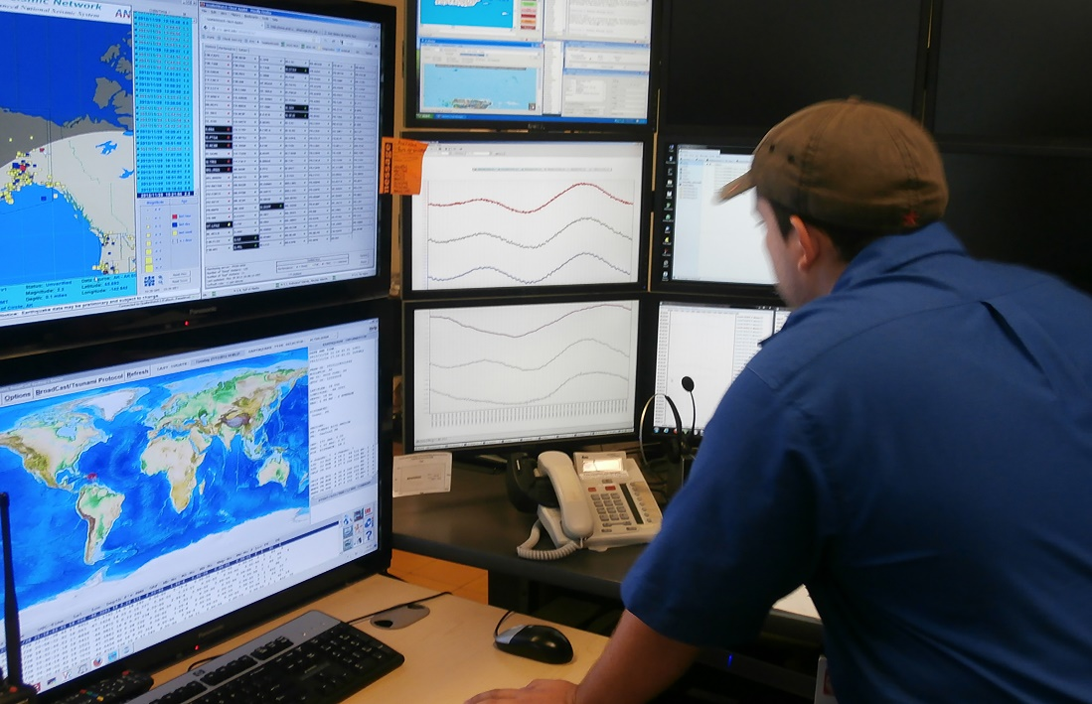
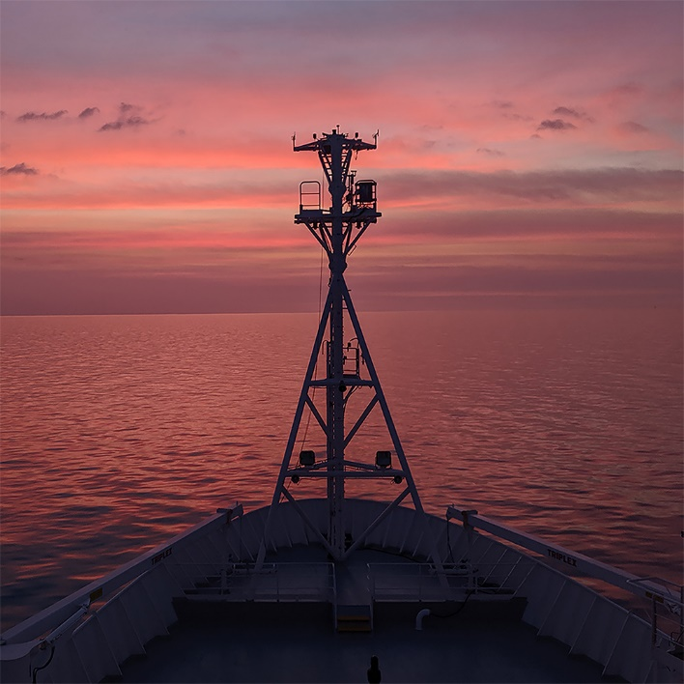
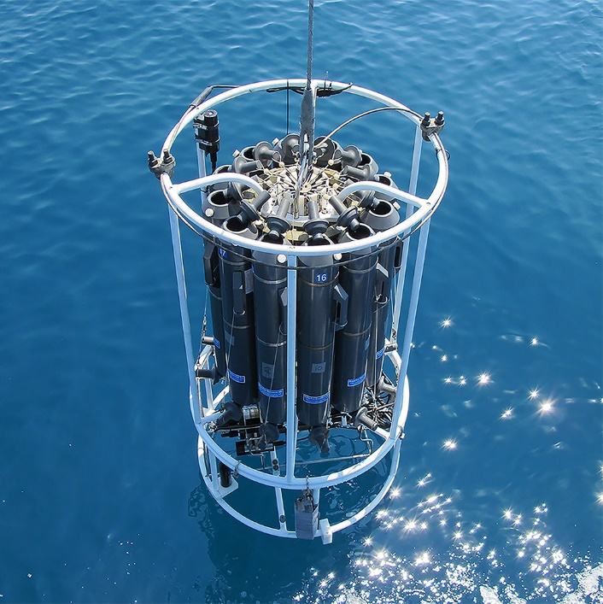
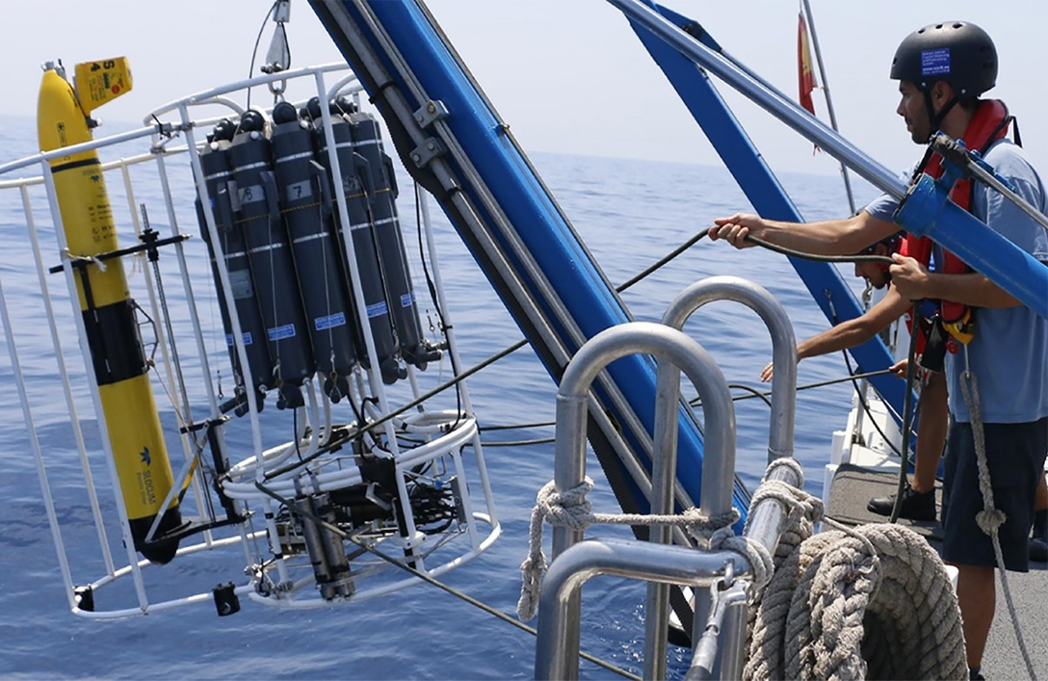
Ocean Practices regional Ambassadors
Cora Hoerstmann,
Jay Pearlman, Rebecca Zitoun
www.oceanbestpractices.org

Slide 2
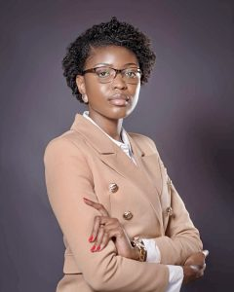
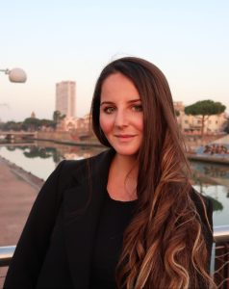
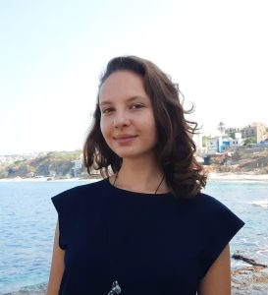
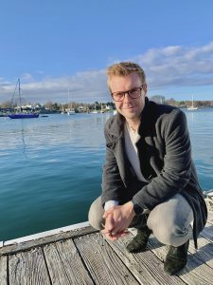
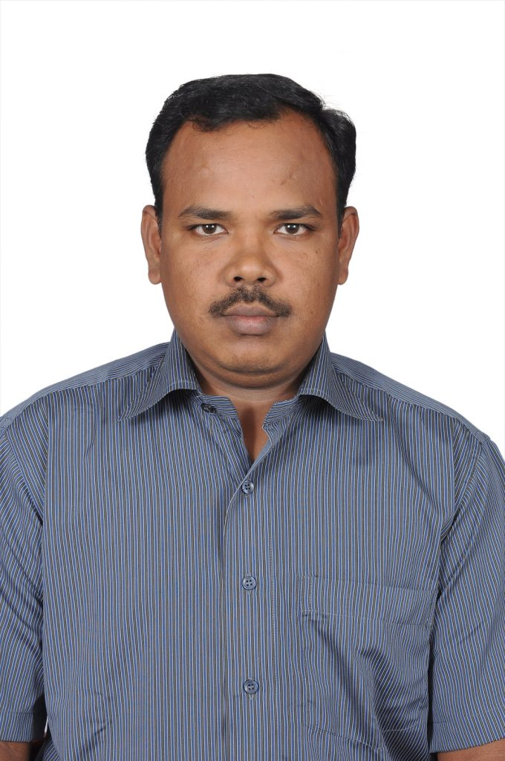
Ambassadors
2023/ 2024
Josephine Edwards,
Lady Marine Consultancy Firm (Founder),
Namibia
Carlotta Santolini,
IUSS Pavia University of Applied Sciences, Italy
Laura Khatib,
Guardians of the Blue (Co-founder), Lebanon
Talen Rimmer, University of Victoria, Canada
Sundar Ranganathan,
Ocean Observation Systems,
NIOT, India

Slide 3
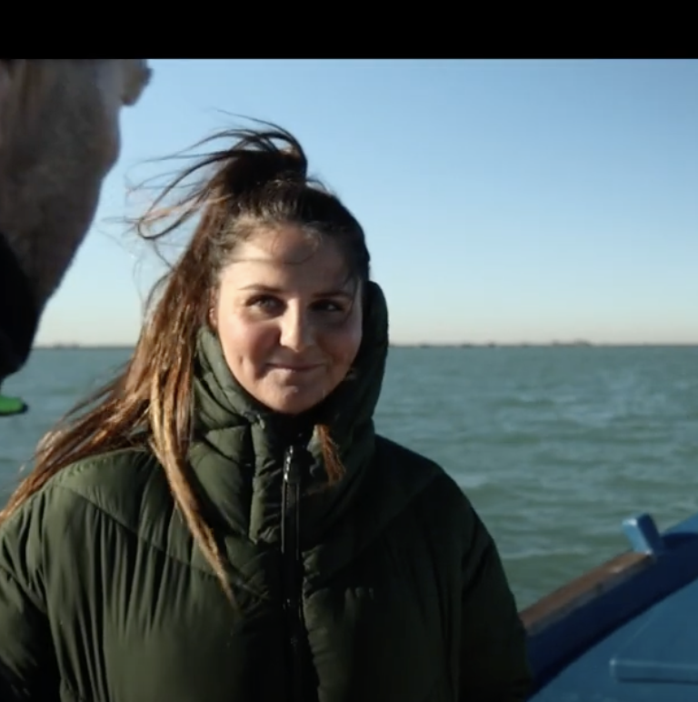
Vision and Mission
Vision:
A global network of Ambassadors that facilitate regional practices to be supported, created, understood and more broadly adopted.
Mission:
Expand regional capabilities of ocean professionals by increasing the knowledge of and access to regional practices and bringing these practices into a global context and vice versa.

Slide 4
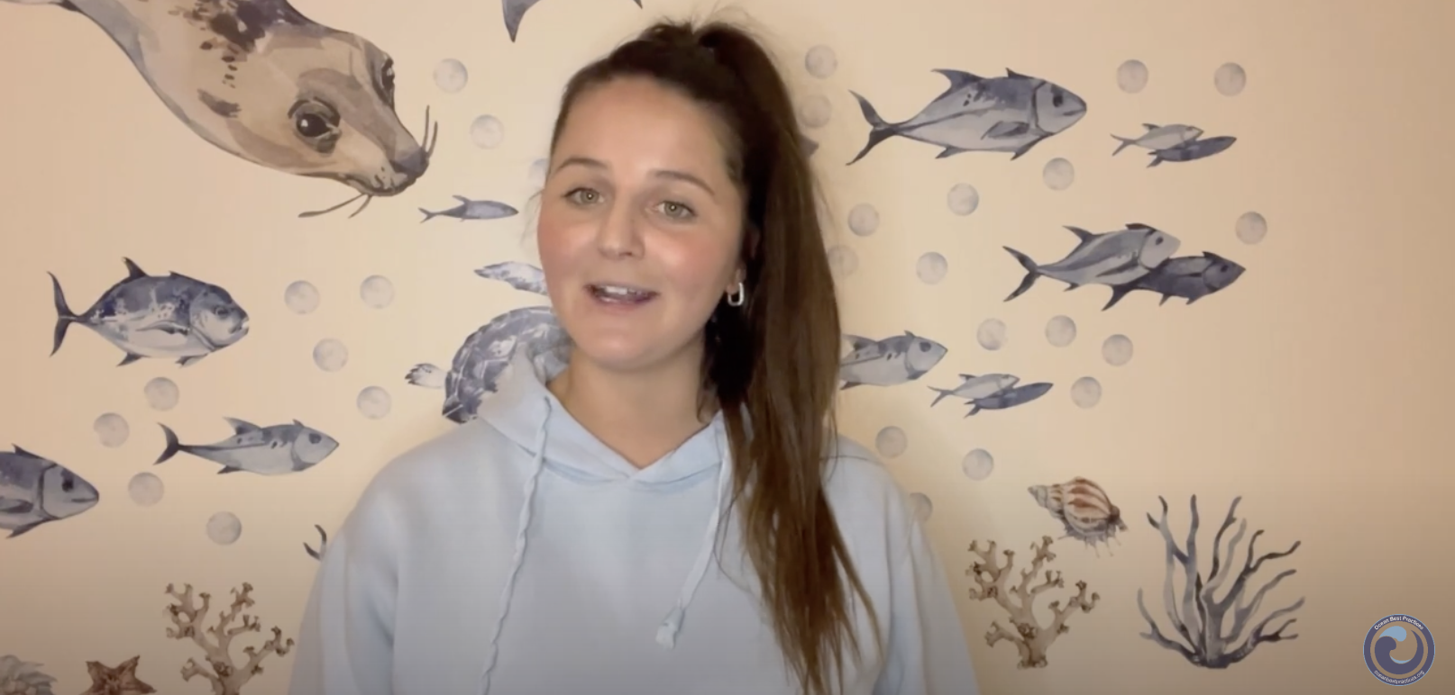
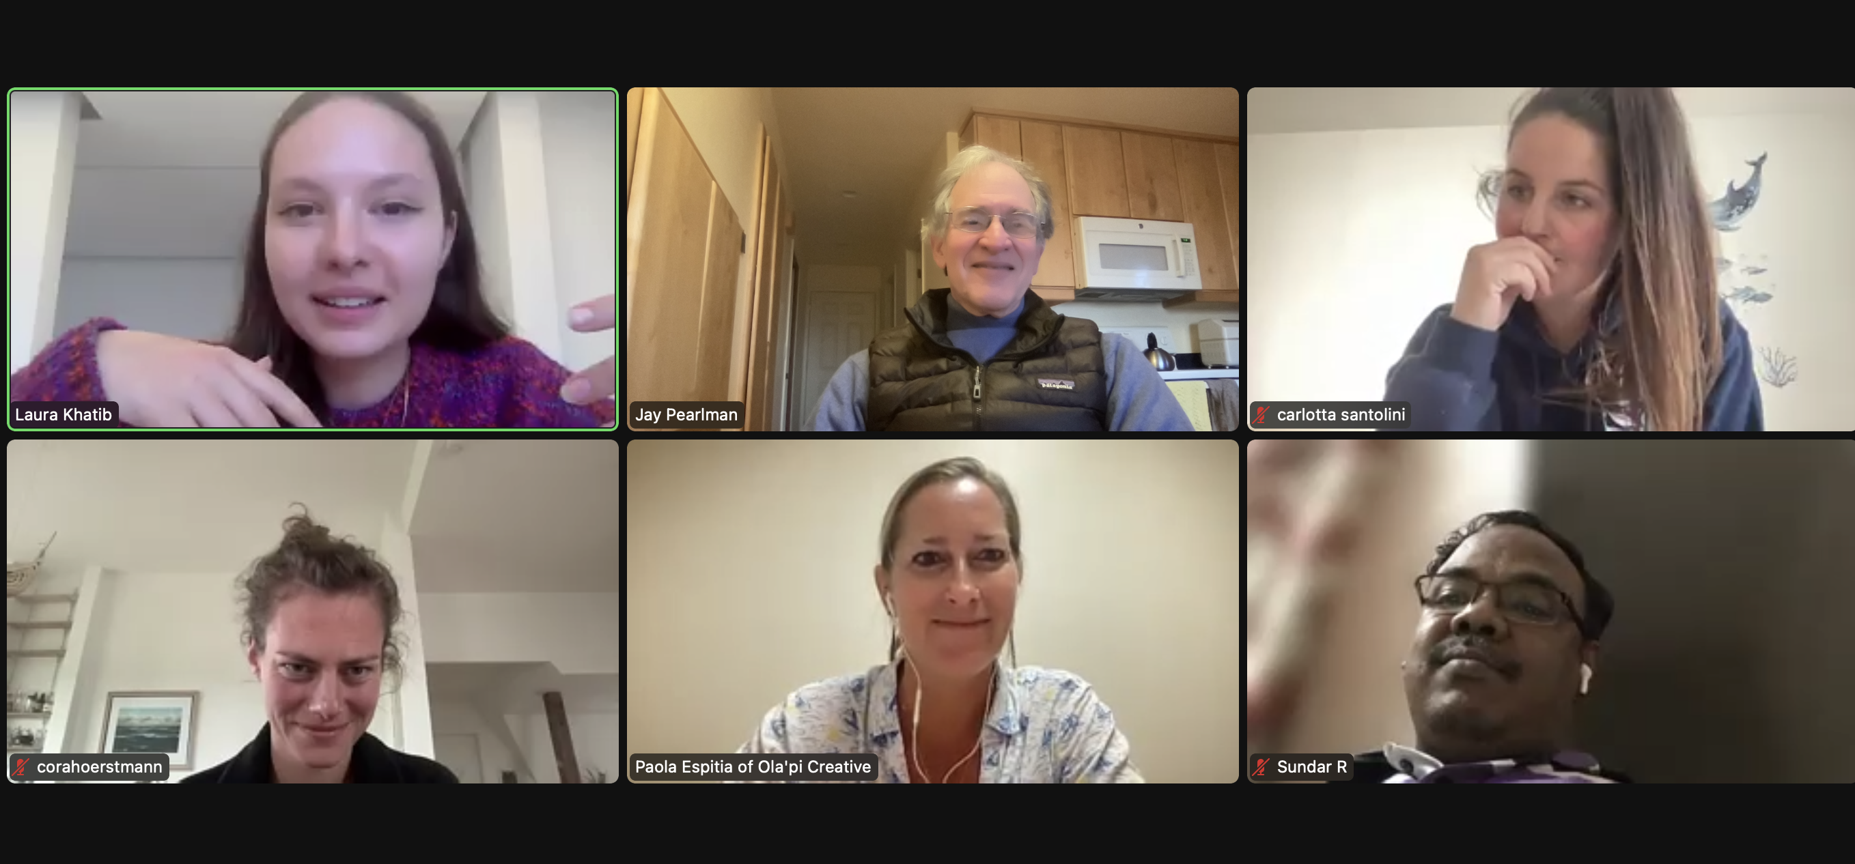
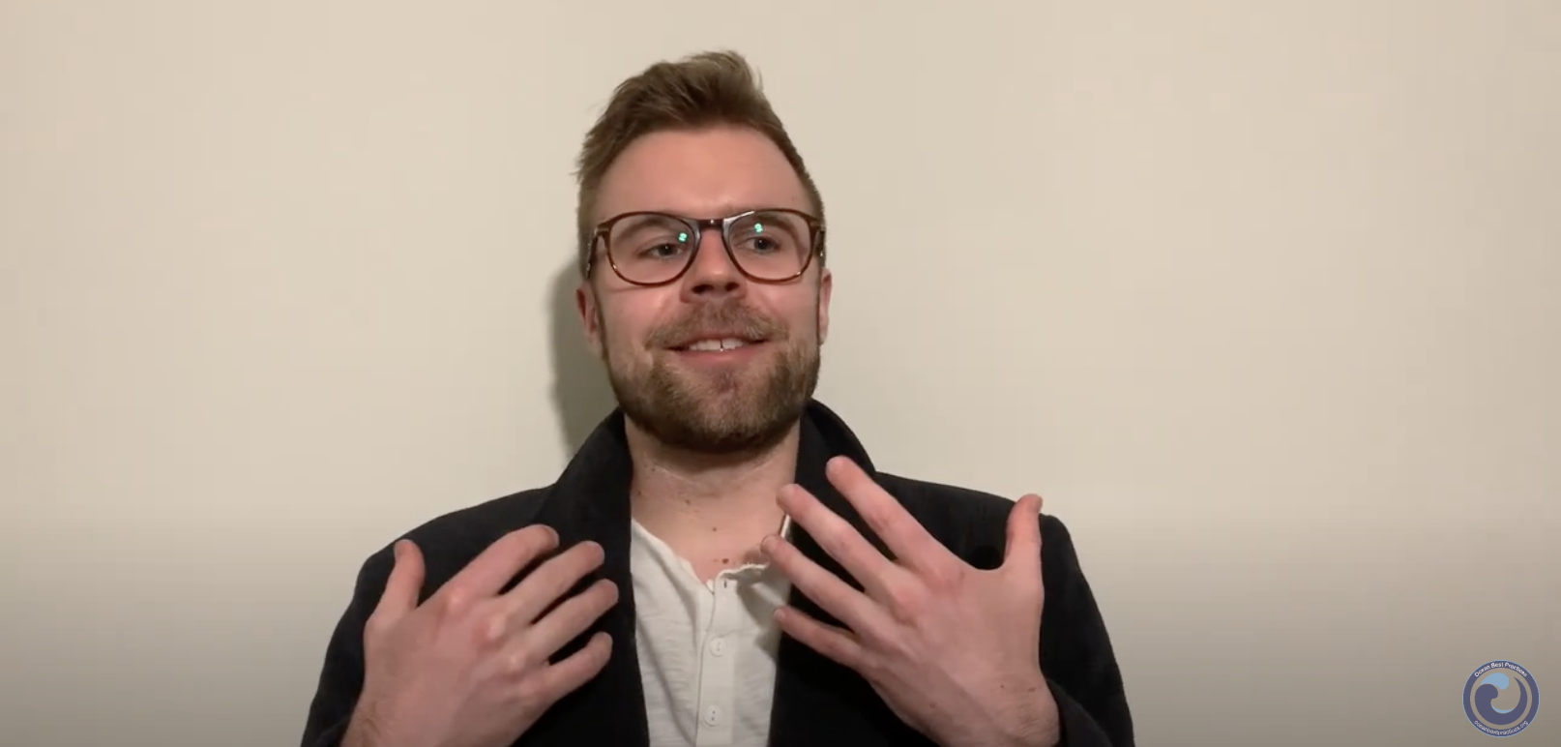
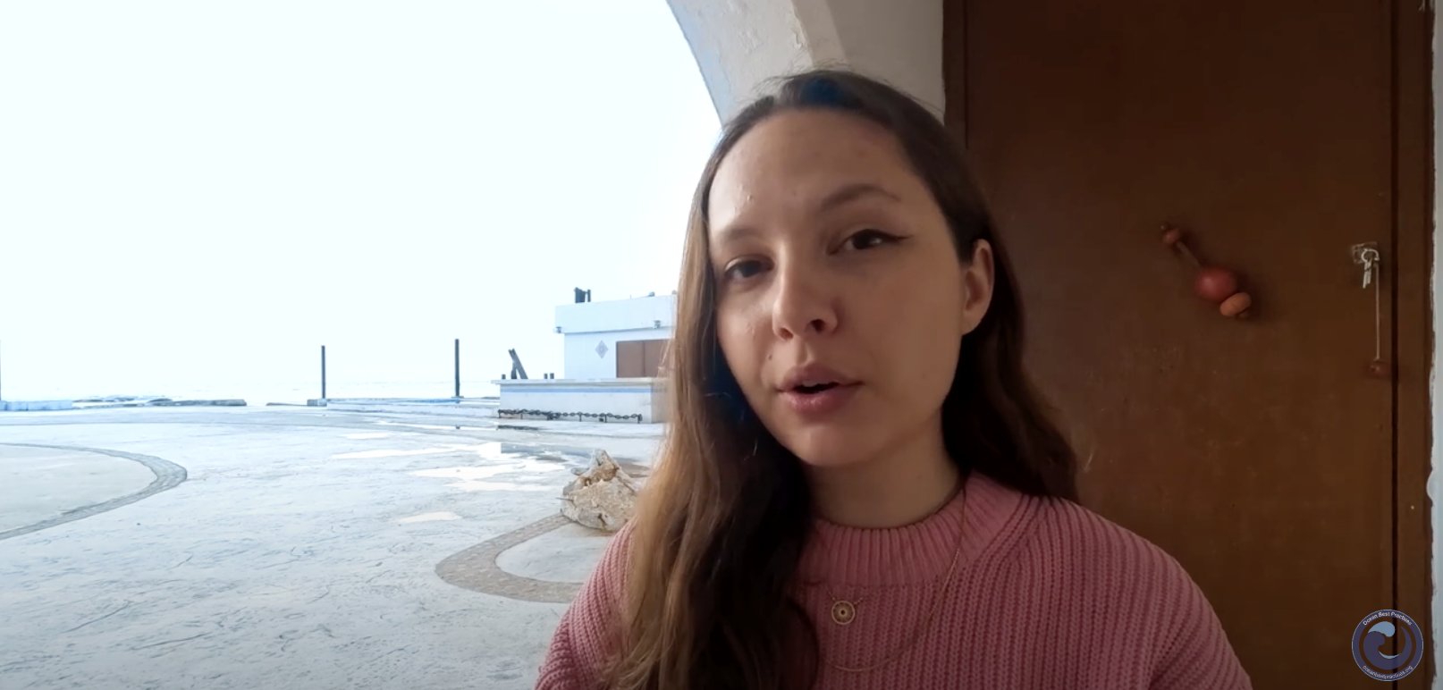
Joint Actions
Communication and Outreach Training
Final output:
Short videos promoting their work as Ambassadors (Carlotta, Talen and Laura) (available through OBPS youtube)
Regular meetings working toward a common goal (2024)

Slide 5
Individual Actions
Guiding and mentoring students and school kids
Ocean Literacy
Support OBPS WS VII
Support OBPS TT
Contributions to Newsflash
Diversity, Equity & Inclusion, Collaboration with ECOP programme

Slide 6
Mentor program
In support of the Ambassador’s work, mentors are committed to strengthening cross-generational exchange and co-development for a period of 1-2 years.
Each OceanPractices Ambassador will work together with a mentor in a one-on-one relationship. Mentors and mentees will meet approximately once every two months (in person, over e-mail, or through zoom).
Successful
Talen – Ana Carolina Mazzuco
Carlotta – Aileen Tan Shau Hwai

Slide 7
2024
UN Ocean Decade Conference, Barcelona, Spain
(Laura: Ocean Literacy/ ECOP programme; Talen: DEI/ ECOP programme) – Joint action together with Ocean Practices for the Decade?
Il ritorno delle Sirene” ("the return of the mermaids”) Festival, Rimini, Italy
(Carlotta, co-organizer. OBPS to support and in the award panel, Laura and Josephine to attend?)
Other conferences, meetings, opportunities?

Slide 8



