Slide 1

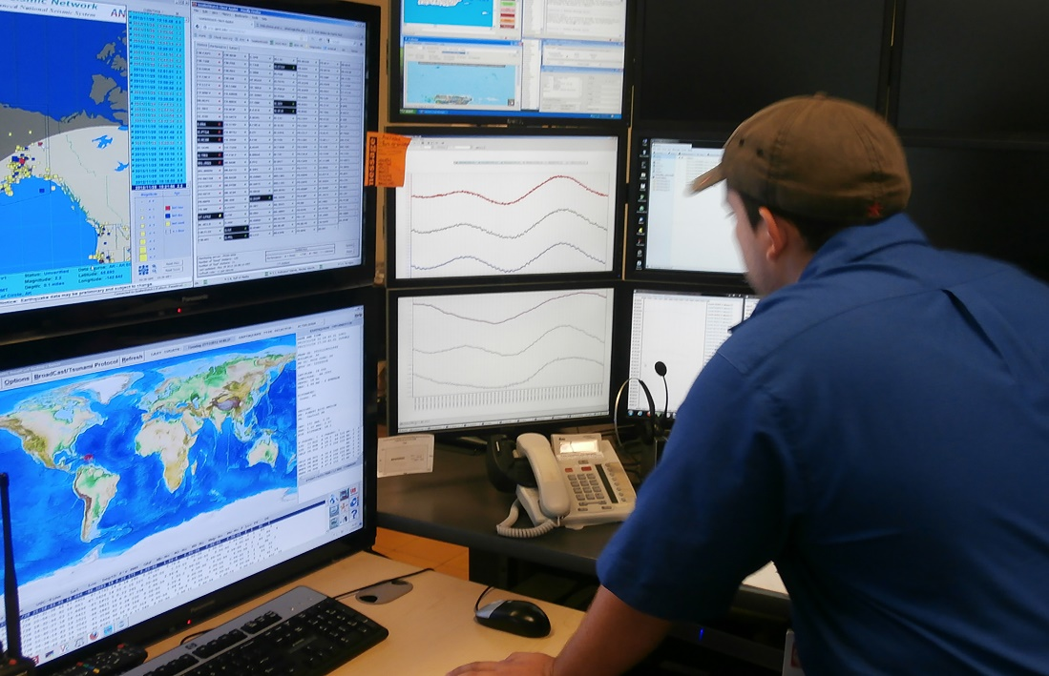
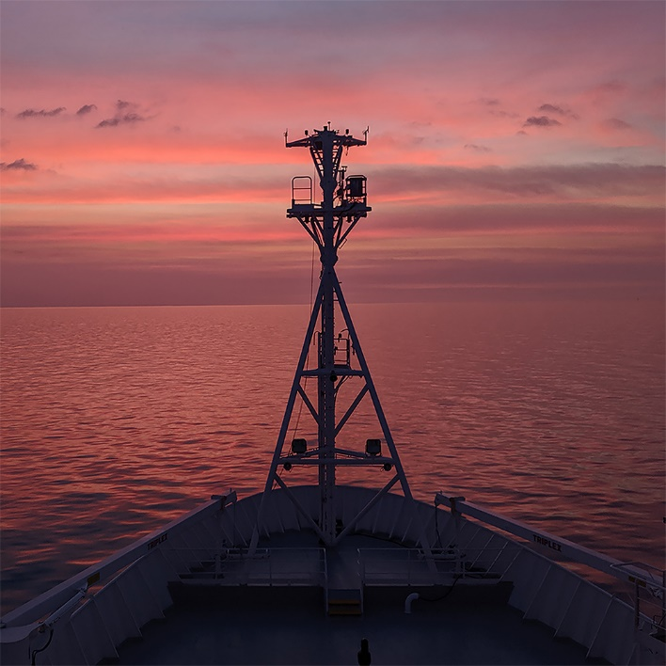
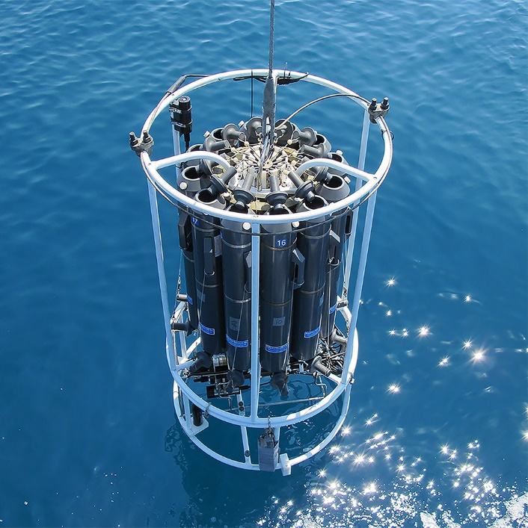
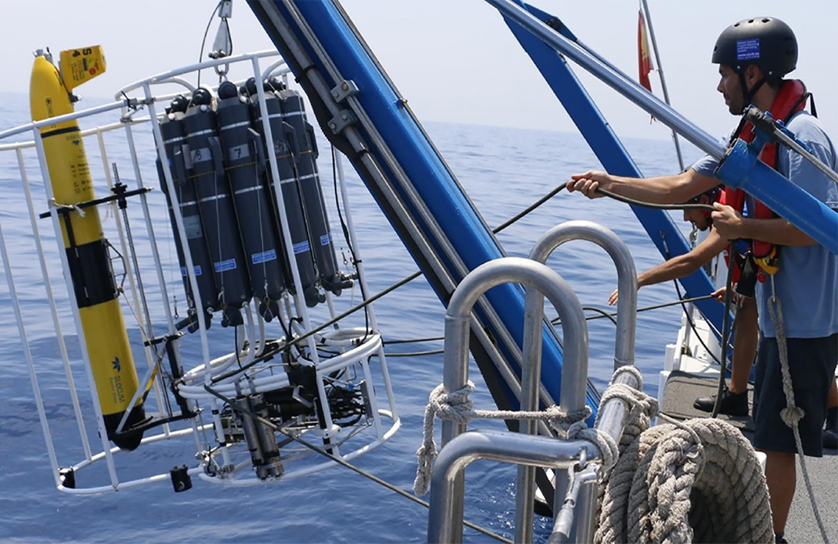
OBPS WS VII
Rene Garello, Cora Hoerstmann
www.oceanbestpractices.org

Slide 2
Workshop attendance
Session | Panelists | Registered | Unique views | Total Users | Max conc views
OBPS Workshop VII, October 9, 2023 | 8 | 371 | 144 | 256 | 110
OBPS Workshop VII, October 10, 2024 | 14 | 386 | 136 | 280 | 90
OBPS Workshop VII, October 11, 2025 | 5 | 396 | 75 | 143 | 36
OBPS Workshop VII, October 12, 2026 | 10 | 396 | 107 | 170 | 82
OBPS Workshop VII, October 13, 2027 | 14 | 395 | 99 | 194 | 67
Totals WS | 44* | 395** | 160* | 1043 | n/a
Best Practices in regional downscaling for operational ocean forecasting | 11 | 78 | 38 | 99 | 33
Digital Twins of the Ocean - Experiences and Best Practices | 16 | 99 | 62 | 99 | 57
OBPS Focus Session on Better Biomolecular Ocean Practices (BeBOP) | 3 | 25 | 7 | 12 | 7
Unlocking ocean-based solutions to climate change (speaker did not show up) | 1 | 60 | 22 | 28 | 21
Exploring Ocean-Climate Dynamics: Observations, Collaboration, and Policy Implications | 14 | 53 | 27 | 53 | 27
Ocean Practices Federated Network - Governance | 15 | 38 | 17 | 42 | 12
EarthServer: Federated Fusion on Analysis-Ready Datacubes | 1 | 18 | 6 | 9 | 9
Best Practices on Storytelling and the Restoration of Ecosystem: How to effectively engage stakeholders | 14 | 104 | 43 | 82 | 41
Challenges of Using Citizen-Generated Data for Ocean Sustainability and Policy Advancement | 8 | 83 | 47 | 69 | 43
Best Practices for Observing the Air-Sea Transition Zone (open session) | 11 | 62 | 24 | 43 | 21
Totals FS | 85* | 620** | 223* | 536 | n/a
Total | 127* | 1015** | 363* | 1579
Total Views | 1,112

Slide 3
Gaps
Coastal Modeling:
Model standards
Calibration and validation using reference data.
Citizen science:
Standardization of citizen science approaches
legal issues

Slide 4
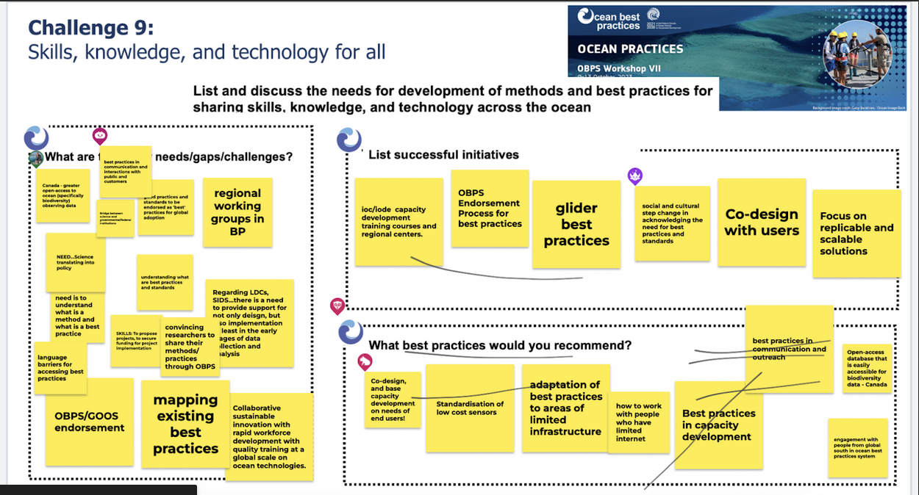

Slide 5
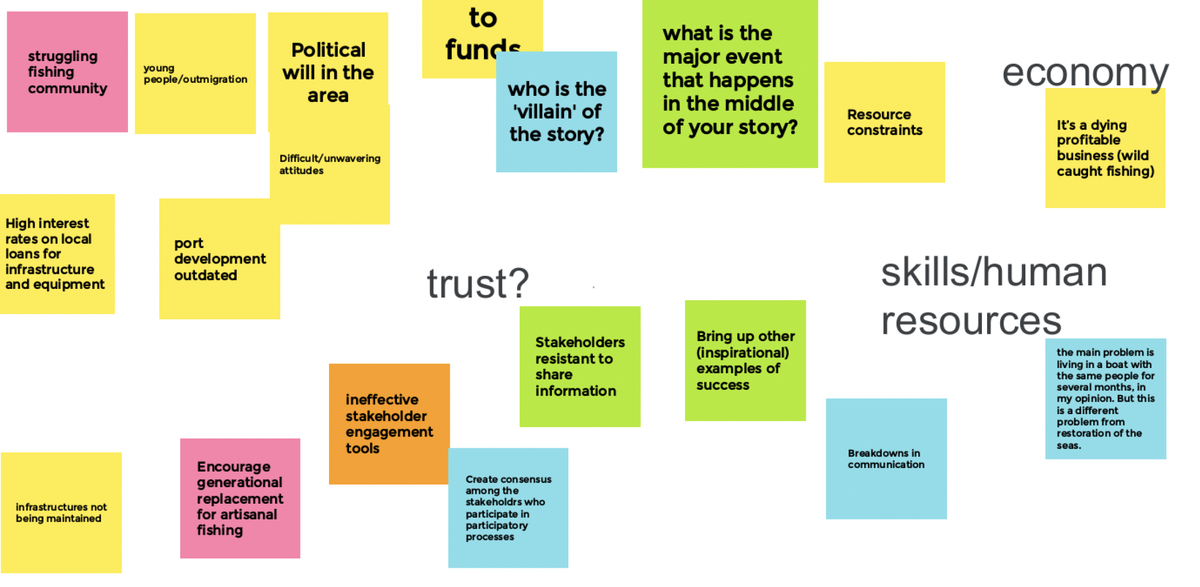
Focussed session on storytelling

Slide 6

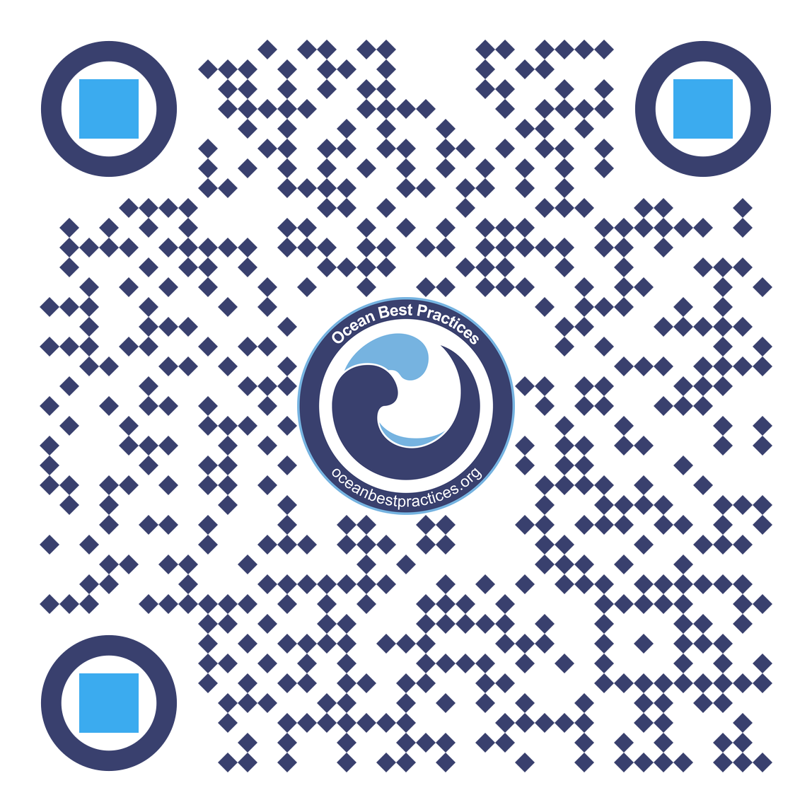
Add other logos or acknowledgements here

