Slide 1

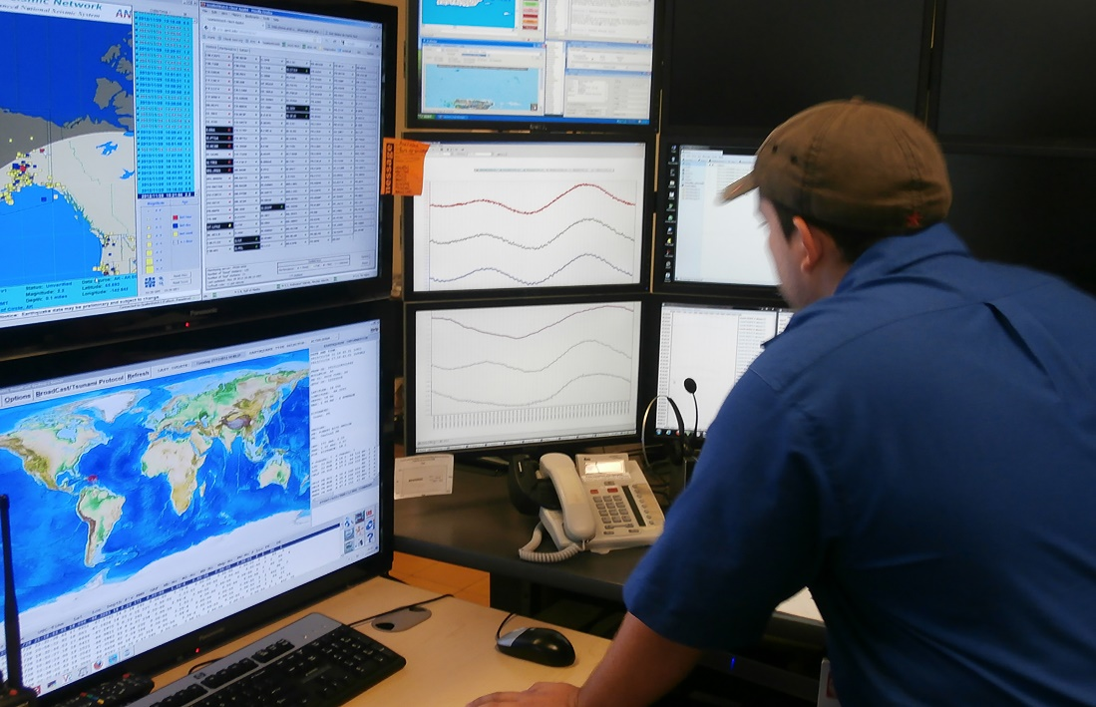

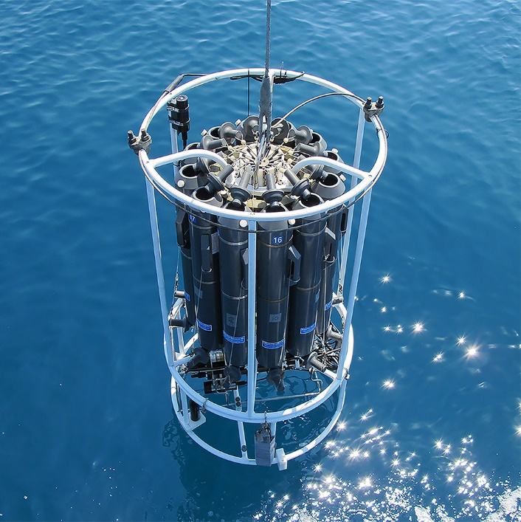
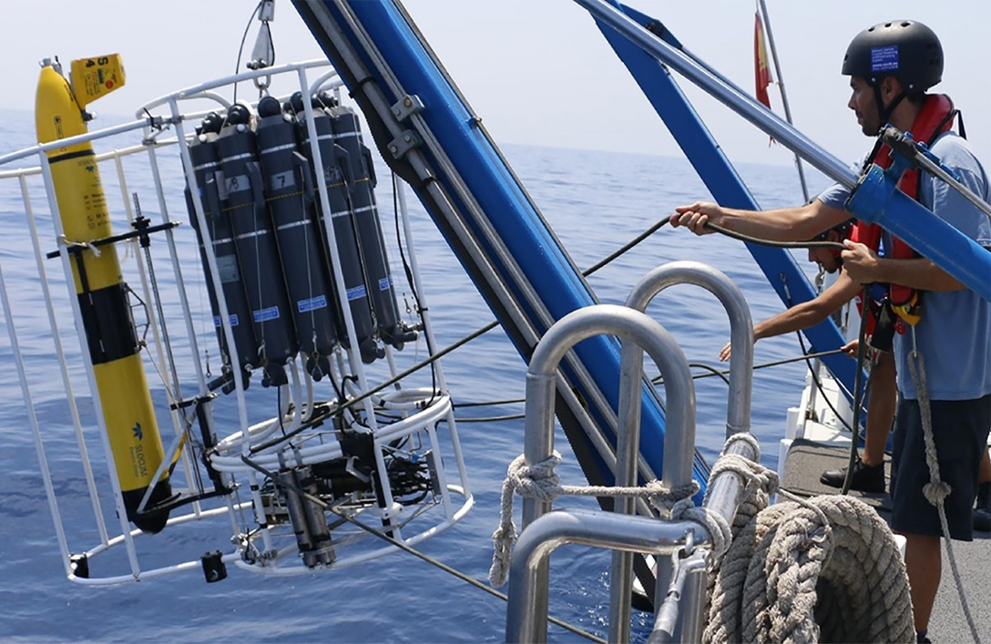
TT 21-02 Value chain analysis and KPIs status updates
(Agenda Item 11)
SG Meeting 12 – 14 December 2023
UNESCO - Paris
www.oceanbestpractices.org

Slide 2
Task Team objective
Identify and characterize the KPIs to track OBPS success and provide guidance toward strategic objectives completion.

Slide 3
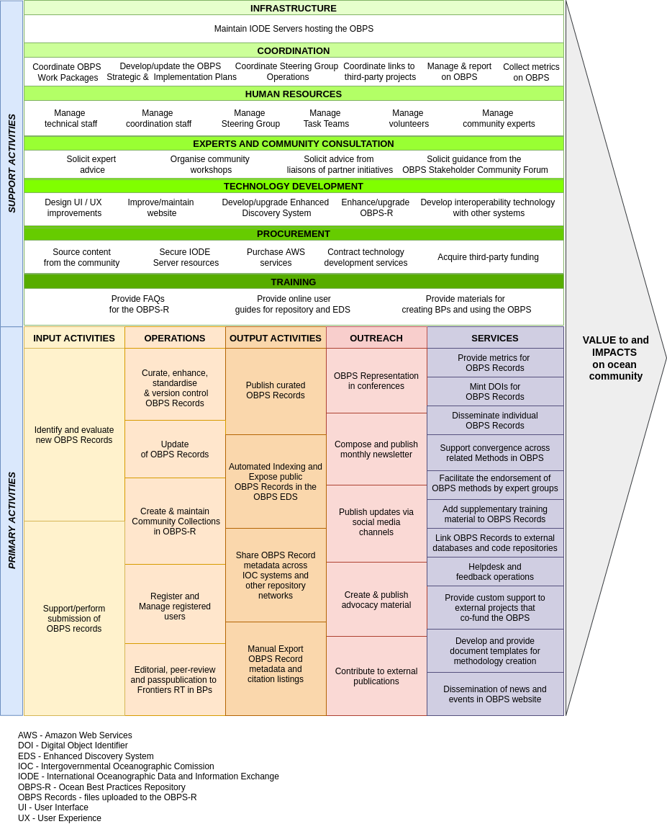
The
OBPS
Value
Chain

Slide 4
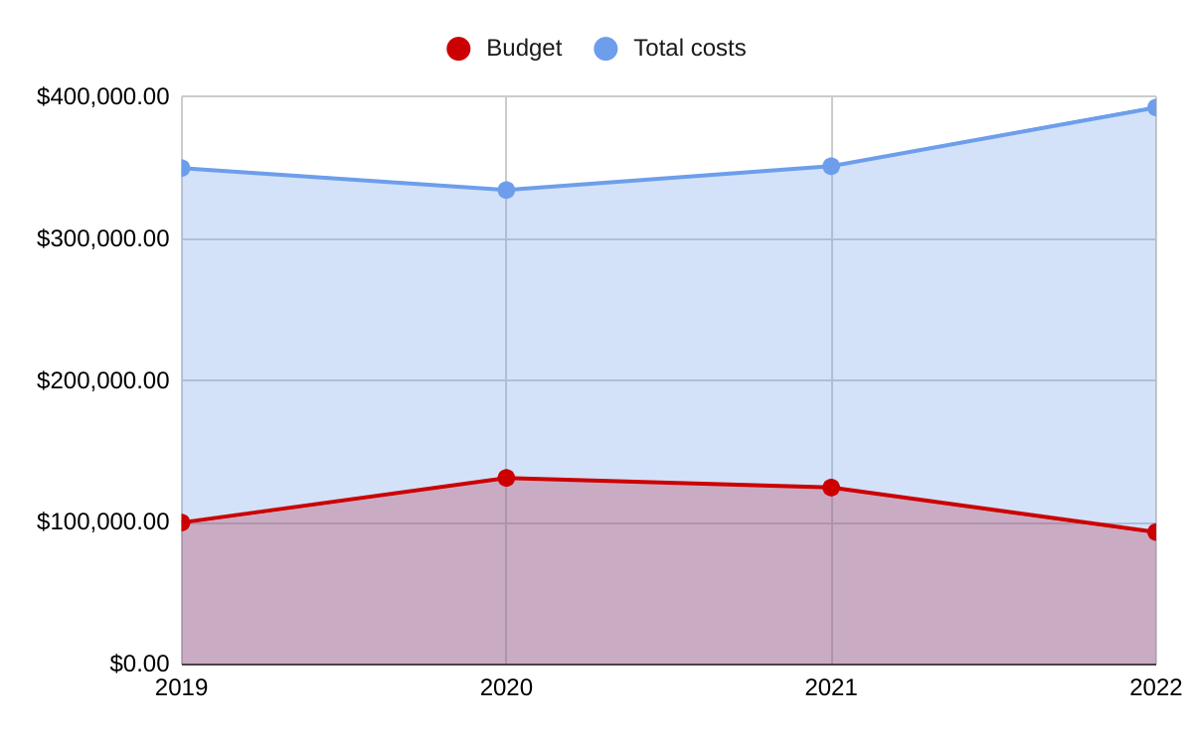
Value Chain Cost Analysis
Voluntary contribution
Notes:
The VCA allowed us to estimate the yearly costs of running OBPS. For every dollar invested from our funders, the system is providing 3 dollars more.
Our annual budget may not be growing at the same pace as the system contribution, so we are more and more relying on voluntary work to maintain the show.
This may become a problem when it comes to cover needs for system upgrades and improvements or increasing the volume of operations.

Slide 5
VCA
Cost Value Analysis
User Stories/
success cases/
Impacts
Opportunities to optimize OBPS to align with BPs uptake
BPs uptake paper
OBPS Value Documenting Analysis
OBPS KPIs Programme
Results presentation
Data sources
KPIs
definition
OBPS Strategic Objectives

Slide 6
Cost Value Analysis
VCA
OBPS Value Documenting Analysis
OBPS KPIs Programme
Results presentation
Data sources
KPIs
definition
OBPS Strategic Objectives

Slide 7
KPIs Aims
Attract and increase external funders/sponsors
Monitoring achievement of Strategic Objectives

Slide 8



KPIs for who?
FUNDERS
USERS
INTERNAL

Slide 9
Measure performance against outcomes
SO-01 Outcomes:
  The OBPS is a trusted, certified, responsive and sustained community resource
  The OBPS hosts best practices that are tailored to a broad spectrum of resource / capability environments
  OBPS has broad community participation and ownership in the development and operations of the System
  The OBPS provides functionality which allows use by traditional knowledge holders and communities with multiple ways of storing and transmitting practical knowhow
SO-02 Outcomes:
  Trusted protocols for creation, convergence and endorsement of best practices
  Interoperability across all dimensions of ocean stakeholders’ needs through propagation and linking of best practices, data and standards
  Broad community engagement in the creation and adoption of best practices
SO-03 Outcomes:
  Training resources provided by OTGA and other training providers available through the OBPS repository
  Provision of a portfolio of courses on best practice development, consensus building and submission created by the community for the community
  OBPS courses embedded in relevant university curricula and Continuing Professional Development (CPD) opportunities
SO-04 Outcomes:
  A global collection of independent methodology management systems, seamlessly interoperating with the OBPS, that will provide the technology needed to support a cultural shift in how diverse ocean communities advance their practices
  The OBPS continuously exchanges (meta)data with related methodology management systems through ODIS and other digital infrastructures, federating queries across partner systems, promoting access to best-practices methodology content hosted elsewhere
  A process to identify, harness, and co-design cross-system technologies to detect gaps and opportunities for convergence in distributed ocean methodology holdings

Slide 10
Measure performance against outcomes
OUTCOME
The OBPS is a trusted, certified, responsive and sustained community resource
KPI
Increase number of users that access methods in OBPS Repository
TARGET
80.000 new users per year
METRICS
Number of OBPS Repository users provided from GoogleAnalytics

Slide 11
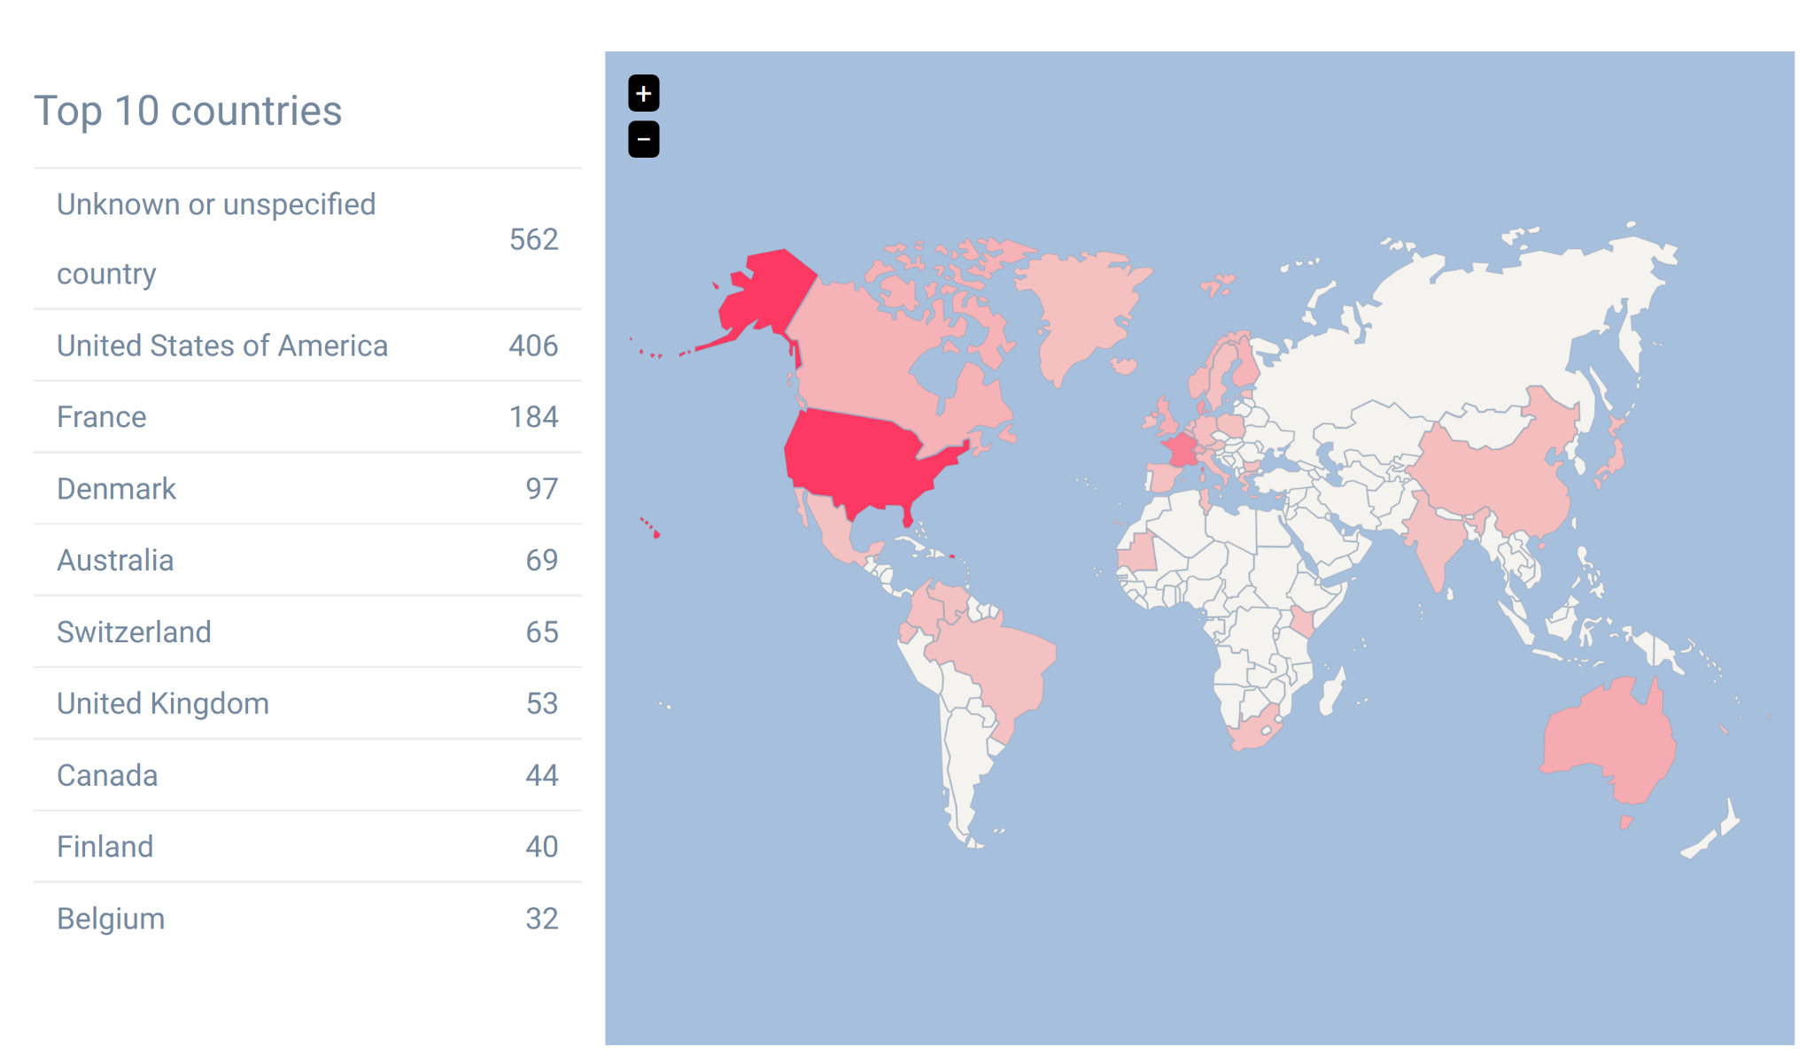
Lack of completeness & consistency
32% of the records have no specified country
Notes:
In metadata submission the place of publication is a mix between city, city-country, country.
It is tricky to recover information by countries.

Slide 12
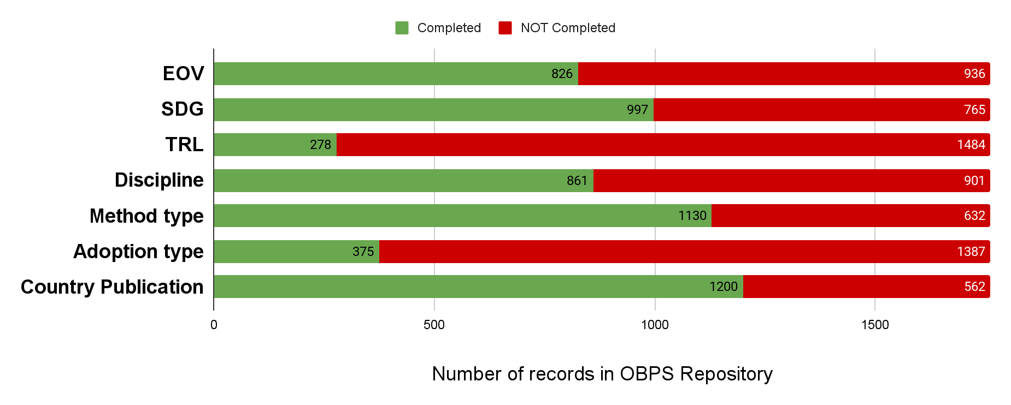
Lack of completeness

Slide 13
KPI Program design and development
Dec 2022
Feb 2023
Jul 2023
Agree KPI Strategy
KPI Program DRAFT
KPI Program Final Version

Slide 14

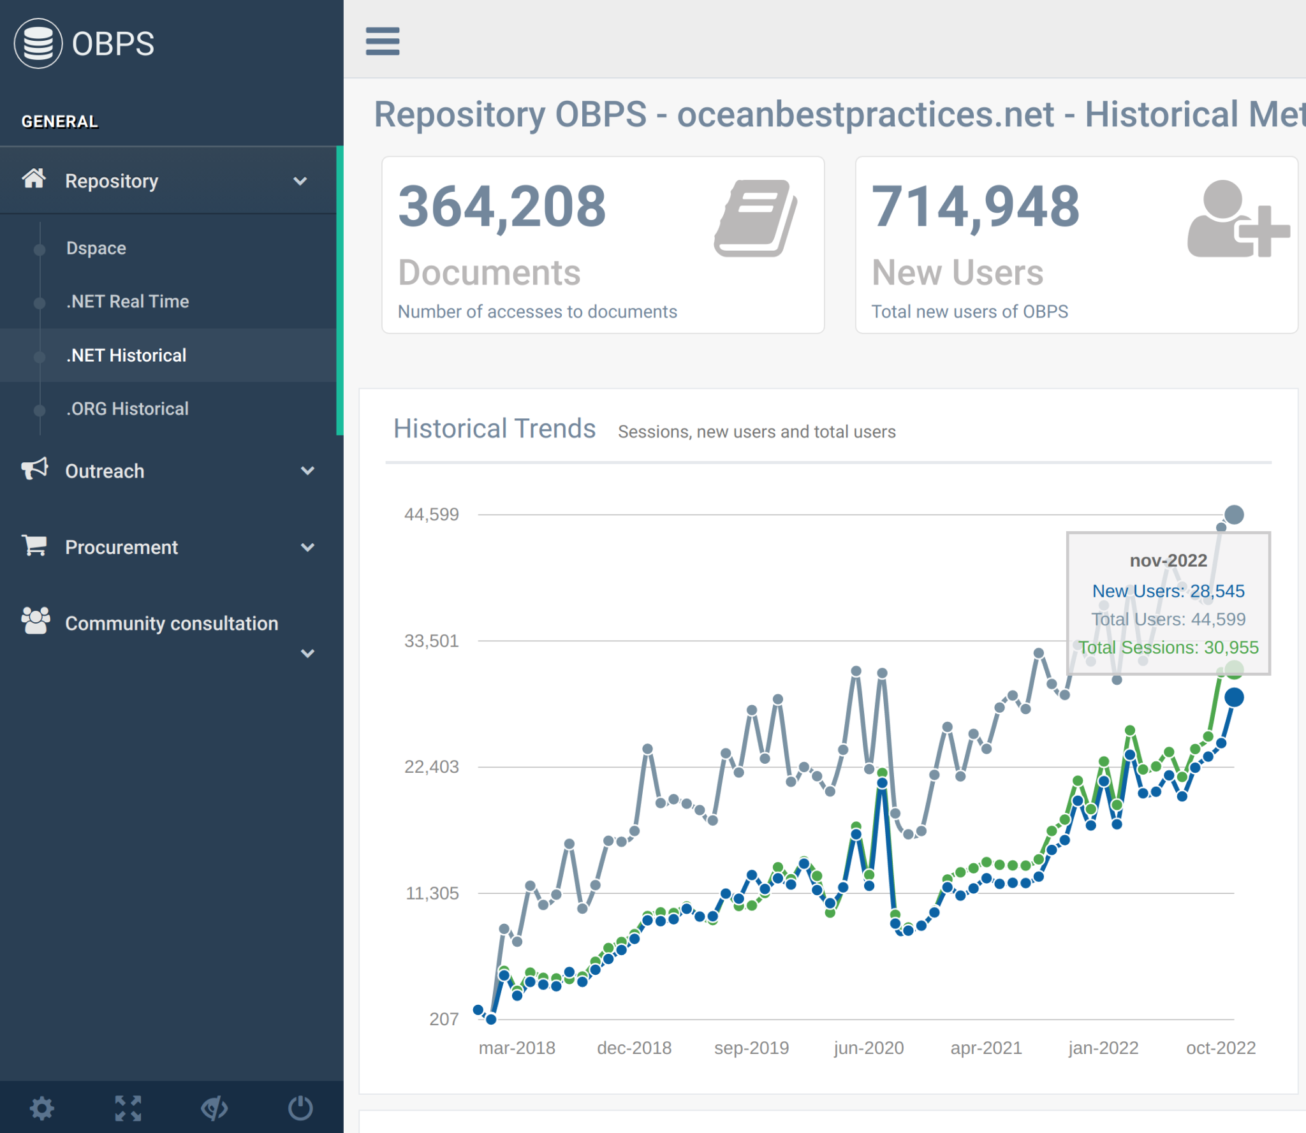






OBPS by the numbers
OBPS Metrics DB

Slide 15
Recommendations (I)
Identify limited core essential targets and metrics for the KPIs program
Metrics need to be cheap to compile and persistent.
We need to limit manual metrics collection to the essential cases.

Slide 16
Recommendations (II)
Metadata is an asset for OBPS
Metadata curation in Repository Database is needed for extracting relevant metrics
Ambassadors program could potentially contribute to “recruit specialists” for such curation
Possible OTGA dedicated training to be offered
When is the change state of certain metadata fields updated in the system? Is it through new versions of the documents? Link to endorsement/convergence. Process needs to be defined

Slide 17
Recommendations (III)
Value generated by OBPS VC not yet identified. Direct link to
  Value proposition and business case are to be defined
  Impact definition for OBPS not yet done

Slide 18




