Slide 1

Strategic Objective 8
GOAL 3
GOOS 12th Steering Committee meeting, 25 - 26 April 2023

Slide 2
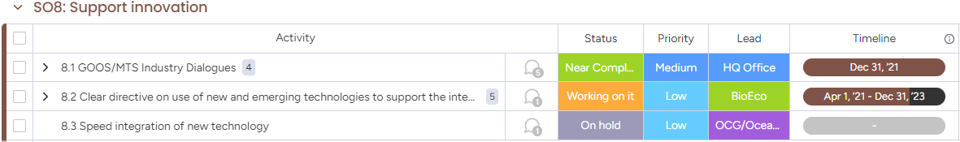
Actions
Support innovation in observing technologies and networks

Slide 3
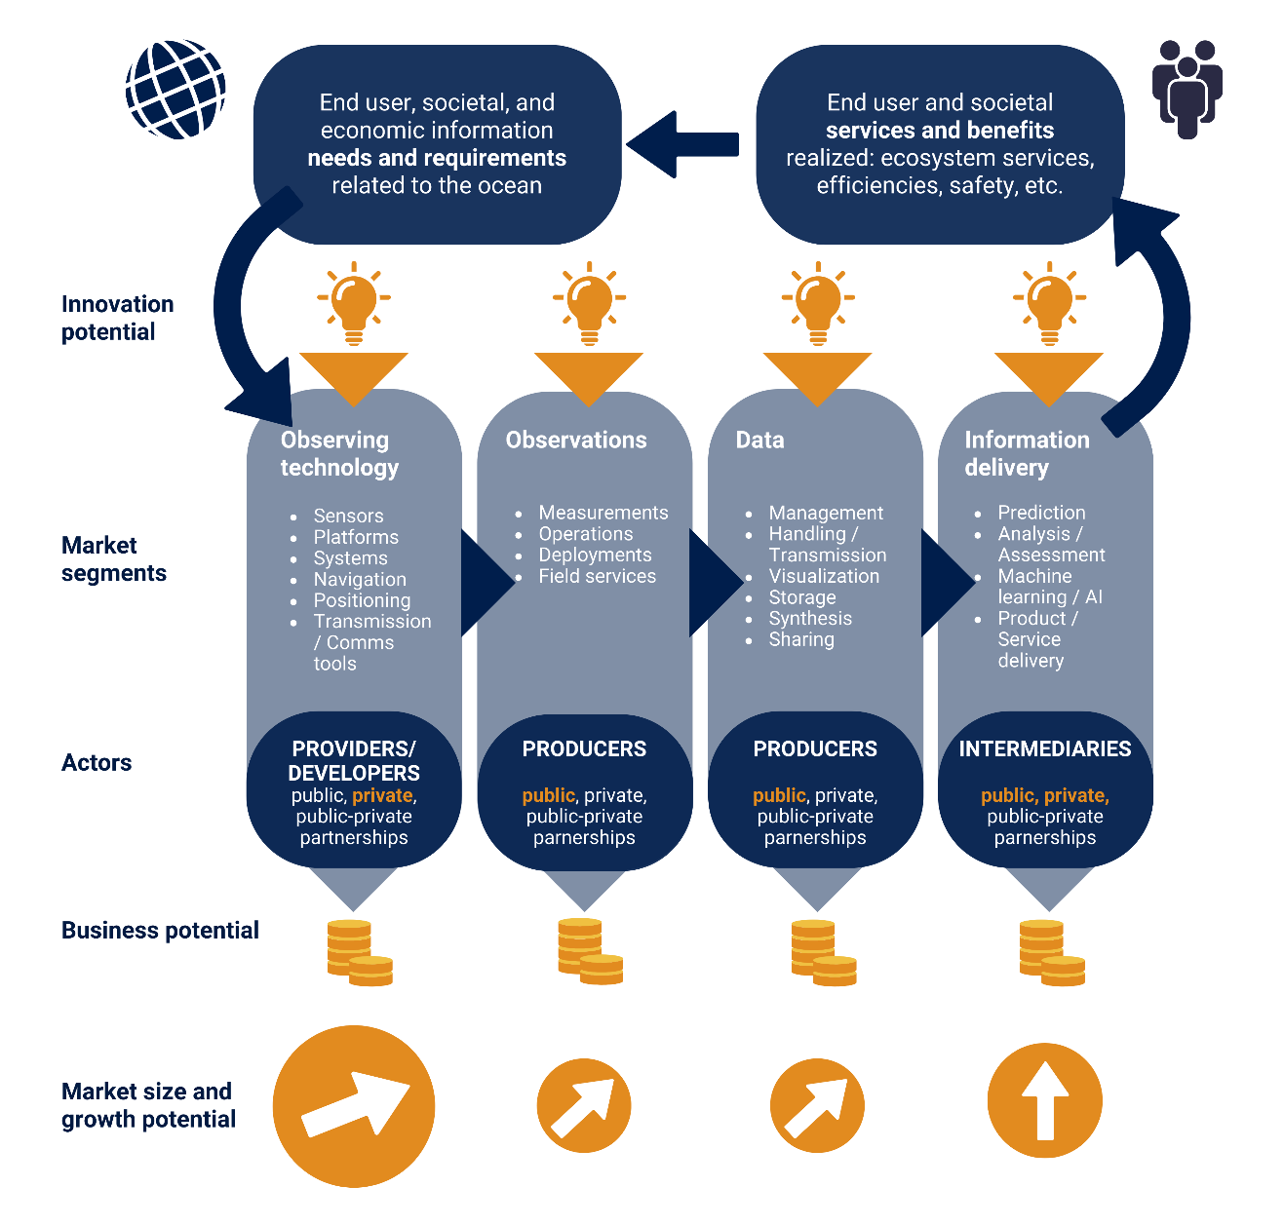
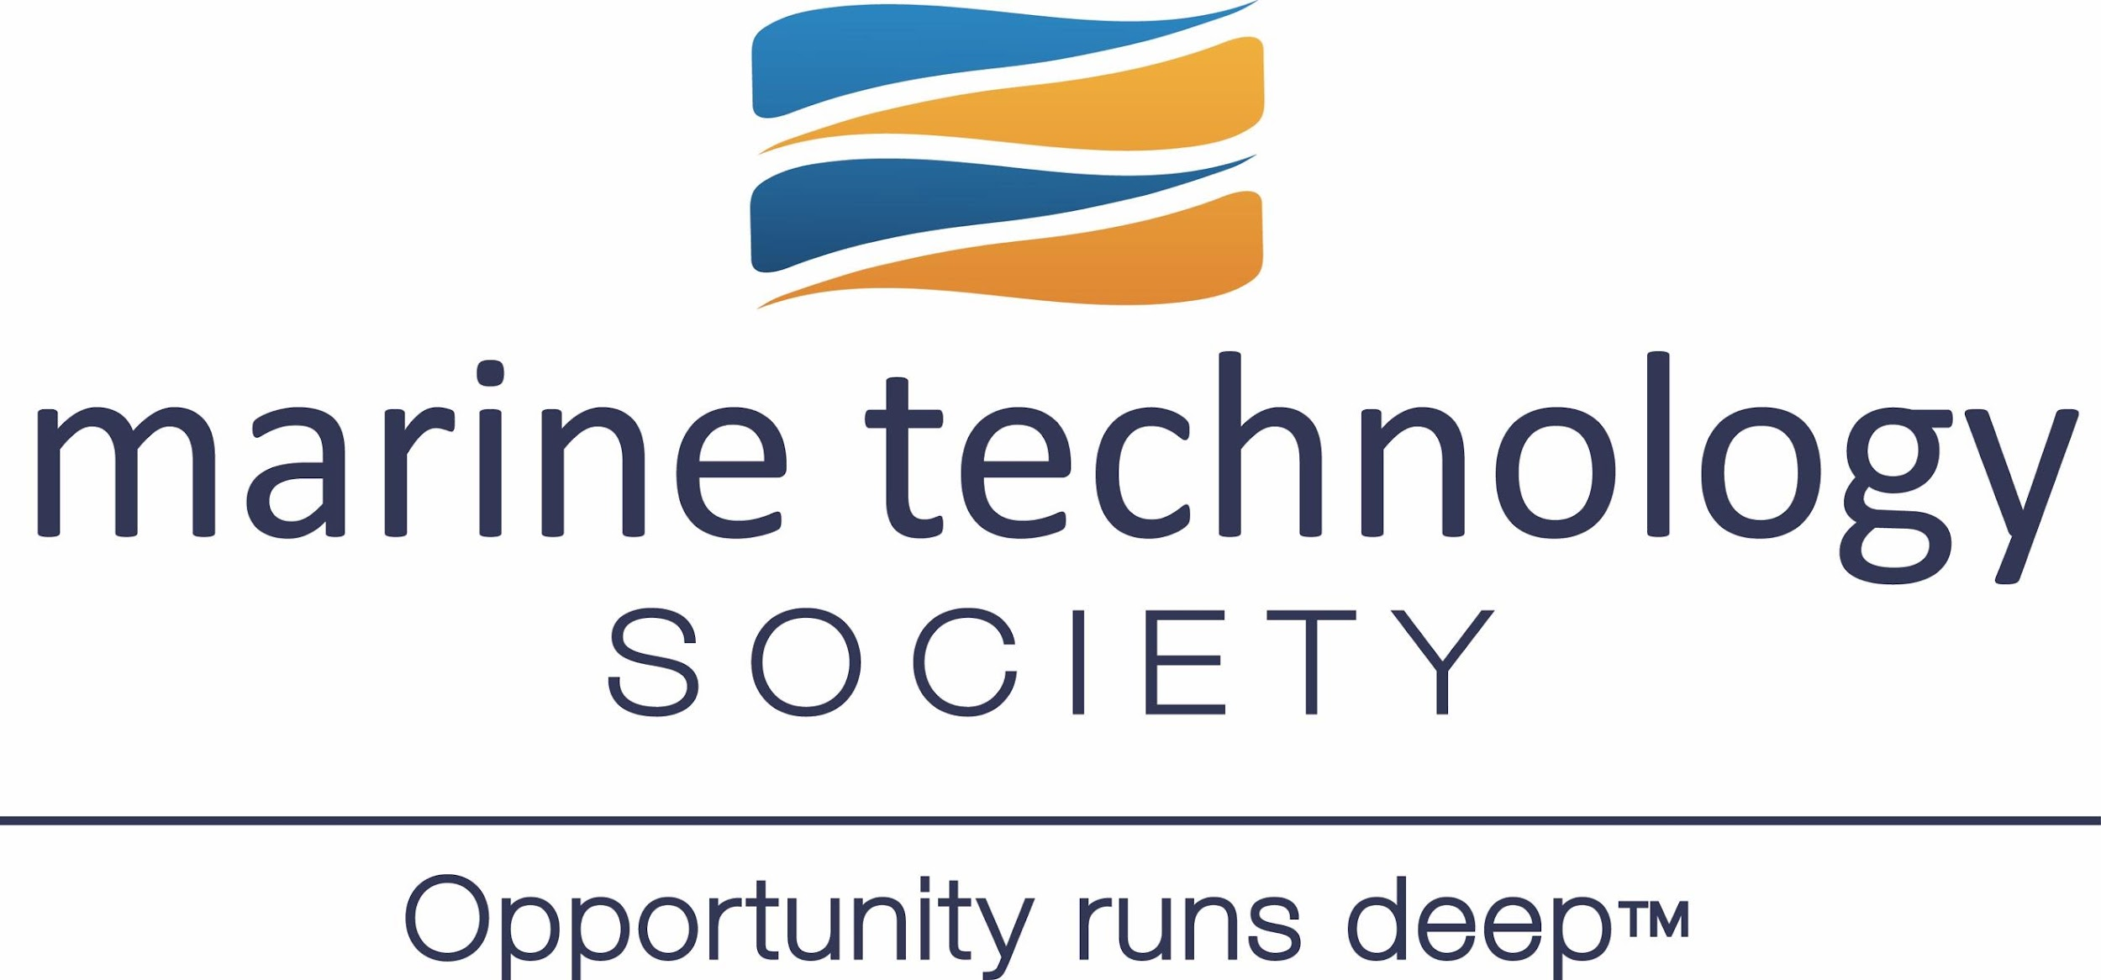

Dialogues with Industry
Dialogue between public and private sectors with an aim to dismantle barriers and highlight opportunities towards achieving a mature, multi-sectoral ocean observing enterprise
Developed from issues reported by the OCG networks, how do we work with new commercial networks (like SoFar and Saildrone), how to fast track promising new technology, more commercial companies developing services using ocean data, leverage private investment
Mature the ocean observing and services ‘market’ – industry not see OO as a market - result high cost/poor service, slower development, development not focused on OO needs
      4 sessions - Sep 2022 - Jan 2023 - background paper and session reports available here
Notes:
Societal need for expanded ocean observations and services is increasing exponentially – driven by key factors:
Climate Change – forecasts, adaptation, investment in carbon storage
Ocean management – ecosystem services and sustainable blue growth
Dialogues with Industry is a significant opportunity to connect the public and private sector stakeholders in the Global Ocean Observing System

Slide 4
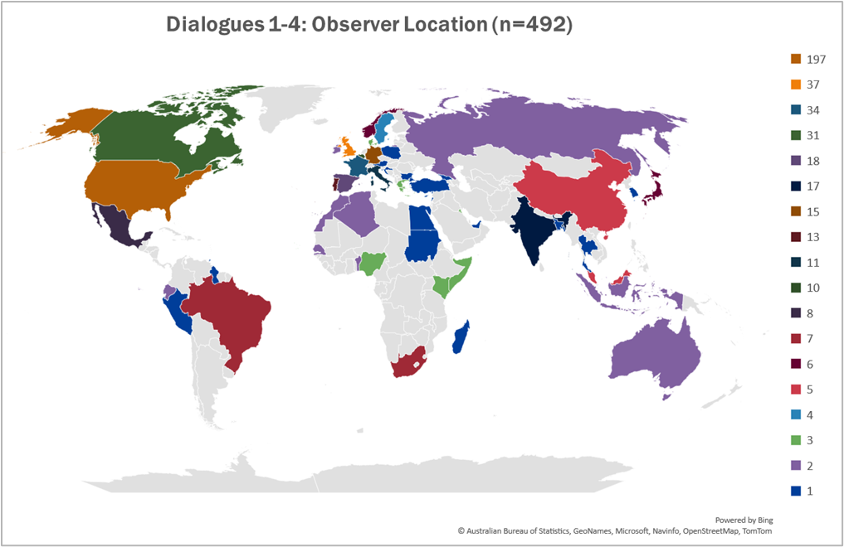
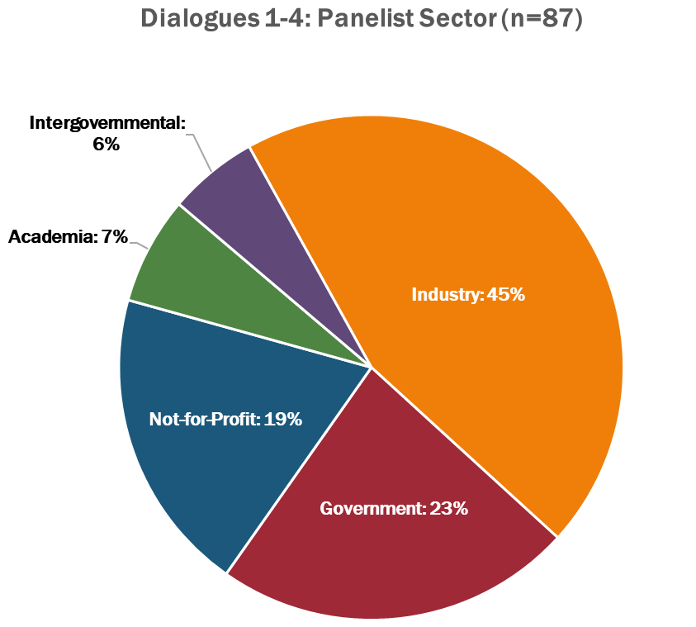
Participant Demographics
A total of 89 panellists (by invitation, skewed towards industry/not-for-profit/NGO/government)
A total of 492 observers mostly from government, industry, academia and not-for-profit/NGO
Notes:
The panelists were invited to participate. The focus of the panelists was on representatives from the industry and not-for-profit sector. Across the four Dialogues with Industry sessions, 69% of the participants were from that sector. While a global distribution of panelists is the goal, the heavy participation by North America, Europe, and Australia follows the current market trend of companies within the marine sector.
But when you look at it across the world, it is somewhat reflective of where we know the ocean businesses exist currently. It is certainly somewhat reflective of the planning team and who we knew, but it definitely shows that we are not reaching the entire globe. And as we look at going forward in discussing these results, we need to make sure that we are conscious that we are getting into parts of the world that are not represented here.

Slide 5
Initial Synthesis
❶
❷
❸
❹
Market elements shaping the future
Improving the market
Societal/ Governmental change
Collaboration to Grow
Focus Areas
Market size and aggregation
Risk
Bringing in new actors
Data and mission as a service
Ocean data perception
Standards
Intermediaries
Data access
Blue tech clusters, incubators, and accelerators
Workforce
Technology transfer
Emerging technology
Categories
Dialogues with Industry Draft Synthesis Report – here - summarises across the 4 dialogues; common themes, fresh view of market dynamics from different perspectives, insight and recommendations.
Notes:
First and foremost Ocean Observing and Services must be viewed as essential to lives and livelihoods of everyone, on par with the Weather Enterprise. This does not exist now. Too often ocean observing is considered ancillary.
While the dialogues followed the value chain, common themes emerged. These are represented by the 4 focus areas that reflect essential actions needed across the Ocean Enterprise market. Under each of the focus areas, twelve categories were identified to expose unseen dynamics of the ocean observing and services market to help structure the intended future conversations with stakeholders.
. That we coalesced recommendations into four focus areas, and that we had four dialogues, is purely coincidental – the four focus areas we used to bring together the 12 categories of recommendations do not map to each dialogue. Instead, input from each of the four dialogues is spread across all areas of the report synthesis.

Slide 6
Improving the Market
Ocean Observing and Services not seen as an independent market activity
Ocean observing can de-risk Blue Investment but Investors do not understand the capability the Ocean Enterprise
Understanding/articulating the market size drives investment
  Fragmented market hinders investment
New markets will be driven by applications rather than general concepts
Low cost/easy to use NOT low cost/low risk to develop
  Industry needs assurance of market after development
Lack of sustained funding in the public sector stymies growth
Aggregation of Demand is missing
New Actors
Notes:
Understanding and articulating market size helps facilitate and drive investment. It is the perception that today's market is fragmented, it's a niche, it's specialized, one-off sensors and can be a static market.
Ocean Observing and Services not established as an industry. While we are seeing an significant increase in companies making sensors/platforms/offering these as services – hard to capture impact. The OE study by US, Canada and UK have captured this – not systematically captured in industry codes/studies
You told us that there is uncertainty by Blue market investors because Blue investing is risky. They believe more Ocean information could help them de-risk investments but they are unaware of the Ocean Enterprise Capacity.
Is ocean observing and services actually an ocean activity that can be systematically measured? So that's one thing that we needed to look at, and that fed into market aggregation, understanding that market impact, and having the need to have more market reports and market understanding.
We heard that specific applications will drive the observing market and regulations and international conventions can help spur this
Risk took on a number of forms, but by and large, it is how do we create an enabling environment to move towards economies of scale and away from the high cost, high risk, customized, one-off, short-term projects? We need a market that has the ability to quickly scale to manufacturing. We need to be able to create a market that has volume purchases, does not over-design, and that clearly the user's needs are understood so that we can make that fit for purpose.
Bringing in new actors - The introduction of new technologies is hard, particularly if you're an operational agency and you have a mission to provide, how do you insert the new technology while still delivering on that operational capability? Further, industry has sometimes found that agencies and observing systems networks are a closed club and hard to break into, which can be a distinct disadvantage to small and medium businesses that are often agile and have the potential to provide disruptive technologies.

Slide 7
Societal/Government Change
Perception change needed from ocean data from being peripheral to essential
  Critical infrastructure
Data and Missions as a service – a paradigm shift
Multi-sectoral ocean observing architectures require a better understanding between sectors & are not risk-free
The private sector - Data is an asset
  Adopt licensing schema that supports public sector missions and private sector profitability; academic sector access
Notes:
Understanding the differences between the motivations, timelines and expectations across the Ocean Enterprise sectors is fundamental to realizing a high functioning multi-sectoral ocean observing system. That's not unknown, but we need to continue to reinforce that.
Data as a mission and service – represents a new way of doing business that presents both opportunities and risks. This will involve a cultural shift on how the public sector does business. It does not come without risk, particularly when regard to looking at that data sharing, and how do you put together end user license agreements that allow for that market productivity but still is reasonable for the mission of an agency, and yet does not leave our academic partners and international agreements behind? We can look to the space enterprise and the weather enterprise from that perspective.
Ocean data perception
Goes back to my opening statement – Ocean data can not be ancillary. This extends to branding, clear communication, and imparting ocean literacy at all levels of education with reach out to different departments at the graduate and undergraduate level – Use real-world problems of societal/national/international concern that are grounded in ocean science as a means to expose individuals outside of the ocean community to the importance of the ocean.
Ocean information and services must be considered critical infrastructure

Slide 8
Collaboration to Grow
Standards – a significant barrier to accelerating the Ocean Enterprise
Largest component today producers, largest component on the future Intermediaries?
The blurred lines between the roles of public and private components can create an impedance for the private sector.
Public and Private sector data complementary
  Public data is still confusing
  Private sector data being made interoperable to be ready to plug into future market areas
Some classes of data may never be profitably generated
Notes:
So looking at areas to grow, our whole core team was, surprised that was brought up in all 4 of the dialogues. And what you told us about standards is that, that's both for hardware and software, those protocols not being there is a significant barrier to growth and that we need to be able to be transparent. It levels the playing field. But the key here is, what standards are most impactful and how do we go about really working towards a few standards that will really make a big impact?
When we talk about intermediaries, those that are taking the ocean information and providing value. We see great aspects for the growth in this area, but where is that cultural shift from the public sector that starts to rely on an intermediary providing that service? One could say the same thing for the providers of ocean platforms providing missions or data as a service. As both of these areas grow how will the public agencies’ perceptions shift to be able to accommodate the private sector. That's going to take a lot of discussion as to where that lines should be between public and private roles. We suggest that line will always be a blur but one that will require persistent conversations.
Data access continues to be an area we need to focus on. Two areas. One, can we get to that data easily? We have major programs out there, GOOS, IOOS, IMOS, EMODnet, all providing these portals, but yet we still have this concern that it's not easy to get to that data. So what are those issues that remain, that we need to continue? Where are those siloed datas? How do we work across corporate to be able to release that data as well?
Blue tech, clusters a and accelerators. They are beneficial but can be overwhelming as this space as grown rapidly in the recent past. Making sense of these efforts through pilot projects that would highlight new technologies represent a multi-sectoral ocean observing architecture to solve a problem/ocean observing gap. The project could serve as a blueprint for achieving a multi-sectoral observing architecture and mixed public, private and academic investment, development and testing.

Slide 9
Market Elements Shaping the Future
Significant obstacle to market growth is the hiring a skilled workforce
  How do we attract talent from other sectors?
  Careers in Industry should be on par with careers in academia
Tech Transfer - Early engagement with commercial partners is critical for transitioning innovation from the public and academic sectors
Funding for anticipation of market technology future needs
Future lies in finding the right combination of devices and the platforms on which they are deployed to address specific use cases
Biggest transformation - new generation of sensors, which will provide insights into biochemistry, ocean health, and marine life
AI/Machine learning can be used for the characterization of big data
Notes:
Work Forces came up in every dialogue. A universal issue that will require a coordinated Ocean Enterprise wide campaign to solve. There is no simple answer to this. This is a collective initiative that we can all work together on communicating the value and the passion and the enthusiasm we have for careers in the ocean-related fields, and how do we communicate that?
Technology Transfer – These are not new issues but the reinforcement of working with industry early to ensure successful transfer and the need remains for public programs that can truly help with the transfer of new technologies to a scalable and sustained commercial markets
Emerging Technology – many examples of exciting work that ranges from AI, to Communications to new sensors, from Molecular technology, autonomy to muli-purpose to crowdsourcing. To reiterate reaching across to different industry sectors to advance these technologies and creating hubs that provide a credible source of reliable information can help create the aggregate market demand that you told us was going to be crucial to grow this Ocean Enterprise.

Slide 10
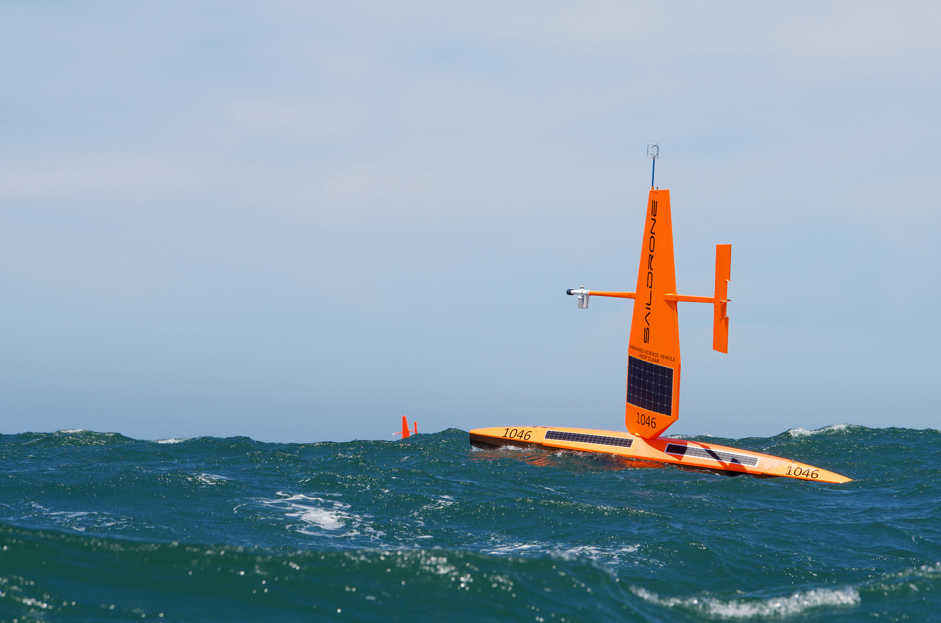
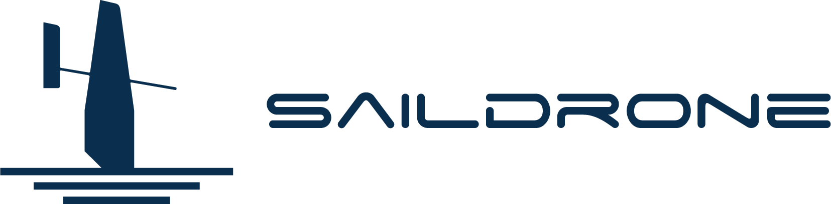


Progress/Achievements
Action 8. 2
Not being undertaken as written - perhaps delete/replace?
Action 8.3: Speed integration of new technology
OCG:
developed data templates for exchange RT data from uncrewed vehicles (e.g. gliders, Saildrone, etc)
numerous technological advances being evaluated within global networks
eDNA samples taken from a few GO-SHIP cruises and mooring cruises
Saildrone have been deployed in hurricanes
BGC Panel:
agreed join Ocean Foundation Initiative for replicating GOA-ON in a Box to address oxygen and nutrients and expand monitoring capacity in the US Caribbean, proposal submitted to IOOS
BioEco Panel:
European MARCO-BOLO Project
Ocean Decade BioEco Projects such as OBON, and MBARI Synchronicity Programme
Notes:
This project will replicate the model of the “GOA-ON in a Box” kit for two additional Essential Ocean Variables - oxygen and nutrients. The proposal has been submitted end of last year to the Ocean Technology Transition program of the Integrated Ocean Observing System of the US. Alexis Valauri-Orton

Slide 11
Outcomes & Assessment
No. | SO8 Outcomes | Assessments
1 | Faster adoption of new technology | Unknown - Adoption yes, but faster? Do we need to develop some systematic approach for testing new tech or evaluating?
2 | Increase scope, efficiency and observational capability | On track (30%) – the scope is being increased, we need to think about how we assess efficiency
3 | Focused and faster technological development to meet new observing challenges, including geographic equity | Slow but on track (30%) - several recommendations in the Dialogues with Industry, could expect to see developments move faster from here.

Slide 12
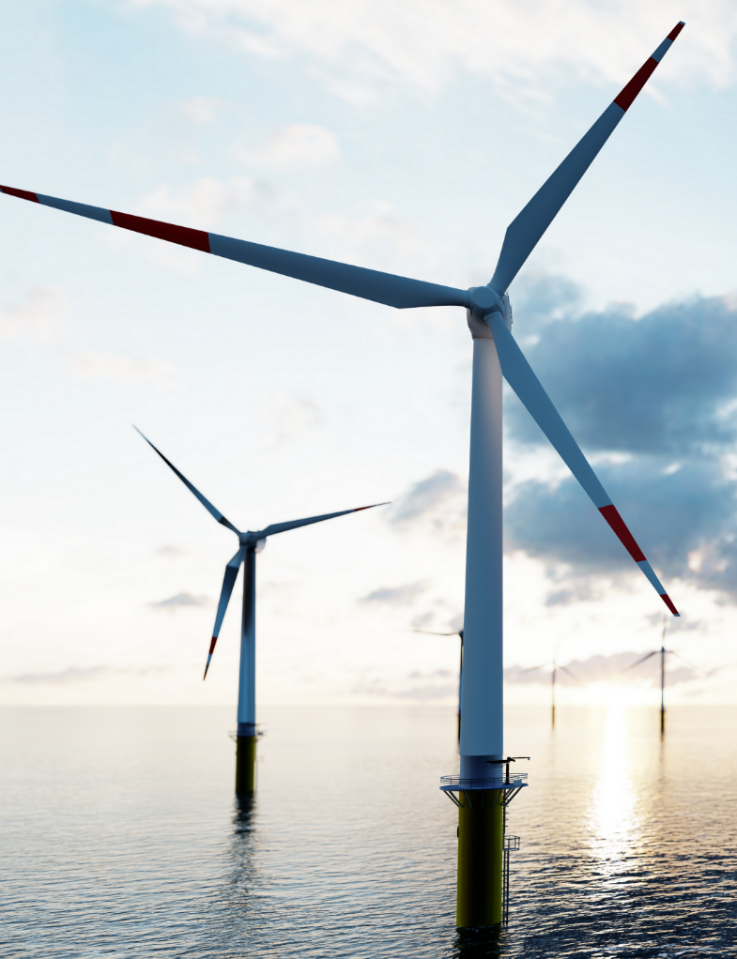
Gaps
Some could include:
  Targeting new tech development to meet needs of the observing system/users/policy
  More systematic testing on new tech – protocol, sharing of results, targeted testing, comparison

Slide 13
Next/Future Steps
Dialogues with Industry
18-20 April 2023
Summer 2023
Fall 2023
Community engagement
Ocean Business 2023
Final Report / Roadmap
Build a Vibrant Ocean Enterprise
Plenary: Realizing a Robust Ocean Enterprise – Dialogues with Industry Results
3 Focus Sessions
Draft Synthesis Report
May-Aug to prioritize recommendations and near, mid-term activities

Slide 14
Resource required - new
None at this stage. MTS has some potential for funds to support the next stage, taking the key Dialogues with Industry recommendations forward with GOOS as close and key partner

