Slide 1

Strategic Objective 4:
Empower end user applications
GOAL 1
GOOS 12th Steering Committee meeting, 25 - 26 April 2023

Slide 2
Implementation Priority for 2023
 | Strategic Objective | Task
GOAL 1 Deepening Engagement & Impact | SO1. Strengthen partnerships to improve delivery of forecasts, services, and scientific assessments | GRA capabilities across the value chain assessment Coordinate work across GOOS in partnership development for delivery
 | SO2. Build advocacy and visibility for the observing system with stakeholders, communicating with key users and national funders | Value of Ocean Observations Project GOOS Communications
 | SO3. Regularly evaluate the system to assess fitness-for-purpose | Map of networks for biological monitoring Map of ocean forecasting systems Ocean forecast evaluation and metrics Observing System evaluation/metrics in OceanOPS Global Ocean Indicators Framework
 | SO4. Strengthen knowledge and exchange around value creation from ocean observation, empowering the spread of end user applications at a local level | Data Integration Products Across GRAs Toolkit/Guide on Operational Ocean and Monitoring and Forecasting Systems GOOS product and services portfolio for Ocean Prediction centres

Slide 3
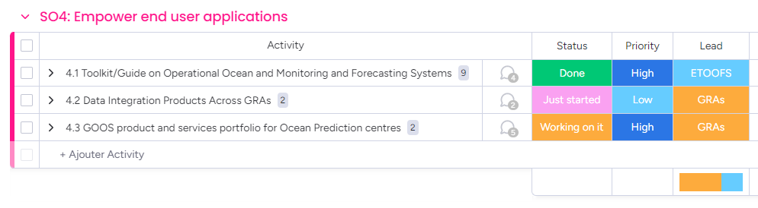
Actions
Strengthen knowledge and exchange around value creation from ocean observation, empowering the spread of end user applications at a local level

Slide 4
GOAL 1: DEEPENING ENGAGEMENT & IMPACT
Strategic Objective 4.
Strengthen knowledge and exchange around value creation from ocean observation, empowering the spread of end user applications at a local level
  Progress and Achievement
The ETOOFS Guide is finalized, published, and promoted within the marine community
IMOS has started to work on data integration to pave the way for a more general GRA approach. IOOS has also started.
  Outcome
  A tool (a publication + online version) to disseminate ocean prediction know-how and support capacity development
  An example with IMOS or IOOS use cases that could be expanded to other GRAs
  General Assessment
The uptake of GOOS observation data by ocean prediction centres is a very active and dynamic area, where user engagement and impact is key. What GOOS sees is weaker than the reality
The Ocean Decade will help

Slide 5
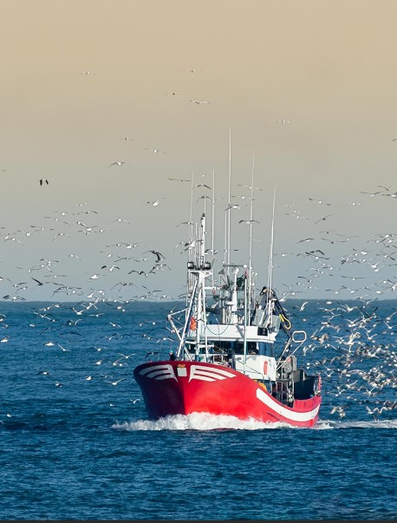



Progress/Achievements
4.1 Guide on Operational Ocean Monitoring and Forecasting - ETOOFS
The OOFS Guide was highlighted at the Lisbon UN Ocean Conference in June 2022. It is published as an online document with DOI and is available to view /download at the Mercator Ocean International and GOOS websites
Launch of the guide on ‘Implementing Operational Ocean Monitoring and Forecasting Systems’ (unesco.org)
4.2 Data Integration Products across GRAs
Not further discussed at the recent GRA Council meeting ( Feb 2023). Need to organize a meeting on 4.2
IMOS has started product integration. A report on the progress was provided to the Secretariat (April 2023). IOOS is also working on it.
4.3 GOOS Product and Services Portfolio for Ocean Prediction Centres - GRAs
Organize dedicated workshops on 4.3 required to better define the scope and activities
Define /identify GOOS products and services
Develop descriptions about products and services

Slide 6
Outcomes & Assessment
No. | SO4 Outcomes | Assessments
1 | GOOS Toolkit/Guide for Operational Ocean and Monitoring and Forecasting Systems | DONE. The ETOOFS Guide, GOOS reference document, is finalized, published, and warmly welcomed. Is identified to support the (Un Decade) OceanPrediction DCC action. => Further conversation on joint IOC-WMO publication.
2 | Case study examples drawn across GRAs on data integration and delivery by combining physical and biological data streams to increase access to and use of observations | JUST STARTED. Work organized in a few GRAs only, with IMOS, IOOS => Need to assess their progress, share experience with other GRAs
3 | a better understanding of GOOS resources that can be exploited by ocean forecasting centres to develop themselves and their activities, and consequently enrich the end-to-end value chain | WORKING ON IT Not yet started although there are some elements across GOOS. => The (UN Decade) OceanPrediction DCC has started structuring actions connectiong ETOOFS (and Guide) with GRAs (ocean prediction centres by regions).

Slide 7
GOAL 1: DEEPENING ENGAGEMENT & IMPACT
Strategic Objective 4.
Strengthen knowledge and exchange around value creation from ocean observation, empowering the spread of end user applications at a local level
  Gaps
Huge gap between the overall motivation and the reality of the possible action by GOOS
  Resource Implications
Coordination of the ocean prediction GRAs/ETOOFS
  Future Steps
Clarify the provider/user interface that we want to improve (there are many, choose one)
Use the Ocean Decade framework

Slide 8

Gaps
There is a huge gap between the general ambition (which is to promote the use of ocean observations by a larger number of users from a larger number of sectors) and the reality of the action possible by GOOS.
The concept of users within GOOS is still too vague and the dedicated resources are too small: we therefore only capture partial illustrations of interesting situations.
Within the GRAs, this is the same situation and this is difficulty to set a clear plan.
=> Choose the provider / user interface that we want to improve (there are many) and focus on it

Slide 9
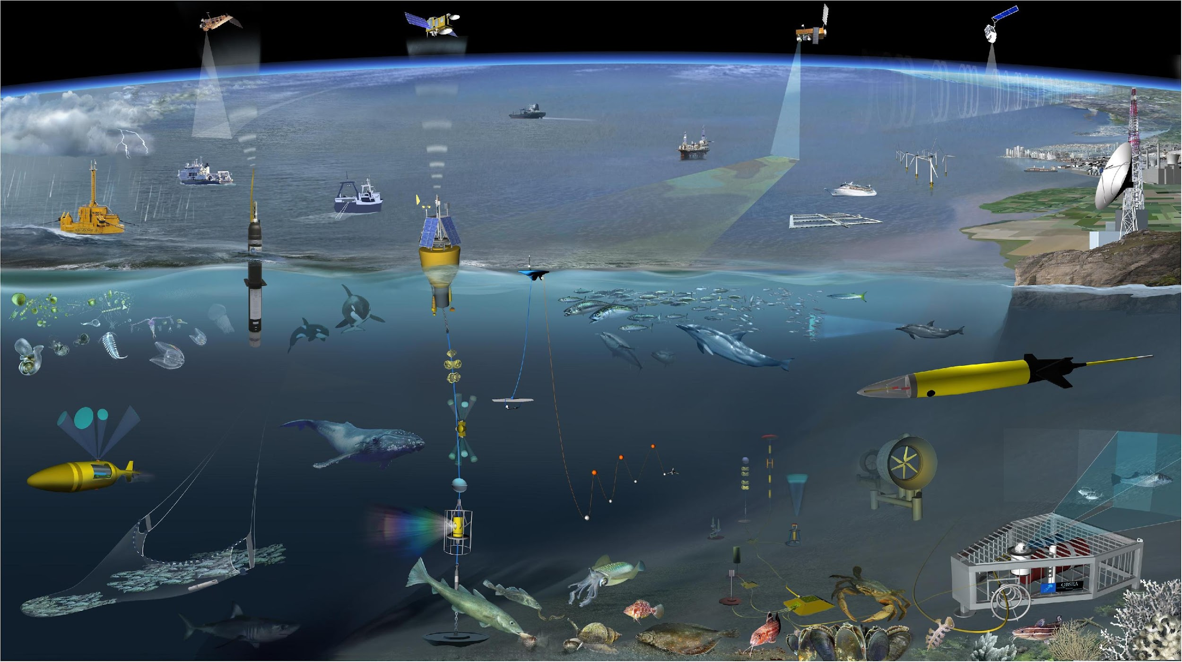
Next/Future Steps
To be discussed ! (incl. with ETOOFS and GRAs)
Focus on the conditions of use
  by the ocean prediction centres (= users)
  of the marine observations (=GOOS products).
And identify a priority: biogeochemistry.
****
4.1 Continue promoting the ETOOFS Guide within the community; update its content when needed (e.g. regarding biology). See the dialogue open with IOCCP.
4.2 Exploit the IMOS and IOOS momentum to understand how to expand to other GRAs
4.3 Prepare Product and Services Portfolio for Ocean Prediction Centres in GRAs, using the OceanPrediction DCC (connected to ETOOFS, OceanPredict, and regional with GRAs)

Slide 10

Resource required - new
Funding to:
Help in the coordination ETOOFS/GRAs
Potential funding sources:
?

Slide 11
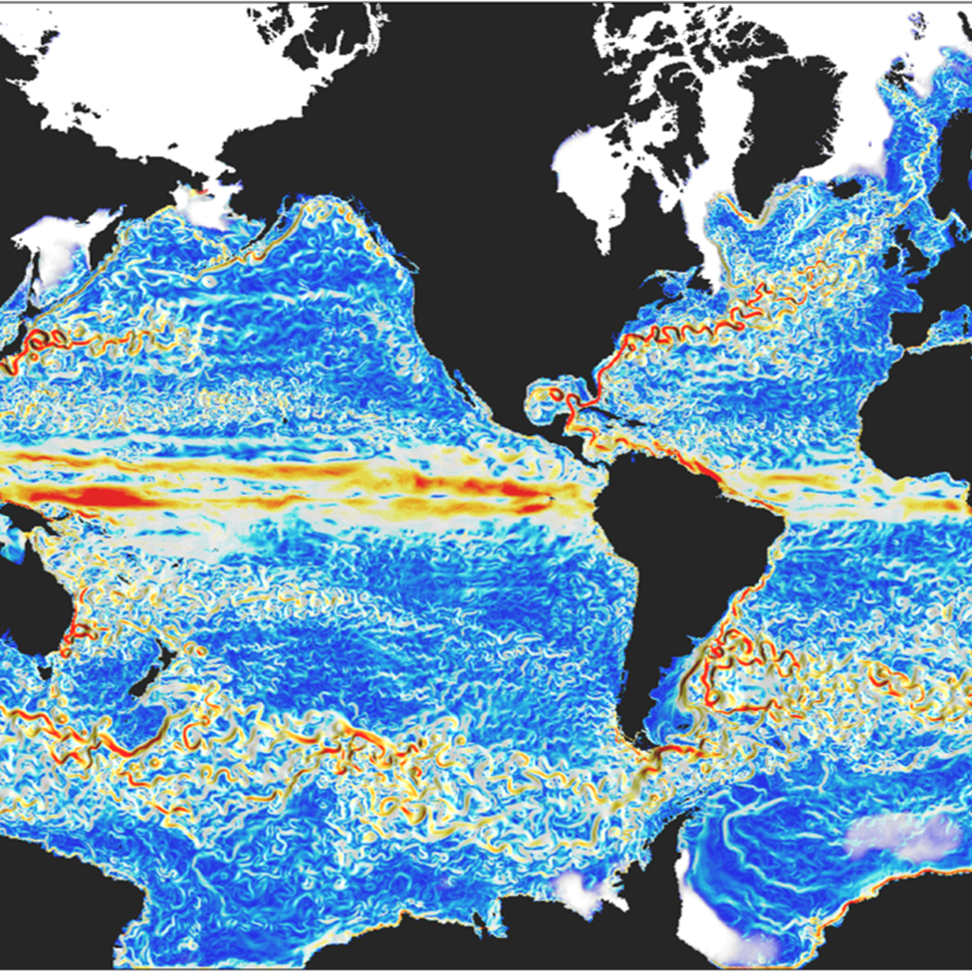
Thank you
goosocean.org

