Slide 1

Report of other ICGs and TOWS-WG
Silvia Chacón Barrantes

Slide 2
ICG/NEAMTWS
Had online Steering Committee in April 2022
Next session November 2023
CoastWave Project: adopting Tsunami Ready at 7 communities
TSP INGV testing products based on PTHA

Slide 3
Tsunami in Turkey and Syria
~ 50k death toll by the earthquake
Minor flooding in Iskenderun due to
  Subsidence
  High tide
  Collapsed drainage system
Fishermen and coastguards observed the wave

Slide 4
ICG/IOTWS
13th session November 2022
Has 9 new Tsunami Ready communities
Created a Working Group on Tsunami Ready implementation
Will have a Tsunami Symposium in December 2024: 20th anniversary!
TSP Australia
  Able to create products for non seismic tsunamis
  Non-seismic SOPs worked well for HTHH
  Able to issue NAVAREA products
TSP Indonesia and TSP India currently developing SOPs for non-seismic sources
Will assist NTWC on developing SOPs for non-seismic sources

Slide 5
ICG/PTWS
Next session September 2023 at Tonga (30th session)
24 communities from 7 Member States are Tsunami Ready

Slide 6
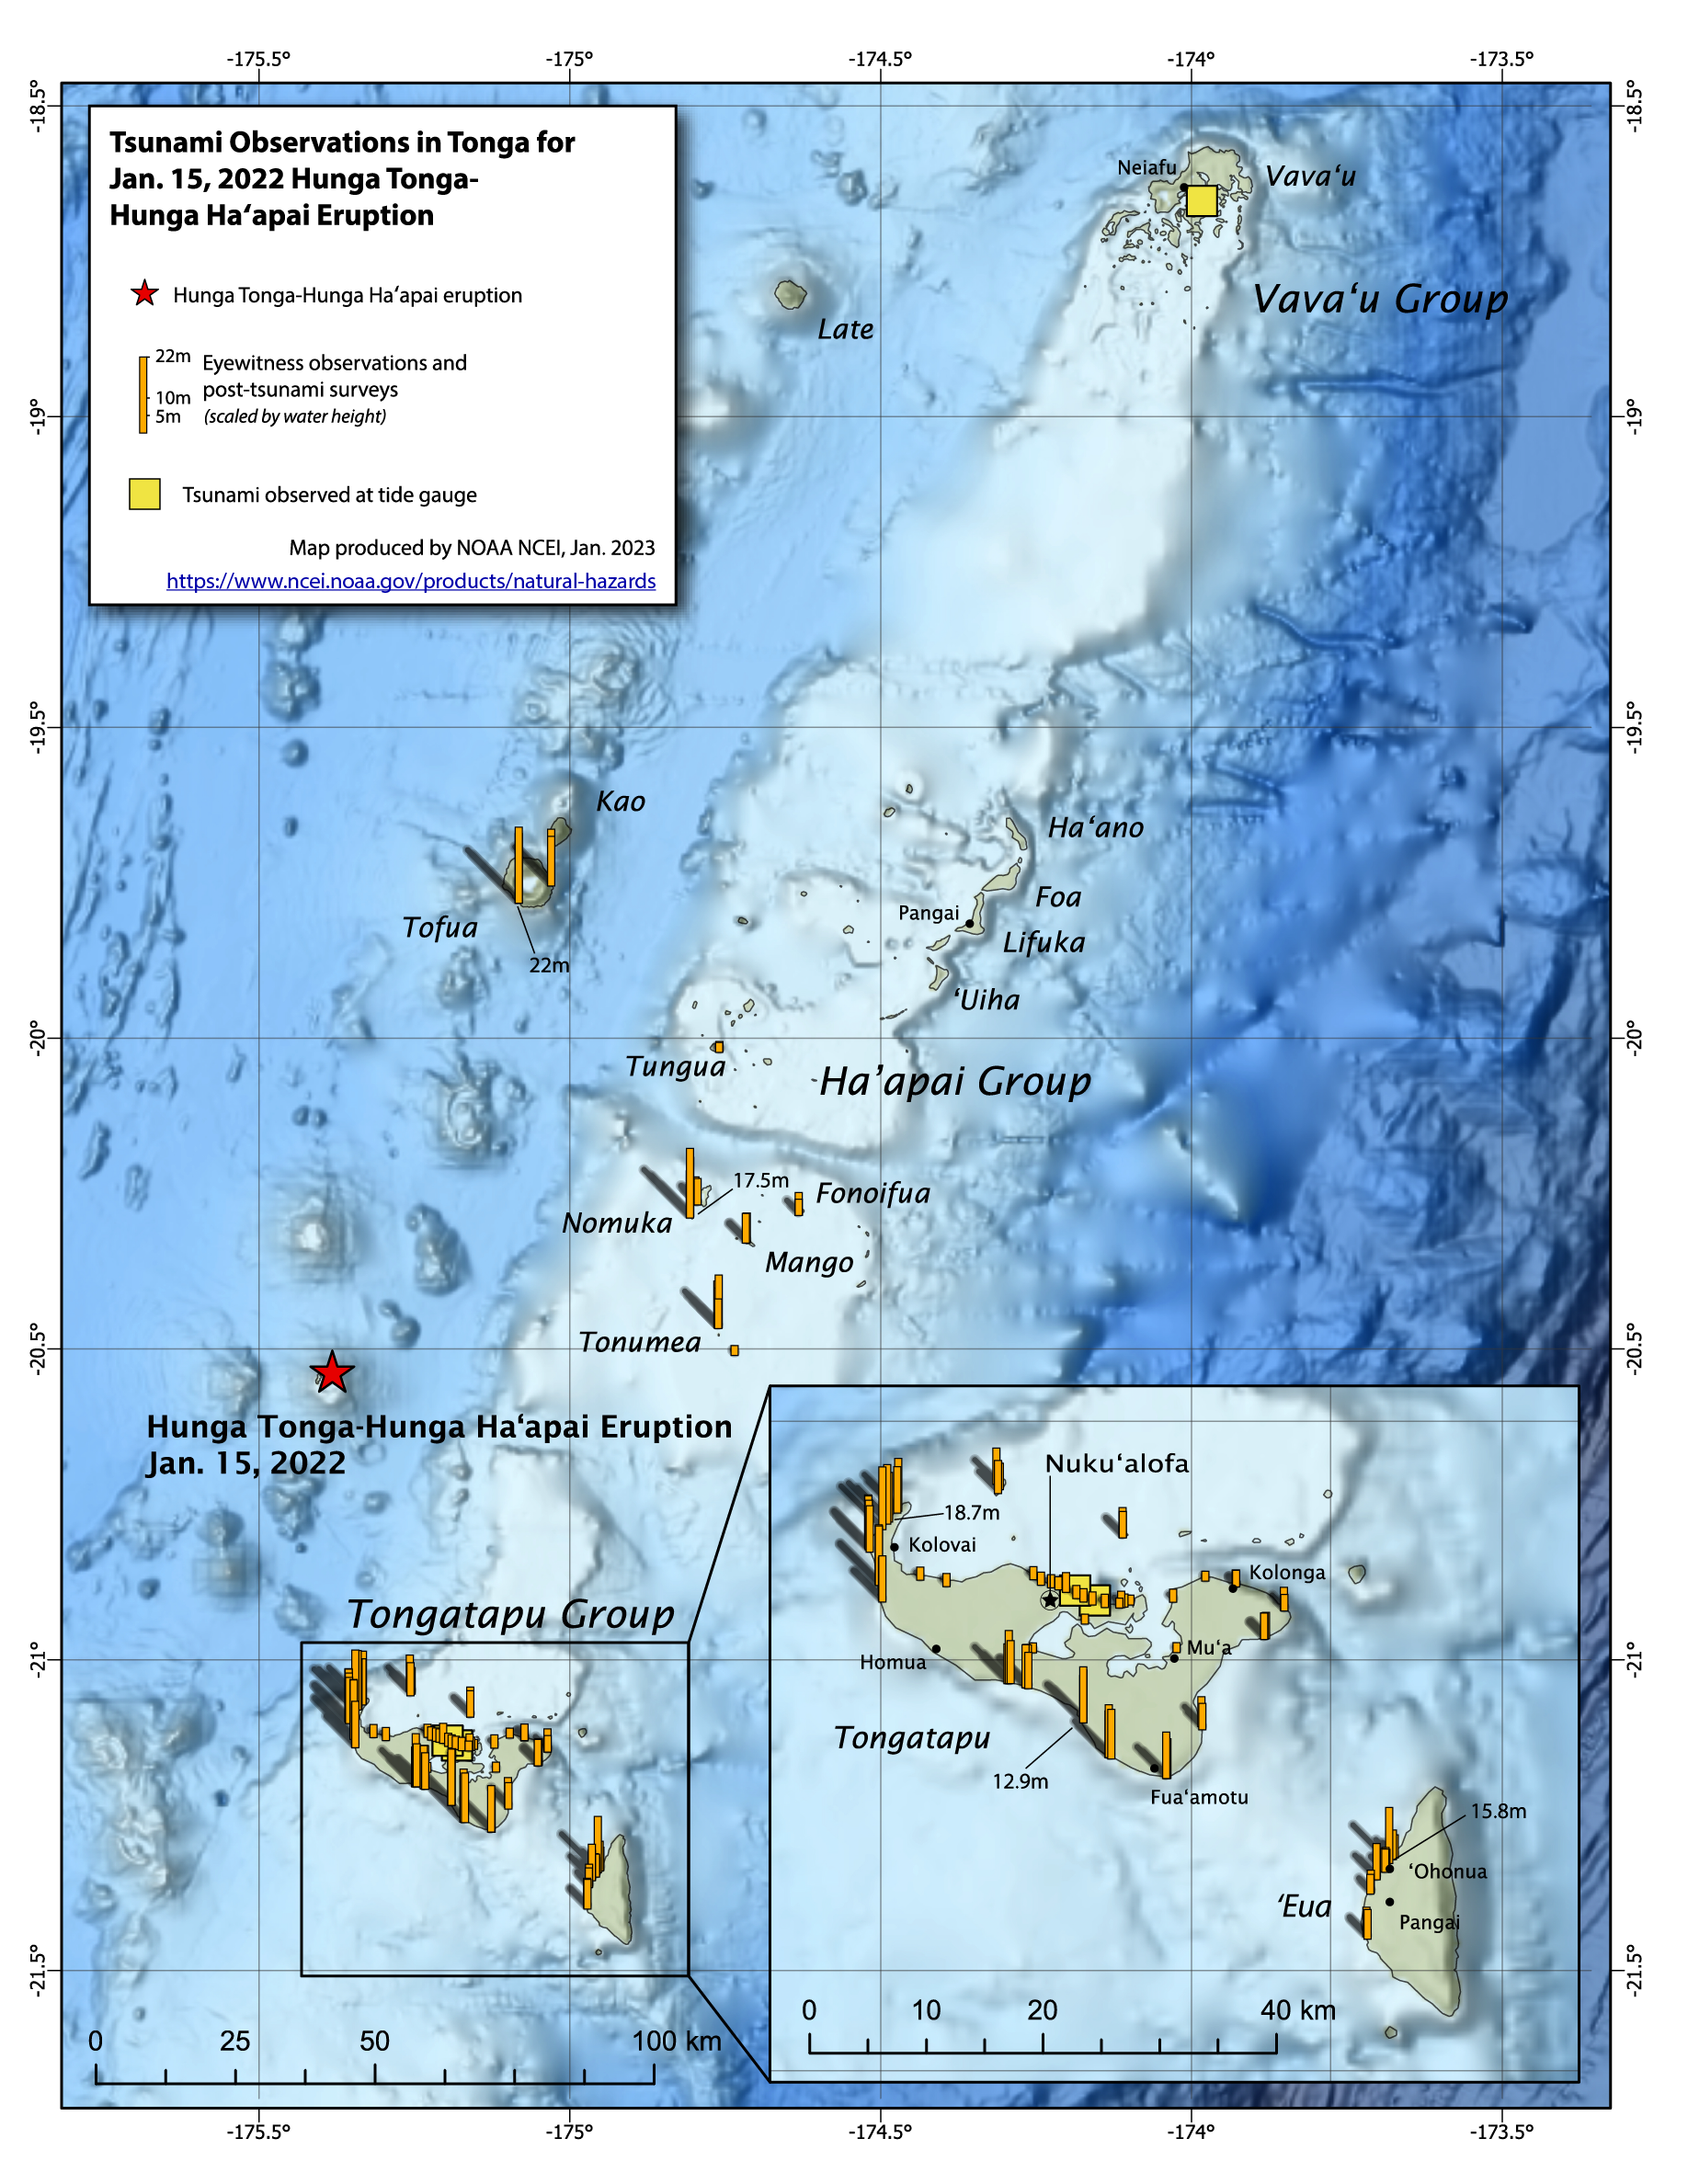
Hunga Tonga – Hunga Ha’apai tsunami
Generation mechanism(s) still under investigation, proposed:
  Explosion and pyroclastic density currents: localized impact
  Shockwave coupled tsunami
  Proudmann resonance of #2 when reaching trenches then propagating freely
Challenge on comms and products
PTWC developed and implemented new products in case new eruption

Slide 7
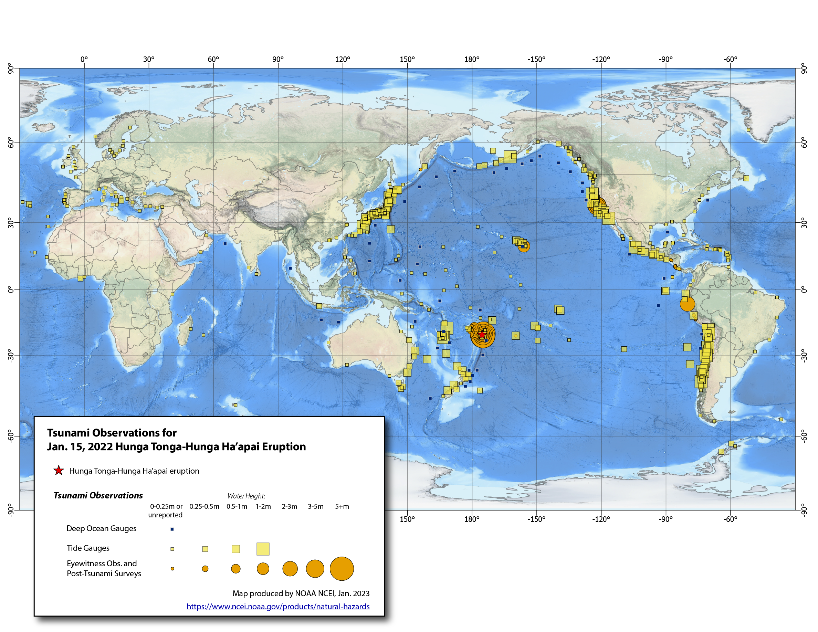

Slide 8
Tsunami exercises
NEAMWAVE
  Had subregional exercises in 2022
IOWAVE
  October 2020
  Next one 2023
PACWAVE
  September – November 2022
  Had subregional PICT exercise on HTHH interim procedures and international information sharing and communications
  Subregional exercises Central America and South East Pacific (South America)

Slide 9
TOWS-WG Challenges
Expanding borders: S Atlantic not covered
Including other sources: more obvious after HTHH
Increasing efficiency
Multi Hazard Early Warning System

Slide 10
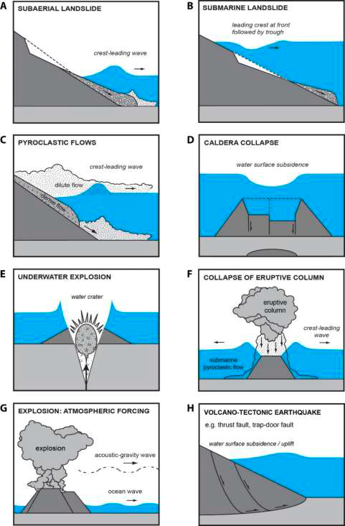
Tsunamis Generated by Volcanoes (TGV) ad hoc Team
Prepared a questionnaire for Volcanic Observatories (VO)
Established a list of VO for volcanoes near or under the ocean
Prepared a list of potentially tsunamigenic volcanoes
Defined volcano monitoring requirements for tsunami warning
Issue recommendations

Slide 11
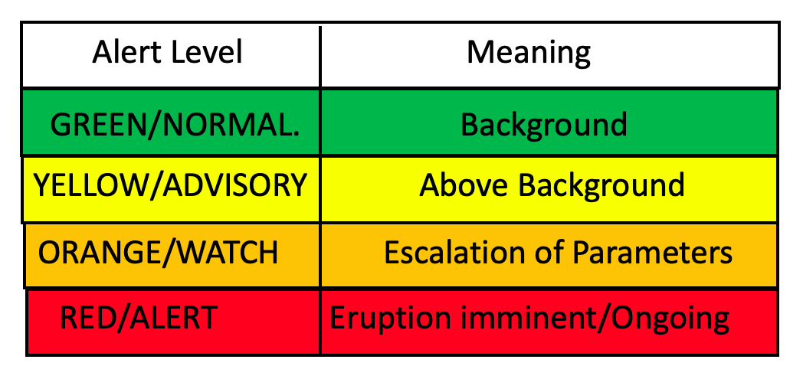
TGV (2)
Volcano alert level (VAL) provide info on:
  Volcano status
Volcano alert level (VAL) don’t provide info on:
  Tsunami estimated arrival time
  Tsunami threat level
Proposed Volcanic Tsunami Alert Notification (VOTAN)
  Similar strategy to ash dispersal
  Two levels of pre-eruption
  Ongoing eruption
  Eruption cessation

Slide 12
TGV (3): Recommendations Monitoring and warning
Designate organization(s)
Deploy instrumentation for volcano monitoring
Ensure proper SL network
Develop SOPs
In coordination with NTWC, TSPs, national and regional Volcano SP if any
All volcanoes listed must be monitored
Include methods to alert persons in remote áreas (e.g. hikers, scientists in the field)
TGV warning SOPs linked with existing Volcano Alert Activity scales

Slide 13
TGV (4): Recommendations Risk Assessment and Preparedness
TGV Hazard and risk assessment should be undertaken
Multi-stakeholder meetings to discuss on worst-case and credible scenario
During heightened TGV Hazard close access to vulnerable areas
Signage incl. evacuation routes
Public awareness campaigns

Slide 14
Task Team on Meteotsunamis
Does not include tsunamis by shockwaves
Very common
Infrequently risky
  Usually only for hotspots
  Usually at mid latitudes
  For hotspots SOPs exist based on numerical weather predictions
Still not clear the role of Global TWS/TSPs/NTWCs for meteotsunamis
WMO-IOC-JCB requested that meteotsunamis will be discussed at next meeting to clarify roles and responsabilities and how to best support MS

