Slide 1

GOOS Project Updates:
Tropical Pacific Observing System (TPOS)
Billy Kessler [ NOAA Pacific Marine Environmental Laboratory - TPOS Co-Chair ]
and Fei Chai [ Xiamen University - TPOS Co-Chair ]
GOOS 12th Steering Committee Meeting, 25 - 27 April 2023

Slide 2
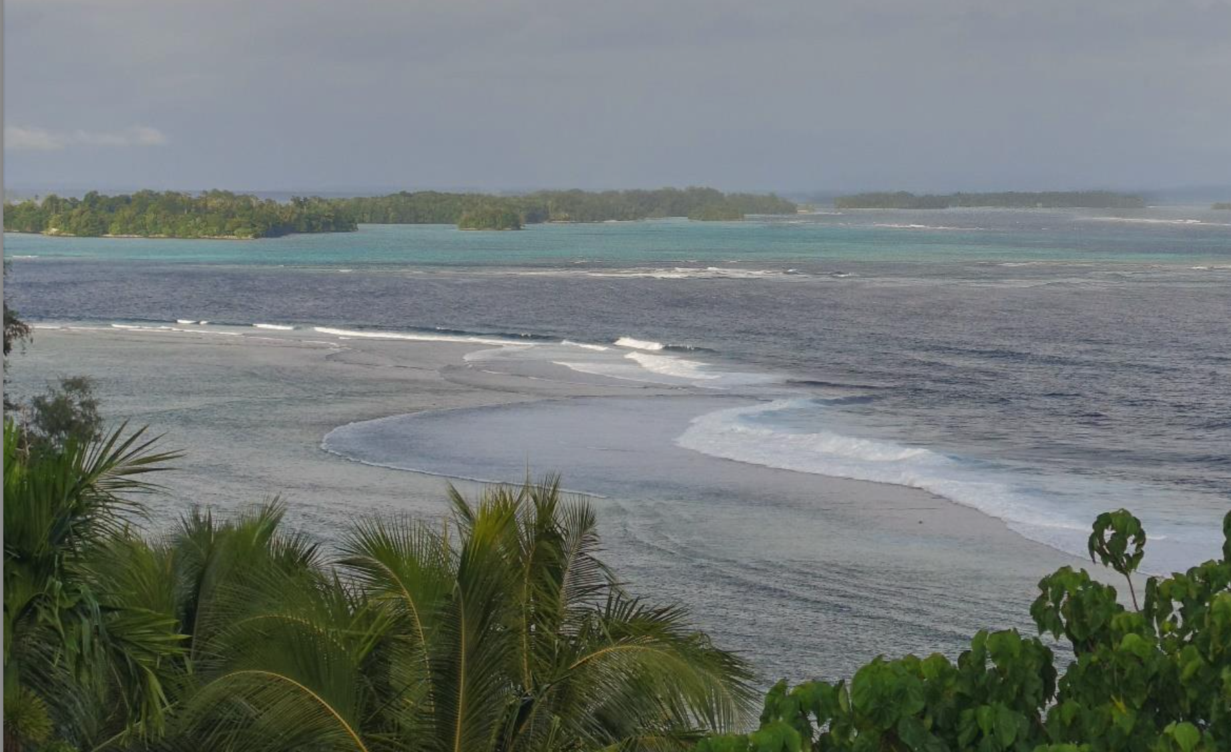
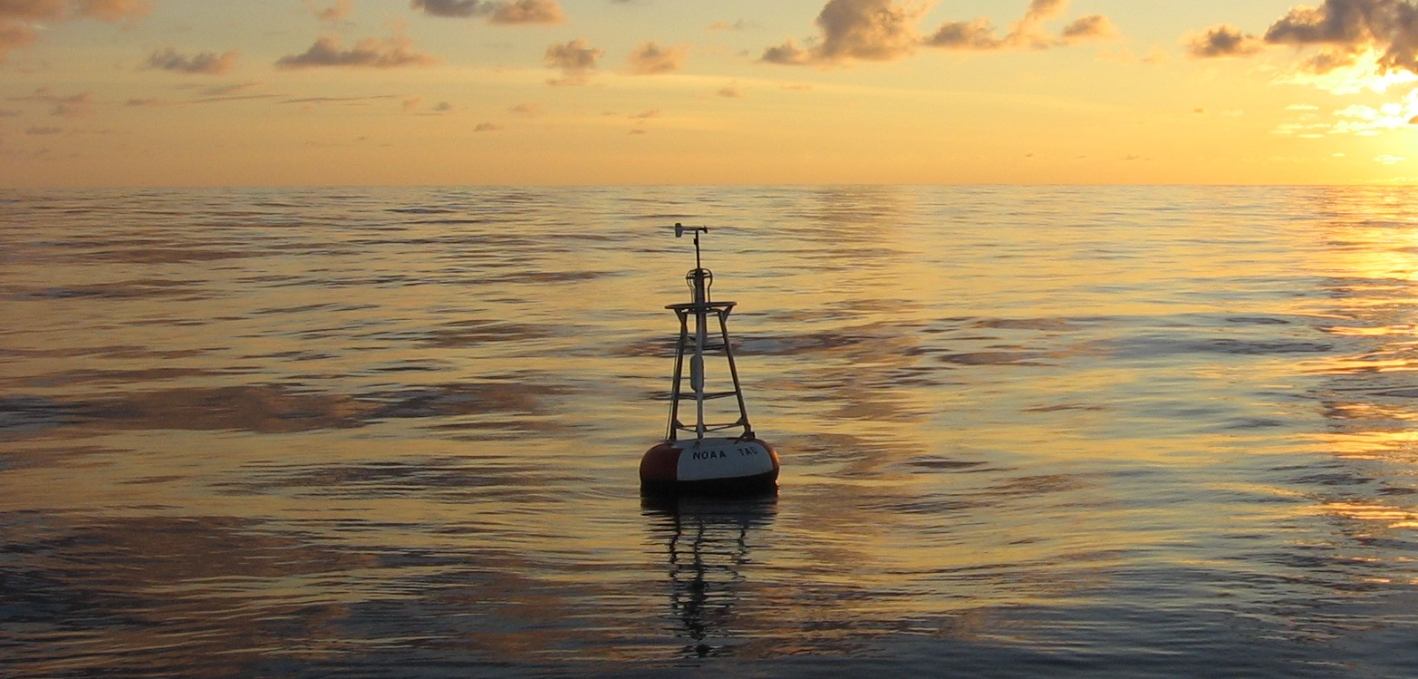
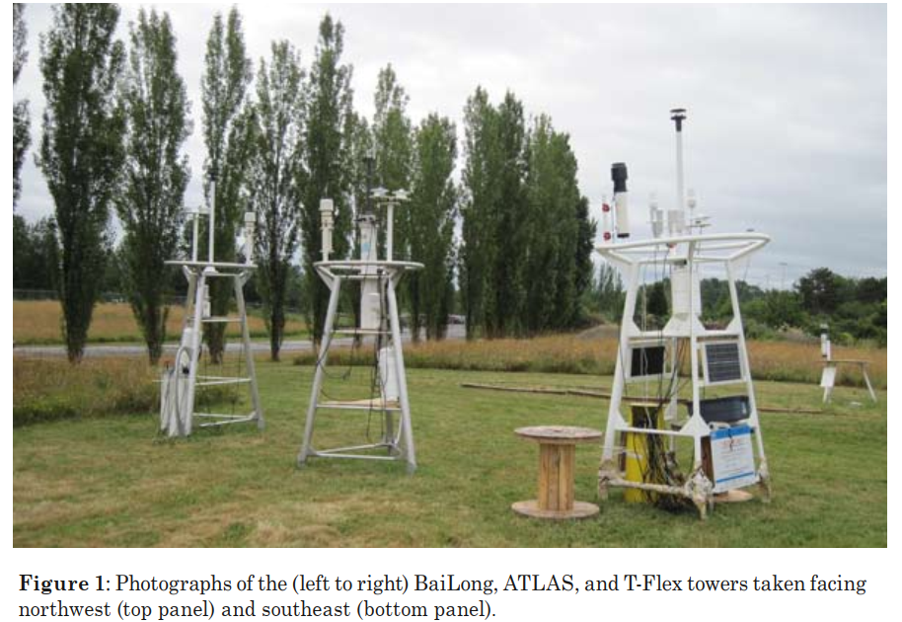
TPOS Implementation: Current Activities
  New TPOS Governance
- Scientific Advisory Committee
- Implementation Coordination Group
Priorities include: Eastern and Western boundary regimes, stepping into Ecosystem work.
  NOAA Recapitalizes TAO
Refocus moorings to make best use of their unique strengths. Fast phenomena: the ocean mixed layer and co-located air-sea observations.
With Argo and satellites, the new moorings are part of an integrated observing system.
  Implementation Phase
With TPOS 2020’s plans largely accepted, we focus on advising our sponsors on implementation issues: integrating pilot study results, using OSEs to evaluate and tune the arrays, coordination among the implementers, and intercomparison studies.

Slide 3
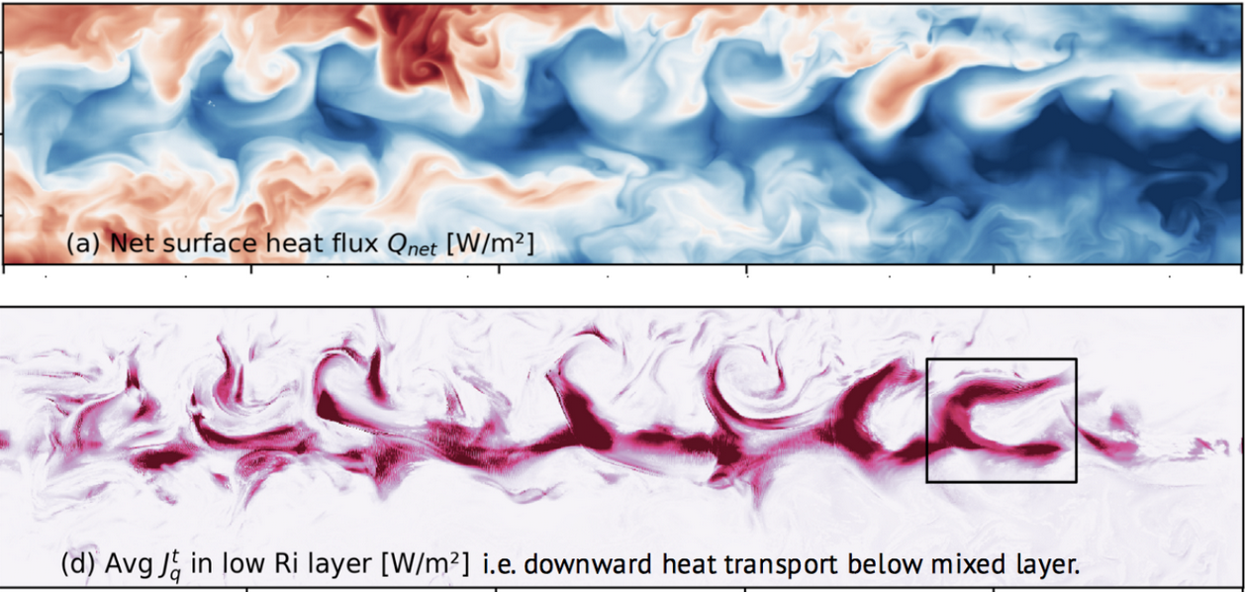
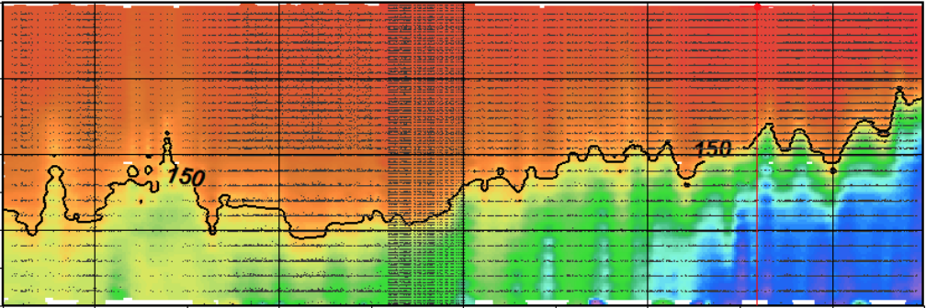
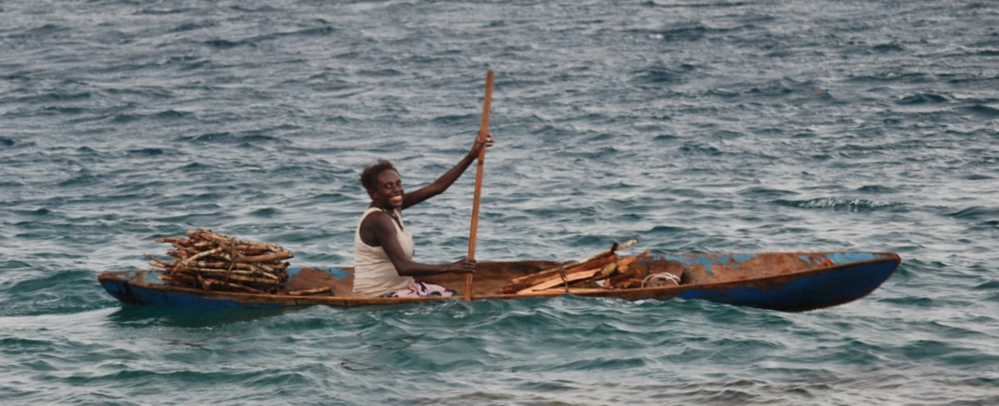
TPOS Implementation: Future Plans
  Process Studies
Towards 2030 and beyond:
Planning underway for process studies: PUMP & EEWP
NOAA funded pre-field modeling. Seeking international collaborations.
  TPOS 2020 undone parts
A complete observing system for the tropical Pacific must include the distinct eastern and western boundary regimes. This work was only begun; we are organizing for engagement and observation in these regions.
  Stakeholders Group
TPOS 2020 responded primarily to our investing sponsors. We now see our stakeholders more broadly, to include the island nations, international organizations, and potential partners at all levels.

Slide 4
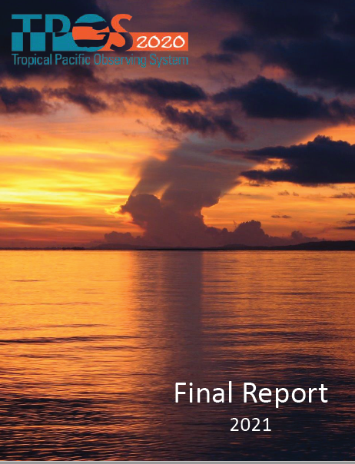
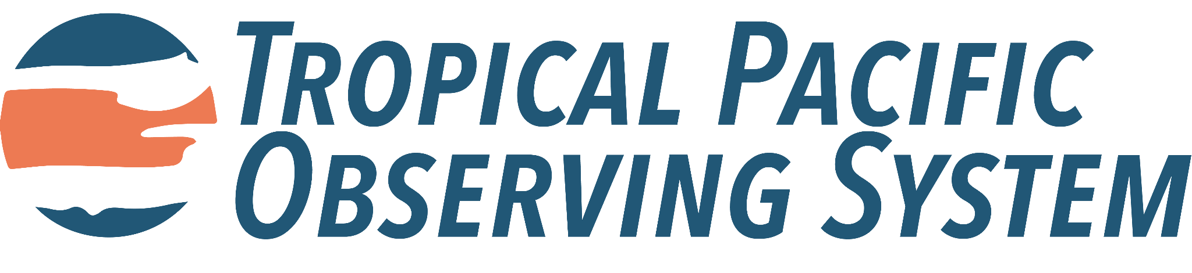
Thank You
www.tropicalpacific.org

