Slide 1
5.3 Report of Tsunami Service Providers from SCSTAC
The Intergovernmental Coordination Group for the Pacific Tsunami Warning and Mitigation System Steering Committee (ICG/PTWS SC) Meeting, 6 - 9 March 2023
South China Sea Tsunami Advisory Center

Slide 2
SOPs for SCSTAC
Bulletin type |  | Criteria | Content | Timeline
Tsunami Information | Only one bulletin | Mag. of 6.0-6.4; or on land; or depth≥100km | EQ parameters and statement of ‘No tsunami threat’ | 8-10 min
 | Only one bulletin unless minor waves observed and should be reported | Mag. of 6.5-7.0 | EQ parameters and statement of ‘No tsunami threat’ | 8-10 min
Tsunami Threat Message | Bulletin with quantitative forecast | 7.1 and above | EQ parameters and quantitative forecasts on threat level and Estimated Time of Arrival (ETA) | 8-15 min
 | Supplementary with observations |  | EQ parameters, quantitative forecast and tidal gauge observations | If revision on EQ & tsunami forecasts, or observation available
 | Final bulletin |  | Statement of ‘No tsunami confirmed or threat passed’ | hazardous waves has passed or no significant tsunami observations

Slide 3
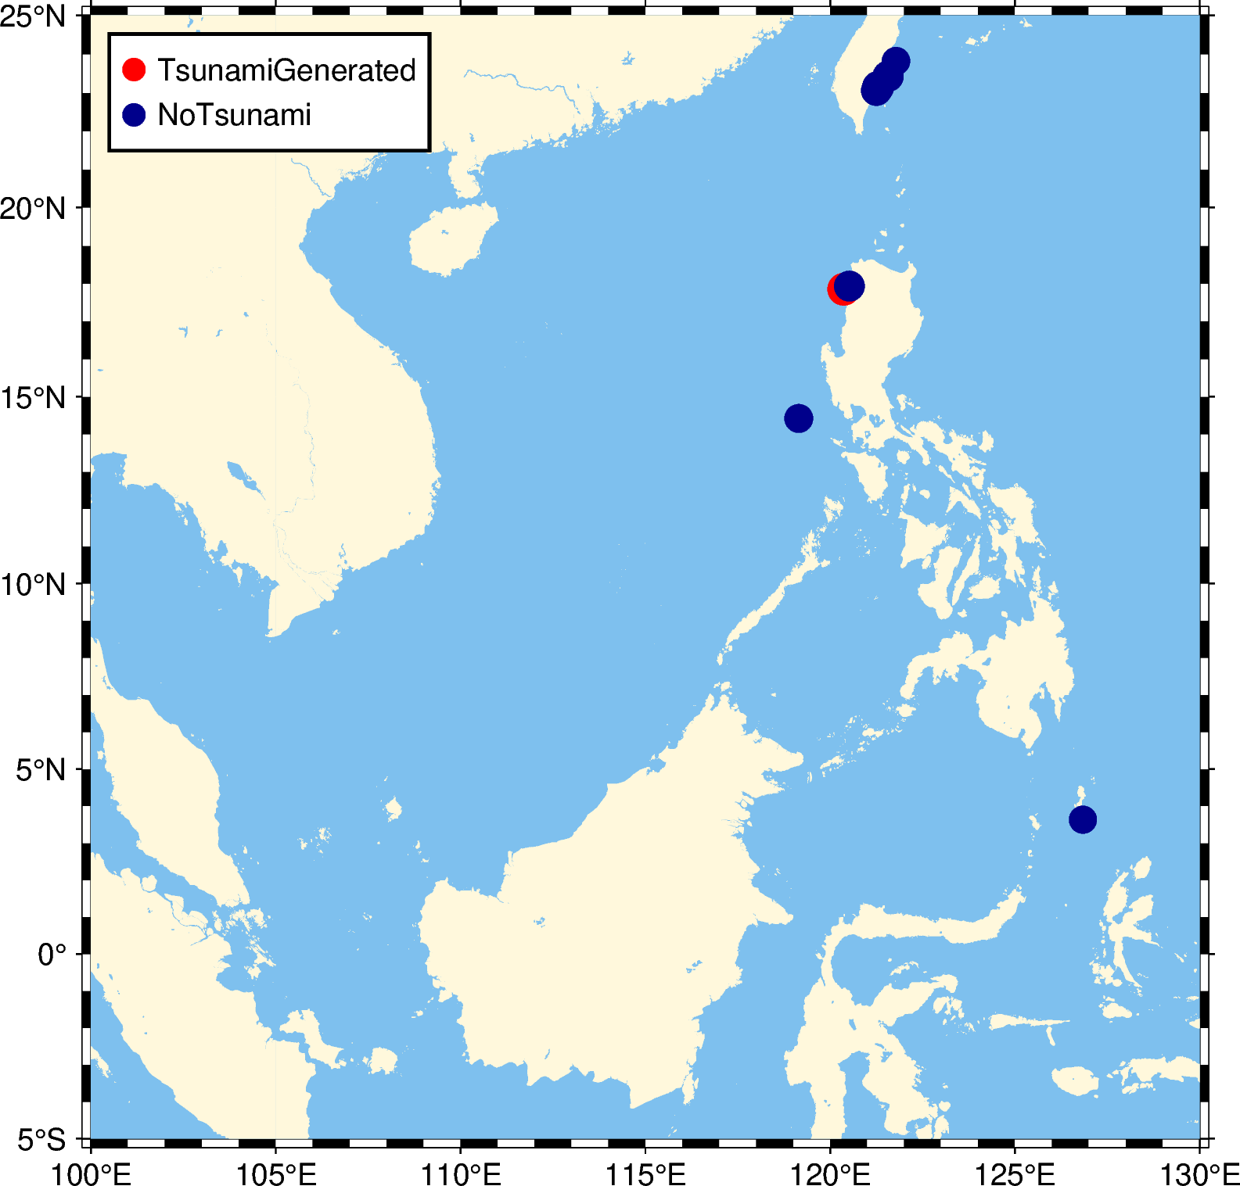
Tsunami Bulletins in 2022
SCSTAC issues 10 bulletins of 8 earthquake events in 2022.
All bulletins were issued in no more than 8 minutes.
The tsunami with 8cm amplitude generated in Philipines on 27 July 2022.

Slide 4
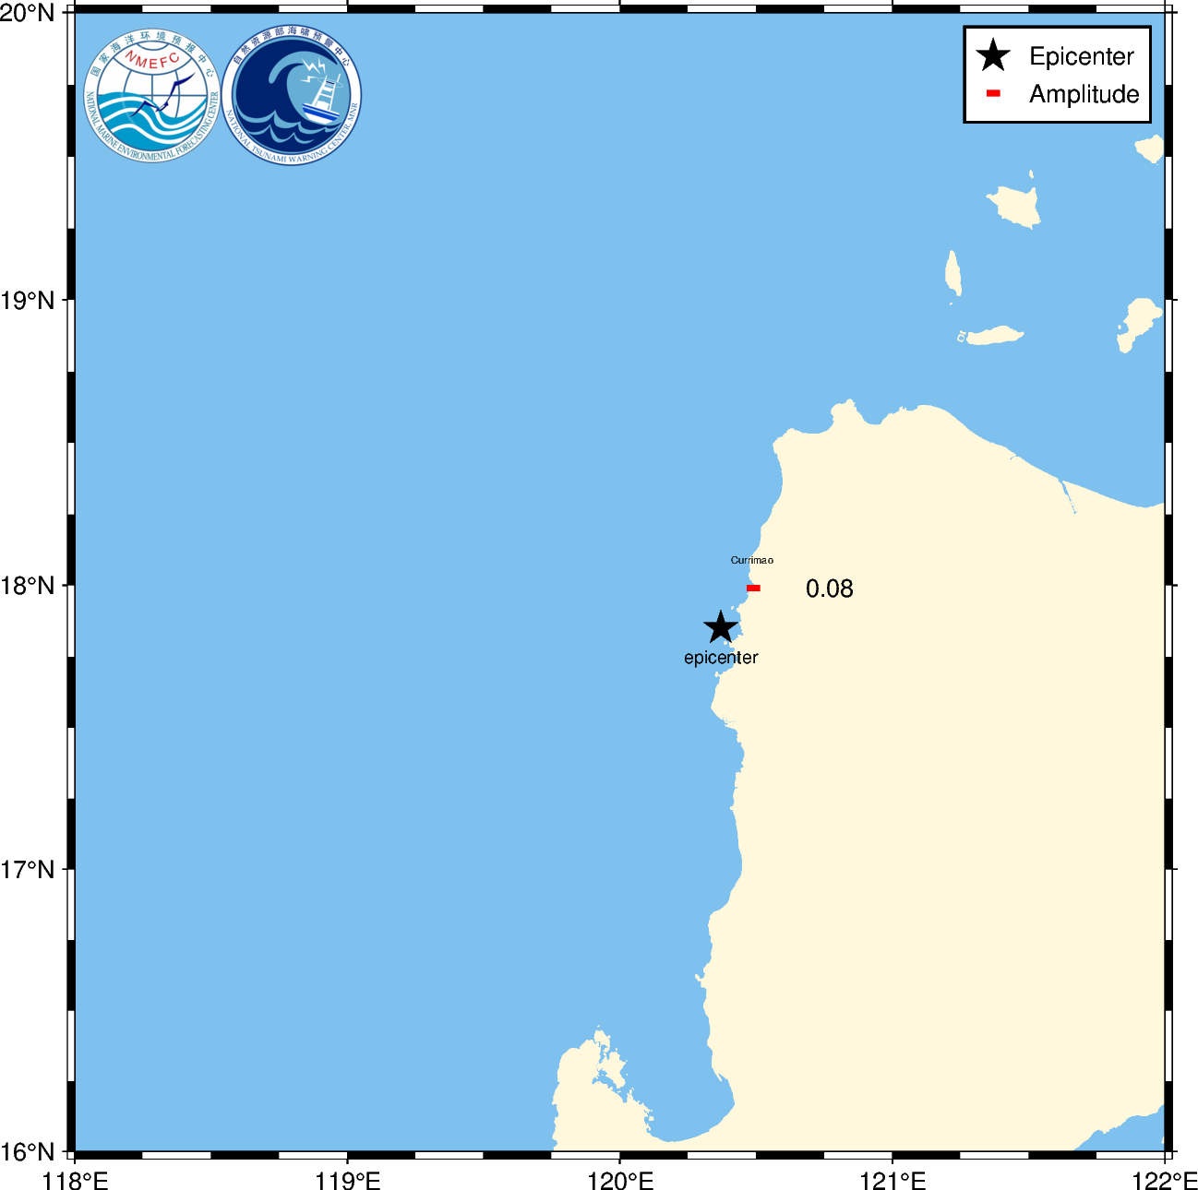
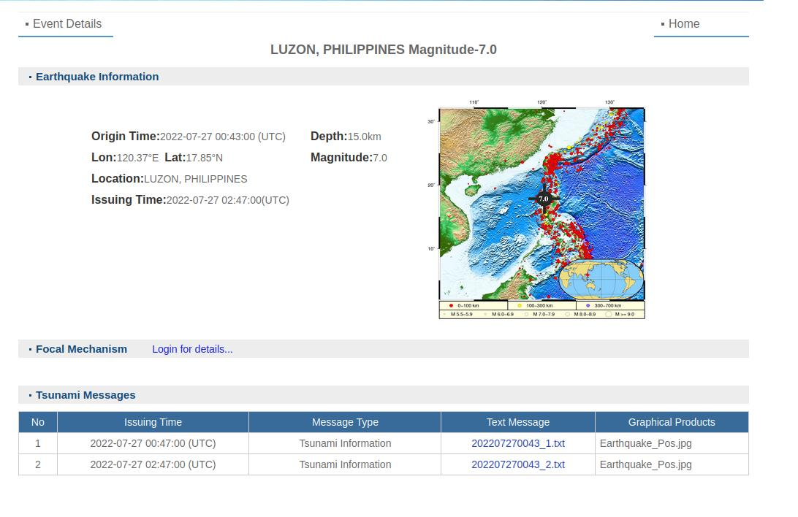
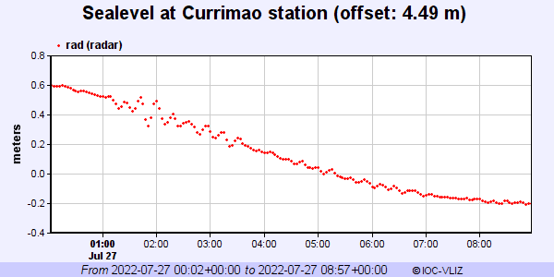
LUZON, PHILIPPINES Earthquake Tsunami
SCSTAC issued 2 tsunami bulletins. A small wave with height 0.08m was recorded at Currimao, Luzon, Philipines

Slide 5
Tsunami Communication Tests
SCSTAC conducted 3 communications tests on 11 Feb, 21 May, and 13 Sep 2022. The purpose was to verify that communications links to the recipient organizations of its tsunami advisories in the SCS countries and territories were functioning properly.

Slide 6
Communication Test on 11 Feb 2022
SCSTWC（NMEFC）received feedbacks from 8 SCS countries(or areas).
SCSTAC COMMUNICATIONS TEST
ISSUED BY SOUTH CHINA SEA TSUNAMI ADVISORY CENTER (SCSTAC)
ISSUED AT 0600Z 11 FEB 2022
THIS IS A TEST BULLETIN
THIS IS A TEST TO VERIFY COMMUNICATION LINKS AND DETERMINE
TRANSMISSION TIMES INVOLVED IN THE DISSEMINATION OF OPERATIONAL
TSUNAMI ADVICE PRODUCTS FROM THE SOUTH CHINA SEA TSUNAMI ADVISORY
CENTER TO DESIGNATED 24-HOUR TSUNAMI WARNING FOCAL POINTS OF THE SOUTH
CHINA SEA TSUNAMI WARNING SYSTEM.
RECIPIENTS ARE REQUESTED TO PLEASE RESPOND BACK TO THE SOUTH CHINA SEA
TSUNAMI ADVISORY CENTER.
PLEASE RESPOND VIA ONE OF THE FOLLOWING MEANS
*TEL:+86-10-62104561
*EMAIL:TSU@NMEFC.CN
*FAX:+86-10-62173638
THANK YOU FOR YOUR PARTICIPATION IN THIS COMMUNICATION TEST
Orgnization | Country | GTS | Email | Fax
Malaysian Meteorological Department | Malaysia | 00:00 | 00:06 | 00:03
National Disaster Warning Center | Thailand | Failed to receive | 00:01 | 00:11
Earthquake Information and Tsunami Warning | Vietnam | Failed to receive | 00:00/00:00/00:00/00:00 | Failed to receive
Brunei Darussalam Meteorological Department | Brunei | 00:01 | 00:00 | 00:03
Meteorological Service Singapore | Singapore | 00:00 | 00:00/00:00 | 00:00/00:00/00:00
SOEPD | Philipines | 00:01 | 00:00/00:00/00:00 | Failed to receive
Agency For Meteorology, Climatology and Geophysics | Indonesia | 00:02 | 00:00 | Failed to receive
Hong Kong Observatory | Hongkong, China | 00:02 | 00:01/00:01 | 00:01/00:09

Slide 7
Communication Test on 21 May 2022
SCSTWC（NMEFC）received feedbacks from 7 SCS countries(or areas) .
SCSTAC COMMUNICATIONS TEST
ISSUED BY SOUTH CHINA SEA TSUNAMI ADVISORY CENTER (SCSTAC)
ISSUED AT 0600Z 21 MAY 2022
THIS IS A TEST BULLETIN
THIS IS A TEST TO VERIFY COMMUNICATION LINKS AND DETERMINE
TRANSMISSION TIMES INVOLVED IN THE DISSEMINATION OF OPERATIONAL
TSUNAMI ADVICE PRODUCTS FROM THE SOUTH CHINA SEA TSUNAMI ADVISORY
CENTER TO DESIGNATED 24-HOUR TSUNAMI WARNING FOCAL POINTS OF THE SOUTH
CHINA SEA TSUNAMI WARNING SYSTEM.
RECIPIENTS ARE REQUESTED TO PLEASE RESPOND BACK TO THE SOUTH CHINA SEA
TSUNAMI ADVISORY CENTER.
PLEASE RESPOND VIA ONE OF THE FOLLOWING MEANS
*TEL:+86-10-62104561
*EMAIL:TSU@NMEFC.CN
*FAX:+86-10-62173638
THANK YOU FOR YOUR PARTICIPATION IN THIS COMMUNICATION TEST
Orgnization | Country | GTS | Email | Fax
Malaysian Meteorological Department | Malaysia | 00:00 | 00:00
National Disaster Warning Center | Thailand | Failed to receive | 00:06 | Failed to receive
Brunei Darussalam Meteorological Department | Brunei | 00:00 | 00:00 | 00:00
Meteorological Service Singapore | Singapore | 00:00 | 00:00 | 00:02
SOEPD | Philipines | 00:01 | 00:00 | Failed to receive
Agency For Meteorology, Climatology and Geophysics | Indonesia | 00:01 | 00:00 | Failed to receive
Hong Kong Observatory | Hongkong, China | 00:04 | 00:00 | Failed to receive

Slide 8
Communication Test on 13 Sep 2022
SCSTWC（NMEFC）received feedbacks from 6 SCS countries (or areas).
SCSTAC COMMUNICATIONS TEST
ISSUED BY SOUTH CHINA SEA TSUNAMI ADVISORY CENTER (SCSTAC)
ISSUED AT 0600Z 13 SEP 2022
THIS IS A TEST BULLETIN
THIS IS A TEST TO VERIFY COMMUNICATION LINKS AND DETERMINE
TRANSMISSION TIMES INVOLVED IN THE DISSEMINATION OF OPERATIONAL
TSUNAMI ADVICE PRODUCTS FROM THE SOUTH CHINA SEA TSUNAMI ADVISORY
CENTER TO DESIGNATED 24-HOUR TSUNAMI WARNING FOCAL POINTS OF THE SOUTH
CHINA SEA TSUNAMI WARNING SYSTEM.
RECIPIENTS ARE REQUESTED TO PLEASE RESPOND BACK TO THE SOUTH CHINA SEA
TSUNAMI ADVISORY CENTER.
PLEASE RESPOND VIA ONE OF THE FOLLOWING MEANS
*TEL:+86-10-62104561
*EMAIL:TSU@NMEFC.CN
*FAX:+86-10-62173638
THANK YOU FOR YOUR PARTICIPATION IN THIS COMMUNICATION TEST
Orgnization | Country | GTS | Email | Fax
Malaysian Meteorological Department | Malaysia | 00:00 | 00:00 | Failed
National Disaster Warning Center | Thailand | Failed to receive | 00:00 | 00:07
Earthquake Information and Tsunami Warning | Vietnam | Failed to receive | 00:00 | Failed to receive
Brunei Darussalam Meteorological Department | Brunei | 00:05 | 00:00 | Failed to receive
Meteorological Service Singapore | Singapore | Failed to receive | 00:00/00:00 | Failed to receive
Hong Kong Observatory | Hongkong, China | 00:01 | 00:01 | 00:10

Slide 9
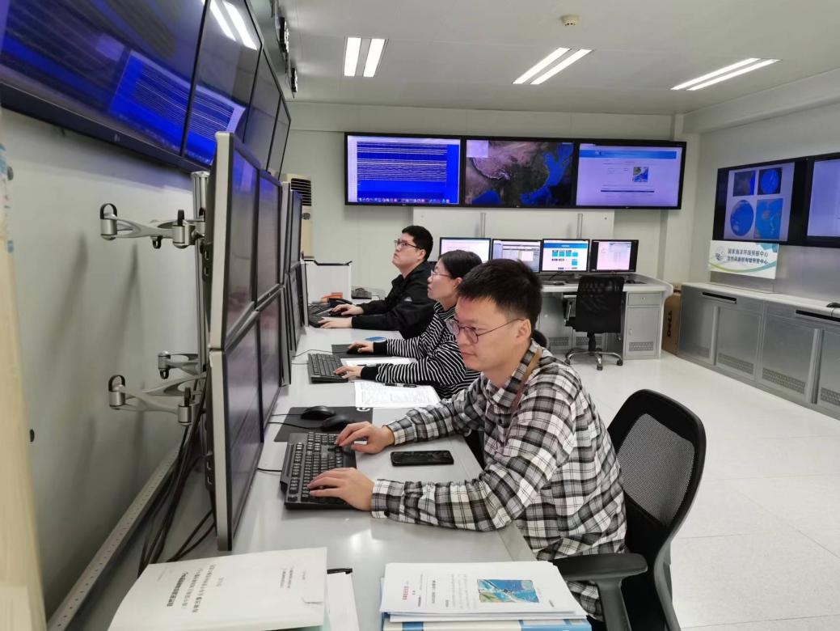
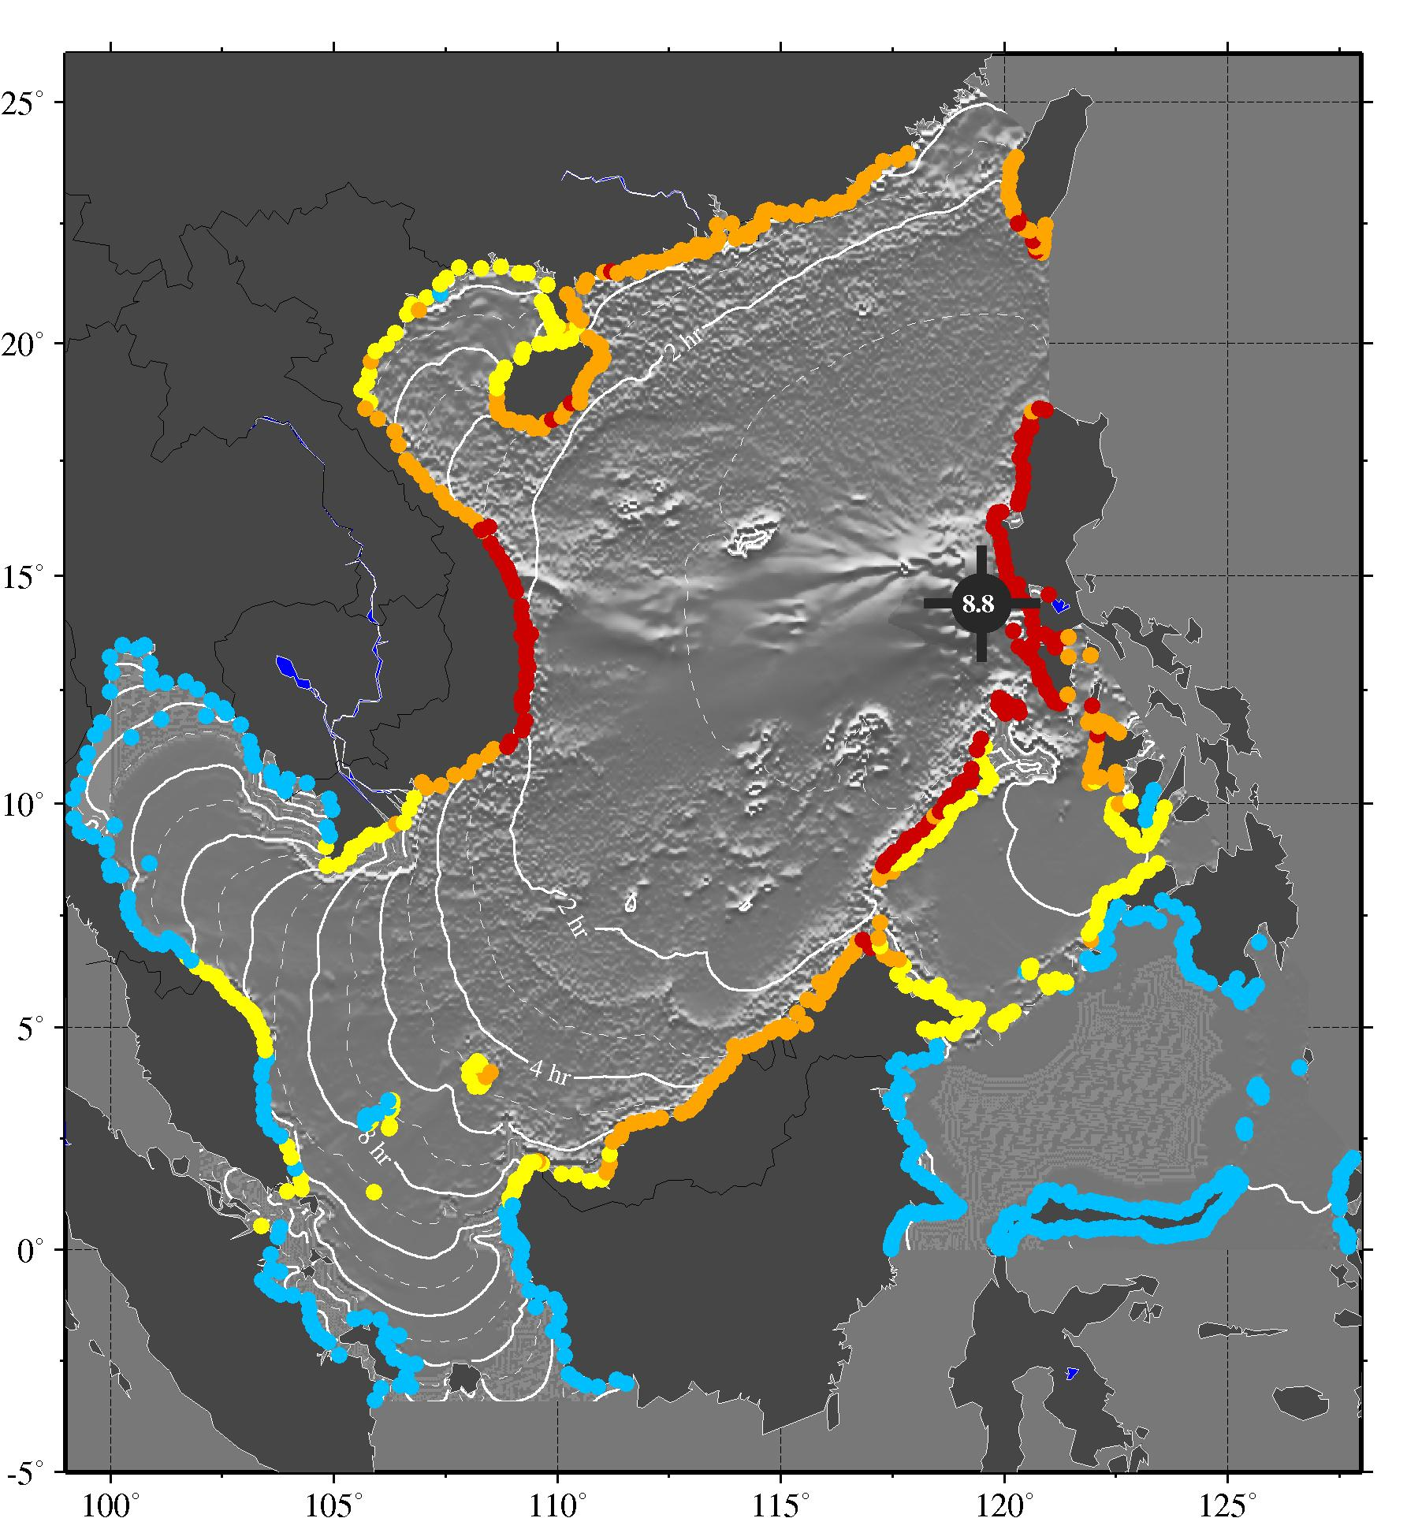
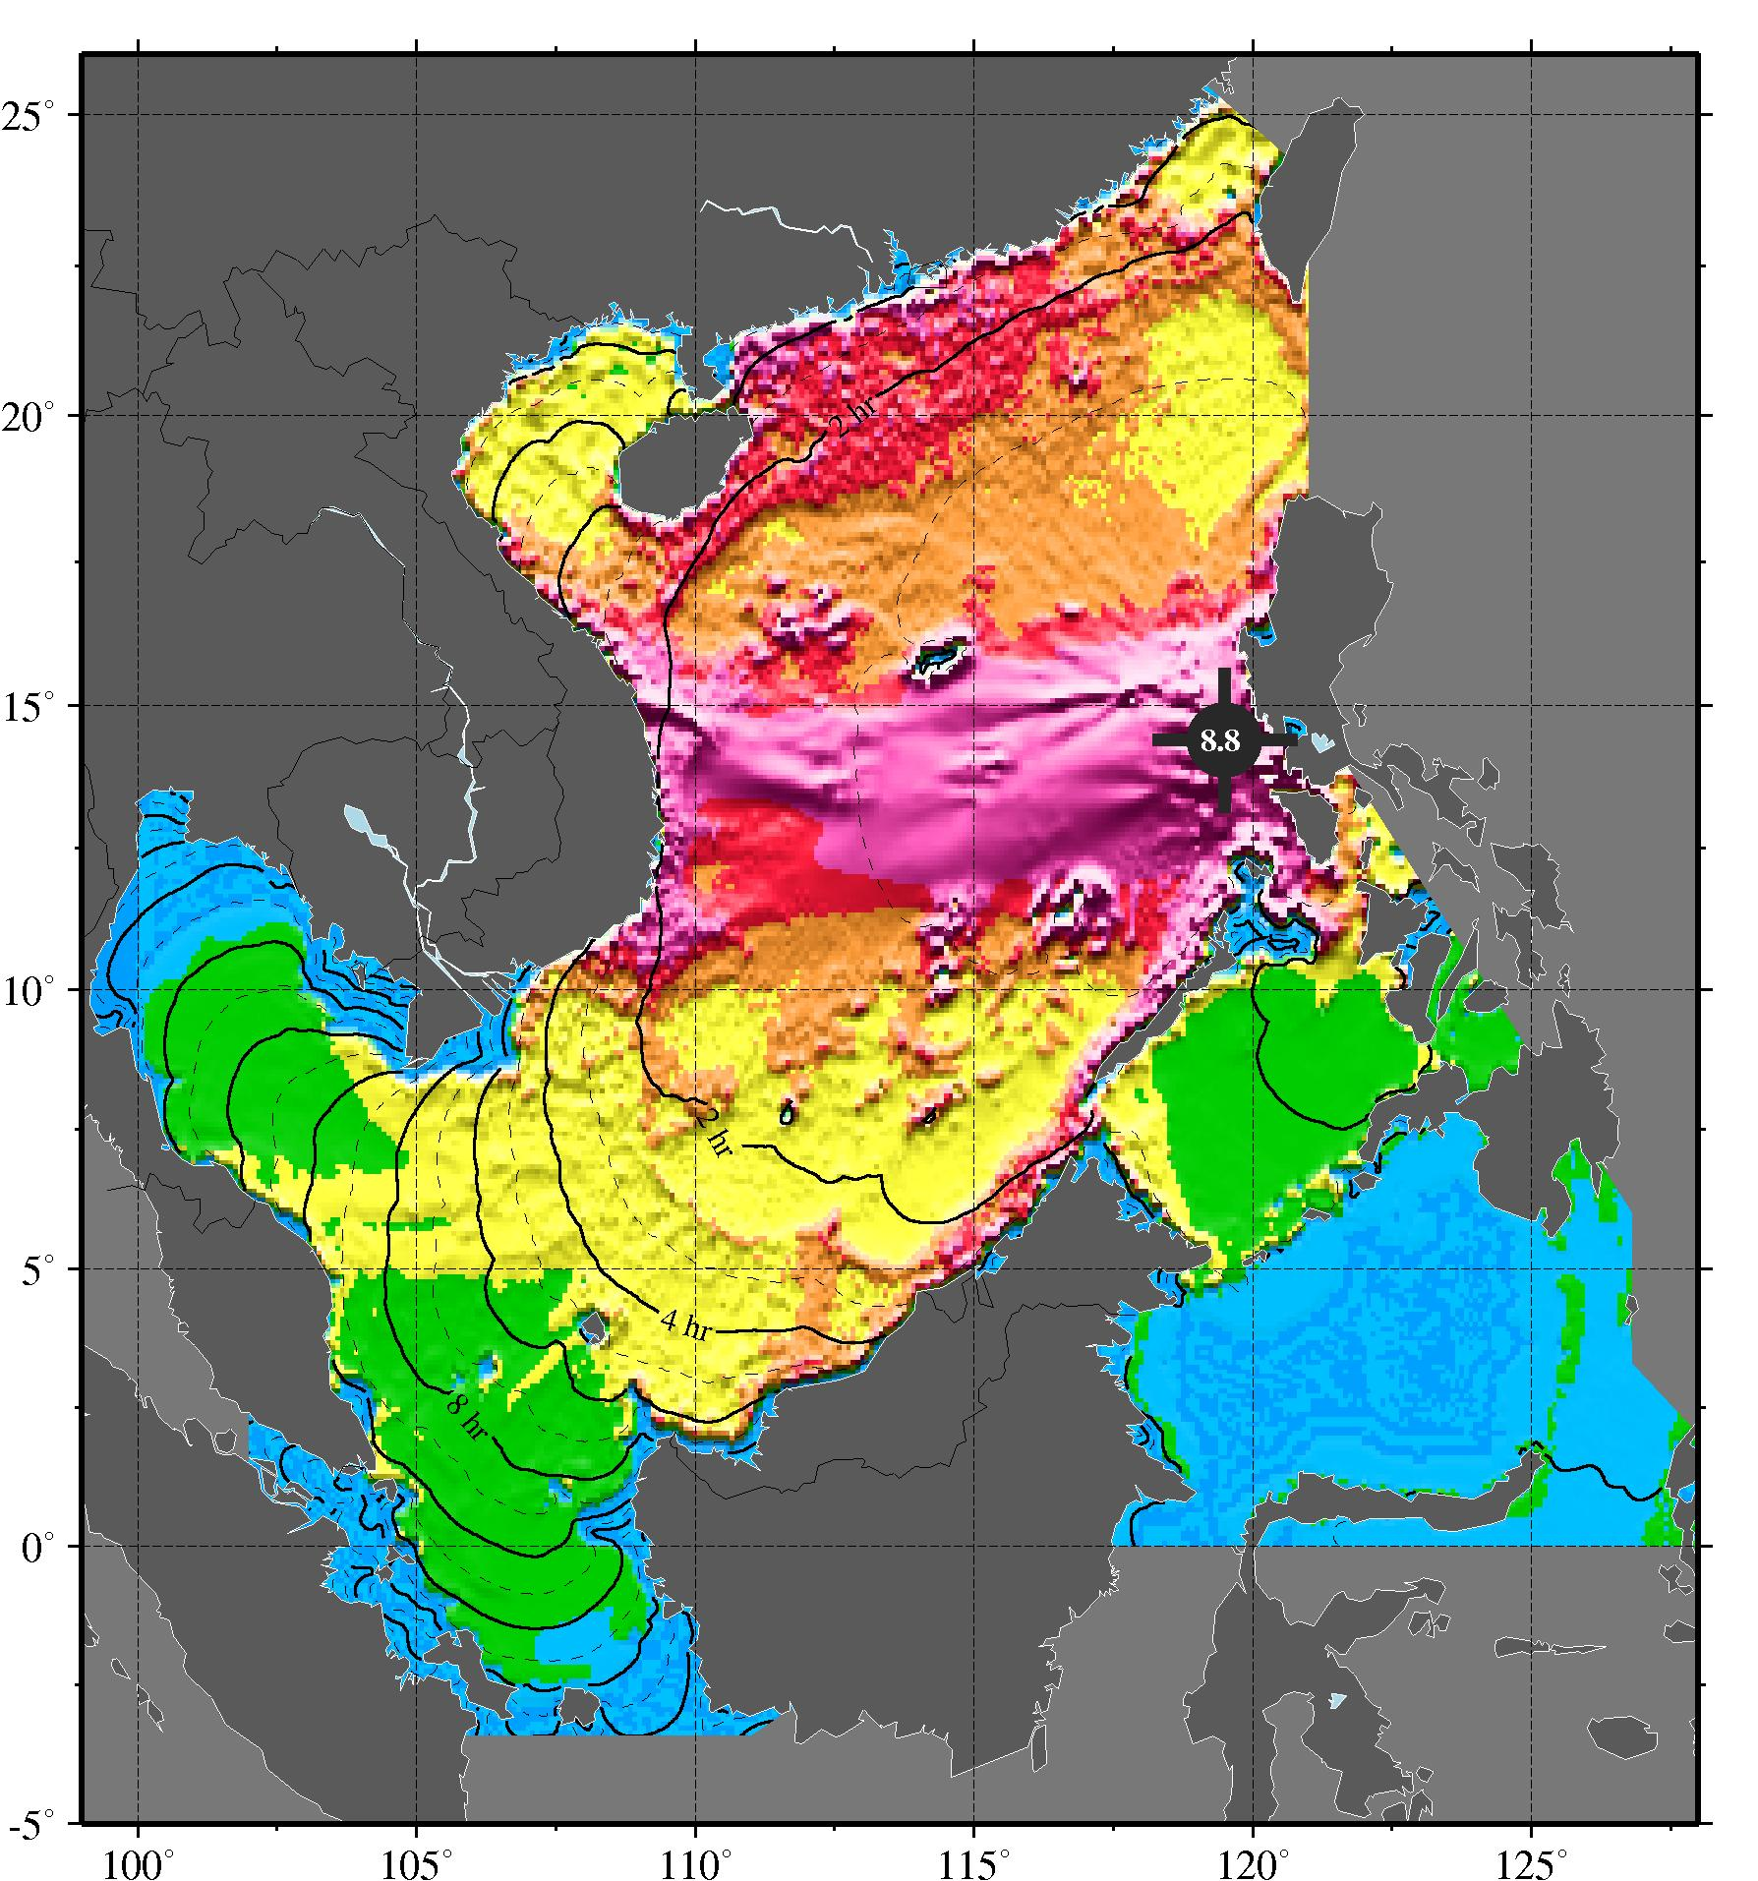
PacWave 2022 in SCS
SCSTAC conducted tsunami exercise in SCS region on 13 Oct 2022
**TEST** PACWAVE22 TSUNAMI EXERCISE **TEST**
ISSUED BY SOUTH CHINA SEA TSUNAMI ADVISORY CENTER (SCSTAC)
ISSUED AT 0000Z 13 OCT 2022
THIS IS A COMMUNICATION TEST BULLETIN FOR PACWAVE22 TSUNAMI EXERCISE.
THIS IS A TEST TO VERIFY COMMUNICATION LINKS AND DETERMINE
TRANSMISSION TIMES INVOLVED IN THE DISSEMINATION OF OPERATIONAL
TSUNAMI ADVICE PRODUCTS FROM THE SOUTH CHINA SEA TSUNAMI ADVISORY
CENTER TO DESIGNATED 24-HOUR TSUNAMI WARNING FOCAL POINTS OF THE SOUTH
CHINA SEA TSUNAMI WARNING SYSTEM.
THIS TEST MESSAGE IS SENT BY GTS, FAX AND EMAIL.
RECIPIENTS ARE REQUESTED TO PLEASE RESPOND BACK TO ICG PTWS TASK TEAM
ON PACWAVE22. GUIDANCE FOR THE EXERCISE CAN BE FOUND IN
THE PACWAVE22 EXERCISE MANUAL LOCATED AT
WWW.PACWAVE.INFO
PLEASE RESPOND BEFORE THE DUE DATE SPECIFIED IN THE EXERCISE MANUAL.
THANK YOU FOR YOUR PARTICIPATION IN THIS COMMUNICATION TEST
PLEASE TAKE NOTE OF THE TIME YOU RECEIVE THIS MESSAGE AND THE METHOD(S)
BY WHICH YOU RECEIVE THIS MESSAGE AND REPORT BACK THROUGH THE EXERCISE
PACWAVE POST-EXERCISE ONLINE EVALUATION SURVEY BY 23 OCTOBER 2022

