Slide 1
Informational Webinar
PacWave22 PICT Regional Exercise
23:00UTC– 2nd November, 2023

Slide 2
PacWave22 PICT Regional Exercise Debrief Session
Objectives:
1. Test the Hunga Tonga Hunga Ha'apai (HTHH) PTWC Interim Procedures and PTWS Products (IOC Circular Letter 2902) and whether the HTHH PTWS products are intercepted PICT Member States accurately and in a timely manner, and
2. Test regional communication and cooperation between PICT Member States, and the value of information sharing in facilitating national tsunami alert decision-making.
Register on Zoom Meeting Link
https://unesco-org.zoom.us/meeting/register/tZcudOiopzovHd0yfxa_v_QgUlbvWxEEPsW4

Slide 3
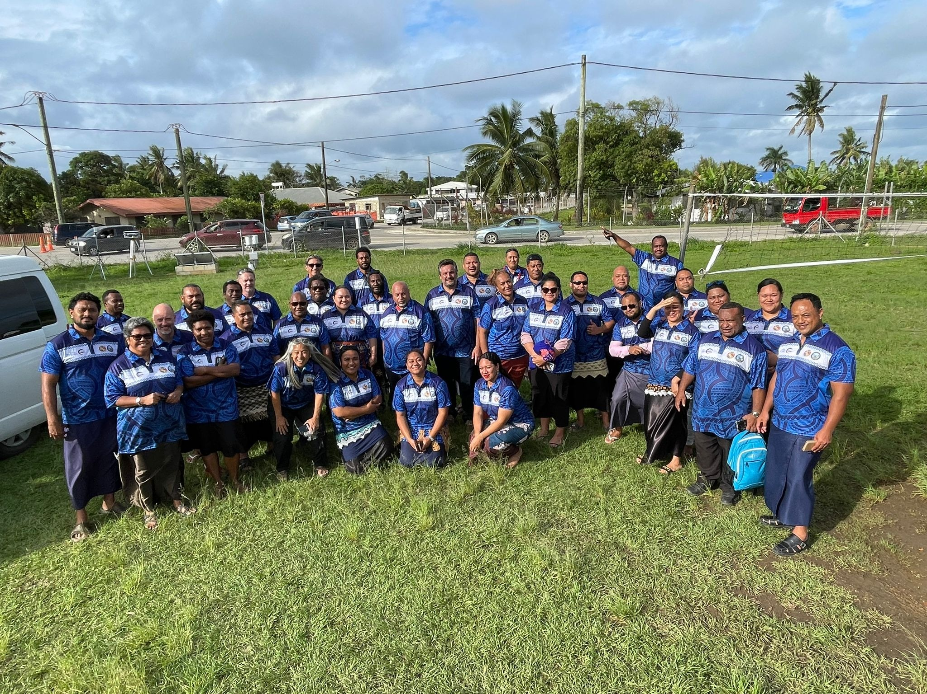
Exercise Evaluation
21st December, 2022
Deadline to complete and submit PacWave22-PICT Regional
Post-Exercise Evaluation Form – Under Final Review to be posted Shortly!
More Detailed Information:
http://itic.ioc-unesco.org/index.php?option=com_content&view=article&id=2224&Itemid=2333

Slide 4
Informational Webinar
Meeting Website:
https://oceanexpert.org/event/3655
Register: https://oceanexpert.org/registerEvent/3655
Agenda Items & Documents:
https://oceanexpert.org/event/3655#agenda

Slide 5


Social Media
#GetToHighGround
#EarlyWarningForAll
#PacWave22
#PacWave22-PICT

